Slide 1

Accounting for
Partnerships
Chapter 12
Wild, Shaw, and Chiappetta
Fundamental Accounting Principles
23rd Edition
Notes:
Chapter 12: Accounting for Partnerships

Slide 2
Chapter 12 Learning Objectives
CONCEPTUAL
C1 Identify characteristics of partnerships and similar organizations.
ANALYTICAL
A1 Compute partner return on equity and use it to evaluate partnership performance.
PROCEDURAL
P1 Prepare entries for partnership formation.
P2 Allocate and record income and loss among partners.
P3 Account for the admission and withdrawal of partners.
P4 Prepare entries for partnership liquidation.
2
2
2

Slide 3
C1:
Identify characteristics of partnerships and similar organizations.
Learning Objective
Notes:
.

Slide 4
Partnership Formation
Partnership Agreement
Voluntary Association
Limited
Life
Taxation
Unlimited Liability
Mutual Agency
Co-Ownership of Property
Learning Objective C1: Identify characteristics of partnerships and similar organizations.
Notes:
A partnership is an unincorporated association of two or more people to pursue a business for profit as co-owners. Many businesses are organized as partnerships. They are especially common in small retail and service businesses. Many professional practitioners, including physicians, lawyers, investors, and accountants, also organize their practices as partnerships.
Forming a partnership requires that two or more legally competent people (who are of age and of sound mental capacity) agree to be partners. Their agreement becomes a partnership contract, also called articles of copartnership. Although it should be in writing, the contract is binding even if it is only expressed verbally. Partnership agreements normally include details of the partners’ (1) names and contributions, (2) rights and duties, (3) sharing of income and losses, (4) withdrawal arrangement, (5) dispute procedures, (6) admission and withdrawal of partners, and (7) rights and duties in the event a partner dies.
A partnership is not subject to taxes on its income. The income or loss of a partnership is allocated to the partners according to the partnership agreement, and it is included in determining the taxable income for each partner’s tax return. Partnership income or loss is allocated each year whether or not cash is distributed to partners.

Slide 5
Organizations with Partnership Characteristics
Limited Partnerships
(LP)
Limited Liability Partnerships
(LLP)
Limited Liability Companies
(LLC)
General partners assume management duties and unlimited liability for partnership debts.
Limited partners have no personal liability beyond invested amounts.
Protects innocent partners from malpractice or negligence claims.
Most states hold all partners personally liable for partnership debts.
Members have same limited liability feature as owners of a corporation.
A limited liability corporation typically has a limited life.
Learning Objective C1: Identify characteristics of partnerships and similar organizations.
Notes:
Some individuals who want to invest in a partnership are unwilling to accept the risk of unlimited liability. Their needs can be met with a limited partnership. This type of organization is identified in its name with the words “Limited Partnership” or “Ltd.” or “LP.” A limited partnership has two classes of partners, general and limited. At least one partner must be a general partner, who assumes management duties and unlimited liability for the debts of the partnership. The limited partners have no personal liability beyond the amounts they invest in the partnership. Limited partners have no active role except as specified in the partnership agreement. A limited partnership agreement often specifies unique procedures for allocating income and losses between general and limited partners. The accounting procedures are similar for both limited and general partnerships.
Most states allow individuals to form a limited liability partnership. This is identified in its name with the words “Limited Liability Partnership” or by “LLP.” This type of partnership is designed to protect innocent partners from malpractice or negligence claims resulting from the acts of another partner. When a partner provides service resulting in a malpractice claim, that partner has personal liability for the claim. The remaining partners who were not responsible for the actions resulting in the claim are not personally liable for it. Accounting for a limited liability partnership is the same as for a general partnership.
A relatively new form of business organization is the limited liability company. The names of these businesses usually include the words “Limited Liability Company” or an abbreviation such as “LLC” or “LC.” This form of business has certain features similar to a corporation and others similar to a limited partnership. The owners, who are called members, are protected with the same limited liability feature as owners of corporations. While limited partners cannot actively participate in the management of a limited partnership, the members of a limited liability company can assume an active management role. For income tax purposes, a limited liability company is typically treated as a partnership.

Slide 6
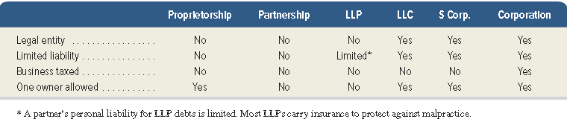
Choosing a Business Form
Many factors should be considered when choosing the proper business form.
Learning Objective C1: Identify characteristics of partnerships and similar organizations.
Notes:
Choosing the proper business form is crucial. Many factors should be considered, including taxes, liability risk, tax and fiscal year-end, ownership structure, estate planning, business risks, and earnings and property distributions. The table shown summarizes several important characteristics of these business entities.

Slide 7
P1:
Prepare entries for partnership formation.
Learning Objective

Slide 8
Accounting for
Partnership Formation
Partners can invest both assets and liabilities in the partnership.
Assets and liabilities are recorded at an agreed-upon value, normally fair market value.
Asset contributions increase the partner’s capital account.
Withdrawals from the partnership decrease the partner’s capital account.
Learning Objective P1: Prepare entries for partnership formation.
Notes:
When partners invest in a partnership, their capital accounts are credited for the invested amounts. Partners can invest both assets and liabilities. Each partner’s investment is recorded at an agreed-on value, normally the market values of the contributed assets and liabilities at the date of contribution.

Slide 9


Organizing a Partnership
On 1/11, Kayla Zayn and Hector Perez organize a partnership called BOARDS. Zayn’s initial investment is $7,000 cash, $33,000 in boarding facilities, and a note payable for $10,000 on the boarding facilities. Perez’s initial investment is $10,000 cash.
Learning Objective P1: Prepare entries for partnership formation.
Notes:
Kayla Zayn and Hector Perez organize a partnership on January 11 called BOARDS that offers year-round facilities for skateboarding and snowboarding. Zayn’s initial net investment in BOARDS is $30,000, made up of cash ($7,000), boarding facilities ($33,000), and a note payable reflecting a bank loan for the new business ($10,000). Perez’s initial investment is cash of $10,000. These amounts are the values agreed on by both partners. The entries to record these investments are shown.

Slide 10
Organizing a Partnership
In accounting for partnerships:
Partners’ withdrawals are debited to their own separate withdrawals account.
Partners’ capital accounts are credited (or debited) for their shares of net income (or net loss) when closing the accounts at the end of the period.
Each partner’s withdrawal account is closed to that partner’s capital account. Separate capital and withdrawals accounts are kept for each partner.
Learning Objective P1: Prepare entries for partnership formation.
Notes:
In accounting for partnerships, the following additional relations hold true:
Partners’ withdrawals are debited to their own separate withdrawals account.
Partners’ capital accounts are credited (or debited) for their shares of net income (or net loss) when closing the accounts at the end of the period.
Each partner’s withdrawal account is closed to that partner’s capital account. Separate capital and withdrawals accounts are kept for each partner.
Review what you have learned in the following NEED-TO-KNOW Slide.

Slide 11
NEED-TO-KNOW 12-1
LeBron and Durant organize a partnership on January 1. LeBron’s initial net investment is $1,500,
consisting of cash ($350), equipment ($1,650), and a note payable reflecting a bank loan for the new
business ($500). Durant’s initial investment is cash of $800. These amounts are the values agreed on by
both partners. Prepare journal entries to record (1) LeBron’s investment and (2) Durant’s investment.
Date
General Journal
Debit
Credit
Jan. 1
Cash
350
Equipment
1,650
Note payable
500
LeBron, Capital
1,500
To record investment of LeBron
Jan. 1
Cash
800
Durant, Capital
800
To record investment of Durant
Learning Objective P1: Prepare entries for partnership formation.
Notes:
LeBron and Durant organize a partnership on January 1. LeBron’s initial net investment is $1,500, consisting of cash ($350), equipment ($1,650), and a note payable reflecting a bank loan for the new business ($500). Durant’s initial investment is cash of $800. These amounts are the values agreed on by both partners.
Prepare journal entries to record (1) LeBron’s investment and (2) Durant’s investment. To record LeBron's investment, we debit Cash for the amount invested, $350, debit Equipment, $1,650, and credit Notes payable for $500. Since the assets are increasing by $2,000 and liabilities are increasing by $500, LeBron's net investment, the credit to his capital account, is $1,500. Durant's initial investment is Cash of $800. To record this investment, we debit Cash and credit Durant's capital.

Slide 12
P2:
Allocate and record income and loss among partners.
Learning Objective

Slide 13
Dividing Partnership
Income or Loss
Partners are not employees of partnership but are its owners. No salaries reported as expense on the income statement. Profits or losses of the partnership are divided on some agreed upon ratio.
Three frequently used methods to divide income or loss are allocation on:
  Stated ratios.
  Capital balances.
  Services, capital, and stated ratios.
Learning Objective P2: Allocate and record income and loss among partners.
Notes:
Partners are not employees of the partnership but are its owners. If partners devote their time and services to their partnership, they are understood to do so for profit, not for salary. This means there are no salaries to partners that are reported as expenses on the partnership income statement. However, when net income or loss of a partnership is allocated among partners, the partners can agree to allocate “salary allowances” reflecting the relative value of services provided. Partners also can agree to allocate “interest allowances” based on the amount invested.
Partners can agree to any method of dividing income or loss. In the absence of an agreement, the law says that the partners share income or loss of a partnership equally. If partners agree on how to share income but say nothing about losses, they share losses the same way they share income. Three common methods to divide income or loss use (1) a stated ratio basis, (2) the ratio of capital balances, or (3) salary and interest allowances and any remainder according to a fixed ratio. We explain each of these methods in this section.

Slide 14
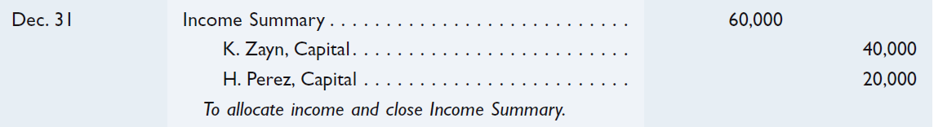
Allocation on Stated Ratios
In the partnership agreement, Zayn is to receive 2/3 and Perez 1/3 of partnership income or loss. If the partnership income is $60,000, we will allocate the income to partners as follows:
$60,000 × 2/3 = $40,000
$60,000 × 1/3 = $20,000
Learning Objective P2: Allocate and record income and loss among partners.
Notes:
The stated ratio (also called the income-and-loss-sharing ratio, the profit and loss ratio, or the P&L ratio) method of allocating partnership income or loss gives each partner a fraction of the total. Partners must agree on the fractional share each receives. To illustrate, assume the partnership agreement of K. Zayn and H. Perez says Zayn receives two-thirds and Perez one-third of partnership income and loss. If their partnership’s net income is $60,000, it is allocated to the partners when the Income Summary account is closed as shown.

Slide 15
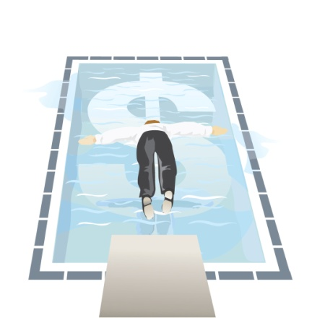
Allocation on Capital Balances
In their partnership agreement, Zayn and Perez agree to allocate profits and losses on the basis of their beginning capital balances.
Learning Objective P2: Allocate and record income and loss among partners.
Notes:
The capital balances method of allocating partnership income or loss assigns an amount based on the ratio of each partner’s relative capital balance. If Zayn and Perez agree to share income and loss on the ratio of their beginning capital balances— Zayn’s $30,000 and Perez’s $10,000—Zayn receives three-fourths of any income or loss ($30,000/$40,000) and Perez receives one-fourth ($10,000/$40,000).
The entry shown allocates income to partner capital.

Slide 16
Allocation on Services, Capital, and Stated Ratios
Zayn and Perez have a partnership agreement with the following conditions:
Zayn receives a $36,000 annual salary allowance and Perez receives an allowance of $24,000.
Each partner is allowed an annual interest allowance of 10% on their beginning capital balance.
Any remaining balance of income or loss is allocated equally.
Net income is $70,000.
Learning Objective P2: Allocate and record income and loss among partners.
Notes:
Now, let’s look at a more complex, and realistic way that partners may decide to divide profits and losses. Zayn and Perez have a partnership agreement with the following conditions:
Zayn receives a $36,000 annual salary allowance and Perez receives an allowance of $24,000.
Each partner is allowed an annual interest allowance of 10% on their beginning capital balance.
Any remaining balance of income or loss is allocated equally.
Let’s see how the net income of $70,000 will be allocated.

Slide 17
Allocation on Services, Capital, and Stated Ratios
$30,000 × 10% = $3,000
$10,000 × 10% = $1,000
$6,000 × ½ = $3,000
Learning Objective P2: Allocate and record income and loss among partners.
Notes:
We begin with the $70,000 of income to allocate to the two partners. Next, we provide an allowance for salary of $36,000 to Zayn and $24,000 to Perez. After this allowance, we have $10,000 remaining to be allocated to the partners. Next, we provide the interest on beginning capital. Zayn will receive an allocation of $3,000 (10% times beginning capital balance of $30,000) and Perez will be allocated $1,000 (10% times beginning capital balance of $10,000). After this allocation, we have $6,000 remaining to be allocated. Finally, we allocate the remainder equally between Zayn and Perez. We will allocate $3,000 to each partner. When the allocation is complete, Zayn will have income of $42,000 and Perez will have income of $28,000.

Slide 18
Allocation on Services, Capital, and Stated Ratios
Now let’s assume that net income is only $50,000.
($14,000) × ½ = ($7,000)
Learning Objective P2: Allocate and record income and loss among partners.
Notes:
Now, we begin with the $50,000, instead of $70,000 in our previous example, of income to allocate to the two partners. First, we provide an allowance for salary of $36,000 to Zayn and $24,000 to Perez. After this allowance, we have a negative $10,000 remaining to be allocated to the partners. Next, we provide the interest on beginning capital. Zayn will receive an allocation of $3,000 (10% times beginning capital balance of $30,000) and Perez will be allocated $1,000 (10% times beginning capital balance of $10,000). After this allocation, we have a negative $14,000 remaining to be allocated. Finally, we allocate the negative $14,000 equally between Zayn and Perez. Each partner will receive a reduction of $7,000. We can see that Zayn has income of $32,000 and Perez has income of $18,000.
Review what you have learned in the following NEED-TO-KNOW Slides.

Slide 19
Partnership Financial Statements
During 2016, Zayn withdrew $20,000 cash from the partnership and Perez withdrew $12,000. Net income for the year is $70,000.
Learning Objective P2: Allocate and record income and loss among partners.
Notes:
Partnership financial statements are similar to those of other organizations. The statement of partners’ equity, also called statement of partners’ capital, is one exception. It shows each partner’s beginning capital balance, additional investments, allocated income or loss, withdrawals, and ending capital balance. To illustrate, this slide shows the statement of partners’ equity for BOARDS prepared using the sharing agreement discussed earlier. Recall that BOARDS’s income was $70,000; also, assume that Zayn withdrew $20,000 and Perez $12,000 at year-end.
The equity section of the balance sheet of a partnership usually shows the separate capital account balance of each partner. In the case of BOARDS, both K. Zayn, Capital, and H. Perez, Capital, are listed in the equity section along with their balances of $52,000 and $26,000, respectively.

Slide 20
NEED-TO-KNOW 12-2
Merkel and Putin began a partnership by investing $6,000 and $4,000, respectively. During its first year, the
partnership earned $80,000. Prepare calculations showing how the $80,000 income is allocated to the partners
under each of the following three separate plans for sharing income and loss:
(1) The partners failed to agree on a method to share income.
(2) The partners agreed to share income and loss in proportion to their initial investments.
(3) The partners agreed to share income by granting a $35,000 per year salary allowance to Merkel,
a $13,000 per year salary allowance to Putin, 20% interest on their initial capital investments, and any
remaining balance shared 70% to Merkel and 30% to Putin.
Income Summary
Dec. 31
80,000
Merkel, Capital
Putin, Capital
Invest.
6,000
Invest.
4,000
Learning Objective P2: Allocate and record income and loss among partners.
Notes:
Merkel and Putin began a partnership by investing $6,000 and $4,000, respectively. During its first year, the partnership earned $80,000. Prepare calculations showing how the $80,000 income is allocated to the partners under each of the following three separate plans for sharing income and loss:
1. The partners failed to agree on a method to share income.
2. The partners agreed to share income and loss in proportion to their initial investments.
3. The partners agreed to share income by granting a $35,000 per year salary allowance to Merkel, a $13,000 per year salary allowance to Putin, 20% interest on their initial capital investments, and any remaining balance shared 70% to Merkel and 30% to Putin.

Slide 21
NEED-TO-KNOW 12-2
(1) The partners failed to agree on a method to share income.
Plan 1
Merkel
Putin
Total
$80,000 x 1/2
$40,000
$40,000
$80,000
Date
General Journal
Debit
Credit
Dec. 31
Income summary
80,000
Merkel, Capital
40,000
Putin, Capital
40,000
To allocate income under plan 1
Income Summary
Dec. 31
80,000
Close
80,000
-0-
Merkel, Capital
Putin, Capital
Invest.
6,000
Invest.
4,000
Close
40,000
Close
40,000
Dec. 31
46,000
Dec. 31
44,000
Learning Objective P2: Allocate and record income and loss among partners.
Notes:
(1) The partners failed to agree on a method to share income. In the absence of a partnership agreement, any income or loss is allocated evenly among the partners; half of the $80,000 is allocated to Merkel, and the other half is allocated to Putin. The journal entry to record the allocation is a debit to Income summary, $80,000, and a credit to each of the partners' capital accounts for $40,000. After this closing entry is posted, the balance in Income summary is $0, the balance in Merkel's capital account has increased to $46,000, and the balance in Putin's capital account has increased to $44,000.

Slide 22
NEED-TO-KNOW 12-2
(2) The partners agreed to share income and loss in proportion to their initial investments.
Plan 2
Merkel
Putin
Total
$80,000 x ($6,000 / $10,000)
$48,000
$48,000
$80,000 x ($4,000 / $10,000)
$32,000
32,000
$48,000
$32,000
$80,000
Date
General Journal
Debit
Credit
Dec. 31
Income summary
80,000
Merkel, Capital
48,000
Putin, Capital
32,000
To allocate income under plan 2
Income Summary
Dec. 31
80,000
Close
80,000
-0-
Merkel, Capital
Putin, Capital
Invest.
6,000
Invest.
4,000
Close
48,000
Close
32,000
Dec. 31
54,000
Dec. 31
36,000
Learning Objective P2: Allocate and record income and loss among partners.
Notes:
(2) The partners agreed to share income and loss in proportion to their initial investments. The total of the partners' initial investments', the denominator in our proportion, is $10,000. To allocate the $80,000 to Merkel, we take $80,000 and multiply by Merkel's investment, $6,000, divided by the total investment of $10,000; $48,000 of the $80,000 is allocated to Merkel. The amount allocated to Putin is calculated by taking the $80,000, multiplying by Putin's investment, $4,000, divided by the total investment of $10,000; $80,000 multiplied by 40% is $32,000. In summary, $48,000 allocated to Merkel and $32,000 allocated to Putin allocates total partnership income of $80,000.
The journal entry is a debit to Income summary for $80,000; a credit to Merkel's capital account, $48,000; and a credit to Putin's capital account for $32,000. This closes the balance in Income summary, and increases Merkel's capital balance to $54,000, and Putin's capital balance to $36,000.

Slide 23
NEED-TO-KNOW 12-2
(3) The partners agreed to share income by granting a $35,000 per year salary allowance to Merkel,
a $13,000 per year salary allowance to Putin, 20% interest on their initial capital investments, and any
remaining balance shared 70% to Merkel and 30% to Putin.
Plan 3
Merkel
Putin
Total
Net income
$80,000
Salary Allowances:
$35,000
$13,000
48,000
Interest Allowances:
$6,000 x 20%
1,200
1,200
$4,000 x 20%
800
800
Total Salary and Interest Allowances
50,000
Balance of income
30,000
Balance allocated (Merkel, 70%; Putin, 30%)
21,000
9,000
30,000
Balance of income
$0
Shares of each partner
$57,200
$22,800
Date
General Journal
Debit
Credit
Dec. 31
Income summary
80,000
Merkel, Capital
57,200
Putin, Capital
22,800
To allocate income under plan 3
Learning Objective P2: Allocate and record income and loss among partners.
Notes:
(3) The partners agreed to share income by granting a $35,000 per year salary allowance to Merkel, a $13,000 per year salary allowance to Putin, 20% interest on their initial capital Investments and any remaining balance shared 70% to Merkel and 30% to Putin. From the net income amount, $80,000, we subtract the total of the salary and interest allowances. The salary allowances, $35,000 to Merkel and $13,000 to Putin, total $48,000. The interest allowances, 20% of their initial investments, $6,000 multiplied by 20% is $1,200 for Merkel and $4,000 multiplied by 20% is $800 for Putin. The total of the salary and interest allowances is $50,000. When we subtract the $50,000 in allowances from net income of $80,000, the balance of income is $30,000. This balance of income is allocated 70% to Merkel and 30% to Putin; 70% of $30,000 is $21,000, and 30% of $30,000 is $9,000.

Slide 24
P3:
Account for the admission and withdrawal of partners.
Learning Objective

Slide 25
Admission of a Partner
When the makeup of the partnership changes, the existing partnership is dissolved.
A new partnership may be immediately formed.
New partner acquires partnership interest by:
  Purchasing it from the other partners, or
  Investing assets in the partnership.
Learning Objective P3: Account for the admission and withdrawal of partners.
Notes:
A partnership is based on a contract between individuals. When a partner is admitted or withdraws, the present partnership ends. Still, the business can continue to operate as a new partnership consisting of the remaining partners.
A new partner is admitted in one of two ways: by purchasing an interest from one or more current partners or by investing cash or other assets in the partnership.

Slide 26
Purchase of Partnership Interest
A new partner can purchase partnership interest directly from the existing partners.
  The cash goes to the partners, not to the partnership.
To become a partner, the new partner must be accepted by the current partners.
Learning Objective P3: Account for the admission and withdrawal of partners.
Notes:
The purchase of partnership interest is a personal transaction between one or more current partners and the new partner. To become a partner, the current partners must accept the purchaser. Accounting for the purchase of partnership interest involves reallocating current partners’ capital to reflect the transaction.

Slide 27
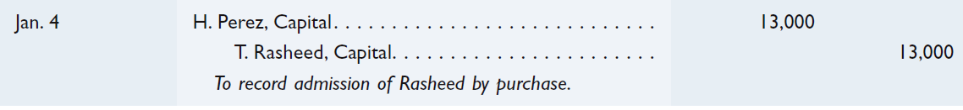
Purchase of Partnership Interest
On January 4th, Hector Perez sells one-half of his partnership interest to Tyrell Rasheed for $18,000. Perez gives up a $13,000 recorded interest in the partnership.
Learning Objective P3: Account for the admission and withdrawal of partners.
Notes:
To illustrate, at the end of BOARDS’ first year, H. Perez sells one-half of his partnership interest to Tyrell Rasheed for $18,000. This means that Perez gives up a $13,000 recorded interest ($26,000 / 2) in the partnership (see the ending capital balance above). The partnership records this January 4 transaction as follows.
After this entry is posted, BOARDS’ equity shows K. Zayn, Capital; H. Perez, Capital; and T. Rasheed, Capital, and their respective balances of $52,000, $13,000, and $13,000.
Two aspects of this transaction are important. First, the partnership does not record the $18,000 Rasheed paid Perez. The partnership’s assets, liabilities, and total equity are unaffected by this transaction among partners. Second, Zayn and Perez must agree that Rasheed is to become a partner. If they agree to accept Rasheed, a new partnership is formed and a new contract with a new income-and-loss-sharing agreement is prepared. If Zayn or Perez refuses to accept Rasheed as a partner, then (under the Uniform Partnership Act) Rasheed gets Perez’s sold share of partnership income and loss. If the partnership is liquidated, Rasheed gets Perez’s sold share of partnership assets. Rasheed gets no voice in managing the company unless Rasheed is admitted as a partner.

Slide 28
Investing Assets in a Partnership
The new partner can gain partnership interest by contributing assets to the partnership.
The new assets will increase the partnership’s net assets.
After admission, both assets and equity will increase.
Learning Objective P3: Account for the admission and withdrawal of partners.
Notes:
Admitting a partner by accepting assets is a transaction between the new partner and the partnership. The invested assets become partnership property.

Slide 29
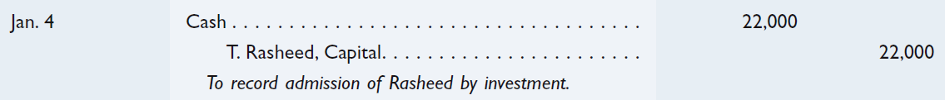
Investing Assets in a Partnership
On January 4th, Tyrell Rasheed is admitted to the partnership with a payment of $22,000 cash.
Learning Objective P3: Account for the admission and withdrawal of partners.
Notes:
If Zayn (with a $52,000 interest) and Perez (with a $26,000 interest) agree to accept Rasheed as a partner in BOARDS after an investment of $22,000 cash, this is recorded as shown.
After this entry is posted, both assets (cash) and equity (T. Rasheed, Capital) increase by $22,000. Rasheed now has a 22% equity in the assets of the business, computed as $22,000 divided by the entire partnership equity ($52,000 / $26,000 / $22,000). Rasheed does not necessarily have a right to 22% of income. Dividing income and loss is a separate matter on which partners must agree.

Slide 30
Bonus to Old or New Partners
When the current value of a partnership is greater than the recorded amounts of equity, the old partners usually require a new partner to pay a bonus when joining.
Bonus to Old Partners
The partnership may grant a bonus to a new partner if the business is in need of cash or if the new partner has exceptional talents.
Bonus to New Partners
Learning Objective P3: Account for the admission and withdrawal of partners.
Notes:
When the current value of a partnership is greater than the recorded amounts of equity, the partners usually require a new partner to pay a bonus for the privilege of joining. When the balance in the new partner’s capital account does not equal the amount of net assets invested, the difference is called a bonus either to or from the current partners.

Slide 31

Bonus to Old Partners
On January 4th, Zayn and Perez agree to accept Rasheed as a partner upon his investment of $42,000 cash in the partnership. Rasheed is to receive a 25% ownership interest in the new partnership. Any bonus is attributable to the existing partners and is shared equally.
Learning Objective P3: Account for the admission and withdrawal of partners.
Notes:
To illustrate, assume that Zayn and Perez agree to accept Rasheed as a partner with a 25% interest in BOARDS if Rasheed invests $42,000. Recall that the partnership’s accounting records show that Zayn’s recorded equity in the business is $52,000 and Perez’s recorded equity is $26,000. Rasheed’s equity is determined as follows.
Although Rasheed invests $42,000, the equity attributed to Rasheed in the new partnership is only $30,000. The $12,000 difference is called a bonus and is allocated to existing partners (Zayn and Perez) according to their income-and-loss-sharing agreement. A bonus is shared in this way because it is viewed as reflecting a higher value of the partnership that is not yet reflected in income.

Slide 32
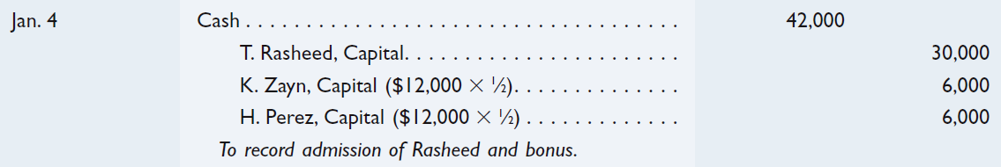
Bonus to Old Partners
On January 4th, Zayn and Perez agree to accept Rasheed as a partner upon his investment of $42,000 cash in the partnership. Rasheed is to receive a 25% ownership interest in the new partnership. Any bonus is attributable to the existing partners and is shared equally.
$42,000 - $30,000 = $12,000 × ½ = $6,000
Learning Objective P3: Account for the admission and withdrawal of partners.
Notes:
We know that Rasheed will pay $42,000 cash into the partnership and receive a capital account balance of $30,000. The difference is $12,000 and is attributable to the existing partners, Zayn and Perez. Both Zayn and Perez will be given credit for half of the $12,000, or $6,000 each.

Slide 33
Bonus to New Partner
On January 4th, Zayn and Perez agree to accept Rasheed as a partner upon his investment of $18,000 cash in the partnership. Rasheed is to receive a 25% ownership interest in the new partnership. Any bonus is attributable to Rasheed’s excellent business skills.
Learning Objective P3: Account for the admission and withdrawal of partners.
Notes:
Alternatively, existing partners can grant a bonus to a new partner. This usually occurs when they need additional cash or the new partner has exceptional talents. The bonus to the new partner is in the form of a larger share of equity than the amount invested. To illustrate, assume that Zayn and Perez agree to accept Rasheed as a partner with a 25% interest in the partnership, but they require Rasheed to invest only $18,000. Rasheed’s equity is determined as shown.
Let’s prepare the entry to admit Rasheed into the partnership.

Slide 34
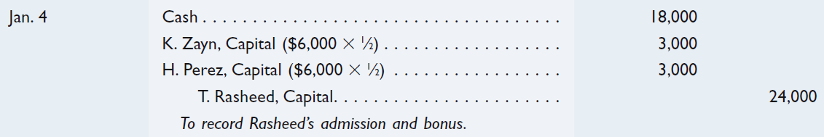
Bonus to New Partner
On January 4th, Zayn and Perez agree to accept Rasheed as a partner upon his investment of $18,000 cash in the partnership. Rasheed is to receive a 25% ownership interest in the new partnership. Any bonus is attributable to Rasheed’s excellent business skills.
$18,000 - $24,000 = $(6,000) × ½ = $(3,000)
Learning Objective P3: Account for the admission and withdrawal of partners.
Notes:
The old partners contribute the $6,000 bonus (computed as $24,000 minus $18,000) to Rasheed according to their income-and-loss-sharing ratio. Moreover, Rasheed’s 25% equity does not necessarily entitle Rasheed to 25% of future income or loss. This is a separate matter for agreement by the partners. The entry to record the admission and investment of Rasheed is shown.
Review what you have learned in the following NEED-TO-KNOW Slides.

Slide 35
NEED-TO-KNOW 12-3
Anne, Portia, and Hedison are partners and share income and loss in a 2:3:5 ratio. The partnership’s capital
balances are as follows: Anne, $300; Portia, $150; and Hedison, $450. Ellen is admitted to the partnership on
May 1 with a 25% equity. Prepare journal entries to record Ellen’s entry into the partnership under each of the
following separate assumptions: Ellen invests (a) $300; (b) $100; and (c) $700.
a) Ellen invests $300.
Partnership Capital
Before
Change
After
Anne, Capital
$300
$0
$300
Portia, Capital
150
0
150
Hedison, Capital
450
0
450
Ellen, Capital
($900 + $300) x 25%
300
300
Total
$900
$300
$1,200
Date
General Journal
Debit
Credit
May 1
Cash
300
Ellen, Capital
($900 + $300) x 25%
300
To record admission of Ellen, with no bonus
Learning Objective P3: Account for the admission and withdrawal of partners.
Notes:
Anne, Portia, and Hedison are partners and share income and loss in a 2:3:5 ratio. The partnership’s capital balances are as follows: Anne, $300; Portia, $150; and Hedison, $450. Ellen is admitted to the partnership on May 1 with a 25% equity. Prepare journal entries to record Ellen’s entry into the partnership under each of the following separate assumptions: Ellen invests (a) $300; (b) $100; and (c) $700.
a) Ellen invests $300. Before Ellen's admission to the partnership, total partnership capital is $900. Because Ellen is increasing the assets of the partnership by $300, total partnership assets, and therefore equity after her admission, total $1,200. The balance in Ellen's capital account is equal to 25% of new partnership capital; 25% of $1,200 is $300. There will be no change in the capital balances of the original partners. When the admission of a new partner has no impact on the capital balances of the original partners, the admission is said to be "without bonus.” Total partnership capital after Ellen's admission is $1,200. The journal entry to admit Ellen to the partnership is a debit to Cash, $300, and a credit to Ellen's capital account, 25% of new partnership capital, $300.

Slide 36
NEED-TO-KNOW 12-3
Anne, Portia, and Hedison are partners and share income and loss in a 2:3:5 ratio. The partnership’s capital
balances are as follows: Anne, $300; Portia, $150; and Hedison, $450. Ellen is admitted to the partnership on
May 1 with a 25% equity. Prepare journal entries to record Ellen’s entry into the partnership under each of the
following separate assumptions: Ellen invests (a) $300; (b) $100; and (c) $700.
b) Ellen invests $100.
Partnership Capital
Before
Change
After
Anne, Capital
($250 - $100) x 2/10
$300
($30)
$270
Portia, Capital
($250 - $100) x 3/10
150
(45)
105
Hedison, Capital
($250 - $100) x 5/10
450
(75)
375
Ellen, Capital
($900 + $100) x 25%
250
250
Total
$900
$100
$1,000
Date
General Journal
Debit
Credit
May 1
Cash
100
Anne, Capital
($250 - $100) x 2/10
30
Portia, Capital
($250 - $100) x 3/10
45
Hedison, Capital
($250 - $100) x 5/10
75
Ellen, Capital
($900 + $100) x 25%
250
To record admission of Ellen, with bonus
Learning Objective P3: Account for the admission and withdrawal of partners.
Notes:
b) Ellen invests $100. Since the assets are increasing by $100, total equity will increase by $100, bringing new partnership capital up to $1,000. Ellen's capital balance is equal to 25% of $1,000, $250. Since total capital is only increasing by $100, and Ellen's capital balance will increase by $250, the capital balances of the original partners will decrease by a total of $150; there is a $150 bonus to Ellen, the new partner. This $150 bonus is allocated in the ratio of 2:3:5. $150 multiplied by 2/10 is $30; $150 multiplied by 3/10 is $45; and $150 multiplied by 5/10 is $75. Total partnership capital after Ellen's admission totals $1,000. The journal entry to admit Ellen to the partnership is a debit to Cash, $100, a credit to Ellen's capital account, 25% of total new partnership capital, $250, a debit to Anne's Capital account, for 2/10 of the $150 bonus, $30; debit Portia's capital account 3/10 of $150, $45, and debit Hedison's capital account, 5/10 of $150, $75.

Slide 37
NEED-TO-KNOW 12-3
Anne, Portia, and Hedison are partners and share income and loss in a 2:3:5 ratio. The partnership’s capital
balances are as follows: Anne, $300; Portia, $150; and Hedison, $450. Ellen is admitted to the partnership on
May 1 with a 25% equity. Prepare journal entries to record Ellen’s entry into the partnership under each of the
following separate assumptions: Ellen invests (a) $300; (b) $100; and (c) $700.
c) Ellen invests $700.
Partnership Capital
Before
Change
After
Anne, Capital
($700 - $400) x 2/10
$300
$60
$360
Portia, Capital
($700 - $400) x 3/10
150
90
240
Hedison, Capital
($700 - $400) x 5/10
450
150
600
Ellen, Capital
($900 + $700) x 25%
400
400
Total
$900
$700
$1,600
Date
General Journal
Debit
Credit
May 1
Cash
700
Anne, Capital
($700 - $400) x 2/10
60
Portia, Capital
($700 - $400) x 3/10
90
Hedison, Capital
($700 - $400) x 5/10
150
Ellen, Capital
($900 + $700) x 25%
400
To record admission of Ellen, with bonus
Learning Objective P3: Account for the admission and withdrawal of partners.
Notes:
c) Ellen invests $700. Since the assets are increasing by $700, total equity will also increase by $700. Total capital after Ellen's admission is $1,600. The balance in Ellen's capital account is 25% of $1,600, $400. Since total partnership capital increases by $700, and Ellen's capital account increases by only $400, the capital balances of the original partners will increase by a total of $300; there is a $300 bonus to the original partners. The $300 bonus is allocated to the original partners capital accounts using the profit and loss ratio of 2:3:5. $300 multiplied by 2/10 is $60; $300 multiplied by 3/10 is $90; and $300 multiplied by 5/10 is $150. Total partnership capital after Ellen's admission totals $1,600. The journal entry to admit Ellen to the partnership debits Cash, $700; credits Ellen's capital account; 25% of new partnership capital, $1,600, is $400; credits Anne's capital account, $300 multiplied by 2/10, $60; Portia's capital account, $300 multiplied by 3/10, $90; and Hedison's capital account, $300 multiplied by 5/10, $150. Assets and equity increase by a total of $700.

Slide 38
Withdrawal of a Partner
A partner can withdraw in two ways:
The partner can sell his/her partnership interest to another person.
The partnership can distribute cash and/or other assets to the withdrawing partner.
Learning Objective P3: Account for the admission and withdrawal of partners.
Notes:
A partner generally withdraws from a partnership in one of two ways. (1) First, the withdrawing partner can sell his or her interest to another person who pays for it in cash or other assets. For this, we need only debit the withdrawing partner’s capital account and credit the new partner’s capital account. (2) The second case is when cash or other assets of the partnership are distributed to the withdrawing partner in settlement of his or her interest.

Slide 39

Withdrawal of a Partner - No Bonus
At the date of the withdrawal of Perez, the partners have the following capital balances: Perez - $38,000, Zayn - $84,000, and Rasheed - $38,000. The partners share income and loss equally. Perez is to receive $38,000 cash upon withdrawal from the partnership.
Learning Objective P3: Account for the admission and withdrawal of partners.
Notes:
To illustrate these cases, assume that Perez withdraws from the partnership of BOARDS in some future period. The partnership shows the following capital balances at the date of Perez’s withdrawal: K. Zayn, $84,000; H. Perez, $38,000; and T. Rasheed, $38,000. The partners (Zayn, Perez, and Rasheed) share income and loss equally. Accounting for Perez’s withdrawal depends on whether a bonus is paid. We describe three possibilities.
No Bonus - If Perez withdraws and takes cash equal to Perez’s capital balance, the entry is shown.
Perez can take any combination of assets to which the partners agree to settle Perez’s equity. Perez’s withdrawal creates a new partnership between the remaining partners. A new partnership contract and a new income-and-loss-sharing agreement are required.

Slide 40

Withdrawal of a Partner – Bonus to Remaining Partners
At the date of the withdrawal of Perez, the partners have the following capital balances: Perez - $38,000, Zayn - $84,000, and Rasheed - $38,000. The partners share income and loss equally. Perez is to receive $34,000 cash upon withdrawal from the partnership.
Capital balance | $ 38,000
Cash settlement | 34,000
Bonus | 4,000
Times | 50%
Bonus to each partner | $ 2,000
Learning Objective P3: Account for the admission and withdrawal of partners.
Notes:
A withdrawing partner is sometimes willing to take less than the recorded value of his or her equity to get out of the partnership or because the recorded value is overstated. Whatever the reason, when this occurs, the withdrawing partner in effect gives the remaining partners a bonus equal to the equity left behind. The remaining partners share this unwithdrawn equity according to their income-and-loss-sharing ratio. To illustrate, if Perez withdraws and agrees to take $34,000 cash in settlement of Perez’s capital balance, the entry is shown.
Perez withdrew $4,000 less than Perez’s recorded equity of $38,000. This $4,000 is divided between Zayn and Rasheed according to their income-and-loss-sharing ratio.

Slide 41

Withdrawal of a Partner - Bonus to Withdrawing Partner
At the date of the withdrawal of Perez, the partners have the following capital balances: Perez - $38,000, Zayn - $84,000, and Rasheed - $38,000. The partners share income and loss equally. Perez is to receive $40,000 cash upon withdrawal from the partnership.
Capital balance | $ 38,000
Cash settlement | 40,000
Deficiency | 2,000
Times | 50%
To each partner | $ 1,000
Learning Objective P3: Account for the admission and withdrawal of partners.
Notes:
A withdrawing partner may be able to receive more than his or her recorded equity for at least two reasons. First, the recorded equity may be understated. Second, the remaining partners may agree to remove this partner by giving assets of greater value than this partner’s recorded equity. In either case, the withdrawing partner receives a bonus. The remaining partners reduce their equity by the amount of this bonus according to their income-and-loss-sharing ratio. To illustrate, if Perez withdraws and receives $40,000 cash in settlement of Perez’s capital balance, the entry is shown.

Slide 42
Death of a Partner
A partner’s death dissolves a partnership. A deceased partner’s estate is entitled to receive his or her equity. The partnership agreement should contain provisions for settlement. These provisions usually require:
Closing the books to determine income or loss since the end of the previous period, and
Determining and recording current market values for both assets and liabilities.
Settlement of the deceased partner’s estate can involve selling the equity to remaining partners or to an outsider, or it can involve withdrawal of assets.
Learning Objective P3: Account for the admission and withdrawal of partners.
Notes:
A partner’s death dissolves a partnership. A deceased partner’s estate is entitled to receive his or her equity. The partnership contract should contain provisions for settlement in this case. These provisions usually require (1) closing the books to determine income or loss since the end of the previous period and (2) determining and recording current market values for both assets and liabilities. The remaining partners and the deceased partner’s estate then must agree to a settlement of the deceased partner’s equity. This can involve selling the equity to remaining partners or to an outsider, or it can involve withdrawing assets.
Review what you have learned in the following NEED-TO-KNOW Slides.

Slide 43
NEED-TO-KNOW 12-4
Fluffy, Anjelah, and Lopez are partners and share income and loss in a 2:3:5 ratio. The partnership’s capital
balances are as follows: Fluffy, $330; Anjelah, $270; and Lopez, $400. Lopez decides to withdraw from the
partnership, and the partners agree to not revalue the assets upon Lopez’s retirement. Prepare journal entries
to record Lopez’s May 1 withdrawal from the partnership under each of the following separate assumptions:
(a) Lopez sells his interest to Mencia for $500 after Fluffy and Anjelah approve the entry of Mencia as a
partner.
Before
Change
After
Fluffy, Capital
$330
$330
Anjelah, Capital
270
270
Lopez, Capital
400
($400)
0
Mencia, Capital
400
400
Total
$1,000
$0
$1,000
Date
General Journal
Debit
Credit
May 1
Lopez, Capital
400
Mencia, Capital
400
To record admission of Mencia
Learning Objective P3: Account for the admission and withdrawal of partners.
Notes:
Fluffy, Anjelah, and Lopez are partners and share income and loss in a 2:3:5 ratio. The partnership’s capital balances are as follows: Fluffy, $330; Anjelah, $270; and Lopez, $400. Lopez decides to withdraw from the partnership, and the partners agree to not revalue the assets upon Lopez’s retirement. Prepare journal entries to record Lopez’s May 1 withdrawal from the partnership under each of the following separate assumptions:
(a) Lopez sells his interest to Mencia for $500 after Fluffy and Anjelah approve the entrance of Mencia as a partner. Prior to Lopez's withdrawal from the partnership, the capital balances are $330 for Fluffy, $270 for Anjelah, and $400 for Lopez; a total of $1,000. Mencia is paying $500 to Lopez personally. There is no change in the net assets of the partnership. Therefore, there can be no change in total partnership capital. The balance in Lopez's capital account, $400, is eliminated, and transferred to Mencia's capital balance. After Mencia is admitted to the partnership, Fluffy's capital balance remains at $330, Anjelah's remains at $270, and Mencia is now $400. Total partnership capital is $1,000. The journal entry to effect this change is a debit to Lopez's capital account, $400, and a credit to Mencia's capital account for the same amount.

Slide 44
NEED-TO-KNOW 12-4
Fluffy, Anjelah, and Lopez are partners and share income and loss in a 2:3:5 ratio. The partnership’s capital
balances are as follows: Fluffy, $330; Anjelah, $270; and Lopez, $400. Lopez decides to withdraw from the
partnership, and the partners agree to not revalue the assets upon Lopez’s retirement. Prepare journal entries
to record Lopez’s May 1 withdrawal from the partnership under each of the following separate assumptions:
(b) Lopez gives his interest to a son-in-law, Madrigal, and thereafter Fluffy and Anjelah accept
Madrigal as a partner.
Before
Change
After
Fluffy, Capital
$330
$330
Anjelah, Capital
270
270
Lopez, Capital
400
($400)
0
Madrigal, Capital
400
400
Total
$1,000
$0
$1,000
Date
General Journal
Debit
Credit
May 1
Lopez, Capital
400
Madrigal, Capital
400
To record admission of Madrigal
Learning Objective P3: Account for the admission and withdrawal of partners.
Notes:
(b) Lopez gives his interest to a son-in-law, Madrigal, and thereafter Fluffy and Anjelah accept Madrigal as a partner. Again, there is no change in the net assets of the partnership, therefore total capital cannot change. Lopez's capital account is eliminated in favor of Madrigal's. After Madrigal is admitted to the partnership, Fluffy's capital balance remains at $330, Anjelah's remains at $270, and Madrigal's balance is now $400. Total partnership capital remains unchanged. The journal entry to record the admission of Madrigal is a debit to Lopez, Capital, $400,and a credit to Madrigal, Capital, $400.

Slide 45
NEED-TO-KNOW 12-4
Fluffy, Anjelah, and Lopez are partners and share income and loss in a 2:3:5 ratio. The partnership’s capital
balances are as follows: Fluffy, $330; Anjelah, $270; and Lopez, $400. Lopez decides to withdraw from the
partnership, and the partners agree to not revalue the assets upon Lopez’s retirement. Prepare journal entries
to record Lopez’s May 1 withdrawal from the partnership under each of the following separate assumptions:
(c) Lopez is paid $400 in partnership cash for his equity.
Before
Change
After
Fluffy, Capital
$330
$330
Anjelah, Capital
270
270
Lopez, Capital
400
($400)
0
Total
$1,000
($400)
$600
Date
General Journal
Debit
Credit
May 1
Lopez, Capital
400
Cash
400
To record withdrawal of Lopez, with no bonus
Learning Objective P3: Account for the admission and withdrawal of partners.
Notes:
(c) Lopez is paid $400 in partnership cash for his equity. In this case, partnership assets decrease by $400. This change in assets is matched with a change in equity; the reduction in Lopez's capital balance of $400. After Lopez's withdrawal, the balance in Fluffy's capital account remains at $330, Anjelah's capital balance is $270, for a total of $600. The journal entry to record the withdrawal of Lopez is a debit to Lopez, Capital and a credit to Cash. When a partner withdraws from a partnership, and that withdrawal has no impact on the capital balances of the remaining partners, the withdrawal is said to be "with no bonus.”

Slide 46
NEED-TO-KNOW 12-4
Fluffy, Anjelah, and Lopez are partners and share income and loss in a 2:3:5 ratio. The partnership’s capital
balances are as follows: Fluffy, $330; Anjelah, $270; and Lopez, $400. Lopez decides to withdraw from the
partnership, and the partners agree to not revalue the assets upon Lopez’s retirement. Prepare journal entries
to record Lopez’s May 1 withdrawal from the partnership under each of the following separate assumptions:
(d) Lopez is paid $600 in partnership cash for his equity.
Ratio
Before
Change
After
Fluffy, Capital
($600 - $400) x 2/5
2
$330
($80)
$250
Anjelah, Capital
($600 - $400) x 3/5
3
270
(120)
150
Lopez, Capital
5
400
(400)
0
Total
$1,000
($600)
$400
After Lopez's withdrawal, Fluffy and Anjelah share income and loss in a 2:3 ratio.
Date
General Journal
Debit
Credit
May 1
Lopez, Capital
400
Fluffy, Capital
($600 - $400) x 2/5
80
Anjelah, Capital
($600 - $400) x 3/5
120
Cash
600
To record withdrawal of Lopez, with bonus
Learning Objective P3: Account for the admission and withdrawal of partners.
Notes:
(d) Lopez is paid $600 in partnership cash for his equity. The partnership assets, and therefore equity, decrease by $600. If Lopez's capital balance is reduced by $400, Fluffy and Anjelah's capital balances must decrease by a total of $200; there is a $200 bonus to the retiring partner. Prior to Lopez's withdrawal, the partners shared income and loss in a 2:3:5 ratio. After Lopez withdraws, the remaining ratio is 2:3. $200 multiplied by 2/5 is $80, and $200 multiplied by 3/5 is $120. After Lopez's withdrawal, Fluffy's capital balance has decreased to $250. Anjelah's capital balance has decreased to $150. Total partnership capital after Lopez's withdrawal is $400. The journal entry to record the withdrawal of Lopez is a credit to Cash for $600, a debit to Lopez, Capital, for $400, and the remaining $200 reduction in capital is absorbed by Fluffy and Anjelah. We debit Fluffy's capital account for $80, and Anjelah's capital account for $120.

Slide 47
NEED-TO-KNOW 12-4
Fluffy, Anjelah, and Lopez are partners and share income and loss in a 2:3:5 ratio. The partnership’s capital
balances are as follows: Fluffy, $330; Anjelah, $270; and Lopez, $400. Lopez decides to withdraw from the
partnership, and the partners agree to not revalue the assets upon Lopez’s retirement. Prepare journal entries
to record Lopez’s May 1 withdrawal from the partnership under each of the following separate assumptions:
(e) Lopez is paid $70 in partnership cash plus equipment recorded on the partnership books at $40
less its accumulated depreciation of $10.
Partnership assets decrease by $100; ($70 + $40 - $10).
Ratio
Before
Change
After
Fluffy, Capital
($400 - $100) x 2/5
2
$330
$120
$450
Anjelah, Capital
($400 - $100) x 3/5
3
270
180
450
Lopez, Capital
5
400
($400)
0
Total
$1,000
($100)
$900
After Lopez's withdrawal, Fluffy and Anjelah share income and loss in a 2:3 ratio.
Date
General Journal
Debit
Credit
May 1
Lopez, Capital
400
Accumulated depreciation - Equipment
10
Fluffy, Capital
[$400 - ($70 +$40-$10)] x 2/5
120
Anjelah, Capital
[$400 - ($70 +$40-$10)] x 3/5
180
Equipment
40
Cash
70
To record withdrawal of Lopez, with bonus
Learning Objective P3: Account for the admission and withdrawal of partners.
Notes:
(e) Lopez is paid $70 in partnership cash plus equipment recorded on the partnership books at $40 less its accumulated depreciation of $10. Partnership assets are decreasing by $100; $70 in cash and the book value of the equipment, $30. Since the assets are decreasing by $100, total equity must also decrease by $100. If Lopez's capital balance is reduced by $400, Fluffy and Anjelah's capital balances must increase by a total of $300. There is a $300 bonus to the remaining partners. Prior to Lopez's withdrawal, they shared income and loss in the ratio of 2:3:5. As a result of Lopez's withdrawal, the remaining partners, Fluffy and Anjelah, will share income and loss in a ratio of 2:3. The bonus, $300, is allocated 2/5 to Fluffy (2/5 $300 is $120), and 3/5 to Anjelah (3/5 of $300 is $180). After Lopez's withdrawal, the balance in Fluffy's capital account has increased to $450, and the balance in Anjelah's capital account has also increase to $450. Total partnership capital after Lopez's withdrawal is $900. The journal entry to record Lopez's withdrawal credits cash for $70. We eliminate the book value of the equipment given to Lopez, crediting the equipment account for the cost of $40, and debiting Accumulated depreciation for the depreciation recorded to date of $10. Total assets have decreased by a net of $100. The reduction in equity of $100 consists of a debit to Lopez's capital account, $400; a credit to Fluffy's capital account, 2/5 of $300, $120; and a credit to Anjelah's capital account for 3/5 of $300, $180.

Slide 48
P4:
Prepare entries for partnership liquidation.
Learning Objective

Slide 49
Liquidation of a Partnership
A partnership dissolution requires 3 steps following the sale of noncash assets and the recording of a gain or loss on liquidation.
Gain or loss on liquidation is allocated to partners using their income-and-loss ratio.
Liabilities are paid or settled.
Any remaining cash is distributed to partners based on their capital balances.
Learning Objective P4: Prepare entries for partnership liquidation.
Notes:
When a partnership is liquidated, its business ends and three concluding steps are required.
1. Record the sale of noncash assets for cash, and any gain or loss from liquidation is allocated to partners using their income-and-loss-sharing agreement.
2. Pay or settle all partner liabilities.
3. Distribute any remaining cash to partners based on their capital balances.

Slide 50
No Capital Deficiency
No capital deficiency means that all partners have a zero or credit balance in their capital accounts.
Zayn, Perez, and Rasheed agree to dissolve their partnership.
The only outstanding liability is an account payable of $20,000. Prior to dissolution the partnership has the following balance sheet:
Learning Objective P4: Prepare entries for partnership liquidation.
Notes:
No capital deficiency means that all partners have a zero or credit balance in their capital accounts for final distribution of cash. To illustrate, assume that Zayn, Perez, and Rasheed operate their partnership in BOARDS for several years, sharing income and loss equally. The partners then decide to liquidate. On the liquidation date, the current period’s income or loss is transferred to the partners’ capital accounts according to the sharing agreement. After that transfer, assume the partners’ recorded account balances (immediately prior to liquidation) are shown.

Slide 51
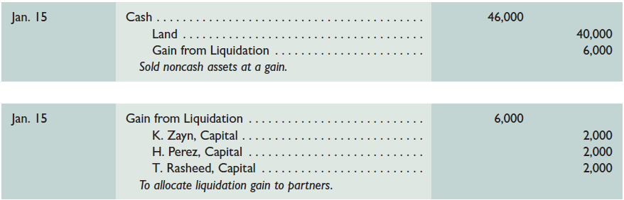
No Capital Deficiency
BOARDS begins the dissolution process by selling the land for $46,000 cash. The gain on the sale of the land is distributed equally among the partners. After the sale of the land the company pays the account payable.
Learning Objective P4: Prepare entries for partnership liquidation.
Notes:
We apply three steps for liquidation:
1. The partnership sells its noncash assets, and any losses or gains from liquidation are shared among partners according to their income-and-loss- sharing agreement (equal for these partners). Assume that BOARDS sells its noncash assets consisting of $40,000 in land for $46,000 cash, yielding a net gain of $6,000. In a liquidation, gains or losses usually result from the sale of noncash assets, which are called losses and gains from liquidation. The entry to sell its assets for $46,000 is shown first.
Allocation of the gain from liquidation per the partners’ income-and-loss-sharing agreement is shown second.

Slide 52
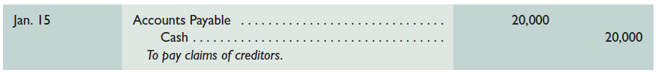
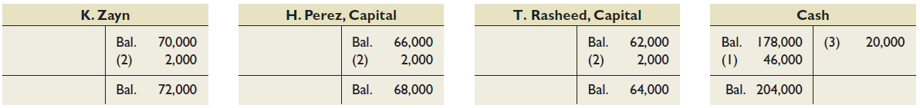
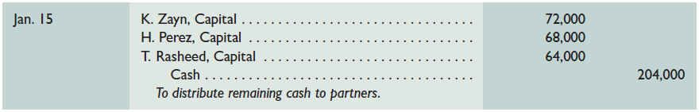
No Capital Deficiency
After step 2, we have the following capital balances along with the remaining cash balance.
Learning Objective P4: Prepare entries for partnership liquidation.
Notes:
The partnership pays its liabilities, and any losses or gains from liquidation of liabilities are shared among partners according to their income-and-loss-sharing agreement. BOARDS’s only liability is $20,000 in accounts payable, and no gain or loss occurred. The entry is shown first in the slide. After step 2, we have the capital balances along with the remaining cash balance shown in the second graphic.
Any remaining cash is divided among the partners according to their capital account balances. The entry to record the final distribution of cash to partners is shown last.
It is important to remember that the final cash payment is distributed to partners according to their capital account balances, whereas gains and losses from liquidation are allocated according to the income-and-loss-sharing ratio.

Slide 53
Capital Deficiency
Capital deficiency means that at least one partner has a debit balance in his or her capital account at the point of final cash distribution. This can arise from liquidation losses, excessive withdrawals before liquidation, or recurring losses in prior periods. A partner with a capital deficiency must, if possible, cover the deficit by paying cash into the partnership.
Learning Objective P4: Prepare entries for partnership liquidation.
Notes:
Capital deficiency means that at least one partner has a debit balance in his or her capital account at the point of final cash distribution (during step 3 as explained in the prior section). This can arise from liquidation losses, excessive withdrawals before liquidation, or recurring losses in prior periods. A partner with a capital deficiency must, if possible, cover the deficit by paying cash into the partnership.

Slide 54

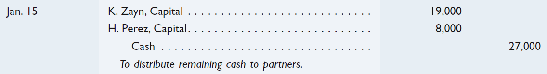
Capital Deficiency
Zayn, Perez, and Rasheed agree to dissolve their partnership.
Prior to the final distribution of cash to the partners, Zayn has a capital balance of $19,000, Perez $8,000, and Rasheed $(3,000). Rasheed owes the partnership $3,000 and is able to pay the amount.
Learning Objective P4: Prepare entries for partnership liquidation.
Notes:
To illustrate, assume that Zayn, Perez, and Rasheed operate their partnership in BOARDS for several years, sharing income and losses equally. The partners then decide to liquidate. Immediately prior to the final distribution of cash, the partners’ recorded capital balances are Zayn, $19,000; Perez, $8,000; and Rasheed, $(3,000). Rasheed’s capital deficiency means that Rasheed owes the partnership $3,000. Both Zayn and Perez have a legal claim against Rasheed’s personal assets. The final distribution of cash in this case depends on how this capital deficiency is handled. Two possibilities exist: the partner pays the deficiency or the partner cannot pay the deficiency.
Partner Pays Deficiency - Rasheed is obligated to pay $3,000 into the partnership to cover the deficiency. If Rasheed is willing and able to pay, the entry to record receipt of payment from Rasheed is shown.
After the $3,000 payment, the partners’ capital balances are Zayn, $19,000; Perez, $8,000; and Rasheed, $0. The entry to record the final cash distributions to partners is shown second.
In the process of liquidation, a capital deficiency means that at least one partner has a debit balance in his/her capital account. A partner with a deficit must, if possible, cover the deficit by paying cash into the partnership. In our liquidation, Zayn has a capital balance of $19,000, Perez $8,000, and Rasheed $(3,000). Rasheed owes the partnership $3,000 and is able to pay the amount. Let’s look at the entries to liquidate the partnership shown on this slide.

Slide 55

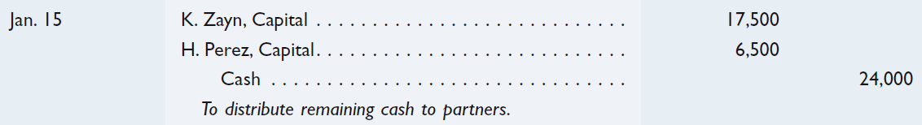
Partner Cannot Pay Deficiency
Let’s use the information from our previous example of a capital deficiency and assume partners divide profit and losses equally.
Learning Objective P4: Prepare entries for partnership liquidation.
Notes:
If the Partner Cannot Pay Deficiency - The remaining partners with credit balances absorb any partner’s unpaid deficiency according to their income-and-loss-sharing ratio. To illustrate, if Rasheed is unable to pay the $3,000 deficiency, Zayn and Perez absorb it. Since they share income and loss equally, Zayn and Perez each absorb $1,500 of the deficiency. This is recorded as shown.
After Zayn and Perez absorb Rasheed’s deficiency, the capital accounts of the partners are Zayn, $17,500; Perez, $6,500; and Rasheed, $0. The entry to record the final cash distribution to the partners is shown second.
Rasheed’s inability to cover this deficiency does not relieve Rasheed of the liability. If Rasheed becomes able to pay at a future date, Zayn and Perez can each collect $1,500 from Rasheed.

Slide 56
NEED-TO-KNOW 12-5
The Danica, Gaga & Oprah partnership was begun with investments by the partners as follows: Danica, $190;
Gaga, $340; and Oprah, $550. Danica, Gaga, and Oprah share income and losses in a 1:1:2 ratio. The
operations did not go well, and the partners eventually decided to liquidate the partnership. On July 31, after all
assets were converted to cash and all creditors were paid, only $80 in partnership cash remained.
1. Compute the capital account balance of each partner after the liquidation of assets and the payment of
creditors.
2. Assume that any partner with a deficit agrees to pay cash to the partnership to cover the deficit. Prepare the
journal entries on July 31 to record (a) the cash receipt from the deficient partner(s) and (b) the final
disbursement of cash to the partners.
3. Assume that any partner with a deficit is not able to reimburse the partnership. Prepare journal entries (a) to
transfer the deficit of any deficient partners to the other partners and (b) to record the final disbursement of
cash to the partners.

Slide 57
NEED-TO-KNOW 12-5 SOLUTION
The Danica, Gaga & Oprah partnership was begun with investments by the partners as follows: Danica, $190;
Gaga, $340; and Oprah, $550. Danica, Gaga, and Oprah share income and losses in a 1:1:2 ratio. The
operations did not go well, and the partners eventually decided to liquidate the partnership. On July 31, after all
assets were converted to cash and all creditors were paid, only $80 in partnership cash remained.
1. Compute the capital account balance of each partner after the liquidation of assets and the payment of
creditors.
Total Assets
Danica, Capital
Gaga, Capital
Oprah, Capital
Total Equity
Before liquidation
$1,080
$190
$340
$550
$1,080
Liquidation of assets
(1,000)
(250)
(250)
(500)
(1,000)
After liquidation of assets
$80
($60)
$90
$50
$80
Allocation of loss:
Danica
$1,000 x 1/4
$250
Gaga
$1,000 x 1/4
250
Oprah
$1,000 x 2/4
500
$1,000

Slide 58
NEED-TO-KNOW 12-5 SOLUTION
2. Assume that any partner with a deficit agrees to pay cash to the partnership to cover the deficit. Prepare the
journal entries on July 31 to record (a) the cash receipt from the deficient partner(s) and (b) the final
disbursement of cash to the partners.
Total Assets
Danica, Capital
Gaga, Capital
Oprah, Capital
Total Equity
Before liquidation
$1,080
$190
$340
$550
$1,080
Liquidation of assets
(1,000)
(250)
(250)
(500)
(1,000)
Subtotal
$80
($60)
$90
$50
$80
Danica pays deficiency
60
60
60
Subtotal
$140
$0
$90
$50
$140
Final cash disbursement
(140)
(90)
(50)
(140)
Post liquidation
$0
$0
$0
$0
$0
Date
General Journal
Debit
Credit
Jul. 31
Cash
60
Danica, Capital
60
Jul. 31
Gaga, Capital
90
Oprah, Capital
50
Cash
140

Slide 59
NEED-TO-KNOW 12-5 SOLUTION
3. Assume that any partner with a deficit is not able to reimburse the partnership. Prepare journal entries (a) to
transfer the deficit of any deficient partners to the other partners and (b) to record the final disbursement of
cash to the partners.
Danica, Gaga, and Oprah share income and losses in a 1:1:2 ratio.
Total Assets
Danica, Capital
Gaga, Capital
Oprah, Capital
Total Equity
Before liquidation
$1,080
$190
$340
$550
$1,080
Liquidation of assets
(1,000)
(250)
(250)
(500)
(1,000)
Subtotal
$80
($60)
$90
$50
$80
Allocation of deficiency
0
60
(20)
(40)
0
Subtotal
$80
$0
$70
$10
$80
Final cash disbursement
(80)
(70)
(10)
(80)
Post liquidation
$0
$0
$0
$0
$0
Date
General Journal
Debit
Credit
Jul. 31
Gaga, Capital
($60 x 1/3)
20
Oprah, Capital
($60 x 2/3)
40
Danica, Capital
60
Jul. 31
Gaga, Capital
70
Oprah, Capital
10
Cash
80

Slide 60
A1:
Compute partner return on equity and use it to evaluate partnership performance.
Learning Objective

Slide 61
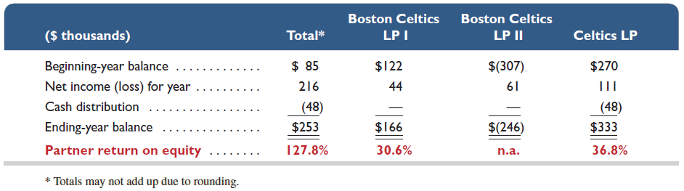
Partner Return on Equity
Partner return
on equity
Partner net income
Average partner equity
=
Exhibit 12.4
216/[(85+253)/2] = 128%
Learning Objective A1: Compute partner return on equity and use it to evaluate partnership performance.
Notes:
We can calculate the return on partner’s equity by dividing partner net income by the average partner capital balance. This is an interesting table because it shows the return on partner capital for the Boston Celtics. Notice that we have two limited partnerships labeled LP I and LP II, and the Celtics limited partnership.
This measure is separately computed for each partner. To illustrate, this slide reports selected data from the Boston Celtics LP. The return on equity for the total partnership is computed as $216 / [($85 + $253) / 2] = 127.8%. However, return on equity is quite different across the partners. For example, the Boston Celtics LP I partner return on equity is computed as $44 / [($122 + $166) / 2] = 30.6%, whereas the Celtics LP partner return on equity is computed as $111 / [($270 + $333) / 2] = 36.8%. Partner return on equity provides each partner an assessment of its return on its equity invested in the partnership. A specific partner often uses this return to decide whether additional investment or withdrawal of resources is best for that partner. This exhibit reveals that the year shown produced good returns for all partners (the Boston Celtics LP II return is not computed because its average equity is negative due to an unusual and large distribution in the prior year).

Slide 62
End of Chapter 12

