Slide 1
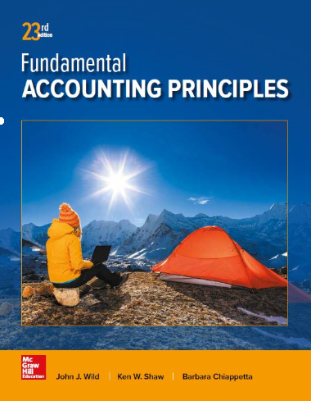
Accounting for Merchandising Operations
Chapter 5
Wild, Shaw, and Chiappetta
Fundamental Accounting Principles
23rd Edition

Slide 2
Chapter 5 Learning Objectives
CONCEPTUAL
C1 Describe merchandise activities and identify income components for a merchandising company.
C2 Identify and explain the inventory asset and cost flows of a merchandising company.
ANALYTICAL
A1 Compute the acid-test ratio and explain its use it to assess liquidity.
A2 Compute the gross margin ratio and explain its use to assess profitability.
PROCEDURAL
P1 Analyze and record transactions for merchandise purchases using a perpetual system.
P2 Analyze and record transactions for merchandise sales using a perpetual system.
P3 Prepare adjustments and close accounts for a merchandising company.
P4 Define and prepare multiple-step and single-step income statements.
P5 Appendix 5A – Record and compare merchandising transactions using both periodic and perpetual
inventory system.
P6 Appendix 5C – Prepare adjustments for discounts, returns and allowances per revenue recognition
rules.
P7 Appendix 5D – Record and compare merchandising transactions using the gross method and net
method.

Slide 3
C1:
Describe merchandise activities and identify income components for a merchandising company.
Learning Objective

Slide 4
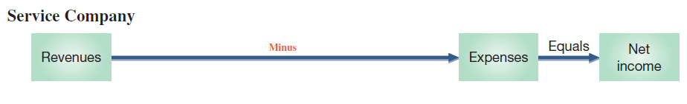
Reporting Income for a Merchandiser
Service organizations sell time to earn revenue.
  Examples: Accounting firms, law firms,
  and plumbing services
Learning Objective C1: Describe merchandise activities and identify income components for a merchandising company.
Notes:
Previous chapters emphasized the accounting activities of service companies. A merchandising company’s activities differ from those of a service company. Merchandise consists of products, also called goods, that a company buys to resell to customers.

Slide 5
Reporting Income for a Merchandiser
Merchandising Companies
Manufacturer
Wholesaler
Retailer
Consumers
Learning Objective C1: Describe merchandise activities and identify income components for a merchandising company.
Notes:
A merchandiser earns net income by buying and selling merchandise. Merchandisers are often wholesalers or retailers. A wholesaler buys products from manufacturers and sells them to retailers. A retailer buys products from manufacturers or wholesalers and sells them to consumers.

Slide 6
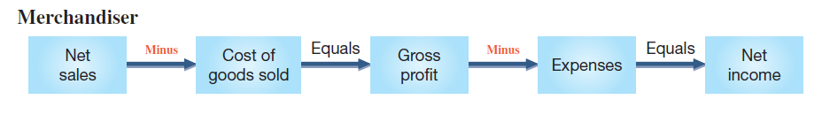
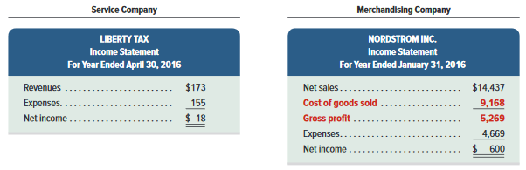
Reporting Income for a Merchandiser
Merchandising companies sell products to earn revenue.
Examples: sporting goods, clothing, and auto parts stores
Exhibit 5.2
Learning Objective C1: Describe merchandise activities and identify income components for a merchandising company.
Notes:
The income statements for a service company, Liberty Tax, and for a merchandiser, Nordstrom, are shown in Exhibit 5.2. The statement for Liberty Tax shows revenues of $173 followed by expenses of $155, which yields $18 in net income. The first two lines of the statement for Nordstrom, a merchandiser, show that products are acquired at a cost of $9,168 and sold for $14,437. The third line shows its $5,269 gross profit, also called gross margin, which equals net sales less cost of goods sold. Additional expenses of $4,669 are reported, which leaves $600 in net income.

Slide 7
C2:
Identify and explain the inventory asset and cost flows of a merchandising company.
Learning Objective

Slide 8
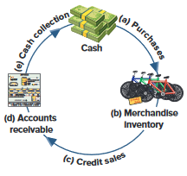
Operating Cycle for a Merchandiser
Begins with the purchase of merchandise and ends with the collection of cash from the sale of merchandise.
Exhibit 5.3
Learning Objective C2: Identify and explain the inventory asset and cost flows of a merchandising company.
Notes:
A merchandising company’s operating cycle begins by purchasing merchandise and ends by collecting cash from selling the merchandise. The length of an operating cycle differs across the types of businesses. Department stores often have operating cycles of two to five months. Operating cycles for grocery merchants usually range from two to eight weeks. A grocer has more operating cycles in a year than clothing or electronics retailers.
This slide illustrates an operating cycle for a merchandiser with credit sales.
The cycle moves from:
(a) cash purchases of merchandise to
(b) inventory for sale to
(c) credit sales to
(d) accounts receivable to
(e) cash.
Companies try to keep their operating cycles short because assets tied up in inventory and receivables are not productive. Cash sales shorten operating cycles.

Slide 9
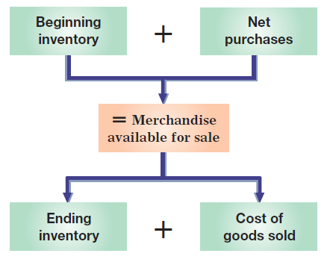
Inventory Systems
Exhibit 5.4
Learning Objective C2: Identify and explain the inventory asset and cost flows of a merchandising company.
Notes:
Exhibit 5.4 shows that a company’s merchandise available for sale consists of what it begins with (beginning inventory) and what it purchases (net purchases). The merchandise available is either sold (cost of goods sold) or kept for future sales (ending inventory).

Slide 10
Inventory Systems
Perpetual systems
  updates accounting records for each purchase and sale of merchandising
Periodic systems
  Updates records for purchase and sale of merchandise only at the end of the accounting period
Learning Objective C2: Identify and explain the inventory asset and cost flows of a merchandising company.
Notes:
Two alternative inventory accounting systems can be used to collect information about cost of goods sold and cost of inventory: perpetual system or periodic system.
Perpetual inventory system updates accounting records for each purchase and sale of inventory.
Periodic inventory system updates the accounting records for purchases and sales of inventory only at the end of a period.
Technological advances and competitive pressures have dramatically increased the use of the perpetual system. It gives managers immediate access to information on sales and inventory levels, where they can strategically react to increase profit.
Review what you have learned in the following NEED-TO-KNOW Slides.

Slide 11
NEED-TO-KNOW 5-1
Use the following information (in random order) from a merchandising company and from a service company.
Hint: Not all information may be necessary for the solutions.
1. For the merchandiser only, compute:
a. Goods available for sale.
b. Cost of goods sold.
c. Gross profit.
2. Compute net income for each company.
SaveCo Merchandiser
Hi-Tech Services
Supplies
$10
Expenses
$170
Beginning inventory
100
Revenues
200
Ending inventory
50
Cash
10
Expenses
20
Prepaid rent
25
Net purchases
80
Accounts payable
35
Net sales
190
Supplies
65
Learning Objective C1: Describe merchandise activities and identify income components for a merchandising company.
Learning Objective C2: Identify and explain the inventory asset and cost flows of a merchandising company.
Notes:
Need-to-Know 5.1

Slide 12
NEED-TO-KNOW 5-1 SOLUTION
SaveCo Merchandiser
Hi-Tech Services
Supplies
$10
Expenses
$170
Beginning inventory
100
Revenues
200
Ending inventory
50
Cash
10
Expenses
20
Prepaid rent
25
Net purchases
80
Accounts payable
35
Net sales
190
Supplies
65
1a.
Computation of goods available for sale:
1b. Computation of cost of goods sold:
Beginning inventory
$100
Beginning inventory
$100
Plus: Net purchases
80
Plus: Net purchases
80
Goods available for sale
$180
Goods available for sale
180
Less: Ending inventory
50
Cost of goods sold
$130
1c. Computation of gross profit:
Net sales
$190
Less: Cost of goods sold
130
Gross profit
$60
2. Compute net income for each company.
SaveCo Merchandiser
Hi-Tech Services
Net sales
$190
Revenues
$200
Less: Cost of goods sold
130
Gross profit
$60
Less: Expenses
20
Less: Expenses
170
Net income
$40
Net income
$30
Learning Objective C1: Describe merchandise activities and identify income components for a merchandising company.
Learning Objective C2: Identify and explain the inventory asset and cost flows of a merchandising company.
Notes:
Need-to-Know 5.1

Slide 13
P1:
Analyze and record transactions for merchandise purchases using a perpetual system.
Learning Objective

Slide 14

Purchases without Cash Discounts
On November 2, Z-Mart purchased $500 of merchandise inventory for cash.
Learning Objective P1: Analyze and record transactions for merchandise purchases using a perpetual system.
Notes:
To illustrate, Z-Mart records a $500 cash purchase of merchandise on November 2 as follows: debit Merchandise Inventory and credit Cash.
If these goods were instead purchased on credit, and no discounts were offered for early payment, Z-Mart would make the same entry except that Accounts Payable would be credited instead of Cash.

Slide 15
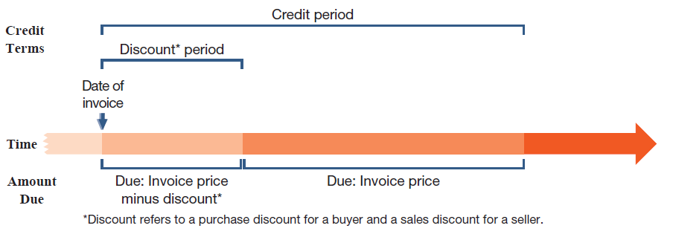
Credit Terms
A deduction from the invoice price granted to induce early payment of the amount due.
Exhibit 5.5
Learning Objective P1: Analyze and record transactions for merchandise purchases using a perpetual system.
Notes:
The purchase of goods on credit requires a clear statement of expected future payments and dates to avoid misunderstandings. Credit terms for a purchase include the amounts and timing of payments from a buyer to a seller. Credit terms usually reflect an industry’s practices. To illustrate, when sellers require payment within 10 days after the end of the month of the invoice date, the invoice will show credit terms as “n/10 EOM,” which stands for net 10 days after end of month (EOM). When sellers require payment within 30 days after the invoice date, the invoice shows credit terms of “n/30,” which stands for net 30 days.
Sellers can grant a cash discount to encourage buyers to pay earlier. A buyer views a cash discount as a purchase discount. A seller views a cash discount as a sales discount. Any cash discounts are described in the credit terms on the invoice. For example, credit terms of “2/10, n/60” mean that full payment is due within a 60-day credit period, but the buyer can deduct 2% of the invoice amount if payment is made within 10 days of the invoice date. This reduced payment applies only for the discount period.

Slide 16
Purchase Discounts
2/10, n/30
Number of Days Discount Is Available
Discount Percent
Otherwise, Net (or All) Is Due in 30 Days
Credit
Period
Learning Objective P1: Analyze and record transactions for merchandise purchases using a perpetual system.
Notes:
Purchase discount terms are typically written as this slide shows. This particular discount term would be read as “two ten, net thirty.”
The first number represents the discount percentage.
The second number represents the discount period (in days).
The letter “n” stands for the word net.
The last number represents the entire credit period (in days).
In this case, if the customer pays within 10 days, then a 2% discount may be taken. If not, then all of the amount is due within 30 days.

Slide 17

Purchases with Cash Discounts
On November 2, Z-Mart purchased $500 of merchandise inventory on account, credit terms are 2/10, n/30.
Learning Objective P1: Analyze and record transactions for merchandise purchases using a perpetual system.
Notes:
To illustrate how a buyer accounts for a purchases discount, assume that on November 2, Z-Mart purchases $500 of merchandise on credit with terms of 2∕10, n∕30. The amount due, if paid on or before November 12, is $490, computed as $500 − ($500 × 2%)—or alternatively computed as $500 × (100% − 2%). Many buyers take advantage of a purchases discount because of the usually high interest rate implied by not taking it.
If Z-Mart does not pay within the 10-day 2% discount period, it can delay payment by 20 more days, at which point it must pay $500. The gross method for recording purchases enters the full invoice (gross) amount for merchandise. If Z-Mart uses the gross method, it makes the following entry dated as of the invoice date: debit to Merchandise Inventory and credit to Accounts Payable for $500.

Slide 18
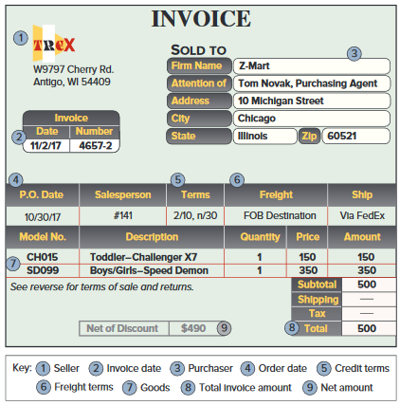
Trade Discounts
Exhibit 5.6
Learning Objective P1: Analyze and record transactions for merchandise purchases using a perpetual system.
Notes:
When a manufacturer or wholesaler prepares a catalog of items it has for sale, it usually gives each item a list price, also called a catalog price. However, an item’s intended selling price equals list price minus a given percent called a trade discount. The amount of trade discount usually depends on whether a buyer is a wholesaler, retailer, or final consumer. A wholesaler buying in large quantities is often granted a larger discount than a retailer buying in smaller quantities. A buyer records the net amount of list price minus trade discount. For example, in the November 2 purchase of merchandise by Z-Mart, the merchandise was listed in the seller’s catalog at $2,000 and Z-Mart received a 40% trade discount. This meant that Z-Mart’s purchase price was $1,200, computed as $2,000 - (40% * $2,000).

Slide 19

Payment within Discount Period
On November 12, Z-Mart paid the amount due on the purchase of November 2.
Learning Objective P1: Analyze and record transactions for merchandise purchases using a perpetual system.
Notes:
If Z-Mart pays the amount due on (or before) November 12, the entry is a debit for the entire Accounts Payable of $500 which is paid off with a cash payment of $490. The difference of $10 is the purchase discount, which is recorded as a reduction in the cost of the Merchandise Inventory.

Slide 20



Payment within Discount Period
After we post these entries, the accounts involved look like these:
Learning Objective P1: Analyze and record transactions for merchandise purchases using a perpetual system.
Notes:
The Merchandise Inventory account after these entries reflects the net cost of merchandise purchased, and the Accounts Payable account shows a zero balance.
A buyer’s failure to pay within a discount period can be expensive. If Z-Mart does not pay within the 10-day 2% discount period, it can delay payment by 20 more days. This delay costs Z-Mart $10, computed as 2% x $500. Most buyers take advantage of a purchase discount because of the usually high interest rate implied from not taking it. Also, good cash management means that no invoice is paid until the last day of the discount or credit period.

Slide 21

Payment after Discount Period
On December 2, Z-Mart paid the amount due on the purchase of November 2.
Learning Objective P1: Analyze and record transactions for merchandise purchases using a perpetual system.
Notes:
If the amount is paid after November 12, the discount is lost. For example, if Z-Mart pays the gross amount due on December 2 (the n∕30 due date), it makes the following entry to debit Accounts Payable and credit Cash for $500.

Slide 22
Purchases with Returns and Allowances
Purchase Return:
  Merchandise returned by the purchaser to the supplier.
Purchase Allowance:
  A price reduction to the buyer of defective or unacceptable merchandise.
Learning Objective P1: Analyze and record transactions for merchandise purchases using a perpetual system.
Notes:
Purchase returns are merchandise a buyer acquires but then returns to the seller. A purchase allowance refers to seller granting a price reduction (allowance) to a buyer of defective or unacceptable merchandise. Buyers often keep defective goods if they can be sold and if the seller grants an acceptable allowance. When a buyer returns or takes an allowance on merchandise, the buyer issues a debit memorandum to inform the seller of a debit made to the account payable in the buyer’s records (debits reduce liabilities).

Slide 23

Purchases Allowances
On November 5, Z-Mart (buyer) issues a $30 debit memorandum for an allowance from Trex for defective merchandise.
Learning Objective P1: Analyze and record transactions for merchandise purchases using a perpetual system.
Notes:
Assume that on November 5, Z-Mart (buyer) issues a $30 debit memorandum for an allowance from Trex for defective merchandise. Z-Mart’s November 5 entry to update its Merchandise Inventory account to reflect the purchase allowance is a debit to Accounts Payable and a credit to Merchandise Inventory for $30. The buyer’s allowance for defective merchandise is subtracted from the buyer’s account payable balance to the seller. When cash is refunded, the Cash account is debited instead of Accounts Payable.

Slide 24
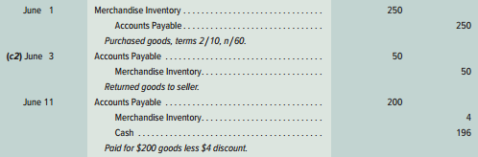
Purchases Returns
Z-Mart purchases $250 of merchandise on June 1 with terms 2/10, n/60. On June 3, Z-Mart returns $50 of goods before paying the invoice. When Z-Mart pays on June 11, it takes the 2% discount only on the $200 remaining balance.
Learning Objective P1: Analyze and record transactions for merchandise purchases using a perpetual system.
Notes:
Returns are recorded at the net costs charged to buyers. To illustrate the accounting for returns, suppose on June 1 that Z-Mart purchases $250 of merchandise with terms 2∕10, n∕60. On June 3, Z-Mart returns $50 of those goods. When Z-Mart pays on June 11, it takes the 2% discount only on the $200 remaining balance ($250 − $50). When goods are returned, a buyer can take a discount on only the remaining balance of the invoice. This means the discount is $4 (computed as $200 × 2%) and the cash payment is $196 ($200 − $4). The entries on this slide reflect this illustration.

Slide 25
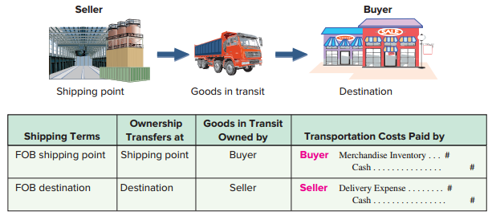
Purchases and Transportation Costs
Exhibit 5.7
Learning Objective P1: Analyze and record transactions for merchandise purchases using a perpetual system.
Notes:
The buyer and seller must agree on who is responsible for paying any freight costs and who bears the risk of loss during transit for merchandising transactions. This is the same as asking at what point ownership transfers from the seller to the buyer. The point of transfer is called the FOB (free on board) point, which determines who pays transportation costs (and often other incidental costs of transit such as insurance). Whoever owns the goods in transit pays the shipping cost.
Exhibit 5.7 identifies two alternative points of transfer. (1) FOB shipping point, also called FOB factory, means the buyer accepts ownership when the goods depart the seller’s place of business. The buyer pays shipping costs and has the risk of loss in transit. The goods are part of the buyer’s inventory when they are in transit since ownership has transferred to the buyer. (2) FOB destination means ownership of goods transfers to the buyer when the goods arrive at the buyer’s place of business. The seller is responsible for paying shipping charges and has the risk of loss in transit.

Slide 26

Transportation Costs
Z-Mart purchased merchandise on terms of FOB shipping point. The transportation charge is $75.
Learning Objective P1: Analyze and record transactions for merchandise purchases using a perpetual system.
Notes:
When a buyer is responsible for paying transportation costs (FOB shipping point), the payment is made to a carrier or directly to the seller depending on the agreement. The cost principle requires that any necessary transportation costs of a buyer (often called transportation-in or freight-in) be included as part of the cost of purchased merchandise. To illustrate, Z-Mart’s entry to record a $75 freight charge from an independent carrier for merchandise purchased FOB shipping point is a debit to Merchandise Inventory and a credit to Cash for $75.

Slide 27
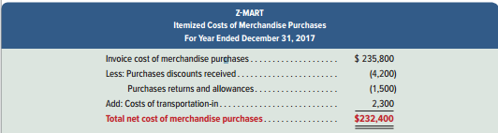
Purchases and Itemized Costs
Exhibit 5.8
Learning Objective P1: Analyze and record transactions for merchandise purchases using a perpetual system.
Notes:
In summary, purchases are recorded as debits to Merchandise Inventory. Any later purchase discounts, returns, and allowances are credited (decreases) to Merchandise Inventory. Transportation-in is debited (added) to Merchandise Inventory. Z-Mart’s itemized costs of merchandise purchases for year 2017 are shown.
Review what you have learned in the following NEED-TO-KNOW Slides.

Slide 28
NEED-TO-KNOW 5-2
Prepare journal entries to record each of the following purchases transactions of a merchandising
company. Assume a perpetual inventory system using the gross method for recording purchases.
Oct. 1
Purchased $1,000 of goods. Terms of the sale are 4/10, n/30, and FOB shipping
point; the invoice is dated October 1.
Oct. 3
Paid $30 cash for freight charges from UPS for the October 1 purchase.
Oct. 7
Returned $50 of the $1,000 of goods from the October 1 purchase and received full credit.
Oct. 11
Paid the amount due from the October 1 purchase, less the return on October 7.
Oct. 31
Assume the October 11 payment was never made and, instead, payment of
the amount due on the October 1 purchase, less the return on October 7,
occurred on October 31.
Learning Objective P1: Analyze and record transactions for merchandise purchases using a perpetual system.
Notes:
Need-to-Know 5.2

Slide 29
NEED-TO-KNOW 5-2 SOLUTION
Oct. 1
Purchased $1,000 of goods. Terms of the sale are 4/10, n/30, and FOB shipping
point; the invoice is dated October 1.
Oct. 3
Paid $30 cash for freight charges from UPS for the October 1 purchase.
Oct. 7
Returned $50 of the $1,000 of goods from the October 1 purchase and received full credit.
Oct. 11
Paid the amount due from the October 1 purchase, less the return on October 7.
Merchandise inventory
Accounts payable
Oct. 1
1,000
Oct. 1
1,000
Oct. 3
30
Oct. 7
50
Oct. 7
50
Oct. 11
950
Oct. 11
38
Oct. 31
942
Date
General Journal
Debit
Credit
Oct. 1
Merchandise inventory
1,000
Accounts payable
1,000
Oct. 3
Merchandise inventory
30
Cash
30
Oct. 7
Accounts payable
50
Merchandise inventory
50
Oct. 11
Accounts payable ($1,000 - $50)
950
Merchandise inventory ($950 x .04)
38
Cash
912
Learning Objective P1: Analyze and record transactions for merchandise purchases using a perpetual system.
Notes:
Need-to-Know 5.2

Slide 30
NEED-TO-KNOW 5-2 SOLUTION
Oct. 1
Purchased $1,000 of goods. Terms of the sale are 4/10, n/30, and FOB shipping
point; the invoice is dated October 1.
Oct. 3
Paid $30 cash for freight charges from UPS for the October 1 purchase.
Oct. 7
Returned $50 of the $1,000 of goods from the October 1 purchase and received full credit.
Oct. 31
Assume the October 11 payment was never made and, instead, payment of
the amount due on the October 1 purchase, less the return on October 7,
occurred on October 31.
Merchandise inventory
Accounts payable
Oct. 1
1,000
Oct. 1
1,000
Oct. 3
30
Oct. 7
50
Oct. 7
50
Oct. 31
950
Oct. 31
980
Date
General Journal
Debit
Credit
Oct. 1
Merchandise inventory
1,000
Accounts payable
1,000
Oct. 3
Merchandise inventory
30
Cash
30
Oct. 7
Accounts payable
50
Merchandise inventory
50
Oct. 31
Accounts payable
950
Cash
950
Learning Objective P1: Analyze and record transactions for merchandise purchases using a perpetual system.
Notes:
Need-to-Know 5.2

Slide 31
P2:
Analyze and record transactions for merchandise sales using a perpetual system.
Learning Objective

Slide 32
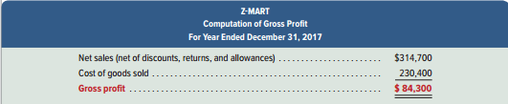
Accounting for Merchandise Sales
Exhibit 5.9
Learning Objective P2: Analyze and record transactions for merchandise sales using a perpetual system.
Notes:
Merchandising companies also must account for sales, sales discounts, sales returns and allowances, and cost of goods sold. A merchandising company such as Z-Mart reflects these items in its gross profit computation.
This shows that customers paid $314,700 for merchandise that cost Z-Mart $230,400, yielding a markup (gross profit) of $84,300.

Slide 33
Sales of Merchandise
Each sales transaction for a seller of merchandise involves two parts:
Revenue received in the form of an asset from a customer.
Recognition of the cost of merchandise sold to a customer.
Learning Objective P2: Analyze and record transactions for merchandise sales using a perpetual system.
Notes:
Each sales transaction for a seller of merchandise involves two parts:
Revenue received in the form of an asset from a customer; and
Recognition of the cost of merchandise sold to a customer.
Accounting for a sales transaction under the perpetual system requires recording information about both parts. This means that each sales transaction for merchandisers, whether for cash or on credit, requires two entries: one for revenue and one for cost.

Slide 34


Sales without Cash Discounts
Z-Mart sold $1,000 of merchandise on credit. The merchandise has a cost basis to Z-Mart of $300.
Revenue side journal entry:
Cost side journal entry:
Learning Objective P2: Analyze and record transactions for merchandise sales using a perpetual system.
Notes:
To illustrate, Z-Mart sold $1,000 of merchandise on credit terms n∕60 on November 12. The revenue part of this transaction is recorded as a debit to Accounts Receivable and a credit to Sales.
The cost side of each sale requires that Merchandise Inventory decrease by that item’s actual cost. For example, the cost of the merchandise Z-Mart sold on November 12 is $300, and the entry to record the cost part of this sales transaction includes a debit to Cost of Goods Sold and a credit to Merchandise Inventory.

Slide 35
Sales Discounts
Sales discounts on credit sales can benefit a seller by decreasing the delay in receiving cash and reducing future collection efforts.
Learning Objective P2: Analyze and record transactions for merchandise sales using a perpetual system.
Notes:
Sales discounts on credit sales can benefit a seller through earlier cash receipts and reduced collection efforts. Many sales discounts are favorable to the buyer, and many buyers will take advantage of them. New revenue recognition rules require that sellers report sales net of expected sales discounts. These rules apply to annual periods of public entities beginning after December 15, 2017 (earlier use is permitted for periods beginning after December 15, 2016).

Slide 36



Sales with Cash Discounts
Z-Mart completes a $1,000 credit sale with terms of 2/10, n/45.
Buyer pays within discount period:
Buyer pays after discount period:
Learning Objective P2: Analyze and record transactions for merchandise sales using a perpetual system.
Notes:
Z-Mart completes a credit sale for $1,000 on November 12 with terms of 2/10, n/45. The entry to record the revenue part of this sale is to debit Accounts Receivable and credit Cash for $1,000. This entry records the receivable and the revenue as if the customer will pay the full amount.
The customer has two options, however. One option is to pay $980 within a 10-day period ending November 22. If the customer pays on (or before) November 22, Z-Mart records the payment as a debit to Cash for $980, debit Sales Discount for $20 (2% x $1,000), and credit Accounts Receivable for the full $1,000.
The second option is to wait 45 days until January 11 and pay the full $1,000. In this case, Z-Mart records that payment as a debit to cash and a credit to accounts receivable for $1,000.
Sales Discounts is a contra revenue account, meaning the Sales Discounts account is deducted from the Sales account when computing a company’s net sales. Management monitors Sales Discounts to assess the effectiveness and cost of its discount policy.

Slide 37
Sales Returns and Allowances
Sales returns and allowances usually involve dissatisfied customers and the possibility of lost future sales.
Sales returns refer to merchandise that customers return to the seller after a sale.
Sales allowances refer to reductions in the selling price of merchandise sold to customers.
Learning Objective P2: Analyze and record transactions for merchandise sales using a perpetual system.
Notes:
Sales returns refer to merchandise that customers return to the seller after a sale. Many companies allow customers to return merchandise for a full refund, sales return, or keep the merchandise along with a partial refund, sales allowance. Most sellers can reliably estimate returns and allowances (abbreviated R&A).

Slide 38



Sales with Returns and Allowances
Customer returns merchandise which sold for $15 and cost $9.
Returned Goods - Not Defective:
Returned Goods - Are Defective:
Learning Objective P2: Analyze and record transactions for merchandise sales using a perpetual system.
Notes:
Recall Z-Mart’s sale of merchandise on November 12 for $1,000 that had cost $300. Assume that the customer returns part of the merchandise on November 26, and the returned items sell for $150 and cost $9. The revenue part of this transaction must reflect the decrease in sales from the customer’s return of merchandise by a debit to Sales Returns and Allowances and a credit to Accounts Receivable for $15.
If the merchandise returned to Z-Mart is not defective and can be resold to another customer, Z-Mart returns these goods to its inventory. The entry to restore the cost of such goods to the Merchandise Inventory account is a debit to Merchandise Inventory and a credit to Cost of Goods Sold for $9.
This entry changes if the goods returned are defective. In this case, the returned inventory is recorded at its estimated value, not its cost. To illustrate, if the goods (costing $9) returned to Z-Mart are defective and estimated to be worth $2, the following entry is made: debit Merchandise Inventory for $2, debit Loss from Defective Merchandise for $7, and credit Cost of Goods Sold for $9.

Slide 39

Sales Allowances
Assume that $40 of the merchandise Z-Mart sold on November 12 is defective but the buyer decides to keep it because Z-Mart offers a $10 price reduction.
Learning Objective P2: Analyze and record transactions for merchandise sales using a perpetual system.
Notes:
To illustrate sales allowances, assume that $40 of the merchandise Z-Mart sold on November 12 is defective but the buyer decides to keep it because Z-Mart offers a $10 price reduction. Z-Mart records this allowance with a debit to Sales Returns and Allowances and credit to Cash for $10. Note: if the seller had not yet collected cash for the goods sold, the seller could credit the buyer’s Account Receivable.
Sales Returns and Allowances is a contra revenue account, meaning it is deducted from sales when computing net sales. The seller usually prepares a credit memorandum to confirm a buyer’s return or allowance. A seller’s credit memorandum informs a buyer a credit made to the buyer’s accounts receivable account in the seller’s records. In summary, net sales equals sales minus sales discounts and minus sales returns and allowances. This means net sales is the amount customers paid for goods kept.
Review what you have learned in the following NEED-TO-KNOW Slides.

Slide 40
NEED-TO-KNOW 5-3
Prepare journal entries to record each of the following sales transactions of a merchandising
company. Assume a perpetual inventory system and use of the gross method (beginning inventory equals $9,000.
Jun. 1
Sold 50 units of merchandise to a customer for $150 per unit under credit
terms of 2/10, n/30, FOB shipping point, and the invoice is dated June 1. The
50 units of merchandise had cost $100 per unit.
Jun. 7
The customer returns 2 units because those units did not fit its needs. The seller
restores those units to its inventory (as they are not defective) and sends the buyer a $300 credit memorandum.
Jun. 11
The seller receives the balance due from the June 1 sale to the customer
less returns and allowances.
Jun. 14
The customer discovers that 10 units have minor damage but keeps them
because the seller sends a $50 cash payment allowance to compensate.
Learning Objective P2: Analyze and record transactions for merchandise sales using a perpetual system.
Notes:
Need-to-Know 5.3

Slide 41
NEED-TO-KNOW 5-3 SOLUTION
Jun. 1
Sold 50 units of merchandise to a customer for $150 per unit under credit
terms of 2/10, n/30, FOB shipping point, and the invoice is dated June 1. The
50 units of merchandise had cost $100 per unit.
Jun. 7
The customer returns 2 units because those units did not fit its needs. The seller
restores those units to its inventory (as they are not defective) and sends the buyer a $300 credit memorandum.
Date
General Journal
Debit
Credit
Jun. 1
Accounts receivable
7,500
Sales (50 @ $150)
7,500
Jun. 1
Cost of goods sold (50 @ $100)
5,000
Merchandise inventory
5,000
Jun. 7
Sales returns and allowances (2 @ $150)
300
Accounts receivable
300
Jun. 7
Merchandise inventory (2 @ $100)
200
Cost of goods sold
200
Learning Objective P2: Analyze and record transactions for merchandise sales using a perpetual system.
Notes:
Need-to-Know 5.3

Slide 42
NEED-TO-KNOW 5-3 SOLUTION
Jun. 11
The seller receives the balance due from the June 1 sale to the customer
less returns and allowances.
Jun. 14
The customer discovers that 10 units have minor damage but keeps them
because the seller sends a $50 cash payment allowance to compensate.
Date
General Journal
Debit
Credit
Jun. 1
Accounts recevable
7,500
Sales (50 @ $150)
7,500
Jun. 01
Cost of goods sold (50 @ $100)
5,000
Merchandise inventory
5,000
Jun. 07
Sales returns and allowances (2 @ $150)
300
Accounts recevable
300
Jun. 07
Merchandise inventory (2 @ $100)
200
Cost of goods sold
200
Jun. 11
Cash
7,056
Sales discounts ($7,200 x .02)
144
Accounts receivable ($7,500 - $300)
7,200
Jun. 14
Sales returns and allowances
50
Cash
50
Learning Objective P2: Analyze and record transactions for merchandise sales using a perpetual system.
Notes:
Need-to-Know 5.3

Slide 43
NEED-TO-KNOW 5-3 SOLUTION
Partial income statement
Sales
$7,500
Sales returns and allowances
$350
Sales discounts
144
(494)
Net sales
7,006
Cost of goods sold
4,800
Gross margin on sales
$2,206
Date
General Journal
Debit
Credit
Jun. 1
Accounts recevable
7,500
Sales (50 @ $150)
7,500
Jun. 01
Cost of goods sold (50 @ $100)
5,000
Merchandise inventory
5,000
Jun. 07
Sales returns and allowances (2 @ $150)
300
Accounts recevable
300
Jun. 07
Merchandise inventory (2 @ $100)
200
Cost of goods sold
200
Jun. 11
Cash
7,056
Sales discounts ($7,200 x .02)
144
Accounts receivable ($7,500 - $300)
7,200
Jun. 14
Sales returns and allowances
50
Cash
50
Learning Objective P2: Analyze and record transactions for merchandise sales using a perpetual system.
Notes:
Need-to-Know 5.3

Slide 44
P3:
Prepare adjustments and close accounts for a merchandising company.
Learning Objective

Slide 45
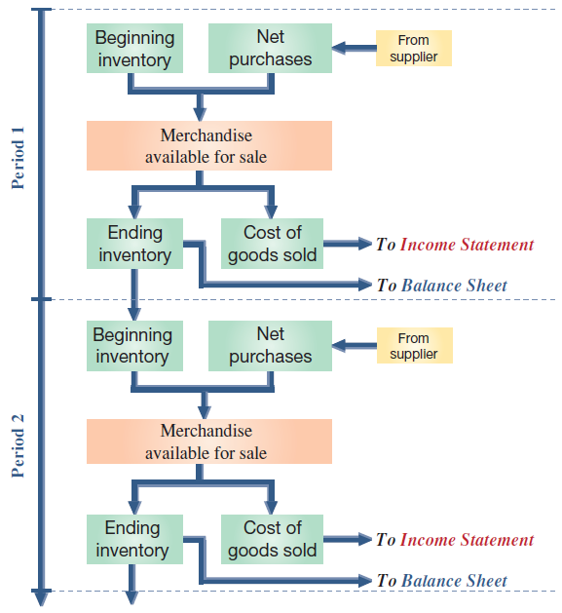
Merchandising Cost Flow in the Accounting Cycle
Exhibit 5.10
Learning Objective P3: Prepare adjustments and close accounts for a merchandising company.
Notes:
This slide shows the flow of merchandising costs during a period and where these costs are reported at period-end. Specifically, beginning inventory plus the net cost of purchases is the merchandise available for sale. As inventory is sold, its cost is recorded in cost of goods sold on the income statement; what remains is ending inventory on the balance sheet. A period’s ending inventory is the next period’s beginning inventory.

Slide 46

Adjusting Entries for Merchandisers
Shrinkage: adjustment to reflect loss of merchandise:
Sales Discounts, Returns and Allowances:
New revenue recognition rules require reporting of sales at net amount expected. Adjusting entries required for:
Expected sales discounts
Expected returns and allowances (revenue side)
Expected returns and allowances (cost side)
Learning Objective P3: Prepare adjustments and close accounts for a merchandising company.
Notes:
Adjusting entries are generally the same for merchandising companies and service companies, including those for prepaid expenses (including depreciation), accrued expenses, unearned revenues, and accrued revenues. However, a merchandiser using a perpetual inventory system is usually required to make another adjustment to update the Merchandise Inventory account to reflect any loss of merchandise, including theft and deterioration. Shrinkage is the loss of inventory, and it is computed by comparing a physical count of inventory with recorded amounts. A physical count is usually performed at least once annually.
To illustrate, Z-Mart’s Merchandise Inventory account at the end of year 2017 has a balance of $21,250, but a physical count reveals that only $21,000 of inventory exists. The adjusting entry to record this $250 shrinkage is a debit to Cost of Goods Sold and a credit to Merchandise Inventory for $250.
Sales are to be reported at the net amount expected, which follows new revenue recognition rules. This means that period-end adjusting entries are commonly made for:
Expected sales discounts.
Expected returns and allowances (revenue side).
Expected returns and allowances (cost side).
These three adjustments produce three new accounts: Allowance for Sales Discounts, Sales Refund Payable, and Inventory Returns Estimated. Appendix 5C explains these accounts and the adjusting entries.

Slide 47
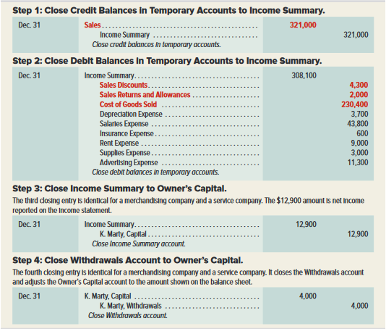
Closing Entries for Merchandisers
Exhibit 5.11
Learning Objective P3: Prepare adjustments and close accounts for a merchandising company.
Notes:
Closing entries are similar for service companies and merchandising companies using a perpetual system. The difference is that we must close some new temporary accounts that arise from merchandising activities.
Closing entries are similar for service companies and merchandising companies using a perpetual system. The difference is that we must close some new temporary accounts that arise from merchandising activities. Z-Mart has several temporary accounts unique to merchandisers: Sales (of goods), Sales Discounts, Sales Returns and Allowances, and Cost of Goods Sold. Their existence in the ledger means that the first two closing entries for a merchandiser are slightly different from the ones described in the prior chapter for a service company. These differences are set in red boldface in the closing entries on this slide.
Review what you have learned in the following NEED-TO-KNOW Slides.

Slide 48
NEED-TO-KNOW 5-4
A merchandising company’s ledger on May 31, its fiscal year-end, includes the following accounts
that have normal balances (it uses the perpetual inventory system). A physical count of its May 31
year-end inventory reveals that the cost of the merchandise inventory still available is $656. (a)
Prepare the entry to record any inventory shrinkage. (b) Prepare the four closing entries as of May 31.
Merchandise inventory
$756
Other operating expenses
$300
Z. Zee, Capital
2,300
Cost of goods sold
2,100
Z. Zee, Withdrawals
150
Depreciation expense
400
Sales
4,300
Salaries expense
600
Sales discounts
50
Sales returns and allowances
250
Debit
Credit
Merchandise inventory
$756
Z. Zee, Capital
$2,300
Z. Zee, Withdrawals
150
Sales
4,300
Sales discounts
50
Sales returns and allowances
250
Cost of goods sold
2,100
Depreciation expense
400
Salaries expense
600
Other operating expenses
300
Learning Objective P3: Prepare adjustments and close accounts for a merchandising company.
Notes:
Need-to-Know 5.4

Slide 49
NEED-TO-KNOW 5-4 SOLUTION
A merchandising company’s ledger on May 31, its fiscal year-end, includes the following accounts
that have normal balances (it uses the perpetual inventory system). A physical count of its May 31
year-end inventory reveals that the cost of the merchandise inventory still available is $656. (a)
Prepare the entry to record any inventory shrinkage. (b) Prepare the four closing entries as of May 31.
Debit
Credit
$756
Merchandise inventory
$656
Z. Zee, Capital
$2,300
Z. Zee, Withdrawals
150
Sales
4,300
Sales discounts
50
Other operating expenses
300
Cost of goods sold
2,100
2,200
Depreciation expense
400
Salaries expense
600
Sales returns and allowances
250
Date
General Journal
Debit
Credit
May 31
Cost of goods sold
100
Merchandise inventory ($756 - $656)
100
Learning Objective P3: Prepare adjustments and close accounts for a merchandising company.
Notes:
Need-to-Know 5.4

Slide 50
NEED-TO-KNOW 5-4 SOLUTION
b) Prepare the four closing entries as of May 31.
Debit
Credit
$756
Merchandise inventory
$656
Z. Zee, Capital
$2,300
Z. Zee, Withdrawals
150
Sales
4,300
Sales discounts
50
Other operating expenses
300
Cost of goods sold
2,100
2,200
Depreciation expense
400
Salaries expense
600
Sales returns and allowances
250
Date
General Journal
Debit
Credit
May 31
Sales
4,300
Income summary
4,300
May 31
Income summary
3,800
Sales discounts
50
Sales returns and allowances
250
Cost of goods sold ($2,100 + $100)
2,200
Depreciation expense
400
Salaries expense
600
Other operating expenses
300
May 31
Income summary
500
Z. Zee, Capital
500
May 31
Z. Zee, Capital
150
Z. Zee, Withdrawals
150
Learning Objective P3: Prepare adjustments and close accounts for a merchandising company.
Notes:
Need-to-Know 5.4

Slide 51
P4:
Define and prepare multiple-step and single-step income statements.
Learning Objective

Slide 52
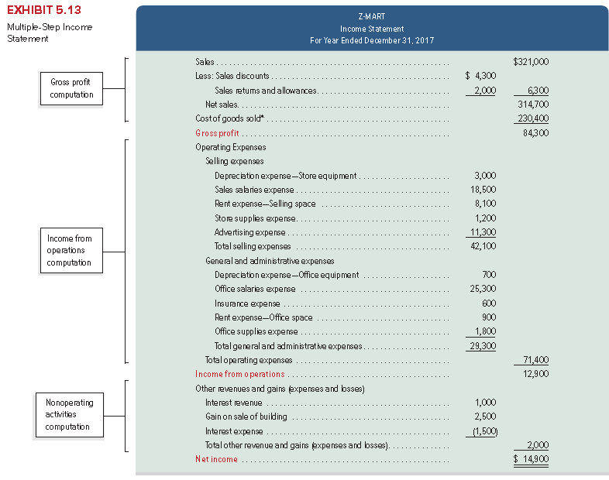
Multiple-Step Income Statement
Learning Objective P4: Define and prepare multiple-step and single-step income statements.
Notes:
Companies are not required to use any one presentation format for financial statements.
A multiple-step income statement shows detailed computations of net sales and other costs and expenses, and reports subtotals for various classes of items. Exhibit 5.13 shows a multiple-step income statement for Z-Mart. The statement has three main parts: (1) gross profit, determined by net sales less cost of goods sold, (2) income from operations, determined by gross profit less operating expenses, and (3) net income, determined by income from operations adjusted for nonoperating items.
Operating expenses are classified into two sections. Selling expenses include the expenses of advertising merchandise, making sales, and delivering goods to customers. General and administrative expenses support a company’s overall operations and include expenses related to accounting, human resource management, and financial management. Expenses are allocated between sections when they contribute to more than one. Z-Mart allocates rent expense of $9,000 from its store building between two sections: $8,100 to selling expense and $900 to general and administrative expense.
Nonoperating activities consist of other expenses, revenues, losses, and gains that are unrelated to a company’s operations. Other revenues and gains commonly include interest revenue, dividend revenue, rent revenue, and gains from asset disposals. Other expenses and losses commonly include interest expense, losses from asset disposals, and casualty losses. When a company has no reportable nonoperating activities, its income from operations is simply labeled net income.

Slide 53
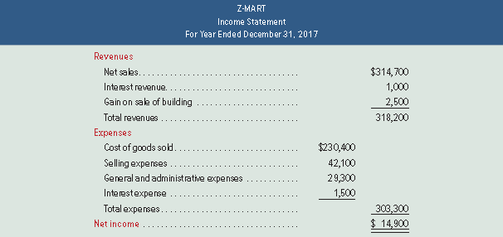
Single-Step Income Statement
Exhibit 5.14
Learning Objective P4: Define and prepare multiple-step and single-step income statements.
Notes:
A single-step income statement is shown in Exhibit 5.14 for Z-Mart. It lists cost of goods sold as another expense and shows only one subtotal for total expenses. Expenses are grouped into very few, if any, categories. Many companies use formats that combine features of both the single- and multiple-step statements. Provided that income statement items are shown sensibly, management can choose the format.
As you can see, net income is the same whether the multi-step or the single-step is used. The only difference is in the amount of detail that is provided on the income statement.

Slide 54

Classified Balance Sheet
Exhibit 5.15
Highly
Liquid
Less
Liquid
Learning Objective P4: Define and prepare multiple-step and single-step income statements.
Notes:
The classified balance sheet reports merchandise inventory as a current asset, usually after accounts receivable according to an asset’s nearness to liquidity. Inventory is usually less liquid than accounts receivable because inventory must first be sold before cash can be received; but it is more liquid than supplies and prepaid expenses.
This slide shows the current asset section of Z-Mart’s classified balance sheet (other sections are as shown and explained in our previous chapter).
Review what you have learned in the following NEED-TO-KNOW Slides.

Slide 55

NEED-TO-KNOW 5-5
Assume Taret’s adjusted trial balance on April 30, 20X1, its fiscal year-end, follows. (a) Prepare
a multiple-step income statement that begins with gross sales, and includes separate categories
for: net sales, cost of goods sold, selling expenses and general and administrative expenses.
(b) Prepare a single-step income statement that begins with net sales and includes these expense
categories: cost of goods sold, selling expenses, and general and administrative expenses.
Debit
Credit
Merchandise inventory
$800
Other (noninventory) assets
2,600
Total liabilities
$500
Taret, Capital
2,100
Taret, Withdrawals
300
Sales
9,500
Sales discounts
260
Sales returns and allowances
240
Cost of goods sold
6,500
Sales salaries expense
450
Rent expense - Selling space
400
Store supplies expense
30
Advertising expense
20
Office salaries expense
420
Rent expense - Office space
72
Office supplies expense
8
Totals
$12,100
$12,100
Learning Objective P4: Define and prepare multiple-step and single-step income statements.
Notes:
Need-to-Know 5.5

Slide 56
NEED-TO-KNOW 5-5 SOLUTION
Debit
Credit
Taret
Merchandise inventory
$800
Income Statement
Other (noninventory) assets
2,600
For Year Ended April 30, 20X1
Total liabilities
$500
Sales
$9,500
Taret, Capital
2,100
Less: Sales discounts
$260
Taret, Withdrawals
300
Sales returns and allowances
240
500
Sales
9,500
Net sales
9,000
Sales discounts
260
Cost of goods sold
6,500
Sales returns and allowances
240
Gross profit
2,500
Cost of goods sold
6,500
Expenses
Sales salaries expense
450
Selling expenses
Rent expense - Selling space
400
Sales salaries expense
450
Store supplies expense
30
Rent expense - Selling space
400
Advertising expense
20
Store supplies expense
30
Office salaries expense
420
Advertising expense
20
Rent expense - Office space
72
Total selling expenses
900
Office supplies expense
8
General and administrative expenses
Totals
$12,100
$12,100
Office salaries expense
420
Rent expense - Office space
72
Office supplies expense
8
Total general and administrative expenses
500
Total expenses
1,400
Net income
$1,100
Learning Objective P4: Define and prepare multiple-step and single-step income statements.
Notes:
Need-to-Know 5.5

Slide 57
NEED-TO-KNOW 5-5 SOLUTION
Taret
Taret
Income Statement
Income Statement
For Year Ended April 30, 20X1
For Year Ended April 30, 20X1
Sales
$9,500
Net sales
$9,000
Less: Sales discounts
$260
Expenses
Sales returns and allowances
240
Cost of goods sold
6,500
Net sales
9,000
Selling expenses
900
Cost of goods sold
6,500
General and administrative expenses
500
Gross profit
2,500
Total expenses
7,900
Expenses
Net income
$1,100
Selling expenses
Sales salaries expense
450
Rent expense - Selling space
400
Store supplies expense
30
Advertising expense
20
Total selling expenses
900
General and administrative expenses
Office salaries expense
420
Rent expense - Office space
72
Office supplies expense
8
Total general and administrative expenses
500
Total expenses
1,400
Net income
$1,100
Learning Objective P4: Define and prepare multiple-step and single-step income statements.
Notes:
Need-to-Know 5.5

Slide 58
A1:
Compute the acid-test ratio and explain its use it to assess liquidity.
Learning Objective

Slide 59
Acid-Test Ratio
Acid-test
ratio
Quick assets
Current liabilities
=
Acid-test
ratio
Cash + Short-term investments + Receivables
Current liabilities
=
A common rule of thumb is the acid-test ratio should have a value of at least 1.0 to conclude a company is unlikely to face liquidity problems in the near future.
Learning Objective A1: Compute the acid-test ratio and explain its use it to assess liquidity.
Notes:
One measure of a merchandiser’s ability to pay its current liabilities (referred to as its liquidity) is the acid-test ratio. It differs from the current ratio by excluding less liquid current assets such as inventory and prepaid expenses that take longer to be converted to cash. The acid-test ratio, also called quick ratio, is defined as quick assets (cash, short-term investments, and current receivables) divided by current liabilities.

Slide 60
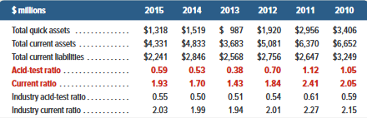
Acid-Test Ratio
JCPenney
Exhibit 5.17
Acid-test
ratio
Cash + Short-term investments + Receivables
Current liabilities
=
Learning Objective A1: Compute the acid-test ratio and explain its use it to assess liquidity.
Notes:
Analysis of JCPenney shows some need for concern regarding its liquidity as its acid-test ratio is less than 1.0. However, retailers such as JCPenney pay many current liabilities from inventory sales; moreover, in all years except 2013, JCPenney’s acid-test ratios exceed the industry norm (and its inventory is fairly liquid).

Slide 61
A2:
Compute the gross margin ratio and explain its use to assess profitability.
Learning Objective

Slide 62

Gross Margin Ratio
Gross
margin
ratio
Net sales - Cost of goods sold
Net sales
=
Percentage of dollar sales available to cover expenses and provide a profit.
Exhibit 5.19
Learning Objective A2: Compute the gross margin ratio and explain its use to assess profitability.
Notes:
The cost of goods sold makes up much of a merchandiser’s expenses. Without sufficient gross profit, a merchandiser will likely fail. Users often compute the gross margin ratio to help understand this relation. It differs from the profit margin ratio in that it excludes all costs except cost of goods sold. The gross margin ratio (also called gross profit ratio) is defined as gross margin (net sales minus cost of goods sold) divided by net sales.
Exhibit 5.19 shows the gross margin ratio of JCPenney for fiscal years 2010 through 2015. For JCPenney, each $1 of sales in 2015 yielded about 34.8¢ in gross margin to cover all other expenses and still produce a net income. This 34.8¢ margin is up from 29.4¢ in 2014. This increase is a favorable development. Success for merchandisers such as JCPenney depends on adequate gross margin. For example, the 5.4¢ increase in the gross margin ratio, computed as 34.8¢ − 29.4¢, means that JCPenney has $662 million more in gross margin! (This is computed as net sales of $12,257 million multiplied by the 5.4% increase in gross margin.)

Slide 63
P5:
Appendix 5A Record and compare merchandising transactions using both periodic and perpetual inventory system.
Learning Objective

Slide 64
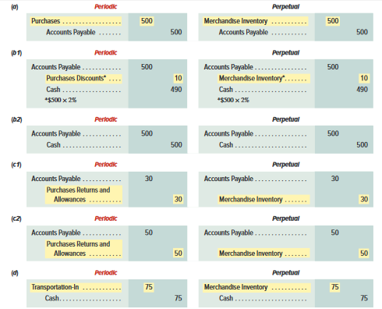
Periodic Inventory System - Purchases
Periodic inventory system updates inventory only at the end of a period to reflect the quantity and cost of goods available and goods sold.
Learning Objective P5: Record and compare merchandising transactions using both periodic and perpetual inventory system.
Notes:
A periodic inventory system requires updating the inventory account only at the end of a period to reflect the quantity and cost of both the goods available and the goods sold. Thus, during the period, the Merchandise Inventory balance remains unchanged. During the period the cost of merchandise is recorded in a temporary Purchases account. When a company sells merchandise, it records revenue but not the cost of the goods sold. At the end of the period when a company prepares financial statements, it takes a physical count of inventory by counting the quantities and costs of merchandise available. The cost of goods sold is then computed by subtracting the ending inventory amount from the cost of merchandise available for sale.
Under a periodic system, purchases, purchase returns and allowances, purchase discounts, and transportation-in transactions are recorded in separate temporary accounts. At period-end, each of these temporary accounts is closed and the Merchandise Inventory account is updated. During the period, the Merchandise Inventory balance remains unchanged.
To illustrate, journal entries under the periodic inventory system are shown for the most common transactions (codes a through d link these transactions to those in the chapter, and we drop explanations for simplicity). For comparison, perpetual system journal entries are shown to the right of each periodic entry.
The periodic system uses a temporary Purchases account that accumulates the cost of all purchase transactions during each period. Z-Mart’s November 2 entry to record the purchase of merchandise for $500 on credit with terms of 2/10, n/30 is illustrated in entry a.
The periodic system uses a temporary Purchase Discounts account that accumulates discounts taken on purchase transactions during the period.
If Z-Mart pays the supplier for the previous purchase in (a) within the discount period, the required payment is $490 ($500 x 98%) and is recorded as illustrated in entry b1.
If payment in (a) is delayed until after the discount period expires, the entry is to debit Accounts Payable and credit Cash for $50 each as shown in entry b2.
Z-Mart returned merchandise purchased on November 2 because of defects. In the periodic system, the temporary Purchase Returns and Allowances account accumulates the cost of all returns and allowances during a period. The recorded cost (including discounts) of the defective merchandise is $30, and Z-Mart records the return with entry c1.
Z-Mart returns $50 of merchandise within the discount period with the entry shown in c2.
Z-Mart paid a $75 freight charge to transport merchandise to its store. In the periodic system, this cost is charged to a temporary Transportation-In account as illustrated in entry d.

Slide 65

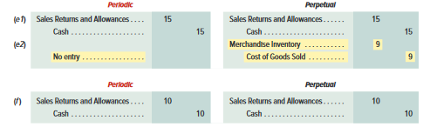
Periodic Inventory System - Sales
Periodic inventory system updates inventory only at the end of a period to reflect the quantity and cost of goods available and goods sold.
Learning Objective P5: Record and compare merchandising transactions using both periodic and perpetual inventory system.
Notes:
Both the periodic and perpetual systems record sales entries similarly, using the gross method. The same holds for entries related to payment of receivables from sales both within and after the discount period. However, under the periodic system, the cost of goods sold is not recorded at the time of each sale (whereas it is under the perpetual system)—we show later in this appendix how to compute cost of goods sold at period-end under the periodic system. The entries to record $1,000 in credit sales (costing $300) is a debit to Accounts Receivable and a credit to Sales. Under the periodic system, the cost of goods sold is not recorded at the time of each sale.
A customer returned part of the merchandise, where the returned items sell for $15 and cost $9. Z-Mart restores the merchandise to inventory and records the November 6 return as illustrated in entry e1 and e2.
A customer received an allowance in transaction f of $10 cash; only the revenue side is impacted as no inventory was returned and cost stays the same. The entry is identical under the periodic and perpetual systems. The seller records this allowance as shown in entry f.

Slide 66
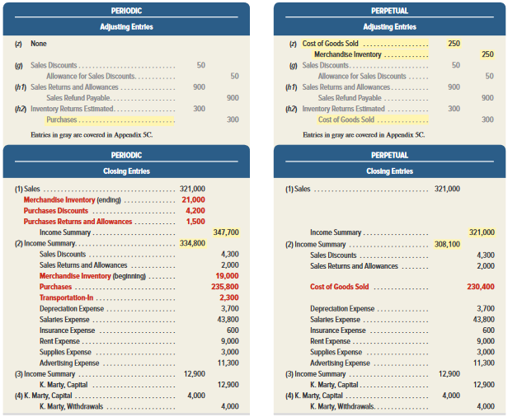
Periodic Inventory– Adjusting & Closing Entries
Exhibit 5A.1
Learning Objective P5: Record and compare merchandising transactions using both periodic and perpetual inventory system.
Notes:
The periodic and perpetual inventory systems have slight differences in closing entries. The period-end Merchandise Inventory balance (unadjusted) is $19,000 under the periodic system. Since the periodic system does not update the Merchandise Inventory balance during the period, the $19,000 amount is the beginning inventory. A physical count of inventory taken at the end of the period reveals $21,000 of merchandise available. The adjusting and closing entries for the two systems are shown in Exhibit 5A.1.
Recording the periodic inventory balance is a two-step process. The ending inventory balance of $21,000 (which includes shrinkage) is entered by debiting the inventory account in the first closing entry. The beginning inventory balance of $19,000 is deleted by crediting the inventory account in the second closing entry 2.

Slide 67
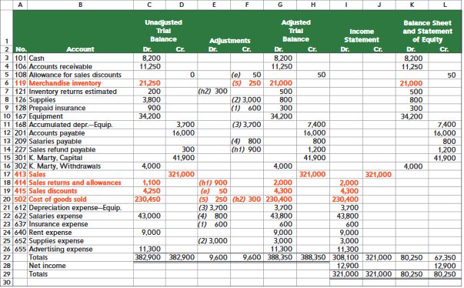
Appendix 5B:
Work Sheet—Perpetual System
Exhibit 5B.1
Learning Objective P5: Record and compare merchandising transactions using both periodic and perpetual inventory system.
Notes:
This slide shows the work sheet for preparing financial statements of a merchandiser. It differs slightly from the work sheet layout in the prior chapter—the differences are in red boldface. The adjustments in the work sheet reflect the following: (1) expiration of $600 of prepaid insurance, (2) use of $3,000 of supplies, (3) depreciation of $3,700 for equipment, (4) accrual of $800 of unpaid salaries, and (5) inventory shrinkage of $250. Once the adjusted amounts are extended into the financial statement columns, the information is used to develop financial statements.

Slide 68
P6:
Appendix 5C – Prepare adjustments for discounts, returns and allowances per revenue recognition rules.
Learning Objective

Slide 69

Adjusting Entries under New Revenue Recognition Rules
Expected Sales Discounts
Adjusting entries required to estimate sales discounts for current-period’s sales expected to be taken in future periods.
Z-Mart has unadjusted Accounts Receivable of $11,250 and Allowance for Sales Discounts of $0.
$2,500 of receivables are within 2% discount period.
Expect buyers to take $50 in future period discounts ($2,500 x 2%).
Learning Objective P6: Prepare adjustments for discounts, returns and allowances per revenue recognition rules.
Notes:
Sales are to be reported at the net amount expected which follows new revenue recognition rules. This means that a period-end adjusting entry is commonly made to estimate sales discounts for current-period’s sales that are expected to be taken in future periods.
To illustrate, assume Z-Mart has the following unadjusted balances: Accounts Receivable, $11,250; and Allowance for Sales Discounts, $0. Of the $11,250 of receivables, $2,500 of them are within the 2% discount period, and we expect buyers to take $50 in future-period discounts (computed as $2,500 × 2%) arising from this period’s sales. The adjusting entry for the $50 update to the allowance for sales discounts is shown in entry g.
Allowance for Sales Discounts is a contra asset account and is reported on the balance sheet as a reduction to the Accounts Receivable asset account. The Allowance for Sales Discounts account has a normal credit balance because it reduces Accounts Receivable, which has a normal debit balance.

Slide 70

Adjusting Entries under New Revenue Recognition Rules
Expected Sales Discounts:
Adjusting entries result in Accounts receivable and sales being reported at their net expected amounts:
Learning Objective P6: Prepare adjustments for discounts, returns and allowances per revenue recognition rules.
Notes:
The adjusting entry for sales discounts results in both accounts receivable and sales being reported at their net expected
amounts.

Slide 71

Adjusting Entries under New Revenue Recognition Rules
Revenue side for Expected R&A:
Seller sets up a Sales Refund Payable, current liability reflecting amount expected to be refunded to customers.
Company estimates future sales refunds to be $1,200.
Unadjusted balance in Sales Refund Payable is $300 credit.
Adjusting entry for $900 update to Sales Refund Payable
Learning Objective P6: Prepare adjustments for discounts, returns and allowances per revenue recognition rules.
Notes:
To avoid overstatement of sales and cost of sales, sellers estimate sales returns and allowances in the period of the sale. Estimating returns and allowances requires companies to maintain the following two balance sheet accounts that are set up with adjusting entries: inventory returns estimated, a current asset, and sales refund payable, a current liability.
The Sales Refund Payable account is updated only during the adjusting entry process. Its balance remains unchanged during the period when actual returns and allowances are recorded.

Slide 72

Adjusting Entries under New Revenue Recognition Rules
Cost side for Expected R&A:
Seller sets up an Inventory Returns Estimated account, current asset reflecting the inventory estimated to be returned.
Company estimates future inventory returns to be $500.
Unadjusted balance in Inventory Returns Estimated is $200 debit.
Adjusting entry for $300 update to Inventory Returns Est.
Learning Objective P6: Prepare adjustments for discounts, returns and allowances per revenue recognition rules.
Notes:
On the cost side, the expected returns and allowances implies that some inventory is expected to be returned, which means that cost of goods sold recorded at the time of sale is overstated due to expected returns. A seller sets up an Inventory Returns Estimated account, which is a current asset reflecting the inventory estimated to be returned.
Extending the example above, assume that the company estimates future inventory returns to be $500 (which is the cost side of the $1,200 expected returns and allowances above). Assume also that the (beginning) unadjusted balance in Inventory Returns Estimated is a $200 debit. The adjusting entry for the $300 update to expected returns is shown in entry h2.
The Inventory Returns Estimated account is updated only during the adjusting entry process. Its balance remains unchanged during the period when actual returns and allowances are recorded.

Slide 73
NEED-TO-KNOW 5-8
At the current year-end, a company shows the following unadjusted balances for selected accounts:
Allowance for Sales Discounts
$75
credit
Sales Discounts
$1,850
debit
Sales Refund Payable
800
credit
Sales Returns and Allowances
4,825
debit
Inventory Returns Estimated
450
debit
Cost of Goods Sold
9,875
debit
a.
After an analysis of future sales discounts, the company estimates that the Allowance for Sales
Discounts account should have a $275 credit balance. Prepare the current year-end adjusting journal
entry for future sales discounts.
b.
After an analysis of future sales returns and allowances, the company estimates that the Sales Refund
Payable account should have a $870 credit balance (revenue side).
c.
After an analysis of future inventory returns, the company estimates that the Inventory Returns
Estimated account should have a $500 debit balance (cost side).
Learning Objective P6: Prepare adjustments for discounts, returns and allowances per revenue recognition rules.
Notes:
Need-to-Know 5.8

Slide 74
NEED-TO-KNOW 5-8 SOLUTION
At the current year-end, a company shows the following unadjusted balances for selected accounts:
Allowance for Sales Discounts
$75
credit
Sales Discounts
$1,850
debit
Sales Refund Payable
800
credit
Sales Returns and Allowances
4,825
debit
Inventory Returns Estimated
450
debit
Cost of Goods Sold
9,875
debit
a.
After an analysis of future sales discounts, the company estimates that the Allowance for Sales
Discounts account should have a $275 credit balance. Prepare the current year-end adjusting journal
entry for future sales discounts.
Step 1: Determine what the current account balance equals.
$75
credit
Step 2: Determine what the current account balance should equal.
$275
credit
Allowance for Sales Discounts
Unadjusted
75
Adjustment
200
Adjusted
275
Step 3: Record an adjusting entry to get from step 1 to step 2.
Date
General Journal
Debit
Credit
Dec. 31
Sales Discounts
200
Allowance for Sales Discounts
200
Adjustment for future discounts
Learning Objective P6: Prepare adjustments for discounts, returns and allowances per revenue recognition rules.
Notes:
Need-to-Know 5.8

Slide 75
NEED-TO-KNOW 5-8 SOLUTION
At the current year-end, a company shows the following unadjusted balances for selected accounts:
Allowance for Sales Discounts
$75
credit
Sales Discounts
$1,850
debit
Sales Refund Payable
800
credit
Sales Returns and Allowances
4,825
debit
Inventory Returns Estimated
450
debit
Cost of Goods Sold
9,875
debit
b.
After an analysis of future sales returns and allowances, the company estimates that the Sales Refund
Payable account should have a $870 credit balance (revenue side).
Step 1: Determine what the current account balance equals.
$800
credit
Step 2: Determine what the current account balance should equal.
$870
credit
Sales Refund Payable
Unadjusted
800
Adjustment
70
Adjusted
870
Step 3: Record an adjusting entry to get from step 1 to step 2.
Date
General Journal
Debit
Credit
Dec. 31
Sales Returns and Allowances
70
Sales Refund Payable
70
Adjustment for future sales refunds
Learning Objective P6: Prepare adjustments for discounts, returns and allowances per revenue recognition rules.
Notes:
Need-to-Know 5.8

Slide 76
NEED-TO-KNOW 5-8 SOLUTION
At the current year-end, a company shows the following unadjusted balances for selected accounts:
Allowance for Sales Discounts
$75
credit
Sales Discounts
$1,850
debit
Sales Refund Payable
800
credit
Sales Returns and Allowances
4,825
debit
Inventory Returns Estimated
450
debit
Cost of Goods Sold
9,875
debit
c.
After an analysis of future inventory returns, the company estimates that the Inventory Returns
Estimated account should have a $500 debit balance (cost side).
Step 1: Determine what the current account balance equals.
$450
debit
Step 2: Determine what the current account balance should equal.
$500
debit
Inventory Returns Estimated
Unadjusted
450
Adjustment
50
Adjusted
500
Step 3: Record an adjusting entry to get from step 1 to step 2.
Date
General Journal
Debit
Credit
Dec. 31
Inventory Returns Estimated
50
Cost of Goods Sold
50
Adjustment for future inventory returns
Learning Objective P6: Prepare adjustments for discounts, returns and allowances per revenue recognition rules.
Notes:
Need-to-Know 5.8

Slide 77
P7:
Appendix 5D – Record and compare merchandising transactions using the gross method and net method.
Learning Objective

Slide 78
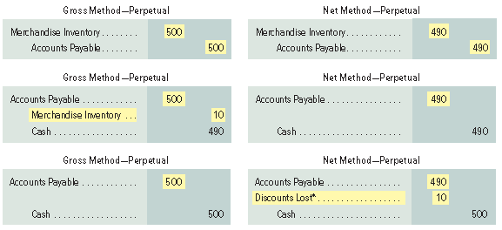
Perpetual System – Net vs Gross Method Purchases
Net method records invoice at its amount net of any discounts.
Learning Objective P7: Record and compare merchandising transactions using the gross method and net method.
Notes:
The net method is another means of recording invoices, which initially records the invoice at its net amount (net of any cash discount). This appendix records merchandising transactions using the net method, where key differences with the gross method are highlighted. When invoices are recorded at net amounts, any cash discounts are deducted from the balance of the Merchandise Inventory account when initially recorded. This assumes that all cash discounts will be taken. If any discounts are later lost, they are recorded in a Discounts Lost expense account reported on the income statement.
A company purchases merchandise on November 2 at a $500 invoice price ($490 net) with terms of 2∕10, n∕30. Its November 2 entries under the gross and net methods are shown in the first entries.
If the invoice is paid on (or before) November 12 within the discount period, it records as shown in the second entries.
If, instead, the invoice is not paid within the discount period, but is later paid on December 2 (the n∕30 due date), after the discount period, it records the third entries shown.

Slide 79
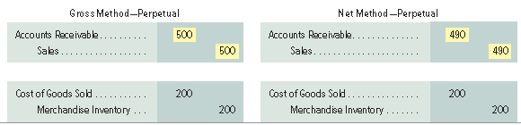
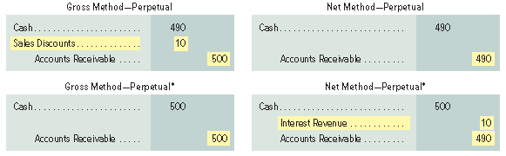
Perpetual System – Net vs Gross Method Sales
Net method records invoice at its amount net of any discounts.
Learning Objective P7: Record and compare merchandising transactions using the gross method and net method.
Notes:
To illustrate, a company sells merchandise on November 2 at a $500 invoice price ($490 net) with terms of 2∕10, n∕30. The goods cost $200. Its November 2 entries under the gross and net methods are shown in the first two entries.
If cash is received on (or before) November 12 within the discount period, company will record the third entries shown.
If, instead, cash is not received within the discount period, but it is later received on December 2 (the n∕30 due date), after the discount period, it records the last entries shown.

Slide 80
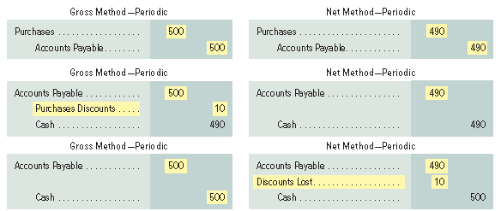
Periodic System – Net vs. Gross Method Purchases
Net method records invoice at its amount net of any discounts.
Learning Objective P7: Record and compare merchandising transactions using the gross method and net method.
Notes:
Under the periodic system, the balance of the Merchandise Inventory account remains
unchanged during the period and is updated at period-end as part of the adjusting process. During the
period, three accounts are used to record purchases of inventory: Purchases; Purchases Discounts; and
Purchases Returns and Allowances. It is helpful to see that the entries below are identical to the perpetual system except that Merchandise Inventory is substituted for each of the three purchases accounts.
To illustrate, we apply the periodic system to purchases transactions. On November 2, a buyer purchases goods ($500 gross; $490 net) with terms of 2∕10, n∕30. Its November 2 entries under the gross and net methods are shown in the first entries.
The second entries shown illustrate if the invoice is paid on (or before) November 12 within the discount period.
The third entries shown illustrate If the invoice is not paid within the discount period, but it is later paid on December 2 (the n∕30 due date), after the discount period.
SALES—Periodic For the above sales transactions, the perpetual and periodic entries are identical except that under the periodic system the cost-side entries are not made at the time of each sale nor for any subsequent returns. Instead, the cost of goods sold is computed at period-end based on a physical count of inventory. This entry is illustrated in Exhibit 5A.1.

Slide 81
End of Chapter 5

