Slide 1
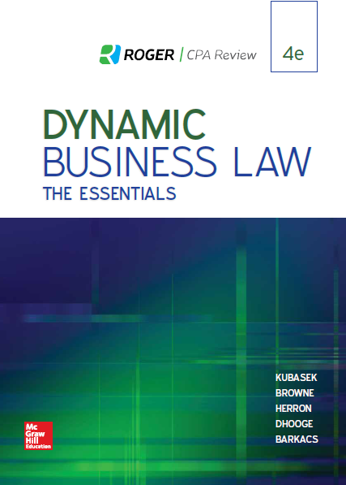
Chapter 11
Capacity and Legality
© 2019 McGraw-Hill Education. All rights reserved. Authorized only for instructor use in the classroom. No reproduction or further distribution permitted without the prior written consent of McGraw-Hill Education.
Notes:
Chapter 11: Capacity and Legality

Slide 2
Contractual Capacity 1
Definition: Mental ability to understand rights and obligations established by contract, with the presumptive ability to understand how to comply with terms of agreement.
Notes:
Contractual capacity is defined as the mental ability to understand rights and obligations established by contract, with the presumptive ability to understand how to comply with the terms of the agreement.

Slide 3
Contractual Capacity 2
General Rule of Law: Natural persons over the age of majority (18 in most states) are presumed to have the full legal capacity to enter into binding legal contracts.
Notes:
As a general rule of law, natural persons over the age of majority (eighteen in most states) are presumed to have the full legal capacity to enter into binding legal contracts.

Slide 4
Individuals Who Have Only Limited Capacity to Contract
Minors.
Mentally Incapacitated Persons.
Intoxicated Persons.
Notes:
Individuals who have only limited capacity to contract include minors, those suffering from a mental deficiency that renders them incapable of understanding the nature and obligations of contracts, and those who are intoxicated.

Slide 5
Covenant Not to Compete/Restrictive Covenant
An agreement not to compete against a party for a set period of time within a designated geographic area.
May occur in the sale of an ongoing business.
May occur in an employment agreement.

Slide 6
Adhesion Contract
A contract created by a party to an agreement that is presented to the other party on a take it or leave it basis. Such contracts are not per se illegal, but are sometimes rescinded on the grounds of unconscionability because one of the parties lacks thre free will to negotiate any of the terms.

Slide 7
Rules Regarding Minor’s “Contractual Power of Avoidance”
Disaffirmance (“Power of Avoidance”): Minors’ right, until reasonable time after reaching age of majority, to disaffirm/avoid their contracts.
To exercise right, minor need only demonstrate, through words and/or actions, intent to rescind contract.
Minor must return any consideration received (if still in minor’s possession/control), regardless of condition.
Even if consideration damaged/destroyed, other party has no recourse against minor.
Rules designed to discourage competent parties from entering into contracts with minors.
Notes:
“Disaffirmance,” also known as the “power of avoidance,” refers to the minor’s right, until a reasonable time after reaching age of majority, to avoid his or her contractual obligations. To exercise the right of disaffirmance, the minor need only demonstrate, through words or actions, intent to rescind the contract. Upon contractual avoidance, the minor must return any consideration received (if still in the minor’s possession or control,) regardless of its condition. Even if the consideration is damaged or destroyed, the other party has no legal recourse against the minor. Rules protecting minors from contractual obligations are designed to discourage competent parties from entering into contracts with minors.

Slide 8
Exceptions to Minor’s Right to Disaffirm Contract 1
Contract for Necessaries (Definition): Contracts that supply minor with basic necessities of life.
Examples: food, clothing, shelter, basic medical services.
Notes:
One exception to a minor’s right to disaffirm a contract includes a “contract for necessaries,” defined as a contract that supplies the minor with the basic necessities of life. Examples of basic necessities include food, clothing, shelter, and essential medical services.

Slide 9
Exceptions to Minor’s Right to Disaffirm Contract 2
Ratification (Definition): Acceptance of terms of contract (entered into as a minor) after reaching age of majority.
Express Ratification: Occurs when, after reaching age of majority, individual states (either orally or in writing) that he/she intends to be bound by contract entered into while a minor.
Implied Ratification: Occurs when former minor takes action after reaching age of majority consistent with intent to ratify contract.
Notes:
Ratification is another exception to a minor’s right to disaffirm contractual obligations. Through ratification, the former minor accepts the terms of a contract entered into as a minor after reaching the age of majority. With express ratification, a former minor states, either orally or in writing, that he or she intends to be bound by the contract entered into while a minor. With implied ratification, the former minor takes action, after reaching the age of majority, consistent with an intent to ratify the contract.

Slide 10
Parental Liability for Minors’ Contracts, Necessaries, and Torts
General Rule: Parents not liable for contracts entered into by their minor children.
Exception: Contracts for necessaries.
General Rule: Parents not liable for torts committed by their minor children.
Exception: Failure to properly supervise child, subjecting others to unreasonable risk of harm from the child.
Notes:
As a general rule, parents are not liable for contracts entered into by their minor children. An exception is a contract for necessaries. Also, parents are not generally liable for torts committed by their minor children. An exception is the failure to properly supervise a child, subjecting others to unreasonable risk of harm from the child.

Slide 11
Individuals Having No Capacity to Contract
Those adjudicated insane.
Those adjudicated habitually intoxicated.
Those with appointed legal guardians.
Notes:
Individuals having no capacity to contract include those adjudicated insane, those adjudicated habitually intoxicated, and those with appointed legal guardians.

Slide 12
Illegal Contracts
Contracts with no legal purpose and/or subject matter.
Example: Agreement to commit crime/tort.
Contracts violating statute(s) and/or “public policy.”
Example: Usurious loan agreement (loan contract exceeding state-imposed maximum interest rate).
Example: Unconscionable contract (Agreement so unfair that it is “void of conscience”).
Notes:
Illegal contracts include contracts with no legal purpose or subject matter. An example is an agreement to commit a crime or tort. Another example of an illegal contract is a contract violating a statute or “public policy.” Examples include a usurious loan agreement (a usurious loan exceeds a state-imposed maximum interest rate) and an “unconscionable” contract (an unconscionable agreement is so unfair that it is “void of conscience.”)

Slide 13
Procedural Versus Substantive Unconscionability
Procedural Unconscionability—Relates to conditions that would impair one party’s understanding of a contract/contract terms.
Example: Adhesion contract (Contract created by a party and presented to other party on a “take-it-or-leave-it” basis).
Substantive Unconscionability—Involves overly harsh or lopsided substance in a contract.
Example: Contract in which one party has little to no legal recourse.
Notes:
There are two main types of unconscionable agreements: procedural and substantive. Procedural unconscionability relates to conditions that would impair one party’s understanding of a contract or contract terms. An adhesion contract is an example of procedural unconscionability. An adhesion contract is a contract created by a party to an agreement presented to another party on a “take-it-or-leave-it” basis. Substantive unconscionability involves overly harsh or lopsided substance in an agreement. An example of substantive unconscionability is an agreement in which one party has little to no legal recourse.

Slide 14
Effect of Illegal Agreement
General Rule: When an agreement is illegal, the contract is void.
Notes:
As a general rule, an illegal contract is void. The effect of a void contract is that neither party can enforce the agreement, and neither party is entitled to recovery.

Slide 15
Questions for Discussion
Have you or anyone you know had to sign a noncompete agreement in connection with your employment?
Should noncompete agreements be allowed in all employment contracts?
In what types of contracts should they be set aside as unconscionable or against public policy?

