Slide 1
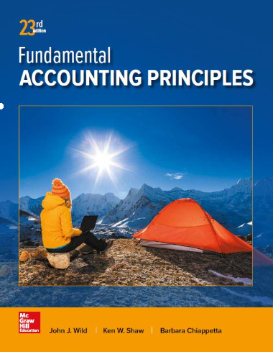
Inventories and Cost of Sales
Chapter 6
Wild, Shaw, and Chiappetta
Fundamental Accounting Principles
23rd Edition

Slide 2
Chapter 6 Learning Objectives
CONCEPTUAL
C1 Identify the items making up merchandise inventory.
C2 Identify the costs of merchandise inventory.
ANALYTICAL
A1 Analyze the effects of inventory methods for both financial and tax reporting.
A2 Analyze the effects of inventory errors on current and future financial statements.
A3 Assess inventory management using both inventory turnover and days’ sales in inventory.
PROCEDURAL
P1 Compute inventory in a perpetual system using the methods of specific identification, FIFO, LIFO, and weighted average.
P2 Compute the lower of cost or market amount of inventory.
P3 Appendix 6A—Compute inventory in a periodic system using the methods of specific identification, FIFO, LIFO, and weighted average.
P4 Appendix 6B—Apply both the retail inventory and gross profit methods to estimate inventory.
2

Slide 3
C1:
Identify the items making up merchandise inventory.
Learning Objective

Slide 4
Determining Inventory Items
Merchandise inventory includes all goods that a company owns and holds for sale, regardless of where the goods are located when inventory is counted.
Items requiring special attention include:
Goods in Transit
Goods Damaged or Obsolete
Goods on Consignment
Learning Objective C1: Identify the items making up merchandise inventory
Notes:
Merchandise inventory includes all goods that a company owns and holds for sale. This is true regardless of where the goods are located when inventory is counted. Certain inventory items require special attention, including goods in transit, goods on consignment, and goods that are damaged or obsolete.

Slide 5
Goods in Transit
FOB Shipping Point
Public
Carrier
Seller
Buyer
Ownership passes
to the buyer here.
Public
Carrier
Seller
FOB Destination Point
Buyer
Learning Objective C1: Identify the items making up merchandise inventory
Notes:
Does a purchaser’s inventory include goods in transit from a supplier? The answer is that if ownership has passed to the purchaser, the goods are included in the purchaser’s inventory. We determine this by reviewing the shipping terms: FOB destination or FOB shipping point. Goods purchased FOB shipping point are included in the buyer’s inventory when the items are shipped. Goods purchased FOB destination are not included in the buyer’s inventory until they arrive at their destination.

Slide 6
Goods on Consignment
Merchandise is included in the inventory of the consignor, the owner of the inventory.
Consignee sells goods for the owner, consignor.
Consignee never reports consigned goods in inventory.
Learning Objective C1: Identify the items making up merchandise inventory
Notes:
Goods on consignment are goods shipped by the owner, called the consignor, to another party, the consignee. A consignee sells goods for the owner. The consignor continues to own the consigned goods and reports them in its inventory. The consignee never reports consigned goods in inventory.

Slide 7
Goods Damaged or Obsolete
Damaged or obsolete goods are not reported in inventory if they cannot be sold.
Cost should be reduced to net realizable value if they can be sold.
Learning Objective C1: Identify the items making up merchandise inventory
Notes:
Damaged and obsolete (and deteriorated) goods are not reported in inventory if they cannot be sold. If these goods can be sold at a reduced price, they are included in inventory at a conservative estimate of their net realizable value. Net realizable value is sales price minus the cost of making the sale. The period when damage or obsolescence (or deterioration) occurs is the period when the loss in value is reported.

Slide 8
C2:
Identify the costs of merchandise inventory.
Learning Objective

Slide 9
Determining Inventory Costs
Include all expenditures necessary to bring an item to a salable condition and location.
Invoice Cost
Minus Discounts and Allowances
Plus
Shipping
Plus
Insurance
Plus
Storage
Learning Objective C2: Identify the costs of merchandise inventory
Notes:
Merchandise inventory includes costs of expenditures necessary, directly or indirectly, to bring an item to a salable condition and location. This means that the cost of an inventory item includes its invoice cost minus any discount, and plus any incidental costs necessary. Incidental costs can include shipping, storage, and insurance.

Slide 10
Internal Controls and Taking a Physical Count
Most companies take a physical count of inventory at least once each year.
When the physical count does not match the Merchandise Inventory account, an adjustment must be made.
Good internal controls over count include:
Pre-numbered inventory tickets.
Counters have no inventory responsibility.
Counters confirm existence, amount, and
quality of inventory item.
Second count is taken.
Manager confirms all items counted.
Learning Objective C2: Identify the costs of merchandise inventory
Notes:
Events can cause the Inventory account balance to differ from the actual inventory available. Such events include theft, loss, damage, and errors. Thus, nearly all companies take a physical count of inventory at least once each year—informally called taking an inventory. This often occurs at the end of a fiscal year or when inventory amounts are low. This physical count is used to adjust the Inventory account balance to the actual inventory available.
A company has adequate internal controls over the inventory count if, (1) it uses pre-numbered inventory tags, (2) inventory counters have no responsibility for inventory, (3) the count confirms the existence, amount, and quality of inventory items counted, (4) a second count of the inventory is made, and (5) a count supervisor confirms that all items in inventory have been counted.
Review what you have learned in the following NEED-TO-KNOW Slides.

Slide 11
NEED-TO-KNOW 6-1
A master carver of wooden birds operates her business out of a garage. At the end of the current period,
the carver has 17 units (carvings) in her garage, three of which were damaged by water and cannot be
sold. The distributor also has another five units in her truck, ready to deliver per a customer order,
terms FOB destination, and another 11 units out on consignment at several small retail stores. How
many units does the carver include in the business’s period-end inventory?
Units in ending inventory
Key point – How many units does she own at year-end?
Units in storage
17
Less damaged (unsalable) units
(3)
Plus units in transit (FOB Destination)
5
Plus units on consignment
11
Total units in ending inventory
30
A distributor of artistic iron-based fixtures acquires a piece for $1,000, terms FOB shipping point.
Additional costs in obtaining it and offering it for sale include $150 for transportation-in, $300 for
import duties, $100 for insurance during shipment, $200 for advertising, a $50 voluntary gratuity to the
delivery person, $75 for enhanced store lighting, and $250 for sales staff salaries. For computing
inventory, what cost is assigned to this artistic piece?
Cost of inventory
Key point – What are the necessary costs to get the asset ready for its intended purpose?
Cost
$1,000
Transportation-in (FOB shipping point)
150
Import duties
300
Insurance cost
100
Inventory cost
$1,550
Learning Objective C1: Identify the items making up merchandise inventory
Learning Objective C2: Identify the costs of merchandise inventory
Notes:
A master carver of wooden birds operates her business out of a garage. At the end of the current period, the carver has 17 units (carvings) in her garage, three of which were damaged by water and cannot be sold. The distributor also has another five units in her truck, ready to deliver per a customer order, terms FOB destination, and another 11 units out on consignment at several small retail stores. How many units does the carver include in the business’s period-end inventory? In order to calculate the number of units in ending inventory, we need to determine how many unit she owns at year-end. She owns the 17 units in the garage, but we subtract the units that are damaged and unsalable; 14 units in her garage are included in inventory. We also include the units that are in transit, because when units are shipped FOB destination, she owns them until they reach their destination. We also include the units that are out on consignment; she owns the units on consignment until they're sold. The total number of units in ending inventory is 30. A distributor of artistic iron-based fixtures acquires a piece for $1,000, terms FOB shipping point. Additional costs in obtaining it and offering it for sale include $150 for transportation-in, $300 for import duties, $100 for insurance during shipment, $200 for advertising, a $50 voluntary gratuity to the delivery person, $75 for enhanced store lighting, and $250 for sales staff salaries. For computing inventory, what cost is assigned to this artistic piece? The cost of the inventory includes all necessary costs to get the asset ready for its intended purpose. The intended purpose is to resell the fixtures. We include the cost of the fixtures, $1,000, plus the incoming freight cost, as the units were purchased FOB shipping point. When units are purchased FOB shipping point, title transfers as soon as the units are shipped. The $300 import duties are also a necessary cost to acquire the units. Insuring the units in transit is another unavoidable cost. The total inventory cost is $1,550. The remaining items are not necessary costs to get the asset ready for its intended purpose. These are business expenses and will be expensed in the period incurred.

Slide 12
Inventory Costing under a Perpetual System
Inventory affects . . .
Balance Sheet
Income Statement
The matching principle requires matching costs with sales.
Learning Objective P1: Compute inventory in a perpetual system using specific identification, FIFO, LIFO and weighted average
Notes:
Accounting for inventory affects both the balance sheet and the income statement. A major goal in accounting for inventory is to properly match costs with sales. We use the expense recognition (or matching) principle to compute how much of the cost of the goods available for sale is expensed and how much is carried forward as inventory.

Slide 13
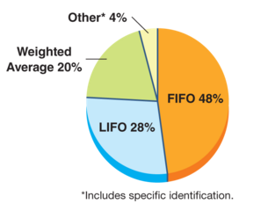
Inventory Costing Management Decisions
Management decisions in accounting for inventory involve the following:
Items included in inventory and their costs.
Costing method (specific identification, FIFO, LIFO,
or weighted average).
Inventory system (perpetual or periodic).
Use of market values or other estimates.
Learning Objective C2: Identify the costs of merchandise inventory
Notes:
Management decisions in accounting for inventory involve the following:
1. Items included in inventory and their costs.
Costing method (specific identification, FIFO, LIFO, or weighted average).
Inventory system (perpetual or periodic).
Use of market values or other estimates
An important issue in accounting for inventory is determining the per unit costs assigned to inventory items. When all units are purchased at the same unit cost, this process is simple. When identical items are purchased at different costs, we must decide which amounts to record in cost of goods sold and which amounts remain in inventory.
Four methods are used to assign costs to inventory and to cost of goods sold: (1) specific identification; (2) first-in, first-out (FIFO); (3) last-in, first-out (LIFO); and (4) weighted average. The graph on this slide shows the frequency in the use of these methods.
With the exception of specific identification, the physical flow and cost flow need not be the same.

Slide 14
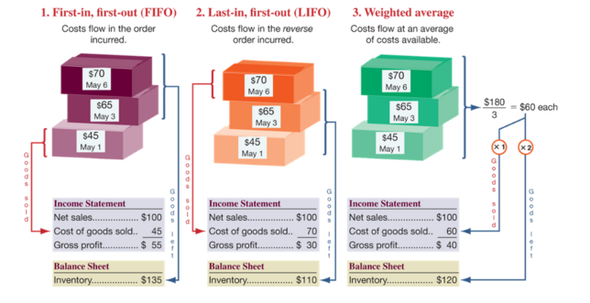
Inventory Cost Flow Assumptions
Exhibit 6.2
Learning Objective C2: Identify the costs of merchandise inventory
Notes:
We must make assumptions about the inventory cost flow. First-in, first-out assumes costs flow in the order incurred. Last-in, first-out assumes costs flow in the reverse order incurred. Weighted average assumes costs flow at an average of the costs available.

Slide 15
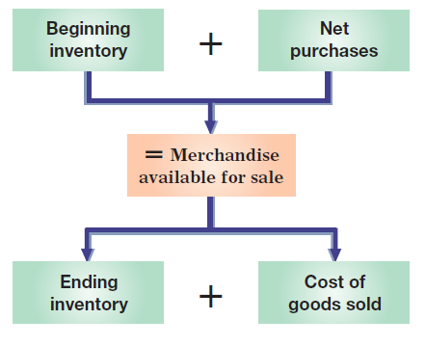
Inventory Cost Flow Assumptions
Learning Objective C2: Identify the costs of merchandise inventory
Notes:
A company’s merchandise available for sale consists of what it begins with (beginning inventory) and what it purchases (net purchases). The merchandise available is either sold (cost of goods sold) or kept for future sales (ending inventory).

Slide 16
P1:
Compute inventory in a perpetual system using the methods of specific identification, FIFO, LIFO and Weighted Average.
Learning Objective

Slide 17
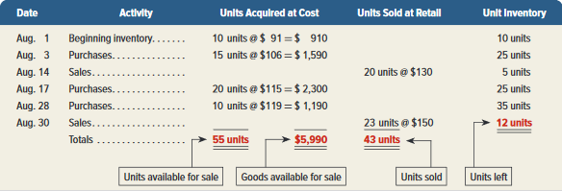
Inventory Costing Illustration
Exhibit 6.3
Here is information about the mountain bike inventory of Trekking for the month of August.
Learning Objective P1: Compute inventory in a perpetual system using specific identification, FIFO, LIFO and weighted average
Notes:
Trekking is a sporting goods store. Among its many products, Trekking carries one type of mountain bike whose sales are directed at resorts that provide inexpensive bikes for guest use. We use Trekking’s data from August. Its mountain bike (unit) inventory at the beginning of August and its purchases and sales during August are shown in this slide. It ends August with 12 bikes remaining in inventory.

Slide 18
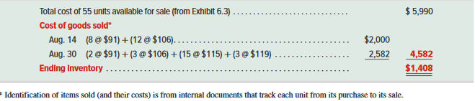
Specific Identification
Exhibit 6.4
Learning Objective P1: Compute inventory in a perpetual system using specific identification, FIFO, LIFO and weighted average
Notes:
When each item in inventory can be matched with a specific purchase and invoice, we can use specific identification or SI (also called specific invoice inventory pricing) to assign costs. We also need sales records that identify exactly which items were sold and when. For example, each bike’s serial number could be used to track costs and compute cost of goods sold. Trekking’s internal documents reveal the following specific unit sales:
August 14 Sold 8 bikes costing $91 each and 12 bikes costing $106 each
August 30 Sold 2 bikes costing $91 each, 3 bikes costing $106 each, 15 bikes costing $115 each, and 3 bikes costing $119 each
Applying specific identification and using the information above, we prepare Exhibit 6.4. This exhibit begins with the $5,990 in total units available for sale—this is from Exhibit 6.3. For the 20 units sold on August 14, the company specifically identified that 8 of them had cost $91 each and 12 had cost $106 each, resulting in an August 14 cost of sales of $2,000. Next, for the 23 units sold on August 30, the company specifically identified that 2 of them had cost $91 each, that 3 had cost $106 each, that 15 had cost $115 each, and 3 had cost $119 each, resulting in an August 30 cost of sales of $2,582. The total cost of sales for the period is $4,582. We then subtract this $4,582 in cost of goods sold from the $5,990 in cost of goods available to get $1,408 in ending inventory. Study Exhibit 6.4 to see the flow of costs. Each unit, whether sold or remaining in inventory, has its own specific cost attached to it.
When using specific identification, Trekking’s cost of goods sold reported on the income statement totals $4,582, the sum of $2,000 and $2,582 from the third column above. Trekking’s ending inventory reported on the balance sheet is $1,408, which is the final inventory balance from the fourth column.

Slide 19
First-In, First-Out (FIFO)
Oldest Costs
Cost of Goods Sold
Recent Costs
Ending Inventory
Learning Objective P1: Compute inventory in a perpetual system using specific identification, FIFO, LIFO and weighted average
Notes:
The first-in, first-out (FIFO) method of assigning costs assumes that inventory items are sold in the order acquired. When sales occur, the costs of the earliest units acquired are charged to cost of goods sold. This leaves the costs from the most recent purchases in ending inventory.

Slide 20
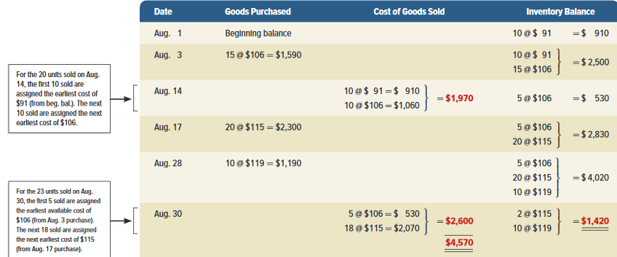
First-In, First-Out (FIFO)
Exhibit 6.5
Learning Objective P1: Compute inventory in a perpetual system using specific identification, FIFO, LIFO and weighted average
Notes:
Use of FIFO for computing the cost of inventory and cost of goods sold is shown in this slide.
This exhibit starts with beginning inventory of 10 bikes at $91 each. On August 3, 15 more bikes costing $106 each are bought for $1,590. Inventory now consists of 10 bikes at $91 each and 15 bikes at $106 each, for a total of $2,500. On August 14, 20 bikes are sold—applying FIFO, the first 10 sold cost $91 each and the next 10 sold cost $106 each, for a total cost of $1,970. This leaves 5 bikes costing $106 each, or $530, in inventory. On August 17, 20 bikes costing $2,300 are purchased, and on August 28, another 10 bikes costing $1,190 are purchased, for a total of 35 bikes costing $4,020 in inventory. On August 30, 23 bikes are sold—applying FIFO, the first 5 bikes sold cost $530 and the next 18 sold cost $2,070, which leaves 12 bikes costing $1,420 in ending inventory.
Trekking’s FIFO cost of goods sold reported on its income statement (reflecting the 43 units sold) is $4,570 ($1,970 + $2,600), and its ending inventory reported on the balance sheet (reflecting the 12 units unsold) is $1,420.

Slide 21
Last-In, First-Out (LIFO)
Recent Costs
Cost of Goods Sold
Oldest Costs
Ending Inventory
Learning Objective P1: Compute inventory in a perpetual system using specific identification, FIFO, LIFO and weighted average
Notes:
The last-in, first-out method is abbreviated as LIFO, and pronounced as Lifo. When using LIFO, we assign the most recent costs to the units sold. That leaves the older costs to be used to value ending inventory.

Slide 22
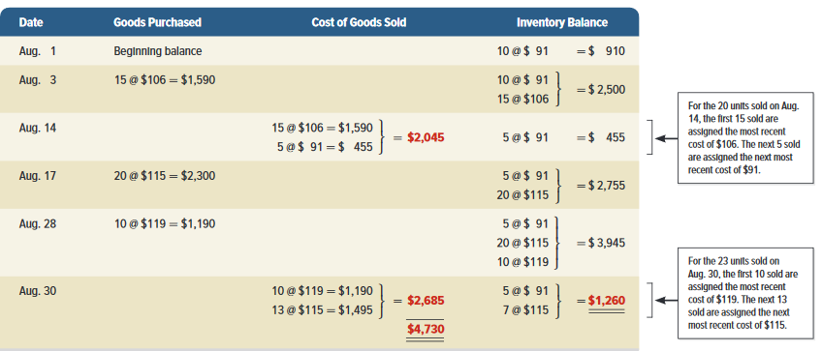
Last-In, First-Out (LIFO)
Exhibit 6.6
Learning Objective P1: Compute inventory in a perpetual system using specific identification, FIFO, LIFO and weighted average
Notes:
The last-in, first-out (LIFO) method of assigning costs assumes that the most recent purchases are sold first. These more recent costs are charged to the cost of goods sold, and the costs of the earliest purchases are assigned to inventory. By assigning costs from the most recent purchases to cost of goods sold, LIFO comes closest to matching current costs of goods sold with revenues (compared to FIFO or weighted average).
This slide shows the LIFO computations. It starts with beginning inventory of 10 bikes at $91 each. On August 3, 15 more bikes costing $106 each are bought for $1,590. Inventory now consists of 10 bikes at $91 each and 15 bikes at $106 each, for a total of $2,500. On August 14, 20 bikes are sold—applying LIFO, the first 15 sold are from the most recent purchase costing $106 each, and the next 5 sold are from the next most recent purchase costing $91 each, for a total cost of $2,045. This leaves 5 bikes costing $91 each, or $455, in inventory. On August 17, 20 bikes costing $2,300 are purchased, and on August 28, another 10 bikes costing $1,190 are purchased, for a total of 35 bikes costing $3,945 in inventory. On August 30, 23 bikes are sold—applying LIFO, the first 10 bikes sold are from the most recent purchase costing $1,190, and the next 13 sold are from the next most recent purchase costing $1,495, which leaves 12 bikes costing $1,260 in ending inventory. Trekking’s LIFO cost of goods sold reported on the income statement is $4,730 ($2,045 + $2,685), and its ending inventory reported on the balance sheet is $1,260.

Slide 23
Weighted Average
When a unit is sold, the average cost of each unit in inventory is assigned to cost of goods sold.
Cost of Goods Available for Sale
Units on hand on the date of sale
÷
Learning Objective P1: Compute inventory in a perpetual system using specific identification, FIFO, LIFO and weighted average
Notes:
The weighted average (also called average cost) method of assigning cost requires that we use the weighted average cost per unit of inventory at the time of each sale. Weighted average cost per unit at the time of each sale equals the cost of goods available for sale divided by the units available.

Slide 24
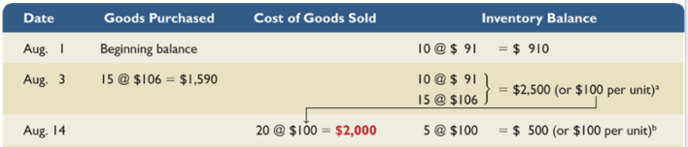
Weighted Average
On August 14, 20 bikes are sold. To determine the cost of the units sold, we first, need to compute the weighted average cost per unit of items in inventory.
÷
The cost of goods sold for the August 14 sale is $2,000. After this sale, there are five $100 units in inventory totaling $500.
Learning Objective P1: Compute inventory in a perpetual system using specific identification, FIFO, LIFO and weighted average
Notes:
On August 1 and August 3, the company purchases inventory. On August 14, it sold 20 bikes. What is the total cost assigned to the bikes sold on August 14?
First, we need to compute the weighted average cost per unit of the items in inventory. We do this by dividing the cost of goods available for sale of $2,500 by the total units in inventory of 25. The average cost per unit is $100.
The cost of goods sold for August 14 is $2,000, or 20 bikes @ $100 each.
After this sale, there are five units left in inventory at an average cost of $100 each for a total inventory balance of $500.

Slide 25
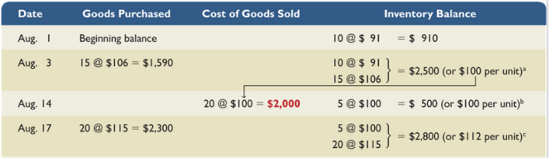
Weighted Average
÷
After the August 14 sale, there are 5 units in inventory totaling $500. On August 17, 20 units are purchased for $2,300. $2,300+500=$2,800 / 25 = $112 per unit.
Learning Objective P1: Compute inventory in a perpetual system using specific identification, FIFO, LIFO and weighted average
Notes:
Next, a purchase is made on August 17. What is the weighted average cost per unit of the items in inventory on August 17? There were 5 units in ending inventory plus the 20 units purchased on August 17. Total cost of goods available for sale is $2,800 divided by 25 units = $112 weighted average cost per unit.

Slide 26
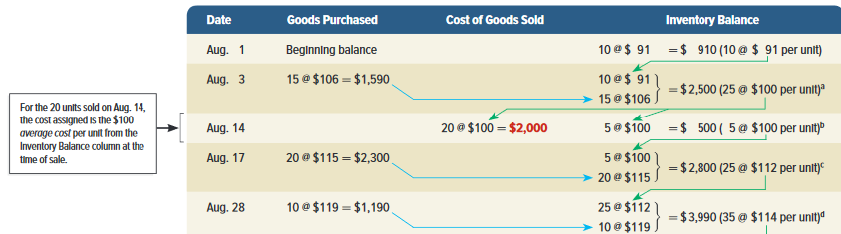
Weighted Average
÷
After the August 28 purchase, there are 35 (5+20+10) units in inventory totaling ($2,800+1,190) $3,990. $3,900 / 35 = $114 per unit.
Learning Objective P1: Compute inventory in a perpetual system using specific identification, FIFO, LIFO and weighted average
Notes:
After the August 28 purchase, there are 35 (5+20+10) units in inventory totaling ($2,800+1,190) $3,990. $3,900 / 35 = $114 per unit.

Slide 27
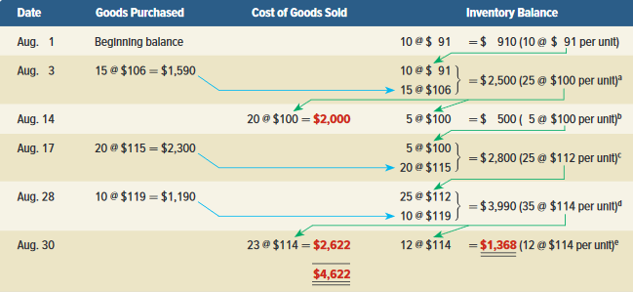
Weighted Average
Exhibit 6.7
Ending inventory is composed of 12 units @ an average cost of $114 each or $1,368.
Cost of goods sold for August 30 sale is = $2,622
Learning Objective P1: Compute inventory in a perpetual system using specific identification, FIFO, LIFO and weighted average
Notes:
The cost of goods sold for the August 31 sale is $2,622.
After the August 30 sale, there are 12 units in inventory at $1,368, or 12 units at an average cost of $114 each.

Slide 28
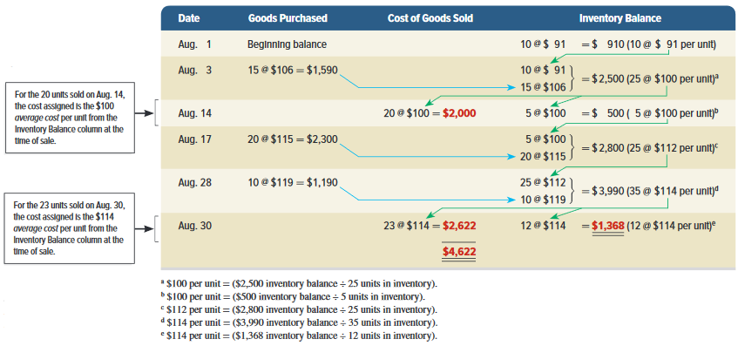
Weighted Average
Exhibit 6.7
Learning Objective P1: Compute inventory in a perpetual system using specific identification, FIFO, LIFO and weighted average
Notes:
This exhibit starts with beginning inventory of 10 bikes at $91 each. On August 3, 15 more bikes costing $106 each are bought for $1,590. Inventory now consists of 10 bikes at $91 each and 15 bikes at $106 each, for a total of $2,500. The average cost per bike for that inventory is $100, computed as $2,500/(10 bikes + 15 bikes). On August 14, 20 bikes are sold—applying WA, the 20 sold are assigned the $100 average cost, for a total cost of $2,000. This leaves 5 bikes with an average cost of $100 each, or $500, in inventory. On August 17, 20 bikes costing $2,300 are purchased, and on August 28, another 10 bikes costing $1,190 are purchased, for a total of 35 bikes costing $3,990 in inventory at August 28. The average cost per bike for the August 28 inventory is $114, computed as $3,990/(5 bikes + 20 bikes + 10 bikes). On August 30, 23 bikes are sold—applying WA, the 23 sold are assigned the $114 average cost, for a total cost of $2,622. This leaves 12 bikes costing $1,368 in ending inventory.
Trekking’s cost of goods sold reported on the income statement (reflecting the 43 units sold) is $4,622 ($2,000 1 $2,622), and its ending inventory reported on the balance sheet (reflecting the 12 units unsold) is $1,368.

Slide 29
A1:
Analyze the effects of inventory methods for both financial and tax reporting.
Learning Objective

Slide 30
Financial Statement Effects of Inventory Costing Methods
Exhibit 6.8
Because prices change, inventory methods nearly always assign different cost amounts.
Learning Objective P1: Compute inventory in a perpetual system using specific identification, FIFO, LIFO and weighted average
Notes:
This exhibit starts with beginning inventory of 10 bikes at $91 each. On August 3, 15 more bikes costing $106 each are bought for $1,590. Inventory now consists of 10 bikes at $91 each and 15 bikes at $106 each, for a total of $2,500. The average cost per bike for that inventory is $100, computed as $2,500/(10 bikes + 15 bikes). On August 14, 20 bikes are sold—applying WA, the 20 sold are assigned the $100 average cost, for a total cost of $2,000. This leaves 5 bikes with an average cost of $100 each, or $500, in inventory. On August 17, 20 bikes costing $2,300 are purchased, and on August 28, another 10 bikes costing $1,190 are purchased, for a total of 35 bikes costing $3,990 in inventory at August 28. The average cost per bike for the August 28 inventory is $114, computed as $3,990/(5 bikes + 20 bikes + 10 bikes). On August 31, 23 bikes are sold—applying WA, the 23 sold are assigned the $114 average cost, for a total cost of $2,622. This leaves 12 bikes costing $1,368 in ending inventory.
Trekking’s cost of goods sold reported on the income statement (reflecting the 43 units sold) is $4,622 ($2,000 1 $2,622), and its ending inventory reported on the balance sheet (reflecting the 12 units unsold) is $1,368.

Slide 31
Financial Statement Effects of Costing Methods
Because prices change, inventory methods nearly always assign different cost amounts.
Learning Objective A1: Analyze the effects of inventory methods for both financial and tax reporting
Notes:
This exhibit reveals two important results. First, when purchase costs regularly rise, as in Trekking’s case, the following occurs:
FIFO assigns the lowest amount to cost of goods sold—yielding the highest gross profit and net income.
LIFO assigns the highest amount to cost of goods sold—yielding the lowest gross profit and net income.
Weighted average yields results between FIFO and LIFO.
Specific identification always yields results that depend on which units are sold.
Second, when costs regularly decline, the reverse occurs for FIFO and LIFO. Namely, FIFO gives the highest cost of goods sold—yielding the lowest gross profit and income. However, LIFO then gives the lowest cost of goods sold—yielding the highest gross profit and income.

Slide 32
Financial Statement Effects of Costing Methods
Advantages of Methods
First-In, First-Out
Last-In, First-Out
Weighted Average
Ending inventory approximates current replacement cost.
Better matches current costs in cost of goods sold with revenues.
Smoothes out price changes.
Learning Objective A1: Analyze the effects of inventory methods for both financial and tax reporting
Notes:
All four inventory costing methods are acceptable. However, a company must disclose the inventory method it uses in its financial statements or notes. Each method offers certain advantages as follows:
FIFO assigns an amount to inventory on the balance sheet that approximates its current cost; it also mimics the actual flow of goods for most businesses.
LIFO assigns an amount to cost of goods sold on the income statement that approximates its current cost; it also better matches current costs with revenues in computing gross profit.
Weighted average tends to smooth out erratic changes in costs. Specific identification exactly matches the costs of items with the revenues they generate.

Slide 33
Tax Effects of Costing Methods
The Internal Revenue Service (IRS) identifies several acceptable inventory costing methods for reporting taxable income.
If LIFO is used for tax purposes, the IRS requires it be used in financial statements.
Learning Objective A1: Analyze the effects of inventory methods for both financial and tax reporting
Notes:
Companies can and often do use different costing methods for financial reporting and tax reporting. The only exception is when LIFO is used for tax reporting; in this case, the IRS requires that it also be used in financial statements—called the LIFO conformity rule.

Slide 34
Consistency in Using Costing Methods
The consistency concept requires a company to use the same accounting methods period after period so that financial statements are comparable across periods.
Learning Objective A1: Analyze the effects of inventory methods for both financial and tax reporting
Notes:
The consistency concept prescribes that a company use the same accounting methods period after period so that financial statements are comparable across periods—the only exception is when a change from one method to another will improve its financial reporting. The full disclosure principle prescribes that the notes to the statements report this type of change, its justification, and its effect on income.
The consistency concept does not require a company to use one method exclusively. For example, it can use different methods to value different categories of inventory.
Review what you have learned in the following NEED-TO-KNOW Slides.

Slide 35
NEED-TO-KNOW 6-2
A company reported the following December purchases and sales data for its only product.
Date
Activities
Units Acquired at Cost
Units Sold at Retail
Dec. 01
Beginning inventory
5 units @ $3.00 = $15.00
Dec. 08
Purchase
10 units @ $4.50 = $45.00
Dec. 09
Sales
8 units @ $7.00
Dec. 19
Purchase
13 units @ $5.00 = $65.00
Dec. 24
Sales
18 units @ $8.00
Dec. 30
Purchase
8 units @ $5.30 = $42.40
36 units
$167.40
26 units
The company uses a perpetual inventory system. Determine the cost assigned to ending inventory and
to cost of goods sold using (a) specific identification, (b) FIFO, (c) LIFO, and (d) weighted average.
(Round per unit costs and inventory amounts to cents.) For specific identification, ending inventory
consists of 10 units, where eight are from the December 30 purchase and two are from the December
8 purchase.
Learning Objective P1: Compute inventory in a perpetual system using specific identification, FIFO, LIFO and weighted average
Notes:
A company reported the following December purchases and sales data for its only product. The company uses a perpetual inventory system. Determine the cost assigned to ending inventory and to cost of goods sold using (a) specific identification, (b) FIFO, (c) LIFO, and (d) weighted average.

Slide 36
NEED-TO-KNOW 6-2
A company reported the following December purchases and sales data for its only product.
Date
Activities
Units Acquired at Cost
Units Sold at Retail
Dec. 01
Beginning inventory
5 units @ $3.00 = $15.00
Dec. 08
Purchase
10 units @ $4.50 = $45.00
Dec. 09
Sales
8 units @ $7.00
Dec. 19
Purchase
13 units @ $5.00 = $65.00
Dec. 24
Sales
18 units @ $8.00
Dec. 30
Purchase
8 units @ $5.30 = $42.40
36 units
$167.40
26 units
The company uses a perpetual inventory system. Determine the cost assigned to ending inventory and
to cost of goods sold using (a) specific identification, (b) FIFO, (c) LIFO, and (d) weighted average.
(Round per unit costs and inventory amounts to cents.) For specific identification, ending inventory
consists of 10 units, where eight are from the December 30 purchase and two are from the December
8 purchase.
Regardless of the method used, the cost of 26 units are included in Cost of Goods Sold, and the cost of 10 units are included in Ending Inventory
Learning Objective P1: Compute inventory in a perpetual system using specific identification, FIFO, LIFO and weighted average
Notes:
Regardless of the method used, the cost of 26 units are included in cost of goods sold, and the cost of ten units are included in ending inventory, (36 units available - 26 units sold).

Slide 37
NEED-TO-KNOW 6-2 SPECIFIC IDENTIFICATION
A company reported the following December purchases and sales data for its only product.
Date
Activities
Units Acquired at Cost
Units Sold at Retail
Dec. 01
Beginning inventory
5 units @ $3.00 = $15.00
Dec. 08
Purchase
10 units @ $4.50 = $45.00
Dec. 09
Sales
8 units @ $7.00
Dec. 19
Purchase
13 units @ $5.00 = $65.00
Dec. 24
Sales
18 units @ $8.00
Dec. 30
Purchase
8 units @ $5.30 = $42.40
36 units
$167.40
26 units
The company uses a perpetual inventory system. Determine the cost assigned to ending inventory and
to cost of goods sold using (a) specific identification, (b) FIFO, (c) LIFO, and (d) weighted average.
(Round per unit costs and inventory amounts to cents.) For specific identification, ending inventory
consists of 10 units, where eight are from the December 30 purchase and two are from the December
8 purchase.
Specific Identification Method
Not an inventory assumption - Actual
Cost of Goods Sold represents the actual cost of the units selected by the customer.
Ending Inventory represents the actual cost of the units that remain in ending inventory.
Learning Objective P1: Compute inventory in a perpetual system using specific identification, FIFO, LIFO and weighted average
Notes:
The specific identification method is not an inventory assumption; it's based on the actual units. Cost of goods sold represents the actual cost of the units selected by the customer, and ending inventory represents the actual cost of the units that remain in ending inventory.

Slide 38
NEED-TO-KNOW 6-2 SPECIFICATION IDENTIFICATION SOLUTION
Date
Activities
Units Acquired at Cost
Units Sold at Retail
Dec. 01
Beginning inventory
5 units @ $3.00 = $15.00
Dec. 08
Purchase
10 units @ $4.50 = $45.00
Dec. 09
Sales
8 units @ $7.00
Dec. 19
Purchase
13 units @ $5.00 = $65.00
Dec. 24
Sales
18 units @ $8.00
Dec. 30
Purchase
8 units @ $5.30 = $42.40
36 units
$167.40
26 units
Ending inventory consists of 10 units, where eight are from the December 30 purchase and two are from the December 8 purchase.
Specific Identification – Cost of exact units sold are expensed as Cost of Goods Sold.
Date
Activities
Units Acquired at Cost
Cost of Goods Sold
Cost of Ending Inventory
Dec. 01
Beginning inventory
5 @ $3.00 = $15.00
5 @ $3.00 = $15.00
Dec. 08
Purchase
10 @ $4.50 = $45.00
8 @ $4.50 = $36.00
2 @ $4.50 = $9.00
Dec. 19
Purchase
13 @ $5.00 = $65.00
13 @ $5.00 = $65.00
Dec. 30
Purchase
8 @ $5.30 = $42.40
8 @ $5.30 = $42.40
36 units
$167.40
26 units
$116.00
10 units
$51.40
Cost of Goods Sold $116.00
Ending inventory 51.40
Goods available for sale $167.40
Learning Objective P1: Compute inventory in a perpetual system using specific identification, FIFO, LIFO and weighted average
Notes:
Using the specific identification method, ending inventory consists of ten units; where eight are from the December 30 purchase, and two were from the December 8 purchase. The eight units from the December 30 purchase were acquired at a cost of $5.30 per unit. The two units purchased on December 8 were acquired at a cost of $4.50 per unit. The total cost of ending inventory is $51.40. There were 36 units available for sale, at a total cost of $167.40.
Since ten units, valued at a total of $51.40, remain in ending inventory, the remaining 26 units, at a total cost of $116.00, have been sold. Cost of goods sold consists of the five units from the beginning inventory, plus eight of the ten units purchased on December 8, plus all 13 units purchased on December 19, and none of the units from December 30. Total cost of goods sold is $116.00.

Slide 39
NEED-TO-KNOW 6-2 FIFO SOLUTION
Date
Activities
Units Acquired at Cost
Units Sold at Retail
Dec. 01
Beginning inventory
5 units @ $3.00 = $15.00
Dec. 08
Purchase
10 units @ $4.50 = $45.00
Dec. 09
Sales
8 units @ $7.00
Dec. 19
Purchase
13 units @ $5.00 = $65.00
Dec. 24
Sales
18 units @ $8.00
Dec. 30
Purchase
8 units @ $5.30 = $42.40
36 units
$167.40
26 units
Perpetual FIFO – Cost of Goods Sold is calculated at the time of the sale. The first items in are the first items out – expensed as Cost of Goods Sold.
Date
Goods Purchased
Cost of Goods Sold
Inventory Balance
Dec. 1
5 @ $3.00
= $15.00
Dec. 8
10 @ $4.50
5 @ $3.00
}
10 @ $4.50
= $60.00
Dec. 9
5 @ $3.00
}
3 @ $4.50
= $28.50
7 @ $4.50
= $31.50
Dec. 19
13 @ $5.00
7 @ $4.50
}
13 @ $5.00
= $96.50
Dec. 24
7 @ $4.50
}
11 @ $5.00
= $86.50
2 @ $5.00
= $10.00
Dec. 30
8 @ $5.30
2 @ $5.00
}
8 @ $5.30
= $52.40
Cost of Goods Sold $ 115.00
Ending inventory 52.40
Goods available for sale $ 167.40
$115.00
Learning Objective P1: Compute inventory in a perpetual system using specific identification, FIFO, LIFO and weighted average
Notes:
In a perpetual inventory system, cost of goods sold is calculated at the time of the sale. Under Perpetual FIFO, the first items in are the first items out, expensed as cost of goods sold. The company begins the month with five units in inventory at a cost of $3.00 per unit; the inventory balance is $15.00.
On December 8, ten units are purchased at $4.50 per unit. These units are added to the inventory balance. As of December 8, there are 15 units in inventory at a total cost of $60.00.
On December 9, the company sells eight units. Since it's a perpetual inventory system, the eight units are removed from the inventory database at the time of the sale. We remove eight units from the inventory database, in chronological order. The first eight units we owned are the five units at $3.00 apiece plus three of the units at $4.50 apiece. Cost of goods sold for the December 9 sale is $28.50. This leaves seven units in inventory at $4.50 per unit, $31.50. $60.00 - $28.50 is $31.50.
On December 19, the company purchases 13 units at $5.00 per unit. The 13 units are added to the inventory database. The company now has a total of 20 units in inventory at a total cost of $96.50; $31.50 plus the $65.00 purchase.
On December 24, they sell 18 units. The first 18 units are removed from the inventory database; seven at $4.50 plus 11 of the units at $5.00 per unit. Cost of goods sold is $86.50. $96.50 - $86.50 is $10.00. Two units remain in inventory at $5.00 per unit, a total of $10.00 of inventory.
On December 30, the company purchases eight units at $5.30 per unit. These units are added to inventory. At the end of the month, the company has a total of ten units in inventory at a total cost of $52.40. Total cost of goods sold is $115.00. Cost of goods sold, $115.00, plus ending inventory of $52.40, agrees with cost of goods available for sale, $167.40.

Slide 40
NEED-TO-KNOW 6-2 LIFO SOLUTION
Date
Activities
Units Acquired at Cost
Units Sold at Retail
Dec. 01
Beginning inventory
5 units @ $3.00 = $15.00
Dec. 08
Purchase
10 units @ $4.50 = $45.00
Dec. 09
Sales
8 units @ $7.00
Dec. 19
Purchase
13 units @ $5.00 = $65.00
Dec. 24
Sales
18 units @ $8.00
Dec. 30
Purchase
8 units @ $5.30 = $42.40
36 units
$167.40
26 units
Perpetual LIFO – Cost of Goods Sold is calculated at the time of the sale. The last items in are the first items out – expensed as Cost of Goods Sold.
Date
Goods Purchased
Cost of Goods Sold
Inventory Balance
Dec. 1
5 @ $3.00
= $15.00
Dec. 8
10 @ $4.50
5 @ $3.00
}
10 @ $4.50
= $60.00
Dec. 9
8 @ $4.50
= $36.00
5 @ $3.00
} = $24.00
2 @ $4.50
Dec. 19
13 @ $5.00
5 @ $3.00
}
2 @ $4.50
= $89.00
13 @ $5.00
Dec. 24
3 @ $3.00
}
2 @ $3.00
= $6.00
2 @ $4.50
= $83.00
13 @ $5.00
Dec. 30
8 @ $5.30
2 @ $3.00
}
8 @ $5.30
= $48.40
$119.00
Cost of Goods Sold $119.00
Ending inventory 48.40
Goods available for sale $167.40
Learning Objective P1: Compute inventory in a perpetual system using specific identification, FIFO, LIFO and weighted average
Notes:
Assuming perpetual LIFO, cost of goods sold is still calculated at the time of the sale, but under perpetual LIFO, the last items in are the first items out, expensed as cost of goods sold. We begin the month with five units in inventory at a cost of $3.00 per unit.
On December 8, the company purchases ten units at $4.50 per unit. These units and these dollars are added to inventory. The company now has 15 units, at a total cost of $60.00 in inventory.
On December 9, the company sells eight units. The units are removed in reverse chronological order; we removed the last eight units to come into the database. Eight units at $4.50 per unit; cost of goods sold is $36.00. This leaves five units at $3.00 per unit, plus two units of $4.50 per unit, in inventory. The inventory balance as of December 9 is $24.00; $60.00 - $36.00 is $24.00.
On December 19, the company purchases 13 units at $5.00 per unit. These units and these dollars are added to inventory. The company now has a total of 20 units in inventory at a total cost of $89.00; $24.00 plus the $65.00 purchase.
On December 24, the company sells 18 units. 18 units are removed from the inventory database in reverse chronological order: 13 units at $5.00 per unit; plus two units at $4.50 per unit, a subtotal of 15 units; and three units from the batch at $3.00 per unit. Total cost of goods sold is $83.00. This leaves two units in inventory at $3.00 per unit. The inventory balance is $6.00; $89.00 - $83.00 is $6.00.
On December 30, the company purchases eight units at $5.30 per unit. These units and these dollars are added to inventory. Ending inventory consists of ten units at a total cost of $48.40. Total cost of goods sold is $119.00. Cost of goods sold, $119.00 plus ending inventory of $48.40 agrees with cost of goods available for sale, $167.40.

Slide 41
NEED-TO-KNOW 6-2 WEIGHTED AVERAGE SOLUTION
Date
Activities
Units Acquired at Cost
Units Sold at Retail
Dec. 01
Beginning inventory
5 units @ $3.00 = $15.00
Dec. 08
Purchase
10 units @ $4.50 = $45.00
Dec. 09
Sales
8 units @ $7.00
Dec. 19
Purchase
13 units @ $5.00 = $65.00
Dec. 24
Sales
18 units @ $8.00
Dec. 30
Purchase
8 units @ $5.30 = $42.40
36 units
$167.40
26 units
Weighted Average – Cost of Goods Sold is calculated at the time of the sale. Average cost is equal to cost of goods available at the time of the sale divided by number of units available at the time of the sale.
Date
Goods Purchased
Cost of Goods Sold
Inventory Balance
Dec. 1
5 @ $3.00
= $15.00
Dec. 8
10 @ $4.50
5 @ $3.00
}
10 @ $4.50
= $60.00
$60 / 15 units = $4.00 avg. cost
Dec. 9
8 @ $4.00
= $32.00
7 @ $4.00
= $28.00
Dec. 19
13 @ $5.00
7 @ $4.00
}
13 @ $5.00
= $93.00
$93 / 20 units = $4.65 avg. cost
Dec. 24
18 @ $4.65
= $83.70
2 @ $4.65
= $9.30
Dec. 30
8 @ $5.30
2 @ $4.65
}
8 @ $5.30
= $51.70
$51.70 / 10 units = $5.17 avg. cost
$115.70
Cost of Goods Sold $115.70
Ending inventory 51.70
Goods available for sale $167.40
Learning Objective P1: Compute inventory in a perpetual system using specific identification, FIFO, LIFO and weighted average
Notes:
And the final method is weighted average. Under a perpetual inventory system, cost of goods sold is calculated at the time of the sale. The average cost is equal to cost of goods available at the time of the sale divided by the number of units available at the time of the sale.
On December 8, the company purchases ten units at $4.50 per unit. These units and these dollars are added to the inventory balance. The company has a total of 15 units at a total cost of $60.00, the $15.00 beginning inventory balance plus the $45.00 purchase. $60.00 divided by 15 units is an average cost of $4.00 per unit.
On December 9, the company sells eight units. Cost of goods sold is calculated using the most recent average cost. Eight units at $4.00 per unit is cost of goods sold of $32.00. This leaves seven units in inventory at a cost of $4.00 per unit, $28.00.
On December 19, the company purchases 13 units at $5.00 per unit, adding 13 units and $65.00 to the inventory balance. The company now has a total of 20 units, at a cost of $93.00 in inventory. $93.00 divided by 20 units is an average cost of $4.65 per unit.
On December 24, the company sells 18 units. 18 units at the most recent average cost of $4.65 per unit is cost of goods sold of $83.70. This leaves two units in inventory at a cost of $4.65 per unit, $9.30 ($93.00 - $83.70 = $9.30).
On December 30, the company purchases eight units at $5.30 per unit. These units and these dollars are added to inventory. The company now has a total of ten units in ending inventory and a total cost of $51.70; $9.30 plus the $42.40 purchase. The final average cost is $51.70 divided by ten units, $5.17 per unit.

Slide 42
P2:
Compute the lower of cost or market amount of inventory.
Learning Objective

Slide 43
Lower of Cost or Market
Inventory must be reported at market value when market is lower than cost.
Defined as current replacement cost (not sales price).
Consistent with
the conservatism
principle.
Can be applied three ways:
(1) separately to each individual item.
(2) to major categories of assets.
(3) to the whole inventory.
Learning Objective P2: Compute the lower of cost or market amount of inventory
Notes:
After companies apply one of four costing methods (FIFO, LIFO, weighted average, or specific identification), inventory is reviewed to ensure it is reported at the lower of cost or market (LCM). LCM requires that inventory be reported at the market value (cost) of replacing inventory when market value is lower than cost.
Market in the term LCM is defined as the current replacement cost of purchasing the same inventory items. A decline in replacement cost reflects a loss of value in inventory. When the recorded cost of inventory is higher than the replacement cost, a loss is recognized. When the recorded cost is lower, no adjustment is made. LCM is applied in one of three ways: (1) to each individual item separately, (2) to major categories of items, or (3) to the whole of inventory.

Slide 44
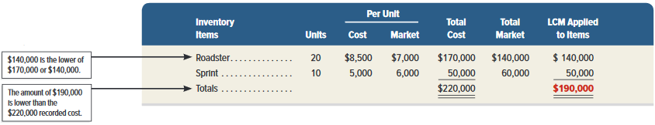
Lower of Cost or Market
Exhibit 6.9
A motor sports retailer has the following items in inventory:
Learning Objective P2: Compute the lower of cost or market amount of inventory
Notes:
When LCM is applied to individual items of inventory, the number of comparisons equals the number of items. For Roadster, $140,000 is the lower of the $160,000 cost and the $140,000 market. For Sprint, $50,000 is the lower of the $50,000 cost and the $60,000 market. This yields a $190,000 reported inventory, computed from $140,000 for Roadster plus $50,000 for Sprint.
Review what you have learned in the following NEED-TO-KNOW Slides.

Slide 45
NEED-TO-KNOW 6-3
A company has the following products in its ending inventory. (a) Compute the lower of cost or market for
its inventory when applied separately to each product. (b) If the LCM amount is less than the recorded cost
of the inventory, then record the December 31 LCM adjustment to the Merchandise Inventory account.
Per Unit
Total
LCM
Units
Cost
Market
Cost
Market
By item
Road bikes
5
$1,000
$800
$5,000
$4,000
$4,000
Mountain bikes
4
500
600
2,000
2,400
2,000
Town bikes
10
400
450
4,000
4,500
4,000
Total
$11,000
$10,000
Date
General Journal
Debit
Credit
Dec. 31
Cost of Goods Sold
1,000
Merchandise Inventory
1,000
Learning Objective P2: Compute the lower of cost or market amount of inventory
Notes:
A company has the following products in its ending inventory. (a) Compute the lower of cost or market for its inventory when applied separately to each product. (b) If the LCM amount is less than the recorded cost of the inventory, then record the December 31 LCM adjustment to the Merchandise Inventory account.
The company has three different products: road bikes, mountain bikes, and town bikes. Each of the five road bikes has a cost $1,000, for a total cost of $5,000. Four mountain bikes at $500 per bike is a total cost of $2,000. And ten town bikes at a cost of $400 per bike is $4,000. The total cost of the inventory is $11,000. Each of the five road bikes has a market value of $800 per bike; the total market value of the road bikes is $4,000. Each of the four mountain bikes has a market value of $600 per bike, for a total of $2,400. And each of the ten town bikes has a market value of $450; a total market value of $4,500.
The December 31 balance sheet will report merchandise inventory at the lower of cost or market, applied to each product. For the road bikes, the LCM is the $4,000 market. For the mountain bikes, the LCM is the $2,000 cost, and for town bikes, the LCM is the cost of $4,000. The total LCM is $10,000. Since this amount is less than cost, we reduce the value of the asset, crediting Merchandise inventory for $1,000, and we debit Cost of goods sold.

Slide 46
A2:
Analyze the effects of inventory errors on current and future financial statements.
Learning Objective

Slide 47
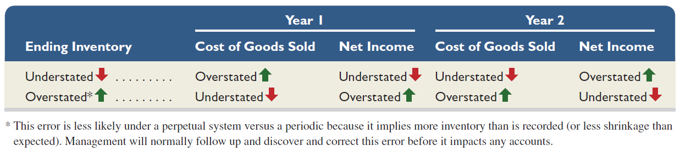
Financial Statement Effects of Inventory Errors
Income Statement Effects
Exhibit 6.10
Learning Objective A2: Analyze the effects of inventory errors on current and future financial statements
Notes:
This slide shows the effects of inventory errors on key amounts in the current and next periods’ income statements. Let’s look at row 1 and year 1. We see that understating ending inventory overstates cost of goods sold. This is clear from the above inventory relation where we subtract a smaller ending inventory amount in computing cost of goods sold. Then a higher cost of goods sold yields a lower income.
To understand year 2 of row 1, remember that an understated ending inventory for year 1 becomes an understated beginning inventory for year 2. Using the inventory relation, we see that if beginning inventory is understated, then cost of goods sold is understated (because we are starting with a smaller amount). A lower cost of goods sold yields a higher income.
Turning to overstatements, let’s look at row 2 and year 1. If ending inventory is overstated, we use the inventory relation to see that cost of goods sold is understated. A lower cost of goods sold yields a higher income. For year 2 of row 2, recall that an overstated ending inventory for year 1 becomes an overstated beginning inventory for year 2. If beginning inventory is overstated, we use the inventory relation to see that cost of goods sold is overstated. A higher cost of goods sold yields a lower income.

Slide 48
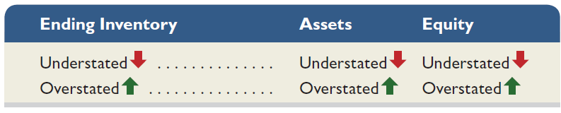
Financial Statement Effects of Inventory Errors
Balance Sheet Effects
Exhibit 6.12
Learning Objective A2: Analyze the effects of inventory errors on current and future financial statements
Notes:
Balance sheet effects of an inventory error can be seen by considering the accounting equation: Assets = Liabilities + Equity. For example, understating ending inventory understates both current and total assets. An understatement in ending inventory also yields an understatement in equity because of the understatement in net income. This slide shows the effects of inventory errors on the current period’s balance sheet amounts. Errors in beginning inventory do not yield misstatements in the end-of-period balance sheet, but they do affect that current period’s income statement.
Review what you have learned in the following NEED-TO-KNOW Slides.

Slide 49
NEED-TO-KNOW 6-4
A company had $10,000 of sales in each of three consecutive years 2015-2017, and it purchased merchan-
dise costing $7,000 in each of those years. It also maintained a $2,000 physical inventory from the beginning
to the end of that three-year period. In accounting for inventory, it made an error at the end of year 2015 that
caused its year-end 2015 inventory to appear on its statements as $1,600 rather than the correct $2,000.
(a) Determine the correct amount of the company’s gross profit in each of the years 2015–2017. (b) Prepare
comparative income statements to show the effect of this error on the company’s cost of goods sold and
gross profit for each of the years 2015–2017
Correct Amounts
Year 2015
Year 2016
Year 2017
Total
Sales
$10,000
$10,000
$10,000
$30,000
Cost of goods sold
Beginning inventory
$2,000
$2,000
$2,000
Cost of purchases
7,000
7,000
7,000
Goods available for sale
9,000
9,000
9,000
Ending inventory
2,000
2,000
2,000
Cost of goods sold
7,000
7,000
7,000
21,000
Gross profit
$3,000
$3,000
$3,000
$9,000
Inventory error
Year 2015
Year 2016
Year 2017
Total
Sales
$10,000
$10,000
$10,000
$30,000
Cost of goods sold
Beginning inventory
$2,000
$1,600
$2,000
Cost of purchases
7,000
7,000
7,000
Goods available for sale
9,000
8,600
9,000
Ending inventory
1,600
2,000
2,000
Cost of goods sold
7,400
6,600
7,000
21,000
Gross profit
$2,600
$3,400
$3,000
$9,000
Learning Objective A2: Analyze the effects of inventory errors on current and future financial statements
Notes:
A company had $10,000 of sales in each of three consecutive years 2015-2017, and it purchased merchandise costing $7,000 in each of those years. It also maintained a $2,000 physical inventory from the beginning to the end of that three-year period. In accounting for inventory, it made an error at the end of year 2015 that caused its year-end 2015 inventory to appear on its statements as $1,600 rather than the correct $2,000. (a) Determine the correct amount of the company’s gross profit in each of the years 2015-2017. (b) Prepare comparative income statements to show the effect of this error on the company’s cost of goods sold and gross profit for each of the years 2015–2017.
In 2015, sales are $10,000. Cost of goods sold is calculated by taking beginning inventory, $2,000, plus purchases of $7,000; total cost of goods available for sale is $9,000. We then subtract the $2,000 ending inventory to calculate the cost of goods sold as $7,000. Gross profit for 2015 is $3,000. These amounts remained constant for 2016 and 2017. Total sales for the three-year period, $30,000, less total cost of goods sold, $21,000, is a total gross profit for the three-year period of $9,000. Next, we're asked to prepare comparative income statements to show the effect of this error on the company's cost of goods sold and gross profit for each of the years. In 2015, total sales is correct. Cost of goods sold: $2,000 plus purchases of $7,000 equals goods available for sale of $9,000. Ending inventory was mistakenly reported as $1,600. Cost of goods sold is $7,400. Gross profit in 2015 is only $2,600. By understating ending inventory, cost of goods sold is overstated by $400. Overstating cost of goods sold understates gross profit.
In 2016, sales are correctly stated at $10,000. The ending inventory balance from 2015 becomes the beginning inventory balance for 2016. We add the purchases of $7,000, to calculate goods available for sale, $8,600. This error does not affect the end-of-year balance in inventory for 2016. Ending inventory is correctly stated at $2,000. Cost of goods sold in 2016 is $6,600. Gross profit is $3,400. Understating beginning inventory will understate cost of goods sold. By understating cost of goods sold, gross profit is overstated.
In 2017, there are no errors. Sales of $10,000 less cost of goods sold, which is correctly stated at $7,000, equals gross profit of $3,000. The total for the three-year period: Total sales of $30,000 less cost of goods sold of $21,000 equals gross profit of $9,000. Inventory errors are said to be self-correcting.

Slide 50
A3:
Assess inventory management using both inventory turnover and days’ sales in inventory.
Learning Objective

Slide 51
Inventory Turnover
Shows how many times a company turns over its inventory during a period. Indicator of how well management is controlling the amount of inventory available.
Inventory
Cost of goods sold
=
turnover
Average inventory
Average Inventory | = | (Beg. Inv. + End Inv.) ÷ 2
Learning Objective A3: Assess inventory management using both inventory turnover and days’ sales in inventory
Notes:
Earlier chapters described two important ratios useful in evaluating a company’s short-term liquidity: current ratio and acid-test ratio. A merchandiser’s ability to pay its short-term obligations also depends on how quickly it sells its merchandise inventory. Inventory turnover, also called merchandise inventory turnover or, simply, turns, is one ratio used to assess this and is calculated as cost of goods sold/average inventory.
This ratio reveals how many times a company turns over (sells) its inventory during a period. If a company’s inventory greatly varies within a year, average inventory amounts can be computed from interim periods such as quarters or months. Users apply inventory turnover to help analyze short-term liquidity and to assess whether management is doing a good job controlling the amount of inventory available. A low ratio compared to that of competitors suggests inefficient use of assets. The company may be holding more inventory than it needs to support its sales volume. Similarly, a very high ratio compared to that of competitors suggests inventory might be too low. This can cause lost sales if customers must back-order merchandise. Inventory turnover has no simple rule except to say a high ratio is preferable provided inventory is adequate to meet demand.

Slide 52
Days’ Sales in Inventory
Reveals how much inventory is available in terms of the number of days’ sales.
Days‘ sales in
Ending inventory
=
×
365
inventory
Cost of goods sold
Learning Objective A3: Assess inventory management using both inventory turnover and days’ sales in inventory
Notes:
To better interpret inventory turnover, many users measure the adequacy of inventory to meet sales demand. Days’ sales in inventory, also called days’ stock on hand, is a ratio that reveals how much inventory is available in terms of the number of days’ sales. It can be interpreted as the number of days one can sell from inventory if no new items are purchased. This ratio is often viewed as a measure of the buffer against out-of-stock inventory and is useful in evaluating liquidity of inventory. It is calculated as ending inventory/cost of goods sold x 365.
Days’ sales in inventory focuses on ending inventory and it estimates how many days it will take to convert inventory at the end of a period into accounts receivable or cash. Days’ sales in inventory focuses on ending inventory whereas inventory turnover focuses on average inventory.

Slide 53
P3 Appendix 6A:
Compute inventory in a periodic system using the methods of specific identification, FIFO, LIFO, and weighted average.
Learning Objective

Slide 54
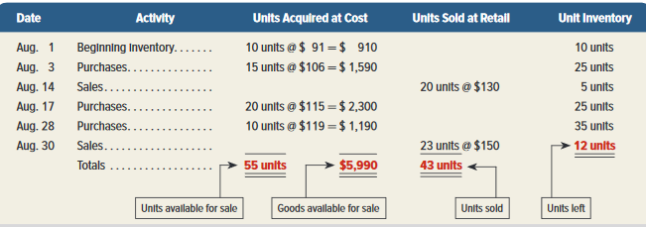
Inventory Costing Illustration
Periodic System
Exhibit 6A.1
Learning Objective P3: Compute inventory in a periodic system using specific identification, FIFO, LIFO and weighted average
Notes:
Take a minute and review this chart. We will use this data throughout our inventory examples so we can compare our results at the end.
The basic aim of the periodic system and the perpetual system is the same: to assign costs to inventory and cost of goods sold. The same four methods are used to assign costs under both systems: specific identification; first-in, first-out; last-in, first-out; and weighted average. The results are the same for both a periodic and perpetual inventory system when using specific identification and FIFO.

Slide 55
Inventory Costing Illustration
Periodic System –
Specification Identification
Total cost of 55 units available for sale |  | $5,990
Cost of goods sold:
Aug 14 (8 @ $91) + (12 @ $106) | $2,000
Aug 30 (2 @ $91) + (3@ $106) + (15@ $115) + (3 @ $119) | 2,582 | 4,582
Ending inventory |  | $1,408
On August 14, Trekking sold 8 bikes costing $91 and 12 bikes costing $106. On August 30, Trekking sold 23 bikes: 2 units costing $91; 3 units costing $106; 15 units costing $115 and 3 units costing $119.
Learning Objective P3: Compute inventory in a periodic system using specific identification, FIFO, LIFO and weighted average
Notes:
First, let’s look at the specific identification method. In this method, we know the specific cost of each unit that is sold. It is most commonly used in businesses that have low sales volume of high dollar items, like car dealerships, exclusive jewelry stores, and custom builders.
On August 1 Trekking has beginning inventory. On August 3, 17 and 28 Trekking purchases inventory. On August 14, it sold 8 bikes that cost $91 each and 12 bikes that cost $106 each. The cost of goods sold for August 14 is $2,000. This is calculated by multiplying the 8 bikes in the first lot by their cost of $91 each and then multiplying 12 bikes in the second lot at $106 each, for a total of $2,000.
On August 30, Trekking sold 23 bikes: 2 that cost $91 each; 3 that cost $106 each; 15 that cost $115 each; and 3 that cost $119 each for a total of $2,582.
Using the specific identification method, the company would report cost of goods sold on its August income statement of $4,582. And, it would report ending inventory of $1,408 on its balance sheet, which is the difference between the total units available for sale and the cost of goods sold.

Slide 56
Inventory Costing Illustration
Periodic System – Specification Identification
Here are the entries to record the purchases and sales. The numbers in red are determined by the cost flow assumption used.
All purchases and sales are made on credit.
The selling price of inventory was as follows:
8/14 $130
8/31 $150
Learning Objective P3: Compute inventory in a periodic system using specific identification, FIFO, LIFO and weighted average
Notes:
Here are the entries to record the purchases and sales discussed previously. All purchases and sales are made on credit.
The selling price of inventory was $130 on August 14 and $150 on August 30.
The numbers in red were determined using the specific identification method. Under the periodic inventory system, Purchases is debited when purchases are made. At the end of the month, Merchandise Inventory is debited for the amount of the ending inventory, $1,408 and Merchandise Inventory is credited for the amount of the beginning inventory of $910. Income Summary is credited for the difference.
Now let’s turn our focus to another and more popular method: FIFO.

Slide 57
Inventory Costing Illustration
Periodic System - FIFO
Total cost of 55 units available for sale |  | $ 5,990
Less ending inventory priced using FIFO:
10 units from Aug 28 purchase at $119 | $ 1,190
2 units from Aug 17 purchase at $115 | 230
Ending inventory |  | 1,420
Cost of goods sold |  | $4,570
During August, Trekking had a total of 55 units available for sale. They had 12 units in ending inventory and sold 43 units. The cost of the 12 bikes in ending inventory will be valued using the most recent purchases since the earlier units are assumed sold under FIFO.
Learning Objective P3: Compute inventory in a periodic system using specific identification, FIFO, LIFO and weighted average
Notes:
The first-in, first-out method is abbreviated as FIFO and pronounced as Fifo. FIFO assumes that inventory is sold in the order acquired. We assign the older, earlier costs to the units sold. That leaves the more recent costs to be used to value ending inventory.
During August, Trekking had a total of 55 units available for sale. They had 12 units left in ending inventory and sold 43 units. Under FIFO, the cost of the 12 bikes in ending inventory will be valued using the most recent purchases since the earlier units are assumed sold under FIFO.

Slide 58
Inventory Costing Illustration
Periodic System - LIFO
Total cost of 55 units available for sale |  | $ 5,990
Less ending inventory priced using LIFO:
10 units from Aug 1 beginning inventory $91 | $ 910
2 units from Aug 3 purchase at $106 | 212
Ending inventory |  | 1,122
Cost of goods sold |  | $ 4,868
During August, Trekking had a total of 55 units available for sale. They had 12 units in ending inventory and sold 43 units. The cost of the 12 bikes in ending inventory will be valued using the earliest purchases since the most recently purchased units are assumed sold under LIFO.
Learning Objective P3: Compute inventory in a periodic system using specific identification, FIFO, LIFO and weighted average
Notes:
The last-in, first-out method is abbreviated as LIFO and pronounced as Lifo. LIFO assumes that the most recent purchases are sold first. That leaves the earlier costs to be used to value ending inventory.
During August, Trekking had a total of 55 units available for sale. They had 12 units left in ending inventory and sold 43 units. Under LIFO, the cost of the 12 bikes in ending inventory will be valued using the earlier purchases beginning with the beginning inventory. The units sold are assumed to be the most recently purchased units.

Slide 59
Inventory Costing Illustration
Periodic System – Weighted Average
When a unit is sold, the average cost of each unit in inventory is assigned to cost of goods sold.
Learning Objective P3: Compute inventory in a periodic system using specific identification, FIFO, LIFO and weighted average
Notes:
When using weighted average, we assign an average cost per unit of the goods available for sale to cost of goods sold. The average cost per unit is determined by dividing the cost of goods available for sale by the units on hand.

Slide 60
Weighted Average – Determining
Average Cost Per Unit
10 units @ $91 | $ 910
15 units @ 106 | 1,590
20 units @ 115 | 2,300
10 units @ 119 | 1,190
55 | $5,990
$5,990 / 55 units | $ 108.91 weighted avg. cost per unit
Total cost of 55 units available for sale | $5,990
Less ending inventory 12 units @ $108.91 | $1,307
Cost of goods sold | $4,683 (43 units at $108.91 each)
Step 1
Step 2
Step 3
Learning Objective P3: Compute inventory in a periodic system using specific identification, FIFO, LIFO and weighted average
Notes:
There are three steps to computing the cost of goods sold using the weighted average method. Step 1 is to determine the total units and total cost of goods sold. Trekking has 55 units available for sale at a total cost of $5,990. Step 2 is to compute the weighted average cost per unit of the items in inventory. We do this by dividing the cost of goods available for sale of $5,990 by the total units available for sale of 55. The average cost per unit is $108.91 . In Step 3, we use the weighted average cost per unit to assign costs to ending inventory and to units sold.
Review what you have learned in the following NEED-TO-KNOW Slides.

Slide 61
NEED-TO-KNOW 6-7
A company reported the following December purchases and sales data for its only product.
Date
Activities
Units Acquired at Cost
Units Sold at Retail
Dec. 01
Beginning inventory
5 units @ $3.00 = $15.00
Dec. 08
Purchase
10 units @ $4.50 = $45.00
Dec. 09
Sales
8 units @ $7.00
Dec. 19
Purchase
13 units @ $5.00 = $65.00
Dec. 24
Sales
18 units @ $8.00
Dec. 30
Purchase
8 units @ $5.30 = $42.40
36 units
$167.40
26 units
The company uses a periodic inventory system. Determine the cost assigned to ending inventory and
to cost of goods sold using (a) specific identification, (b) FIFO, (c) LIFO, and (d) weighted average.
(Round per unit costs and inventory amounts to cents.) For specific identification, ending inventory
consists of 10 units, where eight are from the December 30 purchase and two are from the December
8 purchase.
Learning Objective P3: Compute inventory in a periodic system using specific identification, FIFO, LIFO and weighted average
Notes:
A company reported the following December purchases and sales data for its only product. The company uses a periodic inventory system. Determine the cost assigned to ending inventory and to cost of goods sold using (a) specific identification, (b) FIFO, (c) LIFO, and (d) weighted average.

Slide 62
NEED-TO-KNOW 6-7
A company reported the following December purchases and sales data for its only product.
Date
Activities
Units Acquired at Cost
Units Sold at Retail
Dec. 01
Beginning inventory
5 units @ $3.00 = $15.00
Dec. 08
Purchase
10 units @ $4.50 = $45.00
Dec. 09
Sales
8 units @ $7.00
Dec. 19
Purchase
13 units @ $5.00 = $65.00
Dec. 24
Sales
18 units @ $8.00
Dec. 30
Purchase
8 units @ $5.30 = $42.40
36 units
$167.40
26 units
The company uses a periodic inventory system. Determine the cost assigned to ending inventory and
to cost of goods sold using (a) specific identification, (b) FIFO, (c) LIFO, and (d) weighted average.
(Round per unit costs and inventory amounts to cents.) For specific identification, ending inventory
consists of 10 units, where eight are from the December 30 purchase and two are from the December
8 purchase.
Regardless of the method used, the cost of 26 units are included in Cost of Goods Sold, and the cost of 10 units are included in Ending Inventory
Learning Objective P3: Compute inventory in a periodic system using specific identification, FIFO, LIFO and weighted average
Notes:
Regardless of the method used, the cost of 26 units are included in cost of goods sold, and the cost of ten units are included in ending inventory, (36 units available - 26 units sold).

Slide 63
NEED-TO-KNOW 6-7 SPECIFIC IDENTIFICATION
A company reported the following December purchases and sales data for its only product.
Date
Activities
Units Acquired at Cost
Units Sold at Retail
Dec. 01
Beginning inventory
5 units @ $3.00 = $15.00
Dec. 08
Purchase
10 units @ $4.50 = $45.00
Dec. 09
Sales
8 units @ $7.00
Dec. 19
Purchase
13 units @ $5.00 = $65.00
Dec. 24
Sales
18 units @ $8.00
Dec. 30
Purchase
8 units @ $5.30 = $42.40
36 units
$167.40
26 units
The company uses a periodic inventory system. Determine the cost assigned to ending inventory and
to cost of goods sold using (a) specific identification, (b) FIFO, (c) LIFO, and (d) weighted average.
(Round per unit costs and inventory amounts to cents.) For specific identification, ending inventory
consists of 10 units, where 8 are from the December 30 purchase and 2 are from the December
8 purchase.
Specific Identification Method
Not an inventory assumption - Actual
Cost of Goods Sold represents the actual cost of the units selected by the customer.
Ending Inventory represents the actual cost of the units that remain in ending inventory.
Learning Objective P3: Compute inventory in a periodic system using specific identification, FIFO, LIFO and weighted average
Notes:
The specific identification method is not an inventory assumption; it's based on the actual units. Cost of goods sold represents the actual cost of the units selected by the customer, and ending inventory represents the actual cost of the units that remain in ending inventory.

Slide 64
NEED-TO-KNOW 6-7 SPECIFIC IDENTIFICATION SOLUTION
Date
Activities
Units Acquired at Cost
Units Sold at Retail
Dec. 01
Beginning inventory
5 units @ $3.00 = $15.00
Dec. 08
Purchase
10 units @ $4.50 = $45.00
Dec. 09
Sales
8 units @ $7.00
Dec. 19
Purchase
13 units @ $5.00 = $65.00
Dec. 24
Sales
18 units @ $8.00
Dec. 30
Purchase
8 units @ $5.30 = $42.40
36 units
$167.40
26 units
Ending inventory consists of 10 units, where eight are from the December 30 purchase and two are from the December 8 purchase.
Specific Identification – Cost of exact units sold are expensed as Cost of Goods Sold.
Date
Activities
Units Acquired at Cost
Cost of Goods Sold
Cost of Ending Inventory
Dec. 01
Beginning inventory
5 @ $3.00 = $15.00
5 @ $3.00 = $15.00
Dec. 08
Purchase
10 @ $4.50 = $45.00
8 @ $4.50 = $36.00
2 @ $4.50 = $9.00
Dec. 19
Purchase
13 @ $5.00 = $65.00
13 @ $5.00 = $65.00
Dec. 30
Purchase
8 @ $5.30 = $42.40
8 @ $5.30 = $42.40
36 units
$167.40
26 units
$116.00
10 units
$51.40
Learning Objective P3: Compute inventory in a periodic system using specific identification, FIFO, LIFO and weighted average
Notes:
We're told that ending inventory consists of ten units; where eight are from the December 30 purchase, and two were from the December 8 purchase. The eight units from the December 30 purchase were acquired at a cost of $5.30 per unit. The two units purchased on December 8 were acquired at a cost of $4.50 per unit. The total cost of ending inventory is $51.40. There were 36 units available for sale, at a total cost of $167.40. Since ten units, valued at a total of $51.40, remain in ending inventory, the remaining 26 units, at a total cost of $116.00, have been sold.
Cost of goods sold consists of the five units from the beginning inventory, plus eight of the ten units purchased on December 8, plus all 13 units purchased on December 19, and none of the units from December 30. Total cost of goods sold is $116.00. A periodic inventory system calculates cost of goods sold at the end of the period.

Slide 65
NEED-TO-KNOW 6-7 FIFO SOLUTION
Date
Activities
Units Acquired at Cost
Units Sold at Retail
Dec. 01
Beginning inventory
5 units @ $3.00 = $15.00
Dec. 08
Purchase
10 units @ $4.50 = $45.00
Dec. 09
Sales
8 units @ $7.00
Dec. 19
Purchase
13 units @ $5.00 = $65.00
Dec. 24
Sales
18 units @ $8.00
Dec. 30
Purchase
8 units @ $5.30 = $42.40
36 units
$167.40
26 units
Periodic FIFO – Cost of Goods Sold is calculated at the end of the period. The first items in are the first items out – expensed as Cost of Goods Sold.
Date
Activities
Units Acquired at Cost
Cost of Goods Sold
Cost of Ending Inventory
Dec. 01
Beginning inventory
5 @ $3.00 = $15.00
5 @ $3.00 = $15.00
Dec. 08
Purchase
10 @ $4.50 = $45.00
10 @ $4.50 = $45.00
Dec. 19
Purchase
13 @ $5.00 = $65.00
11 @ $5.00 = $55.00
2 @ $5.00 = $10.00
Dec. 30
Purchase
8 @ $5.30 = $42.40
8 @ $5.30 = $42.40
36 units
$167.40
26 units
$115.00
10 units
$52.40
Learning Objective P3: Compute inventory in a periodic system using specific identification, FIFO, LIFO and weighted average
Notes:
Periodic FIFO assumes that the first items in are the first items out, expensed as cost of goods sold. We still have 26 units sold and ten units in ending inventory. Under FIFO, we assume that the first 26 units in the inventory database are the first 26 units sold: five units from beginning inventory, plus ten units from the December 8 purchase, is a total of 15 units plus 11 units from the December 9 purchase, is a total of 26 units. The cost of the 26 units is $115.00. The remaining two units from the December 19 purchase, and all eight units from the December 30 purchase are still in ending inventory; ten units at a total cost of $52.40.

Slide 66
NEED-TO-KNOW 6-7 LIFO SOLUTION
Date
Activities
Units Acquired at Cost
Units Sold at Retail
Dec. 01
Beginning inventory
5 units @ $3.00 = $15.00
Dec. 08
Purchase
10 units @ $4.50 = $45.00
Dec. 09
Sales
8 units @ $7.00
Dec. 19
Purchase
13 units @ $5.00 = $65.00
Dec. 24
Sales
18 units @ $8.00
Dec. 30
Purchase
8 units @ $5.30 = $42.40
36 units
$167.40
26 units
Periodic LIFO – Cost of Goods Sold is calculated at the end of the period. The last items in are the first items out – expensed as Cost of Goods Sold.
Date
Activities
Units Acquired at Cost
Cost of Goods Sold
Cost of Ending Inventory
Dec. 01
Beginning inventory
5 @ $3.00 = $15.00
5 @ $3.00 = $15.00
Dec. 08
Purchase
10 @ $4.50 = $45.00
5 @ $4.50 = $22.50
5 @ $4.50 = $22.50
Dec. 19
Purchase
13 @ $5.00 = $65.00
13 @ $5.00 = $55.00
Dec. 30
Purchase
8 @ $5.30 = $42.40
8 @ $5.30 = $42.40
36 units
$167.40
26 units
$129.90
10 units
$37.50
Learning Objective P3: Compute inventory in a periodic system using specific identification, FIFO, LIFO and weighted average
Notes:
Periodic LIFO also calculates cost of goods sold at the end of the period. It assumes that the last items in are the first items out, expensed as cost of goods sold. 26 units are sold and ten units remain in ending inventory. The last 26 units to come in are the eight units from the December 30 purchase, plus 13 units from the December 19 purchase (a subtotal of 21 units), which means five of the units from the December 8 purchase were sold. The total cost of the 26 units is $129.90. The remaining five units from the December 8 purchase, and all five units from the beginning inventory remain in ending inventory, at a total cost of $37.50.

Slide 67
NEED-TO-KNOW 6-7 WEIGHTED AVERAGE SOLUTION
Date
Activities
Units Acquired at Cost
Units Sold at Retail
Dec. 01
Beginning inventory
5 units @ $3.00 = $15.00
Dec. 08
Purchase
10 units @ $4.50 = $45.00
Dec. 09
Sales
8 units @ $7.00
Dec. 19
Purchase
13 units @ $5.00 = $65.00
Dec. 24
Sales
18 units @ $8.00
Dec. 30
Purchase
8 units @ $5.30 = $42.40
36 units
$167.40
26 units
Weighted Average – Cost of Goods Sold is calculated at the end of the period. Each unit sold, and each unit in ending inventory is assigned the same cost per unit: the average cost of units available for sale.
Date
Activities
Units Acquired at Cost
Cost of Goods Sold
Cost of Ending Inventory
Dec. 01
Beginning inventory
5 @ $3.00 = $15.00
Dec. 08
Purchase
10 @ $4.50 = $45.00
Dec. 19
Purchase
13 @ $5.00 = $65.00
Dec. 30
Purchase
8 @ $5.30 = $42.40
36 units
$167.40
26 @ $4.65 = $120.90
26 units
10 @ $4.65 = $46.50
10 units
Cost of goods available for sale
Number of units available for sale
$167.40
$4.65 per unit
36 units
Learning Objective P3: Compute inventory in a periodic system using specific identification, FIFO, LIFO and weighted average
Notes:
The final method is called "weighted average.” Since it's a periodic method, cost of goods sold is calculated at the end of the period. The weighted average method assumes that each unit sold and each unit in ending inventory is assigned the same cost per unit; the average cost of units available for sale. To calculate the average cost, we take the total cost of goods available for sale, and divide by the number of units available for sale. $167.40 divided by 36 units is an average cost of $4.65 per unit. 26 units multiplied by $4.65 per unit is cost of goods sold of $120.90. Ten units in ending inventory at a cost of $4.65 per unit is $46.50.

Slide 68
P4 Appendix 6B:
Apply both the retail inventory and gross profit methods to estimate inventory.
Learning Objective

Slide 69
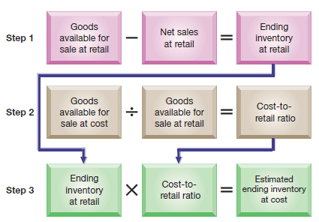
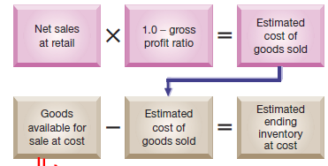
Appendix 6B:
Inventory Estimation Methods
Inventory sometimes requires estimation for interim statements or if some casualty such as fire or flood makes taking a physical count impossible.
Retail Inventory Method
Gross Profit Method
Exhibits
6B.1 & 6B3
69
Learning Objective P4: Apply both the retail inventory and gross profit methods to estimate inventory
Notes:
Inventory sometimes requires estimation for two reasons. First, companies often require interim statements (financial statements prepared for periods of less than one year), but they only annually take a physical count of inventory. Second, companies may require an inventory estimate if some casualty such as fire or flood makes taking a physical count impossible. Estimates are usually only required for companies that use the periodic system. Companies using a perpetual system would presumably have updated inventory data.
This slide summarizes two methods to estimate inventory: the retail inventory method and the gross profit method.
Review what you have learned in the following NEED-TO-KNOW Slide.

Slide 70
NEED-TO-KNOW 6-8
Using the retail method and the following data, estimate the cost of ending inventory.
Cost
Retail
Beginning inventory
$324,000
$530,000
Purchases
195,000
335,000
Sales
320,000
Cost
Retail
Beginning inventory
$324,000
$530,000
Purchases
195,000
335,000
Total merchandise available for sale
$519,000
$865,000
Less: Sales
(320,000)
Ending inventory priced at retail
$545,000
Cost ratio
0.60
Ending inventory at cost
$327,000
Cost-to-retail ratio
Cost of goods available for sale
$519,000
0.60
Retail of goods available for sale
$865,000
Learning Objective P4: Apply both the retail inventory and gross profit methods to estimate inventory
Notes:
Using the retail method in the following data, estimate the cost of ending inventory. Sometimes, it's either not possible or not practical to take an actual inventory count. Instead, we can estimate the cost of ending inventory using the relationship between cost and retail. Beginning inventory at cost is $324,000. This inventory has a retail value of $530,000.
We add the purchases; $195,000 at cost, and $335,000 at retail, to calculate the total merchandise available for sale. At cost it is, $519,000; and at retail; $865,000. When we subtract sales, which are always at retail, ending inventory priced at retail is $545,000. To convert the ending inventory at retail back to cost, we use the cost-to-retail ratio; the cost of goods available for sale divided by the retail value of goods available for sale. $519,000 divided by $865,000 is 60%. When we multiply the ending inventory at retail, $545,000, by the cost ratio of 0.60, the ending inventory cost is estimated to be $327,000.

Slide 71
End of Chapter 6

