Slide 1
Analyzing and Recording Transactions
Chapter 2
Wild, Shaw, and Chiappetta
Fundamental Accounting Principles
23rd Edition
Copyright © 2017 McGraw-Hill Education. All rights reserved. No reproduction or distribution without the prior written consent of McGraw-Hill Education

Slide 2
Chapter 2 Learning Objectives
CONCEPTUAL
C1 Explain the steps in processing transactions and the role of source documents.
C2 Describe an account and its use in recording transactions.
C3 Describe a ledger and a chart of accounts.
C4 Define debits and credits and explain double-entry accounting.
ANALYTICAL
A1 Analyze the impact of transactions on accounts and financial statements.
A2 Compute the debt ratio and describe its use in analyzing financial condition.
PROCEDURAL
P1 Record transactions in a journal and post entries to a ledger.
P2 Prepare and explain the use of a trial balance.
P3 Prepare financial statements from business transactions.
2

Slide 3
C1: Explain the steps in processing transactions and the role of source documents.
Learning Objective

Slide 4
System of Accounts
Business transactions and events are the starting points of financial statements. Process from transactions to financial statements is as follows:
Identify each transaction and event from source documents.
Analyze each transaction and event using the accounting equation.
Record relevant transactions and events in a journal.
Post journal information to ledger accounts.
Prepare and analyze the trial balance and financial statements.
Learning Objective C1: Explain the steps in processing transactions and the role of source documents.
Notes:
Business transactions and events are the starting points of financial statements. The process to get from transactions and events to financial statements includes the following:
Identify each transaction and event from source documents.
Analyze each transaction and event using the accounting equation.
Record relevant transactions and events in a journal.
Post journal information to ledger accounts.
Prepare and analyze the trial balance and financial statements.

Slide 5
Source Documents
Checks
Bills from Suppliers
Purchase Orders
Employee Earnings Records
Bank Statements
Sales Tickets
Learning Objective -C1: Explain the steps in processing transactions and the role of source documents.
Notes:
Source documents identify and describe transactions and events entering the accounting system. They can be in either hard copy or electronic form. Examples are sales tickets, checks, purchase orders, bills from suppliers, employee earnings records, and bank statements.
Source documents, especially if obtained from outside the organization, provide objective and reliable evidence about transactions and events and their amounts.

Slide 6
C2: Describe an account and its use in recording transactions.
Learning Objective

Slide 7
The Account and Its Analysis
An account is a record of increases and decreases in a specific asset, liability, equity, revenue, or expense.
The general ledger is a record of all accounts used by the company.
Learning Objective C2: Describe an account and its use in recording transactions.
Notes:
An account is a record of increases and decreases in a specific asset, liability, equity, revenue, or expense. The general ledger is a record of all accounts used by the company.

Slide 8
The Account and Its Analysis
Exhibit 2.1
Learning Objective C2: Describe an account and its use in recording transactions.
Notes:
Recall the basic accounting equation – Assets are equal to Liabilities plus Equity. The equity section is composed of the owner’s capital account and the owner’s withdrawal account as well as revenues and expenses.
Asset accounts – Assets are resources owned or controlled by a company and that have expected future benefits. Most accounting systems include (at a minimum) separate accounts for the assets described, such as cash, accounts receivable, note receivable, and prepaid accounts.
Liability accounts – Liabilities are claims (by creditors) against assets, which means they are obligations to transfer assets or provide products or services to other entities. Creditors often use a balance sheet to help decide whether to loan money to a company. A loan is less risky if the borrower’s liabilities are small in comparison to assets because this means there are more resources than claims on resources.
Equity Accounts – The owner’s claim on a company’s assets is called equity or owner’s equity. Equity is the owner’s residual interest in the assets of a business after deducting liabilities.

Slide 9
Asset Accounts
Cash
Land
Accounts Receivable
Asset Accounts
Buildings
Notes Receivable
Equipment
Prepaid Accounts
Supplies
Learning Objective C2: Describe an account and its use in recording transactions.
Notes:
Here is a listing of common asset accounts we are likely to find in all businesses.
Cash reflects a company’s cash balances. It includes money and any funds that a bank accepts for deposit (coins, checks, money orders, and checking account balances).
Accounts Receivable are held by a seller and refer to promises of payment from customers to sellers. These transactions are often called credit sales or sales on account (or on credit).
Prepaid accounts, also called prepaid expenses, are assets that represent prepayments of future expenses (expenses expected to be incurred in one or more future accounting periods). When the expenses are later incurred, the amounts in prepaid accounts are transferred to expense accounts. Examples include prepaid insurance, prepaid rent, and prepaid services.

Slide 10
Liability Accounts
Accounts Payable
Notes Payable
Liability Accounts
Accrued Liabilities
Unearned Revenue
Learning Objective C2: Describe an account and its use in recording transactions.
Notes:
Liabilities are claims by creditors against assets, which means they are obligations to transfer assets or provide products or services to others. Creditors are individuals and organizations that have rights to receive payments from a company.
This is a listing of common liability accounts we are likely to see in the general ledger. An unearned revenue is one in which the cash has been received but the product or service has not been delivered. If you subscribe to a magazine, you generally pay a one-year subscription in advance. For the publishing company, cash is received but nothing has been done to earn the revenue. As the magazine is delivered to you, the publishing company recognizes a portion of the money received as revenue. At the end of the year, all the revenue will be earned and the liability no longer exists.

Slide 11
Equity Accounts
-
Owner’s Withdrawals
+
Owner’s Capital
Equity Accounts
+
Revenues
-
Expenses
Learning Objective C2: Describe an account and its use in recording transactions.
Notes:
The owner’s claim on a company’s assets is called equity. Equity is the owner’s residual interest in the assets of a business after deducting liabilities. Equity is impacted by four types of accounts:
Owner’s capital
Owner’s withdrawals
Revenues
Expenses

Slide 12
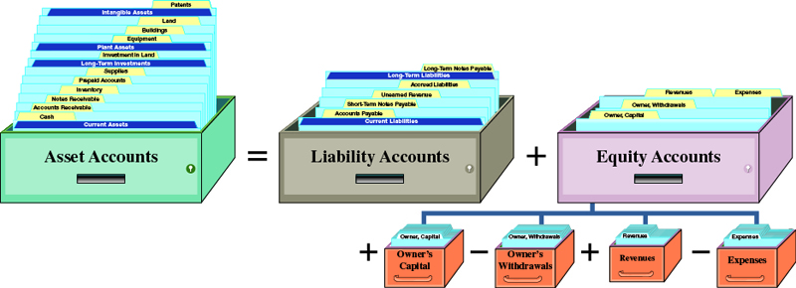
The Account and Its Analysis
Revenues and owner’s contributions increase equity.
Expenses and owner’s withdrawals decrease equity.
Exhibit 2.2
Learning Objective C2: Describe an account and its use in recording transactions.
Notes:
Do you remember the expanded accounting equation we used to record transactions in Chapter 1? Remember that revenues increase the equity side of the equation and expenses decrease equity. In addition, owner’s contributions increase equity and owner’s withdrawals decrease equity.
Review what you have learned in the following NEED-TO-KNOW Slide.

Slide 13
C3: Describe a ledger and chart of accounts.
Learning Objective

Slide 14
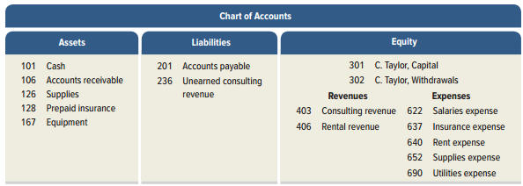
Ledger and Chart of Accounts
The ledger is a collection of all accounts for an accounting system. A company’s size and diversity of operations affect the number of accounts needed.
The chart of accounts is a list of all accounts and includes an identifying number for each account.
Exhibit 2.4
Learning Objective C3: Describe a ledger and chart of accounts .
Notes:
The ledger is a collection of all accounts and their balances for an accounting system. A company’s size and diversity of operations affect the number of accounts needed.
A chart of accounts is a listing of all accounts in the ledger and each account includes an identifying number. Notice that all assets accounts begin with an account number of one, all liabilities with two, equities with three, revenues with four, and expenses with six.
Review what you have learned in the following NEED-TO-KNOW Slide.

Slide 15
NEED-TO-KNOW 2-1
Classify each of the following as assets (A), liabilities (L), or equity (EQ).
1)
(A) Asset
Prepaid Rent
2)
(EQ) Equity
Owner, Capital
3)
(A) Asset
Note Receivable
4)
(L) Liability
Accounts Payable
5)
(A) Asset
Accounts Receivable
6)
(A) Asset
Equipment
7)
(L) Liability
Interest Payable
8)
(L) Liability
Unearned Revenue
9)
(A) Asset
Land
10)
(A) Asset
Prepaid Insurance
11)
(L) Liability
Wages Payable
12)
(L) Liability
Rent Payable
Key words to look for in account titles:
Prepaid
Always an asset
Receivable
Always an asset
Payable
Always a liability
Unearned
Always a liability
Learning Objective C1: Explain the steps in processing transactions and the role of source documents.
Learning Objective C2: Describe an account and its use in recording transactions.
Learning Objective C3: Describe a ledger and chart of accounts .
Notes:
Classify each of the following as assets (A), liabilities (L), or equity (EQ). There are some key words to look for in account titles to be able to determine the type of account involved. Whenever you see the word "prepaid" in an account title, it's always an asset. Prepaid rent is an asset. Capital is an equity account; it represents the investment by our owner. Another key word is "receivable.” Whenever you see the word "receivable" in an account title, it's always an asset. Notes receivable is an asset. Whenever you see the word "payable,” it always indicates a liability account. Accounts payable is a liability. Accounts receivable is an asset, just like Notes receivable. Equipment is also an asset. Interest payable, like Accounts payable, is a liability. Another key word to look for is the word "unearned.” "Unearned" always indicates a liability account; it's a liability that will be worked off; rather than paid off. So even though you see the word revenue, and might think that it's an equity account, whenever you see the word "unearned" it's always a liability. Land is an asset. And Prepaid insurance, like Prepaid rent, is also an asset.

Slide 16
C4: Define debits and credits and explain double-entry accounting.
Learning Objective

Slide 17
Debits and Credits
A T-account represents a ledger account and is used to depict the effects of one or more transactions.
Exhibit 2.5
Learning Objective C4: Define debits and credits and explain double-entry accounting.
Notes:
Accountants often use a T-account to represent a general ledger account. It is a quick way to analyze transactions before we enter the information in the journal. The account title is entered on the top of the T-account. The left side of a T-account is always called the debit side, and the right side is always called the credit side. This terminology comes from the time when the first double-entry system was developed. We still use the terms as a convention. The term debit or credit, by itself, does not mean increase or decrease. Whether a debit or a credit is an increase or decrease depends on the account. The difference between total debits and total credits for an account, is the account balance. When the sum of the debits exceed the sum of the credits in a particular account, the account has a debit balance.

Slide 18
Double-Entry Accounting
=
+
Assets
Liabilities
Equity
Exhibit 2.6
Learning Objective C4: Define debits and credits and explain double-entry accounting.
Notes:
Double-entry accounting requires that for each transaction:
● At least two accounts are involved, with at least one debit and one credit.
● The total amount debited must equal the total amount credited.
● The accounting equation must not be violated.
After we decide on the terms to use for the left and right side of a ledger account, we must establish the mathematics of the double-entry system. Liabilities and equity have the opposite sign of assets. If we were to move the liabilities to the left side of the equation, it would read assets minus liabilities equal equity. As a convention of double-entry accounting we have decided that a debit, or left side, to an asset account will represent an increase in the asset account balance. Once this decision is made, all the remaining math is determined. Because liabilities and equity have the opposite sign of assets, a debit to a liability or equity account means a decrease and a credit means an increase. Instead of using the terms increase and decrease, we use the terms debit and credit. It is important to remember whether we are talking about an asset, liability, or equity account for the meaning of a debit or a credit.
Another method for working with debits and credits is to use the accounting equation as a guide. Assets are on the left hand side of the accounting equation. Therefore all increases to assets are on the debit (left) side of the T-account. Liabilities and equity accounts are on the right hand side of the accounting equation. Therefore all increases to liabilities and equity accounts are on the credit (right) side of the T-account.
It will take you a short while to become accustomed to using the terms debit and credit, but with practice you will master the concept easily.

Slide 19
Double-Entry Accounting
Here is the expanded accounting equation showing the equity section.
Exhibit 2.7
Learning Objective C4: Define debits and credits and explain double-entry accounting.
Notes:
Here is the expanded accounting equation showing the equity section. Because revenues increase equity, a revenue account must be recorded just like the Owner’s Capital account. A credit is an increase in revenues and a debit is an increase in expenses. The Capital and revenue accounts are both increased with a credit and decreased with a debit. Owner's Withdrawals and expenses have an opposite sign, so these accounts are increased with a debit and decreased with a credit.

Slide 20
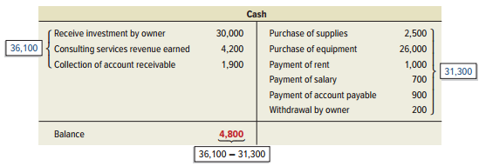
Double-Entry Accounting
An account balance is the difference between the increases and decreases in an account. Notice the T-Account.
Exhibit 2.8
Learning Objective C4: Define debits and credits and explain double-entry accounting.
Notes:
We determined the balance in the accounts in the last chapter, but in this chapter we will look at a more comprehensive way to determine an account balance.
The cash account is an asset, so increases, or receipts, are shown on the debit, or left side, and decreases, or payments, are shown on the credit side, or right side. To determine if an account has a debit or credit balance, we total the right and left sides and place the balance on the larger side. In this example, our increases in cash amount to $36,100 and the decreases total $31,300 so the cash account has a debit, or positive balance of $4,800.
Review what you have learned in the following NEED-TO-KNOW Slide.

Slide 21
NEED-TO-KNOW 2-2
Identify the normal balance (debit [Dr] or credit [Cr]) for each of the following accounts.
1)
Dr. Debit
Prepaid Rent
7)
Cr. Credit
Interest Payable
2)
Cr. Credit
Owner, Capital
8)
Cr. Credit
Unearned Revenue
3)
Dr. Debit
Note Receivable
9)
Dr. Debit
Land
4)
Cr. Credit
Accounts Payable
10)
Dr. Debit
Prepaid Insurance
5)
Dr. Debit
Accounts Receivable
11)
Dr. Debit
Owner, Withdrawals
6)
Dr. Debit
Equipment
12)
Dr. Debit
Supplies
Assets
=
Liabilities
+
Equity
Increase
Decrease
Decrease
Increase
Decrease
Increase
Debits
Credits
Debits
Credits
Debits
Credits
Withdrawals
Investments
Normal
Normal
Expenses
Revenues
Owner, Withdrawals
Owner, Capital
↓ Equity
↑ Equity
Withdrawals
Investments
Normal
Normal
Expenses
Revenues
↓ Equity
↑ Equity
Expenses
Revenues
Normal
Normal
Learning Objective C4: Define debits and credits and explain double-entry accounting.
Notes:
Identify the normal balance (debit [Dr] or credit [Cr]) for each of the following accounts. Well, before we discuss normal balances, let's review the rules for debits and credits. We begin with the accounting equation: Assets = Liabilities + Equity. Then we turn each of the three components into a T-account. An account increases based on its location in the accounting equation.
Assets are on the left-hand side of the equation; they increase on the left. Liabilities and equity are both on the right-hand side of the equation; they increase on the right. And it stands to reason then, that they'll decrease on the opposite side. Assets decrease on the right and liabilities and equity decrease on the left. The word debit simply means left. The word credit means "right.” So assets increase on the left-hand side; they increase with debits and decrease with credits. Liabilities increase on the right; liabilities increase with credits, and they decrease on the left, with debits. Equity increases on the right, with credits, and decreases on the left, with debits. The normal ending balance for an account is the same side as its increase.
Assets are on the left-hand side of the equation; they increase on the left, with debits, and have a normal ending debit balance. Liabilities are on the right-hand side of the equation; they increase on the right, with credits, and have a normal ending credit balance. So far, so easy! But remember, equity doesn't exist as a single account. Instead, there are four subsets of equity. Equity increases for owner investments and revenues, and is decreased for owner withdrawals and expenses. When we expand our accounting equation, equity has four separate T-accounts. The Owner, Capital account will always increase equity. Therefore, the capital account will always have a normal credit balance. Revenues will always increase equity. Therefore revenues will always (and only) have normal credit balances. Owner withdrawals will always decrease equity. Therefore, the Owner, Withdrawal account has a normal debit balance. And expenses will always decrease equity. Expenses will always (and only) have ending debit balances. Prepaid rent is an asset. Assets sit on the left-hand side of the equation, and have a normal balance on the left, a debit balance.
Owner, Capital is one of the four subsets of equity. Since its purpose is to record an increase to equity, it has a normal credit balance. Notes receivable is an asset. Assets sit on the left-hand side of the equation, and have a normal ending balance on the left, a debit. Accounts payable is a liability. Liabilities are on the right-hand side of the equation, and have normal ending balances on the right, credits. Accounts receivable, like prepaid rent and notes receivable, is another asset account. All assets have normal ending debit balances. The same is true for equipment; all assets are on the left-hand side of the equation. Interest payable and Unearned revenue are both liability accounts. Liabilities are on the right-hand side of the equation, and have normal ending balances on the right, credits. Land and Prepaid Insurance are both asset accounts. Assets are on the left-hand side of the equation; their normal ending balance is on the left, debits. Owner, Withdrawals decrease equity. Equity decreases on the left, with debits. The Withdrawals account has a normal debit balance.

Slide 22
P1: Record transactions in a journal and post entries to a ledger.
Learning Objective

Slide 23
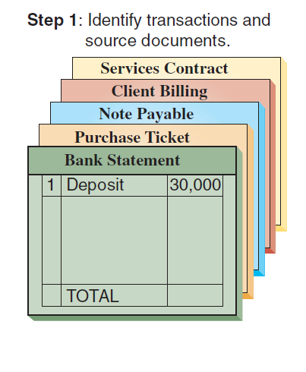
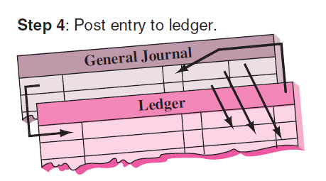
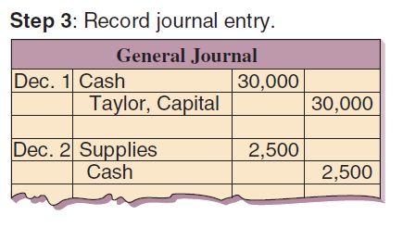
Journalizing and Posting Transactions
Exhibit 2.9
Learning Objective P1: Record transactions in a journal and post entries to a ledger.
Notes:
In the accounting process, you first analyze a transaction by looking at proper source documentation. Next, we apply the rules of double-entry accounting and record a general journal entry. The general journal is a chronological listing of the transactions. At the end of the accounting period, we post the information from the general journal to the proper general ledger account. The general ledger groups all transactions that impact a particular account. That is, all the transactions that increase or decrease the cash account are posted to the general ledger cash account.

Slide 24
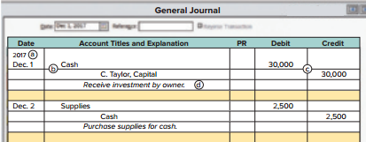
Journalizing Transactions
Exhibit 2.10
Transaction Date
Titles of Affected Accounts
Transaction explanation
Dollar amount of debits and credits
Learning Objective P1: Record transactions in a journal and post entries to a ledger.
Notes:
Here is an example of the proper recording of a general journal transaction. We have seen a similar transaction before. In this case, the owner of the business contributes $30,000 cash to start the business. Let’s see how we get the various pieces.
The transaction occurred on December 1, 2017. The date is important when recording general journal transactions and is recorded on the left side of the journal.
Next we identify the accounts affected by the transactions. The cash account is an asset that has increased. We show increases in asset accounts with a debit to that account. The C. Taylor, Capital account also increased and we show increases in equity accounts with a credit. Debits are always listed first in the journal followed by credits that are slightly indented below the debits.
The dollar amount is placed in the appropriate debit or credit column. In this case, the cash account was debited for $30,000, so we place that amount in the debit column.
Finally, we prepare a brief description of the transaction so that other people who view our work will understand the nature of the transaction. This explanation is indented about as far as the credited account titles to avoid confusing it with accounts and it is italicized.

Slide 25
Balance Account Column
Exhibit 2.11
T-accounts are useful illustrations, but balance column ledger accounts are used in practice.
Learning Objective P1: Record transactions in a journal and post entries to a ledger.
Notes:
T-accounts are useful illustrations, but balance column ledger accounts are used in practice.
The balance column account format is similar to a T-account in having columns for debits and credits. It is different in including transaction date and explanation columns. It also has a column with the balance of the account after each entry is recorded. The Cash account is debited on December 1 for the $30,000 owner investment, yielding a $30,000 debit balance. The account is credited on December 2 for $2,500, yielding a $27,500 debit balance. On December 3, it is credited again, this time for $26,000, and its debit balance is reduced to $1,500. The Cash account is debited for $4,200 on December 10, and its debit balance increases to $5,700; and so on.

Slide 26
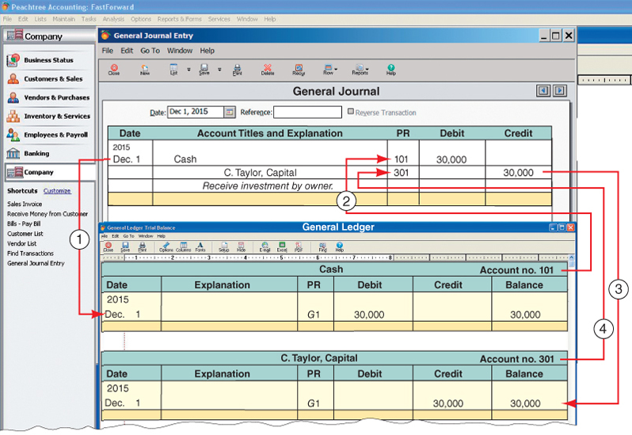
Posting Journal Entries
Exhibit 2.12
Learning Objective P1: Record transactions in a journal and post entries to a ledger.
Notes:
Posting is the process of transferring the information from the general journal to the general ledger. There are four steps in the posting process.
Identify debit account in Ledger: enter date, journal page, amount, and balance.
Enter the debit account number from the Ledger in the PR column of the journal.
Identify the credit account in Ledger: enter date, journal page, amount, and balance.
Enter the credit account number from the Ledger in the PR column of the journal.

Slide 27
A1: Analyze the impact of transactions on accounts and financial statements.
Learning Objective

Slide 28
Processing Transactions
Double-entry accounting is useful in analyzing and processing transactions. Analysis of each transaction follows these four steps.
Learning Objective A1: Analyze the impact of transactions on accounts and financial statements.
Notes:
Double-entry accounting is useful in analyzing and processing transactions. To analyze each transaction follow these four steps:
Identify the transaction and any source documents.
Analyze the transaction using the accounting equation.
Record the transaction in journal entry form applying double-entry accounting.
Post the entry (for simplicity, we use T-accounts to represent ledger accounts).
Let’s look at some examples.

Slide 29
Processing Transactions
Learning Objective A1: Analyze the impact of transactions on accounts and financial statements.
Notes:
In the first transaction, the owner invests $30,000 to start a company called FastForward. From our previous work, we know that the cash account and the C. Taylor, Capital account will increase.
We record this information in the general journal with a debit, increase, to cash, and a credit, increase, to C. Taylor, Capital. Notice that the account number for the cash account is 101 and C. Taylor, Capital is 301. We are going to post the information in the journal to the general ledger. We will use T-accounts to accomplish this.
We place the $30,000 on the left, or debit, side of the cash account and on the right, or credit, side of the C. Taylor, Capital account. Our books are in balance because total assets are equal to total liabilities plus equity. Let’s move to another transaction.

Slide 30
Processing Transactions
Learning Objective A1: Analyze the impact of transactions on accounts and financial statements.
Notes:
In our second transaction, FastForward purchases office supplies paying $2,500 cash. We have exchanged one asset, cash, for another asset, supplies. The cash account will decrease and the supplies account will increase. Can you make the general journal entry to record this transaction?
We increase the supplies account with a debit and decrease the asset account, cash, with a credit. Let’s post the amounts.
The general ledger account for supplies increased by $2,500, so the amount is placed on the debit side of the account. The cash account, an asset, decreased by $2,500, so the amount is placed on the credit side of the general ledger account. Let’s move on to another transaction.

Slide 31
Processing Transactions
Learning Objective A1: Analyze the impact of transactions on accounts and financial statements.
Notes:
In our third transaction, FastForward purchases equipment paying $26,000 cash. Once again, we have exchanged one asset, cash, for another asset, equipment. The cash account will decrease and the equipment account will increase. This general journal entry will look similar to the one we just completed.
We increase the equipment account with a debit and decrease the asset account, cash, with a credit. Let’s post the amounts.
The general ledger account for equipment increased by $26,000, so it is placed on the debit side of the account. The cash account, an asset, decreased by $26,000, so the amount is placed on the credit side of the general ledger account. Let’s look at another transaction.

Slide 32
Processing Transactions
Learning Objective A1: Analyze the impact of transactions on accounts and financial statements.
Notes:
In this transaction, FastForward purchases $7,100 of office supplies on account. The supplies account, an asset, will increase and the liability account, accounts payable will increase. Let’s make the general journal entry to record this transaction.
We increase the supplies account with a debit and increase the liability account, accounts payable, with a credit. It is time to post the transaction.
The general ledger account for supplies increased by $7,100, so the amount is placed on the debit side of the account. The accounts payable account, a liability, increased by the same amount, so we place it on the credit side of the general ledger account. Let’s analyze another transaction.

Slide 33
Processing Transactions
Learning Objective A1: Analyze the impact of transactions on accounts and financial statements.
Notes:
FastForward provided consulting services and collected $4,200 cash. The asset account, cash, increased by $4,200 and the equity account, consulting revenue, increased by the same amount. See if you can make the general journal entry to record this transaction before moving to the next slide.
We increase the cash account with a debit and increase the revenue account, consulting revenue, with a credit. Let’s post the amounts.
The general ledger account for cash increased by $4,200, so the amount is placed on the debit side of the account. The consulting revenue account increased by the same amount, so it is placed on the credit side of the general ledger account.
We could continue on with more transactions, but your homework will help reinforce what we have done here. Let’s take a look at the trial balance of FastForward at the end of December.
Review what you have learned in the following NEED-TO-KNOW Slides.

Slide 34
Processing Transactions
Learning Objective A1: Analyze the impact of transactions on accounts and financial statements.
Notes:
FastForward provided pays $1,000 cash for December rent. The asset account, cash, decreased by $1,000 and the equity account, rent expense, increased by the same amount.
We decrease the cash account with a credit and decrease the expense account, rent expense, with a debit. Let’s post the amounts.
The general ledger account for cash decreased by $1,000, so the amount is placed on the credit side of the account. The rent expense account decreased by the same amount, so it is placed on the debit side of the general ledger account.

Slide 35
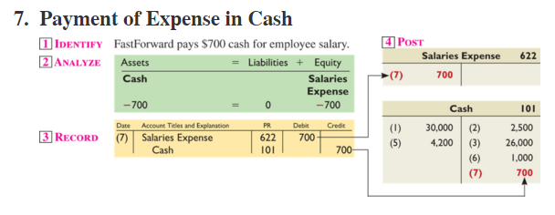
Processing Transactions
Learning Objective A1: Analyze the impact of transactions on accounts and financial statements.
Notes:
FastForward provided pays $700 cash for employee salaries. The asset account, cash, decreased by $700 and the equity account, rent expense, increased by the same amount.
We decrease the cash account with a credit and decrease the expense account, salaries expense, with a debit. Let’s post the amounts.
The general ledger account for cash decreased by $700, so the amount is placed on the credit side of the account. The rent expense account decreased by the same amount, so it is placed on the debit side of the general ledger account.

Slide 36
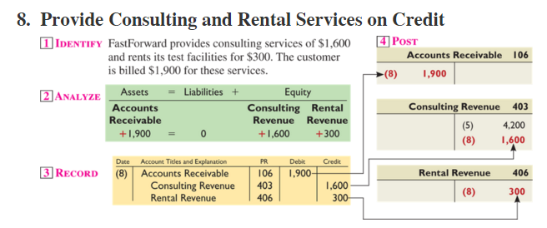
Processing Transactions
Learning Objective A1: Analyze the impact of transactions on accounts and financial statements.
Notes:
FastForward provided consulting services of $1,600 and rents its test facilities for $300. The customer is billed $1,900 for services.
The asset account, accounts receivable, increased by $1,900, the equity account, consulting revenue, increased by $1,600 and the equity account, rental revenue, increased by $300.
We increase the accounts receivable account with a debit and increase the two revenue accounts, consulting revenue and rental revenue, with credits. This is a compound journal entry which affects three or more accounts.
The general ledger account for accounts receivable increased by $1,900, so the amount is placed on the debit side of the account. The consulting revenue account increased by $1,600 and rental revenue increased by $300, so these are placed on the credit side of the general ledger accounts.

Slide 37
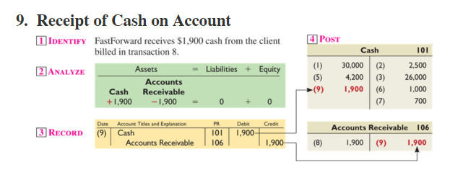
Processing Transactions
Learning Objective A1: Analyze the impact of transactions on accounts and financial statements.
Notes:
FastForward receives $1,900 cash from the client billed in transaction 8. This transaction will increase the cash account and decrease the accounts receivable account by $1,900.
We increase the cash account with a debit and decrease the accounts receivable account for $1,900.
In posting these amounts to the general ledger accounts, $1,900 is placed on the debit side of the cash account and $1,900 is placed on the credit side of the accounts receivable account.

Slide 38
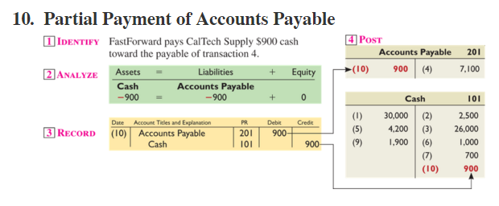
Processing Transactions
Learning Objective A1: Analyze the impact of transactions on accounts and financial statements.
Notes:
FastForward pays $900 cash toward the payable in transaction 4. This transaction will decrease the cash account and decrease the accounts payable account by $900.
Decrease the cash account with a credit and decrease the accounts payable account with a debit for $900.
In posting these amounts to the general ledger accounts, $900 is placed on the credit side of the cash account and $900 is placed on the debit side of the accounts payable account.

Slide 39
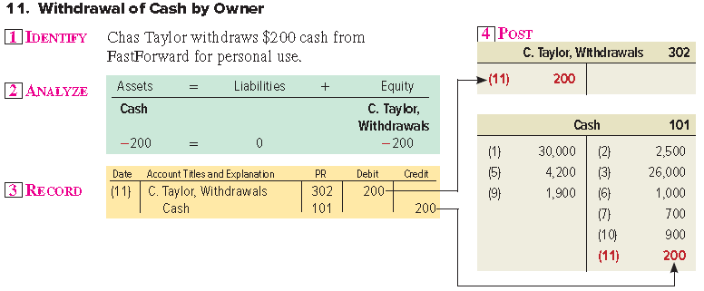
Processing Transactions
Learning Objective A1: Analyze the impact of transactions on accounts and financial statements.
Notes:
Chas Taylor withdraws $200 cash from FastForward for personal use. This transaction will decrease the cash account and increase the C. Taylor, Withdrawals account by $200.
Decrease the cash account with a credit and increase the C. Taylor, Withdrawals account with a debit for $200.
In posting these amounts to the general ledger accounts, $200 is placed on the credit side of the cash account and $200 is placed on the debit side of the withdrawals account.

Slide 40
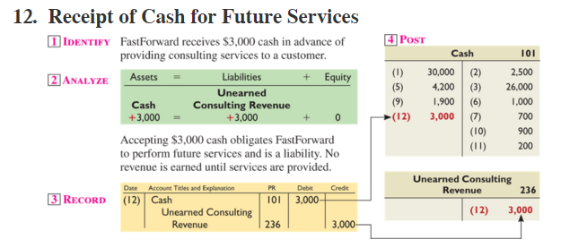
Processing Transactions
Learning Objective A1: Analyze the impact of transactions on accounts and financial statements.
Notes:
FastForward receives $3,000 cash in advance of providing consulting services to a customer. This transaction will increase the cash account and increase the liability account, unearned consulting revenue account by $3,000.
We increase the cash account with a debit and increase the unearned consulting revenue account for $3,000.
In posting these amounts to the general ledger accounts, $3,000 is placed on the debit side of the cash account and $3,000 is placed on the credit side of the unearned consulting revenue account.

Slide 41
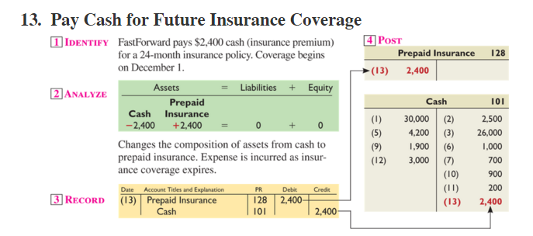
Processing Transactions
Learning Objective A1: Analyze the impact of transactions on accounts and financial statements.
Notes:
FastForward pays $2,400 cash for a 24-month insurance poilicy. This transaction will decrease the cash account and increase the asset account, prepaid insurance account by $2,400.
Decrease the cash account with a credit and increase the prepaid insurance account with a debit for $2,400.
In posting these amounts to the general ledger accounts, $2,400 is placed on the credit side of the cash account and $2,400 is placed on the debit side of the prepaid insurance account.

Slide 42
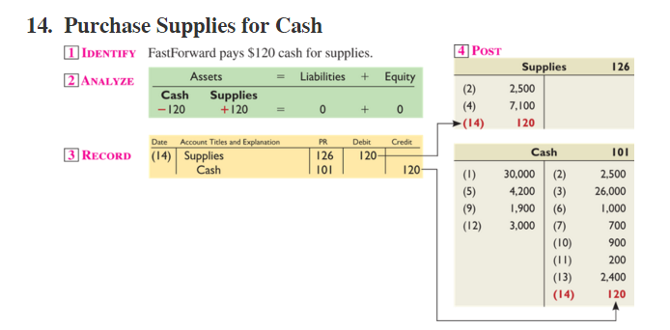
Processing Transactions
Learning Objective A1: Analyze the impact of transactions on accounts and financial statements.
Notes:
FastForward pays $120 cash for supplies. This transaction will decrease the cash account and decrease the asset account, supplies account by $120.
Decrease the cash account with a credit and increase the supplies account with a debit for $120.
In posting these amounts to the general ledger accounts, $120 is placed on the credit side of the cash account and $120 is placed on the debit side of the supplies account.

Slide 43
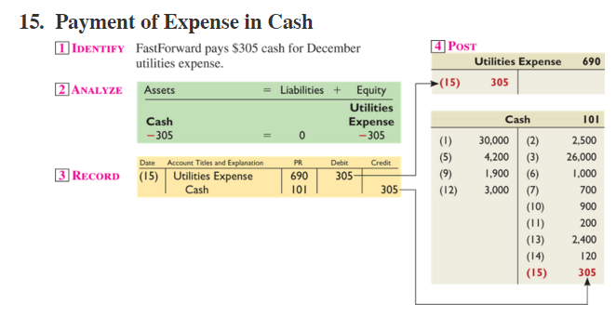
Processing Transactions
Learning Objective A1: Analyze the impact of transactions on accounts and financial statements.
Notes:
FastForward pays $305 cash for December utilities expense. This transaction will decrease the cash account and increase the equity account, utilities expense account by $305.
Decrease the cash account with a credit and increase the utilities expense account with a debit for $305.
In posting these amounts to the general ledger accounts, $305 is placed on the credit side of the cash account and $305 is placed on the debit side of the utilities expense account.

Slide 44
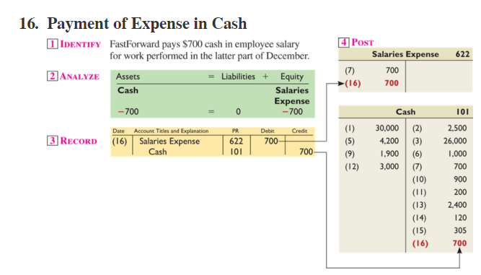
Processing Transactions
Learning Objective A1: Analyze the impact of transactions on accounts and financial statements.
Notes:
FastForward provided pays $700 cash for employee salaries. The asset account, cash, decreased by $700 and the equity account, rent expense, increased by the same amount.
We decrease the cash account with a credit and decrease the expense account, salaries expense, with a debit. Let’s post the amounts.
The general ledger account for cash decreased by $700, so the amount is placed on the credit side of the account. The rent expense account decreased by the same amount, so it is placed on the debit side of the general ledger account.
Review what you have learned in the following NEED-TO-KNOW Slides.

Slide 45
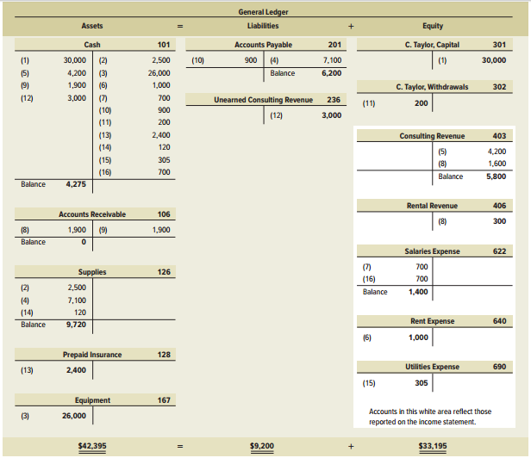
Debit and Credit Rules
Exhibit 2.13
Learning Objective A1: Analyze the impact of transactions on accounts and financial statements.
Notes:
Exhibit 2.13 shows the ledger accounts (in T-account form) of FastForward after all 16 transactions are recorded and posted and the balances computed. The accounts are grouped into three columns corresponding to the accounting equation: assets, liabilities, and equity. The totals for the three columns obey the accounting equation: assets equal $42,395 ($4,275 + $0 + $9,720 + $2,400 + $26,000); liabilities equal $9,200 ($6,200 + $3,000); and equity equals $33,195 ($30,000 - $200 + $5,800 + $300 - $1,400 - $1,000 - $305) which obey the accounting equation: $42,395 = $9,200 + $33,195. The capital, withdrawals, revenue, and expense accounts reflect transactions that change equity.
Review what you have learned in the following NEED-TO-KNOW Slides.

Slide 46
NEED-TO-KNOW 2-3
Assume Tata began operations on January 1 and completed the following transactions during its first month of
operations.
Jan. 1
Jamsetji invested $4,000 cash in the Tata company.
Jan. 5
The company purchased $2,000 of equipment on credit.
Jan. 14
The company provided $540 of services for a client on credit.
For each transaction, (a) analyze the transaction using the accounting equation, (b) record the transaction in
journal entry form, and c) post the entry using T-accounts to represent the general ledger accounts.
Learning Objective A1: Analyze the impact of transactions on accounts and financial statements.
Notes:
Assume Tata Company began operations on January 1 and completed the following transactions during its first month of operations. For each transaction, (a) analyze the transaction using the accounting equation, (b) record the transaction in journal entry form, and (c) post the entry using T-accounts to represent the general ledger accounts.

Slide 47
NEED-TO-KNOW 2-3
Jan. 1
Jamsetji invested $4,000 cash in the Tata company.
a) Analyze
Assets =
Liabilities + Equity
+ $4,000
+ $4,000
b) Record
Date
General Journal
Debit
Credit
Jan. 1
Cash
4,000
J. Tata, Capital
4,000
c) Post
Cash
Jan. 1
4,000
J. Tata, Capital
Jan. 1
4,000
Assets
=
Liabilities
+
Equity
Increase
Decrease
Decrease
Increase
Decrease
Increase
Debits
Credits
Debits
Credits
Debits
Credits
Owner, Withdrawals
Owner Investments
Normal
Normal
Expenses
Revenues
Learning Objective A1: Analyze the impact of transactions on accounts and financial statements.
Notes:
On Jan. 1 Jamsetji Tata invested $4,000 cash in the Tata Company. This transaction increases both assets and equity. To record this transaction, we increase the asset, Cash, by debiting Cash for $4,000, and we increase equity by crediting the owner's capital account for $4,000. We post the entry to the T-accounts, debiting Cash and crediting the owner's capital account.

Slide 48
NEED-TO-KNOW 2-3
Jan. 5
The company purchased $2,000 of equipment on credit.
a) Analyze
Assets =
Liabilities + Equity
+ $2,000
+ $2,000
b) Record
Date
General Journal
Debit
Credit
Jan. 5
Equipment
2,000
Accounts Payable
2,000
c) Post
Equipment
Jan. 5
2,000
Accounts Payable
Jan. 5
2,000
Assets
=
Liabilities
+
Equity
Increase
Decrease
Decrease
Increase
Decrease
Increase
Debits
Credits
Debits
Credits
Debits
Credits
Owner, Withdrawals
Owner Investments
Normal
Normal
Expenses
Revenues
Learning Objective A1: Analyze the impact of transactions on accounts and financial statements.
Notes:
On Jan. 5 the company purchased $2,000 of equipment on credit. This transaction increases both assets and liabilities. The journal entry to record the transaction increases the asset, Equipment, debiting Equipment for $2,000, and increases the liability account, Accounts payable, by the same amount. We post the journal entry, debiting Equipment and crediting Accounts payable.

Slide 49
NEED-TO-KNOW 2-3
Jan. 14
The company provided $540 of services for a client on credit.
a) Analyze
Assets =
Liabilities + Equity
+ $540
+ $540
b) Record
Date
General Journal
Debit
Credit
Jan. 14
Accounts receivable
540
Services revenue
540
c) Post
Accounts receivable
Jan. 14
540
Services revenue
Jan. 14
540
Assets
=
Liabilities
+
Equity
Increase
Decrease
Decrease
Increase
Decrease
Increase
Debits
Credits
Debits
Credits
Debits
Credits
Owner, Withdrawals
Owner Investments
Normal
Normal
Expenses
Revenues
Learning Objective A1: Analyze the impact of transactions on accounts and financial statements.
Notes:
On Jan. 14 the company provided $540 of services for a client on credit. This transaction increases both assets and equity. The journal entry to record this transaction increases the asset, Accounts receivable, debiting Accounts receivable, $540, and credits the equity account, Services revenue, for $540. We post the journal entry, debiting Accounts receivable and crediting Services revenue.

Slide 50
P2: Prepare and explain the use of a trial balance.
Learning Objective

Slide 51
Preparing a Trial Balance
Preparing a trial balance involves three steps:
List each account title and its amount (from ledger) in the trial balance. If an account has a zero balance, list it with a zero in the normal balance column (or omit it entirely).
Compute the total of debit balances and the total of credit balances.
Verify (prove) total debit balances equal total credit balances.
Learning Objective P2: Prepare and explain the use of a trial balance.
Notes:
Preparing a trial balance involves three steps:
List each account title and its amount (from ledger) in the trial balance. If an account has a zero balance, list it with a zero in the normal balance column (or omit it entirely).
Compute the total of debit balances and the total of credit balances.
Verify (prove) total debit balances equal total credit balances.
The total of debit balances equals the total of credit balances for the trial balance. However, equality of these two totals does not guarantee that no errors were made.

Slide 52
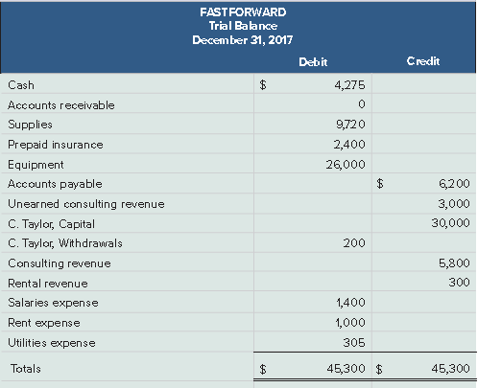
After processing its remaining transactions for December, FastForward’s Trial Balance is prepared.
The trial balance lists all ledger accounts and their balances at a point in time. If the books are in balance, the total debits will equal the total credits.
Learning Objective P2: Prepare and explain the use of a trial balance.
Notes:
The total of debit balances equals the total of credit balances for the trial balance as shown in this slide. Equality of these two totals does not guarantee that no errors were made. For example, the column totals still will be equal when a debit or credit of a correct amount is made to a wrong account. Another error that does not cause unequal column totals occurs when equal debits and credits of an incorrect amount are entered.

Slide 53
Searching for Errors
If the trial balance does not balance, the error(s) must be found and corrected.
❶ Make sure the trial balance columns are correctly added.
❹ Re-compute each account balance in the ledger.
❷ Make sure account balances are correctly entered from the ledger.
❺ Verify that each journal entry is posted correctly.
❸ See if debit or credit accounts are mistakenly placed on the trial balance.
❻ Verify that each original journal entry has equal debits and credits.
Learning Objective P2: Prepare and explain the use of a trial balance.
Notes:
If the trial balance does not balance, the error(s) must be found and corrected.
Step 1: Verify that the trial balance columns are correctly added.
Step 2: Verify that account balances are accurately entered from the ledger.
Step 3: See whether a debit (or credit) balance is mistakenly listed in the trial balance as a credit (or debit).
Step 4: Re-compute each account balance in the ledger.
Step 5: Verify that each journal entry is properly posted.
Step 6: Verify that the original journal entry has equal debits and credits.

Slide 54
P3: Prepare financial statements from business transactions.
Learning Objective

Slide 55
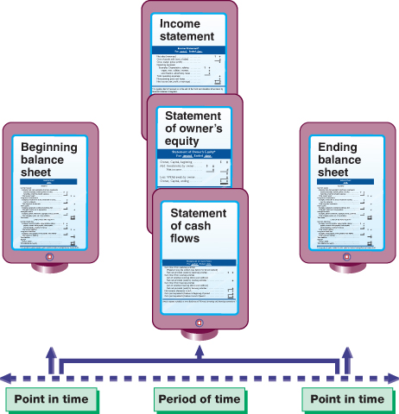
Financial Statements Prepared from Trial Balance
Exhibit 2.15
Learning Objective P3: Prepare financial statements from business transactions.
Notes:
As we have seen in the last chapter, after the trial balance has been prepared we begin preparing the financial statements. We always begin with the income statement because net income from the income statement appears on the statement of owner's equity. After the income statement, we prepare the statement of owner's equity because the ending balance in owner's equity appears on the balance sheet. Next, we prepare the balance sheet and, finally, we prepare the statement of cash flows.

Slide 56
Financial Statements
The four financial statements and their purposes are:
Income statement — reports revenues less expenses along with the resulting net income or loss over a period of time due to earnings activities.
Statement of owner’s equity— reports how equity changes over the reporting period from net income (or loss) and from any owner investments and withdrawals over a period of time.
Balance sheet — reports the financial position (types and amounts of assets, liabilities, and equity) at a point in time.
Statement of Cash Flows — The statement of cash flows lists the cash inflows and cash outflows for the period.
**For simplicity, we do not show the statement of cash flows for FastForward in this chapter, but we do return to this statement in the next chapter.**
Learning Objective P3: Prepare financial statements from business transactions.
Notes:
This section introduces us to how financial statements are prepared from the analysis of business transactions. The four financial statements and their purposes are:
Income statement — reports revenues less expenses along with the resulting net income or loss over a period of time due to earnings activities.
Statement of owner’s equity— reports how equity changes over the reporting period from net income (or loss) and from any owner investments and withdrawals over a period of time.
Balance sheet — reports the financial position (types and amounts of assets, liabilities, and equity) at a point in time.

Slide 57
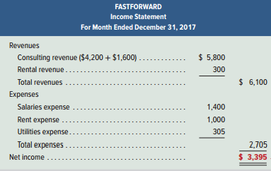
Income Statement
Exhibit 2.16
Learning Objective P3: Prepare financial statements from business transactions.
Notes:
FastForward’s income statement for December is shown in this slide. Information about revenues and expenses is conveniently taken from the trial balance. Net income of $3,395 is reported at the bottom of the statement. Owner investments and withdrawals are not part of income.

Slide 58
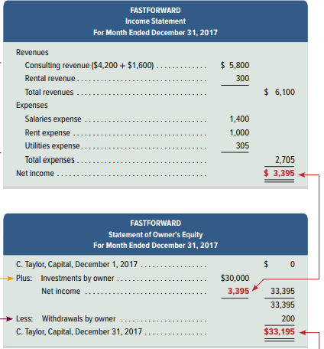
Statement of Owner’s Equity
Exhibit 2.16
Learning Objective P3: Prepare financial statements from business transactions.
Notes:
FastForward’s statement of owner’s equity is the second report in this slide. It shows the $30,000 owner investment, the $3,395 of net income, the $200 withdrawal, and the $33,195 end-of-period (capital) balance. (The beginning balance in the statement of owner’s equity is rarely zero; an exception is for the first period of operations. The beginning capital balance in January 2018 is $33,195, which is December 2017’s ending balance.)

Slide 59
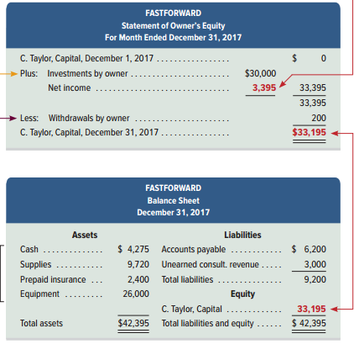
Balance Sheet
Exhibit 2.16
Learning Objective P3: Prepare financial statements from business transactions.
Notes:
FastForward’s balance sheet is the bottom report shown in this slide. This statement refers to financial condition at the close of business on December 31. The left side of the balance sheet lists its assets: cash, supplies, prepaid insurance, and equipment. The upper right side of the balance sheet shows that it owes $6,200 to creditors and $3,000 in services to customers who paid in advance. The equity section shows an ending balance of $33,195. Note the link between the ending balance of the statement of owner’s equity and the capital balance.

Slide 60
Presentation Issues
Dollar signs are not used in journals and ledgers.
Dollar signs appear in financial statements and other reports such as trial balances. The usual practice is to put dollar signs beside only the first and last numbers in a column.
When amounts are entered in the journal, ledger, or trial balance, commas are optional to indicate thousands, millions, and so forth.
Commas are always used in financial statements.
Companies commonly round amounts in reports to the nearest dollar, or even to a higher level.
Learning Objective P3: Prepare financial statements from business transactions.
Notes:
There are many common standards for formatting in accounting. Here are some standards used by most companies:
Dollar signs are not used in journals and ledgers.
Dollar signs appear in financial statements and other reports such as trial balances. The usual practice is to put dollar signs beside only the first and last numbers in a column.
When amounts are entered in the journal, ledger, or trial balance, commas are optional to indicate thousands, millions, and so forth.
Commas are always used in financial statements.
Companies commonly round amounts in reports to the nearest dollar, or even to a higher level.
Review what you have learned in the following NEED-TO-KNOW Slides.

Slide 61
NEED-TO-KNOW 2-4
Prepare a trial balance for Apple using the following condensed data from its fiscal year-ended
September 26, 2015.
Owner, Capital
$111,547
Owner, Withdrawals
$45,586
Accounts payable
35,490
Investments and other assets
230,039
Other liabilities
135,634
Land and equipment
22,471
Cost of sales (expense)
140,089
Selling and other expense
40,232
Cash
21,120
Accounts receivable
16,849
Revenues
233,715
APPLE
Trial Balance
September 26, 2015
Debit
Credit
Assets Normal
Liabilities Normal
Owner, Capital Normal
Owner, Withdrawals Normal
Revenues Normal
Expenses Normal
Totals Debits = Credits
Learning Objective P2: Prepare and explain the use of a trial balance.
Notes:
Prepare a trial balance for Apple using the following condensed data from its fiscal year-ended September 26, 2015. A trial balance lists every account from the general ledger with its balance, either a debit or a credit. The accounts are listed in financial statement order, based on their numbering in the chart of accounts. Assets are listed first. Assets have normal debit balances, as they sit on the left-hand side of the equation. Next, we list the liabilities. Liabilities have normal credit balances, as they sit on the right-hand side of the equation. Then we follow with the subsets of equity. The owner's capital account has a normal credit balance, as investments by the owner increase equity. Withdrawals by the owner decrease equity. Therefore, the owner's drawing account has a normal debit balance. Revenues increase equity, so they have normal credit balances. And, finally, we list the expenses. Expenses have normal debit balances, as they decrease equity. The trial balance proves that the total of the debits equals the total of the credits.

Slide 62
NEED-TO-KNOW 2-4
Prepare a trial balance for Apple using the following condensed data from its fiscal year-ended
September 26, 2015.
Owner, Capital
$111,547
Owner, Withdrawals
$45,586
Accounts payable
35,490
Investments and other assets
230,039
Other liabilities
135,634
Land and equipment
22,471
Cost of sales (expense)
140,089
Selling and other expense
40,232
Cash
21,120
Accounts receivable
16,849
Revenues
233,715
APPLE
Trial Balance
September 26, 2015
Debit
Credit
Cash
$21,120
Accounts receivable
16,849
Land and equipment
22,471
Investments and other assets
230,039
Accounts payable
$35,490
Other liabilities
135,634
Owner, Capital
111,547
Owner, Withdrawals
45,586
Revenues
233,715
Cost of sales (expense)
140,089
Selling and other expense
40,232
Totals
$516,386
$516,386
Learning Objective P2: Prepare and explain the use of a trial balance.
Notes:
Apple Co. has four different assets. All assets have normal debit balances: Cash, $21,120; Accounts receivable, $16,849; Land and equipment, $22,471; and Investments and other assets, $230,039. Assets are listed in order of liquidity. Next, we list the liabilities with their normal credit balances: Accounts payable, $35,490; and Other liabilities, $135,634. The equity accounts include the owner's capital account, which increases equity, and has a normal credit balance, $111,547. Owner, Withdrawals of $56,586 decrease equity; the withdrawal account has a normal debit balance. Revenues increase equity. Revenues have normal credit balances, $233,715. Expenses include: Cost of sales, $140,089; and Selling and other expense, $40,232. Expenses always have normal debit balances, as they decrease equity. The total of the debits, $516,386, equals the total of the credits.

Slide 63
A2: Compute the debt ratio and describe its use in analyzing financial condition.
Learning Objective

Slide 64
Debt Ratio
Total Liabilities
Debt Ratio =
Total Assets
Evaluates the level of debt risk.
A higher ratio indicates that there is a greater probability that a company will not be able to pay its debt in the future.
Learning Objective A2: Compute the debt ratio and describe its use in analyzing financial condition.
Notes:
Borrowing money is risky business. The debt to assets ratio helps evaluate the level of debt risk. We determine a company’s ability to pay its debts (liabilities) using the debt ratio. The debt ratio is equal to total liabilities divided by total assets. A higher ratio indicates that there is greater probability a company will not be able to pay its debts in the future.

Slide 65
Debt Ratio
Exhibit 2.18
Total Liabilities
Debt Ratio =
Total Assets
Learning Objective A2: Compute the debt ratio and describe its use in analyzing financial condition.
Notes:
Skechers’s debt ratio ranges from a low of 0.30 to a high of 0.33—also, see graph in margin. Its ratio is lower than the industry norm, suggesting a lower than average risk from financial leverage. If Skechers is making more money with this debt than it is paying the lenders, then it is successfully borrowing money to make more money. A company’s use of debt can quickly turn unprofitable if its return from that money drops below the rate it is paying lenders.

Slide 66
End of Chapter 2

