Slide 1
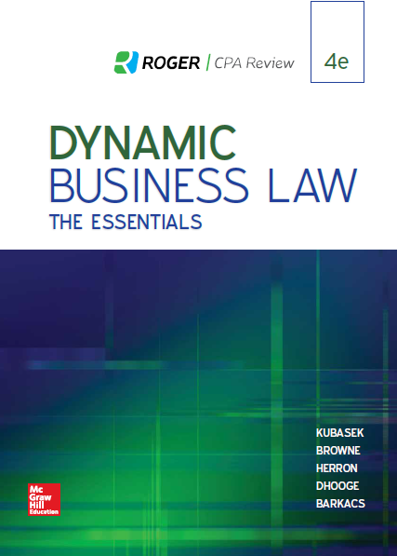
Chapter 9
Introduction to Contracts and Agreement
© 2019 McGraw-Hill Education. All rights reserved. Authorized only for instructor use in the classroom. No reproduction or further distribution permitted without the prior written consent of McGraw-Hill Education.
Notes:
Chapter 9: Introduction to Contracts and Agreement

Slide 2
Contract
A contract is a set of legally enforceable promises.
Notes:
A contract is defined as a set of legally enforceable promises.

Slide 3
Elements Required For Contract Formation
Agreement (Offer and Acceptance).
Consideration (Bargained-For Exchange).
Contractual Capacity (Legal Ability to Enter Into Binding Contract).
Legal Object.
Notes:
Elements required for contract formation include an agreement (represented by a valid offer and a valid acceptance,) mutual consideration (meaning that both parties must give value in order to support the enforceability of the agreement, in the form of a bargained-for exchange) contractual capacity (the legal ability to enter into a binding contract,) and legal object (meaning that the contract cannot be either illegal or against public policy.)

Slide 4
Defenses to Enforcement of Contract
Lack of genuine assent (fraud, duress, undue influence, misrepresentation).
Lack of proper form requirements (statute of frauds writing requirement).
Notes:
Defenses to the enforceability of a contract include the lack of genuine assent as a result of fraud, duress, undue influence, or misrepresentation, and lack of proper form requirements, usually indicating non-compliance with the statute of frauds, a rule of law requiring that certain types of contracts be in writing in order to be enforceable.

Slide 5
Sources of Contract Law
State common law.
The Uniform Commercial Code (Article 2).
Governs contracts for the sale of goods.
Notes:
Sources of contract law include state common law, as well as Article 2 of the Uniform Commercial Code, which governs contracts for the sale of goods.

Slide 6
Classification of Contracts: Express or Implied
“Express” Contract: Based on written or spoken words.
“Implied” Contract: Based on conduct or actions.
“Quasi-Contract” (“Implied-in-law” contract): Imposed in certain cases to avoid unjust enrichment, even if all elements of contract formation not satisfied.
Notes:
Contracts can be classified as “express” or “implied.” An express contract is based on written or spoken words, while an implied contract is based on the conduct or actions of the parties. A “quasi-contract,” also referred to as an “implied-in-law” contract, is imposed in certain cases to avoid unjust enrichment, even if all elements of contract formation are not satisfied.

Slide 7
Classification of Contracts
Bilateral
Unilateral
The offeror and offeree both exchange promises.
A promise for a promise.
The offeror makes a promise and asks for acceptance by performing an act.
A promise for an act.
Examples are contests and rewards.

Slide 8
Classification of Contracts: Valid, Void, or Voidable
“Valid” Contract: All elements of contract formation satisfied.
“Void” Contract: Illegal purpose/subject matter; unenforceable.
“Voidable” Contract: One or both parties can withdraw from contract.
Notes:
Contracts can be classified as “valid,” “void,” or “voidable.” In a valid contract, all elements of contract formation have been satisfied. A void contract involves an illegal purpose and/or subject matter, and is therefore unenforceable. A voidable contract allows one or both parties to withdraw legally from the contract.

Slide 9
Classification of Contracts: Executed or Executory
“Executed” Contract: All terms of contract fully performed.
“Executory” Contract: Some duties under contract not performed by one/both parties.
Notes:
Contracts can be classified as “executed” or “executory.” An executed contract means that all terms of the contract have been fully performed. With an executory contract, some duties under the contract have not been performed by one or both parties.

Slide 10
Classification of Contracts: Formal or Informal
“Formal” Contract: Must meet special form requirements.
Examples: Contracts under seal, “recognizances,” letters of credit, and negotiable instruments.
“Informal” Contract: No formalities required in making; a “simple” contract.
Notes:
Contracts can be classified as “formal” or “informal.” A formal contract must meet special form requirements. Examples of formal contracts include contracts under seal, “recognizances,” letters of credit, and negotiable instruments. An informal contract requires no formalities; it is a “simple” contract.

Slide 11
The Agreement: Offer and Acceptance
Notes:
A legally enforceable agreement includes a valid offer and a valid acceptance.

Slide 12
Elements of a Valid Offer
Manifestation of offeror’s intent to be bound.
Intent determined by objective, “reasonable person” standard.
Preliminary negotiations and advertisements do not constitute offers.
Definite and certain terms (including subject matter, price, quantity, quality, and parties).
Communication of offer to offeree (or offeree’s agent).
Notes:
In order for an offer to be valid, there must first be a manifestation of the offeror’s intent to be bound by contract. Intent is determined by an objective, “reasonable person” standard. Preliminary negotiations and advertisements do not constitute offers. A valid offer also requires definite and certain terms, including subject matter, price, quantity, quality, and the names of the contracting parties. Finally, a valid offer requires communication of the offer from the offeror (or the offeror’s agent) to the offeree (or the offeree’s agent.)

Slide 13
Auctions
Auction With Reserve:
Seller merely expresses intent to receive offers.
Auctioneer (as representative of seller) may withdraw item from auction at any time before “hammer falls.”
Before hammer falls (signaling acceptance of offer), bidder/offeror may revoke bid.
Auction Without Reserve:
Seller must accept highest bid.
Notes:
Auctions can be classified as either “with reserve” or “without” reserve. In an auction with reserve, the seller merely expresses the intent to receive offers. The auctioneer, as a representative of the seller, may withdraw the item from the auction at any time before the “gavel falls.” Before the gavel falls (signaling acceptance of offer,) the bidder-offeror may revoke his or her bid. In an auction without reserve, the seller must accept the highest bid.

Slide 14
Termination of Offer
Revocation by Offeror.
Rejection by Offeree.
Death/Incapacity of Offeror.
Destruction/Subsequent Illegality of Subject Matter of Offer.
Lapse of Time/Failure of Condition(s) Specified in Offer.
Notes:
Events that terminate an offer include revocation of the offer by the offeror, rejection of the offer by the offeree, death or incapacity of the offeror, destruction or subsequent illegality of the subject matter of the offer, and a lapse of time specified in the offer or the failure of another condition specified in the offer.

Slide 15
Acceptance
Represents offeree’s intent to be bound by terms of offer and resulting contract.
Silence generally does not constitute acceptance.
Terms of acceptance must be identical to terms of offer (“Mirror-Image” Rule).
Effective when communicated by offeree to offeror.
If no method of communicating acceptance specified in offer, any reasonable means of acceptance effective (Examples: telephone, mail, fax, e-mail).
Notes:
Acceptance represents an offeree’s intent to be bound by the terms of the offer and the resulting contract. Silence generally does not constitute acceptance. According to the “mirror-image” rule, the terms of the acceptance must be identical to the terms of the offer. Acceptance is effective when it is communicated by the offeree to the offeror. If no method of communicating acceptance is specified in the offer, any reasonable means of acceptance is effective, such as by telephone, mail, fax, or e-mail.

Slide 16
The Mirror Image Rule
Under the common law, the offer and the acceptance must be mirror images of each other. They cannot contain additional or different terms.
Article 2 of the U C C modifies this rule in sale of goods contracts.

Slide 17
The Mailbox Rule
Acceptance by mail is effective when placed in mailbox; however, revocation of offer is effective only when received by offeree.
Notes:
The mailbox rule holds that acceptance by mail is effective when it is placed in the mailbox; however, revocation of the offer is effective only when it is received by the offeree. The mailbox rule has been expanded to apply to faxes in some jurisdictions, with courts holding that once the fax has been transmitted, the acceptance is effective. It is likewise applied to e-mail transmissions, in that once acceptance is sent via e-mail, it is considered effective.

