Slide 1

Cash, Fraud, and Internal Controls
Chapter 8
Wild, Shaw, and Chiappetta
Fundamental Accounting Principles
23rd Edition
Notes:
Chapter 8: Cash, Fraud, and Internal Controls

Slide 2
Chapter 8 Learning Objectives
CONCEPTUAL
C1 Define internal control and identify its purpose and principles.
C2 Define cash and cash equivalents and explain how to report them.
ANALYTICAL
A1 Compute the days’ sales uncollected ratio and use it to assess liquidity.
PROCEDURAL
P1 Apply internal control to cash receipts and disbursements.
P2 Explain and record petty cash fund transactions.
P3 Prepare a bank reconciliation.
P4 Appendix 8A Describe use of documentation and verification to control cash disbursements.
2

Slide 3
C1:
Define internal control and identify its purpose and principles.
Learning Objective

Slide 4
Internal Control System
Policies and procedures managers use to:
  Protect assets.
  Ensure reliable accounting.
  Uphold company policies.
  Promote efficient operations.
Learning Objective C1: Define internal control and identify its purpose and principles.
Notes:
Managers (or owners) of small businesses often control the entire operation. They know from personal contact and observation whether the business is actually receiving the assets and services paid for. Most companies cannot maintain personal supervision and must delegate responsibilities and rely on formal procedures in controlling business activities.
Managers use an internal control system to monitor and control business activities. An internal control system consists of the policies and procedures managers use to:
Protect assets.
Ensure reliable accounting.
Uphold company policies.
Promote efficient operations.

Slide 5
Sarbanes-Oxley Act (SOX)
The Sarbanes-Oxley Act requires managers and auditors of public companies to document and certify the system of internal controls.
Section 404 of SOX requires that managers document and assess the effectiveness of all internal control processes that can impact financial reporting.
Learning Objective C1: Define internal control and identify its purpose and principles.
Notes:
The Sarbanes-Oxley Act (SOX) requires managers and auditors of companies whose stock is traded on an exchange (called public companies) to document and certify the system of internal controls. Following are some of the specific requirements:
Executives and board of directors must install effective internal controls.
Auditors must evaluate internal controls.
Violators receive harsh penalties up to 25 years in prison with severe fines.
Auditors’ work overseen by the Public Company Accounting Oversight Board (PCAOB).
SOX has greatly impacted companies, and the costs of its implementation are high. Importantly, SOX requires that managers document and assess the effectiveness of all internal control processes that can impact financial reporting. The benefits include greater confidence in accounting systems and their related reports. However, the public continues to debate the costs versus the benefits of SOX. Section 404 of SOX requires that managers document and assess their internal controls and that auditors provide an opinion on managers’ documentation and assessment. Costs of complying with SOX for companies is reported to average $4 million (Financial Executives Institute).

Slide 6
Principles of Internal Control
Internal control principles common to all companies:
Establish responsibilities.
Maintain adequate records.
Insure assets and bond key employees.
Separate recordkeeping from custody of assets.
Divide responsibility for related transactions.
Apply technological controls.
Perform regular and independent reviews.
Learning Objective C1: Define internal control and identify its purpose and principles.
Notes:
Internal control policies and procedures vary from company to company because of the nature and size of the business. Certain fundamental internal control principles apply to all companies. The principles of internal control are to
Establish responsibilities.
Maintain adequate records.
Insure assets and bond key employees.
Separate recordkeeping from custody of assets.
Divide responsibility for related transactions.
Apply technological controls.
Perform regular and independent reviews.

Slide 7
Technology, Fraud, and Internal Control
Reduced
Processing
Errors
More
Extensive Testing
of Records
Separation of
Duties
Limited
Evidence of
Processing
Increased
E-Commerce
Learning Objective C1: Define internal control and identify its purpose and principles.
Notes:
The fundamental principles of internal control are relevant no matter what the technological state of the accounting system, from purely manual to fully automated systems. Technology allows us quicker access to information. Technology improves managers’ abilities to monitor and control business activities. This section describes technological impacts we must be alert to.
Reduced Processing Errors Technologically advanced systems reduce, but do not eliminate all errors in processing information. Provided the software and data entry are correct, the risk of mechanical and mathematical errors is nearly eliminated. Less human involvement can cause data entry errors to go undiscovered. Moreover, errors in software can produce consistent but inaccurate processing of transactions.
More Extensive Testing of Records A review of electronic records can include broader testing when information is easily accessible. When accounting records are kept manually, only small samples of data are usually tested. When data are accessible with technology, large samples or even the entire database can be quickly tested.
Limited Evidence of Processing Many data processing steps are increasingly done by computer. Accordingly, fewer hard-copy items of documentary evidence are available for review. Yet technologically advanced systems can provide new evidence. They can, for instance, record who made the entries, the date and time, the source of the entry, and so on. Technology can also be designed to require the use of passwords or other identification before access to the system is granted. This means that internal control depends more on the design and operation of the information system and less on the analysis of its resulting documents.
Separation of Duties A company with a smaller workforce risks losing its separation of duties. For instance, the person who designs and programs the information system should not operate it. The company must also separate control over programs and files from the activities related to cash receipts and disbursements. For instance, a computer operator should not control check-writing activities. Increased E-Commerce Amazon and eBay are examples of successful e-commerce companies. Most companies have some e-commerce transactions. All such transactions involve at least three risks. (1) Credit card number theft is a risk of using, transmitting, and storing such data online. This increases the cost of e-commerce. (2) Computer viruses are malicious programs that attach themselves to innocent files for purposes of infecting and harming other files and programs. (3) Impersonation online can result in charges of sales to bogus accounts, purchases of inappropriate materials, and the unknowing giving up of confidential information to hackers. Companies use both firewalls and encryption to combat some of these risks—firewalls are points of entry to a system that require passwords to continue, and encryption is a mathematical process to rearrange contents that cannot be read without the process code. Nearly 5% of Americans already report being victims of identity theft, and roughly 10 million say their privacy has been compromised.

Slide 8
Limitations of Internal Control
Human Error
Human Fraud
Negligence
Fatigue
Misjudgment
Confusion
Intent to
defeat internal
controls for
personal gain
Human fraud triple-threat:
Opportunity, Pressure, and Rationalization
The costs of internal controls
must not exceed their benefits.
Learning Objective C1: Define internal control and identify its purpose and principles.
Notes:
Internal control policies and procedures are applied by people. This human element creates several potential limitations that we can categorize as either (1) human error or (2) human fraud. Human error occurs from carelessness, misjudgment, or confusion. Human fraud is people intentionally defeating internal controls, such as management override, for personal gain. Human fraud is driven by the triple-threat of fraud:
Opportunity—refers to internal control weaknesses in a business.
Pressure—refers to financial, family, society, and other stresses to succeed.
Rationalization—refers to employees justifying fraudulent behavior.
The second limitation on internal control is the cost-benefit principle, which says that the costs of internal controls must not exceed their benefits. Analysis of costs and benefits must consider all factors, including the impact on morale. Most companies, for instance, have a legal right to read employees’ e-mails, yet companies rarely do unless there is evidence of potential harm to the company.
Review what you have learned in the following NEED-TO-KNOW Slides.

Slide 9
NEED-TO-KNOW 8-1
Identify the following phrases/terms as best linked with the (a) purposes of an internal control system,
(b) principles of internal control, or (c) limitations of internal control.
1)
Protect assets
2)
Establish responsibilities
3)
Human error
4)
Maintain adequate records
5)
Apply technological controls
6)
Ensure reliable accounting
7)
Insure assets and bond key employees
8)
Human fraud
9)
Separate recordkeeping from custody of assets
10)
Divide responsibility for related transactions
11)
Cost-benefit principle
12)
Promote efficient operations
13)
Perform regular and independent reviews
14)
Uphold adherence to company policies
Learning Objective C1: Define internal control and identify its purpose and principles.
Notes:
Identify the following phrases/terms as best linked with the (a) purposes of an internal control system, (b) principles of internal control, or (c) limitations of internal control.

Slide 10
NEED-TO-KNOW 8-1 - SOLUTION
1)
Protect assets
a) Purpose of internal controls
2)
Establish responsibilities
3)
Human error
4)
Maintain adequate records
5)
Apply technological controls
6)
Ensure reliable accounting
a) Purpose of internal controls
7)
Insure assets and bond key employees
8)
Human fraud
9)
Separate recordkeeping from custody of assets
10)
Divide responsibility for related transactions
11)
Cost-benefit principle
12)
Promote efficient operations
a) Purpose of internal controls
13)
Perform regular and independent reviews
14)
Urge adherence to company policies
a) Purpose of internal controls
a)
Purposes of internal controls
Protect assets.
Promote efficient operations.
Ensure reliable accounting.
Urge adherence to company policies.
Learning Objective C1: Define internal control and identify its purpose and principles.
Notes:
The purposes of internal controls are to: protect the assets, promote efficient operations, ensure reliable accounting, and urge adherence to company policies.

Slide 11
NEED-TO-KNOW 8-1 SOLUTION
1)
Protect assets
a) Purpose of internal controls
2)
Establish responsibilities
b) Principles of internal controls
3)
Human error
4)
Maintain adequate records
b) Principles of internal controls
5)
Apply technological controls
b) Principles of internal controls
6)
Ensure reliable accounting
a) Purpose of internal controls
7)
Insure assets and bond key employees
b) Principles of internal controls
8)
Human fraud
9)
Separate recordkeeping from custody of assets
b) Principles of internal controls
10)
Divide responsibility for related transactions
b) Principles of internal controls
11)
Cost-benefit principle
12)
Promote efficient operations
a) Purpose of internal controls
13)
Perform regular and independent reviews
b) Principles of internal controls
14)
Urge adherence to company policies
a) Purpose of internal controls
a)
Purposes of internal controls
Protect assets.
Promote efficient operations.
Ensure reliable accounting.
Urge adherence to company policies.
b)
Principles of internal controls
Establish responsibilities.
Maintain adequate records.
Insure assets and bond key employees.
Separate recordkeeping from custody of assets.
Divide responsibility for related transactions.
Apply technological controls.
Perform regular and independent reviews.
Learning Objective C1: Define internal control and identify its purpose and principles.
Notes:
The principles of internal controls are to: establish responsibilities; maintain adequate records; insure assets and bond key employees; separate recordkeeping from custody of assets; divide responsibility for related transactions; apply technological controls; and perform regular and independent reviews.

Slide 12
NEED-TO-KNOW 8-1 SOLUTION
1)
Protect assets
a) Purpose of internal controls
2)
Establish responsibilities
b) Principles of internal controls
3)
Human error
c) Limitations of internal controls
4)
Maintain adequate records
b) Principles of internal controls
5)
Apply technological controls
b) Principles of internal controls
6)
Ensure reliable accounting
a) Purpose of internal controls
7)
Insure assets and bond key employees
b) Principles of internal controls
8)
Human fraud
c) Limitations of internal controls
9)
Separate recordkeeping from custody of assets
b) Principles of internal controls
10)
Divide responsibility for related transactions
b) Principles of internal controls
11)
Cost-benefit principle
c) Limitations of internal controls
12)
Promote efficient operations
a) Purpose of internal controls
13)
Perform regular and independent reviews
b) Principles of internal controls
14)
Urge adherence to company policies
a) Purpose of internal controls
a)
Purposes of internal controls
c)
Limitations of internal controls
Protect assets.
Human elements include:
Promote efficient operations.
Human error.
Ensure reliable accounting.
Human fraud.
Urge adherence to company policies.
Cost-benefit principle.
b)
Principles of internal controls
Establish responsibilities.
Maintain adequate records.
Insure assets and bond key employees.
Separate recordkeeping from custody of assets.
Divide responsibility for related transactions.
Apply technological controls.
Perform regular and independent reviews.
Learning Objective C1: Define internal control and identify its purpose and principles.
Notes:
The limitations of internal controls are two-fold: the human element includes human error and human fraud; and also the cost-benefit principle.

Slide 13
C2:
Define cash and cash equivalents and explain how to report them.
Learning Objective

Slide 14

Control of Cash
An effective system of internal control that protects cash and cash equivalents should meet three basic guidelines:
Handling cash
is separated from recordkeeping for cash.
Cash receipts
are promptly deposited in a bank.
Cash disbursements are made by check.
Learning Objective C2: Define cash and cash equivalents and explain how to report them.
Notes:
Cash is the most liquid of all assets and easily hidden and moved. An effective system of internal controls protects cash assets and it should meet three basic guidelines:
Handling cash is separate from recordkeeping of cash.
Cash receipts are promptly deposited in a bank.
Cash disbursements are made by check (or electronic funds transfer, EFT).

Slide 15
Cash, Cash Equivalents, and Liquidity
Cash and similar assets are called liquid assets because they can be readily used to settle such obligations.
  Cash
  Currency, coins, and amounts on deposit in bank accounts, checking accounts, and some savings accounts. Also includes items such as customer checks, cashier checks, certified checks, and money orders.
Cash Equivalents
Short-term, highly liquid investments that are:
    Readily convertible to a known cash amount.
    Close to maturity date and not sensitive to interest rate changes.
Learning Objective C2: Define cash and cash equivalents and explain how to report them.
Notes:
Good accounting systems help in managing the amount of cash and controlling who has access to it. Liquidity refers to a company’s ability to pay for its near-term obligations. Cash and similar assets are called liquid assets because they can be readily used to settle obligations. A company needs liquid assets to effectively operate.
Cash includes currency, coins, deposits in bank accounts, checking accounts, and savings accounts. Cash also includes items that are acceptable for deposit in these accounts such as customer checks, cashier’s checks, certified checks, and money orders.
Cash equivalents are short-term, highly liquid investment assets meeting two criteria: (1) readily convertible to a known cash amount and (2) sufficiently close to their due date so that their market value is not sensitive to interest rate changes. Only investments purchased within three months of their due date usually satisfy these criteria. Examples of cash equivalents are short-term investments in assets such as U.S. Treasury bills and money market funds.

Slide 16
Cash Management
The goals of cash management are twofold:
Plan cash receipts to meet cash payments when due.
Keep a minimum level of cash necessary to operate.
Effective cash management involves applying
the following cash management principles:
Encourage collection of receivables.
Delay payment of liabilities.
Keep only necessary assets.
Plan expenditures.
Invest excess cash.
Learning Objective C2: Define cash and cash equivalents and explain how to report them.
Notes:
One of the most common reasons companies fail is inability to manage cash. Companies must plan both cash receipts and cash payments.
The goals of cash management are:
Plan cash receipts to meet cash payments when due.
Keep a minimum level of cash necessary to operate.
The treasurer of the company is responsible for cash management. Effective cash management involves applying the following cash management principles.
Encourage collection of receivables. The more quickly customers and others pay the company, the more quickly that company can use the money. Some companies offer discounts for payments received early.
Delay payment of liabilities. The more delayed a company is in paying others, the more time it has to use the money. Companies regularly wait to pay their bills until the last possible day.
Keep only necessary assets. The less money tied up in unused assets, the more money to invest in productive assets. Some companies lease warehouse space or rent equipment as needed instead of buying it.
Plan expenditures. Companies must look at seasonal and business cycles to plan expenditures when money is available.
Invest excess cash. Excess cash earns no return and should be invested. Excess cash from seasonal cycles can be placed in a short-term investment for interest. Excess cash beyond what’s needed for regular business should be invested in productive assets like factories and inventories.

Slide 17
P1:
Apply internal control to cash receipts and disbursements.
Learning Objective

Slide 18
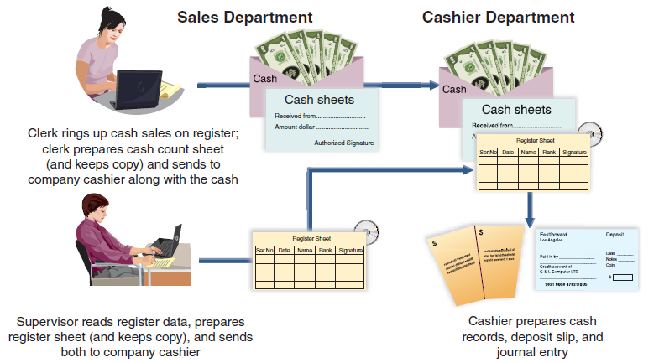
Over-the-Counter Cash Receipts
This graphic illustrates that none of the people involved can make a mistake or divert cash without the difference being revealed.
Learning Objective P1: Apply internal control to cash receipts and disbursements.
Notes:
For purposes of internal control, over-the-counter cash receipts from sales should be recorded on a cash register at the time of each sale. To help ensure that correct amounts are entered, each register should be located so customers can read the amounts entered. Clerks also should be required to enter each sale before wrapping merchandise and to give the customer a receipt for each sale. The design of each cash register should provide a permanent, locked-in record of each transaction. In many systems, the register is directly linked with computing and accounting services. Less advanced registers record each transaction on a paper tape or electronic file locked inside the register.
Custody over cash should be separate from recordkeeping. For over-the-counter cash receipts, this separation begins with the cash sale. The clerk who has access to cash in the register should not have access to its record. At the end of the clerk’s work period, the clerk should count the cash in the register, record the amount, and turn over the cash and a record of its amount to the company cashier. The cashier, like the clerk, has access to the cash but should not have access to accounting records (or the register tape or file). A third employee, often a supervisor, compares the record of total register transactions (or the register tape or file) with the cash receipts reported by the cashier. This record is the basis for a journal entry recording over-the-counter cash receipts. The third employee has access to the records for cash but not to the actual cash. The clerk and the cashier have access to cash but not to the accounting records. None of them can make a mistake or divert cash without the difference being revealed.

Slide 19

Cash Over and Short
Sometimes errors in making change are discovered from differences between the cash in the cash register and the record of the amount of cash receipts.
If a cash register’s record shows $550 but the count of cash in the register is $555, we would prepare the following journal entry:
Learning Objective P1: Apply internal control to cash receipts and disbursements.
Notes:
Sometimes errors in making change are discovered from differences between the cash in a cash register and the record of the amount of cash receipts. One or more customers can be given too much or too little change. This means that at the end of a work period, the cash in a cash register might not equal the record of cash receipts.
This difference is reported in the Cash Over and Short account, also called Cash Short and Over, which is an income statement account recording the income effects of cash overages and cash shortages. To illustrate, if a cash register’s record shows $550 but the count of cash in the register is $555, the entry to record cash sales and its overage is shown above.

Slide 20

Cash Over and Short
Sometimes errors in making change are discovered from differences between the cash in the cash register and the record of the amount of cash receipts.
On the other hand, if a cash register’s record shows $625 but the count of cash in the register is
$621, the entry to record cash sales and its shortage is:
Learning Objective P1: Apply internal control to cash receipts and disbursements.
Notes:
Alternatively, if a cash register’s record shows $625 but the count of cash in the register is $621, the entry to record cash sales and its shortage is shown.

Slide 21
Cash Receipts by Mail
Preferably, two people are assigned the task of opening the mail.
The cashier deposits the money in a bank.
The recordkeeper records the amounts received in the accounting records.
Learning Objective P1: Apply internal control to cash receipts and disbursements.
Notes:
Control of cash receipts that arrive through the mail starts with the person who opens the mail. Preferably, two people are assigned the task of, and are present for, opening the mail. In this case, theft of cash receipts by mail requires collusion between these two employees. Specifically, the person(s) opening the mail enters a list (in triplicate) of money received. This list should contain a record of each sender’s name, the amount, and an explanation of why the money is sent. The first copy is sent with the money to the cashier. A second copy is sent to the recordkeeper in the accounting area. A third copy is kept by the clerk(s) who opened the mail. The cashier deposits the money in a bank, and the recordkeeper records the amounts received in the accounting records.
This process reflects good internal control. That is, when the bank balance is reconciled by another person (explained later in the chapter), errors or acts of fraud by the mail clerks, the cashier, or the recordkeeper are revealed. They are revealed because the bank’s record of cash deposited must agree with the records from each of the three. Moreover, if the mail clerks do not report all receipts correctly, customers will question their account balances. If the cashier does not deposit all receipts, the bank balance does not agree with the recordkeeper’s cash balance. The recordkeeper and the person who reconciles the bank balance do not have access to cash and therefore have no opportunity to steal cash. This system makes errors and fraud highly unlikely. The exception is employee collusion.

Slide 22
Control of Cash Disbursements
Control of cash disbursements is especially important as most large thefts occur from payment of fictitious invoices.
Keys to Controlling Cash Disbursements
Require all expenditures to be made by check.
Limit access to checks except for those who have the authority to sign checks.
Learning Objective P1: Apply internal control to cash receipts and disbursements.
Notes:
Control of cash disbursements is especially important as most large thefts occur from payment of fictitious invoices. One key to controlling cash disbursements is to require all expenditures to be made by check. The only exception is small payments made from petty cash. Another key is to deny access to the accounting records to anyone other than the owner who has the authority to sign checks. A small-business owner often signs checks and knows from personal contact that the items being paid for are actually received. This arrangement is impossible in large businesses. Instead, internal control procedures must be substituted for personal contact. Such procedures are designed to assure the check signer that the obligations recorded are properly incurred and should be paid.

Slide 23
Voucher System of Control
A voucher system establishes procedures for:
  Verifying, approving, and recording obligations for eventual cash disbursements.
  Issuing checks for payment of verified, approved, and recorded obligations.
Learning Objective P1: Apply internal control to cash receipts and disbursements.
Notes:
A voucher system is a set of procedures and approvals designed to control cash disbursements and the acceptance of obligations. The voucher system of control establishes procedures for
Verifying, approving, and recording obligations for eventual cash disbursement.
Issuing checks for payment of verified, approved, and recorded obligations.
A reliable voucher system follows standard procedures for every transaction. This applies even when multiple purchases are made from the same supplier.

Slide 24
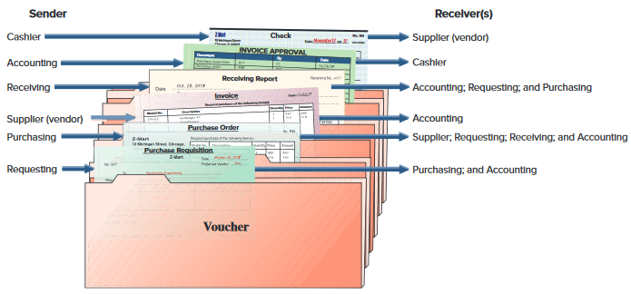
Voucher System of Control
Exhibit 8.1
Learning Objective P1: Apply internal control to cash receipts and disbursements.
Notes:
A voucher system’s control over cash disbursements begins when a company incurs an obligation that will result in payment of cash. A key factor in this system is that only approved departments and individuals are authorized to incur such obligations. The system often limits the type of obligations that a department or individual can incur. In a large retail store, for instance, only a purchasing department should be authorized to incur obligations for merchandise inventory. Another key factor is that procedures for purchasing, receiving, and paying for merchandise are divided among several departments (or individuals). These departments include the one requesting the purchase, the purchasing department, the receiving department, and the accounting department. To coordinate and control responsibilities of these departments, a company uses several different business documents. This slide shows how documents are accumulated in a voucher, which is an internal document (or file) used to accumulate information to control cash disbursements and to ensure that a transaction is properly recorded.
Review what you have learned in the following NEED-TO-KNOW Slide.

Slide 25
NEED-TO-KNOW 8-2
A good system of internal control for cash provides adequate procedures for protecting both cash receipts
and cash disbursements. Which of the following statements are true regarding the control of cash receipts
and disbursements?
1. Over-the-counter cash receipts from sales should be recorded on a cash register at the time of
each sale.
True – All sales should be recorded on a cash register.
2. Custody over cash should be separate from the recordkeeping of cash.
True – Segregation of duties
3. For control of cash receipts that arrive through the mail, two people should be assigned the task
of, and be present for, opening that mail.
True – Segregation of duties
4. One key to controlling cash disbursements is to require that no expenditures be made by check;
instead, all expenditures should be made from petty cash.
False – Only small amounts should be paid from petty cash.
5. A voucher system of control should be applied only to purchases of inventory and never to other
expenditures.
False – A voucher system should be applied to all purchases.
Learning Objective P1: Apply internal control to cash receipts and disbursements.
Notes:
A good system of internal control for cash provides adequate procedures for protecting both cash receipts and cash disbursements. Which of the following statements is true regarding the control of cash receipts and disbursements?
1. Over-the-counter cash receipts from sales should be recorded on a cash register at the time of each sale. This is true; all sales should be recorded on a cash register.
2. Custody over cash should be separate from the recordkeeping of cash. This is also true; it's important to have segregation of duties.
3. For control of cash receipts that arrive through the mail, two people should be assigned the task of, and be present for, opening that mail. This is also true.
4. One key to controlling cash disbursements is to require that no expenditures be made by check; instead, all expenditures should be made from petty cash. This is false; only small amounts should be paid from petty cash.
5. A voucher system of control should be applied only to purchases of inventory and never to other expenditures. This is also false; a voucher system should be applied to all purchases.

Slide 26
P2:
Explain and record petty cash fund transactions.
Learning Objective

Slide 27
Petty Cash System of Control
Small payments required in most companies for items such as postage, courier fees, repairs, and supplies.
Learning Objective P2: Explain and record petty cash fund transactions.
Notes:
A basic principle for controlling cash disbursements is that all payments must be made by check. An exception to this rule is made for petty cash disbursements, which are the small payments required for items such as postage, courier fees, minor repairs, and low-cost supplies. To avoid the time and cost of writing checks for small amounts, a company sets up a petty cash fund to make small payments. (Petty cash activities are part of an imprest system, which designates advance money to establish the fund, to withdraw from the fund, and to reimburse the fund.)

Slide 28

Operating a Petty Cash Fund
To establish a petty cash fund:
Petty Cash is debited to increase
Cash is credited to decrease
Learning Objective P2: Explain and record petty cash fund transactions.
Notes:
Here is how a petty cash system works. The company cashier processes a check for the petty cash amount and gives it to the petty cashier. In this example, Z-Mart establishes a petty cash account for $75. To illustrate, assume Z-Mart establishes a petty cash fund on November 1 and designates one of its office employees as the petty cashier. A $75 check is drawn, cashed, and the proceeds given to the petty cashier. The entry to record the setup of this petty cash fund is shown in this slide as a debit to Petty Cash for $75 and a credit to Cash for $75.

Slide 29
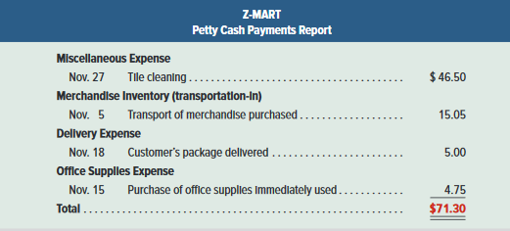
Operating a Petty Cash Fund
Summary of petty cash receipts:
Exhibit 8.3
Learning Objective P2: Explain and record petty cash fund transactions.
Notes:
Next, assume that Z-Mart’s petty cashier makes several November payments from petty cash. Each person who received payment is required to sign a receipt. On November 27, after making a $46.50 cash payment for tile cleaning, only $3.70 cash remains in the fund. The petty cashier then summarizes and totals the petty cash receipts as shown in this slide.

Slide 30
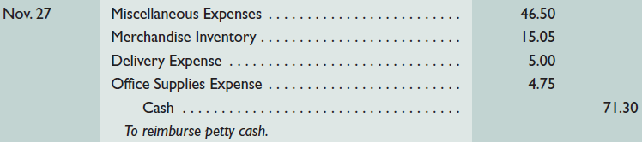
Reimbursement of Petty Cash Fund
Cash payments report is used in making the journal entry to reimburse the fund.
Debit each of the expenses and credit Cash.
Learning Objective P2: Explain and record petty cash fund transactions.
Notes:
The petty cash payments report and all receipts are given to the company cashier in exchange for a $71.30 check to reimburse the fund. The petty cashier cashes the check and puts the $71.30 cash in the petty cashbox. The company records this reimbursement as shown in this slide.

Slide 31


Increasing or Decreasing a Petty Cash Fund
To increase, debit Petty Cash and credit Cash.
To decrease, debit Cash and credit Petty Cash.
Learning Objective P2: Explain and record petty cash fund transactions.
Notes:
If a decision is made to increase the Petty Cash fund, Petty Cash is debited, to increase, and Cash is credited, to decrease.
Alternatively, if the company decides to decrease the fund, Cash is debited, to increase, and Petty Cash is credited, to decrease.

Slide 32
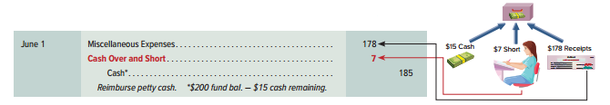
Cash Over and Short
If petty cashier fails to obtain a receipt for payment or overpays an amount, cash over or short will result.
Petty cash payments report plus cash left in account will not total to the fund balance.
Difference is debited, if short, to Cash Over and Short.
Difference is credited, if over, to Cash Over and Short.
Learning Objective P1: Apply internal control to cash receipts and disbursements.
Notes:
Sometimes errors in making change are by the petty cashier which will result in a difference between the amount of total receipts and cash required to bring the fund back to it’s original balance.
This difference is reported in the Cash Over and Short account, also called Cash Short and Over, which is an income statement account recording the income effects of cash overages and cash shortages.
To illustrate, a petty cash fund had $200 and the cash payments report shows $178 in miscellaneous expenses and $15 cash left. This means that the fund is short $7 ($200 – 15 = $185. $185 – 178 = $7). The entry to record the reimbursement includes a debit to Miscellaneous Expenses for $178, a debit to Cash Over and Short for $7, and a credit to Cash for $185.
Review what you have learned in the following NEED-TO-KNOW Slides.

Slide 33
NEED-TO-KNOW 8-3
Bacardi Company established a $150 petty cash fund with Eminem as the petty cashier. When the fund
balance reached $19 cash, Eminem prepared a petty cash payment report, which follows.
Receipt No.
Account Charged
Approved by
Received by
12
Delivery Expense
$29
Eminem
A. Smirnoff
13
Merchandise Inventory
18
Eminem
J. Daniels
15
(Omitted)
32
Eminem
C. Carlsberg
16
Miscellaneous Expense
41
(Omitted)
J. Walker
Total
$120
Required:
1.
Identify four internal control weaknesses from the payment report.
Petty cash ticket no. 14 is missing. All petty cash tickets should be pre-numbered and all
numbers should be accounted for.
Since total cash on hand is only $19, $131 has been withdrawn ($150 - $19). Only $120 in
expenditures has been documented. Management should investigate the $11 cash shortage.
The petty cashier did not sign petty cash receipt no. 16. Was the expense approved, or was this
an oversight?
Petty cash receipt no. 15 does not indicate the account to be charged. If possible, management
should determine the correct account; if impossible, Miscellaneous Expense should be charged.
Learning Objective P2: Explain and record petty cash fund transactions.
Notes:
Bacardi Company established a $150 petty cash fund with Eminem as the petty cashier. When the fund balance reached $19 cash, Eminem prepared a petty cash payment report, which follows.
1. Identify four internal control weaknesses from the payment report. The first weakness is that petty cash ticket number 14 is missing. All petty cash tickets should be pre-numbered and all numbers should be accounted for. Since total cash on hand is only $19, $131 has been withdrawn from the Petty Cash Fund ($150 - $19). Only $120 in expenditures has been documented. Management should investigate the $11 cash shortage. The petty cashier did not sign petty cash receipt no. 16. Was the expense approved, or was this an oversight? And petty cash receipt number 15 does not indicate the account to be charged. If possible, management should determine the correct account; and, if impossible, Miscellaneous Expense should be charged.

Slide 34
NEED-TO-KNOW 8-3 SOLUTION
Bacardi Company established a $150 petty cash fund with Eminem as the petty cashier. When the fund
balance reached $19 cash, Eminem prepared a petty cash payment report, which follows.
Receipt No.
Account Charged
Approved by
Received by
12
Delivery Expense
$29
Eminem
A. Smirnoff
13
Merchandise Inventory
18
Eminem
J. Daniels
15
(Omitted)
32
Eminem
C. Carlsberg
16
Miscellaneous Expense
41
(Omitted)
J. Walker
Total
$120
2.
Prepare general journal entries to record the establishment of the fund and the
reimbursement of the fund. (Assume that management was unable to verify the account
number for receipt no. 15.)
Date
General Journal
Debit
Credit
Establish
Petty cash
150
Cash
150
Reimburse
Delivery expense
29
Merchandise inventory
18
Miscellaneous expense
73
Cash short and over
11
Cash ($150 - $19)
131
Learning Objective P2: Explain and record petty cash fund transactions.
Notes:
Prepare general journal entries to record the establishment of the fund and the reimbursement of the fund. When the fund is established, the journal entry is a debit to Petty cash, $150, and a credit to Cash. To reimburse the fund, the total credit to Cash is for $131. This is the amount necessary to bring the cash on hand, $19, back up to the amount of the fund, $150. The reimbursement will always bring cash on hand back up to the amount the fund, regardless of the total of the receipts. After we've determined the credit to Cash, we turn our attention to the petty cash payment report. We debit Delivery expense for $29, debit Merchandise inventory, $18, and assuming that management was unable to verify the account number for receipt number 15, both receipts 15 and 16 are charged to Miscellaneous expense, a total of $73. Since the amount of the replenishment is $131, but the receipts total only $120, the difference is debited to Cash short and over, $11.

Slide 35
NEED-TO-KNOW 8-3 SOLUTION
Bacardi Company established a $150 petty cash fund with Eminem as the petty cashier. When the fund
balance reached $19 cash, Eminem prepared a petty cash payment report, which follows.
Receipt No.
Account Charged
Approved by
Received by
12
Delivery Expense
$29
Eminem
A. Smirnoff
13
Merchandise Inventory
18
Eminem
J. Daniels
15
(Omitted)
32
Eminem
C. Carlsberg
16
Miscellaneous Expense
41
(Omitted)
J. Walker
Total
$120
3.
What is the Petty Cash account balance immediately before reimbursement?
$150
Immediately after reimbursement?
$150
The balance in Petty cash remains constant unless the amount of the fund is changed.
Learning Objective P2: Explain and record petty cash fund transactions.
Notes:
The balance in the Petty cash account immediately before the reimbursement is $150. Since the journal entry to reimburse the fund does not affect the petty cash account, the balance in the petty cash general ledger immediately after the reimbursement remains at $150. The balance in the petty cash account only changes if the company decides to change the amount of the fund.

Slide 36
Basic Bank Services
Signature Cards
Bank Accounts
Deposit Tickets
Bank Statements
Checks
Electronic Funds Transfer
Learning Objective P2: Explain and record petty cash fund transactions.
Notes:
Banks offer certain protections for your cash. For example, use of a bank account is a more secure place for your cash than a safe at the office. Signature cards are used so the bank knows whose signature is approved for use on checks. Deposit tickets provide support for deposits to your account. Checks provide authorization for disbursements from your account. Electronic funds is the transfer of cash from one party to another. Bank statements are provided so customers can reconcile their accounts in a timely manner and can detect any unusual or unauthorized activity.

Slide 37
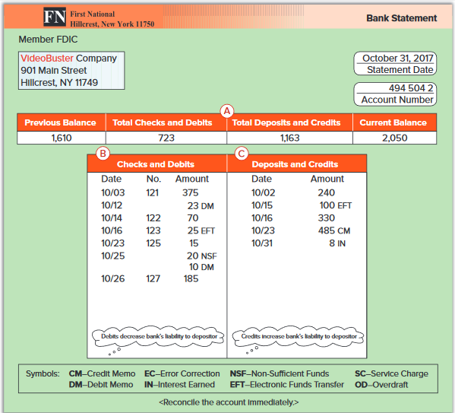
Bank Statement
Exhibit 8.6
Usually once a month, the bank sends each depositor a bank statement showing the activity in the account.
Learning Objective P2: Explain and record petty cash fund transactions.
Notes:
Usually once a month, the bank sends a bank statement showing the activity in the account. Although a monthly statement is common, companies often regularly access information on their banking transactions. (Companies can choose to record any accounting adjustments required from the bank statement immediately or later, say, at the end of each day, week, month, or when reconciling a bank statement.) Different banks use different formats for their bank statements, but all of them include the following items of information:
Beginning-of-period balance of the depositor’s account.
Checks and other debits decreasing the account during the period.
Deposits and other credits increasing the account during the period.
End-of-period balance of the depositor’s account.
This slide shows one type of bank statement. Identify each of these four items in that statement. Part A summarizes changes in the account. Part B lists paid checks along with other debits. Part C lists deposits and credits to the account, and part D shows the daily account balances.

Slide 38
P3:
Prepare a bank reconciliation.
Learning Objective

Slide 39
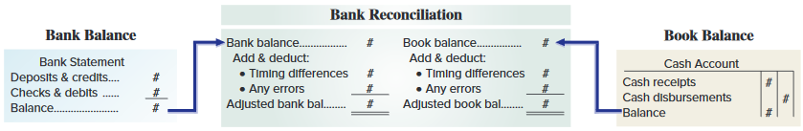
Bank Reconciliation
A bank reconciliation is prepared periodically to explain the difference between cash reported on the bank statement and the cash balance on company’s books.
Learning Objective P3: Prepare a bank reconciliation.
Notes:
When a company deposits all cash receipts and makes all cash payments (except petty cash) by check, it can use the bank statement to prove the accuracy of its cash records. This is done using a bank reconciliation, which is a report explaining any differences between the checking account balance according to the depositor’s records and the balance reported on the bank statement.

Slide 40
Bank Reconciliation
The balance of a checking account reported on the bank statement rarely equals the balance in the depositor’s accounting records.
Cash Balance per Bank
Cash Balance per Book
+ Deposits in Transit
+ Collections & Interest
- Outstanding Checks
- Uncollectible items
+/- Errors
+/- Errors
Adjusted Cash Balance
=
Adjusted Cash Balance
Adjusting entries are recorded for the reconciling items on the book side of the reconciliation.
Learning Objective P3: Prepare a bank reconciliation.
Notes:
The balance of a checking account reported on the bank statement rarely equals the balance in the depositor’s accounting records. This is usually due to information that one party has that the other does not. We must therefore prove the accuracy of both the depositor’s records and those of the bank. This means we must reconcile the two balances and explain or account for any differences in them. The bank statement balance differs from the depositor’s book balance because of:
Deposits in transit
Outstanding checks
Additions for collections and for interest
Deductions for uncollectible items for services
Errors

Slide 41
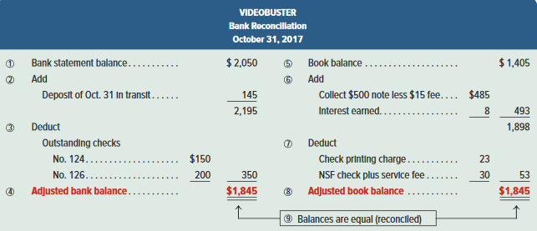
Bank Reconciliation
Exhibit 8.7
We follow nine steps in preparing the bank reconciliation.
Learning Objective P3: Prepare a bank reconciliation.
Notes:
In preparing the bank reconciliation, it is helpful to refer to Exhibit 8.7 and steps 1 through 9.
1. Identify the bank statement balance of the Cash account (balance per bank). VideoBuster’s bank balance is $2,050.
2. Identify and list any unrecorded deposits and any bank errors understating the bank balance. Add them to the bank balance. VideoBuster’s $145 deposit placed in the bank’s night depository on October 31 is not recorded on its bank statement.
3. Identify and list any outstanding checks and any bank errors overstating the bank balance. Subtract them from the bank balance. VideoBuster’s comparison of canceled checks with its books shows two checks outstanding: No. 124 for $150 and No. 126 for $200.
4. Compute the adjusted bank balance, also called the corrected or reconciled balance.

Slide 42
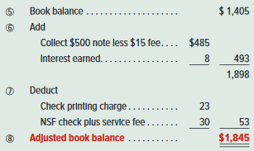
Bank Reconciliation
We follow nine steps in preparing the bank reconciliation.
Learning Objective P3: Prepare a bank reconciliation.
Notes:
5. Identify the company’s book balance of the Cash account (balance per book). VideoBuster’s book balance is $1,405.
6. Identify and list any unrecorded credit memoranda from the bank, any interest earned, and errors understating the book balance. Add them to the book balance. VideoBuster’s bank statement includes a credit memorandum showing the bank collected a note receivable for the company on October 23. The note’s proceeds of $500 (minus a $15 collection fee) are credited to the company’s account. VideoBuster’s bank statement also shows a credit of $8 for interest earned on the average cash balance. There was no prior notification of this item, and it is not yet recorded.
7. Identify and list any unrecorded debit memoranda from the bank, any service charges, and errors overstating the book balance. Deduct them from the book balance. Debits on VideoBuster’s bank statement that are not yet recorded include (a) a $23 charge for check printing and (b) an NSF check for $20 plus a related $10 processing fee. (The NSF check is dated October 16 and was included in the book balance.)
8. Compute the adjusted book balance, also called corrected or reconciled balance.

Slide 43
Bank Reconciliation
Exhibit 8.7
We follow nine steps in preparing the bank reconciliation.
Adjusting entries are recorded for the reconciling items on the book side of the reconciliation.
Learning Objective P3: Prepare a bank reconciliation.
Notes:
Verify that the two adjusted balances from steps 4 and 8 are equal. If so, they are reconciled. If not, check for accuracy and missing data to achieve reconciliation.
A bank reconciliation often identifies unrecorded items that need recording by the company. In VideoBuster’s reconciliation, the adjusted balance of $1,845 is the correct balance as of October 31. But the company’s accounting records show a $1,404.58 balance. We must prepare journal entries to adjust the book balance to the correct balance. Only items reconciling the book balance require adjustment.

Slide 44

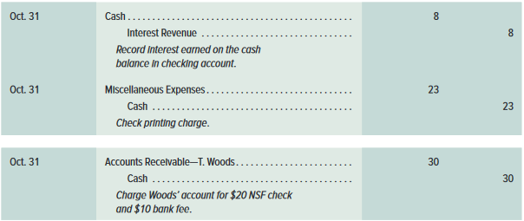
Bank Reconciliation
Only items reconciling the book balance require adjustment.
Learning Objective P3: Prepare a bank reconciliation.
Notes:
The first entry is to record the proceeds of its note receivable collected by the bank less the expense of having the bank perform that service.
The second entry records interest credited to its account by the bank.
The third entry records expenses for the check printing charge.
The fourth entry records the NSF check that is returned as uncollectible. The $20 check was originally received from T. Woods in payment of his account and then deposited. The bank charged $10 for handling the NSF check and deducted $30 total from VideoBuster’s account. This means the entry must reverse the effects of the original entry made when the check was received and must record (add) the $10 bank fee. After these four entries are recorded, the book balance of cash is adjusted to the correct amount of $1,845 (the adjusted book balance).
Review what you have learned in the following NEED-TO-KNOW Slides.

Slide 45
NEED-TO-KNOW 8-4
The following information is available to reconcile Gucci’s book balance of cash with its bank statement
cash balance as of December 31. Prepare the bank reconciliation for this company as of December 31.
a.
The December 31 cash balance according to the accounting records is $1,610, and the bank statement
cash balance for that date is $1,900.
b.
Gucci’s December 31 daily cash receipts of $800 were placed in the bank’s night depository on
December 31, but do not appear on the December 31 bank statement.
c.
Check No. 6273 for $400 and Check No. 6282 for $100, both written and entered in the accounting
records in December, are not among the canceled checks. Two checks, No. 6231 for $2,000 and No.
6242 for $200, were outstanding on the most recent November 30 reconciliation. Check No. 6231 is
listed with the December canceled checks, but Check No. 6242 is not.
d.
When the December checks are compared with entries in the accounting records, it is found that Check
No. 6267 had been correctly drawn for $340 to pay for office supplies but was erroneously entered in
the accounting records as $430.
e.
A credit memorandum indicates that the bank collected $500 cash on a note receivable for the
company, deducted a $30 collection fee, and credited the balance to the company’s Cash account.
Gucci had not recorded this transaction before receiving the statement.
f.
Two debit memoranda are enclosed with the statement and are unrecorded at the time of the reconciliation.
One debit memorandum is for $150 and dealt with an NSF check for $140 received from a customer,
Prada Inc., in payment of its account. The bank assessed a $10 fee for processing it. The second
debit memorandum is a $20 charge for check printing. Gucci had not recorded these transactions
before receiving the statement.
Learning Objective P3: Prepare a bank reconciliation.
Notes:
The following information is available to reconcile Gucci’s book balance of cash with its bank statement cash balance as of December 31. Prepare the bank reconciliation for this company as of December 31. And we're given information related to several timing differences and errors. The majority of items on the bank reconciliation relate to timing differences; items that have been recorded either by the company or the bank, but have not yet been reflected in the other party's balance. The bank reconciliation adjusts for the timing differences. We begin with the bank statement balance, and then add items that have already been added to the book balance but not yet added to the bank balance. We deduct items that have already been subtracted from the book balance but have not yet been subtracted from the bank balance. This will give us the adjusted bank balance. The book balance may exclude some items that have already been recorded by the bank.

Slide 46
NEED-TO-KNOW 8-4 SOLUTION
Gucci
Bank Reconciliation
December 31
Bank statement balance
Book balance
Add: Items already added to the book balance that have not yet been added to the bank balance.
Add: Items already added to the bank balance that have not yet been added to the book balance.
Deduct: Items already subtracted from the book balance that have not yet been subtracted from the bank balance.
Deduct: Items already subtracted from the bank balance that have not yet been subtracted from the book balance.
Adjusted bank balance
Adjusted book balance
In the case of an error, whichever party made the error (book or bank) will show the correction as an adjustment.
Learning Objective P3: Prepare a bank reconciliation.
Notes:
To reconcile the balance, we add in any items that have already been added to the bank balance but have not yet been added to the book balance, and then deduct items that have already been subtracted from the bank balance, but not yet subtracted from the book balance.
The adjusted bank balance should always equal the adjusted book balance. Occasionally, there will be an error made by either the bank or the company. In the case of an error, whichever party made the error will show the correction as an adjustment.

Slide 47
NEED-TO-KNOW 8-4 SOLUTION
Gucci
Bank Reconciliation
December 31
Bank statement balance
$1,900
Book balance
$1,610
Add:
Add:
Deposit of December 31
800
Deduct:
Checks No.
6273
$400
Deduct:
6282
100
6242
200
Adjusted bank balance
Adjusted book balance
a.
The December 31 cash balance according to the accounting records is $1,610, and the bank statement
cash balance for that date is $1,900.
b.
Gucci’s December 31 daily cash receipts of $800 were placed in the bank’s night depository on
December 31, but do not appear on the December 31 bank statement.
c.
Check No. 6273 for $400 and Check No. 6282 for $100, both written and entered in the accounting
records in December, are not among the canceled checks. Two checks, No. 6231 for $2,000 and No.
6242 for $200, were outstanding on the most recent November 30 reconciliation. Check No. 6231 is
listed with the December canceled checks, but Check No. 6242 is not.
Learning Objective P3: Prepare a bank reconciliation.
Notes:
The December 31 cash balance according to the accounting records is $1,610, and the bank statement cash balance for that date is $1,900. Gucci’s December 31 daily cash receipts of $800 were placed in the bank’s night depository on December 31, but do not appear on the December 31 bank statement. This $800 has already been added to the book balance, but has not yet been added to the bank balance. We add this amount as a reconciling item; deposit in transit of $800. Check No. 6273 for $400 and Check No. 6282 for $100, both written and entered in the accounting records in December, are not among the canceled checks. Both of these amounts have already been subtracted in the calculation of the book balance.
Checks that have not yet cleared the bank are called "outstanding checks,” and are recorded as deductions from the bank balance until the checks clear. We subtract both checks; No. 6273 for $400, and No. 6282 for $100.
Two checks, No. 6231 for $2,000 and No. 6242 for $200, were outstanding on the most recent November 30 reconciliation. Check No. 6231 is listed with the December canceled checks, but Check No. 6242 is not. Once a check is listed as an outstanding check, it stays on the reconciliation until it clears the bank. Since Check No. 6231 has now cleared the bank, it is no longer a reconciling item. Check No. 6242 has not yet cleared the bank; it remains a reconciling item.

Slide 48
NEED-TO-KNOW 8-4 SOLUTION
Gucci
Bank Reconciliation
December 31
Bank statement balance
$1,900
Book balance
$1,610
Add:
Add:
Deposit of December 31
800
Error (Ck 6267)
$90
2,700
Proceeds of note less $30 fee
470
560
Deduct:
2,170
Checks No.
6273
$400
Deduct:
6282
100
NSF check
$150
6242
200
700
Printing fee
20
170
Adjusted bank balance
$2,000
Adjusted book balance
$2,000
d.
When the December checks are compared with entries in the accounting records, it is found that Check
No. 6267 had been correctly drawn for $340 to pay for office supplies but was erroneously entered in
the accounting records as $430.
e.
A credit memorandum indicates that the bank collected $500 cash on a note receivable for the
company, deducted a $30 collection fee, and credited the balance to the company’s Cash account.
Gucci had not recorded this transaction before receiving the statement.
f.
Two debit memoranda are enclosed with the statement and are unrecorded at the time of the reconciliation.
One debit memorandum is for $150 and dealt with an NSF check for $140 received from a customer,
Prada Inc., in payment of its account. The bank assessed a $10 fee for processing it. The second
debit memorandum is a $20 charge for check printing. Gucci had not recorded these transactions
before receiving the statement.
Learning Objective P3: Prepare a bank reconciliation.
Notes:
When the December checks are compared with entries in the accounting records, it is found that Check No. 6267 had been correctly drawn for $340 to pay for office supplies but was erroneously entered in the accounting records as $430. This is an error that was made by the company. Gucci subtracted $430, but should have only subtracted $340. To correct for this error, we add back the difference, $90. A credit memorandum indicates that the bank collected $500 cash on a note receivable for the company, deducted a $30 collection fee, and credited the balance to the company’s Cash account. Gucci had not recorded this transaction before receiving the statement.

Slide 49
NEED-TO-KNOW 8-4 SOLUTION
Gucci
Bank Reconciliation
December 31
Bank statement balance
$1,900
Book balance
$1,610
Add:
Add:
Deposit of December 31
800
Error (Ck 6267)
$90
2,700
Proceeds of note less $30 fee
470
560
Deduct:
2,170
Checks No.
6273
$400
Deduct:
6282
100
NSF check
$150
6242
200
700
Printing fee
20
170
Adjusted bank balance
$2,000
Adjusted book balance
$2,000
Date
General Journal
Debit
Credit
Dec. 31
Cash
90
Office supplies
90
Dec. 31
Cash
470
Collection expense
30
Notes receivable
500
Dec. 31
Accounts receivable - Prada Inc.
150
Cash
150
Dec. 31
Miscellaneous expenses
20
Cash
20
Learning Objective P3: Prepare a bank reconciliation.
Notes:
The bank statement balance of $1,900 already includes the $470 cash receipt. The book balance does not yet include the $470, so we include it as a reconciling item: proceeds of the note less the $30 fee, $470. Two debit memoranda are enclosed with the statement and are unrecorded at the time of the reconciliation. One debit memorandum is for $150 and dealt with an NSF check for $140 received from a customer, Prada Inc., in payment of its account. The bank assessed a $10 fee for processing it. The bank has already subtracted $150 in the calculation of the bank statement balance. The $150 has not yet been subtracted from the book balance, so we subtract the amount as a reconciling item, $150. The second debit memorandum is a $20 charge for check printing. Gucci had not recorded these transactions before receiving the statement. The $20 has already been subtracted from the bank statement balance, but not yet subtracted from the book balance.
We subtract the $20 as a reconciling item. Now we simply do the arithmetic. $1,900 plus $800 is $2,700. When we subtract the total of the outstanding checks, $700, the adjusted bank balance is $2,000. We have two additions to the book balance, a total of $560. $1,610 plus $560 is $2,170. We have total subtractions of $170, giving us an adjusted book balance of $2,000. The adjusted bank balance should always equal the adjusted book balance. The next step is to prepare journal entries to make sure that the general ledger reflects the true cash balance, $2,000. There are no journal entries required for adjustments to the bank balance. The first adjustment increases the balance in the cash account by $90. Office supplies had originally been overstated by $90. To correct the error, we credit the Office supplies account for $90. The next item also increases the balance in the Cash account. We debit Cash for $470. The fee is recorded as a Collection expense, $30, and we credit the asset, Notes receivable.
The next item decreases Cash by $150. When a customer's check is returned, we bill the customer back for the original amount owed plus any fees. The journal entry is a debit to Accounts receivable, $150, and a credit to Cash. The final item also decreases the balance in the Cash account. The service fees are debited to Miscellaneous expenses, and we credit Cash.

Slide 50
A1:
Compute the days’ sales uncollected ratio and use it to assess liquidity.
Learning Objective

Slide 51
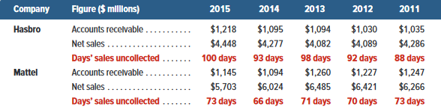
Days’ Sales Uncollected
Exhibit 8.9
Indicates how much time is likely to pass before
we receive cash receipts from credit sales.
Days’
sales
uncollected
Accounts receivable
Net sales
=
× 365
Learning Objective A1: Compute the days’ sales uncollected ratio and use it to assess liquidity.
Notes:
One measure of how quickly a company can convert its accounts receivable into cash is the days’ sales uncollected, also called days’ sales in receivables. This measure is computed by dividing the current balance of receivables by net credit sales over the year just completed and then multiplying by 365 (number of days in a year). Since net credit sales usually are not reported to external users, the net sales (or revenues) figure is commonly used in the computation as shown in this slide.
We use days’ sales uncollected to estimate how much time is likely to pass before the current amount of accounts receivable is received in cash. For evaluation purposes, we need to compare this estimate to that for other companies in the same industry. We also make comparisons between current and prior periods. To illustrate, we select data from the annual reports of two toy manufacturers, Hasbro and Mattel.
Their days’ sales uncollected figures are shown in this slide.
Days’ sales uncollected for Hasbro in 2015 is computed as ($1,218/$4,448) × 365 days = 100 days. This means that it will take about 93 days to collect cash from ending accounts receivable. This number reflects one or more of the following factors: a company’s ability to collect receivables, customer financial health, customer payment strategies, and discount terms. To further assess days’ sales uncollected for Hasbro, we compare it to its own four prior years and to those of Mattel. We see that Hasbro’s days’ sales uncollected has worsened in 2015 as it took longer to collect its receivables relative to 2014. In comparison, Mattel worsened in 2015 as its days’ sales uncollected increased by 7 days. For all years, Mattel is superior to Hasbro on this measure of cash management.

Slide 52
P4 (Appendix 8-A):
Describe use of documentation and verification to control cash disbursements.
Learning Objective

Slide 53
Appendix 8A:
Documentation and Verification
Purchase Requisition
Purchase Order
Invoice
Receiving Report
Learning Objective P4: Describe use of documentation and verification to control cash disbursements.
Notes:
This appendix describes the important business documents of a voucher system of control.
Department managers are usually not allowed to place orders directly with suppliers for control purposes. Instead, a department manager must inform the purchasing department of its needs by preparing and signing a purchase requisition, which lists the merchandise needed and requests that it be purchased.
A purchase order is a document the purchasing department uses to place an order with a vendor (seller or supplier).
An invoice is an itemized statement of goods prepared by the vendor listing the customer’s name, items sold, sales prices, and terms of sale. An invoice is also a bill sent to the buyer from the supplier. From the vendor’s point of view, it is a sales invoice.
Many companies maintain a separate department to receive all merchandise and purchased assets. When each shipment arrives, this receiving department counts the goods and checks them for damage and agreement with the purchase order. It then prepares four or more copies of a receiving report, which is used within the company to notify the appropriate persons that ordered goods have been received and to describe the quantities and condition of the goods.

Slide 54
Invoice Approval
Accounting department will record purchase and approve payment after all documents are in order.
Information across all documents are verified.
Invoice approval also called check authorization.
Checklist of steps necessary for approving invoice and payment.
Learning Objective P4: Describe use of documentation and verification to control cash disbursements.
Notes:
The accounting department should have copies of the following documents in the voucher: purchase requisition, purchase order, and invoice. With the information in these documents, the accounting department can record the purchase and approve its payment. In approving an invoice for payment, it checks and compares information across all documents. To facilitate this checking and to ensure that no step is omitted, it often uses an invoice approval, also called check authorization.

Slide 55
Voucher
Voucher is complete after invoice has been checked and approved.
Used to authorize recording obligation.
Certain information is required on the inside of a voucher.
Certain information is also required on the outside of a voucher.
Learning Objective P4: Describe use of documentation and verification to control cash disbursements.
Notes:
Once an invoice has been checked and approved, the voucher is complete. A complete voucher is a record summarizing a transaction. Once the voucher certifies a transaction, it authorizes recording an obligation. A voucher also contains approval for paying the obligation on an appropriate date.
Typical information required on the inside of a voucher is shown in Exhibit 6A.4, and that for the outside is shown in Exhibit 6A.5. This information is taken from the invoice and the supporting documents filed in the voucher.

Slide 56
End of Chapter 8

