Slide 1
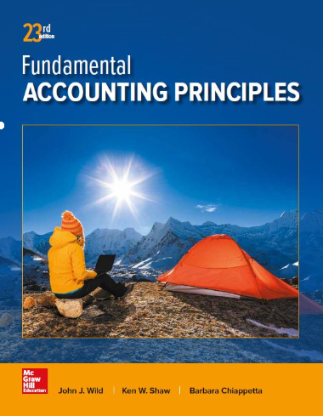
Reporting the Statement of Cash Flows
Chapter 16
Wild, Shaw, and Chiappetta
Fundamental Accounting Principles
23rd Edition
Notes:
Chapter 16: Reporting the Statement of Cash Flows

Slide 2
Chapter 16 Learning Objectives
CONCEPTUAL
C1 Distinguish between operating, investing, and financing activities, and describe how noncash investing and financing activities are disclosed.
ANALYTICAL
A1 Analyze the statement of cash flows and apply the cash flow on total assets ratio.
PROCEDURAL
P1 Prepare a statement of cash flows.
P2 Compute cash flows from operating activities using the indirect method.
P3 Determine cash flows from both investing and financing activities.
P4 Appendix 16A – Illustrate use of a spreadsheet to prepare a statement of cash flows.
P5 Appendix 16B – Compute cash flows from operating activities using the direct method.
2

Slide 3
Purpose of the Statement of Cash Flows
How does a company receive its cash?
Where does a company spend its cash?
What explains the change in the cash balance?
Notes:
The purpose of the statement of cash flows is to report cash receipts (inflows) and cash payments (outflows) during a period. This includes separately identifying the cash flows related to operating, investing, and financing activities. It is the detailed disclosure of individual sources and uses of cash that makes this statement useful to users. Information in this statement helps users answer questions such as these:
What explains the change in the cash balance?
Where does a company spend its cash?
How does a company receive its cash?

Slide 4
Importance of Cash Flows
What explains the change in the cash balance?
Where does a company spend its cash?
How does a company receive its cash?
Why do income and cash flows differ?
Notes:
Information about cash flows can influence decision makers in important ways. For instance, we prefer a company to pay expenses with cash from operations rather than one that does it by selling assets. Information about cash flows helps users decide whether a company has enough cash to pay its debts as they mature. It is helps to evaluate a company’s ability to meet unexpected obligations and pursue unexpected opportunities.

Slide 5
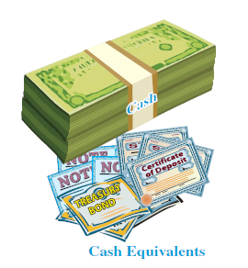
Measurement of Cash Flows
Cash equivalents are…
short-term, highly liquid investments.
readily convertible into cash.
sufficiently close to maturity so that market value is unaffected by interest rate changes.
Notes:
Cash flows include both cash and cash equivalents. The statement of cash flows explains the difference between the beginning and ending balances of cash and cash equivalents. We continue to use the phrases cash flows and the statement of cash flows, but remember that both phrases refer to cash and cash equivalents.
A cash equivalent must satisfy two criteria: (1) be readily convertible to a known amount of cash and (2) be sufficiently close to its maturity so its market value is unaffected by interest rate changes.

Slide 6
C1:
Distinguish between operating, investing, and financing activities, and describe how noncash investing and financing activities are disclosed.
Learning Objective

Slide 7
Classification of Cash Flows
The Statement of Cash Flows includes the following three sections:
  Operating Activities
  Investing Activities
  Financing Activities
Learning Objective C1: Distinguish between operating, investing, and financing activities, and describe how noncash investing and financing activities are disclosed.
Notes:
Since cash and cash equivalents are combined, the statement of cash flows does not report transactions between cash and cash equivalents, such as cash paid to purchase cash equivalents and cash received from selling cash equivalents. However, all other cash receipts and cash payments are classified and reported on the statement in one of three categories—operating, investing, or financing activities. Individual cash receipts and payments for each of these three categories are labeled to identify their originating transactions or events. A net cash inflow (source) occurs when the receipts in a category exceed the payments. A net cash outflow (use) occurs when the payments in a category exceed the receipts.

Slide 8
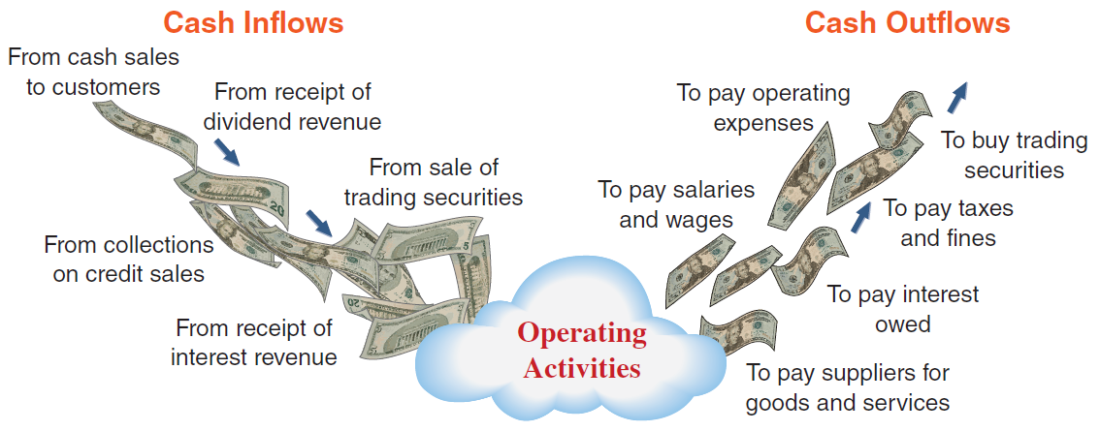
Operating Activities
Exhibit 16.1
Learning Objective C1: Distinguish between operating, investing, and financing activities, and describe how noncash investing and financing activities are disclosed.
Notes:
Operating activities include those transactions and events that determine net income. Examples are the production and purchase of inventory, the sale of goods and services to customers, and the expenditures to operate the business. Not all items in income, such as unusual gains and losses, are operating activities (we discuss these exceptions later). This slide lists the more common cash inflows and outflows from operating activities.

Slide 9
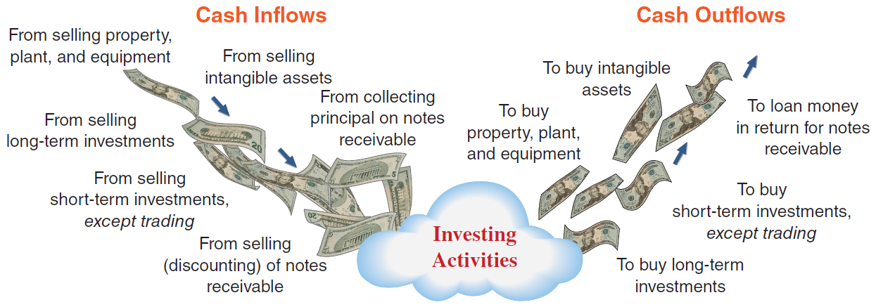
Investing Activities
Exhibit 16.2
Learning Objective C1: Distinguish between operating, investing, and financing activities, and describe how noncash investing and financing activities are disclosed.
Notes:
Investing activities generally include those transactions and events that affect long-term assets—namely, the purchase and sale of long-term assets. They also include (1) the purchase and sale of short-term investments in other entities, except trading securities, and (2) lending and collecting money for notes receivable. This slide lists examples of cash flows from investing activities. Cash from collecting the principal amounts of notes that result from a loan to another party are classified as investing. However, the FASB requires that the collection of interest on notes be reported as an operating activity; also, if a note results from sales to customers, it is classified as operating.

Slide 10
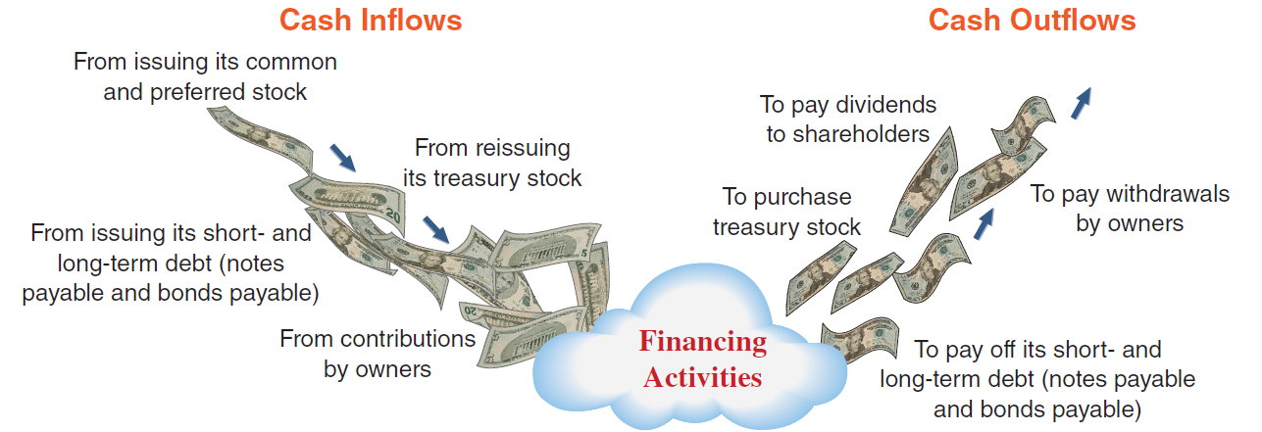
Financing Activities
Exhibit 16.3
Learning Objective C1: Distinguish between operating, investing, and financing activities, and describe how noncash investing and financing activities are disclosed.
Notes:
Financing activities include those transactions and events that affect long-term liabilities and equity. Examples are (1) obtaining cash from issuing debt and repaying the amounts borrowed and (2) receiving cash from or distributing cash to owners. These activities involve transactions with a company’s owners and creditors. They also involve borrowing and repaying principal amounts relating to both short- and long-term debt. GAAP requires that payments of interest expense be classified as operating activities. This slide lists examples of cash flows from financing activities.

Slide 11
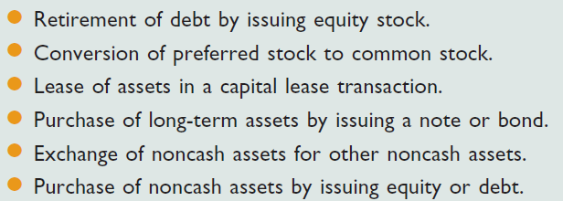
Noncash Investing and Financing
Examples of Noncash Investing and Financing Activities
Learning Objective C1: Distinguish between operating, investing, and financing activities, and describe how noncash investing and financing activities are disclosed.
Notes:
Some important investing and financing activities do not affect cash receipts or payments. One example of such a transaction is the purchase of long-term assets using a long-term note payable (loan). This transaction involves both investing and financing activities but does not affect any cash inflow or outflow, so it is not reported in any of the three sections of the statement of cash flows. Such transactions are reported at the bottom of the statement of cash flows or in a note to the statement because of their importance and the full-disclosure principle. This slide lists transactions commonly disclosed as noncash investing and financing activities.

Slide 12
P1:
Prepare a statement of cash flows.
Learning Objective

Slide 13
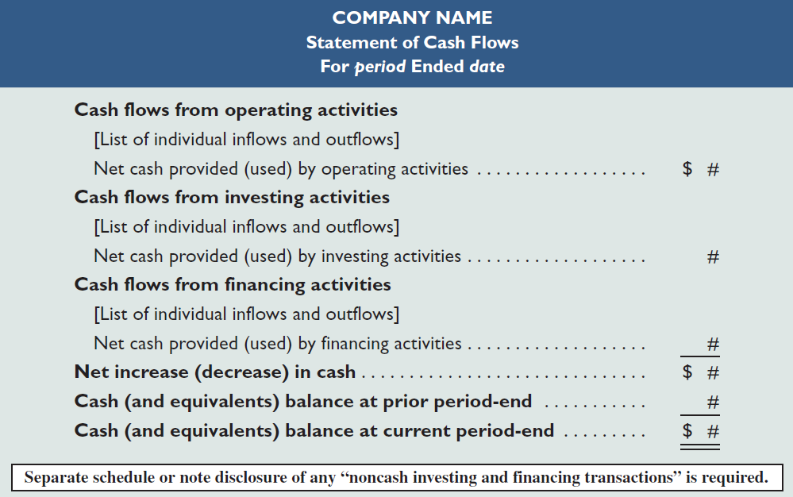
Format of the Statement of Cash Flows
Exhibit 16.6
Learning Objective P1: Prepare a statement of cash flows.
Notes:
A statement of cash flows reports information about a company’s cash receipts and cash payments during the period. This slide shows the usual format. A company must report cash flows from three activities: operating, investing, and financing. The statement then shows the net increase or decrease from those activities. Finally, it explains how transactions and events impact the prior period-end cash balance to produce its current period-end balance. Any non-cash investing and financing transactions are disclosed in a note disclosure or separate schedule.

Slide 14
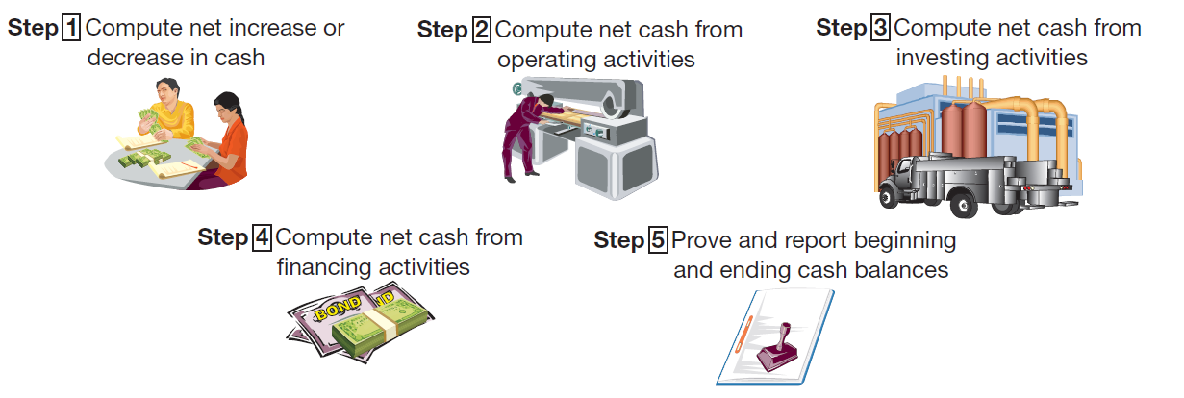
Preparing the Statement of Cash Flows
Exhibit 16.7
Learning Objective P1: Prepare a statement of cash flows.
Notes:
Preparing a statement of cash flows involves five steps:
Compute the net increase or decrease in cash;
Compute and report net cash provided or used by operating activities;
Compute and report net cash provided or used by investing activities;
Compute and report net cash provided or used by financing activities;
Compute the net cash flow from all sources, and then prove it by adding it to the beginning cash balance to show that it equals the ending cash balance.
We will follow these steps in the preparation of our example statement of cash flows.

Slide 15
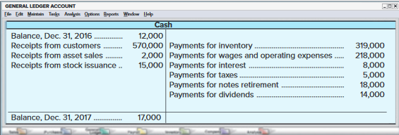
Analyzing the Cash Account
Exhibit 16.8
The Cash account is a natural place to look for information about cash flows from operating, investing, and financing activities.
Learning Objective P1: Prepare a statement of cash flows.
Notes:
Computing the net increase or net decrease in cash is a simple but crucial computation. It equals the current period’s cash balance minus the prior period’s cash balance. This is the bottom-line figure for the statement of cash flows and is a check on accuracy.
Analyzing the Cash Account
A company’s cash receipts and cash payments are recorded in the Cash account in its general ledger. The Cash account is therefore a natural place to look for information about cash flows from operating, investing, and financing activities. To illustrate, see the summarized Cash T-account of Genesis, Inc., in this slide. The Cash account increased $5,000, from $12,000 to $17,000. Individual cash transactions are summarized in this Cash account according to the major types of cash receipts and cash payments. For instance, only the total of cash receipts from all customers is listed. Individual cash transactions underlying these totals can number in the thousands. Accounting software is available to provide summarized cash accounts.
The statement of cash flows summarizes and classifies the transactions that led to the $5,000 increase in the Cash account. Preparing a statement of cash flows requires determining whether an individual cash inflow or outflow is an operating, investing, or financing activity, and then listing each by activity.

Slide 16
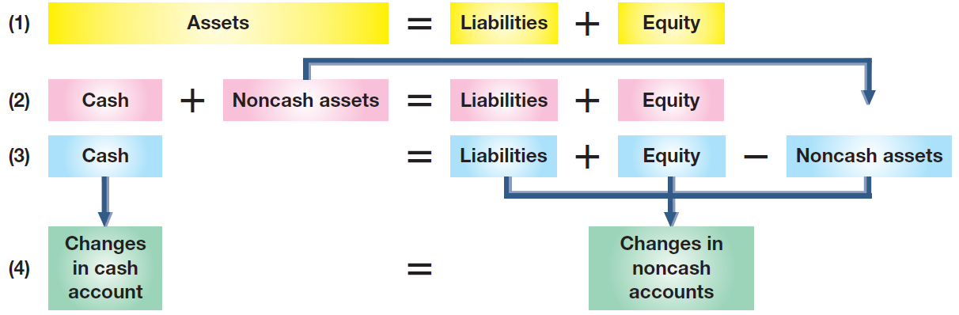
Analyzing Noncash Account
Exhibit 16.9
A second approach to preparing the statement of cash flows is analyzing noncash accounts.
Learning Objective P1: Prepare a statement of cash flows.
Notes:
A second approach to preparing the statement of cash flows is analyzing noncash accounts. This approach uses the fact that when a company records cash inflows and outflows with debits and credits to the Cash account (see prior slide), it also records credits and debits in noncash accounts (reflecting double-entry accounting). Many of these noncash accounts are balance sheet accounts—for instance, from the sale of land for cash. Others are revenue and expense accounts that are closed to equity. For instance, the sale of services for cash yields a credit to Services Revenue that is closed to Retained Earnings for a corporation.
In sum, all cash transactions eventually affect noncash balance sheet accounts. Thus, we can determine cash inflows and outflows by analyzing changes in noncash balance sheet accounts.
This slide uses the accounting equation to show the relation between the Cash account and the noncash balance sheet accounts. This exhibit starts with the accounting equation (at the top). It is then expanded in line (2) to separate cash from noncash asset accounts. To isolate cash on one side of the equation, line (3) shows noncash asset accounts being subtracted from both sides of the equation. Cash now equals the sum of the liability and equity accounts minus the noncash asset accounts. Line (4) points out that changes on one side of the accounting equation equal changes on the other side. It shows that we can explain changes in cash by analyzing changes in the noncash accounts consisting of liability accounts, equity accounts, and noncash asset accounts. By analyzing noncash balance sheet accounts and any related income statement accounts, we can prepare a statement of cash flows.

Slide 17
Information to Prepare the Statement
Information to prepare the statement of cash flows usually comes from three sources:
Comparative
Balance Sheets
Current
Income Statement
Additional
Information
Learning Objective P1: Prepare a statement of cash flows.
Notes:
Information to prepare the statement of cash flows usually comes from three sources:
comparative balance sheets,
the current income statement, and
additional information.
Comparative balance sheets are used to compute changes in noncash accounts from the beginning to the end of the period. The current income statement is used to help compute cash flows from operating activities. Additional information often includes details on transactions and events that help explain both the cash flows and non-cash investing and financing activities.
Review what you have learned in the following NEED-TO-KNOW Slides.

Slide 18
NEED-TO-KNOW 16-1
Classify the following cash flows as operating, investing, or financing activities.
a.
Purchase equipment for cash
g.
Cash paid for utilities
b.
Cash payment of wages
h.
Cash paid to acquire investments
c.
Issuance of stock for cash
i.
Cash paid to retire debt
d.
Receipt of cash dividends from investments
j.
Cash received as interest on investments
e.
Cash collections from customers
k.
Cash received from selling investments
f.
Note payable issued for cash
l.
Cash received from a bank loan
Operating activities - Day-to-day cash receipts and disbursements that determine
net income (Generally related to current assets and current liabilities.)
Investing activities - Cash receipts and disbursements generally related to the purchase
and sale of long-term assets. (And non-operating short-term investments)
Financing Activities - Cash receipts and disbursements generally related to long-term
liabilities and equity. (And non-operating short-term debts)
Learning Objective C1: Distinguish between operating, investing, and financing activities, and describe how noncash investing and financing activities are disclosed.
Notes:
Classify the following cash flows as operating, investing, or financing activities.
Operating activities - Day-to-day cash receipts and disbursements that determine net income. (Generally related to current assets and current liabilities.)
Investing activities - Cash receipts and disbursements generally related to the purchase and sale of long-term assets.
Financing Activities - Cash receipts and disbursements generally related to long-term liabilities and equity.

Slide 19
NEED-TO-KNOW 16-1
XYZ Company
Balance Sheet
December 31, 20X1
Operating
Assets
Liabilities
Current assets
Current liabilities
Investing
Financing
Plant assets
Long-term liabilities
Equity
Total assets
Total liabilities and equity
Learning Objective P1: Prepare a statement of cash flows.
Notes:
An easy way to remember this is to think about the balance sheet. Cash flow related to the current items, current assets and current liabilities, are generally classified as operating activities. Cash flow related to long-term assets are generally considered investing activities. And cash flow related to long-term liabilities or equity are financing activities.

Slide 20
NEED-TO-KNOW 16-1 SOLUTION
Classify the following cash flows as operating, investing, or financing activities.
a.
Purchase equipment for cash
g.
Cash paid for utilities
b.
Cash payment of wages
h.
Cash paid to acquire investments
c.
Issuance of stock for cash
i.
Cash paid to retire debt
d.
Receipt of cash dividends from investments
j.
Cash received as interest on investments
e.
Cash collections from customers
k.
Cash received from selling investments
f.
Note payable issued for cash
l.
Cash received from a bank loan
Operating activities - Day-to-day cash receipts and disbursements that determine
net income (Generally related to current assets and current liabilities.)
b.
Cash payment of wages
d.
Receipt of cash dividends from investments
e.
Cash collections from customers
g.
Cash paid for utilities
j.
Cash received as interest on investments
Investing activities - Cash receipts and disbursements generally related to the purchase
and sale of long-term assets. (And non-operating short-term investments)
a.
Purchase equipment for cash
h.
Cash paid to acquire investments
k.
Cash received from selling investments
Financing Activities - Cash receipts and disbursements generally related to long-term
liabilities and equity. (And non-operating short-term debts)
c.
Issuance of stock for cash
f.
Note payable issued for cash
i.
Cash paid to retire debt
l.
Cash received from a bank loan
Learning Objective P1: Prepare a statement of cash flows.
Notes:
(a) Purchased equipment for cash. Equipment is a long-term asset; this is an investing activity.
(b) Cash payment of wages. This is a day-to-day cash flow; it's an operating activity.
(c) Issuance of stock for cash is a financing activity; common stock is an equity account.
(d) Receipt of cash dividends from investments is a routine cash inflow related to the income statement; we include it as an operating activity.
(e) Cash collections from customers are also operating activities.
(f) Note payable issued for cash is a financing activity. Even if the note payable is a short-term note, because it's simply a borrowing transaction, it would be listed as a financing activity.
(g) Cash paid for utilities is an operating activity.
(h) Cash paid to acquire investments is an investing activity.
(i) Cash paid to retire debt is a financing activity.
(j) Cash received as interest on investments is an operating activity.
(k) Cash received from selling investments is an investing activity, and
(l) Cash received from a bank loan is a financing activity.

Slide 21
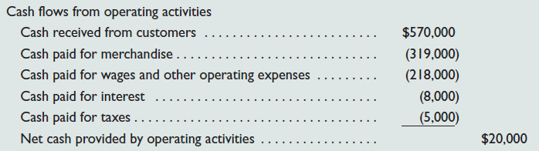
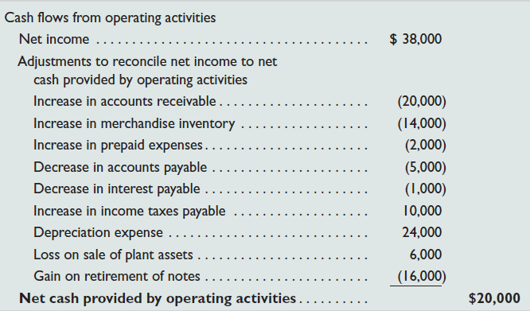
Cash Flows from Operating
Indirect and Direct Methods of Reporting
Direct
Method
Indirect
Method
The net cash amount provided by operating activities is identical under both the direct and indirect methods.
Learning Objective P1: Prepare a statement of cash flows.
Notes:
Cash flows provided (used) by operating activities are reported in one of two ways: the direct method or the indirect method. These two different methods apply only to the operating activities section.
The direct method separately lists each major item of operating cash receipts (such as cash received from customers) and each major item of operating cash payments (such as cash paid for inventory). The cash payments are subtracted from cash receipts to determine the net cash provided (used) by operating activities.
The indirect method reports net income and then adjusts it for items necessary to obtain net cash provided or used by operating activities. It does not report individual items of cash inflows and cash outflows from operating activities. Instead, the indirect method reports the necessary adjustments to reconcile net income to net cash provided or used by operating activities. The net cash amount provided by operating activities is identical under both the direct and indirect methods. This equality always exists. The difference in these methods is with the computation and presentation of this amount. The FASB recommends the direct method, but because it is not required and the indirect method is arguably easier to compute, nearly all companies report operating cash flows using the indirect method.

Slide 22
P2:
Applying the Indirect Method of Reporting.
Learning Objective

Slide 23
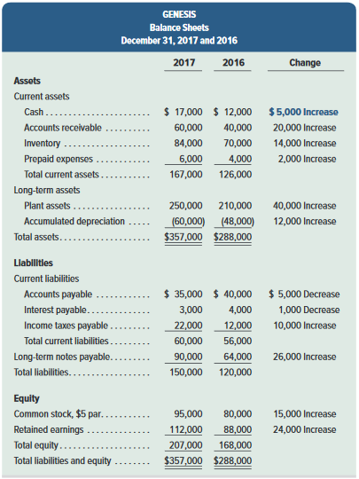
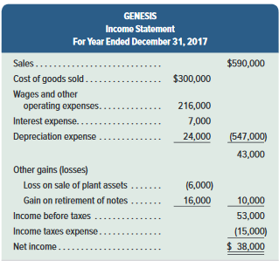
Exhibit 16.10
These financial statements will help us prepare the statement of cash flows for Genesis using the indirect method.
Notes:
To illustrate, we prepare the operating activities section of the statement of cash flows for Genesis. This slide shows the December 31, 2016 and 2017, balance sheets of Genesis along with its 2017 income statement. We use this information to prepare a statement of cash flows that explains the $5,000 increase in cash for 2017 as reflected in its balance sheets. This $5,000 is computed as Cash of $17,000 at the end of 2017 minus Cash of $12,000 at the end of 2016.

Slide 24
Applying the
Indirect Method of Reporting
Additional information on Genesis Inc.’s 2017 transactions:
a. The accounts payable balances result from inventory
purchases.
b. Purchased $60,000 in plant assets by issuing $60,000 of
notes payable.
c. Sold plant assets with a book value of $8,000 (original
cost of $20,000 and accumulated depreciation of
$12,000) for $2,000 cash, yielding a $6,000 loss.
d. Received $15,000 cash from issuing 3,000 shares of
common stock.
e. Paid $18,000 cash to retire notes with a $34,000 book
value, yielding a $16,000 gain.
f. Declared and paid cash dividends of $14,000.
Learning Objective P2: Compute cash flows from operating activities using the indirect method.
Notes:
Additional information for 2017:
a. The accounts payable balances result from inventory purchases.
b. Purchased $60,000 in plant assets by issuing $60,000 of notes payable.
c. Sold plant assets with a book value of $8,000 (original cost of $20,000 and accumulated
depreciation of $12,000) for $2,000 cash, yielding a $6,000 loss.
d. Received $15,000 cash from issuing 3,000 shares of common stock.
e. Paid $18,000 cash to retire notes with a $34,000 book value, yielding a $16,000 gain.
f. Declared and paid cash dividends of $14,000.

Slide 25
Applying the Indirect Method
Changes in noncash current assets and current liabilities
1
Cash Flows from Operating Activities
Net Income
2
3
+ Noncash expenses such as depreciation and amortization
+ Losses and - Gains
Learning Objective P2: Compute cash flows from operating activities using the indirect method.
Notes:
The indirect method starts with the accrual based net income and makes three types of adjustments to arrive at cash flows from operating activities. Adjustments to the accrual based net income include (1) changes in noncash current assets and current liabilities, (2) adding back any noncash items that are included to arrive at net income, such as depreciation and amortization, and (3) adjusting for gains and losses on the sale of assets. On the next slide, we will discuss further the adjustments for changes in noncash current assets and current liabilities.
The adjustment to add back the noncash items such as depreciation and amortization on the statement of cash flows basically cancels out the fact that they were originally subtracted to arrive at net income. Since these items do not represent cash outlays, we would not want them included in the statement of cash flows.
We also need to adjust for gains and losses that result from the sale of an asset. Gains are added on the income statement and losses are subtracted on the income statement to arrive at net income. Since the gains and losses do not represent operating cash flows, we cancel out gains by subtracting them and cancel out losses by adding them to net income in the operating section. The actual cash flow from the sale of the asset will be properly reported, in most cases, in the investing section.

Slide 26
Adjustments for Changes in
Current Assets and Current Liabilities
Use this table when adjusting Net Income to Operating Cash Flows.
Learning Objective P2: Compute cash flows from operating activities using the indirect method.
Notes:
This chart explains how to treat a change in a noncash current asset or current liability in the operating section of the statement of cash flows. Maybe a couple of examples will help you see how this table works. Let’s start with current assets. If accounts receivable, a current asset, decreased during the year, this decrease would be added to net income. A decrease in accounts receivable means that customer cash payments on account exceeded customer charges on account during the period. This excess of cash payments over charges is used to adjust the accrual based revenues reported on the income statement to report the total cash received from customers during the period. Similarly, if accounts receivable increased during the year, this increase would be subtracted from net income. An increase in accounts receivable means that customer charges on account exceeded customer cash payments on account during the period. This excess of charges over cash payments is used to adjust the accrual based revenues reported on the income statement to report the total cash received from customers during the period. Now, let’s look at how to treat changes in current liabilities. If salaries payable, a current liability, decreased during the year, this decrease would be subtracted from net income. A decrease in salaries payable means that the company paid off more in salaries than it charged to expense during the period. This excess of cash payments over charges is used to adjust the accrual based expense reported on the income statement to report the total cash paid for salaries during the period. Similarly, if salaries payable increased during the year, this increase would be added to net income. An increase in salaries payable means the company charged more to expense than it paid off during the period. This excess of charges over cash payments is used to adjust the accrual based expense reported on the income statement to report the total cash paid for salaries during the period.

Slide 27
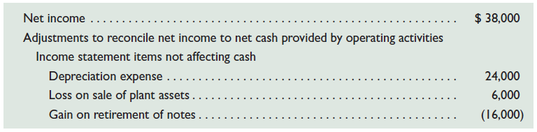
Adjustments for Changes in
Current Assets and Current Liabilities
Learning Objective P2: Compute cash flows from operating activities using the indirect method.
Notes:
To illustrate, the indirect method begins with Genesis’s net income of $38,000 and adjusts it to obtain net cash provided by operating activities of $20,000. This slide shows the results of the indirect method of reporting operating cash flows, which adjusts net income for two types of adjustments.
There are:
1. Adjustments to income statement items that neither provide nor use cash and
2. Adjustments to reflect changes in balance sheet current assets and current liabilities (linked to operating activities).

Slide 28
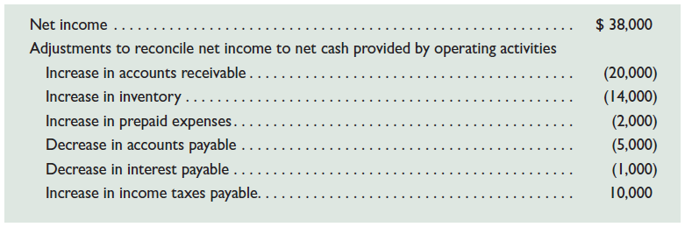
Adjustments for Operating Items
Not Providing or Using Cash
Learning Objective P2: Compute cash flows from operating activities using the indirect method.
Notes:
Adjustments for Income Statement Items Not Affecting Cash
The income statement usually includes some expenses and losses that do not reflect cash outflows. Examples are depreciation, amortization, depletion, bad debts expense, loss from an asset sale, and loss from retirement of notes payable. When there are expenses and losses that do not reflect cash outflows, the indirect method for reporting operating cash flows requires the following adjustment: Expenses and losses with no cash outflows are added back to net income.
To see the logic of this adjustment, recall that items such as depreciation, amortization, and depletion have no cash effect, and adding them back cancels their deductions. To see the logic for losses, consider that items such as a plant asset sale and a notes retirement are usually recorded by recognizing the cash, removing all plant asset or notes accounts, and recording any loss or gain. The cash received or paid is part of either investing or financing cash flows. No operating cash flow effect occurs, and adding it back to net income cancels the deduction.
Similarly, when net income includes revenues that do not reflect cash inflows, the indirect method for reporting operating cash flows requires the following adjustment: Revenues and gains with no cash inflows are subtracted from net income. We apply these adjustments to the income statement items in this slide that do not affect cash.
Depreciation. Depreciation expense is Genesis’s only operating item that has no effect on cash flows. We must add back the $24,000 depreciation expense to net income when computing cash provided by operating activities. Adding it back cancels the expense. (We later explain that any cash outflow to acquire a plant asset is reported as an investing activity.) Loss on sale of plant assets. Genesis reports a $6,000 loss on sale of plant assets as part of net income. This loss is a proper deduction in computing income, but it is not part of operating activities. Instead, a sale of plant assets is part of investing activities. Thus, the $6,000 nonoperating loss is added back to net income. Adding it back cancels the loss. We later explain how to report the cash inflow from the asset sale in investing activities.
Gain on retirement of debt. A $16,000 gain on retirement of debt is properly included in net income, but it is not part of operating activities. This means the $16,000 nonoperating gain must be subtracted from net income to obtain net cash provided by operating activities. Subtracting it cancels the recorded gain. We later describe how to report the cash outflow to retire debt.

Slide 29
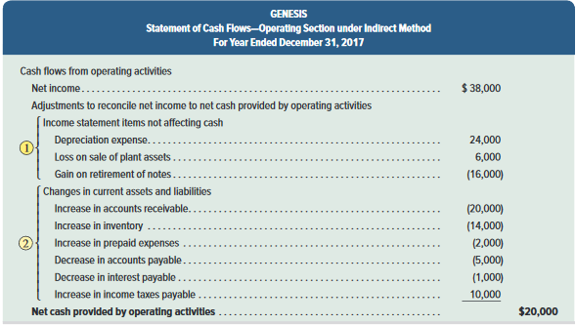
Adjustments for Nonoperating Items
Exhibit 16.11
Learning Objective P2: Compute cash flows from operating activities using the indirect method.
Notes:
2. Adjustments for Changes in Current Assets and Current Liabilities
Adjustments for changes in current assets.
Decreases in current assets require the following adjustment: Decreases in current assets are added to net income.
Increases in current assets require the following adjustment: Increases in current assets are subtracted from net income.
Adjustments for changes in current liabilities.
Increases in current liabilities require the following adjustment to net income when computing operating cash flows: Increases in current liabilities are added to net income.
Conversely, when current liabilities decrease, the following adjustment is required: Decreases in current liabilities are subtracted from net income.

Slide 30
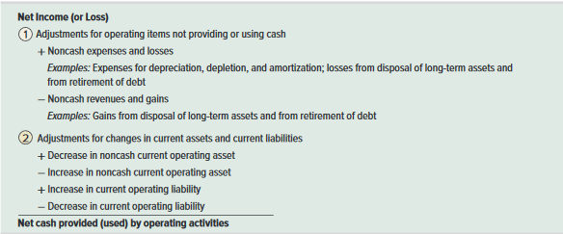
Summary of Adjustments for Indirect Method
Exhibit 16.12
Common adjustments to net income when computing net cash provided or used by operating activities under the indirect method:
Learning Objective P2: Compute cash flows from operating activities using the indirect method.
Notes:
This slide summarizes the adjustments to net income when computing net cash provided or used by operating activities under the indirect method.
Review what you have learned in the following NEED-TO-KNOW Slides.

Slide 31
NEED-TO-KNOW 16-2
A company’s current year income statement and selected balance sheet data at December 31
of the current and prior years follow. Prepare the cash flows from operating activities section
only of its statement of cash flows using the indirect method for the current year.
Income Statement
Selected Balance Sheet Accounts
For Current Year Ended December 31
At December 31
Current Yr.
Prior Yr.
Sales revenue
$120
Accounts receivable
$12
$10
Expenses:
Inventory
6
9
Cost of goods sold
50
Accounts payable
7
11
Depreciation expense
30
Salaries payable
8
3
Salaries expense
17
Interest payable
1
0
Interest expense
3
Net income
$20
Learning Objective P2: Compute cash flows from operating activities using the indirect method.
Notes:
A company’s current year income statement and selected balance sheet data at December 31 of the current and prior years follow. Prepare the cash flows from operating activities section only of its statement of cash flows using the indirect method for the current year.

Slide 32
NEED-TO-KNOW 16-2
General Format - Operating Activities section - Indirect method
Net income
Adjustments to reconcile net income to net cash provided by operating activities
Adjust for changes in current operating assets (other than cash)
Opposite direction
Add the decreases
Subtract the increases
Adjust for changes in current operating liabilities
Same direction
Add the increases
Subtract the decreases
Adjust for non-cash revenues and expenses
Opposite direction
Add any expenses that don't require cash
Subtract any revenues that don't provide cash
Adjust for any gains/losses related to long-term accounts
Opposite direction
Add the losses
Subtract the gains
Net cash provided (used) by operating activities
Learning Objective P2: Compute cash flows from operating activities using the indirect method.
Notes:
Under the indirect method, net cash provided or used by operating activities begins with net income. Then we make adjustments to reconcile net income to net cash provided or used by operating activities, Operating activities generally relate to current assets and current liabilities. We adjust for the changes in current operating assets (other than cash) in the opposite direction; we add the decreases, and subtract the increases. To adjust for the changes in current operating liabilities, we adjust in the same direction; adding the increases and subtracting the decreases. Other adjustments relate to items found on the income statement. We adjust for any noncash revenues and expenses. We adjust in the opposite direction of the item's impact on net income; we add back any expenses that don't require cash, and subtract any revenues that don't provide cash. We also adjust for gains or losses related to long-term accounts, again in the opposite direction of their impact on net income. We add back the losses and subtract the gains. And believe it or not, that gets us to net cash provided or used by operating activities.

Slide 33
NEED-TO-KNOW 16-2 SOLUTION
Income Statement
Selected Balance Sheet Accounts
For Current Year Ended December 31
At December 31
Current Yr.
Prior Yr.
Sales revenue
$120
Accounts receivable
$12
$10
Expenses:
Inventory
6
9
Cost of goods sold
50
Accounts payable
7
11
Depreciation expense
30
Salaries payable
8
3
Salaries expense
17
Interest payable
1
0
Interest expense
3
Net income
$20
General Format - Operating Activities section - Indirect method
Net income
$20
Adjustments to reconcile net income to net cash provided by
operating activities:
Depreciation expense
30
Increase in accounts receivable
(2)
Decrease in inventory
3
Decrease in accounts payable
(4)
Increase in salaries payable
5
Increase in interest payable
1
33
Net cash provided by operating activities
$53
Learning Objective P2: Compute cash flows from operating activities using the indirect method.
Notes:
So, let's see how it works. We begin with net income, $20. Then we make adjustments to reconcile net income to net cash provided by operating activities. Let's begin by looking at the items on the income statement. Any noncash revenues or expenses are included as adjustments. Depreciation expense is subtracted in the calculation of net income, but does not affect cash flow; we add back the amount of depreciation expense, $30. The remaining income statement items do affect cash flow, so we're done with our review of the income statement.
Now we turn our attention to the balance sheet. The company has two current operating assets. We adjust for the change in operating assets in the opposite direction, adding the decreases and subtracting the increases. Accounts receivable increased by $2; we subtract the amount of the increase. Inventory decreased by $3; we add back the amount of the decrease. The company has three current operating liabilities. We adjust for the change in current liabilities in the same direction; adding the increases and subtracting the decreases. Accounts payable decreased by $4; we subtract the amount of the decrease. Salaries payable increased by $5; we add the amount of the increase. Interest payable also increased; we add the amount of the increase. We have total adjustments of $33. Net cash provided by operating activities is $53.

Slide 34
P3:
Determine cash flows from both investing and financing activities.
Learning Objective

Slide 35
Cash Flows from Investing
A three-stage process to determine cash provided or used by investing activities:
Identify changes in investing-related accounts
Explain these changes using reconstruction analysis
Report their cash flow effects
Learning Objective P3: Determine cash flows from both investing and financing activities.
Notes:
The third major step in preparing the statement of cash flows is to compute and report cash flows from investing activities. We normally do this by identifying changes in (1) all noncurrent asset accounts and (2) the current accounts for both notes receivable and investments in securities (excluding trading securities). We then analyze changes in these accounts to determine their effect, if any, on cash and report the cash flow effects in the investing activities section of the statement of cash flows. Reporting of investing activities is identical under the direct method and indirect method.
Information to compute cash flows from investing activities is usually taken from beginning and ending balance sheets and the income statement. We use a three-stage process to determine cash provided or used by investing activities: (1) identify changes in investing-related accounts, (2) explain these changes using reconstruction analysis, and (3) report their cash flow effects.

Slide 36
Cash Flows from Investing
Exhibit 16.10
This analysis reveals a $40,000 increase in plant assets from $210,000 to $250,000 and a $12,000 increase in accumulated depreciation from $48,000 to $60,000.
Learning Objective P3: Determine cash flows from both investing and financing activities.
Notes:
Information about the Genesis transactions provided earlier reveals that the company both purchased and sold plant assets during the period. Both transactions are investing activities and are analyzed for their cash flow effects in this section.
Plant Asset Transactions The first stage in analyzing the Plant Assets account and its related Accumulated Depreciation account is to identify any changes in these accounts from comparative balance sheets shown in this slide. This analysis reveals a $40,000 increase in plant assets from $210,000 to $250,000 and a $12,000 increase in accumulated depreciation from $48,000 to $60,000.

Slide 37
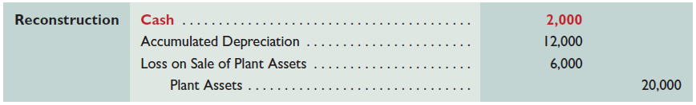
Cash Flows from Investing
Item b: Genesis purchased plant assets of $60,000 by issuing $60,000 in notes payable to the seller.
Item c reports that Genesis sold plant assets costing $20,000 (with $12,000 of accumulated depreciation) for $2,000 cash, resulting in a $6,000 loss.
We also reconstruct the entry for Depreciation Expense using information from the income statement.
Learning Objective P3: Determine cash flows from both investing and financing activities.
Notes:
The second stage is to explain these changes. Items b and c of the additional information discussed in an earlier slide affect plant assets. Recall that the Plant Assets account is affected by both asset purchases and sales; its Accumulated Depreciation account is normally increased from depreciation and decreased from the removal of accumulated depreciation in asset sales. To explain changes in these accounts and to identify their cash flow effects, we prepare reconstructed entries from prior transactions; they are not the actual entries by the preparer.
To illustrate, item b reports that Genesis purchased plant assets of $60,000 by issuing $60,000 in notes payable to the seller. The reconstructed entry for analysis of item b is shown.
The $60,000 purchase described in item b and financed by issuing notes is a noncash investing and financing activity. It is reported in a note or in a separate schedule to the statement.
Next, item c reports that Genesis sold plant assets costing $20,000 (with $12,000 of accumulated depreciation) for $2,000 cash, resulting in a $6,000 loss. The reconstructed entry for analysis of item c is shown.
We also reconstruct the entry for Depreciation Expense from the income statement. Depreciation expense results in no cash flow effect.
Review what you have learned in the following NEED-TO-KNOW Slides.

Slide 38
NEED-TO-KNOW 16-3
Use the following information to determine this company’s cash flows from investing activities.
a.
A factory with a book value of $100 and an original cost of $800 was sold at a loss of $10.
b.
Paid $70 cash for new equipment.
c.
Long-term stock investments were sold for $20 cash, yielding a loss of $4.
d.
Sold land costing $175 for $160 cash, yielding a loss of $15.
We use a three-stage process to determine cash provided or used by investing activities:
(1) identify changes in investing-related accounts, (2) explain these changes using reconstruction analysis,
and (3) report their cash flow effects
Learning Objective P3: Determine cash flows from both investing and financing activities.
Notes:
Use the following information to determine this company’s cash flows from investing activities. We use a three-stage process to determine cash provided or used by investing activities: (1) Identify changes in investing-related accounts, (2) explain these changes using reconstruction analysis, and (3) report their cash flow effects.

Slide 39
NEED-TO-KNOW 16-3 SOLUTION
a.
A factory with a book value of $100 and an original cost of $800 was sold at a loss of $10.
Factory
Accumulated Depreciation
Cost
800
To date
700
Book Value = $100
General Journal
Debit
Credit
a)
Cash
90
Loss on sale of factory
10
Accumulated Depreciation
700
Factory
800
Cash flows from operating activities:
Net income
$XXX
Adjustments to reconcile net income to net cash provided by
operating activities:
Loss on sale of factory
10
Cash flows from investing activities:
Cash received from sale of factory
90
Learning Objective P3: Determine cash flows from both investing and financing activities.
Notes:
(a) A factory with a book value of $100 and an original cost of $800 was sold at a loss of $10. The cost of the factory is a debit balance in the Factory account. It has a book value of $100, which means it's been depreciated by $700 to date. The journal entry to record the sale eliminates the book value, crediting the Factory account for the cost of $800, and debiting Accumulated Depreciation for the amount recorded to date, $700. The factory was sold at a loss of $10. Loss on sale is a debit, as it reduces equity. So we can back into the amount of the cash receipt, $90. The cash flow is reported as a cash flow from investing activities, cash received from sale of factory, $90. This transaction will also affect the cash flows from operating activities section as an adjustment to reconcile net income to net cash provided by operating activities. The loss on sale is added back within the operating activities section.

Slide 40
NEED-TO-KNOW 16-3 SOLUTION
b.
Paid $70 cash for new equipment.
General Journal
Debit
Credit
b)
Equipment
70
Cash
70
Cash flows from operating activities:
Net income
$XXX
Adjustments to reconcile net income to net cash provided by
operating activities:
Loss on sale of factory
10
Cash flows from investing activities:
Cash received from sale of factory
90
Cash paid for new equipment
(70)
Learning Objective P3: Determine cash flows from both investing and financing activities.
Notes:
(b) Paid $70 cash for new equipment. This transaction resulted in a debit to the Equipment account and a credit to Cash. The cash outflow is reported in the investing activities section.

Slide 41
NEED-TO-KNOW 16-3 SOLUTION
c.
Long-term stock investments were sold for $20 cash, yielding a loss of $4.
General Journal
Debit
Credit
c)
Cash
20
Loss on sale of investments
4
Long-term investments
24
Cash flows from operating activities:
Net income
$XXX
Adjustments to reconcile net income to net cash provided by
operating activities:
Loss on sale of factory
10
Loss on sale of investments
4
Cash flows from investing activities:
Cash received from sale of factory
90
Cash paid for new equipment
(70)
Cash received from sale of long-term investments
20
Learning Objective P3: Determine cash flows from both investing and financing activities.
Notes:
(c) Long-term stock investments were sold for $20 cash, yielding a loss of $4. Debit Cash for the amount received, $20; debit Loss on sale of investments, $4; and credit the Long-term investment account for $24. We record the cash receipt in the investing activities section of the statement of cash flows. The loss on sale of investments, like the loss on sale of factory, is added back within the operating activities section as an adjustment to reconcile net income to net cash provided by operating activities.

Slide 42
NEED-TO-KNOW 16-3 SOLUTION
d.
Sold land costing $175 for $160 cash, yielding a loss of $15.
General Journal
Debit
Credit
d)
Cash
160
Loss on sale of land
15
Land
175
Cash flows from operating activities:
Net income
$XXX
Adjustments to reconcile net income to net cash provided by
operating activities:
Loss on sale of factory
10
Loss on sale of investments
4
Loss on sale of land
15
Cash flows from investing activities:
Cash received from sale of factory
90
Cash paid for new equipment
(70)
Cash received from sale of long-term investments
20
Cash received from sale of land
160
Net cash provided by investing activities
$200
Learning Objective P3: Determine cash flows from both investing and financing activities.
Notes:
(d) Sold land costing $175 for $160 cash, yielding a loss of $15. We reconstruct the entry: crediting Land for the cost of $175, debit Cash for the amount received, $160; and debit Loss on sale of land for $15. The cash receipt is included in the investing activities section of the statement of cash flows, and we add back the Loss on sale of land as an adjustment to reconcile net income to net cash provided by operating activities. Net cash provided by investing activities is $200.

Slide 43
Cash Flows from Financing
A three-stage process to determine cash provided or used by financing activities:
Identify changes in financing-related accounts
Explain these changes using reconstruction analysis
Report their cash flow effects
Learning Objective P3: Determine cash flows from both investing and financing activities.
Notes:
The fourth major step in preparing the statement of cash flows is to compute and report cash flows from financing activities. We normally do this by identifying changes in all noncurrent liability accounts (including the current portion of any notes and bonds) and the equity accounts.
These accounts include long-term debt, notes payable, bonds payable, common stock, and retained earnings. Changes in these accounts are then analyzed using available information to determine their effect, if any, on cash. Results are reported in the financing activities section of the statement. Reporting of financing activities is identical under the direct method and indirect method.
Three-Stage Process of Analysis
We again use a three-stage process to determine cash provided or used by financing activities: (1) identify changes in financing-related accounts, (2) explain these changes using reconstruction analysis, and (3) report their cash flow effects.

Slide 44
Cash Flows from Financing
Exhibit 16.10
This analysis reveals:
an increase in notes payable from $64,000 to $90,000.
Learning Objective P3: Determine cash flows from both investing and financing activities.
Notes:
Information about Genesis provided earlier reveals two transactions involving noncurrent liabilities. We analyzed one of those, the $60,000 issuance of notes payable to purchase plant assets. This transaction is reported as a significant noncash investing and financing activity in a footnote or a separate schedule to the statement of cash flows. The other remaining transaction involving noncurrent liabilities is the cash retirement of notes payable.
Notes Payable Transactions
The first stage in analysis of notes is to review the comparative balance sheets shown. This analysis reveals an increase in notes payable from $64,000 to $90,000.

Slide 45

Cash Flows from Financing
Item e: Notes with a carrying value of $34,000 are retired for $18,000 cash, resulting in a $16,000 gain.
Learning Objective P3: Determine cash flows from both investing and financing activities.
Notes:
The second stage explains this change. Item e of the additional information provided earlier reports that notes with a carrying value of $34,000 are retired for $18,000 cash, resulting in a $16,000 gain. The reconstructed entry for analysis of item e is shown.
This entry reveals an $18,000 cash outflow for retirement of notes and a $16,000 gain from comparing the notes payable carrying value to the cash received. This gain does not reflect any cash inflow or outflow.

Slide 46
Cash Flows from Financing
Item d: Issued 3,000 shares of common stock at par for $5 per share.
Item f: Cash dividends of $14,000 are paid.
Learning Objective P3: Determine cash flows from both investing and financing activities.
Notes:
The Genesis information reveals two transactions involving equity accounts. The first is the issuance of common stock for cash. The second is the declaration and payment of cash dividends. We analyze both.
The first stage in analyzing common stock is to review the comparative balance sheets from slide 43, which reveal an increase in common stock from $80,000 to $95,000.
The second stage explains this change. Item d of the additional information provided earlier reports that 3,000 shares of common stock are issued at par for $5 per share. The reconstructed entry for analysis of item d is shown. This entry reveals a $15,000 cash inflow from stock issuance.
The first stage in analyzing the Retained Earnings account is to review the comparative balance sheets shown earlier. This reveals an increase in retained earnings from $88,000 to $112,000.
The second stage explains this change. Item f of the additional information provided earlier reports that cash dividends of $14,000 are paid. The reconstructed entry is shown.
We now have identified and explained all of the Genesis cash inflows and cash outflows and one noncash investing and financing transaction.

Slide 47
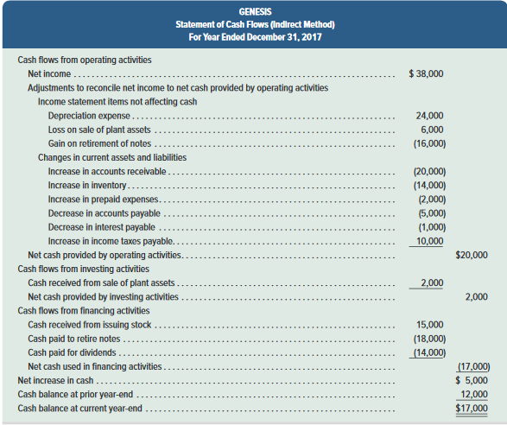
Exhibit 16.13
Learning Objective P3: Determine cash flows from both investing and financing activities.
Notes:
The fifth and final step in preparing the statement is to report the beginning and ending cash balances and prove that the net change in cash is explained by operating, investing, and financing cash flows. This step is shown here for Genesis.
Review what you have learned in the following NEED-TO-KNOW Slide.

Slide 48
NEED-TO-KNOW 16-4
Use the following information to determine this company’s cash flows from financing activities.
a.
Issued common stock for $40 cash.
b.
Paid $70 cash to retire a note payable at its $70 maturity value.
c.
Paid cash dividend of $15.
d.
Paid $5 cash to acquire its treasury stock
Cash flows from financing activities:
Cash received from issuance of common stock
$40
Cash paid to settle note payable
(70)
Cash paid for dividend
(15)
Cash paid to acquire treasury stock
(5)
Net cash used by financing activities
($50)
General Journal
Debit
Credit
a)
Cash
40
Common Stock
40
b)
Notes payable
70
Cash
70
c)
Retained earnings
15
Cash
15
d)
Treasury stock
5
Cash
5
Learning Objective P3: Determine cash flows from both investing and financing activities.
Notes:
Use the following information to determine this company’s cash flows from financing activities. Financing activities are cash receipts and cash disbursements related to long-term liabilities and or equity accounts.
(a) Issued common stock for $40 cash. Debit Cash, $40, and credit the equity account, Common stock. We include the cash receipt in the financing activities section; cash received from issuance of common stock, $40.
(b) Paid $70 cash to retire a note payable at its $70 maturity value. We debit the liability account, Notes payable, $70, and credit Cash. Credits to cash are listed as cash outflows; cash paid to settle note payable; $70.
(c) Paid cash dividend of $15. The journal entry debits the equity account, Retained earnings, for $15, and we credit Cash. The financing activities section reports cash paid for dividends of $15.
(d) Paid $5 cash to acquire its treasury stock. Debit the equity account, Treasury stock, for $5, and credit Cash. The cash payment is listed in the financing activities section; cash paid to acquire treasury stock, $5. Net cash used by financing activities is $50.

Slide 49
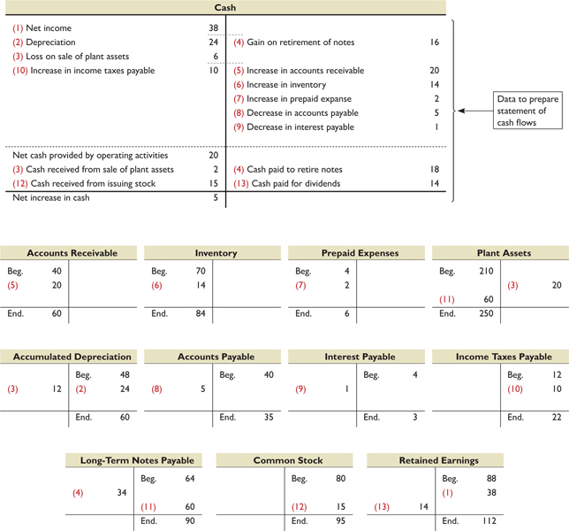
Summary Using T-Accounts
Exhibit 16.14
Learning Objective P3: Determine cash flows from both investing and financing activities.
Notes:
A statement of cash flows is prepared by analyzing changes in noncash balance sheet accounts.
This slide uses T-accounts to summarize how changes in Genesis’s noncash balance sheet accounts affect its cash inflows and outflows (dollar amounts in thousands). The top of the exhibit shows the company’s Cash T-account, and the lower part shows T-accounts for its remaining balance sheet accounts. We see that the $20,000 net cash provided by operating activities and the $5,000 net increase in cash shown in the Cash T-account agree with the same figures in the statement of cash flows shown in a prior slide.
We explain this slide in five parts (amounts in $ thousands):
a. Entry (1) records $38 net income in the credit side of the Retained Earnings account and the debit side of the Cash account. This $38 net income in the Cash T-account is adjusted until it reflects the $5 net increase in cash.
b. Entries (2) through (4) add the $24 depreciation and $6 loss on asset sale to net income, and subtract the $16 gain on retirement of notes.
c. Entries (5) through (10) adjust net income for changes in current asset and current liability accounts.
d. Entry (11) records the noncash investing and financing transaction involving a $60 purchase of assets by issuing $60 of notes.
e. Entries (12) and (13) record the $15 stock issuance and the $14 dividend.

Slide 50
A1:
Analyze the statement of cash flows and apply the cash flow on total assets ratio.
Learning Objective

Slide 51
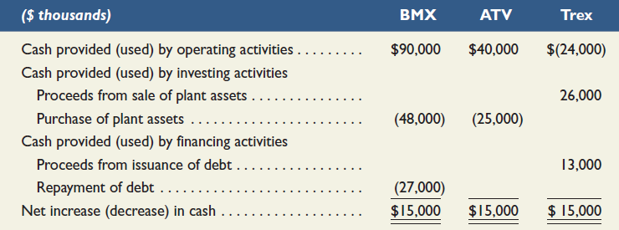
Analyzing Cash
Sources and Uses
Exhibit 16.15
Most managers stress the importance of understanding and predicting cash flows for business decisions.
Learning Objective A1: Analyze the statement of cash flows and apply the cash flow on total assets ratio.
Notes:
Most managers stress the importance of understanding and predicting cash flows for business decisions. Creditors evaluate a company’s ability to generate cash before deciding whether to lend money. Investors also assess cash inflows and outflows before buying and selling stock. Information in the statement of cash flows helps address these and other questions such as (1) How much cash is generated from or used in operations? (2) What expenditures are made with cash from operations? (3) What is the source of cash for debt payments? (4) What is the source of cash for distributions to owners? (5) How is the increase in investing activities financed? (6) What is the source of cash for new plant assets? (7) Why is cash flow from operations different from income? (8) How is cash from financing used?
To effectively answer these questions, it is important to separately analyze investing, financing, and operating activities. To illustrate, consider data from three different companies in Exhibit 16.15. These companies operate in the same industry and have been in business for several years. Each company generates an identical $15,000 net increase in cash, but its sources and uses of cash flows are very different. BMX’s operating activities provide net cash flows of $90,000, allowing it to purchase plant assets of $48,000 and repay $27,000 of its debt. ATV’s operating activities provide $40,000 of cash flows, limiting its purchase of plant assets to $25,000. Trex’s $15,000 net cash increase is due to selling plant assets and incurring additional debt. Its operating activities yield a net cash outflow of $24,000. Overall, analysis of these cash flows reveals that BMX is more capable of generating future cash flows than is ATV or Trex.

Slide 52
Cash Flow on Total Assets
Used, along with income-based ratios, to assess company performance.
Cash flow on
Operating cash flows
=
total assets
Average total assets
Learning Objective A1: Analyze the statement of cash flows and apply the cash flow on total assets ratio.
Notes:
Cash flow information has limitations, but it can help measure a company’s ability to meet its obligations, pay dividends, expand operations, and obtain financing. Users often compute and analyze a cash-based ratio similar to return on total assets except that its numerator is net cash flows from operating activities. The cash flow on total assets ratio is shown in this slide.
Free Cash Flows
Many investors use cash flows to value company stock. However, cash-based valuation models often yield different stock values due to differences in measurement of cash flows. Most models require cash flows that are “free” for distribution to shareholders. These free cash flows are defined as cash flows available to shareholders after operating asset reinvestments and debt payments. Knowledge of the statement of cash flows is key to proper computation of free cash flows. A company’s growth and financial flexibility depend on adequate free cash flows.

Slide 53
P4: Appendix 16A
Illustrate use of a spreadsheet to prepare a statement of cash flows.
Learning Objective

Slide 54
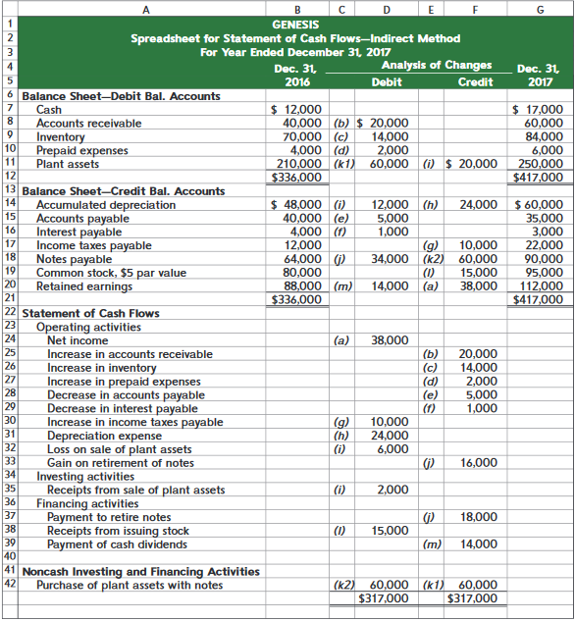
Exhibit 16A.1
Appendix 16A: Spreadsheet Preparation of the Statement of Cash Flows
A spreadsheet, also called work sheet or working paper, can help us organize the information needed to prepare a statement of cash flows.
Learning Objective P4: Illustrate use of a spreadsheet to prepare a statement of cash flows.
Notes:
This appendix explains how to use a spreadsheet (work sheet) to prepare the statement of cash flows under the indirect method.
Preparing the Indirect Method Spreadsheet to analyze noncash accounts can be challenging when a company has a large number of accounts and many operating, investing, and financing transactions. A spreadsheet, also called work sheet or working paper, can help us organize the information needed to prepare a statement of cash flows. A spreadsheet also makes it easier to check the accuracy of our work.
The graphic on this slide shows the indirect method spreadsheet for Genesis. We enter both beginning and ending balance sheet amounts on the spreadsheet. We also enter information in the Analysis of Changes columns (keyed to the additional information items a through m) to explain changes in the accounts and determine the cash flows for operating, investing, and financing activities. Information about noncash investing and financing activities is reported near the bottom.

Slide 55
P5: Appendix 16B
Compute cash flows from operating activities using the direct method.
Learning Objective

Slide 56
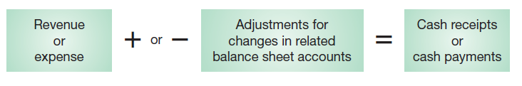
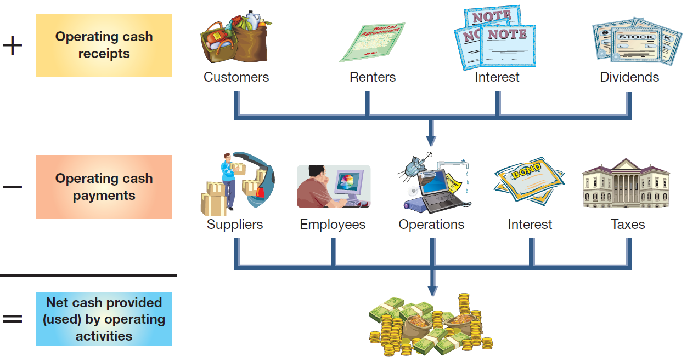
Direct Method of Reporting Operating Cash Flows
Adjust income statement accounts related to operating activities for changes in their related balance sheet accounts:
Exhibit 16B.1
Framework for reporting cash receipts and cash payments
Learning Objective P5: Compute cash flows from operating activities using the direct method.
Notes:
We compute cash flows from operating activities under the direct method by adjusting accrual-based income statement items to the cash basis. The usual approach is to adjust income statement accounts related to operating activities for changes in their related balance sheet accounts as illustrated in the first graphic on this slide. The framework for reporting cash receipts and cash payments for the operating section of the cash flow statement under the direct method is shown in the second graphic on this slide.

Slide 57
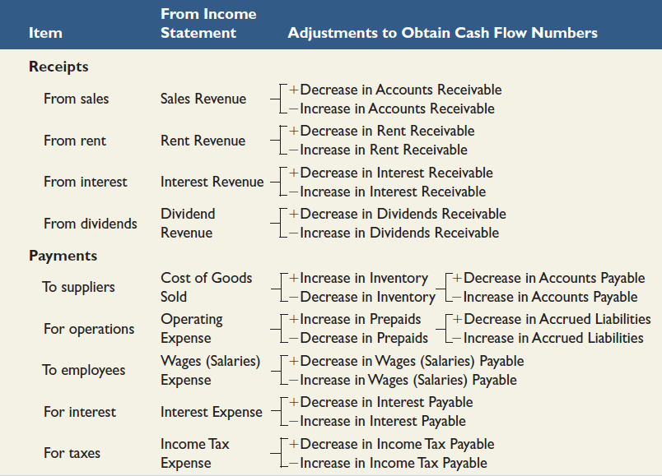
Direct Method of Reporting Operating Cash Flows
Exhibit 16B.6
Learning Objective P5: Compute cash flows from operating activities using the direct method.
Notes:
This slide summarizes common adjustments for net income to yield net cash provided (used) by operating activities under the direct method.
Review what you have learned in the following NEED-TO-KNOW Slide.

Slide 58
NEED-TO-KNOW 16-6
A company's current-year income statement and selected balance sheet data at December 31 of
the current and prior years follow. Prepare the cash flows from operating activities section only of its
statement of cash flows using the direct method for the current year.
Income Statement
Selected Balance Sheet Accounts
For Current Year Ended December 31
At December 31
Current Yr
Prior Yr
Sales revenue
$120
Accounts receivable
$12
$10
Expenses
Inventory
6
9
Cost of goods sold
50
Accounts payable
7
11
Depreciation expense
30
Salaries payable
8
3
Salaries expense
17
Interest payable
1
0
Interest expense
3
Net income
$20
Learning Objective P5: Compute cash flows from operating activities using the direct method.
Notes:
A company's current-year income statement and selected balance sheet data at December 31 of the current and prior years follow. Prepare the cash flows from operating activities section only of its statement of cash flows using the direct method for the current year.

Slide 59
NEED-TO-KNOW 16-6 SOLUTION
Income Statement
Reconstructed entries
Debit
Credit
For Current Year Ended December 31
Sales
Cash
118
Sales revenue
$120
Accounts receivable
2
Expenses
Sales revenue
120
Cost of goods sold
50
Depreciation expense
30
CofGS
Cost of goods sold
50
Salaries expense
17
Accounts payable
4
Interest expense
3
Inventory
3
Net income
$20
Cash
51
Salaries
Salaries expense
17
Selected Balance Sheet Accounts
Salaries payable
5
At December 31
Current Yr
Prior Yr
Cash
12
Accounts receivable
$12
$10
Inventory
6
9
Interest
Interest expense
3
Accounts payable
7
11
Interest payable
1
Salaries payable
8
3
Cash
2
Interest payable
1
0
Cash flows from operating activities - Direct method
Cash received from customers
$118
Cash paid for inventory
(51)
Cash paid for salaries
(12)
Cash paid for interest
(2)
Net cash provided by operating activities
$53
Learning Objective P5: Compute cash flows from operating activities using the direct method.
Notes:
In order to calculate the cash flows from operating activities, we are going to reconstruct the entries linking the income statement accounts to the related balance sheet accounts, including cash.
The first income statement account is sales revenue.
Sales increases equity, and has a normal credit balance. The related balance sheet account is accounts receivable, an asset. The asset increased by $2, from $10 to $12. Assets are increased with debits. We back into the change in cash, a net debit of $118.
The cash flow is reported on the statement of cash flows; cash received from customers, $118.
The next income statement account is an expense, cost of goods sold. Expenses have normal debit balances. The related balance sheet accounts are inventory, which decreased by $3, and accounts payable, which decreased by $4.
Again, we back into the change in cash, a net credit of $51.
The cash flow is reported on the statement of cash flows; cash paid for inventory, $51.
The next expense account, depreciation expense, is a non-cash expenditure. No journal entry needs to be reconstructed.
The next income statement account is salaries expense. Expenses have normal debit balances.
The related balance sheet account is salaries payable, a liability, which increased by $5.
We back into the change in cash, a net credit of $12.
The cash flow is reported on the statement of cash flows; cash paid for salaries, $12.
The final income statement account is interest expense. The related balance sheet account is interest payable, which increased by $1.
We back into the change in cash, a net credit of $2.
The cash flow is reported on the statement of cash flows; cash paid for interest, $2.
When we subtract the cash outflows from the cash inflow, the subtotal is labeled “Net cash provided by operating activities", $53.

Slide 60
End of Chapter 16

