Slide 1
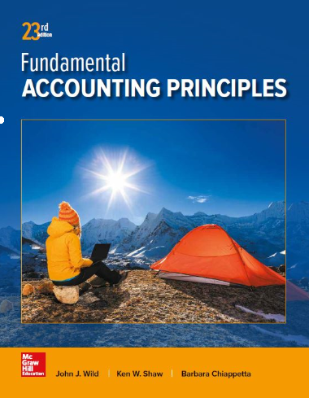
Managerial Accounting Concepts and Principles
Chapter 18
Wild, Shaw, and Chiappetta
Fundamental Accounting Principles
23rd Edition
Notes:
Chapter 18: Managerial Accounting Concepts and Principles

Slide 2
Chapter 18 Learning Objectives
CONCEPTUAL
C1 Explain the purpose and nature of, and the role of ethics in, managerial accounting.
C2 Describe accounting concepts useful in classifying costs.
C3 Define product and period costs and explain how they impact financial statements.
C4 Explain how balance sheets and income statements for manufacturing, merchandising, and service companies differ.
C5 Explain manufacturing activities and the flow of manufacturing costs.
C6 Describe trends in managerial accounting.
ANALYTICAL
A1 Assess raw materials inventory management using raw materials inventory turnover and days’ sales in raw materials inventory.
PROCEDURAL
P1 Compute cost of goods sold for a manufacturer and for a merchandiser.
P2 Prepare a schedule of cost of goods manufactured and explain its purpose and links to financial statements.

Slide 3
C1: Explain the purpose and nature of, and the role of ethics in, managerial accounting.
Learning Objective

Slide 4
Managerial Accounting Basics
Managerial accounting provides financial and
nonfinancial information
for managers of an organization and other
decision makers.
Learning Objective C1: Explain the purpose and nature of, and the role of ethics in, managerial accounting.
Notes:
Managerial accounting provides financial and nonfinancial information to an organization’s managers. Managers include, for example, employees in charge of a company’s divisions; the heads of marketing, information technology, and human resources; and top-level managers such as the chief executive officer (CEO) and chief financial officer (CFO). This section explains the purpose of managerial accounting (also called management accounting) and compares it with financial accounting.

Slide 5
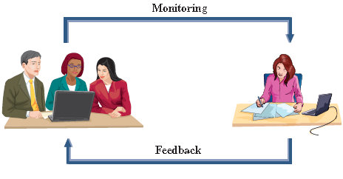
Purpose of Managerial Accounting
Exhibit 18.1
Planning
Develop new products?
Expand into new markets?
Build a new factory?
Control
Are costs too high?
Are services profitable?
Are customers satisfied?
Learning Objective C1: Explain the purpose and nature of, and the role of ethics in, managerial accounting.
Notes:
The purpose of managerial accounting is to provide useful information to aid in three key managerial tasks:
determining the costs of an organization’s products and services
planning future activities
comparing actual results to planned results
Planning is the process of setting goals and making plans to achieve them. Long-term strategic plans usually span a 5-10 year horizon.
Control is the process of monitoring planning decisions and evaluating an organization’s activities and employees. Feedback provided by the control function allows managers to revise their plans.

Slide 6
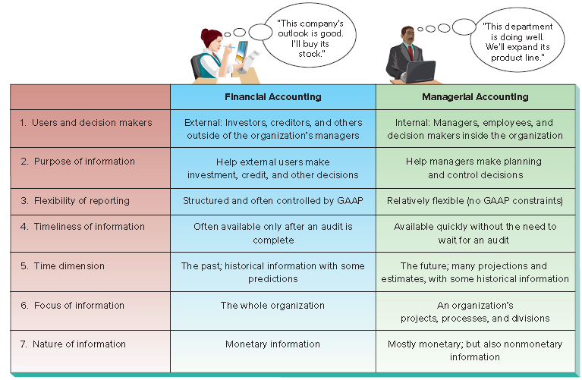
Nature of Managerial Accounting
Exhibit 18.2
Learning Objective C1: Explain the purpose and nature of, and the role of ethics in, managerial accounting.
Notes:
Managerial accounting differs from financial accounting. We discuss seven key differences in this section, as summarized in this slide.

Slide 7
Fraud and Ethics in Managerial Accounting
Fraud affects all business and it is costly: The 2016 Report to the Nations from the Association of Certified Fraud Examiners (ACFE) estimates the average U.S. business loses 5% of its annual revenues to fraud.
An internal control system is the policies and procedures used to:
Ensure reliable accounting
Protect assets
Uphold company policies
Promote efficient operations.
The Institute of Management Accountants has issued a code of ethics to help accountants involved in solving ethical dilemmas.
Learning Objective C1: Explain the purpose and nature of, and the role of ethics in, managerial accounting.
Notes:
Fraud, and the role of ethics in reducing fraud, are important factors in running business operations. Fraud involves the use of one’s job for personal gain through the deliberate misuse of the employer’s assets. Examples include theft of the employer’s cash or other assets, overstating reimbursable expenses, payroll schemes, and financial statement fraud. Three factors must exist for a person to commit fraud: opportunity, financial pressure, and rationalization. This is known as the fraud triangle. Fraud affects all business and it is costly: The 2016 Report to the Nations from the Association of Certified Fraud Examiners (ACFE) estimates the average U.S. business loses 5% of its annual revenues to fraud.
Combating fraud requires ethics in accounting. Ethics are beliefs that distinguish right from wrong. They are accepted standards of good and bad behavior. Identifying the ethical path can be difficult. The Institute of Management Accountants (IMA), the professional association for management accountants, has issued a code of ethics to help accountants in solve ethical dilemmas. The IMA’s Statement of Ethical Professional Practice requires that management accountants be competent, maintain confidentiality, act with integrity, and communicate information in a fair and credible manner.

Slide 8
Careers in Managerial Accounting
Exhibit 18.4
Managerial accountants must:
Have knowledge of Financial accounting
Have knowledge of Managerial accounting
Have strong communication skills
Have knowledge of how businesses work
Be a team player
Learning Objective C1: Explain the purpose and nature of, and the role of ethics in, managerial accounting.
Notes:
Managerial accountants are highly regarded and in high demand. Managerial accountants must have strong communication skills, understand how businesses work, and be team players. They must also possess skills to analyze information and think critically, and they are often considered to be important business advisors. Exhibit 18.4 shows estimated annual salaries from recent surveys.
Review what you have learned in the following NEED-TO-KNOW Slides.

Slide 9
NEED-TO-KNOW 18-1
Following are aspects of accounting information. Classify each as pertaining more to
financial accounting or to managerial accounting.
1. Primary users are external
5. Controlled by GAAP
2. Includes more nonmonetary information
6. Used in managers' planning decisions
3. Focuses more on the future
7. Focuses on the whole organization
4. Uses many estimates and projections
8. Not constrained by GAAP
Financial
Managerial
1. Primary users are external
X
2. Includes more nonmonetary information
X
3. Focuses more on the future
X
4. Uses many estimates and projections
X
5. Controlled by GAAP
X
6. Used in managers' planning decisions
X
7. Focuses on the whole organization
X
8. Not constrained by GAAP
X
Learning Objective C1: Explain the purpose and nature of, and the role of ethics in, managerial accounting.
Notes:
Following are the costs of a company that manufactures computer chips. Classify each as either a product cost or a period cost. Then classify each of the product costs as direct material, direct labor, or factory overhead.
Product costs represent all of the factory costs. Assets are valued on the balance sheet at all necessary costs to get the asset ready for its intended purpose. Product costs include direct material, direct labor, and all other factory costs, called factory overhead. Period costs are the non-factory costs. These costs are expensed on the income statement as incurred, as either selling expense, or general and administrative expense.
The plastic board used to mount the chip is a direct material cost. Advertising costs are non-factory costs, and are expensed in the period incurred. Factory maintenance workers' salaries are factory costs, and therefore product costs, but don't qualify as direct materials or direct labor. Therefore, these costs are classified as factory overhead. Real estate taxes paid on the sales office is non-factory related; this is a period cost. Real estate taxes paid on the factory is a factory cost, but it's not direct materials or direct labor, so again we classify it as factory overhead. The factory supervisor salary is also a product cost, part of factory overhead. Depreciation on factory equipment is also part of factory overhead. The assembly worker's hourly wage to make the chips can be traced directly to the product. Therefore, this factory cost is classified as direct labor.

Slide 10
C2: Describe accounting concepts useful in classifying costs.
Learning Objective

Slide 11
Types of Cost Classifications Fixed versus Variable
Cost behavior refers to how a cost will react to changes in the level of business activity.
Total fixed costs do not change when activity changes.
Total variable costs change in proportion to activity changes.
Cost
Activity
Cost
Activity
Learning Objective C2: Describe accounting concepts useful in classifying costs.
Notes:
Fixed versus Variable – A cost can be classified by how it behaves with changes in the volume of activity. Fixed costs do not change with changes in the volume of activity (within a range of activity known as an activity’s relevant range). For example, straight-line depreciation on equipment is a fixed cost. Variable costs change in proportion to changes in the volume of activity. Sales commissions computed as a percent of sales revenue are variable costs.

Slide 12
Types of Cost Classifications Direct versus Indirect
Direct costs
Costs traceable to a single cost object.
Examples: material and labor cost for a product.
Indirect costs
Costs that cannot be traced to a single cost object.
Example: maintenance expenditure benefiting two or more departments.
Learning Objective C2: Describe accounting concepts useful in classifying costs.
Notes:
A cost is often traced to a cost object, which is a product, process, department, or customer to which costs are assigned. Direct costs are traceable to a single cost object. Indirect costs cannot be easily and cost-beneficially traced to a single cost object.

Slide 13
C3: Define product and period costs and explain how they impact financial statements.
Learning Objective

Slide 14
Types of Cost Classifications Product versus Period Costs
Direct Labor
Direct Material
Manufacturing Overhead
Product
Period costs are expenses not attached to the product.
Selling costs are incurred to obtain orders and to deliver finished goods to customers.
Administrative costs are non-manufacturing costs of staff support and administrative functions.
Learning Objective C3: Define product and period costs and explain how they impact financial statements.
Notes:
All production (or factory) costs are product costs. Product costs are those production costs necessary to create a product and consist of: direct materials, direct labor, and factory overhead. Overhead refers to production costs other than direct materials and direct labor. Product costs are capitalized as inventory during and after completion of the products; they are recorded as cost of goods sold when those products are sold.
Period costs are non-production costs and are usually more associated with activities linked to a time period than with completed products. Common examples of period costs include salaries of the sales staff, wages of maintenance workers, advertising expenses, and depreciation on office furniture and equipment. Period costs and are expensed in the period when incurred either as selling expenses or as general and administrative expenses.

Slide 15
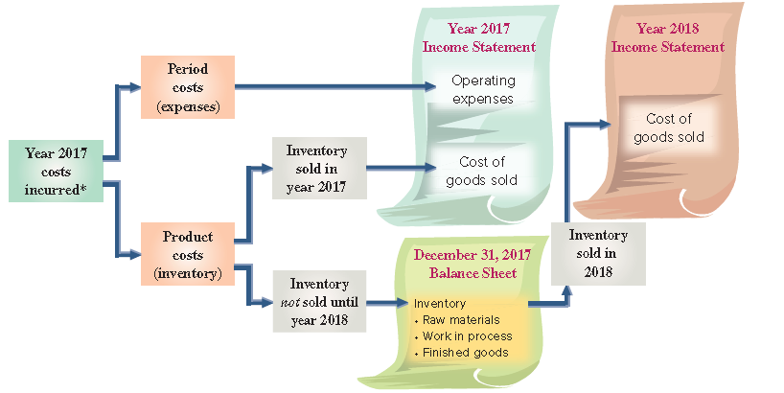
Period and Product Costs in Financial Statements
Exhibit 18.7
Learning Objective C3: Define product and period costs and explain how they impact financial statements.
Notes:
This slide shows the different effects of product and period costs. Period costs flow directly to the current income statement as expenses. They are not reported as assets. Product costs are first assigned to inventory. Their final treatment depends on when inventory is sold or disposed of. Product costs assigned to finished goods that are sold in year 2017 are reported on the 2017 income statement as cost of goods sold. Product costs assigned to unsold inventory are carried forward on the balance sheet at the end of year 2017. If this inventory is sold in year 2018, product costs assigned to it are reported as cost of goods sold in that year’s income statement.

Slide 16
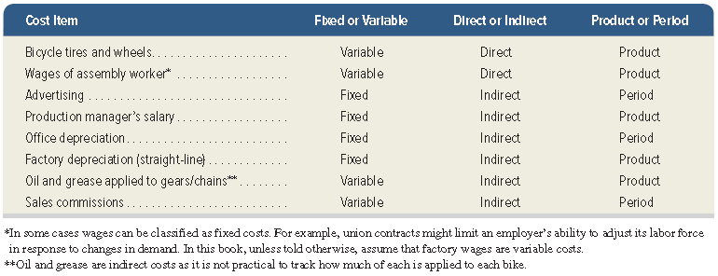
Identifications of Cost Classifications
Exhibit 18.9
Learning Objective C3: Define product and period costs and explain how they impact financial statements.
Notes:
It is important to understand that a cost can be classified using any one (or combination) of the three different means described here. Understanding how to classify costs in several different ways enables managers to use cost information for a variety of decisions. Factory rent, for instance, is classified as a product cost; it is fixed with respect to the number of units produced, and it is indirect with respect to the product. Potential multiple classifications are shown in this slide using different cost items incurred in manufacturing mountain bikes. The finished bike is the cost object. Managerial decisions based on cost data depend on correct cost classifications.

Slide 17
Cost Concepts for Service Companies
The cost concepts described are generally applicable to service organizations.
For example, the cost of beverages for passengers of Southwest Airlines is a variable cost based on number of passengers.
Learning Objective C3: Define product and period costs and explain how they impact financial statements.
Notes:
The cost concepts described also apply to service organizations. For example, consider Southwest Airlines, and assume the cost object is a flight. The airline’s cost of beverages for passengers is a variable cost based on number of flights. The monthly cost of leasing an aircraft is fixed with respect to number of flights. We can also trace a flight crew’s salary to a specific flight whereas we likely cannot trace wages for the ground crew to a specific flight. Classification as product versus period costs is not relevant to service companies because services are not inventoried. Instead, costs incurred by a service firm are expensed in the reporting period when incurred.
To be effective, managers in service companies must understand and apply cost concepts. For example, an airline manager must often decide between canceling or rerouting flights. The manager must be able to estimate costs saved by canceling a flight versus rerouting. Knowledge of fixed costs is equally important.
Review what you have learned in the following NEED-TO-KNOW Slide.

Slide 18
NEED-TO-KNOW 18-2
Following are the costs of a company that manufactures computer chips. Classify each as either a product
cost or a period cost. Then classify each of the product costs as direct material, direct labor, or factory
overhead.
1. Plastic board used to mount the chip
5. Real estate taxes paid on the factory
2. Advertising costs
6. Factory supervisor salary
3. Factory maintenance workers’ salaries
7. Depreciation on factory equipment
4. Real estate taxes paid on the sales office
8. Assembly worker hourly pay to make chips
Product Costs
Direct
Direct
Factory
Period
Material
Labor
Overhead
Cost
1. Plastic board used to mount the chip
X
2. Advertising costs
X
3. Factory maintenance workers’ salaries
X
4. Real estate taxes paid on the sales office
X
5. Real estate taxes paid on the factory
X
6. Factory supervisor salary
X
7. Depreciation on factory equipment
X
8. Assembly worker hourly pay to make chips
X
Product Costs
All Factory Costs
Assets on Balance Sheet
Period Costs
Non-Factory Costs
Expensed on Income Statement as Selling, General and Administrative
Learning Objective C2: Describe accounting concepts useful in classifying costs.
Learning Objective C3: Define product and period costs and explain how they impact financial statements.
Notes:
Following are the costs of a company that manufactures computer chips. Classify each as either a product cost or a period cost. Then classify each of the product costs as direct material, direct labor, or factory overhead.
Product costs represent all of the factory costs. Assets are valued on the balance sheet at all necessary costs to get the asset ready for its intended purpose. Product costs include direct material, direct labor, and all other factory costs, called factory overhead. Period costs are the non-factory costs. These costs are expensed on the income statement as incurred, as either selling expense, or general and administrative expense.
The plastic board used to mount the chip is a direct material cost. Advertising costs are non-factory costs, and are expensed in the period incurred. Factory maintenance workers' salaries are factory costs, and therefore product costs, but don't qualify as direct materials or direct labor. Therefore, these costs are classified as factory overhead. Real estate taxes paid on the sales office is non-factory related; this is a period cost. Real estate taxes paid on the factory is a factory cost, but it's not direct materials or direct labor, so again we classify it as factory overhead. The factory supervisor salary is also a product cost, part of factory overhead. Depreciation on factory equipment is also part of factory overhead. The assembly worker's hourly wage to make the chips can be traced directly to the product. Therefore, this factory cost is classified as direct labor.

Slide 19
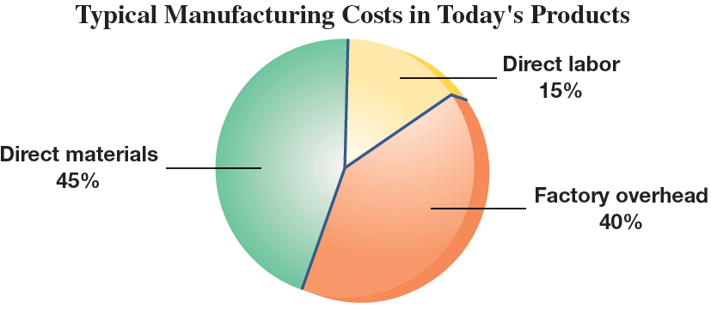
Reporting of Costs
Learning Objective C3: Define product and period costs and explain how they impact financial statements.
Notes:
Companies with manufacturing activities differ from both merchandising and service companies. The main difference between merchandising and manufacturing companies is that merchandisers buy goods ready for sale while manufacturers produce goods from materials and labor. Amazon is an example of a merchandising company. It buys and sells goods without physically changing them. Adidas is primarily a manufacturer of shoes, apparel, and accessories. It purchases materials such as leather, cloth, dye, plastic, rubber, glue, and laces and then uses employees’ labor to convert these materials to products.

Slide 20
Direct Materials
Direct materials costs are the expenditures for direct materials that are separately and readily traced through the manufacturing process to finished goods.
Example:
Steel used in the frame of a mountain bike.
Learning Objective C3: Define product and period costs and explain how they impact financial statements.
Notes:
Direct materials are tangible components of a finished product. Direct material costs are the expenditures for direct materials that are separately and readily traced through the manufacturing process to finished goods. Examples of direct materials in manufacturing a mountain bike include its tires, seat, frame, pedals, brakes, cables, gears, and handlebars.

Slide 21
Direct Labor
Direct labor costs are the wages and salaries for direct labor that are separately and readily traced through the manufacturing process to finished goods.
Example:
Wages paid to a mountain bike assembly worker.
Learning Objective C3: Define product and period costs and explain how they impact financial statements.
Notes:
Direct labor refers to the efforts of employees who physically convert materials to finished product. Direct labor costs are the wages and salaries for direct labor that are separately and readily traced through the manufacturing process to finished goods. Examples of direct labor in manufacturing a mountain bike include operators directly involved in converting raw materials into finished products (welding, painting, forming) and assembly workers who attach materials such as tires, seats, pedals, and brakes.

Slide 22
Factory Overhead
Factory overhead consists of all manufacturing costs that are not direct materials or direct labor and the costs cannot be separately or readily traced to finished goods.
Examples:
Indirect labor – maintenance.
Indirect material – cleaning supplies. Factory utility costs. Supervisory costs.
Learning Objective C3: Define product and period costs and explain how they impact financial statements.
Notes:
Factory overhead, also called manufacturing overhead, consists of all manufacturing costs that are not direct materials or direct labor. Factory overhead costs cannot be separately or readily traced to finished goods. All factory overhead costs are considered indirect costs. These costs include indirect materials, indirect labor, and other costs not directly traceable to the product.
Indirect materials are components used in manufacturing the product, but they are not clearly identified with specific product units. Direct materials are often classified as indirect materials when their costs are low. Examples include screws and nuts used in assembling mountain bikes, and staples and glue used in manufacturing shoes. Applying the materiality principle, it does not make economic sense to individually trace costs of each of these materials to individual products. For example, keeping detailed records of the amount of glue used to manufacture one shoe is not cost-beneficial.
Indirect labor costs refer to the costs of workers who assist in or supervise the manufacturing. Indirect labor are workers who assist or supervise in manufacturing the product, but they are not clearly identified with specific product units. Examples include costs for employees who maintain the manufacturing equipment and salaries of production supervisors.
Nonmanufacturing Costs –Factory overhead does not include selling and administrative expenses because they are not incurred in manufacturing products. These expenses are period costs, and they are recorded as expenses on the income statement when incurred. For a manufacturing company, such costs are also called nonmanufacturing costs. Examples include office workers salaries, depreciation on office equipment, and advertising expenses.

Slide 23
Prime and Conversion Costs
Manufacturing costs are often combined as follows:
Direct Material
Direct Labor
Manufacturing Overhead
Prime Cost
Conversion Cost
Learning Objective C3: Define product and period costs and explain how they impact financial statements.
Notes:
We can classify product costs into prime or conversion costs. Prime costs are expenditures directly associated with the manufacture of finished goods, which includes both direct material and direct labor costs. Conversion costs are expenditures incurred in the process of converting raw materials to finished goods, which includes both direct labor costs and manufacturing overhead costs. Notice that direct labor costs are considered both prime costs and conversion costs. Classification into conversion costs is useful for process costing.

Slide 24
C4: Explain how balance sheets and income statements for manufacturing, merchandising, and service companies differ.
Learning Objective

Slide 25
Reporting Manufacturing Activities
Merchandisers . . .
Buy finished goods.
Sell finished goods.
Manufacturers . . .
Buy raw materials.
Produce and sell finished goods.
SaleMart
Learning Objective C4: Explain how balance sheets and income statements for manufacturing, merchandising, and service companies differ.
Notes:
Companies with manufacturing activities differ from both merchandising and service companies. The main difference between merchandising and manufacturing companies is that merchandisers buy goods ready for sale while manufacturers produce goods from materials and labor.

Slide 26
Manufacturer’s Balance Sheet
Raw Materials
Work in Process
Finished Goods
Materials waiting to be processed.
Can be direct
or indirect.
Partially complete products.
Material to which some labor and/or overhead have been added.
Completed products for sale.
Learning Objective C4: Explain how balance sheets and income statements for manufacturing, merchandising, and service companies differ.
Notes:
Manufacturers carry several unique assets and usually have three inventories instead of the single inventory that merchandisers carry. The three inventories are raw materials, work in process, and finished goods.
Raw materials inventory is the goods a company acquires to use in making products. Companies use raw materials in two ways: directly and indirectly. Raw materials that are possible and practical to trace to product are called direct materials; they are included in raw materials inventory.
Work in process inventory, also called goods in process inventory consists of products in the process of being manufactured but not yet complete. The amount of work in process inventory depends on the type of production process.
Finished goods inventory, which consists of completed products ready for sale, is similar to merchandise inventory owned by a merchandising company.

Slide 27
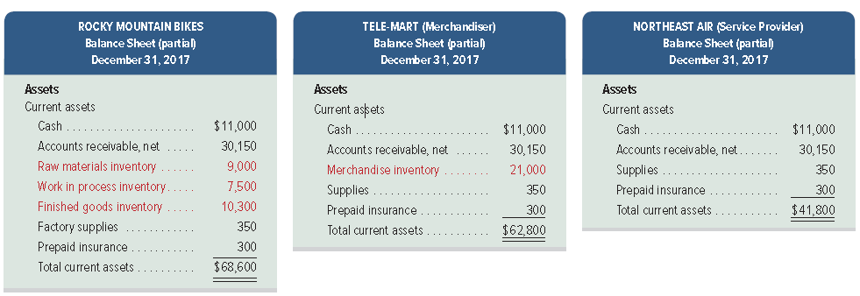
Balance Sheets for Manufacturers, Merchandisers and Servicers
Exhibit 18.11
The primary difference is inventory.
Learning Objective C4: Explain how balance sheets and income statements for manufacturing, merchandising, and service companies differ.
Notes:
The primary difference in the Balance Sheet of a Merchandiser and a Manufacturer is the presentation of Inventory under the Current Assets section. Merchandisers have one category of inventory called Merchandise Inventory. Manufacturers have three major categories of inventory: Raw Materials, Work in Process, also called goods in process, and Finished Goods.
The current assets section of the balance sheet will look different for merchandising and service companies as compared to manufacturing companies. A merchandiser will report only merchandise inventory rather than the three types of inventory reported by a manufacturer. A service company’s balance sheet does not have any inventory held for sale. Exhibit 18.11 shows the current assets section of the balance sheet for a manufacturer, a merchandiser, and a service company.

Slide 28
P1: Compute cost of goods sold for a manufacturer and for a merchandiser.
Learning Objective

Slide 29
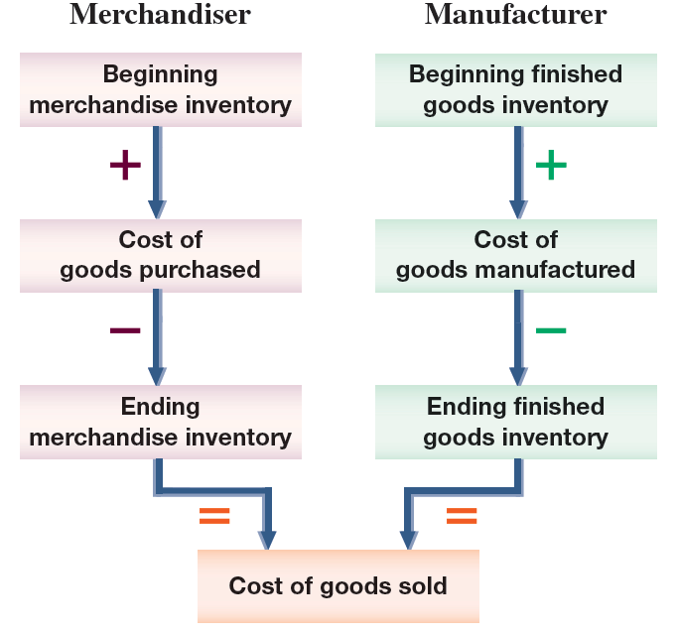
Costs and the Income Statement
Exhibit 18.12
Learning Objective P1: Compute cost of goods sold for a manufacturer and for a merchandiser.
Notes:
The main difference between the income statement of a manufacturer and that of a merchandiser involves the items making up cost of goods sold.
This slide compares the components of cost of goods sold for a merchandiser with those for a manufacturer. Merchandisers add cost of goods purchased to beginning merchandise inventory and then subtract ending merchandise inventory to get cost of goods sold. Manufacturers add cost of goods manufactured to beginning finished goods inventory and then subtract ending finished goods inventory to get cost of goods sold.
In computing cost of goods sold, a merchandiser uses merchandise inventory while a manufacturer uses finished goods inventory. A manufacturer’s inventories of raw materials and work in process are not included in finished goods because they are not available for sale. A manufacturer also shows cost of goods manufactured instead of cost of goods purchased. This difference occurs because a manufacturer produces its goods instead of purchasing them ready for sale.

Slide 30
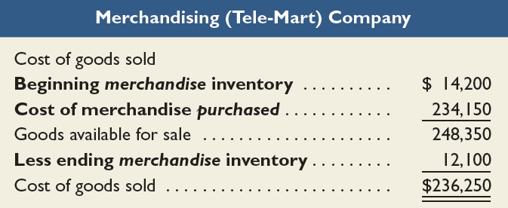
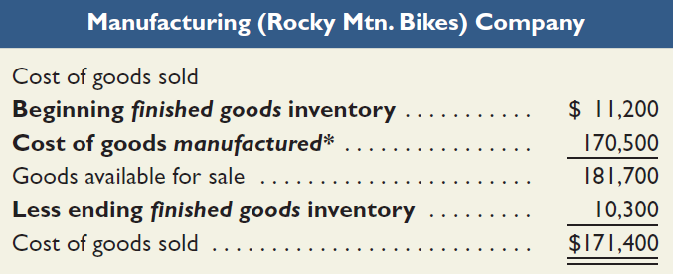
Cost of Goods Sold for a Merchandiser and Manufacturer
Exhibit 18.13
Cost of goods sold for manufacturers differs only slightly from cost of goods sold for merchandisers.
Learning Objective P1: Compute cost of goods sold for a manufacturer and for a merchandiser.
Notes:
The Cost of Goods Sold sections for both a merchandiser (Tele-Mart) and a manufacturer (Rocky Mountain Bikes) are shown in this slide to highlight these differences. The remaining income statement sections are similar for merchandisers and manufacturers.
Although the cost of goods sold computations are similar, the numbers in these computations reflect different activities. A merchandiser’s cost of goods purchased is the cost of buying products to be sold. A manufacturer’s cost of goods manufactured is the sum of direct materials, direct labor, and factory overhead costs incurred in making products.
Since a service provider does not make or buy inventory to be sold, it does not report cost of goods manufactured or cost of goods sold. Instead, its operating expenses include all of the costs it incurs in providing its service.
Review what you have learned in the following NEED-TO-KNOW Slide.

Slide 31
NEED-TO-KNOW 18-3
Indicate whether the following financial statement items apply to a manufacturer, a merchandiser, or a
service provider. Some items apply to more than one type of organization.
1. Merchandise inventory
5. Operating expenses
2. Finished goods inventory
6. Cost of goods manufactured
3. Cost of goods sold
7. Supplies inventory
4. Selling expenses
8. Raw materials inventory
Manufacturer
Produces units for sale
Balance Sheet includes:
Raw Materials Inventory
Work in Process Inventory
Finished Goods Inventory
Merchandiser
Purchases units for resale
Balance Sheet includes:
Merchandise Inventory
Service Provider
Does not provide a product to its customers; no inventories for sale or resale.
Manufacturer
Merchandiser
Service Provider
1. Merchandise inventory
X
2. Finished goods inventory
X
3. Cost of goods sold
X
X
4. Selling expenses
X
X
X
5. Operating expenses
X
X
X
6. Cost of goods manufactured
X
7. Supplies inventory
X
X
X
8. Raw materials inventory
X
Learning Objective P1: Compute cost of goods sold for a manufacturer and for a merchandiser.
Notes:
Indicate whether the following financial statement items apply to a manufacturer, a merchandiser, or a service provider. Some items apply to more than one type of organization.
A manufacturer produces the units that it will sell. The balance sheet includes three different inventories: Raw Materials Inventory, Work in Process Inventory, and Finished Goods Inventory.
A merchandiser does not manufacture its units; instead it purchases units for resale. The balance sheet of a merchandiser includes a single inventory, Merchandise Inventory.
A service provider, as the name indicates, does not provide a product; instead it provides a service. The balance sheet of a service provider will not report any inventories for sale or resale.
So, the Merchandise Inventory account appears on the merchandiser's balance sheet. Finished goods Inventory appears on a manufacturer's balance sheet. Cost of goods sold is inventory expense. Both the manufacturer and the merchandiser carry inventories, and will therefore report cost of goods sold on the income statement. Selling and operating expenses are incurred by all three types of organizations. Cost of goods manufactured only applies to the manufacturer. Cost of goods manufactured represents the cost of units that are completed during the current period, and transferred from the Work in Process Inventory account to the Finished Goods Inventory account. Supplies inventory can apply to all three types of organizations. Raw materials inventory only applies to a manufacturer.

Slide 32
C5: Explain manufacturing activities and the flow of manufacturing costs.
Learning Objective

Slide 33
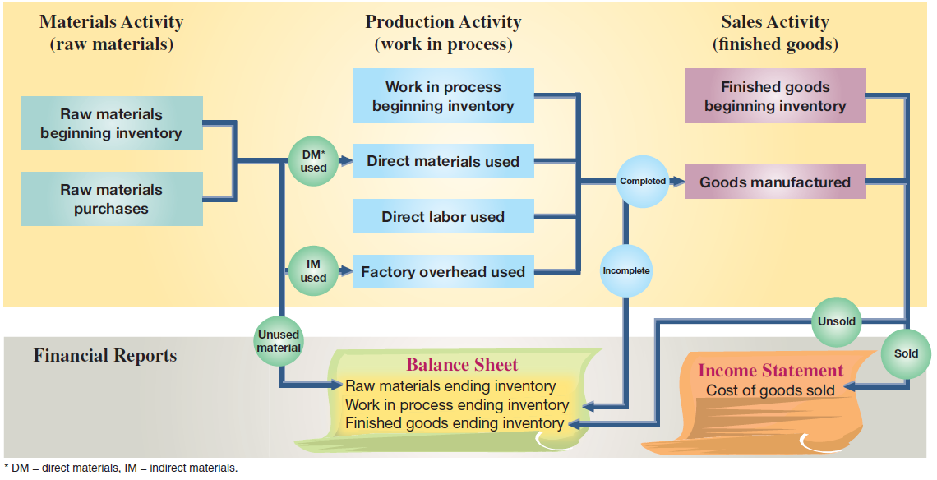
Flow of Manufacturing Activities
Exhibit 18.15
Learning Objective C5: Explain manufacturing activities and the flow of manufacturing costs.
Notes:
In addition to income statements and balance sheets, manufacturing companies prepare additional reports for planning and control. To understand these reports, we must know the flow of manufacturing activities and costs. This slide shows the flow of manufacturing activities and the cost flows of those activities. Looking across the top row the activities flow consists of materials activity followed by production activity followed by sales activity. The boxes below those activities show the costs for each activity and how costs flow across the three activities.
The production activity that takes place in the period results in products that are either finished or not finished at the end of the period. The cost of finished products makes up the cost of goods manufactured for the current period. The cost of goods manufactured is the total cost of making and finishing products in the period.
The company adds the cost of the beginning inventory of finished goods with the cost of the newly completed units (goods manufactured). Together, they make up total finished goods available for sale in the current period. As they are sold, the cost of finished products sold is reported on the income statement as cost of goods sold. The cost of any finished products not sold in the period is reported as a current asset, finished goods inventory, on the current period’s balance sheet.

Slide 34
P2: Prepare a schedule of cost of goods manufactured and explain its purpose and links to financial statements.
Learning Objective

Slide 35
Schedule of Cost of Good Manufactured
Summarizes the types and amounts of costs
incurred in a company’s manufacturing process.
Direct Materials Used
+ Direct Labor
+ Factory Overhead
= Total Manufacturing Costs
+ Beginning Work in Process
– Ending Work in Process
= Cost of Goods Manufactured
Learning Objective P2: Prepare a schedule of cost of goods manufactured and explain its purpose and links to financial statements.
Notes:
Managers of manufacturing firms analyze product costs in detail. Those managers aim to make better decisions about materials, labor, and overhead to reduce the cost of goods manufactured and improve income. A company’s manufacturing activities are described in a report called a schedule of cost of goods manufactured also called a manufacturing statement and a statement of cost of goods manufactured. The schedule of cost of goods manufactured summarizes the types and amounts of costs incurred in the manufacturing process.

Slide 36
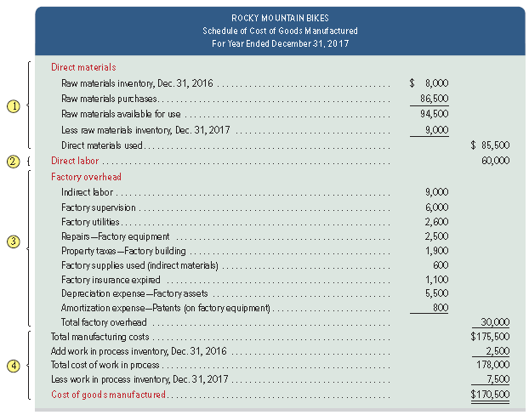
Manufacturing Statement
Exhibit 18.16
Learning Objective P2: Prepare a schedule of cost of goods manufactured and explain its purpose and links to financial statements.
Notes:
This slide shows the schedule of cost of goods manufactured for Rocky Mountain Bikes. The schedule is divided into four parts: direct materials, direct labor, overhead, and computation of cost of goods manufactured.

Slide 37
Manufacturing Statement
Exhibit 18.16
Learning Objective P2: Prepare a schedule of cost of goods manufactured and explain its purpose and links to financial statements.
Notes:
1. Compute direct materials used. Add the beginning raw materials inventory of $8,000 to the current period’s purchases of $86,500. This yields $94,500 of total raw materials available for use. A physical count of inventory shows $9,000 of ending raw materials inventory. If $94,500 of materials were available for use, and $9,000 of materials remains in inventory, then $85,500 of materials were used in the period.

Slide 38
Manufacturing Statement
Exhibit 18.16
Include all direct labor costs incurred during the current period.
Learning Objective P2: Prepare a schedule of cost of goods manufactured and explain its purpose and links to financial statements.
Notes:
2. Compute direct labor costs used. Rocky Mountain Bikes had total direct labor costs of $60,000 for the period. This amount includes payroll taxes and fringe benefits.

Slide 39
Manufacturing Statement
Exhibit 18.16
Learning Objective P2: Prepare a schedule of cost of goods manufactured and explain its purpose and links to financial statements.
Notes:
3. Compute total factory overhead costs used. The statement lists each important factory overhead item and its cost. All of these costs are indirectly related to manufacturing activities. (Period expenses, such as selling expenses and other costs not related to manufacturing activities, are not reported on this statement.) Total factory overhead cost is $30,000. Some companies report only total factory overhead on the schedule of cost of goods manufactured and attach a separate schedule listing individual overhead costs.

Slide 40
Manufacturing Statement
Exhibit 18.16
Learning Objective P2: Prepare a schedule of cost of goods manufactured and explain its purpose and links to financial statements.
Notes:
4. Compute the cost of goods manufactured. Total manufacturing costs for the period are $175,500 ($85,500 + $60,000 + $30,000), the sum of direct materials and direct labor, and overhead costs incurred. This amount is added to beginning work in process inventory which gives the total work in process during the period of $178,000 ($175,500 + $2,500). A physical count shows $7,500 of work in process inventory remains at the end of the period. We then compute the current period’s cost of goods manufactured of $170,500 by taking the $178,000 total work in process and subtracting the $7,500 cost of ending work in process inventory. The cost of goods manufactured amount is also called net cost of goods manufactured or cost of goods completed.
Estimating Cost Per Unit Managers use the schedule of cost of goods manufactured to make rough estimates of per unit costs. For example, if Rocky Mountain Bikes made 1,000 bikes during the year, the average manufacturing cost per unit is $170.50 (computed as $170,500/1,000). Average cost per unit is not always an the appropriate cost for managerial decisions.

Slide 41
Manufacturing Cost Flows Across Accounting Reports
Exhibit 18.17
Learning Objective P2: Prepare a schedule of cost of goods manufactured and explain its purpose and links to financial statements.
Notes:
This slide summarizes how product costs flow through the accounting system: Direct materials, direct labor, and overhead costs are summarized in the schedule of cost of goods manufactured; then the amount of cost of goods manufactured from that statement is used to compute cost of goods sold on the income statement. Physical counts determine the dollar amounts of ending raw materials inventory and work in process inventory, and those amounts are included on the end-of-period balance sheet. (Note: This exhibit shows only partial reports.)
Review what you have learned in the following NEED-TO-KNOW Slides.

Slide 42
NEED-TO-KNOW 18-4
Compute the following three measures using the information below.
1. Cost of materials used
$70,900
Cost of Direct Materials transferred from Raw Materials Inventory to Work in
Process Inventory.
2. Cost of goods manufactured
$173,900
Cost of goods completed in the current period and transferred from Work in
Process Inventory to Finished Goods Inventory.
3. Cost of goods sold
$160,500
Cost of goods leaving Finished Goods Inventory and going to the customer.
Expensed on the income statement.
Beginning raw materials inventory
$15,500
Ending raw materials inventory
$10,600
Beginning work in process inventory
29,000
Ending work in process inventory
44,000
Beginning finished goods inventory
24,000
Ending finished goods inventory
37,400
Raw materials purchased
66,000
Direct labor used
38,000
Total factory overhead used
80,000
Raw Materials Inventory
Work in Process Inventory
Finished Goods Inventory
Beg. Inv.
15,500
Beg. Inv.
29,000
Beg. Inv.
24,000
Purchases
66,000
Matls. Used
70,900
Cost of GM
173,900
Direct Labor
38,000
Fact. OH
80,000
Avail for Use
81,500
217,900
Avail for Sale
197,900
Matls. Used
70,900
Cost of GM
173,900
Cost of GS
160,500
End. Inv.
10,600
End. Inv.
44,000
End. Inv.
37,400
Learning Objective P1: Compute cost of goods sold for a manufacturer and for a merchandiser.
Learning Objective P2: Prepare a schedule of cost of goods manufactured and explain its purpose and links to financial statements.
Notes:
Compute the following three measures using the accounting information below. Cost of materials used; Cost of goods manufactured, and Cost of goods sold. Cost of materials used is the cost of Direct Materials transferred from Raw Materials Inventory to Work in Process Inventory. Cost of goods manufactured is the cost of goods completed in the current period and transferred from Work in Process Inventory to Finished Goods Inventory. And Cost of goods sold is the cost of goods leaving Finished Goods Inventory and going to the customer. The cost of these goods are expensed on the income statement.
So let's set up the T-accounts for Raw Materials, Work in Process and Finished Goods.

Slide 43
NEED-TO-KNOW 18-4 – Part B
Raw Materials Inventory
Work in Process Inventory
Finished Goods Inventory
Beg. Inv.
15,500
Beg. Inv.
29,000
Beg. Inv.
24,000
Purchases
66,000
Matls. Used
70,900
Cost of GM
173,900
Direct Labor
38,000
Fact. OH
80,000
Avail for Use
81,500
Avail for Mfg.
217,900
Avail for Sale
197,900
Matls. Used
70,900
Cost of GM
173,900
Cost of GS
160,500
End. Inv.
10,600
End. Inv.
44,000
End. Inv.
37,400
Balance Sheet
Current assets:
Raw Materials Inventory
$10,600
Work in Process Inventory
44,000
Finished Goods Inventory
37,400
Income Statement
Sales
$XXXXX
Cost of Goods Sold
(160,500)
Learning Objective P1: Compute cost of goods sold for a manufacturer and for a merchandiser.
Learning Objective P2: Prepare a schedule of cost of goods manufactured and explain its purpose and links to financial statements.
Notes:
The beginning inventory of raw materials is $15,500. The beginning inventory of work in process is $29,000, and the beginning inventory of finished goods is $24,000. During the current period, the company purchased $66,000 of raw materials. These costs are debited to the Raw Materials Inventory account. Total cost of materials available for use is $81,500.
At the end of the period, Raw materials has an inventory balance of $10,600. The difference between $81,500 of materials available for use and the amount on hand at the end of the period, $10,600, is the amount that was transferred to Work in Process; cost of materials used, $70,900. $70,900 of materials were transferred from the Raw Materials inventory to the factory, Work in Process. The cost of the direct materials are added to the beginning inventory, along with the cost of direct labor used, $38,000, and factory overhead, $80,000. The total cost of goods available for manufacture is $217,900. At the end of the period, Work in Process Inventory has a value of $44,000. The difference between $217,900 of goods available for manufacture, and $44,000 of goods on hand at the end of the period, represents the cost of completed units. Cost of goods manufactured is $173,900. $173,900 of goods were transferred from Work in Process into the Finished Goods inventory.
The beginning inventory of Finished Goods plus cost of goods manufactured equals cost of goods available for sale, $197,900. The value of Finished Goods Inventory at the end of the period is $37,400. The difference between $197,900 available for sale and the ending inventory balance of $37,400 represents cost of goods sold, $160,500. $160,500 of merchandise was sold to the customer in the current period. The current asset section of the balance sheet will include the three ending inventory balances: Raw Materials Inventory, Work in Process Inventory and Finished Goods Inventory. The income statement will report Sales minus Cost of goods sold.

Slide 44
C6: Describe trends in managerial accounting.
Learning Objective

Slide 45
Trends in Managerial Accounting
Customer Orientation
Global
Economy
Service Economy
E-Commerce
Lean Practices
Value Chain
Learning Objective C6: Describe trends in managerial accounting.
Notes:
Tools and techniques of managerial accounting continue to evolve due to changes in the business environment. This slide presents some of these changes.

Slide 46
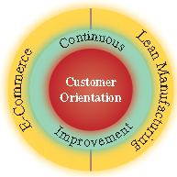
Customer Orientation
Learning Objective C6: Describe trends in managerial accounting.
Notes:
There is increased emphasis on customers as the most important constituent of a business. Customers expect to derive a certain value for the money they spend to buy products and services. Buyers expect that suppliers provide them the right service (or product) at the right time and the right price. This implies that companies accept the notion of customer orientation, which means that managers and employees understand the changing needs and wants of customers and align management and operating practices accordingly.

Slide 47
Total Quality Management
Quality improvement
applied to its
business activities.
Seek and uncover
waste.
Constant Focus on Higher Standards
Employees encouraged to try new methods to improve quality.
Company emphasizes value of quality through quality awards.
Learning Objective C6: Describe trends in managerial accounting.
Notes:
Total quality management focuses on quality improvement to its business activities. Managers and employees seek to uncover waste in business activities including accounting activities such as payroll and disbursements. To encourage an emphasis on quality, the U.S. Congress established the Malcolm Baldrige National Quality Award (MBNQA). Entrants must conduct a thorough analysis and evaluation of their business using guidelines from the Baldrige committee.

Slide 48
Just-In-Time (JIT) Manufacturing
Receive customer orders
Complete products just-in-time to ship to customers
Schedule
Production
Receive materials just-in-time for production
Complete parts just-in-time for assembly into products
Learning Objective C6: Describe trends in managerial accounting.
Notes:
Just-in-time manufacturing is a system that acquires inventory and produces only when needed. An important aspect of JIT is that companies manufacture products only after they receive an order (a demand-pull system) and then deliver the customer’s requirements on time. This means that processes must be aligned to eliminate delays and inefficiencies including inferior inputs and outputs. Companies must also establish good communications with their suppliers. On the downside, JIT is more susceptible to disruption than traditional systems. As one example, several General Motors plants were temporarily shut down due to a strike at a supplier which supplied components just in time to the assembly division.

Slide 49
Value Chain
Exhibit 18.18
The value chain refers to the series of activities that add value to a company’s products or services. Companies can use lean practices to increase efficiency and profits.
Learning Objective C6: Describe trends in managerial accounting.
Notes:
The value chain refers to the series of activities that add value to a company’s products or services. This slide illustrates a possible value chain for a retail cookie company. Companies can use lean practices across the value chain to increase efficiency and profits.

Slide 50
Lean Model Practices Impact for Managerial Accounting
Adopting the lean practices means that all systems and procedures must be realigned.
Managerial accounting has an important role in providing accurate cost and performance information.
Learning Objective C6: Describe trends in managerial accounting.
Notes:
Adopting lean practices can be challenging because all systems and procedures that a company follows must be realigned. Managerial accounting has an important role in providing accurate cost and performance information.

Slide 51
Corporate Social Responsibility
Corporations must consider demands of employees, suppliers, and society.
Corporate social responsibility (CSR) goes beyond law.
Triple bottom line focuses on financial, social and environmental measures.
Adopting a triple bottom line impacts how business report.
Learning Objective C6: Describe trends in managerial accounting.
Notes:
In addition to maximizing shareholder value, corporations must consider the demands of other stakeholders, including employees, suppliers, and society in general. Corporate social responsibility (CSR) is a concept that goes beyond following the law. Triple bottom line, focuses on three measures: financial (“profits”), social (“people”), and environmental (“planet”).
Adopting a triple bottom line impacts how businesses report. In response to a growing trend of such reporting, the Sustainability Accounting Standards Board (SASB) was established to develop reporting standards for businesses’ sustainability activities. Some of the business sectors for which the SASB has developed reporting standards include health care, nonrenewable resources, and renewable resources and alternative energy.

Slide 52
A1: Assess raw materials inventory management using raw materials inventory turnover and days’ sales in raw materials inventory.
Learning Objective

Slide 53
Raw Materials Inventory Turnover
Raw materials Inventory turnover = | Raw materials used
 | Average materials inventory
Learning Objective A1: Assess raw materials inventory management using raw materials inventory turnover and days’ sales in raw materials inventory.
Notes:
A manager can assess how effectively a company manages its raw materials inventory by computing the raw materials inventory turnover ratio as shown in this slide.
This ratio reveals how many times a company turns over (uses in production) its raw materials inventory during a period. Generally, a high ratio of raw materials inventory turnover is preferred, as long as raw materials inventory levels are adequate to meet demand.

Slide 54
Days’ Sales in Raw Materials Inventory
Days’ sales in raw materials inventory = | Ending raw materials inventory
 | Raw materials used
X 365
Learning Objective A1: Assess raw materials inventory management using raw materials inventory turnover and days’ sales in raw materials inventory.
Notes:
To further assess raw materials inventory management, a manager can measure the adequacy of raw materials inventory to meet production demand. Days’ sales in raw materials inventory reveals how much raw materials inventory is available in terms of the number of days’ sales. It is a measure of how long it takes raw materials to be used in production.

Slide 55
End of Chapter 18

