Slide 1
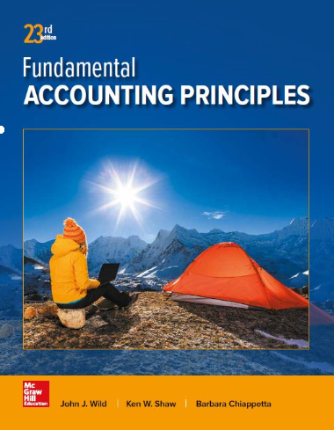
Capital Budgeting and Managerial Decisions
Chapter 25
Wild, Shaw, and Chiappetta
Fundamental Accounting Principles
23rd Edition
Notes:
Chapter 25: Capital Budgeting and Managerial Decisions

Slide 2
Chapter 25 Learning Objectives
CONCEPTUAL
C1 Describe the importance of relevant costs for short-term decisions.
ANALYTICAL
A1 Evaluate short-term managerial decisions using relevant costs.
A2 Analyze a capital investment project using break-even time.
A3 Determine product selling prices using cost data.
PROCEDURAL
P1 Compute payback period and describe its use.
P2 Compute accounting rate of return and explain its use.
P3 Compute net present value and describe its use.
P4 Compute internal rate of return and explain its use.

Slide 3
Capital Budgeting
Capital budgeting is the process of analyzing alternative
long-term investments and deciding which assets
to acquire or sell.
Capital Budgeting Process:
Department or plant manager submits proposals
Capital budget committee evaluates proposals
Board of directors approves capital expenditures.
Notes:
Capital budgeting is the process of analyzing alternative long-term investments and deciding which assets to acquire or sell. Common examples include buying a machine or a building, or acquiring an entire company. An objective for these decisions is to earn a satisfactory return on investment.
Capital budgeting decisions require careful analysis because they are usually the most difficult and risky decisions that managers make.
The process begins with department or plant managers submitting proposals for new investments in property, plant, and equipment. A capital budget committee, usually comprised of members with accounting and finance expertise, evaluates the proposals and forms recommendations for approval or rejection. Finally, the board of directors approves the capital expenditures for the year.

Slide 4
Capital Budgeting
Capital budgeting decisions require careful analysis because they are usually the most difficult and risky decisions that managers make. Specifically, a capital budgeting decision is risky because:
Outcome
is uncertain.
Large amounts of
money are usually
involved.
Decision may be
difficult or impossible
to reverse.
Investment involves a
long-term commitment.
Notes:
Capital budgeting decisions require careful analysis because they are usually the most difficult and risky decisions that managers make. Specifically, a capital budgeting decision is risky because (1) the outcome is uncertain, (2) large amounts of money are usually involved, (3) the investment involves a long-term commitment, and (4) the decision could be difficult or impossible to reverse, no matter how poor it turns out to be. Risk is especially high for investments in technology due to innovations and uncertainty.

Slide 5
Capital Budgeting Cash
Outlows and InFlows
Common Cash Outlflows and Inflows over life of
typical capital expenditures:
Acquisition – initial cash outlfow
Use – generates cash inflows from revenues
Disposal – salvage value can provide cash inflow
Notes:
Managers use several methods to evaluate capital budgeting decisions. Nearly all of these methods involve predicting future cash inflows and cash outflows of proposed investments, assessing the risk of and returns on those cash flows, and then choosing the investments to make.
The process begins with an initial cash outflow to acquire the depreciable asset. Over that asset’s life, it generates cash inflows from revenues. The machine also creates cash outflows for operating costs, repairs, and maintenance. Finally, the machine is disposed of, and its salvage value can provide another cash inflow.
The time value of money is important when evaluating capital investments, but managers sometimes use methods that ignore it. This section describes four methods for evaluating capital spending proposals.

Slide 6
P1:
Compute payback period and describe its use.
Learning Objective

Slide 7
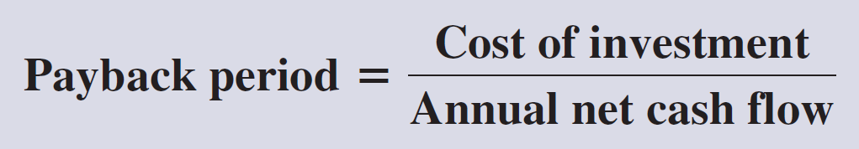
Payback Period
The payback period of an investment
is the amount of time it takes a project to recover
its initial investment amount.
Managers prefer investing in projects with shorter payback periods.
Learning Objective P1: Compute payback period and describe its use..
Notes:
All investments, whether they involve the purchase of a machine or another long-term asset, are expected to produce net cash flows. Net cash flow is cash inflows minus cash outflows. Sometimes managers perform simple analyses of the financial feasibility of an investment’s net cash flow without using the time value of money
The payback period is the expected amount of time it takes a project to recover its initial investment amount.
If the cash inflows of an investment are equal in each year, we can calculate the payback period by dividing the cost of the investment by the annual net cash inflows. Managers prefer investing in assets with shorter payback periods to reduce the risk of an unprofitable investment over the long run.

Slide 8
Payback Period with Even Cash Flows
FasTrac is considering buying a new machine:
Cost…………………………………… $16,000
Useful life……………………………… 8 years
Salvage value…………………………. $ 0
Expected production…………………1,000 units
Product selling price per unit…… $ 30
Calculate the payback period.
Payback
period
Cost of Investment
Annual Net Cash Flow
=
Exhibit 25.4
Payback
period
$16,000
$4,100
=
= 3.9 years
Learning Objective P1: Compute payback period and describe its use..
Notes:
The management at FasTrac is considering a new machine to use in its manufacturing operations. The new machine has these features:
Cost…………………………………… $16,000
Useful life……………………………… 8 years
Salvage value…………………………. $ 0
Expected production…………………1,000 units
Product selling price per unit…… $ 30
Because the net annual cash inflows are the same each year, we can calculate the payback period easily by dividing the machine’s cost by its annual net cash flows. The payback period is 3.9 years. The new machine will return its original cost in annual net cash flows in 3.9 years, less than half of its expected useful life of 8 years.
The amount of net cash flow from the machinery is computed by subtracting expected cash outflows from expected cash inflows. The Expected Net Cash Flow column of Exhibit 25.4 excludes all noncash revenues and expenses. Since depreciation does not impact cash flows, it is excluded.
Management at FasTrac may have an investment decision rule such as: invest only in projects with a payback period of 5 years or less. If so, the company would invest in the new machine because its payback period is less than 5 years.

Slide 9
Payback Period with Uneven Cash Flows
In the previous example, we assumed that the increase in cash flows would be the same each year. Now, let’s look at an example where the cash flows vary each year.
$3,000
$4,000
$4,100
$5,000
Learning Objective P1: Compute payback period and describe its use..
Notes:
Let’s complicate the payback computation a bit by using unequal annual net cash flows for the same machine.
In this case, the payback period is computed using the cumulative total of net cash flows. The word cumulative refers to the addition of each period’s net cash flows as we progress through time.

Slide 10
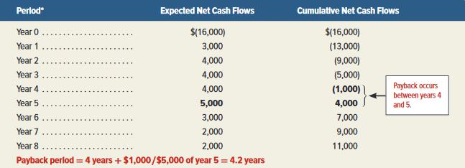
Payback Period with Uneven Cash Flows
FasTrac wants to install a machine that costs $16,000 and has an
8-year useful life with 0 salvage value. Annual net cash flows are:
To get the payback period when we have unequal annual net cash flows, we must add the cash flows each year until the total equals the cost of the investment.
Exhibit 25.5
Payback occurs between years 4 & 5
payback period of 4.2 years
Learning Objective P1: Compute payback period and describe its use..
Notes:
Instead of a constant amount of $4,100 per year, annual net cash flows for the new machine now vary from a low of $2,000 to a high of $5,000 per year. We can no longer divide the cost of the new machine by an equal annual net cash inflow to get the payback period.
To get the payback period when we have unequal annual net cash flows, we must add the cash flows each year until the total equals the cost of the investment. Year 0 refers to the date of initial investment at which the $16,000 cash outflow occurs to acquire the machinery. By the end of year 1, the cumulative net cash flow is reduced to $(13,000), computed as the $(16,000) initial cash outflow plus year 1’s $3,000 cash inflow. This process continues throughout the asset’s life.
FasTrac recovers the $16,000 investment cost between 4 and 5 years. So, we can estimate the payback period at about 4.2 years.
Now let’s review what you have learned in the following NEED-TO-KNOW exercise.

Slide 11
Evaluating the Payback Period
Payback period has two strengths:
1. Uses cash flows, not income
Easy to use
Payback period has three major weaknesses:
1. Does not reflect differences in the timing of net
cash flows
2. Ignores all cash flows occurring after the point
where an investment’s costs are fully recovered
3. Ignores the time value of money
Learning Objective P1: Compute payback period and describe its use..
Notes:
Companies like short payback periods to increase return and reduce risk. The more quickly a company receives cash, the sooner it is available for other uses and the less time it is at risk of loss. A shorter payback period also improves the company’s ability to respond to unanticipated changes and lowers its risk of having to keep an unprofitable investment.
Payback period has two strengths:
1. It uses cash flows, not income.
It is easy to use.
Payback period has three major weaknesses:
1. It does not reflect differences in the timing of net cash flows within the payback period.
2. It ignores all cash flows occurring after the point where an investment’s costs are fully recovered.
It ignores the time value of money.
To illustrate, if FasTrac had another investment with predicted cash inflows of $9,000, $3,000, $2,000, $1,800, and $1,000 in its first five years, its payback period would also be 4.2 years. However, this alternative is more desirable because it returns cash more quickly. In addition, an investment with a 3-year payback period that stops producing cash after 4 years is likely not as good as an alternative with a 5-year payback period that generates net cash flows for 15 years. Because of these limitations, payback period should never be the only consideration in capital budgeting decisions.

Slide 12
NEED-TO-KNOW 25-1
A company is considering purchasing equipment costing $75,000. Future annual net cash
flows from this equipment are $30,000, $25,000, $15,000, $10,000, and $5,000. Cash
flows occur uniformly during the year. What is this investment's payback period?
Period Expected Net Cash Flows Cumulative Net Cash Flows
Year 0
($75,000)
($75,000)
Year 1
30,000
(45,000)
Year 2
25,000
(20,000)
Year 3
15,000
(5,000)
Year 4
10,000
5,000
Year 5
5,000
10,000
Payback between the end of Year 3 and the end of Year 4
Fraction of Year:
Net Cash Outflow Beginning of Payback Year
$5,000
= 0.5
Expected Net Cash Flows During Payback Year
$10,000
Payback = 3.5 years
Learning Objective P1: Compute payback period and describe its use..
Notes:
A company is considering purchasing equipment costing $75,000. Future annual net cash flows from this equipment
are $30,000, $25,000, $15,000, $10,000, and $5,000. Cash flows occur uniformly during the year. What is this investment's payback period?
The payback period is the point in time where cumulative cash inflows, ignoring the time value of money, are exactly equal to the cost of the investment.
We start out with an immediate cash payment of $75,000 to acquire the equipment.
In the first year, net cash flow is $30,000. $30,000 of the machine’s cost has been “paid back”, with a remaining $45,000 to go.
In year 2, net cash flow is $25,000, bringing the cumulative net cash flow to a negative $20,000.
In year 3, net cash flow is $15,000, $5,000 of the machine’s cost is still unpaid.
In year 4, net cash flow is $10,000, bringing the cumulative net cash flow to a positive $5,000.
Since the investment has gone from a net cash outflow of $5,000 to a net cash inflow of $5,000, the investment is
repaid between years 3 and 4. The payback period is greater than 3 years, but less than 4 years.
To calculate the fraction of the year, the numerator is equal to the net cash outflow at the end of year 3, still $5,000 of the investment is unpaid, and the denominator is the amount of the net cash inflow during year 4, $10,000.
The fraction of the year is .5.
The payback period = 3.5 years.

Slide 13
P2:
Compute accounting rate of return and explain its use.
Learning Objective

Slide 14
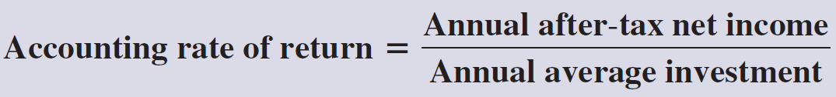
Accounting Rate of Return
Two Ways to Calculate Average Annual Investment
When comparing investments with similar lives and risk, a company will prefer the investment with the higher accounting rate of return.
Learning Objective P2: Compute accounting rate of return and explain its use.
Notes:
The accounting rate of return is the percentage accounting return on annual average investment. It is called an "accounting" return because it is based on net income, rather than on cash flows. It is computed by dividing a project’s after-tax net income by the annual average amount invested in it. The annual average investment in assets is the average book value. If a company uses straight-line depreciation, we can compute the annual average investment as the average of its beginning and ending book values. If a company uses a depreciation method other than straight-line, for example MACRS for tax purposes, the calculation of average book value is more complicated. In this case, the book value of the asset is computed for each year of its life. A general formula for the annual average investment is also shown in this slide.
When accounting rate of return is used to choose among capital investments with similar lives and risk, a company will prefer the investment with the higher accounting rate of return.

Slide 15
Accounting Rate of Return
Let’s revisit the $16,000 investment being considered by FasTrac. The new machine has an annual after-tax net income of $2,100.
Compute the accounting rate of return.
Annual Average Investment Calculation:
Beginning book value ($16,000) + Ending book value ($0)
2
=
$8,000
Accounting $2,100
rate of return $8,000
=
= 26.25%
Learning Objective P2: Compute accounting rate of return and explain its use.
Notes:
FasTrac’s new machine costs $16,000 and has an annual after-tax net income of $2,100.
We need to compute the annual average investment, which is calculated as beginning book value plus the ending book value divided by 2. For FasTrac, the beginning book value is $16,000 and, since there is no salvage value, the ending book value is 0. Dividing $16,000 by 2 yields an $8,000 annual average investment. Now, divide the annual after-tax net income of $2,100 by the annual average investment of $8,000 to arrive at the accounting rate of return of 26.25%. FasTrac’s management must decide whether a 26.25% accounting rate of return is satisfactory. To make this decision, we must factor in the investment’s risk. For instance, we cannot say an investment with a 26.25% return is preferred over one with a lower return unless we consider any differences in risk. When comparing investments with similar lives and risk, a company will prefer the investment with the higher accounting rate of return.

Slide 16

Evaluating Accounting Rate of Return
Accounting Rate of Return has three major weaknesses:
1. Ignores time value of money
2. Focuses on income, not cash
flows
3. If income varies each year, project
may appear desirable in some
years and not in others
Learning Objective P2: Compute accounting rate of return and explain its use.
Notes:
The accounting rate of return has three major weaknesses:
1. It ignores the time value of money.
2. It focuses on income, not cash flows.
3. If income (and thus the accounting rate of return) varies from year to year, the project might appear desirable in some years and not in others.
Because of these limitations, the accounting rate of return should never be the only consideration in capital budgeting decisions.
Now let’s review what you have learned in the following NEED-TO-KNOW exercise.

Slide 17
NEED-TO-KNOW 25-2
The following data relate to a company’s decision on whether to purchase a machine:
Cost
$180,000
Salvage value
15,000
Annual after-tax net income
40,000
Assume net cash flows occur uniformly over each year and the company uses straight-line
depreciation. What is the machine's accounting rate of return?
The Accounting Rate of Return (ARR) measures the amount of net income generated from a capital investment.
Accounting Rate of Return = Annual After-Tax Net Income
Annual Average Investment
Annual After-Tax Net Income
(Cost + Salvage) / 2
$40,000
($180,000 + $15,000) / 2
$40,000
$97,500
41%
Learning Objective P2: Compute accounting rate of return and explain its use.
Notes:
The following data relate to a company’s decision on whether to purchase a machine:
Assume net cash flows occur uniformly over each year and the company uses straight-line depreciation.
What is the machine's accounting rate of return?
The Accounting Rate of Return (ARR) measures the amount of net income generated from a capital investment.
It's calculated by taking the annual after-tax net income and dividing by the annual average investment.
The annual average investment is calculated by taking cost plus salvage and dividing by two.
$40,000 of annual after-tax net income divided by the asset's cost, $180,000, plus the salvage value, $15,000, $195,000, divided by two.
$40,000 of annual after-tax net income divided by the asset's cost, $180,000, plus the salvage value, $15,000, $195,000, divided by two.
$40,000 divided by $97,500
is an accounting rate of return of 41%.

Slide 18
P3:
Compute net present value and describe its use.
Learning Objective

Slide 19
Net Present Value
Net present value analysis applies the time value of money to future cash inflows and cash outflows so management can evaluate a project’s benefits and costs at one point in time.
We calculate Net Present Value (NPV) by:
  Discount the future net cash flows from the
  investment at the required rate of return.
  Subtract the initial amount invested from
  sum of the discounted cash flows.
A company’s required return, often called its hurdle rate, is typically its cost of capital, which is the rate the company must pay to its long-term creditors and shareholders.
Learning Objective P3: Compute net present value and describe its use.
Notes:
Net present value analysis applies the time value of money to future cash inflows and cash outflows so management can evaluate a project’s benefits and costs at one point in time. Specifically, net present value (NPV) is computed by discounting the future net cash flows from the investment at the project’s required rate of return and then subtracting the initial amount invested. A company’s required return, often called its hurdle rate, is typically its cost of capital, which is the rate the company must pay to its long-term creditors and shareholders.

Slide 20
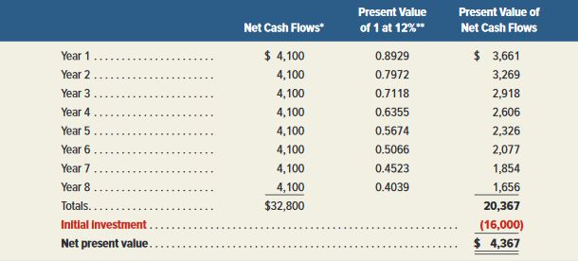

Net Present Value with Equal Cash Flows
FasTrac is considering the purchase of a machine costing $16,000, with an 8-year useful life and zero salvage value, that promises annual net cash inflows of $4,100. FasTrac requires a 12 percent annual return on its investments.
Exhibit 25.7
Exhibit 25.9
FasTrac should invest in the machine because NPV > 0!
Learning Objective P3: Compute net present value and describe its use.
Notes:
FasTrac’s new machine will cost $16,000. It has an eight-year useful life, zero salvage value, and promises annual net cash inflows of $4,100. FasTrac requires a 12 percent annual return on its investments.
To find the present value of a future cash flow, we multiply the annual net cash flow from the first column of the exhibit by the discount factor in the second column (which is the present value of one dollar for 12 percent and the year in which the cash flow occurs). The result, is the present value of the annual cash flow and that is shown in the third column. The present value factors in the exhibit can be found in Table B.1 of Appendix B of your textbook.
To find the net present value, we sum the present values for each year and then subtract the cost of the new machine from the sum. The sum of present values is greater than the cost of the investment, resulting in a net present value of $4,367 dollars. A positive net present value indicates that this project earns more than 12 percent on the investment of $16,000 and FasTrac should invest in the machine. Rule: If NPV > 0, invest.

Slide 21
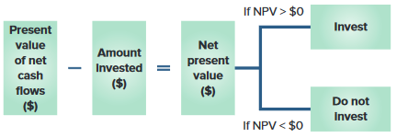
Net Present Value Decision Rule
When an asset's expected future cash flows yield a positive net present value when discounted at the required rate of return, the asset should be acquired.
When comparing several investment opportunities of similar cost and risk, we prefer the one with the highest positive net present value.
Learning Objective P3: Compute net present value and describe its use.
Notes:
The decision rule in applying NPV is as follows: when an asset's expected future cash flows yield a positive net present value when discounted at the required rate of return, the asset should be acquired. This decision rule is reflected in the graphic on this slide. If the net present value is zero or positive, the project is acceptable since the promised return is equal to or greater than the required rate of return. When we have a negative net present value, the project is not acceptable. When comparing several investment opportunities of similar cost and risk, we prefer the one with the highest positive net present value.

Slide 22
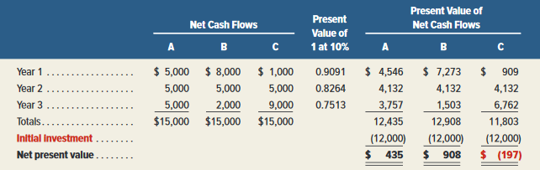
Net Present Value with Uneven Cash Flows
Exhibit 25.10
Exhibit 25.8
Although all projects require the same investment and have
the same total net cash flows, Project B has a higher net present
value because of a larger net cash flow in Year 1.
Learning Objective P3: Compute net present value and describe its use.
Notes:
Net present value analysis can also be used when net cash flows are uneven (unequal). In this example, we see why investments that have larger returns in the early years are preferable to investments that have larger returns in later years. Each investment returns $15,000 in total cash flows over a three-year period. Each investment costs $12,000, but Project B has a larger cash flow in the first year and therefore has a larger net present value. Project C has a lower cash flow in the first year and therefore has a smaller net present value. The present value of 1 factors assuming 10% required return shown in the chart above, can be found in Table B.1 in Appendix B.
Now let’s review what you have learned in the following NEED-TO-KNOW exercise.

Slide 23
Comparing Positive NPV Projects
One way to compare projects when a company cannot fund all positive net present value projects.
Profitability index =
Present value of net cash flows
Investment
Exhibit 25.11 illustrates the computation of the profitability index for three potential investment.
 | 1 | 2 | 3
Present value of net cash flows (a) | $900,000 | $375,000 | $270,000
Amount invested (b) | 750,000 | 250,000 | 300,000
Profitability index (a) ÷ (b) | 1.2 | 1.5 | 0.90
Exhibit 25.11
Investment #2 has the highest profitability index so it should be chosen.
A profitability index less than 1 indicates an investment with a negative NPV so Investment #3 would be ruled out.
Learning Objective P3: Compute net present value and describe its use.
Notes:
When considering several projects of similar investment amounts and risk levels, we can compare the different projects’ NPVs and rank them on the dollar amounts of their NPV’s. However, if the amount invested differs substantially across projects, the NPV is of limited value for comparison purposes. One way to compare projects, especially when a company cannot fund all positive net present value projects, is to use the profitability index, which is computed as the present value of net cash flows for a project divided by its initial investment amount.
On this slide, we see the computation of the profitability index for three potential investments. A profitability index less than 1 indicates an investment with a negative NPV so Investment #3 would be ruled out. Both Investments #1 and #2 have profitability indexes greater than 1, thus they have positive NPVs. If the company was forced to choose, it should select investment #2 as it has the highest profitability index.

Slide 24
Capital Rationing
Capital rationing – constraints that limit firms from accepting all positive NPV projects.
Two forms:
1. Hard rationing – imposed by external forces
2. Soft rationing – internally imposed by
management
Learning Objective P3: Compute net present value and describe its use.
Notes:
Some firms face capital rationing, or financing constraints that limit them from accepting all positive NPV projects. This can be in two forms, hard rationing and soft rationing. Hard rationing is imposed by external forces, such as debt covenants that restrict the firm’s ability to borrow more money. Soft rationing is internally imposed by management and the board of directors. For example, management might place spending limits on certain employees until they show they can make good decisions. Whether due to hard or soft capital rationing, the profitability index can be used to select the best of several competing projects.

Slide 25
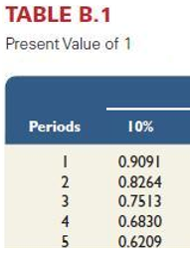
NEED-TO-KNOW 25-3
A company can invest in only one of two projects, A or B. Each project requires a $20,000
investment and is expected to generate end-of-period, annual cash flows as follows:
Net Cash Inflows
Year 1
Year 2
Year 3
Total
Project A
$12,000
$8,500
$4,000
$24,500
Project B
4,500
8,500
13,000
26,000
Assuming a discount rate of 10%, which project has the higher net present value?
Project A
Net Cash
PV of $1 at
PV of Net
Inflows
10%
Cash
Inflows
Year 1
$12,000
0.9091
$10,909
Year 2
8,500
0.8264
7,024
Year 3
4,000
0.7513
3,005
$24,500
$20,938
PV of Net Cash Inflows
$20,938
Amount invested
(20,000)
Net Present Value – Project A
$938
Learning Objective P3: Compute net present value and describe its use.
Notes:
A company can invest in only one of two projects, A or B.
Each project requires a $20,000 investment and is expected to generate end-of-period, annual cash
flows as follows:
Assuming a discount rate of 10%, which project has the higher net present value? Net present value is calculated by subtracting the present value of the cash outflows from the present value of the cash inflows. If the investment’s net present value is positive, it's an acceptable investment.
Project A has three annual cash flows of different amounts. To convert these future values to their present
value, we multiply by the factor found in the Present Value of 1 chart, Table B.1.
At a required return of 10%, the one payment of $12,000 received one year from now is the equivalent of .9091 payments of $12,000 today, $10,909.
One payment of $8,500 received two years from now is the equivalent of .8264 payments of $8,500 today, $7,024.
The final payment of $4,000 received three years from now is the equivalent of .7513 payments of $4,000 today, $3,005.
The present value of the cash inflows, $20,939, less the present value of the cash outflow, the immediate payment of $20,000 today is a net present value of $939. Since the net present value is positive, the investment return is greater than 10%.

Slide 26
NEED-TO-KNOW 25-3
A company can invest in only one of two projects, A or B. Each project requires a $20,000
investment and is expected to generate end-of-period, annual cash flows as follows:
Net Cash Inflows
Year 1
Year 2
Year 3
Total
Project A
$12,000
$8,500
$4,000
$24,500
Project B
4,500
8,500
13,000
26,000
Project B
Net Cash
PV of $1 at
PV of Net
Inflows
10%
Cash
Inflows
Year 1
$4,500
0.9091
$4,091
Year 2
8,500
0.8264
7,024
Year 3
13,000
0.7513
9,767
$26,000
$20,882
PV of Net Cash Inflows
$20,882
PV of Net Cash Inflows
$20,938
Amount invested
(20,000)
Amount invested
(20,000)
Net Present Value – Project B
$882
Net Present Value – Project A
$938
Project A has the higher net present value.
Learning Objective P3: Compute net present value and describe its use.
Notes:
Since Project B is also a 3-year investment with a required return of 10%, the factors remain the same.
We multiply each of the annual cash flows by the present value factor to calculate the present value of the cash inflows, $20,882.
We subtract the present value of the cash outflow, the immediate payment of $20,000, to calculate the net present value of $882. Since the net present value is positive, the investment return is also greater than 10%.
So both projects are acceptable, with returns of greater than 10%, but Project A has a slightly better net present
value. It has a higher rate of return, and should be chosen over Project B.

Slide 27
P4:
Compute internal rate of return and explain its use.
Learning Objective

Slide 28
Internal Rate of Return (IRR)
The interest rate that makes . . .

Present
value of
cash inflows
Initial
investment
-
=
$0
The net present value equals zero.
Learning Objective P4: Compute internal rate of return and explain its use.
Notes:
Another means to evaluate capital investments is to use the internal rate of return (IRR), which equals the discount rate that yields an NPV of zero for an investment. Stated another way, this means that if we compute the total present value of a project’s net cash flows using the IRR as the discount rate and then subtract the initial investment from this total present value, we get a zero NPV.

Slide 29
Internal Rate of Return (IRR)
Projects with even annual cash flows
Project life = 3 years
Initial cost = $12,000
Annual net cash inflows = $5,000
Determine the IRR for this project.
Step 1. Compute present value factor for the investment project.
Step 2. Identify the discount rate (IRR) yielding the present value factor.
$12,000 ÷ $5,000 per year = 2.4000
Learning Objective P4: Compute internal rate of return and explain its use.
Notes:
Consider this example where a project is being considered that costs $12,000, returns annual net cash flows of $5,000, and has a useful life of three years. The two-step process for computing IRR with even cash flows is pictured on this slide. When cash flows are equal, we must first compute the present value factor by dividing the initial investment by its annual net cash flows. In our case, $12,000 divided by $5,000 gives us a present value factor of 2.4000.
Then, in step 2, we use the annuity Table B.3, found in Appendix B, to determine the discount rate equal to this present value factor. Our next slide will show us the line in the table that contains the discount rate.

Slide 30
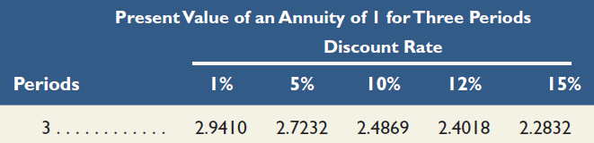
Internal Rate of Return (IRR)
Step 1. Compute present value factor for the investment project.
$12,000 ÷ $5,000 per year = 2.4000
Step 2. Identify the discount rate (IRR) yielding the present value factor.
IRR is
approximately
12%.
Learning Objective P4: Compute internal rate of return and explain its use.
Notes:
Here’s a portion of Table B.3, the Present Value of an Annuity of 1 for Three Periods, located in Appendix B of our chapter. (You may actually want to turn to Appendix B to work through this exercise. )
First, look across the three-period row of Table B.3 and find the discount rate corresponding to the present value factor of 2.4000. We find the value of 2.4018, which roughly equals the value for the 12% rate. Therefore, the internal rate of return for this project, is approximately 12 percent.

Slide 31
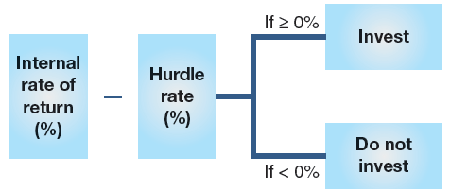
Internal Rate of Return (IRR)
Uneven Cash Flows
If cash inflows are unequal, it is best to use either a calculator or spreadsheet software to compute the IRR. However, we can also use trial and error to compute the IRR.
Use of Internal Rate of Return
When we use the IRR to evaluate a project, we compare the internal rate of return on a project to a predetermined hurdle rate (cost of capital). To be acceptable, a project’s rate of return cannot be less than the company’s cost of capital.
Learning Objective P4: Compute internal rate of return and explain its use.
Notes:
Calculating the internal rate of return becomes much more difficult when a project has unequal cash flows. If cash inflows are unequal, it is best to use either a calculator or spreadsheet software to compute the IRR. However, we can also use trial and error to compute the IRR. We do this by selecting any reasonable discount rate and computing the NPV. If the amount is positive (negative), we recomputed the NPV using a higher (lower) discount rate. Hand calculations using interest rate tables involve multiple trial and error solutions. For this reason, electronic spreadsheets such as Excel or advanced hand-held calculators should be used for projects with unequal cash flows.
When we use the IRR to evaluate a project, we compare the internal rate of return on a project to a predetermined hurdle rate (cost of capital) which is a minimum acceptable rate of return. If the IRR is higher than the hurdle rate, the investment is made. Multiple projects are often ranked by the extent to which their IRR exceeds the hurdle rate.
Now let’s review what you have learned in the following NEED-TO-KNOW exercise.

Slide 32
NEED-TO-KNOW 25-4
A machine costing $58,880 is expected to generate net cash flows of $8,000 per year for each of the next 10 years.
1. Compute the machine’s internal rate of return (IRR).
2. If a company’s hurdle rate is 6.5%, use IRR to determine whether the company should purchase this machine.
Internal rate of return (IRR) is the interest rate at which the net present value of the cash flows from a project or
investment equals zero.
PV of Net Cash Inflows
$58,880
Amount invested
(58,880)
Net Present Value
$0
PV of Net Cash Inflows = Annual Amount x PV Annuity of $1 factor
$58,880
=
$8,000
x
PV of Annuity of $1 factor
$58,880
=
PV of Annuity of $1 factor
$8,000
7.3600
=
PV of Annuity of $1 factor
IRR is approximately 6%.
Since this rate is lower than the 6.5% hurdle rate, the machine should not be purchased.
PV of $1
FV of $1
PV Ord Ann
FV Ord Ann
Learning Objective P4: Compute internal rate of return and explain its use.
Notes:
A machine costing $58,880 is expected to generate net cash flows of $8,000 per year for each of the next 10 years.
1. Compute the machine’s internal rate of return (IRR) and 2. If a company’s hurdle rate is 6.5%, use IRR to
determine whether the company should purchase this machine.
Internal rate of return (IRR) is the interest rate at which the net present value of the cash flows from a project or investment equals zero.
Net present value equals the present value of the cash inflows minus the amount of the investment.
We know the investment is $58,880, so we need to determine the interest rate where the present value of the net cash inflows is equal to $58,880.
The present value of the net cash inflows is calculated by taking the annual dollar amount and multiplying by the present value of an annuity of one factor.
$58,880 equals $8,000 multiplied by the present value of an annuity factor.
To solve for the factor, we divide $58,880 by $8,000. The present value of an annuity factor is 7.36
Now we go to the present value of an ordinary annuity table, for n equals 10, and we look for the
factor of 7.36, and we see the factor of 7.3601 at the intersection of n equals 10 and an interest rate of 6%.
At the intersection of n equals 10 and an interest rate of 6%. The internal rate of return is approximately 6%.
Since this rate is lower than the 6.5% hurdle rate, the machine should not be purchased.

Slide 33
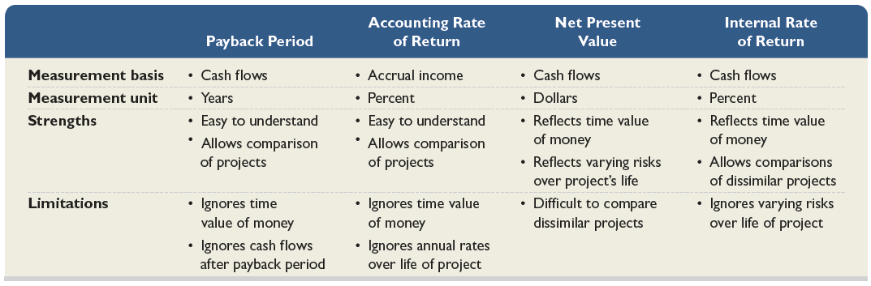
Comparison of Capital
Budgeting Methods
Exhibit 25.12
Learning Objective P4: Compute internal rate of return and explain its use.
Notes:
On this screen, we see a summary comparing the strengths and limitations of each of the four capital budgeting methods that we have studied. Recall that the major limitation of the payback method and the accounting rate of return method is that they neglect the time value of money. This limitation is overcome by using either the net present value or internal rate of return methods.

Slide 34
C1:
Describe the importance of relevant costs for short-term decisions.
Learning Objective

Slide 35
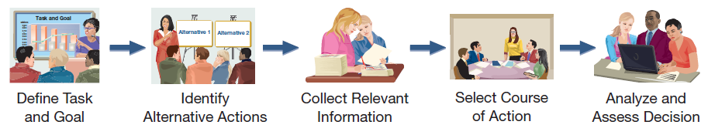
Decision Making
Decision making involves five steps:
  Define the decision task.
  Identify alternative courses of action.
  Collect relevant information on alternatives.
  Select the preferred course of action.
  Analyze and assess decisions made.
Exhibit 25.13
Learning Objective C1: Describe the importance of relevant costs for short-term decisions.
Notes:
These five steps represent an orderly, structured decision-making process that will lead to better decisions. First, we need to clearly define the decision task and consider all feasible alternatives. Next, we need to gather information. Some of the information might not be relevant, so we need to discard that information and concentrate on using only relevant information to select the best alternative. After the decision is made, we should review the outcome in an effort to become even better decision makers in the future.

Slide 36

Relevant Costs
Three types of costs that are pertinent to the discussion of relevant costs are:
Sunk costs
Out-of-pocket costs
Opportunity costs.
  Costs that are applicable
  to a particular decision.
  Costs that should have a bearing on which alternative a manager selects.
  Costs that are avoidable.
  Future costs that differ
  between alternatives.
Learning Objective C1: Describe the importance of relevant costs for short-term decisions.
Notes:
In making short-term decisions, managers should focus on those for which the relevant benefits exceed the relevant costs. The relevant costs in making decisions are the incremental costs, also called differential costs. These are the additional costs incurred if a company pursues a certain course of action. Besides relevant costs, management must consider relevant benefits, the additional or incremental revenue generated by selecting a certain course of action over another.
Three types of costs are pertinent to our discussion of relevant costs: sunk costs, out-of-pocket costs, and opportunity costs.

Slide 37
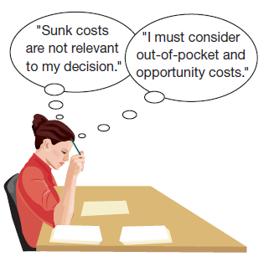
Relevant Costs
Sunk costs are the result of past decisions and
cannot be changed by any current or future decisions.
Sunk costs are irrelevant to current or future decisions.
Out-of-pocket costs are future outlays
of cash associated with a particular decision. Out-of-pocket costs are relevant to decisions.
Opportunity costs are the potential benefits given up when one alternative is selected over another. Opportunity costs are relevant to decisions.
Management must also consider relevant benefits.
Learning Objective C1: Describe the importance of relevant costs for short-term decisions.
37
Notes:
Sunk costs cannot be changed by any decision we make as they have been incurred in the past and cannot possibly differ between any alternative that we might currently choose. Sunk costs should not be considered in the decision process. For example, if you bought an automobile two years ago for $15,000, that amount is a sunk cost. Whether you drive the car, park it, trade it, or sell it, the $15,000 cost will not change.
An out-of-pocket cost is a future outlay of cash associated with a particular decision alternative. Out-of-pocket costs are relevant costs as they are future costs that differ between alternatives. For example, in considering the decision to take a vacation or stay at home, you will have travel costs (out-of-pocket costs) only if you choose a vacation.
Opportunity costs are the potential benefits that are given up when one alternative is selected over another. Opportunity costs are not actual dollar outlays; however, they may impact our decisions. For example, the opportunity cost of attending college is the lost salary that you could have earned by working.

Slide 38
NEED-TO-KNOW 25-5
Match each of the terms below with its definition.
a. Additional costs incurred from a course of action
b. Incremental revenue from a course of action
c. A future outlay of cash
d. Potential benefit lost from taking a course of action
e. A cost that arises from a past decision and cannot be changed
1. Sunk cost
e. A cost that arises from a past decision and cannot be changed
2. Out-of-pocket cost
c. A future outlay of cash
3. Opportunity cost
d. Potential benefit lost from taking a course of action
4. Incremental cost
a. Additional costs incurred from a course of action
5. Relevant benefit
b. Incremental revenue from a course of action
Learning Objective C1: Describe the importance of relevant costs for short-term decisions.
Notes:
A machine costing $58,880 is expected to generate net cash flows of $8,000 per year for each of the next 10 years.
1. Compute the machine’s internal rate of return (IRR) and 2. If a company’s hurdle rate is 6.5%, use IRR to
determine whether the company should purchase this machine.
Internal rate of return (IRR) is the interest rate at which the net present value of the cash flows from a project or investment equals zero.
Net present value equals the present value of the cash inflows minus the amount of the investment.
We know the investment is $58,880, so we need to determine the interest rate where the present value of the net cash inflows is equal to $58,880.
The present value of the net cash inflows is calculated by taking the annual dollar amount and multiplying by the present value of an annuity of one factor.
$58,880 equals $8,000 multiplied by the present value of an annuity factor.
To solve for the factor, we divide $58,880 by $8,000. The present value of an annuity factor is 7.36
Now we go to the present value of an ordinary annuity table, for n equals 10, and we look for the
factor of 7.36, and we see the factor of 7.3601 at the intersection of n equals 10 and an interest rate of 6%.
At the intersection of n equals 10 and an interest rate of 6%. The internal rate of return is approximately 6%.
Since this rate is lower than the 6.5% hurdle rate, the machine should not be purchased.

Slide 39
A1:
Evaluate short-term managerial decisions using relevant costs.
Learning Objective

Slide 40
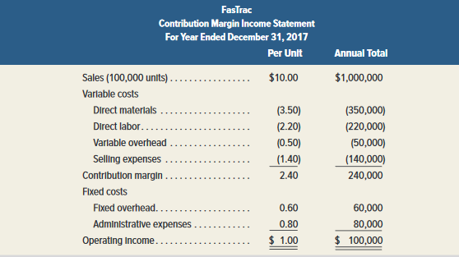
Additional Business
The decision to accept additional business should be based on incremental costs and incremental revenues.
Incremental amounts are those that occur if the company decides to accept the new business.
FasTrac currently sells 100,000 units of its product. They are operating at 80% of full capacity. The company has per unit and annual total sales and costs as shown in the following contribution margin income statement.
Exhibit 25.14
Learning Objective A1: Evaluate short-term managerial decisions using relevant costs.
Notes:
On occasion, we may have the opportunity to accept additional business. We should make the decision to accept or reject the additional business using incremental revenues and incremental costs. Some of our costs may not change if we accept additional business. Those costs are not relevant as they do not differ between the alternatives: accept or reject the additional business.
FasTrac makes 100,000 units of a single product that normally sells for $10.00 per unit. They are currently operating at its normal level of 80% of full capacity. Total cost to make one unit is $9.00, resulting in a $1.00 profit per unit.

Slide 41
Additional Business
A current buyer of FasTrac’s products wants to purchase additional units of its product and export them to another country. This buyer offers to buy 10,000 units of the product at $8.50 per unit, or $1.50 less than the current price. The offer price is low, but FasTrac is considering the proposal because this sale would be several times larger than any single previous sale and it would use idle capacity.
Should FasTrac accept the offer?
Learning Objective A1: Evaluate short-term managerial decisions using relevant costs.
Notes:
A current buyer of FasTrac’s products wants to purchase additional units of its product and export them to another country. This buyer offers to buy 10,000 units of the product at $8.50 per unit, or $1.50 less than the current price. The offer price is low, but FasTrac is considering the proposal because this sale would be several times larger than any single previous sale and it would use idle capacity.
Should FasTrac accept this special order?

Slide 42
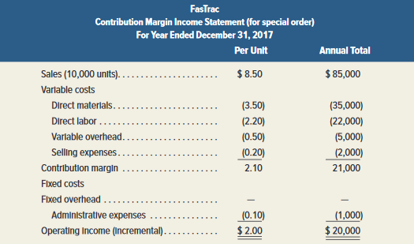
Additional Business
To determine whether to accept or reject this order, management needs to know whether accepting the offer will increase net income.
FasTrac should accept the offer.
Exhibit 25.15
Learning Objective A1: Evaluate short-term managerial decisions using relevant costs.
Notes:
To determine whether to accept or reject this order, management needs to know whether accepting the offer will increase net income. We can see from this analysis that the additional business at $8.50 per unit will increase income by $20,000. Let’s look at the reasons why this is the case.
To correctly make its decision, FasTrac must analyze the costs of this potential new business differently. The $9.00 historical cost per unit is not necessarily the incremental cost of this order.
If we decide to accept this one-time special order, revenue will increase by $85,000 (10,000 units at $8.50 per unit). The variable manufacturing costs to produce this order will be the same as for FasTrac's normal business --$3.50 per unit for direct materials, $2.20 per unit for direct labor, and $0.50 per unit for variable overhead.
* Selling expenses for this order will be $0.20 per unit, which is lower than FasTrac's normal business.
* Fixed overhead expenses will not change whether this order is accepted or not.
This order will incur incremental administrative expenses of $1,000 for clerical work. These are additional fixed costs due to this order.
By comparing incremental revenue of $85,000 with the total incremental costs of $65,000, we see why the income from the additional business is $20,000. Now we can make the correct decision to accept the additional business.
Now let’s review what you have learned in the following NEED-TO-KNOW exercise.

Slide 43
NEED-TO-KNOW 25-6
A company receives a special order for 200 units that requires stamping the buyer’s name on
each unit, yielding an additional fixed cost of $400 to its normal costs. Without the order, the
company is operating at 75% of capacity and produces 7,500 units of product at the
costs below. The company's normal selling price is $22 per unit. The sales price for the
special order is $18 per unit.
Costs
Variable
Fixed costs
(7,500
costs per
units)
unit
Direct materials
$37,500
$5.00
Direct labor
60,000
$8.00
Overhead (30% variable)
20,000
$0.80
$14,000
Selling expenses (60% variable)
25,000
$2.00
$10,000
The special order will not affect normal unit sales and will not increase fixed overhead and
selling expenses. Variable selling expenses on the special order are reduced to one-half
the normal amount. Should the company accept the special order?
In order for the special order to be accepted, it must 1) increase net income; the incremental
revenue must exceed the incremental expense, and 2) not adversely impact normal sales.
Learning Objective A1: Evaluate short-term managerial decisions using relevant costs.
Notes:
A company receives a special order for 200 units that requires stamping the buyer’s name on each
unit, yielding an additional fixed cost of $400 to its normal costs.
Without the order, the company is operating at 75% of capacity and produces 7,500 units of product at the costs below. The company's normal selling price is $22 per unit. The sales price for the special order is $18 per
unit.
The special order will not affect normal unit sales and will not increase fixed overhead and selling expenses. Variable selling expenses on the special order are reduced to one-half the normal amount. Should the company accept the special order?
First we need to determine which costs are variable, costs that will increase on a per unit basis, and which costs are fixed.
Direct materials are variable costs. $37,500 divided by 7,500 units is a variable cost per unit of $5.
Direct labor is also a variable cost. $60,000 divided by 7,500 units is a variable cost per unit of $8.
30% of the overhead is variable. 30% of $20,000 is $6,000. $6,000 divided by 7,500 units is a variable cost per unit of $0.80. The remaining 70%, $14,000, is a fixed cost. Selling expenses: 60% are variable. 60% of $25,000 is $15,000.
$15,000 divided by 7,500 units is a variable cost per unit of $2. The remaining 40%, $10,000, is a fixed cost.
So, now, we can look at the profitability of the additional 200 units. In order for the special order to be accepted, it
must increase net income; the incremental revenue must exceed the incremental expense, and the special order must not adversely impact normal sales.

Slide 44
NEED-TO-KNOW 25-6
A company receives a special order for 200 units that requires stamping the buyer’s name on
each unit, yielding an additional fixed cost of $400 to its normal costs. Without the order, the
company is operating at 75% of capacity and produces 7,500 units of product at the
costs below. The company's normal selling price is $22 per unit. The sales price for the
special order is $18 per unit.
Costs
Variable
Fixed costs
(7,500
costs per
units)
unit
Direct materials
$37,500
$5.00
Direct labor
60,000
$8.00
Overhead (30% variable)
20,000
$0.80
$14,000
Selling expenses (60% variable)
25,000
$2.00
$10,000
The special order will not affect normal unit sales and will not increase fixed overhead and
selling expenses. Variable selling expenses on the special order are reduced to one-half
the normal amount. Should the company accept the special order?
Incremental revenues
(200 units x $18.00)
$3,600
Direct materials
(200 units x $5.00)
$1,000
Direct labor
(200 units x $8.00)
1,600
Overhead (30% variable)
(200 units x $0.80)
160
Selling expenses (60% variable)
(200 units x $2.00 x 50%)
200
Additional fixed costs
(Stamping costs)
400
Total incremental expenses
3,360
Net income increases by:
$240
Yes, the company should accept the special order.
Learning Objective A1: Evaluate short-term managerial decisions using relevant costs.
Notes:
The incremental revenue for this order, 200 units at $18 per unit, $3,600.
The incremental costs will include direct materials:
200 units at $5 per unit, $1,000; Direct labor, 200 units at $8 per unit, $1,600; the variable portion of the overhead, 200 units at $0.80 per unit, $160; variable selling expenses, 200 units multiplied by the $2 per unit multiplied by 50%. So the variable selling expenses are reduced to one-half the normal amount, $200.
The special order will also have additional fixed cost for the stamping of $400.
Total incremental expenses are $3,360. Net income will increase by $240.
So yes, the company should accept the special order.

Slide 45

Make or Buy
Incremental costs are important in the decision to make a product or purchase it from a supplier.
The cost to produce an item must include:
(1) direct materials
(2) direct labor
(3) incremental overhead
We should not use the predetermined overhead
application rate to determine product cost in the
decision.
Learning Objective A1: Evaluate short-term managerial decisions using relevant costs.
Notes:
The managerial decision to make or buy a component is common. The “Make or Buy” decision involves the question of whether it is more economical to produce some goods internally or purchase them from an outside supplier. The process of buying goods or services from an external supplier is called outsourcing. We will again concentrate on incremental costs for this decision. Incremental costs will include the direct materials cost, the direct labor cost and the incremental overhead incurred. We must be careful not to use the historical predetermined overhead application rate to determine the product cost that will be used in the decision.

Slide 46
Make or Buy
FasTrac currently makes Part 417, assigning overhead at 100 percent of direct labor cost, with the following unit cost:
Normal, predetermined overhead application rate is 100% of direct labor cost.
Learning Objective A1: Evaluate short-term managerial decisions using relevant costs.
Notes:
FasTrac is now making Part 417, which is a component part in its final product. As shown on your screen, the unit cost of the part includes direct material, direct labor, and factory overhead. Currently, FasTrac’s normal predetermined overhead application rate is 100% of direct labor cost.

Slide 47
Make or Buy
FasTrac can buy Part 417 from a supplier for $1.20. How much overhead do we have to eliminate before we should buy this part?
Assume management computes an incremental overhead rate of $0.20 per unit if it makes the part. . .
Continue to make the part!
?
We must eliminate $0.25 per unit ($1.20 - $0.95) of overhead,
to make the total cost of making the component
less than the purchase price of $1.20.
Learning Objective A1: Evaluate short-term managerial decisions using relevant costs.
Notes:
An outside supplier offers to make Part 417, and sell it to FasTrac for $1.20 per unit. We know that $1.20 is less than FasTrac’s $1.45 unit cost. Should FasTrac stop making the part and buy it from the outside supplier for $1.20 per unit?
We know that FasTrac will avoid the direct material cost and the direct labor cost if it buys the part instead of making it. But that total is only $0.95. FasTrac cannot afford to pay $1.20 per unit if it will only avoid $0.95 per unit. It must also be able to avoid some of the factory overhead. How much overhead does FasTrac avoid in order to justify buying the part?
FasTrac must be able to eliminate (avoid) a minimum of $0.25 per unit ($1.20-$0.95) in factory overhead costs to justify buying the part. If the avoidable amount of factory overhead per unit is greater than $0.25, FasTrac should buy the part instead of making it. On the other hand, if the avoidable amount of factory overhead per unit is less than $0.25, then FasTrac should continue making the part. In this instance, assume management computes an incremental overhead rate of $0.20 per unit if it makes the part. Based on the per unit analysis on this slide, it is cheaper to make the part than to buy it.
To make the correct make or buy decision, we must always determine the relevant (avoidable) costs of making the part and then compare these avoidable costs to the outside purchase cost. In almost all make or buy decisions, a significant amount of the factory overhead will be unavoidable, and therefore irrelevant to the decision as it will be the same for either alternative.
Now let’s review what you have learned in the following NEED-TO-KNOW exercise.

Slide 48
NEED-TO-KNOW 25-7
A company currently buys a key part for a product it manufactures. The company buys the part for $5 per
unit and believes it can make the part for $1.50 per unit for direct materials and $2.50 per unit for direct
labor. The company allocates overhead costs at the rate of 50% of direct labor. Incremental overhead costs
to make this part are $0.75 per unit. Should the company make or buy the part?
(per unit)
Make
Buy
Direct materials
$1.50
Direct labor
2.50
Overhead (Incremental)
0.75
Cost to buy the part
$5.00
Total
$4.75
$5.00
The company should make the part, because the $4.75 cost to make is less than the $5.00 cost to buy.
Learning Objective A1: Evaluate short-term managerial decisions using relevant costs.
Notes:
A company currently buys a key part for a product it manufactures. The company buys the part for $5 per unit and believes it can make the part for $1.50 per unit for direct materials and $2.50 per unit for direct labor.
The company allocates overhead costs at the rate of 50% of direct labor. Incremental overhead costs to make this part are $0.75 per unit.
Should the company make or buy the part?
The costs to make the part include: Direct materials, $1.50 per unit; Direct labor, $2.50 per unit, and variable overhead, $0.75 per unit.
The cost to buy the part is $5.00 per unit.
The total cost to make each unit is $4.75, which is $0.25 less per unit than the cost to buy the units.
The company should make the part.

Slide 49
Scrap or Rework
Often in manufacturing processes, we have products that do not pass inspection. We can either sell them as is, or rework them to improve the quality.
As long as rework costs are recovered through sale of the product, and rework
does not interfere with normal production, we should rework rather than scrap.
Costs incurred in manufacturing units of product that do not meet quality standards are sunk costs and cannot be recovered so they are irrelevant.
Learning Objective A1: Evaluate short-term managerial decisions using relevant costs.
Notes:
Often in manufacturing processes, we have products that do not pass inspection. We can either sell them as is, or rework them to improve the quality. Once reworked, the products will likely be sold for a higher price. The decision to rework or sell as is should be based on incremental revenues and incremental costs. The costs of manufacturing the product up to the inspection point are sunk and therefore irrelevant.

Slide 50
Scrap or Rework
Example: FasTrac has 10,000 defective units that cost $1.00 each to make. The units can be scrapped now for $0.40 each or reworked at an additional cost of $0.80 per unit. If reworked, the units can be sold for the normal selling price of $1.50 each. Reworking the defective units will prevent the production of 10,000 new units that would also sell for $1.50.
Should FasTrac scrap or rework?
Learning Objective A1: Evaluate short-term managerial decisions using relevant costs.
Notes:
Let’s look at an example of a scrap or rework decision… Let’ assume that FasTrac has 10,000 defective units of a product that have already cost $1 per unit to manufacture. They can be sold as is for $0.40 per unit, or reworked and sold for $1.50. The cost of reworking the defective units is $0.80 each. The $1.00 per unit original cost to make the defective units is a sunk cost and irrelevant to the decision.
FasTrac does not have the capacity to rework the defective units and continue with its normal production. Reworking the defective units will prevent the production of 10,000 new units that would also sell for $1.50.
What should FasTrac do?

Slide 51
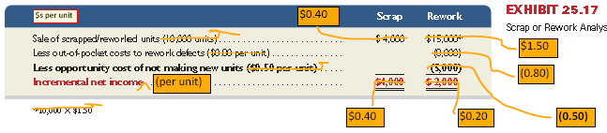
Scrap or Rework
Exhibit 25.17
10,000 units × $0.40 per unit
($.50 per unit)
Decision: FasTrac should scrap
the units now.
Learning Objective A1: Evaluate short-term managerial decisions using relevant costs.
Notes:
Assume that FasTrac has 10,000 defective units of a product that have already cost $1 per unit to manufacture. These units can be sold as is (as scrap) for $0.40 each, or they can be reworked for $0.80 per unit and then sold for their full price of $1.50 each. Should FasTrac sell the units as scrap or rework them?
The $1 per unit manufacturing cost already incurred is irrelevant. Further, if FasTrac is operating near its maximum capacity, reworking the defects means that FasTrac is unable to manufacture 10,000 new units with an incremental cost of $1 per unit and a selling price of $1.50 per unit, meaning it incurs an opportunity cost of $0.50 per unit ($1.50 selling price - $1.00 incremental cost). Our analysis is then reflected in Exhibit 25.17.
Scrapping the 10,000 units would yield incremental income of $4,000; reworking the units would yield only $2,000 of income. Based on this analysis, the defective units should be scrapped and sold as is for $0.40 each. If we had failed to include the opportunity costs of $0.50 per unit, the rework option would have mistakenly have seemed more favorable than scrapping.

Slide 52
Sell or Process Further
Businesses are often faced with the decision to sell partially completed products as is or to process them further for sale as other products.
As a general rule, we process further only if incremental revenues exceed incremental costs.
Example: FasTrac has 40,000 units of partially finished product Q. Processing costs to date are $30,000. The 40,000 unfinished units can be sold as is, for $50,000 or they can be processed further to produce finished products X, Y, and Z. Processing the units further will cost an additional $80,000 and will yield total revenues of $150,000.
FasTrac must decide whether the added revenues from selling finished products X, Y, and Z , exceed the costs of finishing them. . .
Learning Objective A1: Evaluate short-term managerial decisions using relevant costs.
52
Notes:
Many products can be sold in an unfinished state, or processed further into a finished product that will sell for a higher price. The decision to sell or process should be based on incremental revenues and incremental costs. The costs of manufacturing the product up to the sell or process decision point are sunk and therefore irrelevant.
FasTrac has 40,000 partially completed units of product Q that can be sold for a total of $50,000. FasTrac also has the option of further processing the 40,000 units of product Q to obtain products X, Y, and Z. Processing the units further will cost an additional $80,000 and will yield total revenues of $150,000.
What should FasTrac do? First, we need some additional information that is on the next slide before we can make a decision.

Slide 53
Sell or Process Further
 | Sell as Product Q | Process Further into Products X, Y, and Z
Incremental revenue | $50,000 | $150,000
Incremental cost | ----0---- | (80,000)
Incremental income | $50,000 | $70,000
Decision: FasTrac should process further; by doing so,
it will earn an additional $20,000 of income ($70,000 – $50,000).
The $30,000 of previously incurred manufacturing costs are excluded from the analysis. These costs are sunk, and they are not relevant to the decision!
Learning Objective A1: Evaluate short-term managerial decisions using relevant costs.
Notes:
The incremental income from processing further is $70,000. This is greater than the incremental income of $50,000 that would be earned from selling Product Q as is. Therefore, FasTrac should process further; by doing so, it will earn an additional $20,000 of income ($70,000 – $50,000).
The $30,000 of previously incurred manufacturing costs are excluded from the analysis. These costs are sunk, and they are not relevant to the decision. The incremental revenue from selling Product Q as is ($50,000) is properly included. It is the opportunity cost associated with processing further. The net benefit to processing further is $20,000.
Now let’s review what you have learned in the following NEED-TO-KNOW exercise.

Slide 54
NEED-TO-KNOW 25-8
For each of the two independent scenarios below, determine whether the company should sell the partially
completed product as is or process it further into other saleable products.
1. $10,000 of manufacturing costs have been incurred to produce Product Alpha. Alpha can be sold as is
for $30,000 or processed further into two separate products, BB and CC. The further processing will
cost $15,000, and products BB and CC can be sold for total revenues of $60,000.
2. $5,000 of manufacturing costs have been incurred to produce Product Delta. Delta can be sold as is for
$150,000 or processed further into two separate products, YY and ZZ. The further processing will cost
$75,000, and Products YY and ZZ can be sold for total revenues of $200,000.
Learning Objective A1: Evaluate short-term managerial decisions using relevant costs.
Notes:
For each of the two independent scenarios below, determine whether the company should sell the partially completed product as is or process it further into other saleable products.
1. $10,000 of manufacturing costs have been incurred to produce Product Alpha. Alpha can be sold as is for $30,000 or processed further into two separate products, BB and CC. The further processing will cost $15,000, and products BB and CC can be sold for total revenues of $60,000.

Slide 55
NEED-TO-KNOW 25-8
1. $10,000 of manufacturing costs have been incurred to produce Product Alpha. Alpha can be sold as is
for $30,000 or processed further into two separate products, BB and CC. The further processing will
cost $15,000, and products BB and CC can be sold for total revenues of $60,000.
Alpha
Sell as is
Process Further
Incremental revenue
$30,000
$60,000
Incremental cost
0
(15,000)
Incremental income
$30,000
$45,000
Alpha should be processed further; doing so will yield an extra $15,000 ($45,000 - $30,000) of income.
2. $5,000 of manufacturing costs have been incurred to produce Product Delta. Delta can be sold as is for
$150,000 or processed further into two separate products, YY and ZZ. The further processing will cost
$75,000, and Products YY and ZZ can be sold for total revenues of $200,000.
Delta
Sell as is
Process Further
Incremental revenue
$150,000
$200,000
Incremental cost
0
(75,000)
Incremental income
$150,000
$125,000
Delta should be sold as is; doing so will yield an extra $25,000 ($150,000 - $125,000) of income.
Learning Objective A1: Evaluate short-term managerial decisions using relevant costs.
Notes:
The incremental revenue is $30,000 if we sell the products as is. If the units are processed further, they can be sold for $60,000.
There is no incremental cost if we sell the products as is. If we process the units further, the additional cost
will be $15,000. The incremental income if we sell the units as is, $30,000, vs. $45,000 if the units are processed
further.
Alpha should be processed further; doing so will yield an extra $15,000 ($45,000 - $30,000) of income.
2. $5,000 of manufacturing costs have been incurred to produce Product Delta. Delta can be sold as is for $150,000 or processed further into two separate products, YY and ZZ.
The further processing will cost $75,000, and Products YY and ZZ can be sold for total revenues of $200,000.
If we sell the units as is, incremental revenue is $150,000. If they're processed further, incremental revenue is
$200,000. There is no additional cost if we sell the units as is.
The incremental cost if the units are processed further is $75,000. Incremental income if we sell the units as is,
$150,000, vs. incremental income if the units are processed further, $125,000.
Delta should be sold as is; doing so will yield an extra $25,000 ($150,000 - $125,000) of income.

Slide 56
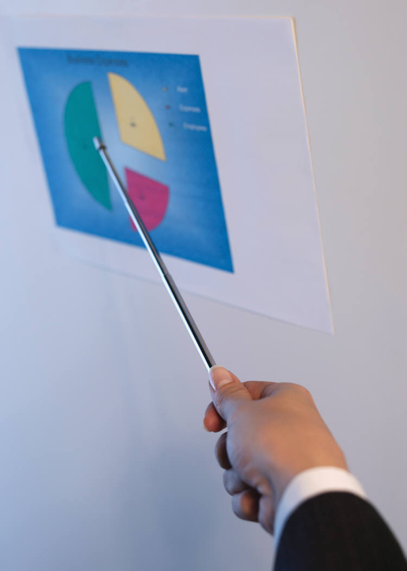
Sales Mix Selection
When a company sells a variety of products, some are likely to be more profitable than others.
Management concentrates sales efforts on more profitable products.
If production facilities or other factors are limited, producing more of one product usually means producing less of others.
In this case, management must identify the most profitable combination, or sales mix of products.
Management focuses on the contribution margin per unit of scarce resource.
Learning Objective A1: Evaluate short-term managerial decisions using relevant costs.
Notes:
All businesses face constraints that affect production and sales decisions. They must make decisions to best utilize constrained resources. When a company sells a variety of products, some are likely to be more profitable than others. Management concentrates sales efforts on more profitable products. If production facilities or other factors are limited, producing more of one product usually means producing less of others.
In this case, management must identify the most profitable combination, or sales mix of products. Management focuses on the contribution margin per unit of scarce resource.
Let’s look at an example.

Slide 57
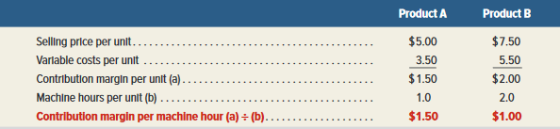
Sales Mix Selection With Limited Resources
Example: FasTrac makes and sells two products, A and B using the same machines. A and B have the following selling prices and variable costs per unit:
 | Product A | Product B
Selling price | $5.00 | $7.50
Variable costs | 3.50 | 5.50
Exhibit 25.19
However, it takes one hour to produce one unit of Product A,
while it takes two hours to produce one unit of Product B.
We need to figure each product’s contribution margin per machine hour.
Decision: Even though Product A’s unit contribution is less, it has a higher contribution margin per machine hour. FasTrac should produce more Product A!
Learning Objective A1: Evaluate short-term managerial decisions using relevant costs.
Notes:
FasTrac produces Product A and Product B. The selling prices and variable costs of each product are shown in the top table.
FasTrac has an existing capacity of 100,000 machine hours per year. In addition, Product A uses 1 machine hour per unit while Product B uses 2 machine hours per unit. With limited resources, FasTrac should focus its productive capacity on the product that yields the highest contribution margin per machine hour, until market demand for that product is satisfied. Exhibit 25.19 shows the relevant analysis.
Exhibit 25.19 shows that although Product B has a higher contribution margin per unit, Product A has a higher contribution margin per machine hour. In this case, FasTrac should produce as much of Product A as possible, up to the market demand. For example, if the market will demand all of Product A that it can produce, FasTrac should produce 100,000 units of Product A and none of Product B. This sales mix would yield a contribution margin of $150,000 per year, the maximum the company could make subject to its resource constraint.
If demand for Product A is limited—say, to 80,000 units—FasTrac will begin by producing those 80,000 units. This production level would leave 20,000 machine hours to devote to production of Product B. FasTrac would use these remaining machine hours to produce 10,000 units (20,000 machine hours - machine hours per unit) of Product B. This sales mix would yield the contribution margin of $120,000 for Product A (80,000 x $1.50 per unit) and $20,000 for Product B (10,000 x $2.00 per unit).
Now let’s review what you have learned in the following NEED-TO-KNOW exercise.

Slide 58
NEED-TO-KNOW 25-9
A company produces two products, Gamma and Omega. Gamma sells for $10 per unit and Omega sells
for $12.50 per unit. Variable costs are $7 per unit of Gamma and $8 per unit of Omega. The company has
a capacity of 5,000 machine hours per month. Gamma uses 1 machine hour per unit, and Omega uses 3
machine hours per unit.
1. Compute the contribution margin per machine hour for each product.
2. Assume demand for Gamma is limited to 3,800 units per month, and demand for Omega is
limited to 1,000 units per month. How many units of Gamma and Omega should the company
produce, and what will be the total contribution margin from this sales mix?
(per unit)
Gamma
Omega
Sales
$10.00
$12.50
Variable costs
(7.00)
(8.00)
Contribution margin per unit
$3.00
$4.50
Machine hours per unit
1
3
Contribution margin per machine hour
$3.00
$1.50
Total machine hours available
5,000
Machine hours used for production of Gamma
(3,800 units x 1 MH per unit)
3,800
Machine hours available for production of Omega
1,200
Machine hours used for production of Omega
(1,200 MHs / 3 MH per unit = 400 units)
1,200
Remaining machine hours
0
Learning Objective A1: Evaluate short-term managerial decisions using relevant costs.
Notes:
A company produces two products, Gamma and Omega. Gamma sells for $10 per unit and Omega sells for $12.50 per unit. Variable costs are $7 per unit of Gamma and $8 per unit of Omega. The company has a capacity of 5,000 machine hours per month. Gamma uses 1 machine hour per unit, and Omega uses 3 machine hours per unit.
1. Compute the contribution margin per machine hour for each product.
Contribution margin per unit is equal to sales:
$10.00 per unit for Gamma, and $12.50 per unit for Omega; minus variable costs; $7.00 per unit for Gamma and $8.00 per unit for Omega. Contribution margin is $3.00 per unit for Gamma and $4.50 per unit for Omega.
At first glance, it may look like the production of Omega is more profitable, but we need to consider the limiting resources, in this case machine hours. It only takes one machine hour to produce 1 unit of Gamma, generating $3.00 in contribution margin per machine hour. It takes 3 machine hours to produce each unit of Omega; the contribution margin per machine hour is only $1.50.
2. Assume demand for Gamma is limited to 3,800 units per month, and demand for Omega is limited to 1,000 units per month.
How many units of Gamma and Omega should the company produce, and what will be the total contribution margin from this sales mix?
With the 5,000 available machine hours, the company should choose to produce the units with the highest contribution margin per machine hour, Gamma, producing as many units as the market demands.
The market demand for Gamma is 3,800 units per month, which will require 3,800 machine hours (1 hour per unit).
With the remaining 1,200 machine hours, the company should produce the less profitable units, Omega. 1,200 machine hours divided by 3 MHs per unit will allow the production of 400 units of Omega.

Slide 59
NEED-TO-KNOW 25-9
A company produces two products, Gamma and Omega. Gamma sells for $10 per unit and Omega sells
for $12.50 per unit. Variable costs are $7 per unit of Gamma and $8 per unit of Omega. The company has
a capacity of 5,000 machine hours per month. Gamma uses 1 machine hour per unit, and Omega uses 3
machine hours per unit.
1. Compute the contribution margin per machine hour for each product.
2. Assume demand for Gamma is limited to 3,800 units per month, and demand for Omega is
limited to 1,000 units per month. How many units of Gamma and Omega should the company
produce, and what will be the total contribution margin from this sales mix?
(per unit)
Gamma
Omega
Sales
$10.00
$12.50
Variable costs
(7.00)
(8.00)
Contribution margin per unit
$3.00
$4.50
Machine hours per unit
1
3
Contribution margin per machine hour
$3.00
$1.50
Contribution margin (calculated on a per unit basis)
Gamma
3,800 units x $3.00 contribution margin per unit
$11,400
Omega
400 units x $4.50 contribution margin per unit
1,800
Total contribution margin
$13,200
Contribution margin (calculated on a per machine hour basis)
Gamma
3,800 machine hours x $3.00 contribution margin per machine hour
$11,400
Omega
1,200 machine hours x $1.50 contribution margin per machine hour
1,800
Total contribution margin
$13,200
Learning Objective A1: Evaluate short-term managerial decisions using relevant costs.
Notes:
At this sales mix, 3,800 units of Gamma, each contributing $3.00 per unit is a total contribution margin of $11,400 for Gamma, and 400 units of Omega, each contributing $4.50 per unit is a total contribution margin of $1,800 for Omega. And 400 units of Omega, each contributing $4.50 per unit is a total contribution margin of $1,800 for
Omega. Total contribution margin is $13,200.
We can prove this answer by calculating the contribution margin per machine hour.
While producing Gamma, the machines run for 3,800 hours generating a contribution margin of $3.00 per machine hour, $11,400. While producing Omega, the machines run 1,200 hours generating a contribution margin of $1.50
per machine hour, $1,800. Total contribution margin, $13,200.

Slide 60

Segment Elimination
A segment is a candidate for elimination if its revenues are less than its avoidable expenses.
Avoidable expenses are amounts the company
would not incur if it eliminated the segment.
FasTrac is considering eliminating its Treadmill Division because it reported a $500 operating loss for the recent year…
Let’s take a closer look at the division’s expenses...
Learning Objective A1: Evaluate short-term managerial decisions using relevant costs.
Notes:
Managers should consider eliminating poorly performing segments. A segment may be a division, territory, store, or product line. You have no doubt seen a segment eliminated. It might have been a large segment such as an automobile or it may have been a much smaller segment such as a store or restaurant closing.
How should we make segment elimination decisions? Let’s look at an example from FasTrac whose Treadmill Division’s total expenses are greater than its sales.

Slide 61
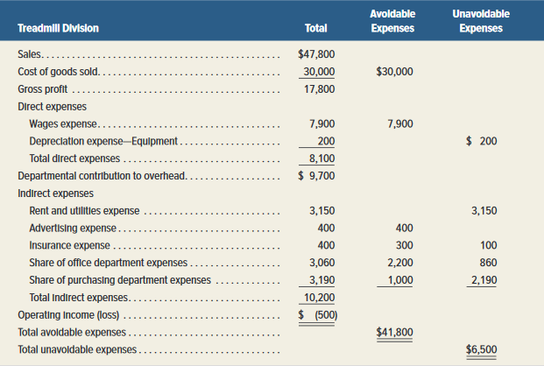
Segment Elimination
Exhibit 25.21
Learning Objective A1: Evaluate short-term managerial decisions using relevant costs.
Notes:
Here we see the total costs in the Treadmill Division. To make the correct decision, we need to know the amount of costs that will be avoided (saved) if we eliminate the Treadmill Division. A segment is a candidate for elimination only if its revenues are less than its avoidable costs.
If we eliminate the Treadmill Division, we will avoid total costs of $41,800. The last column in the table shows the unavoidable expenses of the division. The $6,500 of expenses shown in this column, are unavoidable and would be incurred even if the Treadmill Division is discontinued. These costs are irrelevant to the decision because they are the same for either alternative. Let’s focus on Avoidable expenses and revenue.

Slide 62

Segment Elimination
Do not eliminate
the Treadmill Division!
Learning Objective A1: Evaluate short-term managerial decisions using relevant costs.
Notes:
Because this division’s sales are $47,800, eliminating the division would reduce FasTrac’s income by $6,000 ($47,800-$41,800).
The Treadmill Division’s sale revenue is greater than its avoidable expenses by $6,000. If FasTrac eliminates the Treadmill Division, the company’s income will be $6,000 less. We would have made an incorrect decision using total costs. Remember-we must compare avoidable expenses to sales revenue to make the correct decision.
Now let’s review what you have learned in the following NEED-TO-KNOW exercise.

Slide 63
NEED-TO-KNOW 25-10
A bike maker is considering eliminating its tandem bike division because it operates at a loss of $6,000
per year. Sales for the year total $40,000, and the company reports the costs for this division as shown
below. Should the tandem bike division be eliminated?
Avoidable Expenses
Unavoidable Expenses
Cost of goods sold
$30,000
Direct expenses
8,000
Indirect expenses
2,500
$3,000
Service department costs
250
2,250
Total
$40,750
$5,250
Keep Tandem Division
Eliminate Tandem Division
Sales
$40,000
$0
Total costs and expenses
46,000
5,250
Net income (loss)
($6,000)
($5,250)
Quantitative Analysis: Total avoidable costs of $40,750 are greater than the division’s sales of $40,000, suggesting the division should be eliminated.
Other factors might be relevant, since the shortfall in sales ($750) is low. For example,
are sales expected to increase in the future? Does the sale of tandem bikes help sales of other types
of products?
Learning Objective A1: Evaluate short-term managerial decisions using relevant costs.
Notes:
A bike maker is considering eliminating its tandem bike division because it operates at a loss of $6,000 per year.
Sales for the year total $40,000, and the company reports the costs for this division as shown below. Should the tandem bike division be eliminated?
If the tandem division is kept, sales of $40,000 minus total costs and expenses, both the avoidable and unavoidable expenses of $46,000 is an operating loss of $6,000. If the division is eliminated, sales will be $0, but the unavoidable expenses of $5,250 will remain. The operating loss is $5,250. Based on this information alone, the tandem division should be eliminated. It makes sense to give up $40,000 in revenues if, in doing so, you can avoid $40,750 in expenses. You are $750 better off. Of course, other factors might be relevant. For example, are sales expected to increase in the future? Does the sale of tandem bikes help sales of other types of products?

Slide 64
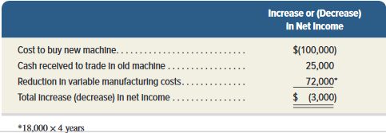
Keep or Replace Equipment
FasTrac currently makes Part 417, assigning overhead at 100 percent of direct labor cost, with the following unit cost:
Exhibit 25.22
Learning Objective A1: Evaluate short-term managerial decisions using relevant costs.
Notes:
If the reduction in variable manufacturing costs with the new equipment is greater than its net purchase price, the equipment should be replaced. In this setting, the net purchase price of the equipment is its total cost minus any trade-in allowance or cash receipt for the old equipment.
For example, FasTrac has a piece of manufacturing equipment with a book value (cost minus accumulated depreciation) of $20,000 and a remaining useful life of four years. At the end of four years the equipment will have a salvage value of zero. The market value of the equipment is currently $25,000. FasTrac can purchase a new machine for $100,000 and receive $25,000 in return for trading in its old machine. The new machine will reduce FasTrac’s variable manufacturing costs by $18,000 per year over the four-year life of the new machine. FasTrac’s incremental analysis is shown in Exhibit 25.22.
Exhibit 25.22 shows that FasTrac should not replace the old equipment with this newer version as it will decrease income by $3,000. The book value of the old equipment
($20,000) is not relevant to this analysis. Book value is a sunk cost, and it cannot be changed regardless of whether FasTrac keeps or replaces this equipment.

Slide 65
A2:
Analyze a capital investment project using break-even time.
Learning Objective

Slide 66
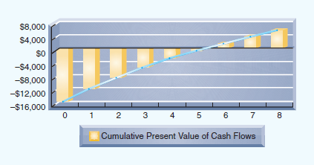
Break-Even Time
Break-even time incorporates time value
of money into the payback period method
of evaluating capital investments.
Break-even time for this investment is between 5 and 6 years.
Learning Objective A2: Analyze a capital investment project using break-even time.
Notes:
The payback example that we saw earlier in the chapter neglected the time value of money. Break-even time is a variation of the payback method that incorporates the time value of money by telling us the number of years an investment requires for its net present value to equal its initial cost.

Slide 67
25A-Appendix:
Using Excel to Compute Net Present Value and Internal Rate of Return.
Learning Objective

Slide 68
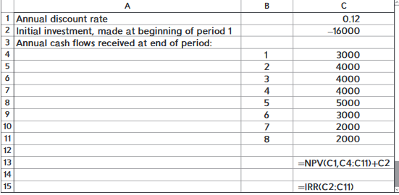
Appendix 25A: Using Excel to
Compute NPV and IRR
Computing present values and internal rates of return for projects with uneven cash flows is tedious and error prone. These calculations can be performed simply and accurately by using functions built into Excel.
Notes:
Appendix 25A: Using Excel to Compute Net Present Value and Internal Rate of Return
Computing present values and internal rates of return for projects with uneven cash flows is tedious and error prone. These calculations can be performed simply and accurately by using functions built into Excel. To illustrate, consider a company that is considering investing in a new machine with the expected cash flows shown on the spreadsheet. Cash outflows are entered as negative numbers, and cash inflows are entered as positive numbers. Assume the company requires a 12% annual return, entered as 0.12 in cell C1.
To compute the net present value of this project, the following is entered into cell C13:
NPV(C1,C4:C11)+C2
To compute the internal rate of return for this project, the following is entered into cell C15:
IRR(C2:C11)

Slide 69
A3: Appendix B
Determine product selling price using cost data.
Learning Objective

Slide 70
Target Costing
Companies may use cost-plus pricing to determine selling prices.
Factors that determine price include:
  Consumer preferences
  Competition
Target costing =
Expected selling price – Desired profit
Learning Objective A3: Determine product selling price using cost data.
Notes:
Companies often use cost-plus pricing as a starting point in determining selling prices. Many factors determine price, including consumer preferences and competition.
When competition is high, companies might be “price-takers,” and have little control in setting prices. In such cases target costing can be useful. Target cost is defined as:
Target cost = Expected selling price – Desired profit. If the target cost is too high, lean techniques can be used to determine if the cost can be reduced enough so that the desired profit can be made.

Slide 71
Other Pricing Methods
Alternatives to cost-plus pricing are based on product or variable costs.
Companies must adjust their desired markup percentage upward to ensure selling price covers all costs.
14% target return x assets of $1,000,000 = $140,000 target profit
$140,000 / 10,000 units sold = $14 target profit per unit
Markup % = $14 / $70 = 20%
Learning Objective A3: Determine product selling price using cost data.
Notes:
In addition to the total cost approach to cost-plus pricing, alternatives include approaches based on either product costs or variable costs. Since these alternative cost amounts are lower than total cost, companies that use these methods must adjust their desired markup percentage upward to ensure that the selling price covers all costs.
Sometimes companies compute the desired markup % using a target return on investment. For example, if MpPro targets a 14% return on invested assets of $1,000,000, its target profit is $140,000. This equals $14 per unit if 10,000 units are sold, as in this example. The markup % is then $14/$70 = 20%.

Slide 72
Variable Cost Method
Cost-plus pricing method
Factors that determine price include consumer preferences and competition.
Target costing = expected selling price – desired profit.
Target profit + Fixed OH + Fixed S&A
Markup % =
Total variable costs
$140,000 + $140,000 + $60,000
Markup % =
= 68%
[($44 + $6) x 10,000]
Selling price =
$50 + ($50 x 68%) = $84
Learning Objective A3: Determine product selling price using cost data.
Notes:
In addition to the total cost approach to cost-plus pricing, alternatives include approaches based on either product costs or variable costs. Because these alternative cost amounts are lower than total cost, companies that use these methods must increase their desired markup percentage to ensure that the selling price covers all costs. For the variable cost method the markup percentage is determined as:
Markup % = Target profit + Fixed overhead costs + Fixed selling and administrative costs
Total variable costs
For MpPro, the markup percentage, using the variable cost approach, is computed as:
Markup % = $140,000 + $140,000 + $60,000 = 68%
[($44 + $6) x 10,000]
With this markup percentage and total variable cost per unit of $50, the selling price is computed as:
Selling price = $50 + ($50 x 68%) = $84

Slide 73
End of Chapter 25

