Slide 1
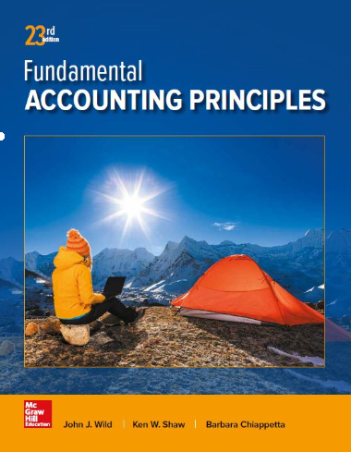
Accounting for Corporations
Chapter 13
Wild, Shaw, and Chiappetta
Fundamental Accounting Principles
23rd Edition
Notes:
Chapter 13: Accounting for Corporations

Slide 2
Chapter 13 Learning Objectives
CONCEPTUAL
C1 Identify characteristics of corporations and their organization.
C2 Explain characteristics of, and distribute dividends between, common and preferred stock.
C3 Explain the items reported in retained earnings.
ANALYTICAL
A1 Compute earnings per share and describe its use.
A2 Compute price-earnings ratio and describe its use in analysis.
A3 Compute dividend yield and explain its use in analysis.
A4 Compute book value and explain its use in analysis.
PROCEDURAL
P1 Record the issuance of corporate stock.
P2 Record transactions involving cash dividends, stock dividends, and stock splits.
P3 Record purchases and sales of treasury stock.

Slide 3
C1:
Identify characteristics of corporations and their organization.
Learning Objective

Slide 4
Corporate Form of Organization
An entity created by law
Privately Held
Existence is separate from owners
Ownership can be
Publicly Held
Has rights and privileges
Learning Objective C1: Identify characteristics of corporations and their organization.
Notes:
A corporation is an entity created by law that is separate from its owners. It has most of the rights and privileges granted to individuals. Owners of corporations are called stockholders or shareholders. Corporations can be separated into two types. A privately held (or closely held) corporation does not offer its stock for public sale and usually has few stockholders. A publicly held corporation offers its stock for public sale and can have thousands of stockholders. Public sale usually refers to issuance of stock and trading on an organized stock market.

Slide 5
Characteristics of Corporations
Advantages
Separate legal entity
Limited liability of stockholders
Transferable ownership rights
Continuous life
Lack of mutual agency for stockholders
Ease of capital accumulation
Disadvantages
Governmental regulation
Corporate taxation
Learning Objective C1: Identify characteristics of corporations and their organization.
Notes:
Corporations represent an important type of organization. Their unique characteristics offer advantages and disadvantages.
Advantages of Corporate Form
Separate legal entity: A corporation operates with the same rights, duties, and responsibilities of a person. It takes actions through its agents, who are its officers and managers.
Limited liability of stockholders: Stockholders are not liable for corporate acts or debt.
Transferable ownership rights: The transfer of shares from one stockholder to another usually has no effect on the corporation or its operations except when this causes a change in the directors who control or manage the corporation.
Continuous life: A corporation’s life continues indefinitely because it is not tied to the physical lives of its owners.
Lack of mutual agency for stockholders: A corporation acts through its agents, who are its officers and managers. Stockholders, who are not its officers and managers, do not have the power to bind the corporation to contracts—referred to as lack of mutual agency.
Ease of capital accumulation: Buying stock is attractive to investors because (1) stockholders are not liable for the corporation’s acts and debts, (2) stocks usually are transferred easily, (3) the life of the corporation is unlimited, and (4) stockholders are not corporate agents. These advantages enable corporations to accumulate large amounts of capital from the combined investments of many stockholders.
Disadvantages of Corporate Form
Government regulation: A corporation must meet requirements of a state’s incorporation laws. Proprietorships and partnerships avoid many of these.
Corporate taxation: Corporations are subject to the same property and payroll taxes as proprietorships and partnerships plus additional taxes. The most burdensome are federal and state income taxes that together can take 40% or more of pretax income. Moreover, corporate income is usually taxed a second time as part of stockholders’ personal income when they receive cash dividends. This is called double taxation.

Slide 6
Corporate Organization and Management
Exhibit 13.1
Stockholders
Corporate governance is the system by which companies are directed and controlled.
Board of Directors
President, Vice President, and other Officers
Employees of the Corporation
Learning Objective C1: Identify characteristics of corporations and their organization.
Notes:
A corporation is created by obtaining a charter from a state. Organization expenses are the costs to organize a corporation; they include legal fees, promoters’ fees, and amounts paid to obtain the corporate charter. Ultimate control of a corporation rests with the stockholders who elect the board of directors. In turn, the members of the board of directors hire the executive officers of the corporation. Finally, officers of the corporation empower others to hire needed employees. Employees, officers, and members of the board of directors may also be owners of the corporation.

Slide 7
Corporate Organization and Management
Stockholders usually meet once a year
Control corporation
Selected by a vote of the stockholders
Overall responsibility for managing the company
Learning Objective C1: Identify characteristics of corporations and their organization.
Notes:
A corporation usually holds a stockholder meeting at least once a year to elect directors and transact business as its bylaws require. A group of stockholders owning or controlling votes of more than a 50% share of a corporation’s stock can elect the board and control the corporation. Stockholders who do not attend stockholders’ meetings must have an opportunity to delegate their voting rights to an agent by signing a proxy, a document that gives a designated agent the right to vote the stock.
Day-to-day direction of corporate business is delegated to executive officers appointed by the board. A corporation’s chief executive officer (CEO) is often its president. Several vice presidents, who report to the president, are commonly assigned specific areas of management responsibility such as finance, production, and marketing. One person often has the dual role of chairperson of the board of directors and CEO. In this case, the president is usually designated the chief operating officer (COO).

Slide 8
Rights of Stockholders
Vote at stockholders’ meetings (or
register proxy votes electronically)
Sell stock
Purchase additional shares of stock
Receive dividends, if any
Share equally in any assets remaining
after creditors are paid in a liquidation
Learning Objective C1: Identify characteristics of corporations and their organization.
Notes:
When investors buy stock, they acquire all specific rights the corporation’s charter grants to stockholders. They also acquire general rights granted stockholders by the laws of the state in which the company is incorporated. When a corporation has only one class of stock, it is identified as common stock. State laws vary, but common stockholders usually have the general right to:
Vote at stockholders’ meetings (or register proxy votes electronically).
Sell or otherwise dispose of their stock.
Purchase their proportional share of any common stock later issued by the corporation. This preemptive right protects stockholders’ proportionate interest in the corporation. For example, a stockholder who owns 25% of a corporation’s common stock has the first opportunity to buy 25% of any new common stock issued.
Receive the same dividend, if any, on each common share of the corporation.
Share in any assets remaining after creditors and preferred stockholders are paid when, and if, the corporation is liquidated. Each common share receives the same amount.
Stockholders also have the right to receive timely financial reports.

Slide 9
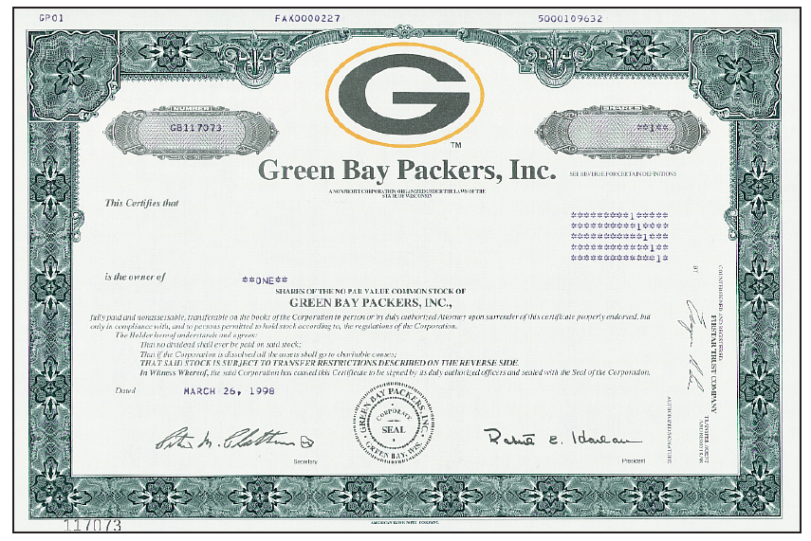
Stock Certificates and Transfer
Exhibit 13.2
Each unit of ownership is called a share of stock.
A stock certificate serves as proof that a stockholder has purchased shares.
When the stock is sold, the stockholder signs a transfer endorsement on the back of the stock certificate.
Learning Objective C1: Identify characteristics of corporations and their organization.
Notes:
Investors who buy a corporation’s stock sometimes receive a stock certificate as proof of share ownership. Many corporations issue only one certificate for each block of stock purchased. A certificate can be for any number of shares. This slide shows a stock certificate of the Green Bay Packers. A certificate shows the company name, stockholder name, number of shares, and other crucial information. Issuance of certificates is becoming less common.

Slide 10
Basics of Capital Stock
Total amount of stock that a corporation’s charter authorizes it to sell.
Total amount of stock that has been issued or sold to stockholders.
Learning Objective C1: Identify characteristics of corporations and their organization.
Notes:
Capital stock is a phrase for any shares issued to obtain capital (owner financing). This section introduces terminology and accounting for capital stock.
Authorized Stock Authorized stock is the number of shares that a corporation’s charter allows it to sell. The number of authorized shares usually exceeds the number of shares issued (and outstanding), often by a large amount. (Outstanding stock refers to issued stock held by stockholders.) No formal journal entry is required for stock authorization. A corporation discloses the number of shares authorized in the equity section of its balance sheet or notes.
In our example, the company has a total of 92,556,295 shares issued and outstanding. Notice that this common stock has a par value of $0.01. Low par values are normal in business.

Slide 11
Basics of Capital Stock
≠
Par value is an arbitrary amount assigned to each share of stock when it is authorized.
Market price is the amount that each share of stock will sell for in the market.
Classes of Stock
Par Value
No-Par Value
Stated Value
Learning Objective C1: Identify characteristics of corporations and their organization.
Notes:
Par value stock is stock that is assigned a par value, which is an amount assigned per share by the corporation in its charter. There is no restriction on the assigned par value. In many states, the par value of a stock establishes minimum legal capital, which refers to the least amount that the buyers of stock must contribute to the corporation or be subject to paying at a future date. For example, if a corporation issues 1,000 shares of $10 par value stock, the corporation’s minimum legal capital in these states would be $10,000.
Market value per share is the price at which a stock is bought and sold. Expected future earnings, dividends, growth, and other company and economic factors influence market value. Traded stocks’ market values are available daily in newspapers such as The Wall Street Journal and online. The current market value of previously issued shares (for example, the price of stock in trades between investors) does not impact the issuing corporation’s stockholders’ equity.
No-par value stock, or simply no-par stock, is stock not assigned a value per share by the corporate charter. Its advantage is that it can be issued at any price without the possibility of a minimum legal capital deficiency.
Stated value stock is no-par stock to which the directors assign a “stated” value per share. Stated value per share becomes the minimum legal capital per share in this case.

Slide 12
Stockholders’ Equity
Corporations’ equity: shareholders’ equity or corporate equity consists of:
paid-in (contributed) capital – cash and other assets received in exchange for stock
retained earnings – cumulative net income (loss) not distributed as dividends.
Learning Objective C1: Identify characteristics of corporations and their organization.
Notes:
Corporations’ equity also known as shareholders’ equity or corporate equity consists of:
paid-in (contributed) capital – cash and other assets corporation receives in exchange for stock
retained earnings – cumulative net income (loss) not distributed as dividends.

Slide 13
P1:
Record the issuance of corporate stock.
Learning Objective

Slide 14
Issuing Par Value Stock at a Premium
Par Value Stock
On June 5, Dillon Snowboard’s, Inc. issued 30,000 shares of $10 par value stock for $12 per share. Let’s record this transaction.
Learning Objective P1: Record the issuance of corporate stock.
Notes:
Par value stock can be issued at par, at a premium (above par), or at a discount (below par). In each case, stock can be exchanged for either cash or noncash assets.
A premium on stock occurs when a corporation sells its stock for more than par (or stated) value. To illustrate, if Dillon Snowboards issues its $10 par value common stock at $12 per share, its stock is sold at a $2 per share premium. The premium, known as paid-in capital in excess of par value, is reported as part of equity; it is not revenue and is not listed on the income statement. The entry to record Dillon Snowboards’s issuance of 30,000 shares of $10 par value stock for $12 per share on June 5, 2015, is shown.

Slide 15
Issuing Par Value Stock
Learning Objective P1: Record the issuance of corporate stock.
Notes:
The Paid-In Capital in Excess of Par Value account is added to the par value of the stock in the equity section of the balance sheet as shown in this slide.

Slide 16
Issuing No-Par Value Stock
No-Par Value Stock
On June 5, Dillon Snowboard’s, Inc. issued 1,000 shares of no-par value stock for $40 per share. Let’s record this transaction.
Learning Objective P1: Record the issuance of corporate stock.
Notes:
No-par value stock can be issued. With no-par value stock, there would not be an entry to the Paid in capital in excess of par account. The total amount debited to Cash is the same amount that is credited to the Common Stock, no-par value account.

Slide 17
Issuing Stated Value Stock
Stated Value Stock
On June 5, Dillon Snowboard’s, Inc. issued 1,000 shares of $40 stated value stock for $50 per share. Let’s record this transaction.
Learning Objective P1: Record the issuance of corporate stock.
Notes:
Stated value stock can be issued. With stated value stock, the difference between the stated value and the selling price is credited (or debited) to the Paid in capital in excess of par account.
If 1,000 shares of $40 stated value stock is issued for $50 per share, Cash is debited for $50 x 1,000, or $50,000, Common Stock, $40 stated value is credited for 1,000 x $40, or $40,000 and Paid in capital in Excess of Stated Value is credited for $10,000.

Slide 18
Issuing Stock for Noncash Assets
Par Value Stock
On June 10, 4,000 shares of $20 par value stock for land valued at $105,000. Let’s record this transaction.
Learning Objective P1: Record the issuance of corporate stock.
Notes:
A corporation can receive assets other than cash in exchange for its stock. (It can also assume liabilities on the assets received such as a mortgage on property received.) The corporation records the assets received at their market values as of the date of the transaction. The stock given in exchange is recorded at its par (or stated) value with any excess recorded in the Paid-In Capital in Excess of Par (or Stated) Value account. (If no-par stock is issued, the stock is recorded at the assets’ market value.) To illustrate, the entry to record receipt of land valued at $105,000 in return for issuance of 4,000 shares of $20 par value common stock on June 10 is shown in this slide.
Review what you have learned in the following NEED-TO-KNOW Slide.

Slide 19
NEED-TO-KNOW 13-1
Prepare journal entries to record the following four separate issuances of stock.
1)
A corporation issued 80 shares of $5 par value common stock for $700 cash.
2)
A corporation issued 40 shares of no-par common stock to its promoters in exchange for their efforts,
estimated to be worth $800. The stock has a $1 per share stated value.
3)
A corporation issued 40 shares of no-par common stock in exchange for land, estimated to be worth
$800. The stock has no stated value.
4)
A corporation issued 20 shares of $30 par value preferred stock for $900 cash.
General Journal
Debit
Credit
1)
Cash
700
Common Stock, $5 par value
(80 shares x $5)
400
Paid-in Capital in excess of par value, Common stock
300
2)
Organization expenses
800
Common Stock, $1 stated value
(40 shares x $1)
40
Paid-in Capital in excess of stated value, Common stock
760
3)
Land
800
Common Stock, No-par value
800
4)
Cash
900
Preferred Stock, $30 par value
(20 shares x $30)
600
Paid-in Capital in excess of par value, Preferred stock
300
Learning Objective P1: Record the issuance of corporate stock.
Notes:
Prepare journal entries to record the following four separate issuances of stock:
1) A corporation issued 80 shares of $5 par value common stock for $700 cash. This transaction increases both assets and equity. We debit Cash for the amount received, $700, and increase equity by crediting Common stock for the par value of the 80 shares issued, $400, and credit Paid-in Capital in excess of par value - Common stock for the difference. Both the Common stock account and Paid-in Capital in excess of par value - Common stock represent the investment by our shareholders. Both are reported in the Paid-in Capital section of stockholders' equity, and do not affect the income statement.
2) A corporation issued 40 shares of no-par common stock to its promoters in exchange for their efforts, estimated to be worth $800. The stock has a $1 per share stated value. This transaction affects both net income and the stockholders' equity section of the balance sheet. We debit Organization expenses for the fair market value of the services, $800, credit the Common stock account for the stated value of 40 shares, $40, and credit Paid-in Capital in excess of stated value - Common stock for the difference.
3) A corporation issued 40 shares of no-par common stock in exchange for land, estimated to be worth $800. The stock has no stated value. This transaction increases both assets and equity. We debit the Land account for the fair market value of the land, $800, and credit Common stock, No-par value for the entire $800. When the stock has neither a par value nor a stated value, there is no Paid-in Capital in excess account.
4) A corporation issued 20 shares of $30 par value preferred stock for $900 cash. This transaction increases both assets and equity. We debit the asset account, Cash, for the amount received, $900; credit the Preferred stock account for the par value of the 20 shares issued, $600; and credit Paid-in Capital in excess of par value - Preferred stock, $300.

Slide 20
P2:
Record transactions involving cash dividends, stock dividends, and stock splits.
Learning Objective

Slide 21

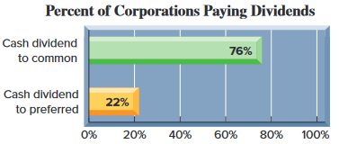
Cash Dividends
Regular cash dividends provide a return to investors and almost always affect the stock’s market value.
Dividends
Stockholders
Corporation
To pay a cash dividend, the corporation must have:
  A sufficient balance in retained earnings; and
  The cash necessary to pay the dividend.
Learning Objective P2: Record transactions involving cash dividends, stock dividends, and stock splits.
Notes:
The decision to pay cash dividends rests with the board of directors and involves more than evaluating the amounts of retained earnings and cash. The directors, for instance, may decide to keep the cash to invest in the corporation’s growth, to meet emergencies, to take advantage of unexpected opportunities, or to pay off debt. Alternatively, many corporations pay cash dividends to their stockholders at regular dates. These cash flows provide a return to investors and almost always affect the stock’s market value.

Slide 22
Accounting for Cash Dividends
Three Important Dates
Date of Declaration
Date of Record
Date of Payment
Record liability
for dividend.
No entry
required.
Record payment of
cash to stockholders.
Learning Objective P2: Record transactions involving cash dividends, stock dividends, and stock splits.
Notes:
Dividend payment involves three important dates: declaration, record, and payment. Date of declaration is the date the directors vote to declare and pay a dividend. This creates a legal liability of the corporation to its stockholders. Date of record is the future date for identifying those stockholders listed in the corporation’s records to receive dividends. Persons who own stock on the date of record receive dividends. Date of payment is the date when the corporation makes payment.

Slide 23
Accounting for Cash Dividends
On January 9, a $1 per share cash dividend is declared
on Z-Tech, Inc.’s 5,000 common shares outstanding. The
dividend will be paid on February 1 to stockholders of
record on January 22.
Date of Declaration
Record liability
for dividend.
Learning Objective P2: Record transactions involving cash dividends, stock dividends, and stock splits.
Notes:
To illustrate, the entry to record a January 9 declaration of a $1 per share cash dividend by the directors of Z-Tech, Inc., with 5,000 outstanding shares is shown above.
Common Dividend Payable is a current liability. The date of record for the Z-Tech dividend is January 22.

Slide 24
Accounting for Cash Dividends
On January 9, a $1 per share cash dividend is declared
on Z-Tech, Inc.’s 5,000 common shares outstanding. The
dividend will be paid on February 1 to stockholders of
record on January 22.
No entry required on January 22, the date of record.
Date of Payment
Record payment of cash to stockholders.
Learning Objective P2: Record transactions involving cash dividends, stock dividends, and stock splits.
Notes:
No formal journal entry is needed on the date of record. The February 1 date of payment requires an entry to record both the settlement of the liability and the reduction of the cash balance, as shown.

Slide 25
Deficits and Cash Dividends
A deficit is created when a company incurs cumulative losses or pays dividends greater
than total profits earned in other years.
Learning Objective P2: Record transactions involving cash dividends, stock dividends, and stock splits.
Notes:
A corporation with a debit (abnormal) balance for Retained Earnings has a retained earnings deficit, which occurs when a company has cumulative losses and/or pays more dividends than total earnings from current and prior years. A deficit is reported as a deduction on the balance sheet, as shown in this slide. Most states prohibit a corporation with a deficit from paying a cash dividend to its stockholders. This legal restriction is designed to protect creditors by preventing distribution of assets to stockholders when the company may be in financial difficulty.
Some state laws allow cash dividends to be paid by returning a portion of the capital contributed by stockholders. This type of dividend is called a liquidating cash dividend, or simply liquidating dividend, because it returns a part of the original investment back to the stockholders. This requires a debit entry to one of the contributed capital accounts instead of Retained Earnings at the declaration date.

Slide 26
Stock Dividends
A distribution of a corporation’s own shares to its stockholders without receiving any payment in return.
Why a stock dividend?
Can be used to keep the market price on the stock affordable.
Can provide evidence of management’s confidence that
the company is doing well.
Small Stock Dividend
Distribution is ≤ 25% of the previously outstanding shares.
Large Stock Dividend
Distribution is > 25% of the previously outstanding shares.
Learning Objective P2: Record transactions involving cash dividends, stock dividends, and stock splits.
Notes:
A stock dividend, declared by a corporation’s directors, is a distribution of additional shares of the corporation’s own stock to its stockholders without the receipt of any payment in return. Stock dividends and cash dividends are different. A stock dividend does not reduce assets and equity but instead transfers a portion of equity from retained earnings to contributed capital.
Stock dividends exist for at least two reasons. First, directors use stock dividends to keep the market price of the stock affordable. When a corporation has a stock dividend, it increases the number of outstanding shares and lowers the per share stock price. Another reason for a stock dividend is to show management’s confidence that the company is doing well and will continue to do well.
A stock dividend transfers part of retained earnings to contributed capital accounts, sometimes described as capitalizing retained earnings. Accounting for a stock dividend depends on whether it is a small or large stock dividend. A small stock dividend is a distribution of 25% or less of previously outstanding shares. It is recorded by capitalizing retained earnings for an amount equal to the market value of the shares to be distributed. A large stock dividend is a distribution of more than 25% of previously outstanding shares. A large stock dividend is recorded by capitalizing retained earnings for the minimum amount required by state law governing the corporation. Most states require capitalizing retained earnings equal to the par or stated value of the stock.

Slide 27
Recording a Small Stock Dividend
Quest has 10,000 shares of $10 par value stock outstanding. On December 31, Quest declared a 10% stock dividend, when the stock was selling for $15 per share. The stock will be distributed to stockholders on January 20. Let’s prepare the December 31 entry.
Capitalize retained earnings for the market value of the shares to be distributed. (10,000 × 10% = 1,000 × $15 = $15,000)
1,000 × $10 par
Learning Objective P2: Record transactions involving cash dividends, stock dividends, and stock splits.
Notes:
Assume that Quest’s directors declare a 10% stock dividend on December 31. This stock dividend of 1,000 shares, computed as 10% of its 10,000 outstanding shares, is to be distributed on January 20 to the stockholders of record on January 15. Since the market price of Quest’s stock on December 31 is $15 per share, this small stock dividend declaration is recorded as shown.
The $10,000 credit in the declaration entry equals the par value of the shares and is recorded in Common Stock Dividend Distributable, an equity account. Its balance exists only until the shares are issued. The $5,000 credit equals the amount by which market value exceeds par value. This amount increases the Paid-In Capital in Excess of Par Value account in anticipation of the issuance of shares.

Slide 28
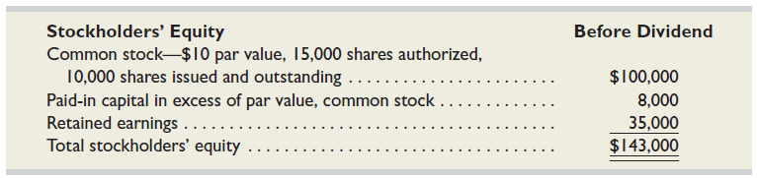
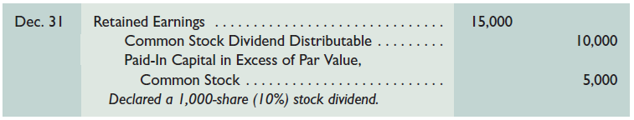
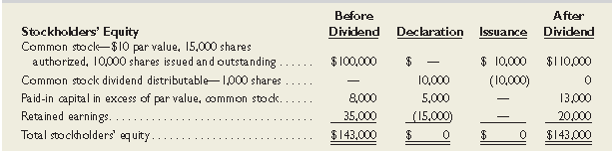
Recording a Small Stock Dividend
Exhibit 13.7
Before the
stock
dividend.
Exhibit 13.8
After the
stock
dividend.
Learning Objective P2: Record transactions involving cash dividends, stock dividends, and stock splits.
Notes:
In general, the balance sheet changes in three ways when a stock dividend is declared. First, the amount of equity attributed to common stock increases; for Quest, from $100,000 to $110,000 for 1,000 additional declared shares. Second, paid-in capital in excess of par increases by the excess of market value over par value for the declared shares. Third, retained earnings decreases, reflecting the transfer of amounts to both common stock and paid-in capital in excess of par. The impact on stockholders’ equity of Quest is shown in Exhibit 13.8 when its 10% stock dividend is declared on December 31.
The combined effect of these stock dividend entries is to transfer (or capitalize) $15,000 of retained earnings to paid-in capital accounts (see far-right column of Exhibit 13.8). The amount of capitalized retained earnings equals the market value of the 1,000 issued shares ($15 × 1,000 shares). A stock dividend has no effect on the ownership percentage of individual stockholders.

Slide 29
Recording a Small Stock Dividend
Quest has 10,000 shares of $1 par value stock outstanding. On December 31, Quest declared a 10% stock dividend, when the stock was selling for $15 per share. The stock will be distributed to stockholders on January 20. Let’s prepare the January 20 entry.
Learning Objective P2: Record transactions involving cash dividends, stock dividends, and stock splits.
Notes:
No entry is made on the date of record for a stock dividend. On January 20, the date of payment, Quest distributes the new shares to stockholders and records this entry shown (this entry is reflected in the “issuance” column of the prior slide).

Slide 30
Recording a Large Stock Dividend
Quest, Inc. has 10,000 shares of $1 par value stock outstanding. On December 31, Quest declared a 30% stock dividend. The stock will be distributed to stockholders on January 20, 2014. Let’s prepare the December 31 entry.
Capitalize retained earnings for the minimum amount required by state law, usually par or stated value of the shares.
(10,000 × 30% = 3,000 shares × $10 par value = $30,000)
Learning Objective P2: Record transactions involving cash dividends, stock dividends, and stock splits.
Notes:
A corporation capitalizes retained earnings equal to the minimum amount required by state law for a large stock dividend. For most states, this amount is the par or stated value of the newly issued shares. To illustrate, suppose Quest’s board declares a stock dividend of 30% instead of 10% on December 31. Since this dividend is more than 25%, it is treated as a large stock dividend. Thus, the par value of the 3,000 (computed as 10,000 outstanding shares x 30%) dividend shares is capitalized at the date of declaration with this entry shown. This transaction decreases retained earnings and increases contributed capital by $30,000. On the date of payment the company debits Common Stock Dividend Distributable and credits Common Stock for $30,000. The effects from a large stock dividend on balance sheet accounts are similar to those for a small stock dividend except for the absence of any effect on paid-in capital in excess of par.

Slide 31
Stock Splits
A distribution of additional shares of stock to stockholders according to their percent ownership.
$20 par value
Old
Shares
Common Stock
100,000 shares
$10 par value
New
Shares
Common Stock
200,000 shares
Learning Objective P2: Record transactions involving cash dividends, stock dividends, and stock splits.
Notes:
A stock split is the distribution of additional shares to stockholders according to their percent ownership. When a stock split occurs, the corporation “calls in” its outstanding shares and issues more than one new share in exchange for each old share. Splits can be done in any ratio, including 2-for-1, 3-for-1, or higher.
To illustrate, CompTec has 100,000 outstanding shares of $20 par value common stock with a current market value of $88 per share. A 2-for-1 stock split cuts par value in half as it replaces 100,000 shares of $20 par value stock with 200,000 shares of $10 par value stock. Market value is reduced from $88 per share to about $44 per share. The split does not affect any equity amounts reported on the balance sheet or any individual stockholder’s percent ownership. Both the Paid-In Capital and Retained Earnings accounts are unchanged by a split, and no journal entry is made. The only effect on the accounts is a change in the stock account description. CompTec’s 2-for-1 split on its $20 par value stock means that after the split, it changes its stock account title to Common Stock, $10 Par Value. This stock’s description on the balance sheet also changes to reflect the additional authorized, issued, and outstanding shares and the new par value.
A stock split is the distribution of additional shares of stock to stockholders according to their percent ownership. When a stock split occurs, the corporation calls in the outstanding shares and issues new shares of stock. In the process of a stock split, the par value of the stock changes.
After the split, the number of shares doubled and the par value was cut in half. There is no change in total par value. The old shares had a total par value of $1,000 (100 shares times $10 per hare par value). The new shares have a total par value of $1,000 (200 shares times $5 par value per share). Notice that an accounting entry is not required, and that Retained Earnings is not reduced.
In many respects, a 100 percent stock dividend and a two-for-one stock split result in similar impacts in the market price of the share outstanding. The stock split usually requires more administrative tasks to call in and reissue stock certificates. However, sometimes corporations do not reissue certificates in a stock split, saving some of the administrative costs.
Review what you have learned in the following NEED-TO-KNOW Slides.

Slide 32
NEED-TO-KNOW 13-2
A company began the current year with the following balances in its Stockholders’ Equity accounts.
Common Stock- $10 par, 500 shares authorized, 200 shares issued and outstanding
$2,000
Paid-in capital in excess of par, Common Stock
1,000
Retained earnings
5,000
Total
$8,000
All outstanding common stock was issued for $15 per share when the company was created. Prepare
journal entries to account for the following transactions during the current year.
Jan. 10
The board declared a $0.10 cash dividend per share to shareholders of record on Jan. 28.
Feb. 15
Paid the cash dividend declared on January 10.
Mar. 31
Declared a 20% stock dividend. The market value of the stock is $18 per share.
May 1
Distributed the stock dividend declared on March 31.
Dec. 1
Declared a 40% stock dividend. The market value of the stock is $25 per share.
Dec. 31
Distributed the stock dividend declared on December 1.
Learning Objective P2: Record transactions involving cash dividends, stock dividends, and stock splits.
Notes:
A company began the current year with the following balances in its stockholders’ equity accounts. All outstanding common stock was issued for $15 per share when the company was created. Prepare journal entries to account for the following transactions during the current year.

Slide 33
NEED-TO-KNOW 13-2 SOLUTION
Common Stock- $10 par, 500 shares authorized, 200 shares issued and outstanding
$2,000
Paid-in capital in excess of par, Common Stock
1,000
Retained earnings
5,000
Total
$8,000
Jan. 10
The board declared a $0.10 cash dividend per share to shareholders of record on Jan. 28.
Feb. 15
Paid the cash dividend declared on January 10.
Mar. 31
Declared a 20% stock dividend. The market value of the stock is $18 per share.
May 1
Distributed the stock dividend declared on March 31.
Dec. 1
Declared a 40% stock dividend. The market value of the stock is $25 per share.
Dec. 31
Distributed the stock dividend declared on December 1.
General Journal
Debit
Credit
Jan. 10
Retained earnings
(200 shares x $0.10)
20
Common dividend payable
20
Jan. 28
No journal entry on the date of record
Feb. 15
Common dividend payable
20
Cash
20
Mar. 31
Retained earnings
(200 shares x 20% = 40 shares x $18 mkt.)
720
Common Stock dividend distributable
(40 shares x $10 par)
400
Paid-in Capital in excess of par value, Common Stock
320
May 1
Common Stock dividend distributable
(40 shares x $10 par)
400
Common Stock, $10 par value
(40 shares x $10 par)
400
Learning Objective P2: Record transactions involving cash dividends, stock dividends, and stock splits.
Notes:
Jan. 10 - The board declared a $0.10 cash dividend per share to shareholders of record on Jan. 28. The journal entry is a debit to Retained earnings, 200 shares outstanding x $0.10 per share, a total of $20, and we credit the liability account, Common dividend payable. On the date of record, January 28, there is no journal entry.
Feb. 15 - Paid the cash dividend declared on January 10. The payment of the liability is a debit to Common dividend payable, and a credit to Cash.
Mar. 31 - Declared a 20% stock dividend. The market value of the stock is $18 per share. A stock dividend increases the number of shares by a certain percentage, in this case 20%. Each shareholder will increase their number of shares by 20%. A small stock dividend is defined as less than a 25% stock dividend, and is valued at the market price. There are 200 shares issued and outstanding prior to the stock dividend. The journal entry is a debit to Retained earnings, 200 shares multiplied by 20%; 40 new shares to be issued, at the market value of $18 per share, a total dividend of $720. The shares will not be issued on March 31; therefore we don't credit the Common stock account yet. Instead, we credit the equity account, Common stock dividend distributable, for the par value of the 40 new shares, $400, and credit Paid-in capital in excess of par value - Common stock for the difference, $320. The Common stock dividend distributable account holds the par value of the shares to be issued between the date of declaration and the date of issuance, May 1.

Slide 34
NEED-TO-KNOW 13-2 SOLUTION
Common Stock- $10 par, 500 shares authorized, 200 shares issued and outstanding
$2,000
Paid-in capital in excess of par, Common Stock
1,000
Retained earnings
5,000
Total
$8,000
Jan. 10
The board declared a $0.10 cash dividend per share to shareholders of record Jan. 28.
Feb. 15
Paid the cash dividend declared on January 10.
Mar. 31
Declared a 20% stock dividend. The market value of the stock is $18 per share.
May 1
Distributed the stock dividend declared on March 31.
Dec. 1
Declared a 40% stock dividend. The market value of the stock is $25 per share.
Dec. 31
Distributed the stock dividend declared on December 1.
General Journal
Debit
Credit
May 1
Common Stock dividend distributable
(40 shares x $10 par)
400
Common Stock, $10 par value
(40 shares x $10 par)
400
Dec. 1
Retained earnings
(240 shares x 40% = 96 shares x $10 par)
960
Common Stock dividend distributable
(96 shares x $10 par)
960
Dec. 31
Common Stock dividend distributable
(96 shares x $10 par)
960
Common Stock, $10 par value
(96 shares x $10 par)
960
Learning Objective P2: Record transactions involving cash dividends, stock dividends, and stock splits.
Notes:
May 1 - Distributed the stock dividend declared on March 31. The journal entry records the issuance of the shares, debiting Common stock dividend distributable, $400, and we credit common stock for the number of shares issued at par value, $400. As of May 1, there are 240 shares issued and outstanding.
Dec. 1 - Declared a 40% stock dividend. The market value of the stock is $25 per share. A stock dividend of greater than 25% is referred to as a large stock dividend; large stock dividends are valued at par. On December 1, debit Retained earnings for the number of shares issued, 240 shares currently outstanding, multiplied by 40% is 96 new shares, multiplied by the par value of $10 per share; a total dividend of $960, and we credit the Common stock dividend distributable account for the 96 shares multiplied by par, $960. Remember the Common stock dividend distributable account holds the par value of shares between the date of declaration of a stock dividend and the date the shares are issued.
Dec. 31 - Distributed the stock dividend declared on December 1. Debit Common stock dividend distributable, $960, and credit Common stock, $10 par value, for the 96 shares, $960.

Slide 35
C2:
Explain characteristics of, and distribute dividends between, common and preferred stock.
Learning Objective

Slide 36
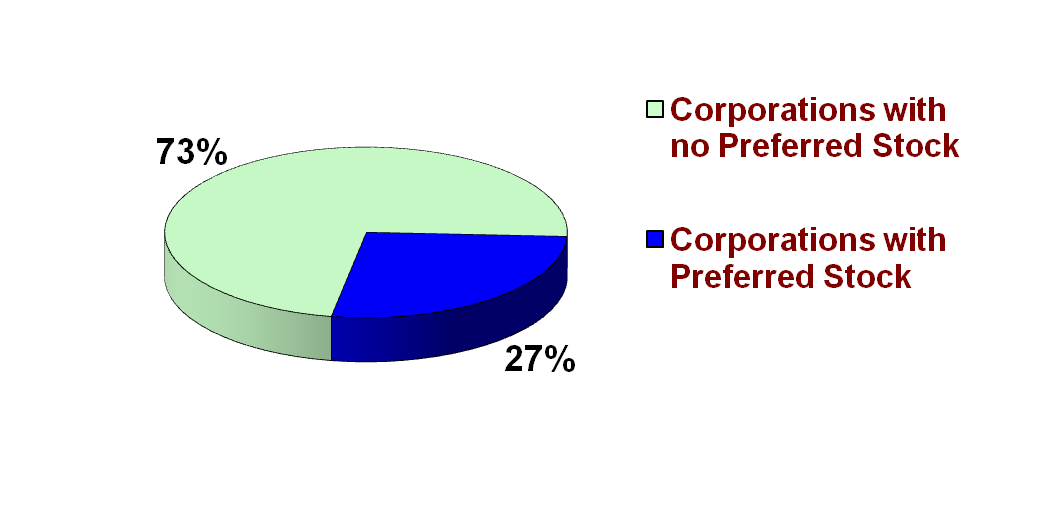
Preferred Stock
A separate class of stock, typically having priority over common shares in . . .
  Dividend distributions
  Distribution of assets in case of liquidation
Usually has a stated dividend rate
Normally has no
voting rights
Exhibit 13.9
Learning Objective C2: Explain characteristics of, and distribute dividends between, common and preferred stock.
Notes:
A corporation can issue two basic kinds of stock, common and preferred. Preferred stock has special rights that give it priority (or senior status) over common stock in one or more areas. Special rights typically include a preference for receiving dividends and for the distribution of assets if the corporation is liquidated. Preferred stock carries all rights of common stock unless the corporate charter nullifies them. Most preferred stock, for instance, does not confer the right to vote.
The graph on this slide shows that preferred stock is issued by about one-fourth of corporations. All corporations issue common stock.

Slide 37
Issuance of Preferred Stock
Cumulative
vs.
Noncumulative
Dividends in arrears must be paid before dividends may be paid on common stock. (Normal case).
Undeclared dividends from current and prior years do not have to be paid in future years.
Consider the following Stockholders’ Equity section of the Balance Sheet. The Board of Directors declares $5,000 of dividends in 2016. In 2017, the Board declared and paid cash dividends of $42,000.
Learning Objective C2: Explain characteristics of, and distribute dividends between, common and preferred stock.
Notes:
Preferred stock usually carries a preference for dividends, meaning that preferred stockholders are allocated their dividends before any dividends are allocated to common stockholders. The dividends allocated to preferred stockholders are usually expressed as a dollar amount per share or a percent applied to par value. A preference for dividends does not ensure dividends. If the directors do not declare a dividend, neither the preferred nor the common stockholders receive one.
Most preferred stocks carry a cumulative dividend right. Cumulative preferred stock gives its owners a right to be paid both the current and all prior periods’ unpaid dividends before any dividend is paid to common stockholders. When preferred stock is cumulative and the directors either do not declare a dividend to preferred stockholders or declare one that does not cover the total amount of cumulative dividend, the unpaid dividend amount is called dividend in arrears. Accumulation of dividends in arrears on cumulative preferred stock does not guarantee they will be paid. Noncumulative preferred stock offers no right to prior periods’ unpaid dividends if they were not declared in those prior periods.
To illustrate the difference between cumulative and noncumulative preferred stock, assume that a corporation’s outstanding stock includes (1) 1,000 shares of $100 par, 9% preferred stock— yielding $9,000 per year (1,000 shares x $100 par x 9%) in potential dividends, and (2) 4,000 shares of $50 par value common stock. During 2016, the first year of operations, the directors declare cash dividends of $5,000. In year 2017, they declare cash dividends of $42,000.

Slide 38
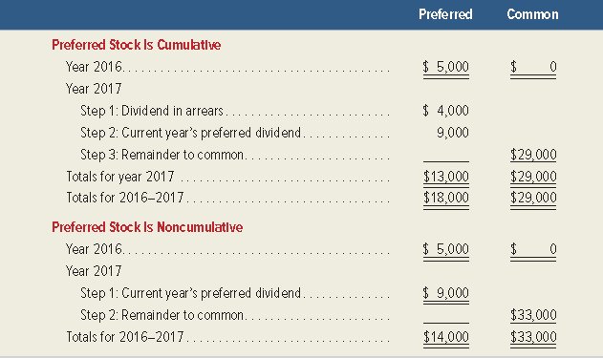
Dividend Preference of
Preferred Stock
Exhibit 13.11
Learning Objective C2: Explain characteristics of, and distribute dividends between, common and preferred stock.
Notes:
This slide shows the allocation of dividends for these two years. Allocation of year 2016 dividends depends on whether the preferred stock is noncumulative or cumulative. With noncumulative preferred, the preferred stockholders never receive the $4,000 skipped in 2016. If the preferred stock is cumulative, the $4,000 in arrears is paid in 2017 before any other dividends are paid.
A liability for a dividend does not exist until the directors declare a dividend. If a preferred dividend date passes and the corporation’s board fails to declare the dividend on its cumulative preferred stock, the dividend in arrears is not a liability. The full disclosure principle requires a corporation to report (usually in a note) the amount of preferred dividends in arrears as of the balance sheet date.

Slide 39
Participating or
Nonparticipating Dividend
Participating
vs.
Nonparticipating
Dividends may exceed a stated amount once common stockholders receive a dividend equal to the preferred stated rate.
Dividends are limited to a maximum amount each year. The maximum is usually the stated dividend rate.
(Normal case)
Reasons for Issuing Preferred Stock
To raise capital without sacrificing control
To boost the return earned by common stockholders through financial leverage
To appeal to investors who may believe the common stock is too risky or that the expected return on common stock is too low
Learning Objective C2: Explain characteristics of, and distribute dividends between, common and preferred stock.
Notes:
Nonparticipating preferred stock has a feature that limits dividends to a maximum amount each year. Once preferred stockholders receive this amount, the common stockholders receive any and all additional dividends. Participating preferred stock has a feature allowing preferred stockholders to share with common stockholders in any dividends paid in excess of the percent or dollar amount stated on the preferred stock. This participation feature does not apply until common stockholders receive dividends equal to the preferred stock’s dividend percent. Many corporations are authorized to issue participating preferred stock but rarely do, and most managers never expect to issue it.
Review what you have learned in the following NEED-TO-KNOW Slides.

Slide 40
NEED-TO-KNOW 13-3 Part 1
A company’s outstanding stock consists of 80 shares of noncumulative 5% preferred stock with a $5
par value and also 200 shares of common stock with a $1 par value. During its first three years of
operation, the corporation declared and paid the following total cash dividends:
Total
2015
$15
2016
5
2017
200
Total
$220
Part 1. Determine the amount of dividends paid each year to each of the two classes of stockholders:
preferred and common. Also compute the total dividends paid to each class for the three years.
Annual preferred dividend
Par value per preferred share
$5
Dividend %
5%
Dividend per preferred share
$0.25
Number of preferred shares
80
Annual preferred dividend
$20
Total
Preferred
Common
2015
$15
$15
$0
2016
5
5
0
2017
200
20
180
Total
$220
$40
$180
Learning Objective C2: Explain characteristics of, and distribute dividends between, common and preferred stock.
Notes:
A company’s outstanding stock consists of 80 shares of noncumulative 5% preferred stock with a $5 par value and also 200 shares of common stock with a $1 par value. During its first three years of operation, the corporation declared and paid the following total cash dividends:
Part 1 - Determine the amount of dividends paid each year to each of the two classes of stockholders: preferred and common. Also compute the total dividends paid to each class for the three years. First, let's calculate the annual preferred dividend. The par value per preferred share is $5. To calculate the dividend, we multiply by the dividend percentage, 5%. The annual dividend per preferred share is $0.25. When we multiply by the number of preferred shares, 80, the annual preferred dividend is $20. Preferred shareholders must receive their annual preferred dividend in full before the common shareholders receive any dividend.
In 2015, a total of only $15 of dividends are declared and paid. This is less than the annual preferred dividend; the preferred shareholders will receive all $15 with common shareholders receiving $0.
In 2016, only $5 of dividends are declared and paid. Again, this is less than the annual preferred dividend of $20. The preferred shareholders receive all $5, and common shareholders receive $0.
In 2017, a total of $200 of dividends are declared and paid. The preferred shareholders receive their annual maximum, $20, and the common shareholders receive the remainder; $180 of dividends are received by the common shareholders. Over the three-year period, preferred shareholders receive a total of $40 of dividends, and the common shareholders receive $180 of dividends. When the stock is noncumulative, the maximum the preferred shareholders can receive in any one year is the preferred dividend of $20. If the amount is not received in full, the unpaid dividend is lost entirely.

Slide 41
NEED-TO-KNOW 13-3 Part 2
A company’s outstanding stock consists of 80 shares of noncumulative 5% preferred stock with a $5
par value and also 200 shares of common stock with a $1 par value. During its first three years of
operation, the corporation declared and paid the following total cash dividends:
Annual preferred dividend
Par value per preferred share
$5
Dividend %
5%
Dividend per preferred share
$0.25
Number of preferred shares
80
Annual preferred dividend
$20
Part 2. Determine the amount of dividends paid each year to each of the two classes of stockholders
assuming that the preferred stock is cumulative. Also determine the total dividends paid to each class
for the three years combined.
Total
Preferred
Arrears
Common
2015
$15
$15
$5
$0
2016
5
5
20
0
2017
200
40
0
160
Total
$220
$60
$160
Learning Objective C2: Explain characteristics of, and distribute dividends between, common and preferred stock.
Notes:
Part 2 - Determine the amount of dividends paid each year to each of the two classes of stockholders assuming that the preferred stock is cumulative. Also determine the total dividends paid to each class for the three years combined. When preferred stock is cumulative, their cumulative dividends must equal $20 per year before the common stockholders receive anything.
In 2015, only $15 of dividends are paid. All $15 is paid to the preferred shareholders, but the unpaid amount, $20 - $15, is not lost; instead the $5 will carry forward and is called a "dividend in arrears." The common shareholders will not receive any dividend in 2015.
In 2016, a total of $5 of dividends is paid. On a cumulative basis, the preferred shareholders need to have received $40, two years at $20 per year, before the common shareholders receive any dividend at all; all $5 is paid to the preferred shareholders. On a cumulative basis, they have received $20 of dividends. They should have received a total of $40 of dividends, two years at $20 per year. At the end of 2016, dividends in arrears are $20. Because there are dividends in arrears, common shareholders will not receive any dividend.
In 2017, a total of $200 of dividends is paid. On a cumulative basis, three years at $20 per year is $60. The preferred shareholders have already received $20 of dividends, so they must receive a total of $40 of dividends in 2017; $20 for the arrearage plus $20 for the current year's dividend. At this point in time the preferred shareholders are paid in full; there are no dividends in arrears. The remaining dividend, $200 -$40, is paid to the common shareholders. Of the $220 paid in total over the three-year period, Preferred shareholders received a total of $60, and the remaining $160 is received by the common shareholders.

Slide 42
P3:
Record purchases and sales of treasury stock and the retirement of stock.
Learning Objective

Slide 43
Treasury Stock
Treasury stock represents shares of a company’s own stock that has been acquired. A corporation might acquire its own stock to:
Use its shares to buy other companies.
Avoid a hostile takeover.
Reissue to employees as compensation.
Support the market price.
Learning Objective P3: Record purchases and sales of treasury stock and the retirement of stock.
Notes:
Corporations acquire shares of their own stock for several reasons: (1) to use their shares to acquire another corporation, (2) to purchase shares to avoid a hostile takeover of the company, (3) to reissue them to employees as compensation, and (4) to maintain a strong market for their stock or to show management confidence in the current price.
A corporation’s reacquired shares are called treasury stock, which is similar to unissued stock in several ways: (1) neither treasury stock nor unissued stock is an asset, (2) neither receives cash dividends or stock dividends, and (3) neither allows the exercise of voting rights.
As this graph indicates, the majority of corporations have some treasury stock.

Slide 44
Purchasing Treasury Stock
On May 1, Cyber, Inc. purchased 1,000 of its own
shares of stock in the open market for $11.50 per share.
Treasury stock is shown as a reduction in total
stockholders’ equity on the balance sheet.
Learning Objective P3: Record purchases and sales of treasury stock and the retirement of stock.
Notes:
Cyber purchases 1,000 of its own shares for $11,500 on May 1, which is recorded as shown.
This entry reduces equity through the debit to the Treasury Stock account, which is a contra equity account.

Slide 45
Selling Treasury Stock at Cost
On May 21, Cyber sold 100 shares of
its treasury stock for $11.50 per share.
Learning Objective P3: Record purchases and sales of treasury stock and the retirement of stock.
Notes:
If treasury stock is reissued at cost, the entry is the reverse of the one made to record the purchase. For instance, if on May 21 Cyber reissues 100 of the treasury shares purchased on May 1 at the same $11.50 per share cost, the entry is shown above.

Slide 46
Selling Treasury Stock
Above Cost
On June 3, Cyber, Inc. sold an additional 400
shares of its treasury stock for $12 per share.
Learning Objective P3: Record purchases and sales of treasury stock and the retirement of stock.
Notes:
If treasury stock is sold for more than cost, the amount received in excess of cost is credited to the Paid-In Capital, Treasury Stock account. This account is reported as a separate item in the stockholders’ equity section. No gain is ever reported from the sale of treasury stock. To illustrate, if Cyber receives $12 cash per share for 400 treasury shares costing $11.50 per share on June 3, the entry is shown.

Slide 47
Selling Treasury Stock
Below Cost
On July 10, Cyber sold an additional 500 shares of its treasury stock for $10 per share.
Learning Objective P3: Record purchases and sales of treasury stock and the retirement of stock.
Notes:
When treasury stock is sold below cost, the entry to record the sale depends on whether the Paid-In Capital, Treasury Stock account has a credit balance. If it has a zero balance, the excess of cost over the sales price is debited to Retained Earnings. If the Paid-In Capital, Treasury Stock account has a credit balance, it is debited for the excess of the cost over the selling price but not to exceed the balance in this account. When the credit balance in this paid-in capital account is eliminated, any remaining difference between the cost and selling price is debited to Retained Earnings. To illustrate, if Cyber sells its remaining 500 shares of treasury stock at $10 per share on July 10, equity is reduced by $750 (500 shares x $1.50 per share excess of cost over selling price), as shown in this entry.
Review what you have learned in the following NEED-TO-KNOW Slides.

Slide 48
NEED-TO-KNOW 13-4
A company began the current year with the following balances in its stockholders’ equity accounts.
Common Stock - $10 par, 500 shares authorized, 200 shares issued and outstanding
$2,000
Paid-in capital in excess of par, Common Stock
1,000
Retained earnings
5,000
Total
$8,000
All outstanding common stock was issued for $15 per share when the company was created. Prepare
journal entries to account for the following transactions during the current year.
Jul. 1
Purchased 30 shares of treasury stock at $20 per share.
Sep. 1
Sold 20 treasury shares at $26 cash per share.
Dec. 1
Sold the remaining 10 shares of treasury stock at $7 cash per share.
Learning Objective P3: Record purchases and sales of treasury stock and the retirement of stock.
Notes:
A company began the current year with the following balances in its stockholders’ equity accounts. All outstanding common stock was issued for $15 per share when the company was created. Prepare journal entries to account for the following transactions during the current year.

Slide 49
NEED-TO-KNOW 13-4 SOLUTION
Common Stock - $10 par, 500 shares authorized, 200 shares issued and outstanding
$2,000
Paid-in capital in excess of par, Common Stock
1,000
Retained earnings
5,000
Total
$8,000
Jul. 1
Purchased 30 shares of treasury stock at $20 per share.
Sep. 1
Sold 20 treasury shares at $26 cash per share.
Dec. 1
Sold the remaining 10 shares of treasury stock at $7 cash per share.
General Journal
Debit
Credit
Jul. 1
Treasury Stock
(30 shares x $20 cost)
600
Cash
600
Sep. 1
Cash
(20 shares x $26)
520
Treasury Stock
(20 shares x $20 cost)
400
Paid-in Capital, Treasury Stock
120
Dec. 1
Cash
(10 shares x $7)
70
Paid-in Capital, Treasury Stock
(Available balance)
120
Retained Earnings
10
Treasury Stock
(10 shares x $20 cost)
200
Learning Objective P3: Record purchases and sales of treasury stock and the retirement of stock.
Notes:
Jul. 1 - Purchased 30 shares of treasury stock at $20 per share. When a company reacquires its own stock from the open market, and holds it temporarily, it's referred to as treasury stock. The journal entry to record the purchase of the 30 shares is a debit to the contra equity account, Treasury stock, 30 shares multiplied by the $20 cost per share,$600, and a credit to Cash. This is the cost method; the par value of the shares is not considered when accounting for treasury stock.
Sep. 1 - Sold 20 treasury shares at $26 cash per share. The company reissues the shares, debiting Cash, 20 shares multiplied by $26 per share, $520. We credit Treasury stock, always at the original cost; 20 shares multiplied by the original cost of $20 per share is $400. The difference of $6 per share is not an income statement gain. Instead, we credit the equity account, Paid-in capital - Treasury stock for the difference, $120.
Dec. 1 - Sold the remaining ten shares of treasury stock at $7 cash per share. Debit Cash for the amount received, ten shares at $7 per share, $70. Credit the Treasury stock account for the cost of the ten shares, $20 per share, $200. And now we have a $130 difference to absorb. Since the assets are only increasing by $70, total equity can only increase by $70. Since we're crediting Treasury stock for $200, we need to debit other equity accounts for a total of $130. The Paid-in capital - Treasury stock account can be debited, but it can never have an ending debit balance. We debit the Paid-in capital - Treasury stock account for its available balance. There was no balance at the beginning of the year, and we credited the account for $120 on September 1; The Paid-in capital - Treasury stock account can absorb $120 of the $130 decrease to equity. The remaining $10 is debited to Retained earnings, and is presumed to be a dividend.

Slide 50
C3:
Explain the items reported in retained earnings.
Learning Objective

Slide 51
Statement of Retained Earnings
Retained earnings is the total cumulative amount of reported net income less any net losses and dividends declared since the company started operating.
Restricted Retained Earnings
Legal Restriction
Most states restrict
the amount of
treasury stock
purchases to the
amount of retained
earnings.
Contractual Restriction
Loan agreements
can include
restrictions on paying
dividends below a
certain amount of
retained earnings.
Learning Objective C3: Explain the items reported in retained earnings.
Notes:
Retained earnings generally consist of a company’s cumulative net income less any net losses and dividends declared since its inception. Retained earnings are part of stockholders’ claims on the company’s net assets, but this does not imply that a certain amount of cash or other assets is available to pay stockholders.
The term restricted retained earnings refers to both statutory and contractual restrictions. A common statutory (or legal) restriction is to limit treasury stock purchases to the amount of retained earnings. The balance sheet in Exhibit 11.14 provides an example. A common contractual restriction involves loan agreements that restrict paying dividends beyond a specified amount or percent of retained earnings. Restrictions are usually described in the notes. The term appropriated retained earnings refers to a voluntary transfer of amounts from the Retained Earnings account to the Appropriated Retained Earnings account to inform users of special activities that require funds.

Slide 52
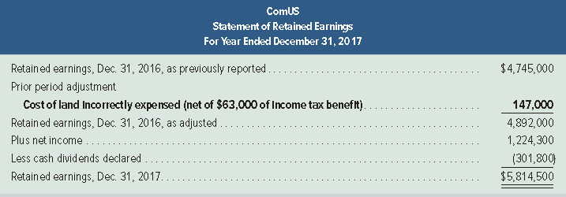
Prior Period Adjustments
Exhibit 13.15
Prior period adjustments are corrections of material errors in past years’ financial statements that result in a change in the beginning balance of retained earnings.
Learning Objective C3: Explain the items reported in retained earnings.
Notes:
Prior period adjustments are corrections of material errors in prior period financial statements. These errors include arithmetic mistakes, unacceptable accounting, and missed facts. Prior period adjustments are reported in the statement of retained earnings (or the statement of stockholders’ equity), net of any income tax effects. Prior period adjustments result in changing the beginning balance of retained earnings for events occurring prior to the earliest period reported in the current set of financial statements. To illustrate, assume that ComUS makes an error in a 2015 journal entry for the purchase of land by incorrectly debiting an expense account. When this is discovered in 2017, the statement of retained earnings includes a prior period adjustment, as shown in this slide. This exhibit also shows the usual format of the statement of retained earnings.

Slide 53
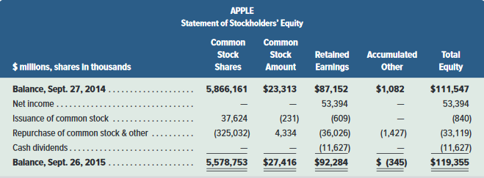
Statement of Stockholders’ Equity
Exhibit 13.16
This is a more inclusive statement than the statement of retained earnings.
Learning Objective C3: Explain the items reported in retained earnings.
Notes:
Instead of a separate statement of retained earnings, companies commonly report a statement of stockholders’ equity that includes changes in retained earnings. A statement of stockholders’ equity lists the beginning and ending balances of key equity accounts and describes the changes that occur during the period. The usual format is to provide a column for each component of equity and use the rows to describe events occurring in the period. This slide shows a condensed statement for Apple.

Slide 54
A1:
Compute earnings per share and describe its use.
Learning Objective

Slide 55
Earnings Per Share
Earnings per share is one of the most widely cited accounting statistics.
Basic
earnings
per share
Net income - Preferred dividends
Weighted-average common shares outstanding
=
Learning Objective A1: Compute earnings per share and describe its use.
Notes:
The income statement reports earnings per share, also called EPS or net income per share, which is the amount of income earned per share of a company’s outstanding common stock. The basic earnings per share formula is shown. When a company has no preferred stock, then preferred dividends are zero. The weighted-average common shares outstanding is measured over the income reporting period; its computation is explained in advanced courses.

Slide 56
A2:
Compute price-earnings ratio and describe its use in analysis.
Learning Objective

Slide 57
Price-Earnings Ratio
This ratio reveals information about the stock market’s expectations for a company’s future growth in earnings, dividends, and opportunities.
Price–
earnings
ratio
Market value (price) per share
Earnings per share
=
Learning Objective A2: Compute price-earnings ratio and describe its use in analysis.
Notes:
A stock’s market value is determined by its expected future cash flows. A comparison of a company’s EPS and its market value per share reveals information about market expectations. This comparison is traditionally made using a price-earnings (or PE) ratio, expressed also as price earnings, price to earnings, or PE. Some analysts interpret this ratio as what price the market is willing to pay for a company’s current earnings stream. Price-earnings ratios can differ across companies that have similar earnings because of either higher or lower expectations of future earnings. The price-earnings ratio is defined in this slide.

Slide 58
A3:
Compute dividend yield and explain its use in analysis.
Learning Objective

Slide 59
Dividend Yield
Tells us the annual amount of cash dividends distributed to common stockholders relative to
the stock’s market price.
Dividend
yield
Annual cash dividends per share
Market value per share
=
Learning Objective A3: Compute dividend yield and explain its use in analysis.
Notes:
Investors buy shares of a company’s stock in anticipation of receiving a return from either or both cash dividends and stock price increases. Stocks that pay large dividends on a regular basis, called income stocks, are attractive to investors who want recurring cash flows from their investments. In contrast, some stocks pay little or no dividends but are still attractive to investors because of their expected stock price increases. The stocks of companies that distribute little or no cash but use their cash to finance expansion are called growth stocks. One way to help identify whether a stock is an income stock or a growth stock is to analyze its dividend yield. Dividend yield, defined in this slide, shows the annual amount of cash dividends distributed to common shares relative to their market value.

Slide 60
A4:
Compute book value and explain its use in analysis.
Learning Objective

Slide 61
Book Value per Common Share
Reflects the amount of stockholders’ equity
applicable to common shares on a per share basis.
Stockholders’ equity applicable
to common shares
Number of common
shares outstanding
Book value per
common share
=
Learning Objective A4: Compute book value and explain its use in analysis.
Notes:
The book value per common share reflects the amount of stockholders’ equity applicable to common shares on a per share basis. It is calculated as stockholders’ equity applicable to common shares divided by the number of common shares outstanding.

Slide 62
End of Chapter 13

