Slide 1
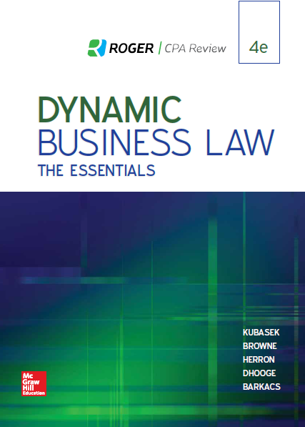
Chapter 12
Reality of Assent
© 2019 McGraw-Hill Education. All rights reserved. Authorized only for instructor use in the classroom. No reproduction or further distribution permitted without the prior written consent of McGraw-Hill Education.
1
Notes:
Chapter 12: Reality of Assent

Slide 2
Legal Assent
Definition: Voluntary, willing promise to transact the law will require contracting parties to obey.
Without assent, contract may be avoided/rescinded.
Cancellation of contract due to lack of assent means party with power of avoidance can require return of consideration given to other party; similarly, party with rescission right must return consideration received from other party.
Major “obstacles” to legal assent: Mistake, misrepresentation, undue influence, and duress.
Notes:
Legal assent is defined as a voluntary, willing promise to transact that the law will require the parties to obey. Without assent, a contract may be avoided or rescinded. Cancellation of contract due to a lack of assent means the party with the power of avoidance can require the return of consideration given to the other party; similarly, the party with a rescission right must return the consideration received from the other party. Major “obstacles” to legal assent include mistake, misrepresentation, undue influence, and duress.

Slide 3
Mistake
Definition: Misunderstandings regarding material facts of contract at time agreement made.
Unilateral Mistake: Mistake made by one contracting party; generally, contract still binding.
Mutual (Bilateral) Mistake: Mistake made by both parties; if mutual mistake of material (significant) fact, either party can rescind contract.
Notes:
Mistakes are misunderstandings regarding the material facts of a contract existing at the time the agreement was made. A unilateral mistake is a mistake made by one contracting party; generally, a contract is still binding even if a unilateral mistake has been made. With a mutual (or bilateral) mistake, a mistake is made by both parties; if the mistake is mutual, and if it pertains to a material (or significant) fact, either party can rescind the contract.

Slide 4
For a mutual mistake to interfere with legal consent, it must involve:
A basic assumption about the subject matter of the contract;
A material effect on the agreement; and,
An adverse effect on a party who did not agree to bear the risk of mistake at the time of the agreement.
Notes:
For a mutual mistake to interfere with legal consent, it must involve: a basic assumption about the subject matter of the contract; a material effect on the agreement; and an adverse effect on a party who did not agree to bear the risk of mistake at the time of the agreement.

Slide 5
Innocent Misrepresentation
Definition: False statement about material fact that person who made statement believed true.
Person who made innocent misrepresentation lacked “scienter”; i.e., had no knowledge of falsity of claim.
Party misled by innocent misrepresentation can rescind contract, but cannot sue for damages.
Notes:
An innocent misrepresentation is a false statement about a fact material to an agreement that the person who made the statement believed to be true. The person who made the false statement had no knowledge of the falsity of the claim; in other words, he or she lacked “scienter.” Innocent misrepresentations permit the party who was misled by the false statement to rescind the contract; however, because the party who made the false statement had no intent to mislead, the aggrieved party cannot sue for damages.

Slide 6
Negligent or Fraudulent Misrepresentation
Negligent Misrepresentation (Definition): Negligent, untruthful assertion of material fact by contracting party; aggrieved party can rescind contract, and sue for damages.
Contrast with “innocent misrepresentation”, when party making false assertion believes it to be true, and is not negligent in making false assertion; although innocent misrepresentation permits misled party to rescind contract, he/she cannot sue for damages.
Fraudulent Misrepresentation (Definition): Intentional, untruthful assertion of material fact by contracting party; aggrieved party can rescind contract, and sue for damages.
Courts permit contract rescission for negligent or fraudulent misrepresentation, assuming:
False assertion.
Negligence resulting in deception, or intent to deceive.
Justifiable reliance on false assertion by innocent party.
Notes:
Negligent misrepresentation is defined as the negligent, untruthful assertion of material fact by a contracting party. If a negligent misrepresentation has occurred, the aggrieved party can rescind the contract, and sue for damages. Negligent misrepresentation is to be contrasted with an innocent misrepresentation, which occurs when the party making the false assertion believes it to be true, and is not negligent in making the false assertion. Although an innocent misrepresentation permits the misled party to rescind the contract, he or she cannot sue for damages. Fraudulent misrepresentation is defined as the intentional, untruthful assertion of a material fact by a contracting party. If a fraudulent misrepresentation has occurred, the aggrieved party can rescind the contract, and sue for damages. Courts permit contract rescission for negligent or fraudulent misrepresentation, assuming proof of a false assertion, negligence resulting in deception or the intent to deceive, and justifiable reliance on the false assertion by the innocent party.

Slide 7
Undue Influence
Definition: Persuasive efforts of dominant party, who uses special relationship to unduly persuade the other party.
Any relationship involving one party’s unusual degree of trust in another can give rise to undue influence.
Examples include attorney-client relationship, and doctor-patient relationship.
Notes:
Undue influence consists of persuasive efforts of a dominant party, who uses a special relationship to interfere with the other party’s free choice of contract terms. Any relationship involving one party’s unusual degree of trust in another can result in undue influence; examples include the attorney-client relationship, and the doctor-patient relationship.

Slide 8
Questions Affecting Determination of Undue Influence
Did dominant party “rush” the other party to consent?
Did dominant party gain unjust enrichment from the agreement?
Was non-dominant party isolated from other advisers at time of agreement?
Is contract unreasonable, in that it overwhelmingly benefits dominant party?
Notes:
Questions affecting a determination of undue influence include the following: Did the dominant party “rush” the other party to consent?; Did the dominant party gain unjust enrichment from the contract?; Was the non-dominant party isolated from other advisers at the time of contract?; and is the contract unreasonable, in that it overwhelmingly benefits the dominant party?

Slide 9
Duress
Definition: Occurs when one party threatens other with wrongful act unless assent given.
Duress is not legal assent, since coercion interferes with contracting party’s free will.
For courts to rescind agreement, injured party must prove duress left no reasonable alternatives to contractual agreement.
Notes:
Duress occurs when one party threatens another with a wrongful act unless assent is given. Duress is not legal assent, since coercion interferes with the contracting party’s free will. For courts to rescind an agreement, the injured party must prove the duress left no reasonable alternative to contractual agreement.

Slide 10
Situations Involving Duress
One party threatens physical harm or extortion to gain consent to contract.
One party threatens to file criminal lawsuit unless consent given to terms of contract.
One party threatens to file frivolous civil lawsuit unless consent given to terms of contract.
One party threatens the other’s economic interests (although in many jurisdictions, recovery based on economic duress/pressure rarely granted).
Notes:
Duress occurs when one party threatens physical harm or extortion to gain consent to contract, when one party threatens to file a criminal lawsuit unless consent is given to the terms of the contract, when one party threatens to file a frivolous civil lawsuit unless consent is given to the terms of the contract, and when one party threatens the other’s economic interests (although in many jurisdictions, recovery based on economic duress or pressure is rarely granted.)

Slide 11
Questions for Discussion
Should contracts made through Tweets be legally enforceable?
Have you ever entered into a contract (other than for the purchase of a consumer product) electronically via the internet? If so, how did the process work? Should Tweets be treated differently by the law?

