Slide 1
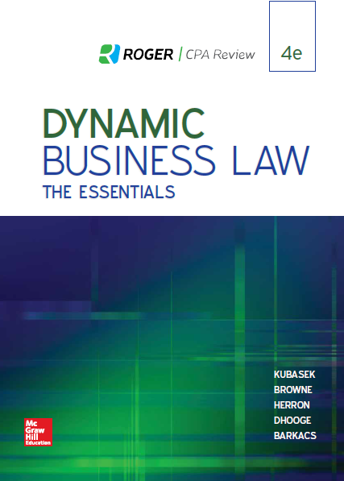
Chapter 2
Business Ethics and Social Responsibility
© 2019 McGraw-Hill Education. All rights reserved. Authorized only for instructor use in the classroom. No reproduction or further distribution permitted without the prior written consent of McGraw-Hill Education.
Notes:
Chapter 2: Business Ethics and Social Responsibility

Slide 2
Chapter 2 Ethical Dilemma
What is the best source for ethical business practices: The individual employee, or the business organization itself? To what extent should individual employees be allowed to lend input in the creation of a code of ethics for a business organization? In the event that an individual employee’s ethical standards differ from his/her employer’s code of ethics, what can/should be done to resolve those differences?
Notes:
Chapter 2 Ethical Dilemma: What is the best source for ethical business practices: The individual employee, or the business organization itself? To what extent should individual employees be allowed to lend input in the creation of a code of ethics for a business organization? In the event that an individual employee’s ethical standards differ from his/her employer’s code of ethics, what can/should be done to resolve those differences?

Slide 3
Business Ethics and Social Responsibility
Ethics: The study and practice of decisions about what is good or right.
Business Ethics: The application of ethics to the problems and opportunities experienced by businesspeople.
Ethical Dilemma: A problem about what a firm should do for which no clear, right decision is available.
Social Responsibility of Business: Expectations that the community imposes on firms doing business inside its borders.
Notes:
In addressing the topics of business ethics and social responsibility, several key topics are important to comprehend. First, “ethics” is the study and practice of decisions about what is good or right. Second, “business ethics” is the application of ethics to the problems and opportunities experienced by businesspeople. Third, an “ethical dilemma” is a problem regarding what a firm should do in situations where no clear, just decision is available. Finally, the “social responsibility” of business represents expectations that the community imposes on firms doing business within its borders.

Slide 4
The “WH” Process of Ethical Decision-Making
Who are the stakeholders?
How should the decision be made?
Notes:
The “WH” process of ethical decision-making first involves a determination of “who” is affected by the decision-making process. These individuals are known as “stakeholders,” and include consumers, owners or investors, management, employees, the community-at-large, and future generations.

Slide 5
Who? Stakeholders
Customers.
Owners or investors.
Management.
Employees.
Community.
Future generations.
A manager needs to identify the stakeholders.

Slide 6
How? Guidelines
Public disclosure.
Universalization.
Golden Rule.
A manager needs a doable set of guidelines on how to make an ethical decision.

Slide 7
Primary Values and Business Ethics
Freedom.
Security.
Justice.
Efficiency.
Notes:
The “WH” process of ethical decision-making involves a determination of the “values” involved in the decision-making process. These values include freedom, security, justice, and efficiency.

Slide 8
Primary Values and Business Ethics: Freedom
To act without restriction from rules imposed by others.
To possess the capacity or resources to act as one wishes.
To escape the cares and demands of this world entirely.
Notes:
The primary values of freedom include the right to act without restriction from rules imposed by others, the right to possess the capacity or resources to act as one wishes, and the right to escape the “cares and demands of this world” entirely.

Slide 9
Primary Values and Business Ethics: Security
To possess a large enough supply of goods and services to meet basic needs.
To be safe from those wishing to interfere with your property rights.
To achieve the psychological condition of self-confidence such that risks are welcome.
Notes:
The primary values of security include the right to possess a large enough supply of goods and services to meet basic needs, the right to be safe from those wishing to interfere with your property rights, and the right to achieve self-confidence such that risks are welcome.

Slide 10
Primary Values and Business Ethics: Justice
To receive the products of your labor.
To treat all humans identically, regardless of race, class, gender, age, and sexual preference.
To provide resources in proportion to need.
To possess anything that someone else is willing to grant you.
Notes:
The primary values of justice include the right to receive the products of your labor, the right to treat all humans identically (regardless of race, class, gender, age, and sexual preference,) the right to provide resources in proportion to need, and the right to possess anything that someone else is willing to grant you.

Slide 11
Primary Values and Business Ethics: Efficiency
To maximize the amount of wealth in society.
To get the most from a particular output.
To minimize costs.
Notes:
The primary values of efficiency include the right to maximize the amount of wealth in society, the right to get the most from a particular output, and the right to minimize costs.

Slide 12
Six Ways To Interpret “The Golden Rule”
Do to others as you want them to gratify you.
Be considerate of others’ feelings as you want them to be considerate of yours.
Treat others as persons of rational dignity like you.
Extend brotherly or sisterly love to others, as you would want them to do to you.
Treat others according to moral insight, as you would have others treat you.
Do to others as God wants you to do to them.
Notes:
There are several appropriate ways to interpret and apply “The Golden Rule.” These include “Do to others as you want them to gratify you,” “Be considerate of others’ feelings as you want them to be considerate of yours,” “Treat others as persons of rational dignity like you,” “Extend brotherly or sisterly love to others, as you would want them to do to you,” “Treat others according to moral insight, as you would have others treat you,” and “Do to others as God wants you to do to them.”

Slide 13
Question for Discussion
Do a firm’s ethical responsibilities extend beyond maximization of profits?

