Slide 1
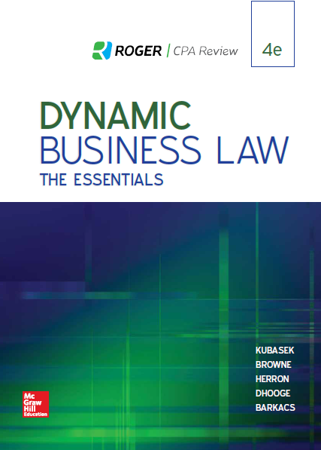
Chapter 10
Consideration
© 2019 McGraw-Hill Education. All rights reserved. Authorized only for instructor use in the classroom. No reproduction or further distribution permitted without the prior written consent of McGraw-Hill Education.
Notes:
Chapter 10: Consideration

Slide 2
Consideration
Definition: What a person will receive in return for performing a contract obligation.
Notes:
Consideration is what a person will receive in return for performing a contract obligation. Consideration can be anything, as long as it is the product of a bargained-for exchange. In a business context, it is often (but not always) money.

Slide 3
Examples of Consideration
Benefit to promisor.
Detriment to promise.
Promise to do something.
Promise to refrain from doing something.
Notes:
Examples of consideration include a benefit to the promisor, a detriment to the promisee, a promise to do something, or a promise to refrain from doing something.

Slide 4
Type of Consideration Based on Type of Contract
Bilateral Contract: Exchange of promises.
Unilateral Contract: Promise in exchange for an act.
Notes:
A bilateral contract is based on an exchange of promises. In a bilateral contract, the consideration for each promise is a return promise. A unilateral contract is based on a promised exchanged for the performance of an act. In a unilateral contract, one party’s consideration is the promise and the other party’s consideration is the act.

Slide 5
Rules of Consideration 1
For a promise to be enforced legally, there must be consideration,
Exception—Promissory Estoppel:
One party makes promise knowing other party will rely on it.
Other party relies on promise (“actual reliance”).
Justice dictates enforcement of promise, even though it is not supported by consideration.
Court rarely considers adequacy of consideration.
Notes:
There are several important rules concerning the contractual requirement of consideration. First, as a general rule, there must be consideration given for a promise in order to legally enforce the promise. An exception is promissory estoppel, which occurs when one party makes a promise knowing the other party will rely on it, and the other party in fact relies on the promise to his or her detriment. In a promissory estoppel situation, justice dictates enforcement of the promise, even though the promise is not supported by consideration. Second, courts rarely consider the adequacy of consideration; in other words, so long as the parties have given mutual consideration, a court will not weigh the relative value of the consideration given to determine whether they are equal in value.

Slide 6
Rules of Consideration 2
Illusory promise does not constitute consideration.
Past consideration does not constitute consideration for purposes of present contract.
Promise to do something you are already legally obligated to do is not valid consideration (“Pre-existing duty rule”).
Notes:
An illusory promise does not constitute consideration, and past consideration does not constitute consideration for the purposes of a present contract. Finally, according to the “pre-existing duty” rule, a promise to do something you are already legally obligated to do is not valid consideration.

Slide 7
Promissory Estoppel
A substitute for consideration.
An otherwise unenforceable agreement may become enforceable due to one party’s detrimental reliance on the promise of the other party.
Occurs when one party makes a promise knowing the other party may rely on it so that the only way to avoid injustice is to enforce the promise.

Slide 8
Adequacy of Consideration
In general, courts do not look at whether consideration is adequate or fair.
A bad bargain will be enforced, absent fraud or some other defense.

Slide 9
Illusory Promise
A situation in which a party appears to commit to something, but really has not committed to anything. Because it is not really a “promise,” it is not legally binding and is not consideration to support a contract.

Slide 10
Partial Payment of Debt
Liquidated Debt: No dispute as to amount of money owed.
Unliquidated Debt: Parties either (in good faith) dispute fact money owed, or dispute amount of money owed.
Notes:
Several terms apply to a partial payment of debt situation. A “liquidated” debt exists when there is no dispute as to the amount of money owed. In an “unliquidated” debt scenario, the parties either (in good faith) dispute the fact that money is owed, or dispute the amount of money owed.

Slide 11
Accord and Satisfaction
An accord and satisfaction is an agreement to set aside one contract and to substitute it with a new one.
The accord is the reaching of a substitute agreement.
The satisfaction is the performance of it.
An accord and satisfaction discharges the original contract.

Slide 12
Chapter 10 Consideration Discussion Questions
Should past consideration be acceptable consideration for a contract?
Why does the law say “past consideration is no consideration?”

