Slide 1

Completing the Accounting Cycle
Chapter 4
Wild, Shaw, and Chiappetta
Fundamental Accounting Principles
23rd Edition

Slide 2
Chapter 4 Learning Objectives
CONCEPTUAL
C1 Explain why temporary accounts are closed each period.
C2 Identify steps in the accounting cycle.
C3 Explain and prepare a classified balance sheet.
ANALYTICAL
A1 Compute the current ratio and describe what it reveals about a company’s financial condition.
PROCEDURAL
P1 Prepare a work sheet and explain its usefulness.
P2 Describe and prepare closing entries.
P3 Explain and prepare a post-closing trial balance.
P4 Appendix 4A – Prepare reversing entries and explain their purpose.

Slide 3
P1:
Prepare a work sheet and explain its usefulness.
Learning Objective

Slide 4
Benefits of a Work Sheet
Aids the preparation of financial statements.
Helps in preparing interim financial statements.
Not a required report.
Reduces risk of errors.
Shows the effects of proposed transactions.
Links accounts and their adjustments.
Learning Objective P1: Prepare a work sheet and explain its usefulness.
Notes:
A work sheet is a document that is used internally by companies to help with adjusting and closing accounts and with preparing financial statements. Specifically, a work sheet:
1. Aids the preparation of financial statements.
Reduces the risk of errors when working with many accounts and adjustments.
Links accounts and adjustments to their impacts in financial statements.
Helps in preparing interim (monthly and quarterly) financial statements when the journalizing and posting of adjusting entries are postponed until year-end.
Shows the effects of proposed or “what-if” transactions.

Slide 5
Use of a Work Sheet
Five important steps:
Step 1: Enter Unadjusted Trial Balance
Step 2: Enter Adjustments
Step 3: Prepare Adjusted Trial Balance
Step 4: Sort Adjusted Trial Balance Amounts
to Financial Statements
Step 5: Total Statement Columns, Compute
Income or Loss, and Balance Columns
Learning Objective P1: Prepare a work sheet and explain its usefulness.
Notes:
When a work sheet is used to prepare financial statements, it is constructed at the end of a period before the adjusting process. Preparing the work sheet has five important steps. Each step, 1 through 5, is color-coded and explained with reference to Exhibits 4.1 and 4.2.
Step 1: The first step in preparing a work sheet is to list the title of every account and its account number that appears on its financial statements. This includes all accounts in the ledger plus any new ones from adjusting entries. The unadjusted balance for each account is then entered in the appropriate Debit or Credit column of the unadjusted trial balance columns. The totals of these two columns must be equal.
Step 2: The second step is to enter adjustments in the Adjustments columns.
Step 3: The adjusted trial balance is prepared by combining the adjustments with the unadjusted balances for each account.
Step 4: This step involves sorting account balances from the adjusted trial balance to their proper financial statement columns. Expenses go to the Income Statement Debit column and revenues to the Income Statement Credit column. Assets and withdrawals go to the Balance Sheet & Statement of Owner’s Equity Debit column. Liabilities and owner’s capital go to the Balance Sheet & Statement of Owner’s Equity Credit column.
Step 5: Each financial statement column (from step 4) is totaled. The difference between the Debit and Credit column totals of the Income Statement columns is net income or net loss. This occurs because revenues are entered in the Credit column and expenses in the Debit column. If the Credit total exceeds the Debit total, there is net income. If the Debit total exceeds the Credit total, there is a net loss.

Slide 6
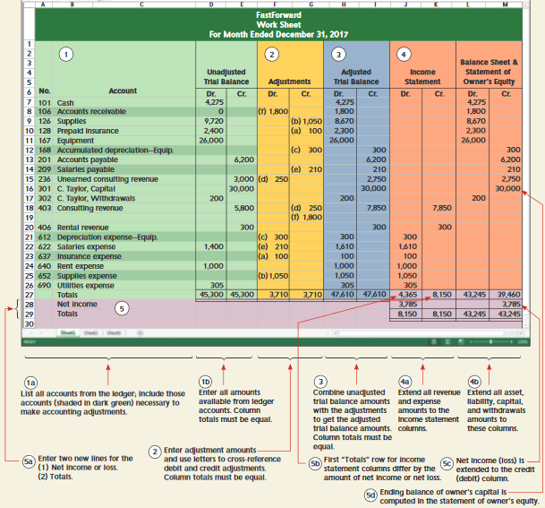
Use of a Work Sheet
Exhibit 4.1
Learning Objective P1: Prepare a work sheet and explain its usefulness.
Notes:
A worksheet organizes information used to prepare adjusting entries, financial statements, and closing entries.
Review what you have learned in the following NEED-TO-KNOW Slides.

Slide 7
NEED-TO-KNOW 4-1
The following 10-column work sheet contains the year-end unadjusted trial balance for Magic Company
as of December 31. Complete the work sheet by entering the necessary adjustments, computing the adjusted
account balances, extending the adjusted balances into the appropriate financial statement columns, and entering
the amount of net income for the period. Note: The Magic, Capital account balance was $75,000 at December 31, 2016.
Balance Sheet
Unadjusted
Adjusted
Income
and Statement of
Trial Balance
Adjustments
Trial Balance
Statement
Owner's Equity
No.
Dr.
Cr.
Dr.
Cr.
Dr.
Cr.
Dr.
Cr.
Dr.
Cr.
101
Cash
13,000
106
Accounts receivable
8,000
183
Land
85,000
201
Accounts payable
10,000
251
Long-term notes payable
33,000
301
Magic, Capital
75,000
302
Magic, Withdrawals
20,000
401
Fees earned
70,000
622
Salaries expense
54,000
650
Office supplies expense
8,000
Totals
188,000
188,000
1. Prepare and complete the work sheet, starting with the unadjusted trial balance and including adjustments
based on the following.
a. The company has earned $9,000 in fees that were not yet recorded at year-end.
b. The company incurred $2,000 in salary expense that was not yet recorded at year-end.
(Hint: For simplicity, assume it records any salary not yet paid as part of accounts payable.)
c. The long-term note payable was issued on December 31 this year. Thus, no interest has yet accrued
on this loan.
Learning Objective P1: Prepare a work sheet and explain its usefulness.
Notes:
The following 10-column work sheet contains the year-end unadjusted trial balance for Magic Company as of December 31, 2016. Complete the worksheet by entering the necessary adjustments, computing the adjusted account balances, extending the adjusted balances into the appropriate financial statement columns, and entering the amount of net income for the period. The Magic, Capital account balance was $75,000 at December 31, 2016. Because the balance in the capital account remains at $75,000 at the end of 2016, we know that Magic did not make any investments during the current year.

Slide 8
NEED-TO-KNOW 4-1 Solution Part 1
Balance Sheet
Unadjusted
Adjusted
Income
and Statement of
Trial Balance
Adjustments
Trial Balance
Statement
Owner's Equity
No.
Dr.
Cr.
Dr.
Cr.
Dr.
Cr.
Dr.
Cr.
Dr.
Cr.
101
Cash
13,000
13,000
13,000
106
Accounts receivable
8,000
(a) 9,000
17,000
17,000
183
Land
85,000
85,000
85,000
201
Accounts payable
10,000
(b) 2,000
12,000
12,000
251
Long-term notes payable
33,000
33,000
33,000
301
Magic, Capital
75,000
75,000
75,000
302
Magic, Withdrawals
20,000
20,000
20,000
401
Fees earned
70,000
(a) 9,000
79,000
79,000
622
Salaries expense
54,000
(b) 2,000
56,000
56,000
650
Office supplies expense
8,000
8,000
8,000
Totals
188,000
188,000
11,000
11,000
199,000
199,000
64,000
79,000
135,000
120,000
Net income
15,000
15,000
Totals
79,000
79,000
135,000
135,000
a. The company has earned $9,000 in fees that were not yet recorded at year-end.
b. The company incurred $2,000 in salary expense that was not yet recorded at year-end.
(Hint: For simplicity, assume it records any salary not yet paid as part of accounts payable.)
c. The long-term note payable was issued on December 31 this year. Thus, no interest has yet accrued
on this loan.
Learning Objective P1: Prepare a work sheet and explain its usefulness.
Notes:
1. The first step is to record the adjustments.
a) The company has earned $9,000 in fees that were not yet recorded at year-end. This is an accrued receivable. The adjustment is a debit to Accounts receivable and a credit to Fees earned.
b) $2,000 in salaries expense have not been recorded at year-end. For simplicity, assume it records any salaries not yet paid as part of accounts payable. This is an accrued payable. The adjustment is a debit to Salaries expense and a credit to Accounts payable.
c) The long-term note payable was issued on December 31. Thus, no interest has yet accrued on this loan. There is no required adjusting entry as no interest has accumulated. We have a total of $11,000 of debits and $11,000 of credits recorded as adjustments.
Next, we calculate the adjusted balances. The adjusted balance in the Cash account is a debit balance of $13,000. Accounts receivable, $8,000 of debits plus $9,000 of debits is an adjusted debit balance of $17,000. The Land balance was unadjusted. Accounts payable, a credit of $10,000, and a credit of $2,000, results in an ending credit balance of $12,000. The balance in Long-term notes payable, the capital account, and the withdrawal accounts were unchanged. Fees earned, a credit balance of $70,000 plus credits of $9,000 yields an adjusted credit balance of $79,000. Salaries expense, a debit balance of $54,000 and a debit of $2,000, is an adjusted debit balance of $56,000. Office supplies expense was unadjusted. The total of the adjusted debit balances is $199,000. The total of the adjusted credit balances is also $199,000.
Every account on the adjusted trial balance is an asset, a liability, or a subset of equity: capital, withdrawals, revenues, and expenses. Assets are reported on the balance sheet. We transfer the adjusted asset balances to the balance sheet column; Cash, Accounts receivable, and Land. Liabilities also appear on the balance sheet, so we transfer the adjusted balances in our liability accounts to the balance sheet columns. Magic's capital balance appears on the statement of owner's equity, as does the amount of Magic, Withdrawals. Fees earned is a revenue account. Revenues appear on the income statement; therefore, the balance appears in the income statement column. Expenses also appear on the income statement; we transfer the amount of the expenses to the income statement columns. We have total debits on the income statement, decreases to income, of $64,000. Total credits in the income statement column, increases to income, of $79,000.
When we subtract our expenses of $64,000 from our revenues of $79,000, net income is equal to the difference, $15,000. Total debits of $79,000 equal total credits. Total debits in the balance sheet and owner's equity column total $135,000. Total credits are $120,000. The difference of $15,000 represents net income which will be added on the statement of owner's equity. Total debits, $135,000, equal the total credits.

Slide 9
NEED-TO-KNOW 4-1 Solution Part 2
Balance Sheet
Unadjusted
Adjusted
Income
and Statement of
Trial Balance
Adjustments
Trial Balance
Statement
Owner's Equity
No.
Dr.
Cr.
Dr.
Cr.
Dr.
Cr.
Dr.
Cr.
Dr.
Cr.
101
Cash
13,000
13,000
13,000
106
Accounts receivable
8,000
(a) 9,000
17,000
17,000
183
Land
85,000
85,000
85,000
201
Accounts payable
10,000
(b) 2,000
12,000
12,000
251
Long-term notes payable
33,000
33,000
33,000
301
Magic, Capital
75,000
75,000
75,000
302
Magic, Withdrawals
20,000
20,000
20,000
401
Fees earned
70,000
(a) 9,000
79,000
79,000
622
Salaries expense
54,000
(b) 2,000
56,000
56,000
650
Office supplies expense
8,000
8,000
8,000
Totals
188,000
188,000
11,000
11,000
199,000
199,000
64,000
79,000
135,000
120,000
Net income
15,000
15,000
Totals
79,000
79,000
135,000
135,000
2. Use information from the completed work sheet in part 1 to prepare adjusting entries.
Date
General Journal
Debit
Credit
Dec. 31
Accounts Receivable
9,000
Fees earned
9,000
Dec. 31
Salaries expense
2,000
Accounts payable
2,000
Dec. 31
No journal entry required
Learning Objective P1: Prepare a work sheet and explain its usefulness.
Notes:
2. Use the information from the completed work sheet in part 1 to prepare the adjusting entries. Adjustment a) was a debit to Accounts Receivable and a credit to Fees earned. Adjustment b) is a debit to Salaries expense and a credit to Accounts payable. Note that there was no journal entry required for c).

Slide 10
NEED-TO-KNOW 4-1 Solution Part 3
3. Prepare the income statement and the statement of owner’s equity for the year ended December 31 and
the unclassified balance sheet at December 31.
Debit
Credit
Magic Company
Cash
$13,000
Income Statement
Accounts receivable
17,000
For Year Ended December 31, 2017
Land
85,000
Fees earned
$79,000
Accounts payable
$12,000
Expenses
Long-term notes payable
33,000
Salaries expense
$56,000
Magic, Capital
75,000
Office supplies expense
8,000
Magic, Withdrawals
20,000
64,000
Fees earned
79,000
Net income
$15,000
Salaries expense
56,000
Office supplies expense
8,000
Magic Company
Totals
$199,000
$199,000
Statement of Owner’s Equity
For Year Ended December 31, 2017
Magic, Capital, Dec. 31 2016
$75,000
Plus: Net income
15,000
Less: Magic, Withdrawals
(20,000)
Magic, Capital, Dec. 31 2017
$70,000
Magic Company
Balance Sheet
December 31, 2017
Assets
Liabilities
Cash
$13,000
Accounts payable
$12,000
Accounts receivable
17,000
Long-term notes payable
33,000
Land
85,000
Total liabilities
45,000
Equity
Magic, Capital
70,000
Total assets
$115,000
Total liabilities and equity
115,000
Learning Objective P1: Prepare a work sheet and explain its usefulness.
Notes:
3. Prepare the income statement and the statement of owner's equity for the year ended December 31 and the unclassified balance sheet at December 31. The adjusted trial balance is presented in financial statement order, beginning with the assets. Assets appear on the balance sheet: Cash, Accounts receivable, and Land. Total assets are $115,000. The next accounts are our liability accounts; Accounts payable and Long-term notes payable. Total liabilities are $45,000. The remaining accounts are subsets of equity. Magic's capital balance of $75,000 is the beginning capital balance on the statement of owner's equity. Magic, Withdrawals are subtracted on the statement of owner's equity. Fees earned is a revenue account; revenues are included on the income statement. And the final two accounts are expense accounts; expenses are subtracted on the income statement. Net income of $15,000 is transferred to the statement of owner's equity. The ending capital balance is $70,000. Ending capital is transferred to the balance sheet. Total liabilities of $45,000 plus ending capital of $70,000 equals total liabilities and equity of $115,000.

Slide 11
C1:
Explain why temporary accounts are closed each period.
Learning Objective

Slide 12
Closing Process
Resets revenue, expense, and withdrawal account balances to zero at the end of the period.
Helps summarize a period’s revenues and expenses in the Income Summary account.
Identify accounts
for closing.
Record and post
closing entries.
Prepare post-closing
trial balance.
Learning Objective C1: Explain why temporary accounts are closed each period.
Notes:
The closing process is an important step at the end of an accounting period after financial statements are completed. It prepares accounts for recording the transactions and the events of the next period. In the closing process we must (1) identify accounts for closing, (2) record and post the closing entries, and (3) prepare a post-closing trial balance. The purpose of the closing process is twofold. First, it resets revenue, expense, and withdrawals account balances to zero at the end of each period (which also updates the owner’s capital account for inclusion on the balance sheet). This is done so that these accounts can properly measure income and withdrawals for the next period. Second, it helps in summarizing a period’s revenues and expenses.

Slide 13
Temporary and
Permanent Accounts
Revenues
Assets
Temporary Accounts
Permanent Accounts
Owner’s Capital
Expenses
Withdrawals
Liabilities
Income Summary
The closing process applies only to temporary accounts.
Learning Objective C1: Explain why temporary accounts are closed each period.
Notes:
Temporary accounts accumulate data related to one accounting period. They include all income statement accounts, the owner withdrawals account, and the Income Summary account. They are temporary because the accounts are opened at the beginning of a period, used to record transactions and events for that period, and then closed at the end of the period. The closing process applies only to temporary accounts.
Permanent accounts report on activities related to one or more future accounting periods. They include asset, liability, and owner capital accounts (all balance sheet accounts). Permanent accounts are not closed each period and carry their ending balance into future periods.

Slide 14
P2:
Describe and prepare closing entries.
Learning Objective

Slide 15
Recording Closing Entries
Close Credit Balances in Revenue Accounts to Income Summary.
Close Debit Balances in Expense accounts to Income Summary.
Close Income Summary account to Owner’s Capital.
Close Withdrawals to Owner’s Capital.
Learning Objective P2: Describe and prepare closing entries.
Notes:
Here are the four steps we always follow in the closing process.
Step 1: Close Credit Balances in Revenue Accounts to Income Summary The first closing entry transfers credit balances in revenue (and gain) accounts to the Income Summary account. We bring accounts with credit balances to zero by debiting them.
Step 2: Close Debit Balances in Expense Accounts to Income Summary The second closing entry transfers debit balances in expense (and loss) accounts to the Income Summary account. We bring expense accounts’ debit balances to zero by crediting them. With a balance of zero, these accounts are ready to record expenses for the next period.
Step 3: Close Income Summary to Owner’s Capital After steps 1 and 2, the balance of Income Summary is equal to the periods net income. The third closing entry transfers the balance of the Income Summary account to the capital account. This entry closes the Income Summary account. The Income Summary account has a zero balance after posting this entry. It continues to have a zero balance until the closing process again occurs at the end of the next period. (If a net loss occurred because expenses exceeded revenues, the third entry is reversed: debit Owner, Capital and credit Income Summary.)
Step 4: Close Withdrawals Account to Owner’s Capital The fourth closing entry transfers any debit balance in the withdrawals account to the owner’s capital account. This entry gives the withdrawals account a zero balance, and the account is now ready to record next period’s withdrawals.
Let’s see how this process works. To prevent confusion, when you first try to make closing entries, it is an excellent idea to follow these four steps exactly.

Slide 16
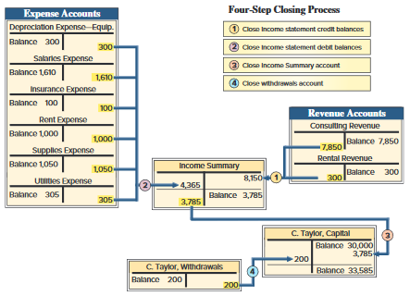
Recording Closing Entries
Exhibit 4.3
Learning Objective P2: Describe and prepare closing entries.
Notes:
Here are the four steps in the closing process for FastForward:
Step 1: Close Credit Balances in Revenue Accounts to Income Summary The first closing entry transfers credit balances in revenue (and gain) accounts to the Income Summary account. We bring accounts with credit balances to zero by debiting them. The $8,150 credit entry to Income Summary equals total revenues for the period.
Step 2: Close Debit Balances in Expense Accounts to Income Summary The second closing entry transfers debit balances in expense (and loss) accounts to the Income Summary account. We bring expense accounts’ debit balances to zero by crediting them. With a balance of zero, these accounts are ready to accumulate a record of expenses for the next period. Total expenses for FastForward are $4,365.
Step 3: Close Income Summary to Owner’s Capital After steps 1 and 2, the balance of Income Summary is equal to the periods net income, $3,785 ($8,150 credit less $4,365 debit) for FastForward. The third closing entry transfers the balance of the Income Summary account to the capital account. This entry closes the Income Summary account. The Income Summary account has a zero balance after posting this entry. It continues to have a zero balance until the closing process again occurs at the end of the next period. (If a net loss occurred because expenses exceeded revenues, the third entry is reversed: debit Owner, Capital and credit Income Summary.)
Step 4: Close Withdrawals Account to Owner’s Capital The fourth closing entry transfers any debit balance in the withdrawals account to the owner’s capital account. This entry gives the withdrawals account a zero balance, and the account is now ready to record next period’s withdrawals. C. Taylor, Capital is debited for $200. The balance in the C. Taylor, Capital account is now $33,585.

Slide 17
P3:
Explain and prepare a post-closing trial balance.
Learning Objective

Slide 18
Post-Closing Trial Balance
List of permanent accounts and their balances after posting closing entries.
Total debits and credits must be equal.
Learning Objective P3: Explain and prepare a post-closing trial balance.
Notes:
After all four of our closing entries have been made, we prepare a post-closing trial balance. A post-closing trial balance is a list of permanent accounts and their balances from the ledger after all closing entries have been journalized and posted. It lists the balances for all accounts not closed. These accounts comprise a company’s assets, liabilities, and equity, which are identical to those in the balance sheet. The aim of a post-closing trial balance is to verify that (1) total debits equal total credits for permanent accounts and (2) all temporary accounts have zero balances. The post-closing trial balance usually is the last step in the accounting process.

Slide 19
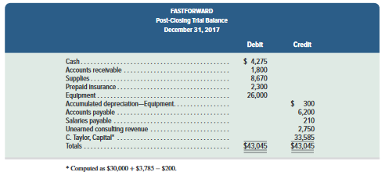
Post-Closing Trial Balance
Exhibit 4.6
Learning Objective P3: Explain and prepare a post-closing trial balance.
Notes:
FastForward’s post-closing trial balance is shown in this slide. The post-closing trial balance usually is the last step in the accounting process.

Slide 20
C2:
Identify steps in the accounting cycle.
Learning Objective

Slide 21
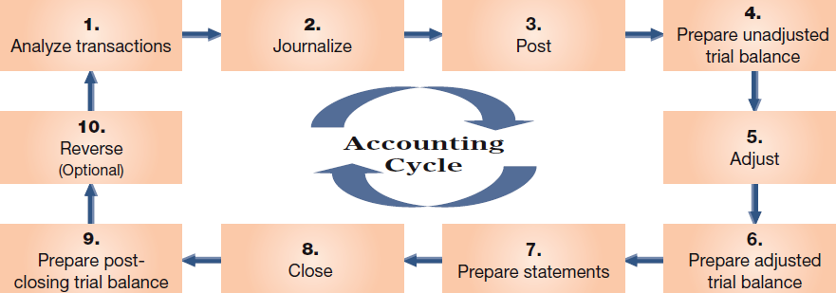
Accounting Cycle
Learning Objective C2: Identify steps in the accounting cycle.
Notes:
The term accounting cycle refers to the steps in preparing financial statements. It is called a cycle because the steps are repeated each reporting period. There are ten steps in the cycle which include:
1. Analyze transactions--Analyze transactions to prepare for journalizing.
2. Journalize--Record accounts, including debits and credits, in a journal.
3. Post--Transfer debits and credits from the journal to the ledger.
4. Prepare unadjusted trial balance--Summarize unadjusted ledger accounts and amounts.
5. Adjust--Record adjustments to bring account balances up to date; journalize and post adjustments.
6. Prepare adjusted trial balance--Summarize adjusted ledger accounts and amounts.
7. Prepare statements--Use adjusted trial balance to prepare financial statements.
8. Close--Journalize and post entries to close temporary accounts.
9. Prepare post-closing trial balance--Test clerical accuracy of the closing procedures.
10. Reverse (optional)--Reverse certain adjustments in the next period—optional step.
Notice that we prepare the financial statements before we complete the closing process.
Review what you have learned in the following NEED-TO-KNOW Slides.

Slide 22
NEED-TO-KNOW 4-2
Use the adjusted trial balance of Magic Company to prepare its closing entries.
Magic Company
Trial Balance
December 31, 2017
Debit
Credit
Cash
$13,000
Accounts receivable
17,000
Land
85,000
Accounts payable
$12,000
Long-term notes payable
33,000
Magic, Capital
75,000
Magic, Withdrawals
20,000
Fees earned
79,000
Salaries expense
56,000
Office supplies expense
8,000
Totals
$199,000
$199,000
Learning Objective P2: Describe and prepare closing entries.
Notes:
Use the adjusted trial balance of Magic Company to prepare its closing entries. Every account on the trial balance is an asset, a liability, or a subset of equity.

Slide 23
NEED-TO-KNOW 4-2 SOLUTION
Debit
Credit
Income summary
Cash
$13,000
Expenses
64,000
Revenues
79,000
Accounts receivable
17,000
Net income
15,000
Land
85,000
Closing
15,000
Accounts payable
$12,000
0
Long-term notes payable
33,000
Magic, Capital
75,000
Magic, Capital
Magic, Withdrawals
20,000
12/31/2016
75,000
Fees Earned
79,000
Magic, Withdrawals
20,000
Net income
15,000
Salaries expense
56,000
12/31/2017
70,000
Office supplies expense
8,000
Totals
$199,000
$199,000
Date
General Journal
Debit
Credit
Dec. 31
Fees Earned
79,000
Income summary
79,000
Dec. 31
Income summary
64,000
Salaries expense
56,000
Office supplies expense
8,000
Dec. 31
Income summary
15,000
Magic, Capital
15,000
Dec. 31
Magic, Capital
20,000
Magic, Withdrawals
20,000
Learning Objective P2: Describe and prepare closing entries.
Notes:
Permanent accounts are balance sheet accounts. The company has total assets of $115,000, total liabilities of $45,000, and the remaining accounts are equity accounts. We know that total liabilities and equity must equal total assets, $115,000. Total equity is $70,000; $115,000 minus the $45,000 in total liabilities. So the end-of-year balance in Magic, Capital, must equal $70,000. The income statement reports revenues, $79,000, minus expenses of $64,000; net income is $15,000. Net income is transferred to the statement of owner's equity, where it's added to the beginning capital balance of $75,000. Withdrawals are subtracted on the statement of owner's equity. The ending capital balance is $70,000. The closing process is the mechanical process of transferring the dollars from the temporary equity accounts to the permanent equity account, Magic, Capital. The closing process parallels the flow of dollars shown on the financial statements.
The first closing entry closes the revenue accounts to a new temporary equity account, called Income summary. Fees earned has a credit balance of $79,000. To close this balance we debit Fees earned, $79,000, and credit Income summary. The second closing entry closes the expense accounts, crediting Salaries expense and Office supplies expense and debiting Income summary for the total, $64,000. The balance in Income summary is now equal to the net income amount. The next step in the closing process is to close Income summary to Magic, Capital, debiting Income summary and crediting Magic, Capital. The final step in the closing process is to close the Withdrawals account, crediting the Withdrawals account for $20,000, and debiting Magic, Capital. Notice that the Withdrawals account is not closed to Income summary, because Withdrawals is not part of the calculation of net income. The balance in Magic, Capital at the end of the period is now $70,000.

Slide 24
C3:
Explain and prepare a classified balance sheet.
Learning Objective

Slide 25
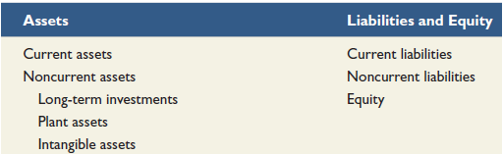
Classified Balance Sheet
Current items are expected to come due (collected and owed) within the longer of one year or the company’s normal operating cycle.
Most operating cycles are less than one year, so most companies use a one year period in deciding what assets and liabilities are current.
Learning Objective C3: Explain and prepare a classified balance sheet.
Notes:
A classified balance sheet organizes assets and liabilities into subgroups that provide more information to decision makers.
A classified balance sheet is the most popular format used by business. On the asset side of the balance sheet, we group assets as current or noncurrent. A current asset is one that is expected to be converted into cash in one year or the company’s normal operating cycle, whichever is longer.
The operating cycle of a company is the time it takes to acquire inventory, sell the inventory, and collect cash. Most operating cycles are less than one year which means that most companies use a one year period in deciding what assets and liabilities are current. These companies would classify an asset as current as long as that asset is expected to be converted into cash within one year.
On the liabilities plus equity side of the balance sheet, we divide liabilities between current and noncurrent. A current liability is one we expect to be paid out of the company’s current assets within the longer of one year or the normal operating cycle.
Let’s see how new classifications appear on the balance sheet.

Slide 26
Current Assets
Current assets are expected to be sold, collected, or used within one year or the company’s operating cycle.
Learning Objective C3: Explain and prepare a classified balance sheet.
Notes:
Current assets are cash and other resources that are expected to expected to come due (collected) within one year or the company’s operating cycle, whichever is longer. Examples are cash, short-term investments, accounts receivable, short-term notes receivable, goods for sale (called merchandise or inventory), and prepaid expenses. The prepaid expenses likely include items such as prepaid insurance, prepaid rent, office supplies, and store supplies. Prepaid expenses are usually listed last because they will not be converted to cash (instead, they are used).

Slide 27
Long-Term Investments
Long-term investments are expected to be held for more than one year or the operating cycle.
Learning Objective C3: Explain and prepare a classified balance sheet.
Notes:
A second major balance sheet classification is long-term (or noncurrent) investments. Notes receivable and investments in stocks and bonds are long-term assets when they are expected to be held for more than the longer of one year or the operating cycle. Land held for future expansion is a long-term investment because it is not used in operations.

Slide 28
Plant Assets
Plant assets are tangible long-lived assets used to produce or sell products and services.
Learning Objective C3: Explain and prepare a classified balance sheet.
Notes:
Plant assets are tangible assets that are both long-lived and used to produce or sell products and services. Examples are equipment, machinery, buildings, and land that are used to produce or sell products and services. The order listing for plant assets is usually from most liquid to least liquid such as equipment and machinery to buildings and land.

Slide 29
Intangible Assets
Intangible assets are long-term resources used to produce or sell products and services and that lack physical form.
Learning Objective C3: Explain and prepare a classified balance sheet.
Notes:
Intangible assets are long-term resources that benefit business operations, usually lack physical form. Examples are patents, trademarks, copyrights, franchises, and goodwill. Their value comes from the privileges or rights granted to or held by the owner.

Slide 30
Current Liabilities
Current liabilities are obligations due within the longer of one year or the company’s operating cycle.
Learning Objective C3: Explain and prepare a classified balance sheet.
Notes:
Current liabilities are obligations due to be paid or settled within one year or the operating cycle, whichever is longer. They are usually settled by paying out cash. Current liabilities often include accounts payable, notes payable, wages payable, taxes payable, interest payable, and unearned revenues. Also, any portion of a long-term liability due to be paid within one year or the operating cycle, whichever is longer, is a current liability. Unearned revenues are current liabilities when they will be settled by delivering products or services within one year or the operating cycle, whichever is longer. Current liabilities are reported in the order of those to be settled first.

Slide 31
Long-Term Liabilities
Long-term liabilities are obligations not due within the longer of one year or the company’s operating cycle.
Learning Objective C3: Explain and prepare a classified balance sheet.
Notes:
Long-term liabilities are obligations not due within one year or the operating cycle, whichever is longer. Notes payable, mortgages payable, bonds payable, and lease obligations are common long-term liabilities. If a company has both short- and long-term items in each of these categories, they are commonly separated into two accounts in the ledger.

Slide 32
Equity
Equity is the owner’s claim on the assets.
Learning Objective C3: Explain and prepare a classified balance sheet.
Notes:
Equity is the owner’s claim on assets. For a proprietorship, this claim is reported in the equity section with an owner’s capital account. (For a partnership, the equity section reports a capital account for each partner. For a corporation, the equity section is divided into two main subsections, contributed capital and retained earnings.)
Review what you have learned in the following NEED-TO-KNOW Slides.

Slide 33
NEED-TO-KNOW 4-3
Use the adjusted trial balance of Magic Company to prepare its classified
balance sheet as of December 31, 2017.
Magic Company
Adjusted Trial Balance
December 31, 2017
Debit
Credit
Cash
$13,000
Accounts receivable
17,000
Land
85,000
Accounts payable
$12,000
Long-term notes payable
33,000
Magic, Capital
75,000
Magic, Withdrawals
20,000
Fees earned
79,000
Salaries expense
56,000
Office supplies expense
8,000
Totals
$199,000
$199,000
Learning Objective C3: Explain and prepare a classified balance sheet.
Notes:
Use the adjusted trial balance of Magic Company to prepare its classified balance sheet as of December 31, 2017.

Slide 34
NEED-TO-KNOW 4-3 SOLUTION
Use the adjusted trial balance of Magic Company to prepare its classified balance sheet as of
December 31, 2017.
Magic Company
Magic Company
Adjusted Trial Balance
Balance Sheet
December 31, 2017
December 31, 2017
Debit
Credit
Assets
Cash
$13,000
Current assets
Accounts receivable
17,000
Cash
$13,000
Land
85,000
Accounts receivable
17,000
Accounts payable
$12,000
Total current assets
30,000
Long-term notes payable
33,000
Plant assets
Magic, Capital
75,000
Land
85,000
Magic, Withdrawals
20,000
Total plant assets
85,000
Fees earned
79,000
Total assets
$115,000
Salaries expense
56,000
Liabilities
Office supplies expense
8,000
Current liabilities
Totals
$199,000
$199,000
Accounts payable
$12,000
Total current liabilities
12,000
Long-term liabilities
Long-term notes payable
33,000
Total liabilities
$45,000
Equity
Magic, Capital
70,000
Total liabilities and equity
$115,000
Learning Objective C3: Explain and prepare a classified balance sheet.
Notes:
A classified balance sheet includes subtotals for current assets versus plant assets and current liabilities versus long-term liabilities. Current assets are assets that are either cash, will be converted to cash, or used, within the current year or the current operating cycle, whichever is longer. Plant assets are long-term assets that are used in the generation of net income. Current liabilities are due within one year or one operating cycle, whichever is longer, and long-term liabilities are due beyond the current year or operating cycle. Cash and Accounts receivable are both current assets. Land is a plant asset. Accounts payable is a current liability; it's due usually within 30 days. Long term notes payable is a long-term liability.
The $75,000 balance in Magic's Capital account is beginning capital; but it's not hard to calculate ending capital. Ending capital includes all of the income statement and statement of owner's equity activity. Magic, Capital at the end of the period equals the beginning capital balance, $75,000, plus the revenues, $79,000, minus expenses, $64,000 and withdrawals, $20,000. The ending balance in Magic's Capital account is $70,000. We calculate the subtotals for each of our categories: total current assets are $30,000; total plant assets, $85,000; total assets, $115,000. Total current liabilities are $12,000, Total liabilities are $45,000. Total equity is $70,000, and total liabilities and equity equals total assets, $115,000.

Slide 35
A1:
Compute the current ratio and describe what it reveals about a company’s financial condition.
Learning Objective

Slide 36

Current Ratio
Helps assess the company’s ability to pay its debts in the near future
 | Current ratio | = | Current assets Current liabilities
Exhibit 4.11
Limited Brands, Inc.
Learning Objective A1: Compute the current ratio and describe what it reveals about a company’s financial condition.
Notes:
An important use of financial statements is to help assess a company’s ability to pay its debts in the near future. Such analysis affects decisions by suppliers when allowing a company to buy on credit. It also affects decisions by creditors when lending money to a company, including loan terms such as interest rate, due date, and collateral requirements. It can also affect a manager’s decisions about using cash to pay debts when they come due. The current ratio is one measure of a company’s ability to pay its short-term obligations. It is defined above as current assets divided by current liabilities.
Limited Brands’ current ratio averaged 1.8 for its fiscal years 2010 through 2015. The current ratio for each of these years suggests that the company’s short-term obligations can be covered with its short-term assets. However, if its ratio would approach 1.0, Limited would expect to face challenges in covering liabilities. If the ratio were less than 1.0, current liabilities would exceed current assets, and the company’s ability to pay short-term obligations could be in doubt. Limited Brands’ liquidity, as evidenced by its current ratio, declined in 2011, 2012, and 2013, which roughly matches the industry decline.

Slide 37
P4:
Prepare reversing entries and explain their purpose.
Learning Objective

Slide 38
Appendix 4A – Reversing Entries
Reversing entries are optional. They are recorded in response to accrued assets and accrued liabilities that were created by adjusting entries at the end of a reporting period. The purpose of reversing entries is to simplify a company’s recordkeeping.
Let’s see how the accounting for our payroll accrual will be handled with and without reversing entries.
Learning Objective P4: Prepare reversing entries and explain their purpose.
Notes:
Reversing entries are optional. They are recorded in response to accrued assets and accrued liabilities that were created by adjusting entries at the end of a reporting period. The purpose of reversing entries is to simplify a company’s recordkeeping.
Let’s see how the accounting for our payroll accrual will be handled with and without reversing entries.

Slide 39
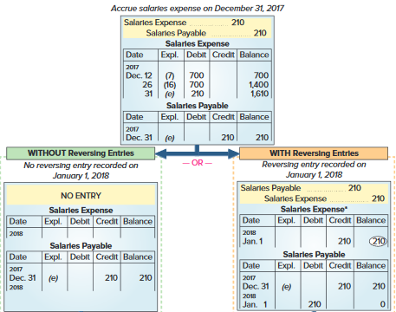
Reversing Entries
Exhibit 4A.1
Learning Objective P4: Prepare reversing entries and explain their purpose.
Notes:
The purpose of reversing entries is to simplify a company’s recordkeeping. This slide shows an example of FastForward’s reversing entries. The top of the exhibit shows the adjusting entry FastForward recorded on December 31 for its employee’s earned but unpaid salary. The entry recorded three days’ salary of $210, which increased December’s total salary expense to $1,610. The entry also recognized a liability of $210. The expense is reported on December’s income statement. The expense account is then closed. The ledger on January 1, 2018, shows a $210 liability and a zero balance in the Salaries Expense account. At this point, the choice is made between using or not using reversing entries.

Slide 40
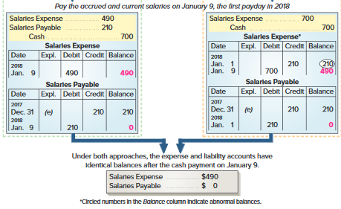
Reversing Entries
Exhibit 4A.1
Without Reversing Entries
With Reversing Entries
Learning Objective P4: Prepare reversing entries and explain their purpose.
Notes:
Accounting without Reversing Entries The path down the left side is described in the chapter. To summarize here, when the next payday occurs on January 9, we record payment with a compound entry that debits both the expense and liability accounts and credits Cash. Posting that entry creates a $490 balance in the expense account and reduces the liability account balance to zero because the debt has been settled. The disadvantage of this approach is the slightly more complex entry required on January 9. Paying the accrued liability means that this entry differs from the routine entries made on all other paydays. To construct the proper entry on January 9, we must recall the effect of the December 31 adjusting entry. Reversing entries overcome this disadvantage.
Accounting with Reversing Entries The right side shows how a reversing entry on January 1 overcomes the disadvantage of the January 9 entry when not using reversing entries. A reversing entry is the exact opposite of an adjusting entry. For FastForward, the Salaries Payable liability account is debited for $210, meaning that this account now has a zero balance after the entry is posted. The Salaries Payable account temporarily understates the liability, but this is not a problem since financial statements are not prepared before the liability is settled on January 9. The credit to the Salaries Expense account is unusual because it gives the account an abnormal credit balance. We highlight an abnormal balance by circling it. Because of the reversing entry, the January 9 entry to record payment is straightforward. This entry debits the Salaries Expense account and credits Cash for the full $700 paid. It is the same as all other entries made to record 10 days’ salary for the employee. Notice that after the payment entry is posted, the Salaries Expense account has a $490 balance that reflects seven days’ salary of $70 per day. The zero balance in the Salaries Payable account is now correct. The lower section shows that the expense and liability accounts have exactly the same balances whether reversing entries are used or not. This means that both approaches yield identical results.

Slide 41
End of Chapter 4

