Slide 1
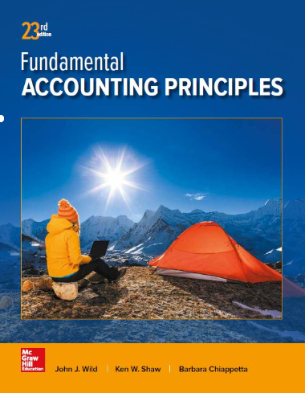
Plant Assets, Natural Resources, and Intangibles
Chapter 10
Wild, Shaw, and Chiappetta
Fundamental Accounting Principles
23rd Edition
Notes:
Chapter 10: Plant Assets, Natural Resources, and Intangibles

Slide 2
Chapter 10 Learning Objectives
CONCEPTUAL
C1 Explain the cost principle for computing the cost of plant assets.
C2 Explain depreciation for partial years and changes in estimates.
C3 Distinguish between revenue and capital expenditures, and account for them.
ANALYTICAL
A1 Compute total asset turnover and apply it to analyze a company’s use of assets.
PROCEDURAL
P1 Compute and record depreciation using the straight-line, units-of-production, and declining-balance methods.
P2 Account for asset disposal through discarding or selling an asset.
P3 Account for natural resource assets and their depletion.
P4 Account for intangible assets.
P5 Appendix 10A Account for asset exchanges.
2
2
2

Slide 3
C1:
Explain the cost principle for computing the cost of plant assets.
Learning Objective

Slide 4
Plant Assets
Tangible in Nature
Actively Used in Operations
Expected to Benefit Future Periods
Called Property, Plant, & Equipment
Learning Objective C1: Explain the cost principle for computing the cost of plant assets.
Notes:
Plant assets are tangible assets used in a company’s operations that have a useful life of more than one accounting period. Plant assets are also called plant and equipment; property, plant, and equipment (PP&E); or fixed assets. For many companies, plant assets make up the single largest class of assets they own.

Slide 5
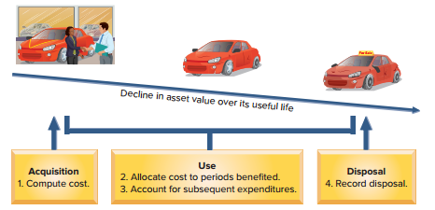
PLANT ASSETS
Exhibit 10.2
Learning Objective C1: Explain the cost principle for computing the cost of plant assets.
Notes:
The four main issues in accounting for plant assets: (1) computing the costs of plant assets, (2) allocating the costs of plant assets (less any salvage amounts) against revenues for the periods they benefit, (3) accounting for expenditures such as repairs and improvements to plant assets, and (4) recording the disposal of plant assets.

Slide 6
Cost Determination
All expenditures needed to prepare the asset for its intended use
Purchase
price
Acquisition
Cost
Acquisition cost includes all normal and reasonable expenditures necessary to get the asset in place and ready for intended use
Learning Objective C1: Explain the cost principle for computing the cost of plant assets.
Notes:
Plant assets are recorded at cost when acquired. This is consistent with the cost principle. Cost includes all normal and reasonable expenditures necessary to get the asset in place and ready for its intended use. The cost of a factory machine, for instance, includes its invoice cost less any discount, plus any necessary freight, unpacking, assembling, installing, and testing costs. Examples are the costs of building a base for a machine, providing electrical hookups, and testing the asset before using it in operations.

Slide 7
Machinery and Equipment
Purchase
price
Taxes
Machinery and Equipment
Transportation
charges
Installing,
assembling, and
testing
Insurance while
in transit
Learning Objective C1: Explain the cost principle for computing the cost of plant assets.
Notes:
The costs of machinery and equipment consist of all costs normal and necessary to purchase them and prepare them for their intended use. These include the purchase price, taxes, transportation charges, insurance while in transit, and the installing, assembling, and testing of the machinery and equipment.

Slide 8
Buildings
Cost of purchase or construction
Title fees
Buildings
Brokerage
fees
Attorney fees
Taxes
Learning Objective C1: Explain the cost principle for computing the cost of plant assets.
Notes:
A Building account is charged for the costs of purchasing or constructing a building that is used in operations. When purchased, a building’s costs usually include its purchase price, brokerage fees, taxes, title fees, and attorney fees. Its costs also include all expenditures to ready it for its intended use, including any necessary repairs or renovations such as wiring, lighting, flooring, and wall coverings.
When a company constructs a building or any plant asset for its own use, its costs include materials and labor plus a reasonable amount of indirect overhead cost. Overhead includes the costs of items such as heat, lighting, power, and depreciation on machinery used to construct the asset. Costs of construction also include design fees, building permits, and insurance during construction.

Slide 9
Land Improvements
Parking lots, driveways, fences, walks, shrubs, and lighting systems.
Depreciate
over useful life of improvements.
Learning Objective C1: Explain the cost principle for computing the cost of plant assets.
Notes:
Land improvements are additions to land and have limited useful lives. Examples are parking lot surfaces, driveways, walkways, fences, landscaping, and sprinkling and lighting systems. Costs of land improvements include expenditures necessary to make those improvements ready for their intended use. While the costs of these improvements increase the usefulness of the land, they are charged to a separate Land Improvement account so that their costs can be allocated to the periods they benefit.

Slide 10
Land
Title insurance premiums
Purchase
price
Property
taxes
Land
Real estate
commissions
Surveying
fees
Title search and transfer fees
Land is not depreciable.
Learning Objective C1: Explain the cost principle for computing the cost of plant assets.
Notes:
Land is the earth’s surface and has an indefinite (unlimited) life. Costs of land include expenditures necessary to make that property ready for its intended use. When land is purchased for a building site, its cost includes the total amount paid for the land, including any real estate commissions, title insurance fees, legal fees, and any accrued property taxes paid by the purchaser. Payments for surveying, clearing, grading, and draining also are included in the cost of land. Other costs include government assessments, whether incurred at the time of purchase or later, for items such as public roadways, sewers, and sidewalks. These assessments are included because they permanently add to the land’s value. Land purchased as a building site sometimes includes structures that must be removed. In such cases, the total purchase price is charged to the Land account as is the cost of removing the structures, less any amounts recovered through sale of salvaged materials.

Slide 11
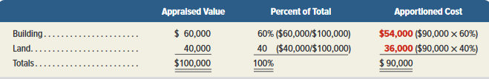
Lump-Sum Purchase
Exhibit 10.4
The total cost of a combined purchase of land and building is allocated based of their relative fair market values.
CarMax paid $90,000 cash to acquire a group of items consisting of land appraised at $30,000, land improvements appraised at $10,000, and a building appraised at $60,000. The $90,000 cost will be allocated on the basis of appraised values as shown:
Learning Objective C1: Explain the cost principle for computing the cost of plant assets.
Notes:
Plant assets sometimes are purchased as a group in a single transaction for a lump-sum price. This transaction is called a lump-sum purchase, or group, bulk, or basket purchase. When this occurs, we allocate the cost of the purchase among the different types of assets acquired based on their relative market values, which can be estimated by appraisal or by using the tax-assessed valuations of the assets. To illustrate, assume CarMax paid $90,000 cash to acquire a group of items consisting of a building appraised at $60,000 and land appraised at $40,000. The $90,000 cost is allocated based on appraised values as shown in this slide.
Review what you have learned in the following NEED-TO-KNOW Slide.

Slide 12
NEED-TO-KNOW 10-1
Compute the amount recorded as the cost of a new machine given the following payments
related to its purchase: gross purchase price, $700,000; sales tax, $49,000; purchase
discount taken, $21,000; freight cost—terms FOB shipping point, $3,500; normal
assembly costs, $3,000; cost of necessary machine platform, $2,500; cost of parts used
in maintaining machine, $4,200.
Measurement Principle
(Cost Principle) requires that assets be valued at all necessary
costs to get the asset ready for its intended purpose.
Gross purchase price
$700,000
Sales tax
49,000
Purchase discount taken
(21,000)
Freight cost (FOB shipping point)
3,500
Normal assembly costs
3,000
Necessary machine platform
2,500
Costs of parts used in maintaining machine
0
Cost of new machine
$737,000
Learning Objective P1: Compute and record depreciation using the straight-line, units-of-production, and declining-balance methods.
Notes:
Compute the amount recorded as the cost of a new machine given the following payments related to its purchase: gross purchase price, $700,000; sales tax, $49,000; purchase discount taken, $21,000; freight cost - terms FOB shipping point, $3,500; normal assembly costs, $3,000; cost of necessary machine platform, $2,500; cost of parts used in maintaining machine, $4,200.
The Measurement Principle (Cost Principle) requires that assets be valued at all necessary costs to get the asset ready for its intended purpose. The purchase price of $700,000 is obviously a necessary cost. We can't buy the machine without paying the sales tax; we add the sales tax into the cost of the machine. The purchase discount taken reduces the cost of the machine. It's not necessary to spend all $700,000 if a sales discount is offered; we subtract the purchase discount taken. The freight cost is a necessary cost because it was shipped to us FOB shipping point. The machine became ours as soon as it was shipped. Normal assembly costs are unavoidable. This machine required a special platform; we add the $2,500 to the cost of the machine. The costs of parts used in maintaining the machine, while necessary, are not required to get the asset ready for its intended purpose. As soon as the company starts to use the machine, the capitalization process ends. The maintenance costs will be expensed as incurred, and are not included in the cost of the machine. The total cost of the new machine is $737,000.

Slide 13
P1:
Compute and record depreciation using the straight-line, units-of-production, and declining-balance methods.
Learning Objective

Slide 14
Depreciation
Depreciation is the process of allocating the cost of a plant asset to expense in the accounting periods benefiting from its use.
Balance Sheet
Income Statement
Cost
Acquisition
Cost
Expense
Allocation
(Unused)
(Used)
Learning Objective P1: Compute and record depreciation using the straight-line, units-of-production, and declining-balance methods.
Notes:
Depreciation is the process of allocating the cost of a plant asset to expense in the accounting periods benefiting from its use. Depreciation does not measure the decline in the asset’s market value each period, nor does it measure the asset’s physical deterioration. Because depreciation reflects the cost of using a plant asset, depreciation charges are only recorded when the asset is actually in service.

Slide 15
Factors in Computing Depreciation
The calculation of depreciation requires three amounts for each asset:
1. Cost
2. Salvage Value
3. Useful Life
Learning Objective P1: Compute and record depreciation using the straight-line, units-of-production, and declining-balance methods.
Notes:
Factors that determine depreciation are (1) cost, (2) salvage value, and (3) useful life.
Cost - The cost of a plant asset consists of all necessary and reasonable expenditures to acquire it and to prepare it for its intended use.
Salvage Value - also called residual value or scrap value, is an estimate of the asset’s value at the end of its benefit period. This is the amount the owner expects to receive from disposing of the asset at the end of its benefit period. If the asset is expected to be traded in on a new asset, its salvage value is the expected trade-in value.
Useful Life - The useful life of a plant asset is the length of time it is productively used in a company’s operations. Useful life, also called service life, might not be as long as the asset’s total productive life. For example, the productive life of a computer can be eight years or more. Some companies, however, trade in old computers for new ones every two years. In this case, these computers have a two-year useful life, meaning the cost of these computers (less their expected trade-in values) is charged to depreciation expense over a two-year period.

Slide 16
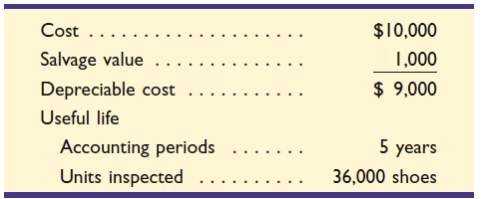
Depreciation Methods
Straight-line
Units-of-production
Declining-balance
Asset we will depreciate in future screens
Learning Objective P1: Compute and record depreciation using the straight-line, units-of-production, and declining-balance methods.
Notes:
Depreciation methods are used to allocate a plant asset’s cost over the accounting periods in its useful life. The most frequently used method of depreciation is the straight-line method. Another common depreciation method is the units-of-production method. We explain both of these methods in this section. This section also describes accelerated depreciation methods, with a focus on the declining-balance method.
The computations in this section use information about a machine that inspects athletic shoes before packaging. Manufacturers such as Converse, Reebok, Adidas, and Fila use this machine. Data for this machine are presented in this slide.
We will use this to illustrate depreciation using the three methods listed. Let’s begin by looking at straight-line depreciation.

Slide 17
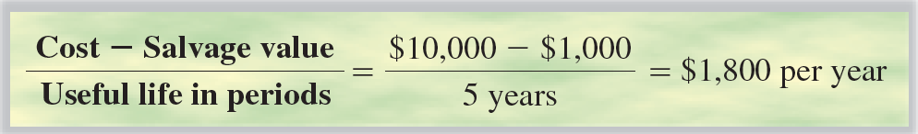
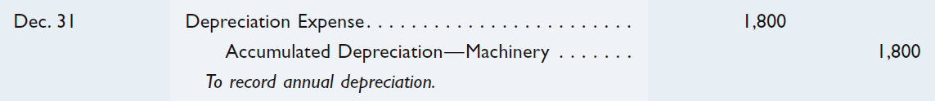
Straight-Line Method
Learning Objective P1: Compute and record depreciation using the straight-line, units-of-production, and declining-balance methods.
Notes:
Straight-line depreciation charges the same amount of expense to each period of the asset’s useful life. A two-step process is used. We first compute the depreciable cost of the asset, also called the cost to be depreciated. It is computed by subtracting the asset’s salvage value from its total cost. Second, depreciable cost is divided by the number of accounting periods in the asset’s useful life.
If this machine is purchased on December 31, 2016, and used throughout its predicted useful life of five years, the straight-line method allocates an equal amount of depreciation to each of the years 2017 through 2021. We make the adjusting entry shown above at the end of each of the five years to record straight-line depreciation of this machine.
The $1,800 Depreciation Expense is reported on the income statement among operating expenses. The $1,800 Accumulated Depreciation is a contra asset account to the Machinery account in the balance sheet.

Slide 18
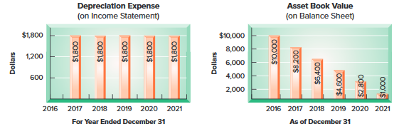
Straight-Line Method
Exhibit 10.7
Balance Sheet Presentation
Machinery | $ 10,000
Less: accumulated depreciation | 3,600 |  | $ 6,400
Learning Objective P1: Compute and record depreciation using the straight-line, units-of-production, and declining-balance methods.
Notes:
The graph on the left in this slide shows the $1,800 per year expenses reported in each of the five years. The graph on the right shows the amounts reported on each of the six December 31 balance sheets.
The net balance sheet amount is the asset book value, or simply book value, and is computed as the asset’s total cost less its accumulated depreciation. For example, at the end of year 2 (December 31, 2018), its book value is $6,400 and is reported in the balance sheet as shown.

Slide 19
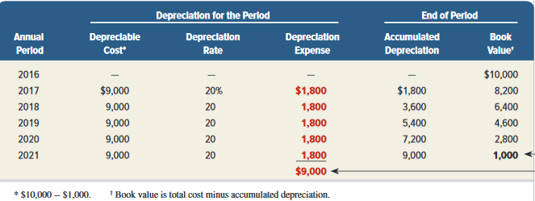
Straight-Line Depreciation Schedule
Exhibit 10.8
Learning Objective P1: Compute and record depreciation using the straight-line, units-of-production, and declining-balance methods.
Notes:
Note three points in this exhibit. First, depreciation expense is the same each period. Second, accumulated depreciation is the sum of current and prior periods’ depreciation expense. Third, book value declines each period until it equals salvage value at the end of the machine’s useful life.

Slide 20
Units-of-Production Method
Step 1:
Depreciation
Per Unit
Cost - Salvage Value
Total Units of Production
=
Step 2:
Number of Units Produced
in the Period
Depreciation
Expense
Depreciation
Per Unit
×
=
Learning Objective P1: Compute and record depreciation using the straight-line, units-of-production, and declining-balance methods.
Notes:
When equipment use varies from period to period, the units-of-production depreciation method can better match expenses with revenues. Units-of-production depreciation charges a varying amount to expense for each period of an asset’s useful life depending on its usage.
A two-step process is used to compute units-of-production depreciation. We first compute depreciation per unit by subtracting the asset’s salvage value from its total cost and then dividing by the total number of units expected to be produced during its useful life. Units of production can be expressed in product or other units such as hours used or miles driven. The second step is to compute depreciation expense for the period by multiplying the units produced in the period by the depreciation per unit.

Slide 21

Units-of-Production Method
Assume that 7,000 units were inspected during the first year. Depreciation would be calculated as follows:
Step 1:
Depreciation
Per Unit
Cost - Salvage Value
Total Units of Production
$9,000
36,000
= $0.25/unit
=
=
Step 2:
Depreciation
Expense
Depreciation
Per Unit
Number of Units Produced
in the Period
=
×
= $0.25 × 7,000 = $1,750
Learning Objective P1: Compute and record depreciation using the straight-line, units-of-production, and declining-balance methods.
Notes:
Using data on the number of shoes inspected by the machine, we can compute the units-of- production depreciation schedule shown in this slide. For example, depreciation for the first year is $1,750 (7,000 shoes at $0.25 per shoe).

Slide 22
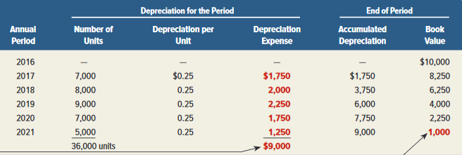
Units-of-Production
Depreciation Schedule
Exhibit 10.10
Units produced and sold during the period.
Learning Objective P1: Compute and record depreciation using the straight-line, units-of-production, and declining-balance methods.
Notes:
Depreciation for the second year is $2,000 (8,000 shoes at $0.25 per shoe). Other years are similarly computed. This graphic shows that depreciation expense depends on unit output, (2) accumulated depreciation is the sum of current and prior periods’ depreciation expense, and (3) book value declines each period until it equals salvage value at the end of the asset’s useful life.

Slide 23
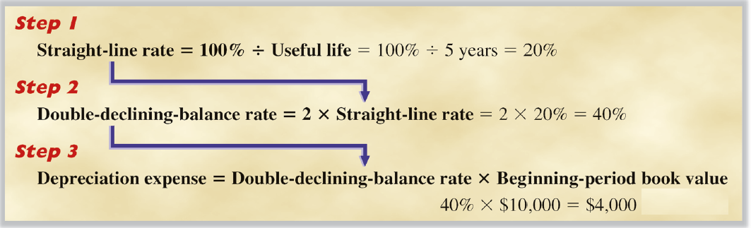
Double-Declining-Balance Method
Learning Objective P1: Compute and record depreciation using the straight-line, units-of-production, and declining-balance methods.
Notes:
An accelerated depreciation method yields larger depreciation expenses in the early years of an asset’s life and less depreciation in later years. The most common accelerated method is the declining-balance method of depreciation, which uses a depreciation rate that is a multiple of the straight-line rate and applies it to the asset’s beginning- of-period book value. The amount of depreciation declines each period because book value declines each period.
To illustrate, let’s apply the double- declining-balance method to compute depreciation expense for our $10,000 machine with a 5-year useful life. This slide shows the first-year depreciation computation for the machine. The three-step process is to (1) divide 100% by five years to determine the straight-line rate of 20%, or 1/5, per year, (2) double this 20% rate to get the declining-balance rate of 40%, or 2/5, per year, and (3) compute depreciation expense as 40%, or 2/5, multiplied by the beginning-of-period book value.

Slide 24
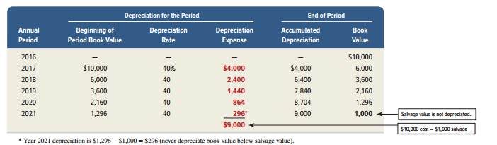
Double-Declining-Balance Method
Exhibit 10.12
Learning Objective P1: Compute and record depreciation using the straight-line, units-of-production, and declining-balance methods.
Notes:
The double-declining-balance depreciation schedule is shown here. The schedule follows the formula except for year 2021, when depreciation expense is $296. This $296 is not equal to 40% x $1,296, or $518.40. If we had used the $518.40 for depreciation expense in 2020, the ending book value would equal $777.60, which is less than the $1,000 salvage value. Instead, the $296 is computed by subtracting the $1,000 salvage value from the $1,296 book value at the beginning of the fifth year (the year when DDB depreciation cuts into salvage value).

Slide 25
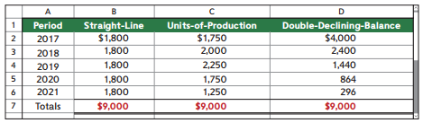
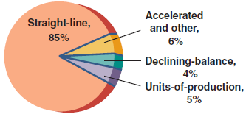
Comparing Depreciation Methods
Exhibit 10.13
Methods Used by Companies
Learning Objective P1: Compute and record depreciation using the straight-line, units-of-production, and declining-balance methods.
Notes:
This first table show depreciation expense for each year of the machine’s useful life under each of the three depreciation methods. While depreciation expense per period differs for different methods, total depreciation expense of $9,000 is the same over the machine’s useful life. The book value of the asset when using straight-line is always greater than the book value from using double-declining-balance, except at the beginning and end of the asset’s useful life, when it is the same. Also, the straight-line method yields a steady pattern of depreciation expense while the units-of-production depreciation depends on the number of units produced. Each of these methods is acceptable because it allocates cost in a systematic and rational manner.
As shown in the above graph, about 85% of companies use straight-line depreciation for plant assets, 5% use units-of-production, and 4% use declining- balance. Another 6% use an unspecified accelerated method—most likely declining-balance.

Slide 26
Depreciation for Tax Reporting
Most corporations use the Modified Accelerated Cost Recovery System (MACRS) for tax purposes.
MACRS depreciation provides for rapid write-off of an asset’s cost in order to stimulate new investment.
Learning Objective P1: Compute and record depreciation using the straight-line, units-of-production, and declining-balance methods.
Notes:
The records a company keeps for financial accounting purposes are usually separate from the records it keeps for tax accounting purposes. This is so because financial accounting aims to report useful information on financial performance and position, whereas tax accounting reflects government objectives in raising revenues. Differences between these two accounting systems are normal and expected. Depreciation is a common example of how the records differ. For example, many companies use accelerated depreciation in computing taxable income. Reporting higher depreciation expense in the early years of an asset’s life reduces the company’s taxable income in those years and increases it in later years, when the depreciation expense is lower. The company’s goal here is to postpone its tax payments.

Slide 27
C2:
Explain depreciation for partial years and changes in estimates.
Learning Objective

Slide 28
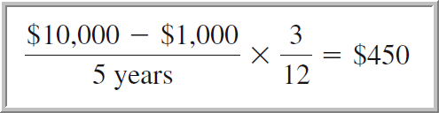
Partial-Year Depreciation
When a plant asset is purchased (or sold) during the year, depreciation is calculated for the fraction of the year the asset is owned.
Cost | $ 10,000
Salvage value | 1,000
Depreciable cost | $ 9,000
Useful life
Accounting periods | 5 years
Units inspected | 36,000 units
Assume our machinery was purchased on October 8, 2016 Let’s calculate depreciation expense for 2016 assuming we use straight-line depreciation.
Learning Objective C2: Explain depreciation for partial years and changes in estimates.
Notes:
When an asset is purchased (or sold) at a time other than the beginning or end of an accounting period, depreciation is recorded for part of a year.
To illustrate, assume that the shoe machine is purchased and placed in service on October 8, 2016, and the annual accounting period ends on December 31. Because this machine is purchased and used for nearly three months in 2015, the calendar-year income statement should report depreciation expense on the machine for that part of the year. Normally, depreciation assumes that the asset is purchased on the first day of the month nearest the actual date of purchase. In this case, because the purchase occurred on October 8, we assume an October 1 purchase date. This means that three months’ depreciation is recorded in 2016. Using straight-line depreciation, we compute three months’ depreciation of $450 as shown in this slide.

Slide 29
Changes in Estimates for Depreciation
Predicted
salvage value
Predicted
useful life
Depreciation
is an estimate
Over the life of an asset, new information may come to light that indicates the original estimates were inaccurate.
Learning Objective C2: Explain depreciation for partial years and changes in estimates.
Notes:
Depreciation is based on estimates of salvage value and useful life. During the useful life of an asset, if our estimate of an asset’s useful life and/or salvage value changes, what should we do? The answer is to use the new estimate to compute depreciation for current and future periods. This means that we revise the depreciation expense computation by spreading the cost yet to be depreciated over the remaining useful life. This approach is used for all depreciation methods.

Slide 30
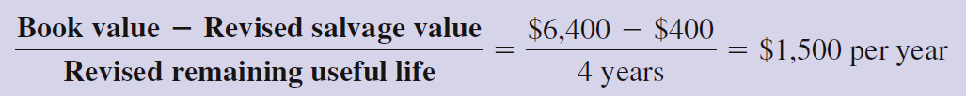
Changes in Estimates for Depreciation
Let’s look at our machinery from the previous examples and assume that at the beginning of the asset’s third year, its book value is $6,400 ($10,000 cost less $3,600 accumulated depreciation using straight-line depreciation). At that time, it is determined that the machinery will have a remaining useful life of 4 years, and the estimated salvage value will be revised downward from $1,000 to $400.
Learning Objective C2: Explain depreciation for partial years and changes in estimates.
Notes:
Let’s return to the machine described in Exhibit 10.8 using straight-line depreciation. At the beginning of this asset’s third year, its book value is $6,400, computed as $10,000 minus $3,600. Assume that at the beginning of its third year, the estimated number of years remaining in its useful life changes from three to four years and its estimate of salvage value changes from $1,000 to $400. Straight-line depreciation for each of the four remaining years is computed as shown above. Thus, $1,500 of depreciation expense is recorded for the machine at the end of the third through sixth years—each year of its remaining useful life.
.

Slide 31
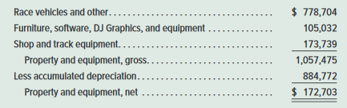
Reporting Depreciation
Learning Objective C2: Explain depreciation for partial years and changes in estimates.
Notes:
Both the cost and accumulated depreciation of plant assets are reported on the balance sheet or in its notes. Dale Jarrett Racing Adventure, for instance, reports the amounts shown in this slide. Many companies also show plant assets on one line with the net amount of cost less accumulated depreciation. When this is done, the amount of accumulated depreciation is disclosed in a note.
Review what you have learned in the following NEED-TO-KNOW Slides.

Slide 32
NEED-TO-KNOW 10-2
Part 1. A machine costing $22,000 with a five-year life and an estimated $2,000 salvage value is
installed on January 1. The factory manager estimates the machine will produce 1,000 units of product
during its life. It actually produces the following units: Year 1, 200; Year 2, 400; Year 3, 300; Year 4, 80;
and Year 5, 30. The total number of units produced by the end of Year 5 exceeds the original
estimate—this difference was not predicted. (The machine must not be depreciated below its estimated
salvage value.) Prepare a table with the following four-column headings: Year; Straight-Line; Units-of-
Production; Double-Declining-Balance; and then compute depreciation for each year (and total
depreciation for all years combined) under each depreciation method.
Year
Straight-Line
Units-of-Production
Double-Declining-Balance
Year 1
Year 2
Year 3
Year 4
Year 5
Total
$20,000
$20,000
$20,000
Learning Objective C2: Explain depreciation for partial years and changes in estimates.
Notes:
Part 1. A machine costing $22,000 with a five-year life and an estimated $2,000 salvage value is installed on January 1. The factory manager estimates the machine will produce 1,000 units of product during its life. It actually produces the following units: Year 1, 200; Year 2, 400; Year 3, 300; Year 4, 80; and Year 5, 30. The total number of units produced by the end of Year 5 exceeds the original estimate - this difference was not predicted. We're reminded that the machine must not be depreciated below its estimated salvage value.
Prepare a table with the following four-column headings: Year; Straight-Line; Units-of-Production; Double-Declining-Balance; and then compute depreciation for each year (and total depreciation for all years combined) under each depreciation method. Regardless of the depreciation method used, total depreciation expense over the life of the asset will equal $20,000; the $22,000 cost minus the $2,000 salvage value.

Slide 33
NEED-TO-KNOW 10-2 SOLUTION
Part 1. A machine costing $22,000 with a five-year life and an estimated $2,000 salvage value is
installed on January 1. The factory manager estimates the machine will produce 1,000 units of product
during its life. It actually produces the following units: Year 1, 200; Year 2, 400; Year 3, 300; Year 4, 80;
and Year 5, 30. The total number of units produced by the end of Year 5 exceeds the original
estimate—this difference was not predicted. (The machine must not be depreciated below its estimated
salvage value.)
Year
Straight-Line
Units-of-Production
Double-Declining-Balance
Year 1
$4,000
Year 2
4,000
Year 3
4,000
Year 4
4,000
Year 5
4,000
Total
$20,000
$20,000
$20,000
Straight-Line
Cost - Salvage
$22,000 - $2,000
$4,000 per year
EUL (years)
5 years
Learning Objective C2: Explain depreciation for partial years and changes in estimates.
Notes:
The formula for straight-line depreciation is: (Cost minus Salvage) divided by the estimated useful life expressed in terms of years. The $22,000 cost minus the $2,000 salvage value divided by five years is depreciation expense of $4,000 per year. Depreciation of $4,000 per year for five years is a total of $20,000, and will reduce the book value from its $22,000 cost to its salvage value of $2,000.

Slide 34
NEED-TO-KNOW 10-2 SOLUTION
Part 1. A machine costing $22,000 with a five-year life and an estimated $2,000 salvage value is
installed on January 1. The factory manager estimates the machine will produce 1,000 units of product
during its life. It actually produces the following units: Year 1, 200; Year 2, 400; Year 3, 300; Year 4, 80;
and Year 5, 30. The total number of units produced by the end of Year 5 exceeds the original
estimate—this difference was not predicted. (The machine must not be depreciated below its estimated
salvage value.)
Year
Straight-Line
Units-of-Production
Double-Declining-Balance
Year 1
$4,000
$4,000
Year 2
4,000
8,000
Year 3
4,000
6,000
Year 4
4,000
1,600
Year 5
4,000
400
Total
$20,000
$20,000
$20,000
Units-of-Production
Cost - Salvage
$22,000 - $2,000
$20 per unit
For first 1,000 units produced!
EUL (units)
1,000 units
Units
Depreciation
Actual
Depreciable
Expense
Year 1
200
200
units @ $20 per unit
$4,000
Year 2
400
400
units @ $20 per unit
8,000
Year 3
300
300
units @ $20 per unit
6,000
Year 4
80
80
units @ $20 per unit
1,600
Year 5
30
20
units @ $20 per unit
400
Total
1,010
1,000
$20,000
Learning Objective C2: Explain depreciation for partial years and changes in estimates.
Notes:
The formula for units-of-production depreciation is similar. The numerator is cost minus salvage, and we divide by the estimated useful life. But under the units-of-production method, the estimated useful life is expressed in terms of units of output. $20,000 divided by 1,000 total units is depreciation expense of $20 per unit. Actual units produced: Year 1, 200; Year 2, 400; Year 3, 300; Year 4, 80; and Year 5, 30. A total of 1,010 units are produced.
If depreciation expense of $20 per unit is recorded for each of the 1,010 units produced, total depreciation expense equals $20,200, this is more than the actual amount and would bring the book value to an amount less than salvage. So it's important to remember that we're depreciating $20 per unit, but only for the first 1,000 units produced. As soon as the machine produces 1,000 units, the depreciation process stops!
In Year 1, total depreciation expense is $4,000; 200 units produced at $20 per unit. In Year 2, they produce twice as many units; depreciation expense is twice as much; $8,000. In Year 3, 300 units produced at $20 per unit is $6,000. In Year 4, 80 units at $20 per unit, $1,600, and in Year 5, 20 units at $20 per unit is depreciation expense of $400. Total depreciation expense is $20,000; cost minus salvage.

Slide 35
NEED-TO-KNOW 10-2 SOLUTION
Part 1. A machine costing $22,000 with a five-year life and an estimated $2,000 salvage value is
installed on January 1. The factory manager estimates the machine will produce 1,000 units of product
during its life.
Year
Straight-Line
Units-of-Production
Double-Declining-Balance
Year 1
$4,000
$4,000
Year 2
4,000
8,000
Year 3
4,000
6,000
Year 4
4,000
1,600
Year 5
4,000
400
Total
$20,000
$20,000
$20,000
Double-Declining-Balance
Step 1: Straight-line rate
100%
100%
20%
EUL (years)
5 years
x 2
Step 2: Double the Straight-line rate
200%
200%
40%
EUL (years)
5 years
Step 3: Depreciation expense = DDB rate x Beginning-period book value
Learning Objective C2: Explain depreciation for partial years and changes in estimates.
Notes:
The final method is called "Double-Declining-Balance" (DDB). Double-declining- balance (DDB) is a three-step process. First, we calculate the straight-line rate. 100% divided by the estimated useful life of five years is a straight-line rate of 20% per year. Since this is the double-declining-balance method, we double the straight line rate; 20% multiplied by 2 is 40%.
Alternatively, you can combine the two steps by taking 200% and dividing by five years; 200% divided by five years is 40%. Step three calculates the depreciation expense. Depreciation expense is calculated by taking the double-declining-balance rate, and multiplying by the beginning-of-year book value.

Slide 36
NEED-TO-KNOW 10-2 SOLUTION
Part 1. A machine costing $22,000 with a five-year life and an estimated $2,000 salvage value is
installed on January 1. The factory manager estimates the machine will produce 1,000 units of product
during its life.
Year
Straight-Line
Units-of-Production
Double-Declining-Balance
Year 1
$4,000
$4,000
$8,800
Year 2
4,000
8,000
5,280
Year 3
4,000
6,000
3,168
Year 4
4,000
1,600
1,901
Year 5
4,000
400
851
Total
$20,000
$20,000
$20,000
Double-Declining-Balance
Book Value = Cost – Accumulated Depreciation
Beginning
DDB
Depreciation
Accumulated
Book
Book Value
Rate
Expense
Depreciation
Value
Year 1
$22,000
40%
$8,800
$8,800
$13,200
Year 2
13,200
40%
5,280
14,080
7,920
Year 3
7,920
40%
3,168
17,248
4,752
Year 4
4,752
40%
1,901
19,149
2,851
Year 5
2,851
40%
1,140
851
20,289
20,000
1,711
2,000
Total
$20,000
Learning Objective C2: Explain depreciation for partial years and changes in estimates.
Notes:
The book value declines over time. The maximum book value is always the asset's cost, $22,000, and the minimum book value is salvage value. Total depreciation expense over the five-year period must equal $20,000. The declining balance is the book value, cost minus accumulated depreciation.
In Year 1, the beginning book value is the cost of $22,000. We multiply by the DDB rate, 40%, to calculate depreciation expense in the first year, $8,800. The journal entry is a debit to Depreciation expense and a credit to Accumulated depreciation, bringing the end-of-year balance in Accumulated depreciation to $8,800. As the balance in Accumulated depreciation increases, the book value decreases. Cost of $22,000 minus accumulated depreciation of $8,800 is an end-of-year book value of $13,200. The book value at the end of Year 1 becomes the beginning book value for Year 2. $13,200 multiplied by 40% is $5,280. The balance in Accumulated depreciation increases to $14,080, reducing the book value to $7,920. $7,920 multiplied by 40% is depreciation expense of $3,168. This increases the balance in Accumulated depreciation to $17,248, and reduces the book value to $4,752. $4,752 multiplied by 40% is $1,901. Accumulated depreciation at the end of Year 4 is $19,149, dropping the book value to $2,851. In Year 5, if we continue the process, $2,851multiplied by 40%; depreciation expense is $1,140. This brings the balance in Accumulated depreciation to $20,289; more than the $20,000 maximum. If we depreciate $1,140 in Year 5, the book value drops to less than salvage, $1,711. So rather than using the rate in Year 5, we calculate depreciation expense to be $851. This brings the balance in Accumulated depreciation up to $20,000 and reduces the book value to its minimum, $2,000 salvage value.

Slide 37
NEED-TO-KNOW 10-2 SOLUTION
Part 2. In early January 20X1, a company acquires equipment for $3,800. The company estimates this equipment to have a useful life of three years and a salvage value of $200. Early in 20X3, the company changes its estimates to a total four-year useful life and zero salvage value. Using the straight-line method, what is depreciation expense for the year ended December 31, 20X3?
Straight-Line Depreciation - Original
Cost minus Salvage
$3,800 - $200
$3,600
Estimated Useful Life (years)
3 years
3
Depreciation expense = $1,200 per year
Straight-Line Depreciation - Revised
Book Value minus Revised Salvage
$1,400 - $0
$1,400
Estimated Remaining Years
2 remaining years
2
Depreciation expense = $700 per year
Year
Beginning
Annual
Year-End
Book Value
Depreciation
Book Value
1
$3,800
$1,200
$2,600
2
2,600
1,200
1,400
3
1,400
700
700
4
700
700
0
Total
$3,800
Learning Objective C2: Explain depreciation for partial years and changes in estimates.
Notes:
Part 2. In early January 20X1, a company acquires equipment for $3,800. The company estimates this equipment to have a useful life of three years and a salvage value of $200. Early in 20X3, the company changes its estimates to a total four-year useful life and zero salvage value. Using the straight-line method, what is depreciation expense for 20X3?
Straight-line depreciation was originally calculated as cost minus salvage divided by the estimated useful life in terms of years. $3,800 minus $200 divided by three years is depreciation expense of $1,200 per year. The beginning book value was $3,800, the equipment's cost. In 20X1, depreciation of $1,200 reduced the book value to $2,600. In 20X2, an additional $1,200 of depreciation reduced the book value to $1,400. At the beginning of 20X3, when the book value is $1,400, the company changes their estimates, so the amount of depreciation must also be changed. The book value minus the revised salvage value is divided by the estimated remaining years. Total depreciation of $1,400 must be reported over the remaining two years; depreciation expense is $700 per year. In 20X3, $700 of depreciation reduces the book value at the end of the year to $700. In 20X4, an additional $700 of depreciation expense reduces the book value to $0. Total depreciation over the four-year period is $3,800, cost minus salvage.

Slide 38
C3:
Distinguish between revenue and capital expenditures, and account for them.
Learning Objective

Slide 39
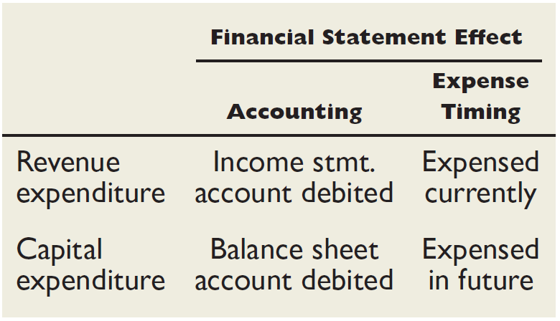
Additional Expenditures
If the amounts involved are not material, most companies expense the item.
Learning Objective C3: Distinguish between revenue and capital expenditures, and account for them.
Notes:
After a company acquires a plant asset and puts it into service, it often makes additional expenditures for that asset’s operation, maintenance, repair, and improvement. In recording these expenditures, it must decide whether to capitalize or expense them (to capitalize an expenditure is to debit the asset account). The issue is whether these expenditures are reported as current- period expenses or added to the plant asset’s cost and depreciated over its remaining useful life.
Revenue expenditures, also called income statement expenditures, are additional costs of plant assets that do not materially increase the asset’s life or productive capabilities. They are recorded as expenses and deducted from revenues in the current period’s income statement.
Capital expenditures, also called balance sheet expenditures, are additional costs of plant assets that provide benefits extending beyond the current period. They are debited to asset accounts and reported on the balance sheet. Capital expenditures increase or improve the type or amount of service an asset provides.

Slide 40
Revenue and Capital
Expenditures
Learning Objective C3: Distinguish between revenue and capital expenditures, and account for them.
Notes:
Ordinary repairs are expenditures to keep an asset in normal, good operating condition. Ordinary repairs do not extend an asset’s useful life beyond its original estimate or increase its productivity beyond original expectations. Examples are normal costs of cleaning, lubricating, adjusting, oil changing, and replacing small parts of a machine. Ordinary repairs are treated as revenue expenditures. This means their costs are reported as expenses on the current-period income statement.
Accounting for betterments and extraordinary repairs is similar—both are treated as capital expenditures.
Betterments (Improvements) Betterments, also called improvements, are expenditures that make a plant asset more efficient or productive. A betterment often involves adding a component to an asset or replacing one of its old components with a better one and does not always increase an asset’s useful life. An example is replacing manual controls on a machine with automatic controls. One special type of betterment is an addition, such as adding a new wing or dock to a warehouse. Because a betterment benefits future periods, it is debited to the asset account as a capital expenditure. The new book value (less salvage value) is then depreciated over the asset’s remaining useful life.
Extraordinary repairs are expenditures extending the asset’s useful life beyond its original estimate. Extraordinary repairs are capital expenditures because they benefit future periods. Their costs are debited to the asset account (or to accumulated depreciation).

Slide 41
P2:
Account for asset disposal through discarding or selling an asset.
Learning Objective

Slide 42
Disposals of Plant Assets
Update depreciation
to the date of disposal.
Journalize disposal by:
Recording cash
received (debit)
or paid (credit).
Recording a
gain (credit)
or loss (debit).
Removing accumulated
depreciation (debit).
Removing the
asset cost (credit).
Learning Objective P2: Account for asset disposal through discarding or selling an asset.
Notes:
Disposals of plant assets occur in one of three basic ways: discarding, sale, or exchange.
The general steps in accounting for a disposal of plant assets are described in this slide. After we dispose of a plant asset, the first thing we do is update depreciation to the date of disposal. After completing the update, we can prepare the journal entry. We do so by recording a debit to the cash account, if cash was received, or credit the cash account, if cash was paid by the company. In addition, we must determine whether a gain or loss is associated with the disposal. A gain is recorded with a credit, just like revenue, and a loss is recorded with a debit, just like an expense account. We complete the entry by removing the plant asset’s cost from our books with a credit, and remove the related accumulated depreciation with a debit.
Let’s see how we calculate the gain or loss associated with the disposal.

Slide 43
Discarding Plant Assets
Update depreciation
to the date of disposal.
If Cash > BV, record a gain (credit).
If Cash < BV, record a loss (debit).
If Cash = BV, no gain or loss.
Journalize disposal by:
Recording cash
received (debit)
or paid (credit).
Recording a
gain (credit)
or loss (debit).
Removing accumulated
depreciation (debit).
Removing the
asset cost (credit).
Learning Objective P2: Account for asset disposal through discarding or selling an asset.
Notes:
If the amount of cash received is greater than the book value of the asset (cost less accumulated depreciation), a gain is associated with the disposal.
If the cash received is less than the book value of the asset, a loss will be recorded.
When the amount of cash is exactly equal to the book value of the asset, there will be no gain or loss in connection with the disposal.
Now let’s look at a specific example of disposal of a plant asset.

Slide 44

Discarding Plant Assets
A machine costing $9,000, with accumulated depreciation of $9,000 on December 31 of the previous year was discarded on June 5th of the current year. The company is depreciating the equipment using the straight-line method over eight years with zero salvage value.
Learning Objective P2: Account for asset disposal through discarding or selling an asset.
Notes:
A plant asset is discarded when it is no longer useful to the company and it has no market value. To illustrate, assume that a machine costing $9,000 with accumulated depreciation of $9,000 is discarded. When accumulated depreciation equals the asset’s cost, it is said to be fully depreciated (zero book value). The entry to record the discarding of this asset is shown in this slide.
This entry reflects all four steps of Exhibit 10.15. Step 1 is unnecessary because the machine is fully depreciated. Step 2 is reflected in the debit to Accumulated Depreciation and credit to Machinery. Because no other asset is involved, step 3 is irrelevant. Finally, because book value is zero and no other asset is involved, no gain or loss is recorded in step 4.

Slide 45
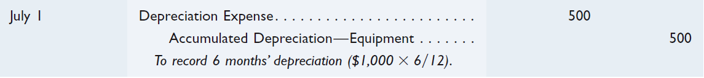
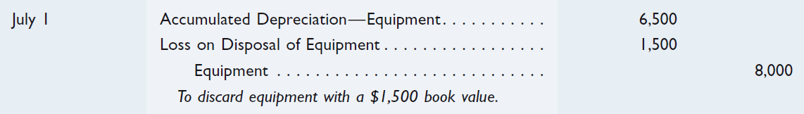
Discarding Plant Assets
Equipment costing $8,000, with accumulated depreciation of $6,000 on December 31st of the previous year was discarded on July 1st of the current year. The company is depreciating the equipment using the straight-line method over eight years with zero salvage value.
Step 1: Bring the depreciation up-to-date.
Step 2: Record discarding of asset.
Learning Objective P2: Account for asset disposal through discarding or selling an asset.
Notes:
How do we account for discarding an asset that is not fully depreciated or one whose depreciation is not up-to-date? To answer this, consider equipment costing $8,000 with accumulated depreciation of $6,000 on December 31 of the prior fiscal year-end. This equipment is being depreciated using the straight-line method over eight years with zero salvage. On July 1 of the current year it is discarded. Step 1 is to bring depreciation up-to-date. The required entry is shown above.
Steps 2 through 4 are reflected in the second (and final) entry. This loss is computed by comparing the equipment’s $1,500 book value ($8,000 - $6,000 - $500) with the zero net cash proceeds. The loss is reported in the Other Expenses and Losses section of the income statement. Discarding an asset can sometimes require a cash payment that would increase the loss.

Slide 46
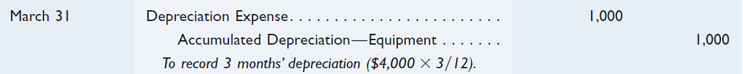
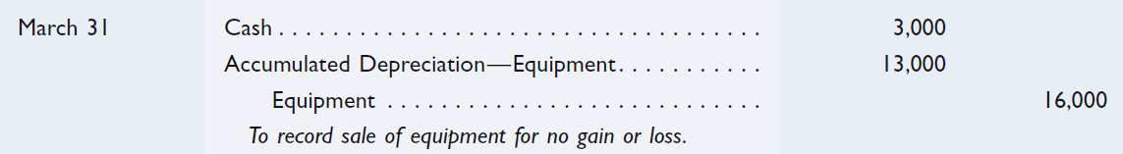
Selling Plant Assets – At Book Value
On March 31st, BTO sells equipment that originally cost $16,000 and has accumulated depreciation of $12,000 at December 31st of the prior calendar year-end. Annual depreciation on this equipment is $4,000 using straight-line depreciation. The equipment is sold for $3,000 cash.
Step 1: Update depreciation to March 31st.
Step 2: Record sale of asset at book value ($16,000 - $13,000 = $3,000).
Learning Objective P2: Account for asset disposal through discarding or selling an asset.
Notes:
Companies often sell plant assets when they restructure or downsize operations. To illustrate the accounting for selling plant assets, we consider BTO’s March 31 sale of equipment that cost $16,000 and has accumulated depreciation of $12,000 at December 31 of the prior calendar year-end. Annual depreciation on this equipment is $4,000 computed using straight-line depreciation. Step 1 of this sale is to record depreciation expense and update accumulated depreciation to March 31 of the current year.
Steps 2 through 4 can be reflected in one final entry that depends on the amount received from the asset’s sale. In this case $3,000.
Sale at Book Value - If BTO receives $3,000 cash, an amount equal to the equipment’s book value as of March 31 (book value = $16,000 - $12,000 - $1,000), no gain or loss occurs on disposal. The entry is shown above.

Slide 47

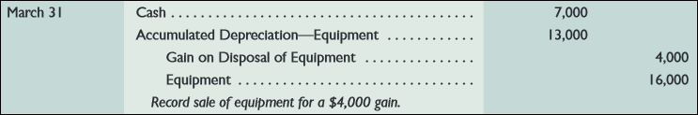
Selling Plant Assets – Above Book Value
On March 31st, BTO sells equipment that originally cost $16,000 and has accumulated depreciation of $12,000 at December 31st of the prior calendar year-end. Annual depreciation on this equipment is $4,000 using straight-line depreciation. The equipment is sold for $7,000 cash.
Step 1: Update depreciation to March 31st.
Step 2: Record sale of asset at a gain. ($7,000 - $3,000 = $4,000 gain).
Learning Objective P2: Account for asset disposal through discarding or selling an asset.
Notes:
As before, we must bring the depreciation up-to-date as of March 31st. The journal entry is to debit Depreciation Expense for $1,000 and credit Accumulated Depreciation – Equipment for the same amount. The balance in the accumulated depreciation account is now $13,000.
Sale Above Book Value - If BTO receives $7,000, an amount that is $4,000 above the equipment’s $3,000 book value as of March 31, a gain on disposal occurs. The entry is shown above.

Slide 48
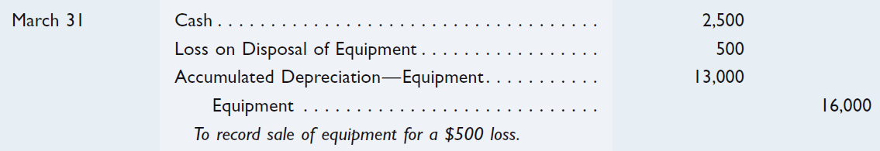
Selling Plant Assets – Below Book Value
On March 31st, BTO sells equipment that originally cost $16,000 and has accumulated depreciation of $12,000 at December 31st of the prior calendar year-end. Annual depreciation on this equipment is $4,000 using straight-line depreciation. The equipment is sold for $2,500 cash.
Step 1: Update depreciation to March 31st.
Step 2: Record sale of asset at a loss. ($3,000 - $2,500 = $500 loss).
Learning Objective P2: Account for asset disposal through discarding or selling an asset.
Notes:
As before, we must bring the depreciation up-to-date as of March 31st. The journal entry is to debit Depreciation Expense for $1,000 and credit Accumulated Depreciation – Equipment for the same amount. The balance in the accumulated depreciation account is now $13,000.
Sale below Book Value - If BTO receives $2,500, an amount that is $500 below the equipment’s $3,000 book value as of March 31, a loss on disposal occurs. The entry is shown above.
Review what you have learned in the following NEED-TO-KNOW Slides.

Slide 49
NEED-TO-KNOW 10-3
A company pays $1,000 for equipment expected to last four years and have a $200 salvage value.
Prepare journal entries to record the following costs related to the equipment.
a) During the second year of the equipment’s life, $400 cash is paid for a new component
expected to increase the equipment’s productivity by 20% a year.
b) During the third year, $250 cash is paid for normal repairs necessary to keep the equipment in
good working order.
c) During the fourth year, $500 is paid for repairs expected to increase the useful life of the
equipment from four to five years.
Betterments, also called improvements, are expenditures that make a plant asset more efficient or productive.
Extraordinary repairs are expenditures extending the asset’s useful life beyond its original estimate.
General Journal
Debit
Credit
Purchase
Equipment
1,000
Cash
1,000
a)
Equipment
400
Cash
400
b)
Repairs expense
250
Cash
250
c)
Equipment
500
Cash
500
Learning Objective P2: Account for asset disposal through discarding or selling an asset.
Notes:
Need-to-Know 10.3

Slide 50
NEED-TO-KNOW 10-3 SOLUTION
A company owns a machine that cost $500 and has accumulated depreciation of $400. Prepare the
entry to record the disposal of the machine on January 2 under each of the following independent situations.
a) The machine needed extensive repairs, and it was not worth repairing. The company disposed of the
machine, receiving nothing in return.
b) The company sold the machine for $80 cash.
c) The company sold the machine for $100 cash.
d) The company sold the machine for $110 cash.
Machine
Accumulated Depreciation - Machine
Cost
500
To date
400
Book Value = $100
General Journal
Debit
Credit
Purchase
Machine
500
Cash
500
Over life
Depreciation expense
400
Accumulated Depreciation - Machine
400
Learning Objective P2: Account for asset disposal through discarding or selling an asset.
Notes:
Need-to-Know 10.3

Slide 51
NEED-TO-KNOW 10-3 SOLUTION
Machine
Accumulated Depreciation - Machine
Cost
500
To date
400
Book Value = $100
a) The machine needed extensive repairs, and it was not worth repairing. The company disposed of the
machine, receiving nothing in return.
b) The company sold the machine for $80 cash.
c) The company sold the machine for $100 cash.
d) The company sold the machine for $110 cash.
General Journal
Debit
Credit
Cash
$ rec’d
Loss on sale of machine
Cash < BV
Accumulated Depreciation - Machine
$ to date
Machine
Cost
Gain on sale of machine
Cash > BV
Learning Objective P2: Account for asset disposal through discarding or selling an asset.
Notes:
Need-to-Know 10.3

Slide 52
NEED-TO-KNOW 10-3 SOLUTION
Machine
Accumulated Depreciation - Machine
Cost
500
To date
400
Book Value = $100
a) The machine needed extensive repairs, and it was not worth repairing. The company disposed of the
machine, receiving nothing in return.
b) The company sold the machine for $80 cash.
c) The company sold the machine for $100 cash.
d) The company sold the machine for $110 cash.
General Journal
Debit
Credit
a)
Accumulated Depreciation - Machine
400
Loss on disposal
100
Machine
500
b)
Cash
80
Loss on sale of machine
20
Accumulated Depreciation - Machine
400
Machine
500
c)
Cash
100
Accumulated Depreciation - Machine
400
Machine
500
Learning Objective P2: Account for asset disposal through discarding or selling an asset.
Notes:
Need-to-Know 10.3

Slide 53
NEED-TO-KNOW 10-3 SOLUTION
Machine
Accumulated Depreciation - Machine
Cost
500
To date
400
Book Value = $100
a) The machine needed extensive repairs, and it was not worth repairing. The company disposed of the
machine, receiving nothing in return.
b) The company sold the machine for $80 cash.
c) The company sold the machine for $100 cash.
d) The company sold the machine for $110 cash.
General Journal
Debit
Credit
d)
Cash
110
Accumulated Depreciation - Machine
400
Machine
500
Gain on sale of machine
10
Learning Objective P2: Account for asset disposal through discarding or selling an asset.
Notes:
Need-to-Know 10.3

Slide 54
P3:
Account for natural resource assets and their depletion.
Learning Objective

Slide 55
Natural Resources
Total cost
is charged to
depletion expense
over periods
benefited.
Extracted from
the natural
environment
and reported
at cost less
accumulated
depletion.
Examples: oil, coal, gold
Learning Objective P3: Account for natural resource assets and their depletion.
Notes:
Natural resources are recorded at cost, which includes all expenditures necessary to acquire the resource and prepare it for its intended use. Depletion is the process of allocating the cost of a natural resource to the period when it is consumed. Natural resources are reported on the balance sheet at cost less accumulated depletion. The depletion expense per period is usually based on units extracted from cutting, mining, or pumping. This is similar to units-of-production depreciation.

Slide 56
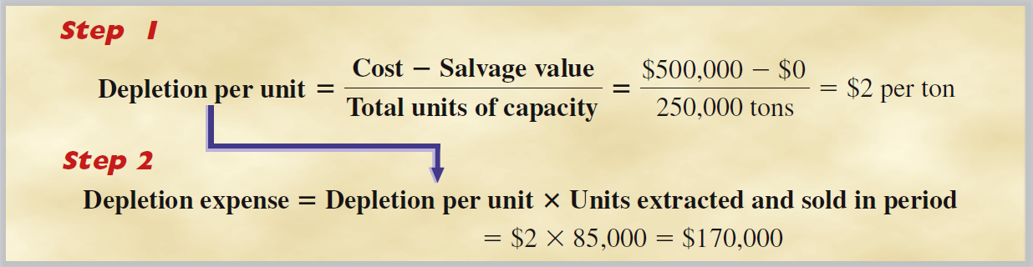
Cost Determination and Depletion
Let’s consider a mineral deposit with an estimated 250,000 tons of available ore. It is purchased for $500,000, and we expect zero salvage value.
Learning Objective P3: Account for natural resource assets and their depletion.
Notes:
Let’s consider a mineral deposit with an estimated 250,000 tons of available ore. It is purchased for $500,000, and we expect zero salvage value. The depletion charge per ton of ore mined is $2, computed as $500,000/250,000 tons. If 85,000 tons are mined and sold in the first year, the depletion charge for that year is $170,000.

Slide 57
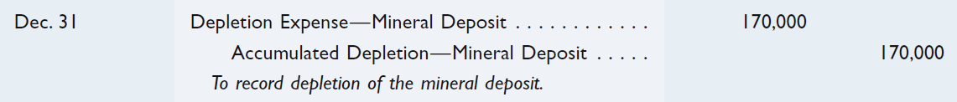
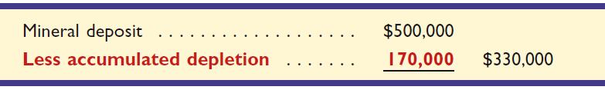
Depletion of Natural Resources
Depletion expense in the first year would be:
Balance Sheet presentation of natural resources:
Learning Objective P3: Account for natural resource assets and their depletion.
Notes:
If the company extracts and sells 85,000 tons during the year, depletion expense will be $170,000 (85,000 tons times $2 per ton). The journal entry to record depletion is to debit Depletion Expense – Mineral Deposit for $170,000, and credit Accumulated Depletion – Mineral Deposit for the same amount.
The period-end balance sheet reports the mineral deposit as shown in this slide. Since all 85,000 tons of the mined ore are sold during the year, the entire $170,000 of depletion is reported on the income statement. If some of the ore remains unsold at year-end, however, the depletion related to the unsold ore is carried forward on the balance sheet and reported as Ore Inventory, a current asset.

Slide 58
Plant Assets Tied into Extracting
Specialized plant assets may be required to extract the natural resource.
These assets are recorded in a separate account and depreciated.
Learning Objective P3: Account for natural resource assets and their depletion.
Notes:
The conversion of natural resources by mining, cutting, or pumping requires machinery, equipment, and buildings. When the usefulness of these plant assets is directly related to the depletion of a natural resource, their costs are depreciated using the units-of-production method in proportion to the depletion of the natural resource. For example, if a machine is permanently installed in a mine and 10% of the ore is mined and sold in the period, then 10% of the machine’s cost (less any salvage value) is allocated to depreciation expense. The same procedure is used when a machine is abandoned once resources have been extracted. If, however, a machine will be moved to and used at another site when extraction is complete, the machine is depreciated over its own useful life.
Review what you have learned in the following NEED-TO-KNOW Slide.

Slide 59
NEED-TO-KNOW 10-4
A company acquires a zinc mine at a cost of $750,000. It incurs additional costs of $100,000 to access the
mine, which is estimated to hold 200,000 tons of zinc. The estimated value of the land after the zinc is
removed is $50,000.
1)
Prepare the entry(ies) to record the cost of the zinc mine.
2)
Prepare the year-end adjusting entry if 50,000 tons of zinc are mined, but only 40,000 tons are sold the
first year.
Depletion - Units-of-Production
Cost - Salvage
$850,000 - $50,000
$4 per ton
EUL (units)
200,000 tons
General Journal
Debit
Credit
1)
Zinc mine
850,000
Cash
850,000
2)
Depletion expense - Zinc mine
40,000 tons x $4
160,000
Zinc inventory
10,000 tons x $4
40,000
Accumulated depletion - Zinc mine
50,000 tons x $4
200,000
Learning Objective P3: Account for natural resource assets and their depletion.
Notes:
A company acquires a zinc mine at a cost of $750,000. It incurs additional costs of $100,000 to access the mine, which is estimated to hold 200,000 tons of zinc. The estimated value of the land after the zinc is removed is $50,000.
1) Prepare the entry(ies) to record the cost of the zinc mine. To record the purchase, we debit the Zinc mine for the entire cost of $850,000, all necessary costs to get the asset ready for its intended purpose, and we credit Cash.
2) Prepare the year-end adjusting entry if 50,000 tons of zinc are mined, but only 40,000 tons are sold the first year. The year-end adjusting entry is for depletion, which is basically units-of-production depreciation, only for a natural resource. The formula takes (Cost minus Salvage) and divides by the estimated units of production. The $850,000 cost minus the $50,000 salvage value, divided by the total capacity of the mine, 200,000 tons, is depletion of $4 per ton. 50,000 tons are extracted.
We credit Accumulated depletion for the number of tons extracted, 50,000, multiplied by the $4 per ton; total depletion is $200,000. 40,000 tons have been sold. Since the revenue has been realized, we match it with an expense; Depletion expense, 40,000 tons at $4 per ton, $160,000. The remaining 10,000 tons are in inventory. We had the depletion to the inventory cost; 10,000 tons at $4 per ton, $40,000. This $40,000 will be expensed at the time those tons are sold.

Slide 60
P4:
Account for intangible assets.
Learning Objective

Slide 61
Intangible Assets
Noncurrent assets
without physical
substance.
Often provide
exclusive rights
or privileges.
Intangible
Assets
Useful life is
often difficult
to determine.
Usually acquired
for operational
use.
Learning Objective P4: Account for intangible assets.
Notes:
Intangible assets are nonphysical assets (used in operations) that give companies long- term rights, privileges, or competitive advantages. Examples are patents, copyrights, licenses, leaseholds, franchises, goodwill, and trademarks. Lack of physical substance does not necessarily imply an intangible asset. Notes and accounts receivable, for instance, lack physical substance, but they are not intangibles.

Slide 62
Cost Determination and Amortization
Patents
Copyrights
Franchises and Licenses
Trademarks and Trade Names
Goodwill
Leaseholds
Leasehold Improvements
Research and Development
Other Intangibles
Record at cost, including purchase price, legal fees, and filing fees.
Learning Objective P4: Account for intangible assets.
Notes:
An intangible asset is recorded at cost when purchased. Intangibles are then separated into those with limited lives or indefinite lives. If an intangible has a limited life, its cost is expensed over its estimated useful life through the process of amortization. If an intangible asset has an indefinite life—meaning that no legal, regulatory, contractual, competitive, economic, or other factors limit its useful life—it should not be amortized. (If an intangible with an indefinite life is later judged to have a limited life, it is amortized over that limited life.)
Review what you have learned in the following NEED-TO-KNOW Slide.

Slide 63
NEED-TO-KNOW 10-5
Part 1. A publisher purchases the copyright on a book for $1,000 on January 1 of this year. The copyright
legally protects its owner for 5 more years. The company plans to market and sell prints of the original for 7
years. Prepare entries to record the purchase of the copyright on January 1 of this year, and its annual
amortization on December 31 of this year.
General Journal
Debit
Credit
Jan. 1
Copyright
1,000
Cash
1,000
Dec. 31
Amortization expense - Copyright
$1,000 / 5 years
200
Accumulated amortization - Copyright
200
Part 2. On January 3 of this year, a retailer incurs a $9,000 cost to modernize its store. Improvements
include lighting, partitions, and a sound system. These improvements are estimated to yield benefits for 5
years. The retailer leases its store and has 3 years remaining on its lease. Prepare the entry to record (a)
the cost of modernization and (b) amortization at the end of this current year.
General Journal
Debit
Credit
Jan. 3
Leasehold improvements
9,000
Cash
9,000
Dec. 31
Amortization expense - Leasehold Improv.
$9,000 / 3 years
3,000
Accumulated amortization - Leasehold improvements
3,000
Learning Objective P4: Account for intangible assets.
Notes:
A publisher purchases the copyright on a book for $1,000 on January 1 of this year. The copyright legally protects its owner for five more years. The company plans to market and sell prints of the original for seven years. Prepare entries to record the purchase of the copyright on January 1 of this year, and its annual amortization on December 31 of this year. The journal entry to record the purchase is a debit to the intangible asset account, Copyright, for the cost of $1,000, and a credit to Cash. On December 31, we debit Amortization expense – Copyright for $1,000 divided by five years. Even though the company plans to market and sell the prints for seven years, the life of the copyright is only five more years. The annual amortization expense is $200. We credit the contra asset account, Accumulated amortization - Copyright. The carrying value of the copyright at the end of the first year is $800.
On January 3 of this year, a retailer incurs a $9,000 cost to modernize its store. Improvements include lighting, partitions, and a sound system. These improvements are estimated to yield benefits for five years. The retailer leases its store and has three years remaining on its lease. Prepare the entry to record (a) the cost of modernization and (b) amortization at the end of this current year. The journal entry to record the cost of modernization is a debit to the intangible asset account, Leasehold improvements, $9,000, and a credit to Cash. On December 31, these costs are amortized over the remaining term of the lease. Debit Amortization expense - Leasehold improvements, $9,000 divided by three years remaining on the lease, $3,000, and credit Accumulated amortization - Leasehold improvements.
On January 6 of this year, a company pays $6,000 for a patent with a remaining 12-year legal life to produce a supplement expected to be marketable for three years. Prepare entries to record its acquisition and the December 31 amortization entry for the current year. The cost of the patent is a debit to the Patents account, $6,000, and a credit to Cash. In order to adhere to the expense recognition principle, we match the cost with the three years of expected revenues. Debit Amortization expense - Patents, $6,000 divided by three years, $2,000, and credit Accumulated amortization - Patents.

Slide 64
NEED-TO-KNOW 10-5
Part 3. On January 6 of this year, a company pays $6,000 for a patent with a remaining 12-year legal life
to produce a supplement expected to be marketable for 3 years. Prepare entries to record its acquisition
and the December 31 amortization entry for this current year.
General Journal
Debit
Credit
Jan. 6
Patents
6,000
Cash
6,000
Dec. 31
Amortization expense - Patents
$6,000 / 3 years
2,000
Accumulated amortization - Patents
2,000
Learning Objective P4: Account for intangible assets.
Notes:
Need-to-Know 10.5

Slide 65
A1:
Compute total asset turnover and apply it to analyze a company’s use of assets.
Learning Objective

Slide 66
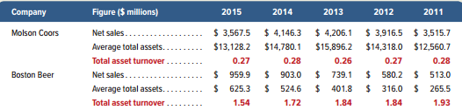
Total Asset Turnover
Exhibit 10.19
Total asset
turnover
Net sales
Average total assets
=
Provides information about a company’s
efficiency in using its assets.
Learning Objective A1: Compute total asset turnover and apply it to analyze a company’s use of assets.
Notes:
A company’s assets are important in determining its ability to generate sales and earn income. Managers devote much attention to deciding what assets a company acquires, how much it invests in assets, and how to use assets most efficiently and effectively. One important measure of a company’s ability to use its assets is total asset turnover.
Total asset turnover is equal to the net sales for the period divided by the average total assets. The average total assets is computed by taking the beginning balance of total assets, adding the ending balance, and dividing the result by two.
To show how we use total asset turnover, let’s look at Molson Coors. We express Molson Coors’s use of assets in generating net sales by saying “it turned its assets over 0.27 times during 2015.” This means that each $1.00 of assets produced $0.27 of net sales. Is a total asset turnover of 0.27 good or bad? It is safe to say that all companies desire a high total asset turnover. Like many ratio analyses, however, a company’s total asset turnover must be interpreted in comparison with those of prior years and of its competitors. Interpreting the total asset turnover also requires an understanding of the company’s operations. Some operations are capital-intensive meaning that a relatively large amount is invested in assets to generate sales. This suggests a relatively lower total asset turnover. Other companies’ operations are labor-intensive, meaning that they generate sales more by the efforts of people than the use of assets. In that case, we expect a higher total asset turnover. Companies with low total asset turnover require higher profit margins (examples are hotels and real estate); companies with high total asset turnover can succeed with lower profit margins (examples are food stores and toy merchandisers). Molson Coors’s turnover is much lower than that for Boston Beer and many other competitors. Total asset turnover for Molson Coors’s competitors, available in industry publications such as Dun & Bradstreet, is generally in the range of 0.5 to 1.0 over this same period. Overall, Molson Coors must improve relative to its competitors on total asset turnover.

Slide 67
P5: Appendix A
Account for asset exchanges.
Learning Objective

Slide 68
10A – Exchanging Plant Assets
Many plant assets such as machinery, automobiles, and office equipment are disposed of by exchanging them for newer assets. In a typical exchange of plant assets, a trade-in allowance is received on the old asset and the balance is paid in cash. Accounting for the exchange of assets depends on whether the transaction has commercial substance.
Commercial substance implies the company’s future cash flows will be altered.
Learning Objective P5: Account for asset exchanges.
Notes:
Many plant assets such as machinery, automobiles, and equipment are disposed of by exchanging them for newer assets. In a typical exchange of plant assets, a trade-in allowance is received on the old asset and the balance is paid in cash. Accounting for the exchange of assets depends on whether the transaction has commercial substance. An exchange has commercial substance if the company’s future cash flows change as a result of the exchange of one asset for another asset.
If an asset exchange has commercial substance, a gain or loss is recorded based on the difference between the book value of the asset(s) given up and the market value of the asset(s) received.

Slide 69
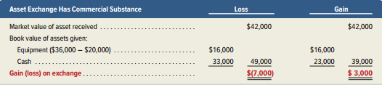
Exchange with Commercial Substance: A Loss
Exhibit 10A.1
A company acquires $42,000 in new equipment. In exchange, the company pays $33,000 cash and trades in old equipment. The old equipment originally cost $36,000 and has accumulated depreciation of $20,000 (book value is $16,000). This exchange has commercial substance. The old equipment has a trade-in allowance of $9,000.
Learning Objective P5: Account for asset exchanges.
Notes:
A company acquires $42,000 in new equipment. In exchange, the company pays $33,000 cash and trades in old equipment. The old equipment originally cost $36,000 and has accumulated depreciation of $20,000, which implies a $16,000 book value at the time of exchange. We are told this exchange has commercial substance and that the old equipment has a trade-in allowance of $9,000. This exchange yields a loss as computed above.

Slide 70
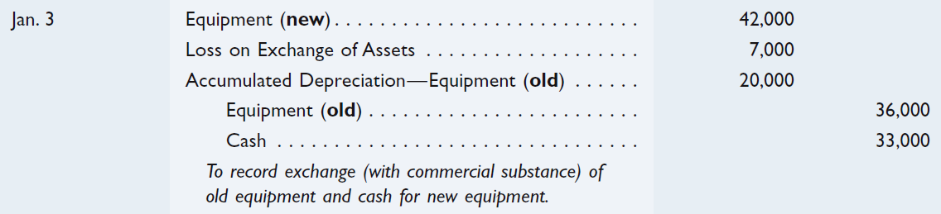
Exchange with Commercial Substance: A Loss
A company acquires $42,000 in new equipment. In exchange, the company pays $33,000 cash and trades in old equipment. The old equipment originally cost $36,000 and has accumulated depreciation of $20,000 (book value is $16,000). This exchange has commercial substance. The old equipment has a trade-in allowance of $9,000.
Learning Objective P5: Account for asset exchanges.
Notes:
In our case, the book value of the two assets given up (book value of old equipment plus cash) are greater than the market value of the asset received, so we will recognize a loss of $7,000.
The journal entry is debit Equipment for $42,000 (new), debit Loss on Exchange of Assets for $7,000, debit Accumulated Depreciation – Equipment for $20,000, credit Equipment for $36,000 (old), and credit Cash for $33,000.

Slide 71
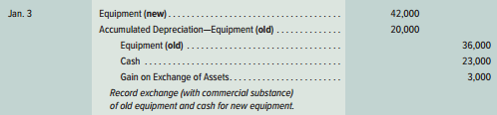
Exchange With Commercial Substance: A Gain
Let’s assume the same facts as on the previous screen except that the company pays $23,000 cash with the trade-in.
Learning Objective P5: Account for asset exchanges.
Notes:
Let’s assume the same facts as in the preceding asset exchange except that the company pays $23,000 cash, not $33,000, with the trade-in.
We are told that this exchange has commercial substance and that the old equipment has a trade-in allowance of $19,000. This exchange yields a gain as computed in the right-most (Gain) columns of Exhibit 10A.1; the gain is computed as Asset received − Assets given = $42,000 − $39,000 = $3,000. We can also compute the gain as Trade-in allowance − Book value of assets given = $19,000 − $16,000 = $3,000. The entry to record this asset exchange is shown on this slide.

Slide 72
NEED-TO-KNOW 10-7
A company acquires $45,000 in new web servers. In exchange, the company trades in old web servers along
with a cash payment. The old servers originally cost $30,000 and had accumulated depreciation of $23,400 at
the time of the trade. Prepare entries to record the trade under two different assumptions where (a) the exchange
has commercial substance and the old servers have a trade-in allowance of $3,000 and (b) the exchange has
commercial substance and the old servers have a trade-in allowance of $7,000.
Does the exchange have commercial substance? If the answer is “yes”, then the answer to “Are gains and losses recognized?” is also “yes”.
Per SFAS 153, commercial substance implies that it alters the company’s future cash flows.
Cost of old equipment
$30,000
Accumulated depreciation
(23,400)
Book value of old equipment
$6,600
Trade-in allowance
$3,000
Loss on exchange
$3,600
Loss to be recognized?
Yes
With Commercial Substance
General Journal
Debit
Credit
Equipment (new)
45,000
Accumulated Depreciation
23,400
Loss on Exchange of Assets ($6,600 - $3,000)
3,600
Cash ($45,000 - $3,000)
42,000
Equipment (old)
30,000
Learning Objective P5: Account for asset exchanges.
Notes:
Need-to-Know 10.7

Slide 73
NEED-TO-KNOW 10-7
A company acquires $45,000 in new web servers. In exchange, the company trades in old web servers along
with a cash payment. The old servers originally cost $30,000 and had accumulated depreciation of $23,400 at
the time of the trade. Prepare entries to record the trade under two different assumptions where (a) the exchange
has commercial substance and the old servers have a trade-in allowance of $3,000 and (b) the exchange has
commercial substance and the old servers have a trade-in allowance of $7,000.
Does the exchange have commercial substance? If the answer is “yes”, then the answer to “Are gains and losses recognized?” is also “yes”.
Cost of old equipment
$30,000
Accumulated
(23,400)
Book value of old equipment
$6,600
Trade-in allowance
$7,000
Gain on exchange
$400
Gain to be recognized?
Yes
With Commercial Substance
General Journal
Debit
Credit
Equipment (new)
45,000
Accumulated Depreciation
23,400
Cash ($45,000 - $7,000)
38,000
Equipment (old)
30,000
Gain on Exchange of Assets
400
Learning Objective P5: Account for asset exchanges.
Notes:
Need-to-Know 10.7

Slide 74
End of Chapter 10

