Slide 1
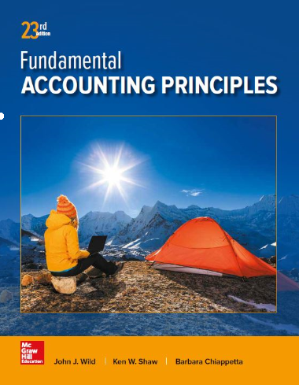
Process Costing
Chapter 20
Wild, Shaw, and Chiappetta
Fundamental Accounting Principles
23rd Edition
Notes:
Chapter 20: Process Costing

Slide 2
Chapter 20 Learning Objectives
CONCEPTUAL
C1 Explain process operations and the way they differ from job order operations.
C2 Define and compute equivalent units and explain their use in process costing.
C3 Describe accounting for production activity and preparation of a process cost summary using weighted average.
C4 Appendix 20-A Describe accounting for production activity and preparation of a process cost summary using FIFO.
ANALYTICAL
A1 Compare process costing and job order costing.
A2 Explain and illustrate a hybrid costing system.
PROCEDURAL
P1 Record the flow of materials costs in process costing.
P2 Record the flow of labor costs in process costing.
P3 Record the flow of factory overhead costs in process costing.
P4 Record the transfer of goods across departments, to Finished Goods Inventory, and to Cost of Goods Sold.

Slide 3
C1: Explain process operations and the way they differ from job order operations.
Learning Objective

Slide 4
Process Operations
Used for production of identical, low-cost items.
Mass produced in automated continuous production process.
Costs cannot be directly traced to each unit of product.
Series of repetitive processes.
Each process applies direct materials, labor, and overhead to move toward completion.
Final process produces finished goods ready for sale to customers.
Learning Objective C1: Explain process operations and the way they differ from job order operations.
Notes:
Process operations involve the mass production of similar products in a continuous flow of sequential processes. A key feature of process operations is the high level of standardization needed if the system is to produce large volumes of products. Thus, process operations use a standardized process to make similar products; job order operations use a customized process to make unique products.
Involves operations having a series of repetitive processes resulting in a noncustomized product or service. Understanding processes for companies with process operations is crucial for measuring their costs. Increasingly, process operations use machines and automation to control product quality and reduce manufacturing costs.
In a process operation, each process is identified as a separate production department. With the exception of the first process or department, each receives the output from the prior department as a partially processed product. Depending on the nature of the process, each process applies direct labor, overhead, and additional direct materials to move the product toward completion. Only the final process or department in the series produces finished goods ready for sale to customers.

Slide 5
A1: Compare process costing and job order costing.
Learning Objective

Slide 6
Comparing Process and Job Order Costing Systems
Job Order Systems
Custom/individual job
Heterogeneous products
Low production volume
High product flexibility
Low/medium standardization
Process Systems
Individual process
Homogeneous product
High production volume
Low product flexibility
High standardization
Learning Objective A1: Compare process costing and job order costing.
Notes:
Both job order costing systems and process costing systems track direct materials, direct labor, and overhead costs. The measurement focus in a job order costing system is on the individual job or batch, whereas in a process costing system, it is on the individual process. Regardless of the measurement focus, we are ultimately interested in determining the cost per unit of product (or service) resulting from either system.
While both measure costs per unit, these two accounting systems differ in terms of how they do so. A job order system measures cost per unit upon completion of a job, by dividing the total cost for that job by the number of units in that job. As we showed in the previous chapter, job cost sheets accumulate the costs for each job. In a job order system, the cost object is a job. A process costing system measures unit costs at the end of a period (for example, a month) by combining the costs per equivalent unit from each separate department. In process costing, the cost object is the process.

Slide 7
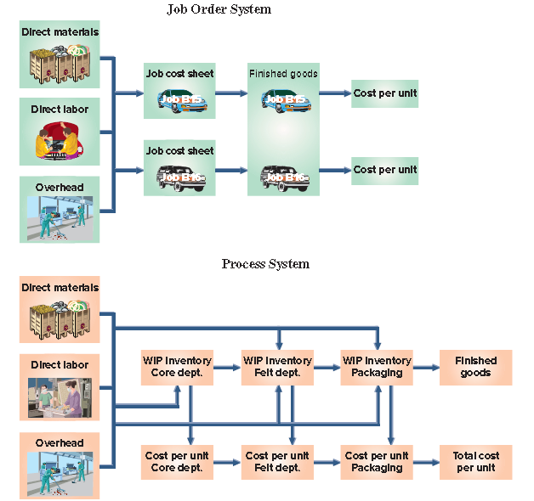
Comparing Process and Job Order Costing Systems
Exhibit 20.2
Learning Objective A1: Compare process costing and job order costing.
Notes:
Job order costing often uses only one Work in Process Inventory account; the balance in this account agrees with the accumulated balances across all the job cost sheets for the jobs still in process.
Process costing, however, uses separate Work in Process Inventory accounts for each department. When the production process is complete in process costing, the completed goods and the accumulated costs are transferred from the Work in Process Inventory account for the final department in the series of processes to the Finished Goods Inventory account.
Review what you have learned in the following NEED-TO-KNOW Slide.

Slide 8
NEED-TO-KNOW 20-1
Complete the following table with either a yes or no regarding the attributes of job order and
process costing systems.
Job Order
Process
Use direct materials, direct labor, and overhead costs
Yes
Yes
Use job cost sheets to accumulate costs
Yes
No
Typically use several Work in Process Inventory accounts
No
Yes
Yield a cost per unit of product
Yes
Yes
Learning Objective A1: Compare process costing and job order costing.
Notes:
Complete the following table with either a yes or no regarding the attributes of job order and process costing systems.
Use direct materials, direct labor, and overhead costs. This is true for both job order and process costing systems.
Use job cost sheets to accumulate costs. This is only true for job order costing; process costing does not use job sheets.
Typically use several Work in Process Inventory accounts. This is not true for job order costing. Instead, the detail of the Work in Process is held on the various job cost sheets. Under process costing, it is very common to have several Work in Process Inventory accounts.
And, both job order and process costing systems yield a cost per unit of product.

Slide 9
C2: Define and compute equivalent units and explain their use in process costing.
Learning Objective

Slide 10
Equivalent Units of Production (EUP)
EUP must be calculated for the Work in Process account.
Learning Objective C2: Define and compute equivalent units and explain their use in process costing.
Notes:
Companies with process operations typically end each period with inventories of both finished goods and work in process.
A key idea in process costing is that of Equivalent Units of Production (EUP), a term that refers to the number of units that could have been started and completed given the costs incurred during the period. For example, 100,000 tennis balls that are 60% through the production process is equivalent to 60,000 (100,000 units 3 60%) tennis balls that have completed the entire production process. This means that the cost to put 100,000 units 60% of the way through the production process is equivalent to the cost to put 60,000 units completely through the production process. Having information about the costs of partially
completed goods makes it possible to measure the firm’s production activity for the period.

Slide 11
EUP for Materials and Conversion Costs
Learning Objective C2: Define and compute equivalent units and explain their use in process costing.
Notes:
In many processes, the equivalent units of production for direct materials are not the same with respect to direct labor and overhead. For example, direct materials, like rubber for tennis ball cores, might enter production entirely at the beginning of a process; direct labor and overhead, in contrast, might be used continuously throughout the process. How does a manufacturer account for these timing differences? Again, by measuring equivalent units of production. For example, if all of the direct materials to produce 10,000 units have entered the production process, but those units have received only 20% of their direct labor and overhead costs, equivalent units would be computed as shown in this slide.

Slide 12
Weighted Average versus FIFO
versus
Weighted Average
FIFO
Learning Objective C2: Define and compute equivalent units and explain their use in process costing.
Notes:
The weighted-average method combines units and costs across two periods in computing equivalent units. The FIFO method computes equivalent units based only on production activity in the current period. The objectives, concepts, and journal entries (but not amounts) are the same under the weighted-average and FIFO methods; the computations of equivalent units differ. While the FIFO method is generally considered to be more precise than the weighted-average method, it requires more calculations. Often, the differences between the two methods are not large. When using a just-in-time inventory system, these different methods will yield very similar results because inventories are immaterial.

Slide 13
C3: Describe accounting for production activity and preparation of a process cost summary using weighted average.
Learning Objective

Slide 14
Process Costing Illustration
GenX uses a weighted average cost flow system with the following four steps:
Determine physical flow of units.
Compute equivalent units of production.
Compute cost per equivalent unit.
Assign and reconcile costs.
Learning Objective C3: Describe accounting for production activity and preparation of a process cost summary using weighted average.
Notes:
As with all situations involving inventory costs, we must choose a cost flow method. We will use the weighted average method for GenX. Process cost applications can be overwhelming if we do not use a well-planned approach. The four-step procedure will enable us to solve a process cost application in manageable parts. The four steps are:
1. Determine physical flow of units.
2. Compute equivalent units of production.
3. Compute cost per equivalent unit.
4. Assign and reconcile costs.

Slide 15
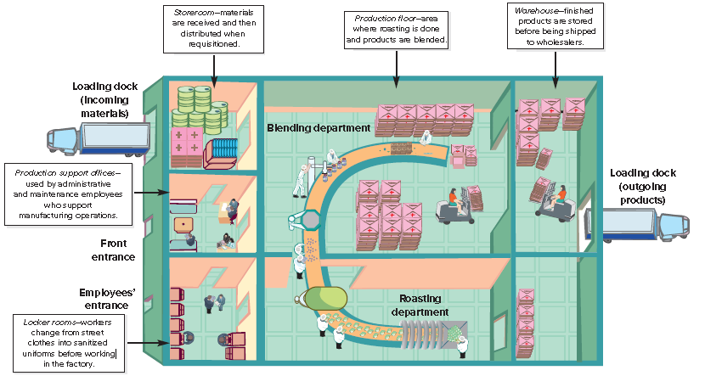
Overview of GenX Company’s Process Operation
Exhibit 20.4
Learning Objective C3: Describe accounting for production activity and preparation of a process cost summary using weighted average.
Notes:
The GenX Company produces an organic trail mix called FitMix. Its target customers are active people who are interested in fitness and the environment. GenX sells FitMix to wholesale distributors, who in turn sell it to retailers. FitMix is manufactured in a continuous, two-process operation (roasting and blending), shown in this slide.
In the first process (roasting department), GenX roasts, oils, and salts organically grown peanuts. These peanuts are then passed to the blending department, the second process. In the blending department, machines blend organic chocolate pieces and organic dried fruits with the peanuts from the first process. The blended mix is then inspected and packaged for delivery. In both departments, direct materials enter production at the beginning of the process, while conversion costs
occur continuously throughout each department’s processing.

Slide 16
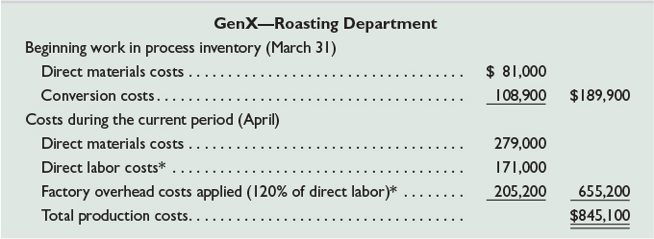
Process Operations – GenX
Exhibit 20.5
Exhibit 20.6
Learning Objective C3: Describe accounting for production activity and preparation of a process cost summary using weighted average.
Notes:
Here we see the units processed and the completion percentages. Take a minute to become familiar with these numbers before moving on to the cost information. Process costing applications include lots of numbers and in the first process (roasting department), GenX roasts, oils, and salts organically grown peanuts. These peanuts are then passed to the blending department, the second process. In the blending department, machine blends organic chocolate pieces and organic dried fruits with the peanuts from the first process. The blended mix is then inspected and packaged for delivery. In both departments, direct materials enter production at the beginning of the process, while conversion costs occur continuously throughout each department’s processing.
Exhibit 20.5 presents production data (in units) for GenX’s roasting department. This exhibit includes the percentage of completion for both materials and conversion; beginning work in process inventory is 100% complete with respect to materials but only 65% complete with respect to conversion. Ending work in process inventory is 100% complete with respect to materials but only 25% complete with respect to conversion. Units completed and transferred to the blending department are 100% complete with respect to both materials and conversion.
The bottom graphic represents production cost data for GenX’s roasting department. We will use the data to illustrate the four-step approach to process costing.

Slide 17
Determine Physical Flow of Units
Exhibit 20.7
Learning Objective C3: Describe accounting for production activity and preparation of a process cost summary using weighted average.
Notes:
Step 1 is to determine the physical flow of units. A physical flow reconciliation is a report that reconciles (1) the physical units started in a period with (2) the physical units completed in that period. A physical flow reconciliation for GenX’s roasting department is shown in this slide for April.

Slide 18
Compute Equivalent Units of Production
Exhibit 20.8
*Transferred to next department or finished goods inventory.
Exhibit 20.9
Learning Objective C3: Describe accounting for production activity and preparation of a process cost summary using weighted average.
Notes:
Step 2 is to compute equivalent units of production for direct materials and conversion costs for April. Since direct materials and conversion costs typically enter a process at different rates, departments must compute equivalent units separately for direct materials and conversion costs. The top graphic shows the formula to compute equivalent units under the weighted-average method for both direct materials and conversion costs.
For GenX’s roasting department, we must convert the 120,000 physical units measure to equivalent units based on how each input has been used. The roasting department fully completed its work on 100,000 units, and partially completed its work on 20,000 units. Equivalent units are computed by multiplying the number of units accounted for (from Step 1) by the percentage of completion for each input—see the second graphic.
The first row of the second graphic reflects units transferred out in April. The roasting department entirely completed its work on the 100,000 units transferred out. These units have 100% of the materials and conversion required, or 100,000 equivalent units of each input (100,000 x 100%).
GenX ended the month with 20,000 partially completed units. For direct materials, the units in ending work in process inventory include all materials required, so there are 20,000 equivalent units (20,000 x 100%) of materials in the unfinished physical units. Regarding conversion, the units in ending work in process inventory include 25% of the conversion required, which implies 5,000 equivalent units of conversion (20,000 x 25%).
The final row reflects the total equivalent units of production, which is whole units of product that could have been manufactured with the amount of inputs used to create some complete and some incomplete units. For GenX, the amount of inputs used to produce 100,000 complete units and to start 20,000 additional units is equivalent to the amount of direct materials in 120,000 whole units and the amount of conversion in 105,000 whole units.
Review what you have learned in the following NEED-TO-KNOW Slide.

Slide 19
NEED-TO-KNOW 20-2
A department began the month with 8,000 units in work in process inventory. These units were 100%
complete with respect to direct materials and 40% complete with respect to conversion. During the month,
the department started 56,000 units and completed 58,000 units. Ending work in process inventory includes
6,000 units, 100% complete with respect to direct materials and 70% complete with respect to
conversion. Use the weighted-average method of process costing to:
1. Compute the department’s equivalent units of production for the month for direct materials.
64,000
2. Compute the department’s equivalent units of production for the month for conversion.
62,200
Work in Process Inventory - Units
Beginning Units
8,000
Started
56,000
Total Units
64,000
Transferred out
58,000
Ending Units
6,000
Units Schedule (Physical Flow Reconciliation)
Units in Beginning Inventory
8,000
Units completed and transferred out
58,000
Units Started
56,000
Units in Ending Inventory
6,000
Total Units to Account For
64,000
Total Units Accounted For
64,000
% Completion
EUP
Physical Units
Materials
Conversion
Materials
Conversion
Transferred out
58,000
100%
100%
58,000
58,000
Ending Inventory
6,000
100%
70%
6,000
4,200
Total units
64,000
64,000
62,200
Learning Objective C3: Describe accounting for production activity and preparation of a process cost summary using weighted average.
Notes:
A department began the month with 8,000 units in work in process inventory. These units were 100% complete with respect to direct materials and 40% complete with respect to conversion. During the month, the department started 56,000 units and completed 58,000 units. Ending work in process inventory includes 6,000 units, 100% complete with respect to direct materials and 70% complete with respect to conversion. Use the weighted-average method of process costing to:
1. Compute the department’s equivalent units of production for the month for direct materials.
2. Compute the department’s equivalent units of production for the month for conversion.
Before we do the calculations, I think it's really helpful to set up a T-account in terms of units. We had 8,000 units in beginning inventory and the department started an additional 56,000 units. There are 64,000 units to account for. By the end of the month, the department has completed and transferred out 58,000 units, leaving 6,000 units in ending inventory. This units T-account is very helpful to create the units schedule, the physical flow reconciliation. 8,000 units in beginning inventory plus 56,000 units started equals 64,000 units to account for. We account for the units by describing their location at the end of the period. By the end of the period, 58,000 units have been transferred out and 6,000 units remain in ending inventory. Total units accounted for, 64,000.
Using the weighted average method of process costing, we focus on the condition of the units at the end of the period. To calculate the equivalent units of production, we take the physical units, 58,000 units that have been transferred out and 6,000 units in ending inventory, a total of 64,000, and we multiplied by the percentage of completion to calculate the equivalent units of production (abbreviated as EUP). Since the units have been transferred out, they must be 100% complete with respect to materials and 100% complete with respect to conversion; otherwise the subsequent department would have rejected those units!
To calculate the equivalent units of production, we multiply the physical units by the percentage of completion. 58,000 units multiplied by 100% is 58,000 equivalent units of materials. 58,000 physical units that are 100% complete with respect to conversion is the equivalent of 58,000 units of production. The 6,000 units in ending inventory are 100% complete with respect to materials; 6,000 units multiplied by 100% is 6,000 equivalent units of materials. The ending inventory units are only 70% complete with respect to conversion; 6,000 units multiplied by 70% is 4,200 equivalent units of production. The 64,000 units represent 64,000 equivalent units of materials and 62,200 equivalent units of conversion.

Slide 20
⬥ Compute Cost Per Equivalent Unit
Exhibit 20.10
Learning Objective C3: Describe accounting for production activity and preparation of a process cost summary using weighted average.
Notes:
Step 3 is to compute the cost per equivalent unit. Under the weighted-average method, the computation of EUP does not separate the units in beginning inventory from those started this period, as shown above. Similarly, the weighted average method combines the costs of beginning work in process inventory with the costs incurred in the current period. This total cost is then divided by the equivalent units of production (from Step 2), to compute the average cost per equivalent unit. This process is illustrated in this slide. For direct materials, the cost averages $3.00 per EUP. For conversion, the cost per equivalent unit averages $4.62 per unit.

Slide 21
Assign and Reconcile Costs
Exhibit 20.11
Learning Objective C3: Describe accounting for production activity and preparation of a process cost summary using weighted average.
Notes:
Step 4 is to assign and reconcile costs. The EUP from Step 2 and the cost per EUP from Step 3 are used in Step 4 to assign costs to units that the roasting department completed and transferred to the blending department (100,000 units), and (b) units that remain in process in the roasting department (20,000 units). This is illustrated in this slide.
Cost of Units Completed and Transferred - The 100,000 units completed and transferred to the blending department required 100,000 EUP of direct materials and 100,000 EUP of conversion. Thus, we assign $300,000 (100,000 EUP x $3.00 per EUP) of direct materials cost to those units. Similarly, we assign $462,000 (100,000 EUP x $4.62 per EUP) of conversion to those units. The total cost of the 100,000 completed and transferred units is $762,000 ($300,000 + $462,000) and their average cost per unit is $7.62 ($762,000 / 100,000 units).
Cost of Ending Work in Process Inventory - There are 20,000 incomplete units in work in process inventory at period-end. For direct materials, those units have 20,000 EUP of material (from Step 2) at a cost of $3.00 per EUP (from Step 3), which yields the materials cost of work in process inventory of $60,000 (20,000 EUP x $3.00 per EUP). For conversion, the in-process units reflect 5,000 EUP (from Step 2). Using the $4.62 conversion cost per EUP (from Step 3) we obtain conversion costs for in-process inventory of $23,100 (5,000 EUP x $4.62 per EUP). Total cost of work in process inventory at period-end is $83,100 ($60,000 + $23,100).
Review what you have learned in the following NEED-TO-KNOW Slide.

Slide 22
NEED-TO-KNOW 20-3
A department began the month with conversion costs of $65,000 in its beginning work in process inventory.
During the month, the department incurred $55,000 of conversion costs. Equivalent units of production
for conversion for the month was 15,000 units. The department completed and transferred 12,000
units to the next department.
1. Compute the department’s cost per equivalent unit for conversion for the month.
$8.00
2. Compute the department’s conversion cost of units transferred to the next department for the month.
$96,000
Work in Process Inventory
Beginning Inventory
65,000
DL and OH
55,000
120,000
Transferred out
96,000
Ending Inventory
24,000
EUP
Cost
Allocated
Conversion
per EUP
Cost
Transferred out
12,000
$8.00
$96,000
Ending Inventory
3,000
$8.00
24,000
Total units
15,000
$120,000
Cost per Equivalent Unit
Cumulative Costs
$120,000
Total EUP
15,000
$8.00
per equivalent unit of conversion
Learning Objective C3: Describe accounting for production activity and preparation of a process cost summary using weighted average.
Notes:
A department began the month with conversion costs of $65,000 in its beginning work in process inventory. During the month, the department incurred $55,000 of conversion costs. Equivalent units of production for conversion for the month was 15,000 units. The department completed and transferred 12,000 units to the next department.
1. Compute the department’s cost per equivalent unit for conversion for the month. To calculate the cost per equivalent unit, we take the cumulative costs and divide by the total equivalent units of production. The cumulative costs include the beginning inventory cost of $65,000 plus the current month's cost of $55,000, a total of $120,000. When we divide by the total equivalent units of production, 15,000 equivalent units of conversion, the cost per equivalent unit of conversion is $8.
2. Compute the department’s conversion cost of units transferred to the next department for the month. Of the total 15,000 equivalent units of conversion, 12,000 units have been transferred out. 12,000 equivalent units of production multiplied by $8 per unit is a total allocated cost of $96,000. The remaining 3,000 equivalent units of production relate to the ending inventory, 3,000 equivalent units of production multiplied by $8 per unit is an allocated cost of $24,000. All $120,000 has been allocated. $96,000 of the conversion costs have been transferred out, with $24,000 of conversion costs remaining in ending inventory.

Slide 23
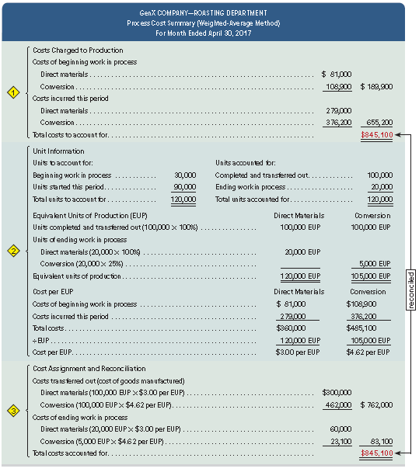
Process Cost Summary
Exhibit 20.13
Learning Objective C3: Describe accounting for production activity and preparation of a process cost summary using weighted average.
Notes:
An important managerial accounting report for a process costing system is the process cost summary (also called production report), which is prepared separately for each process or production department. Three reasons for the summary are to (1) help department managers control and monitor their departments, (2) help factory managers evaluate department managers’ performances, and (3) provide cost information for financial statements. A process cost summary achieves these purposes by describing the costs charged to each department, reporting the equivalent units of production achieved by each department, and determining the costs assigned to each department’s output.

Slide 24
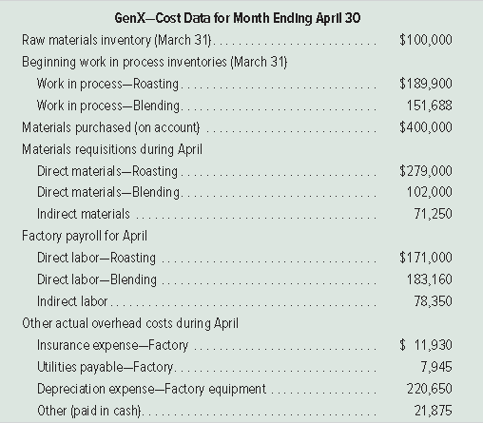
Exhibit 20.15
Cost Data For GenX
Learning Objective C3: Describe accounting for production activity and preparation of a process cost summary using weighted average.
Notes:
This slide presents cost data for GenX. Roasting department costs are from earlier slides. We use these data next to show the journal entries in a process costing system.

Slide 25
P1: Record the flow of materials costs in process costing.
Learning Objective

Slide 26
Accounting for Material Costs
Learning Objective P1: Record the flow of materials costs in process costing.
Notes:
The summary entry for receipts of raw materials in April follows (dates in journal entries are omitted because they are summary entries, often reflecting two or more transactions or events).
The entry to record the use of direct materials by GenX’s production departments in April follows. These direct materials costs flow into each department’s separate Work in Process Inventory account.
The last entry records the cost of indirect materials used by GenX in April.

Slide 27
P2: Record the flow of labor costs in process costing.
Learning Objective

Slide 28
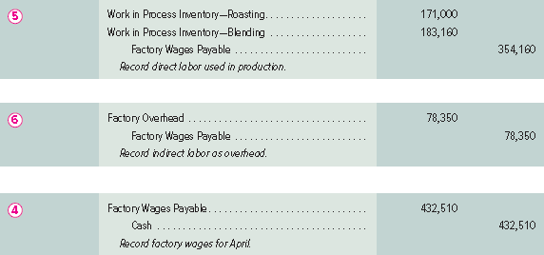
Accounting for Labor Costs
Learning Objective P2: Record the flow of labor costs in process costing.
Notes:
The first entry then records direct labor used. These direct labor costs flow into each department’s separate Work in Process Inventory account.
The second entry records these indirect labor costs.
After GenX posts these entries for direct and indirect labor, the Factory Wages Payable account has a balance of $432,510 ($354,160 + $78,350). The final entry shows the payment of this total payroll. After this entry, the Factory Wages Payable account has a zero balance.

Slide 29
P3: Record the flow of factory overhead costs in process costing.
Learning Objective

Slide 30
Accounting for Factory Overhead
Learning Objective P3: Record the flow of factory overhead costs in process costing.
Notes:
The first entry records overhead costs other than indirect materials and indirect labor for April. These overhead items include the costs of insuring production assets, renting the factory building, using factory utilities, and depreciating factory equipment not directly related to a specific process.
GenX records its applied overhead with the second entry. Recall that companies use predetermined overhead rates to apply overhead. These rates are estimated at the beginning of a period and used to apply overhead during the period. The application of overhead allows managers to obtain up-to-date estimates of the costs of their processes during the period. This is important for process costing, where goods are transferred across departments before the entire production process is
complete.
Factory overhead is applied to processes by relating overhead cost to another variable such as direct labor hours or machine hours used. In many situations, a single allocation basis such as direct labor hours (or a single rate for the entire plant) fails to provide useful allocations. As a result, management may use different rates for different production departments.
Review what you have learned in the following NEED-TO-KNOW Slides.

Slide 31
NEED-TO-KNOW 20-4
Tower Mfg. estimates it will incur $200,000 of total overhead costs during the year. Tower allocates overhead
based on machine hours; it estimates it will use a total of 10,000 machine hours during the year. During
February, the assembly department of Tower Mfg. uses 375 machine hours. In addition, Tower incurred
actual overhead costs as follows during February: indirect materials, $1,800; indirect labor, $5,700;
depreciation on factory equipment, $8,000; factory utilities, $500.
1. Compute the company’s predetermined overhead rate for the year.
$20 per machine hour
Predetermined Overhead Rate =
Estimated Overhead Costs
$200,000
Estimated Activity Base
10,000 machine hours
=
$20 per machine hour
Machine Hours Used
x Predetermined OH rate
= OH Applied
Assembly Dept.
375 hours
x $20 per hour
= $7,500 OH applied
Factory Overhead
Actual OH Incurred
OH Applied to Production
Learning Objective P3: Record the flow of factory overhead costs in process costing.
Notes:
Tower Mfg. estimates it will incur $200,000 of total overhead costs during the year. Tower allocates overhead based on machine hours; it estimates it will use a total of 10,000 machine hours during the year. During February, the assembly department of Tower Mfg. uses 375 machine hours. In addition, Tower incurred actual overhead costs as follows during February: indirect materials, $1,800; indirect labor, $5,700; depreciation on factory equipment, $8,000; factory utilities, $500.
1. Compute the company’s predetermined overhead rate for the year. The predetermined overhead rate is calculated by taking the estimated overhead costs and dividing by the estimated activity base. $200,000 in estimated overhead costs divided by 10,000 machine hours is a predetermined overhead rate of $20 per machine hour. The predetermined overhead rate is used to assign overhead costs to production. During February, the assembly department used 375 machine hours. For each machine hour used, the production will be charged with $20 of overhead. The total amount of overhead applied to the units produced during February is $7,500. The Factory Overhead account is debited for the actual overhead costs incurred, and credited for the overhead applied to production.

Slide 32
NEED-TO-KNOW 20-4
Tower Mfg. estimates it will incur $200,000 of total overhead costs during the year. Tower allocates overhead
based on machine hours; it estimates it will use a total of 10,000 machine hours during the year. During
February, the assembly department of Tower Mfg. uses 375 machine hours. In addition, Tower incurred
actual overhead costs as follows during February: indirect materials, $1,800; indirect labor, $5,700;
depreciation on factory equipment, $8,000; factory utilities, $500.
2. Prepare journal entries to record (a) overhead applied for the assembly department for the month and
(b) actual overhead costs used during the month.
General Journal
Debit
Credit
a)
Work in Process Inventory
7,500
Factory Overhead (375 machine hours x $20 per MH)
7,500
b)
Factory Overhead
16,000
Raw Materials Inventory
1,800
Factory Wages Payable
5,700
Accumulated Depreciation - Factory Equipment
8,000
Utilities Payable
500
Factory Overhead
Actual OH Incurred
OH Applied to Production
Ind. Materials
1,800
Ind. Labor
5,700
Fact. Deprec.
8,000
Fact. Utilities
500
16,000
7,500
Underapplied
8,500
Learning Objective P3: Record the flow of factory overhead costs in process costing.
Notes:
The journal entry to apply overhead to the assembly department for the month is a debit to Work in Process Inventory, $7,500, and a credit to Factory Overhead. The Factory Overhead account is credited for $7,500. The journal entry to record actual overhead costs used during the month will result in debits to the Factory Overhead account. Indirect materials result in a debit to Factory Overhead and a credit to Raw Materials Inventory. Indirect labor costs are debits to Factory Overhead and credits to Factory Wages Payable. Depreciation on factory equipment results in a debit to Factory Overhead and a credit to Accumulated Depreciation - Factory Equipment. And factory utilities result in debits to Factory Overhead and credits to Utilities Payable. The total actual overhead incurred is $16,000. For the month of February, actual overhead costs incurred exceed the amount of overhead applied. This results in an underapplied balance of $8,500.

Slide 33
P4: Record the transfer of goods across departments, to finished goods inventory, and to cost of goods sold.
Learning Objective

Slide 34
Accounting for Transfers
Learning Objective P4: Record the transfer of goods across departments, to finished goods inventory, and to cost of goods sold.
Notes:
The process cost summary for the roasting department shows that the 100,000 units transferred to the blending department are assigned a cost of $762,000. The entry to record this transfer is shown first.
At the end of the month, the blending department transferred 97,000 completed units, with a related cost of $1,262,940, to finished goods. The entry to record this transfer is shown second.
Assume that GenX sold 106,000 units of FitMix this period, and that its beginning finished goods inventory was 26,000 units with a cost of $338,520. Also assume that its ending finished goods inventory consists of 20,000 units at a cost of $260,400. Using this information, cost of goods sold is computed as $1,341,060.
The summary entry to record cost of goods sold for this period is shown last.

Slide 35
Trends in Process Operations
Process design
Just-in-time production
Customer orientation
Yield
Automation
Services
Continuous Processing
Learning Objective P4: Record the transfer of goods across departments, to finished goods inventory, and to cost of goods sold.
Notes:
Recent trends in process operations include:
Process design - Management concerns with production efficiency can lead companies to entirely reorganize production processes. For example, instead of producing different types of computers in a series of departments, a separate work center for each computer can be established in one department. The process cost system is then changed to account for each work center’s costs.
Just-in-time production - Companies are increasingly adopting just-in-time techniques. With a just-in-time inventory system, inventory levels can be minimal. If raw materials are not ordered or received until needed, a Raw Materials Inventory account might be unnecessary. Instead, materials cost is immediately debited to the goods in process inventory account. Similarly, a finished goods inventory account may not be needed. Instead, cost of finished goods may be immediately debited to the cost of goods sold account.
Automation - Advances in technology increasingly enable companies to automate their production processes. This allows them to reduce direct labor costs.
Continuous Processing - In some companies, like Pepsi Bottling, materials move continuously through the manufacturing process. In these cases, a materials consumption report summarizes the materials used and replaces materials requisitions.
Services - Service-based businesses are increasingly prevalent. For routine, standardized services like oil changes and simple tax returns, computing costs based on the process is simpler and more useful than a cost per individual job.
Customer orientation - Focus on customer orientation also leads to improved processes. A manufacturer of control devices improved quality and reduced production time by forming teams to study processes and suggest improvements. Oregon Ice Cream Company studied customer tastes to develop a more pleasing ice cream texture.
Yield – many process operations convert large amounts of raw materials into finished goods. Yield is the amount of material output relative to the amount of material input. When yields are lower than expected, managers usually ask why and then take corrective action.

Slide 36
A2: Explain and illustrate a hybrid costing system.
Learning Objective

Slide 37
Hybrid Costing System
Hybrid system (operation costing system) contains features of both process and job order operations.
Requires a hybrid costing system to determine cost of products/services.
Companies try to standardize processes while also meeting customer needs.
Important to monitor and control costs.
Learning Objective A2: Explain and illustrate a hybrid costing system.
Notes:
This chapter explained the process costing system and contrasted it with the job order costing system. Many organizations use a hybrid system that contains features of both process and job order operations. A recent survey of manufacturers revealed that a majority use hybrid systems (also called operation cost
systems).
A hybrid system of processes requires a hybrid costing system to properly cost products or services.
Today companies are increasingly trying to standardize processes while attempting to meet individual customer needs. To the extent that differences among individual customers’ requests are large, understanding the costs to satisfy those requests is important. Thus, monitoring and controlling both process
and job order costs are important.

Slide 38
C4: Describe accounting for production activity and preparation of a process cost summary using FIFO.
Learning Objective

Slide 39
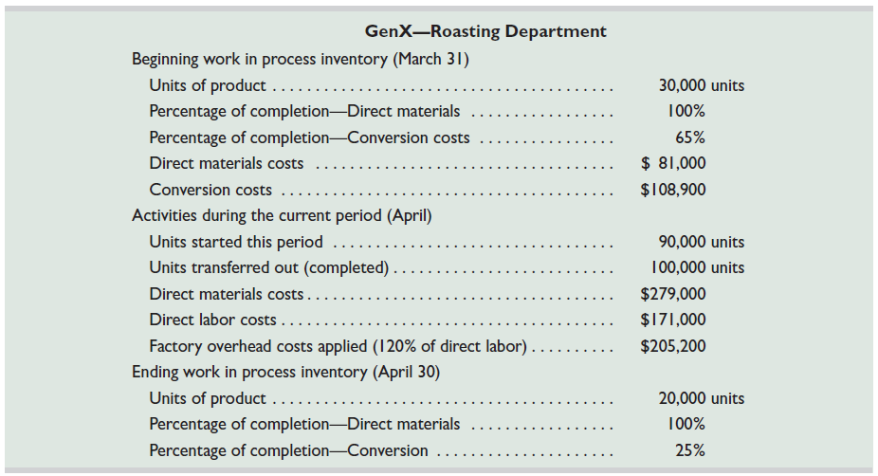
FIFO Method of Process Costing
Exhibit 20A.3
The same GenX data for April will also be used to illustrate the FIFO method.
Learning Objective C4: Describe accounting for production activity and preparation of a process cost summary using FIFO.
Notes:
In computing cost per equivalent unit, the FIFO method ignores the cost of beginning work in process inventory. Instead, FIFO uses only the costs incurred in the current period.
This slide shows selected information from GenX’s roasting department for the month of April. Accounting for a department’s activity for a period includes four steps: (1) determine physical flow, (2) compute equivalent units, (3) compute cost per equivalent unit, and (4) determine cost assignment and reconciliation.

Slide 40
Determine Physical Flow of Units
Exhibit 20A.4
Learning Objective C4: Describe accounting for production activity and preparation of a process cost summary using FIFO.
Notes:
Step 1: determine the physical flow of units. A physical flow reconciliation is a report that reconciles (1) the physical units started in a period with (2) the physical units completed in that period. The physical flow reconciliation for GenX’s roasting department is shown in this slide for April.

Slide 41
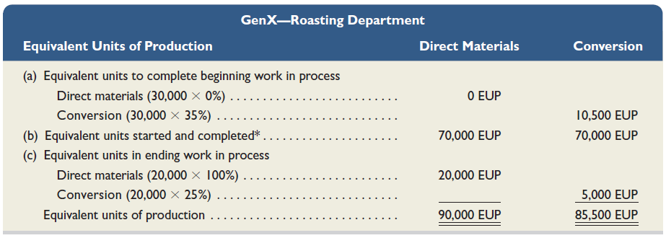
Compute Equivalent Units of Production
Exhibit 20A.6
* | Units completed this period | 100,000
 | Less units in beginning goods in process | 30,000
 | Units started and completed this period | 70,000
Learning Objective C4: Describe accounting for production activity and preparation of a process cost summary using FIFO.
Notes:
Step 2: compute the equivalent units of production. In computing the equivalent units of production, the roasting department must consider these three distinct groups of units:
Units in beginning work in process inventory (30,000).
Units started and completed during the month (70,000).
Units in ending work in process inventory (20,000).
GenX’s roasting department then computes equivalent units of production under FIFO as shown in this slide. We compute EUP for each of the three distinct groups of units, and sum them to find total EUP.
Review what you have learned in the following NEED-TO-KNOW Slide.

Slide 42
NEED-TO-KNOW 20-8
A department began the month with 50,000 units in work in process inventory. These units were 90%
complete with respect to direct materials and 40% complete with respect to conversion. During the month,
the department started 286,000 units; 220,000 of these units were completed during the month. The
Remaining 66,000 units are in ending work in process inventory, 80% complete with respect to direct materials
and 30% complete with respect to conversion. Use the FIFO method of process costing to:
1. Compute the department’s equivalent units of production for the month for direct materials.
277,800
2. Compute the department’s equivalent units of production for the month for conversion.
269,800
Work in Process Inventory - Units
Beginning Units
50,000
Beginning Units
50,000
Started
286,000
Started and Completed
220,000
Total units
336,000
Transferred out
270,000
Ending Units
66,000
Units Schedule (Physical Flow Reconciliation)
Units in Beginning Inventory
50,000
Units completed and transferred out
270,000
Units Started
286,000
Units in Ending Inventory
66,000
Total Units to Account For
336,000
Total Units Accounted For
336,000
Physical Units
% Done in
Current Month
EUP
Materials
Conversion
Materials
Conversion
Finish Beginning Inventory
50,000
10%
60%
5,000
30,000
Start and Complete
220,000
100%
100%
220,000
220,000
Start Ending Inventory
66,000
80%
30%
52,800
19,800
Total units
336,000
277,800
269,800
Learning Objective C4: Describe accounting for production activity and preparation of a process cost summary using FIFO.
Notes:
Need-to-Know 20-8

Slide 43
⬥ Compute Cost Per Equivalent Unit – FIFO
Exhibit 20A.7
Learning Objective C4: Describe accounting for production activity and preparation of a process cost summary using FIFO.
Notes:
Step 3 is to compute the cost per equivalent unit. To compute cost per equivalent unit, we take the direct materials and conversion costs added in April and divide by the equivalent units of production from Step 2. This slide illustrates these computations.
It is essential to compute costs per equivalent unit for each input because production inputs are added at different times in the process. The FIFO method computes the cost per equivalent unit based solely on this period’s EUP and costs (unlike the weighted-average method, which adds in the costs of the beginning work in process inventory).
Review what you have learned in the following NEED-TO-KNOW Slide.

Slide 44
NEED-TO-KNOW 20-9
A department started the month with beginning work in process inventory of $130,000 ($90,000 for direct
materials and $40,000 for conversion). During the month, the department incurred additional direct materials
costs of $700,000 and conversion costs of $500,000. Assume that, using the FIFO method, equivalent units
for the month were computed as 250,000 for materials and 200,000 for conversion.
1. Compute the department’s cost per equivalent unit of production for the month for direct materials.
2. Compute the department’s cost per equivalent unit of production for the month for conversion.
Cost per Equivalent Unit of Direct Materials:
Direct Material costs added in the current month
$700,000
Equivalent units of Production - Current Month
250,000
$2.80
per equivalent unit of direct materials
Cost per Equivalent Unit of Conversion:
Conversion costs added in the current month
$500,000
Equivalent units of Production - Current Month
200,000
$2.50
per equivalent unit of conversion
Learning Objective C4: Describe accounting for production activity and preparation of a process cost summary using FIFO.
Notes:
A department started the month with beginning work in process inventory of $130,000 ($90,000 for direct materials and $40,000 for conversion). During the month, the department incurred additional direct materials costs of $700,000 and conversion costs of $500,000. Assume that, using the FIFO method, equivalent units for the month were computed as 250,000 for materials and 200,000 for conversion.
1. Compute the department’s cost per equivalent unit of production for the month for direct materials.
2. Compute the department’s cost per equivalent unit of production for the month for conversion.
Using the FIFO method, cost per equivalent unit of production is calculated by taking the cost added in the current month and dividing by the equivalent units of production. The cost per equivalent unit of direct materials is calculated by taking the direct material costs added in the current month and dividing by the equivalent units of production; materials work done in the current month. $700,000 divided by 250,000 equivalent units of materials is a cost of $2.80 per equivalent unit of direct materials. To calculate the cost per equivalent unit of conversion, we take the conversion costs added in the current month and divide by the equivalent units of production. $500,000 divided by 200,000 equivalent units is a cost of $2.50 per equivalent unit of conversion. Notice that the costs of beginning Work in Process Inventory are not included in the calculation of cost per equivalent unit when using the FIFO method.

Slide 45
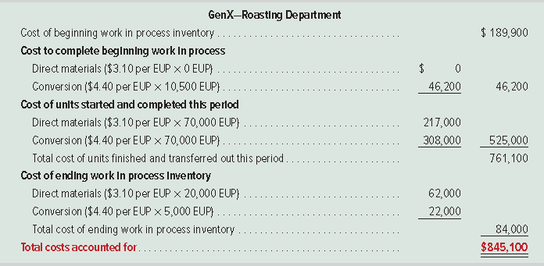
Assign and Reconcile Costs
Exhibit 20A.8
Learning Objective C4: Describe accounting for production activity and preparation of a process cost summary using FIFO.
Notes:
Step 4 is to assign and reconcile costs. The equivalent units determined in Step 2 and the cost per equivalent unit computed in Step 3 are both used to assign costs (1) to units that the production department completed and transferred to the blending department and (2) to units that remain in process at period-end. In this slide, under the section for cost of units transferred out, we see that the cost of units completed in April includes the $189,900 cost carried over from March for work already applied to the 30,000 units that make up beginning work in process inventory, plus the $46,200 incurred in April to complete those units. This next section includes the $525,000 of cost assigned to the 70,000 units started and completed this period. Thus, the total cost of goods manufactured in April is $761,100. The average cost per unit for goods completed in April is $7.611 ($761,100 / 100,000 completed units).
The computation for cost of ending work in process inventory is in final section of the Exhibit 20A.8. That cost of $84,000 ($62,000 + $22,000) also is the ending balance for the Work in Process Inventory— Roasting account.

Slide 46
Assign and Reconcile Costs
Exhibit 20A.9
Learning Objective C4: Describe accounting for production activity and preparation of a process cost summary using FIFO.
Notes:
We reconcile the costs accounted for in Step 3 to the costs that production was charged for as shown in this slide.

Slide 47
End of Chapter 20

