Slide 1

Accounting Information Systems
Chapter 7
Wild, Shaw, and Chiappetta
Fundamental Accounting Principles
23rd Edition
Notes:
Chapter 7: Accounting Information Systems

Slide 2
Chapter 7 Learning Objectives
CONCEPTUAL
C1 Identify the principles and components of accounting information systems.
C2 Explain the goals and uses of special journals.
C3 Describe the use of controlling accounts and subsidiary ledgers.
ANALYTICAL
A1 Compute segment return on assets and use it to evaluate segment performance.
PROCEDURAL
P1 Journalize and post transactions using special journals.
P2 Prepare and prove the accuracy of subsidiary ledgers.
2

Slide 3
C1:
Identify the principles and components of accounting information systems.
Learning Objective

Slide 4
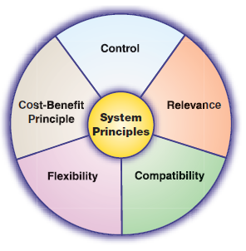
System Principles
Exhibit 7.1
Accounting information systems collect and process data from transactions and events, organize them in reports, and communicate results to decisions makers.
Learning Objective C1: Identify the principles and components of accounting information systems.
Notes:
Accounting information systems collect and process data from transactions and events, organize them in reports, and communicate results to decision makers. With the increasing complexity of business and the growing need for information, accounting information systems are more important than ever.
In an accounting system, the fundamental principles that must be included in any system are: control, relevance, compatibility, flexibility, and cost-benefit.
The control principle prescribes that an accounting information system has internal controls. Internal controls are methods and procedures allowing managers to control and monitor business activities.
The relevance principle prescribes that an accounting information system report useful, understandable, timely, and pertinent information for effective decision making.
The compatibility principle prescribes that an accounting information system conform with a company’s activities, personnel, and structure.
The flexibility principle prescribes that an accounting information system be able to adapt to changes in the company, business environment, and needs of decision makers.
The cost-benefit principle prescribes that the benefits from an activity in an accounting information system outweigh the costs of that activity.

Slide 5
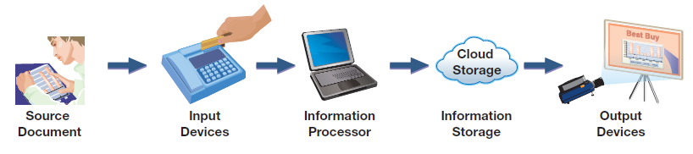
System Components
Increasingly, source documents are electronic files creating a “paperless” system.
Exhibit 7.2
Keyboards
Scanners
Computer technology
Notes:
All accounting information systems share components. The five basic components of accounting systems are source documents, input devices, information processors, information storage, and output devices.
Source documents provide the information processed by an accounting system. Examples of source documents include bank statements and checks, invoices from suppliers, billings to customers, cash register files, and employee earnings records. Source documents can be paper, although they increasingly are taking the form of electronic files and Web communications.
Input devices capture information from source documents and transfers it to the information processing component. These devices convert data on source documents to a form usable for the system. Keyboards and scanners are the most common input devices. For example, bar code readers capture code numbers and transfer them to the organization’s computer for processing.
Information processors transform and summarize information for use in analysis and reporting.
Information storage keeps data accessible to information processors. After being input and processed, data are stored for use in future analyses and reports. Auditors rely on this database when they audit both financial statements and a company’s controls.
Output devices take information out of an accounting system and make it available to users. Common output devices are printers, monitors, projectors, and web communications. Output devices provide users a variety of items including bills to customers, checks to suppliers, employee paychecks, financial statements, and internal reports.
Review what you have learned in the following NEED-TO-KNOW Slide.

Slide 6
NEED-TO-KNOW 7-1
Match each of the numbered descriptions with the principle, component, or descriptor that it best reflects.
Indicate your answer by entering the letter A through J in the blank provided.
A.
Control principle
F.
Source documents
B.
Relevance principle
G.
Input devices
C.
Compatibility principle
H.
Information processors
D.
Flexibility principle
I.
Information storage
E.
Cost-benefit principle
J.
Output devices
1.
J
Means to take information out of an accounting system and make it available to users.
2.
I
Keeps data in a form accessible to information processors.
3.
H
Systems that interpret, transform, and summarize information for use.
4.
G
Capture information from source documents and enable its transfer to information processing.
5.
F
Information for entries that can be in either paper or electronic form.
6.
E
Prescribes that benefits from an activity in a system outweigh the costs.
7.
D
Prescribes that a system be adaptable to changes in the company, environment, and user needs.
8.
C
Prescribes that a system conform with a company’s activities, personnel, and structure.
9.
B
Prescribes that a system report useful, understandable, timely, and pertinent information.
10.
A
Prescribes that a system have internal controls.
Learning Objective C1: Identify the principles and components of accounting information systems.
Notes:
Match each of the numbered descriptions with the principle, component, or descriptor that it best reflects.
1. Means to take information out of an accounting system and make it available to users. J - Output devices.
2. Keeps data in a form accessible to information processors. I - Information storage.
3. Systems that interpret, transform, and summarize information for use are Information processors; - H.
4. Capture information from source documents and enable its transfer to information processing. G - Input devices.
5. Information for entries that can be in either paper or electronic form. These are the Source documents - F.
6. Prescribes that benefits from an activity in a system outweigh the costs. This is the Cost-benefit principle - E.
7. Prescribes that a system be adaptable to changes in the company, environment, and user needs. This is the Flexibility principle - D.
8. Prescribes that a system conform with a company’s activities, personnel, and structure. This is the Compatibility principle - C.
9. Prescribes that a system report useful, understandable, timely, and pertinent information. This is the Relevance principle - B.
10. Prescribes that a system have internal controls. This is the Control principle - A.

Slide 7
C2:
Explain the goals and uses of special journals.
Learning Objective

Slide 8
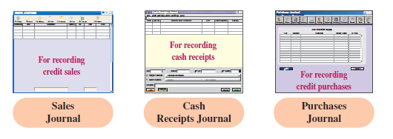
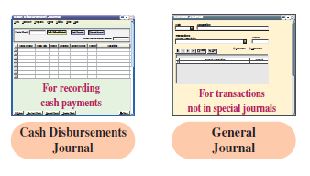
Special Journals in Accounting
Exhibit 7.3
Learning Objective C2: Explain the goals and uses of special journals.
Notes:
A special journal is used to record and post transactions of similar type. Most transactions of a merchandiser, for instance, can be categorized into the journals shown in this slide.
This is done, for instance, by accumulating debits and credits of similar transactions, which allows posting of amounts as column totals rather than as individual amounts. The advantage of this system increases as the number of transactions increases. Special journals allow an efficient division of labor, which is also an effective control procedure.

Slide 9
C3:
Describe the use of controlling accounts and subsidiary ledgers.
Learning Objective

Slide 10
Subsidiary Ledgers
Characteristic | Controlling Account | Subsidiary Ledger
Amounts due from customers | Accounts Receivable | Accounts Receivable Ledger
Amounts owed to creditors | Accounts Payable | Accounts Payable Ledger
Subsidiary ledgers are a listing of individual accounts with common characteristics.
Learning Objective C3: Describe the use of controlling accounts and subsidiary ledgers.
Notes:
To understand special journals, it is necessary to understand a subsidiary ledger, which is a list of individual accounts with a common characteristic. A subsidiary ledger contains detailed information on specific accounts in the general ledger. Information systems often include several subsidiary ledgers.
Two of the most important are:
Accounts receivable ledger—stores transaction data of individual customers.
Accounts payable ledger—stores transaction data of individual suppliers.

Slide 11
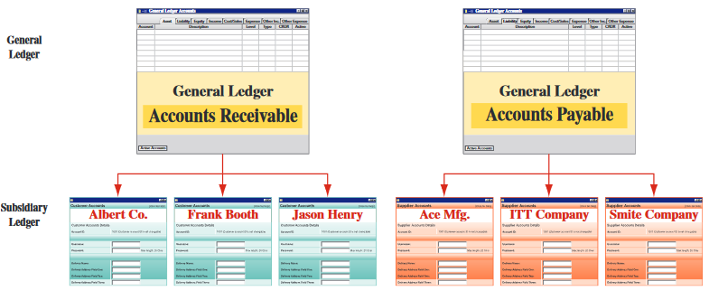
Accounts Receivable Ledger
Exhibit 7.4
After all items are posted, the balance in the accounts receivable controlling account is equal to the sum of the balances in the accounts receivable subsidiary ledger.
Learning Objective C3: Describe the use of controlling accounts and subsidiary ledgers.
Notes:
The general ledger usually has a single Accounts Receivable account, and a subsidiary ledger is set up to keep a separate account for each customer. This subsidiary ledger is called the accounts receivable ledger (also called accounts receivable subsidiary ledger or customers ledger), and it can exist in electronic or paper form.
Many companies buy on credit from several suppliers. This means that companies must keep a separate account for each supplier by keeping an Accounts Payable controlling account in the general ledger and a separate account for each supplier (creditor) in an accounts payable ledger (also called accounts payable subsidiary ledger or creditors ledger).
The total of the balances in all the subsidiary accounts should total to the balance in the control account.
Review what you have learned in the following NEED-TO-KNOW Slide.

Slide 12
NEED-TO-KNOW 7-2
Match each of the numbered descriptions with the term, title, or phrase that it best reflects. Indicate your answer
by entering the letter A through J in the blank provided.
A. General journal
D. Accounts receivable ledger
G. Sales journal
B. Special journal
E. Accounts payable ledger
H. Cash receipts journal
C. Subsidiary ledger
F. Controlling account
I. Purchases journal
J. Cash disbursements journal
1.
J
Used to record all cash payments.
2.
I
Used to record all credit purchases.
3.
H
Used to record all receipts of cash.
4.
G
Used to record sales of inventory on credit.
5.
F
Account that is said to control a specific subsidiary ledger.
6.
E
Stores transaction data of individual suppliers.
7.
D
Stores transaction data of individual customers.
8.
C
Contains detailed information on a specific account from the general ledger.
9.
B
Used to record and post transactions of similar type.
10.
A
All-purpose journal in which we can record any transaction.
Learning Objective C2: Explain the goals and uses of special journals.
Learning Objective C3: Describe the use of controlling accounts and subsidiary ledgers.
Notes:
Match each of the numbered descriptions with the term, title, or phrase that it best reflects.
1. Used to record all cash payments. This is the cash disbursements journal.
2. Used to record all credit purchases. All credit purchases are recorded in the purchases journal.
3. Used to record all receipts of cash. This is the cash receipts journal.
4. Used to record sales of inventory on credit. This is the sales journal.
5. Account that is said to control a specific subsidiary ledger is a controlling account.
6. Stores transaction data of individual suppliers. This is the accounts payable ledger.
7. Stores transaction data of individual customers. This is the accounts receivable ledger.
8. Contains detailed information on a specific account from the general ledger. This is a subsidiary ledger.
9. Used to record and post transactions of similar type. These are the special journals.
10. All-purpose journal in which we can record any transaction is the general journal.

Slide 13
P1:
Journalize and post transactions using special journals.
Learning Objective

Slide 14
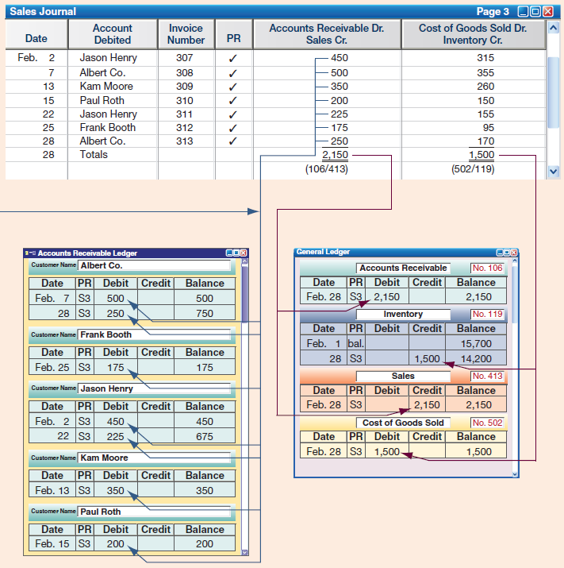
Sales Journal
Exhibit 7.5
Learning Objective P1: Journalize and post transactions using special journals.
Notes:
This slide shows a sales journal from a merchandiser. It has columns for recording the date, customer’s name, invoice number, posting reference, and the sales and cost amounts of each credit sale. The sales journal in this exhibit is called a columnar journal, which is any journal with more than one column.
Each transaction recorded in the sales journal yields an entry in the Accounts Receivable Dr., Sales Cr. column. We usually need only one column for these two accounts. (An exception is when managers need more information about taxes, returns, and other sales details.) Each transaction in the sales journal also yields an entry in the Cost of Goods Sold Dr., Inventory Cr. column. This entry reflects the perpetual inventory system of tracking costs with each sale. To illustrate, on February 2, this company sold merchandise on account to Jason Henry for $450. The invoice number is 307, and the cost of this merchandise is $315. This information is captured on one line in the sales journal. No further explanations or entries are necessary, saving time and effort. Moreover, this sales journal is consistent with most inventory systems that use bar codes to record both sales and costs with each sale transaction. Note that the Posting Reference (PR) column is not used when entering transactions but instead is used when posting.
Posting A sales journal is posted as reflected in the arrow lines on the slide. Two types of posting can be identified: (1) posting to the subsidiary ledger(s) and (2) posting to the general ledger.
Individual transactions in the sales journal are posted regularly to customer accounts in the accounts receivable ledger. These postings keep customer accounts up-to-date, which is important for the person granting credit to customers. When sales recorded in the sales journal are individually posted to customer accounts in the accounts receivable ledger, check marks are entered in the sales journal’s PR column. Check marks are used rather than account numbers because customer accounts usually are arranged alphabetically in the accounts receivable ledger. Posting debits to Accounts Receivable twice—once to Accounts Receivable and once to the customer’s subsidiary account—does not violate the accounting equation of debits equal credits. The equality of debits and credits is always maintained in the general ledger.
Posting to general ledger. The sales journal’s account columns are totaled at the end of each period (the month of February in this case). For the “sales” column, the $2,150 total is debited to Accounts Receivable and credited to Sales in the general ledger (see slide). For the “cost” column, the $1,500 total is debited to Cost of Goods Sold and credited to Inventory in the general ledger. When totals are posted to accounts in the general ledger, the account numbers are entered below the column total in the sales journal for tracking. For example, we enter (106/413) below the total in the sales column after this amount is posted to account number 106 (Accounts Receivable) and account number 413 (Sales).
A company identifies in the PR column of its subsidiary ledgers the journal and page number from which an amount is taken. We identify a journal by using an initial. Items posted from the sales journal have the initial S before their journal page numbers in a PR column. Likewise, items from the cash receipts journal have the initial R; items from the cash disbursements journal have the initial D; items from the purchases journal have the initial P; and items from the general journal have the initial G.

Slide 15
P2:
Prepare and prove the accuracy of subsidiary ledgers.
Learning Objective

Slide 16
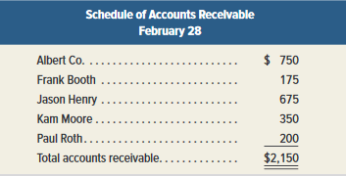
Proving the Ledgers
Exhibit 7.6
A schedule of accounts receivable lists each customer and the balance owed.
The balance of the Accounts Receivable controlling account in the general ledger should equal the accounts in the accounts receivable subsidiary ledger.
Learning Objective P2: Prepare and prove the accuracy of subsidiary ledgers.
Notes:
Account balances in the general ledger and subsidiary ledgers are periodically proved (or reviewed) for accuracy after posting. To do this, we prepare a trial balance of the general ledger to confirm that debits equal credits. Second, we test a subsidiary ledger by preparing a schedule of individual accounts and amounts. A schedule of accounts receivable lists each customer and the balance owed. If this total equals the balance of the Accounts Receivable controlling account, the accounts in the accounts receivable ledger are assumed correct.

Slide 17
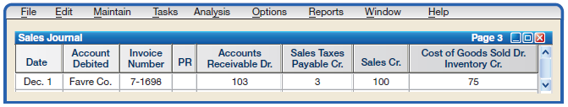
Sales Taxes
Governmental agencies often require sellers to collect sales taxes from customers and to periodically send these taxes to the appropriate agency.
Learning Objective P1: Journalize and post transactions using special journals.
Notes:
State and city governments require sellers to collect sales taxes from customers and send these taxes to the appropriate agency. When using a columnar sales journal, we can keep a record of taxes collected by adding a Sales Taxes Payable column as illustrated on this slide.
Individual amounts in the Accounts Receivable column would continue to be posted immediately to customer accounts in the accounts receivable ledger. Individual amounts in the Sales Taxes Payable and Sales columns are not posted. Column totals would continue to be posted as usual. (A company that collects sales taxes on its cash sales can also use a Sales Taxes Payable column in its cash receipts journal.)

Slide 18

Sales Returns and Allowances
If a company has few sales returns, they may be recorded in the General Journal.
A company with many sales returns may use a Sales Returns and Allowances Journal.
Learning Objective P1: Journalize and post transactions using special journals.
Notes:
A company with only a few sales returns and allowances can record them in a general journal. The debit in this entry is posted to the Sales Returns and Allowances account (no. 414). The credit is posted to both the Accounts Receivable controlling account (no. 106) and to the customer’s account. When we enter the account number and the check mark, 106/✓, in the PR column on the credit line, this means both the Accounts Receivable controlling account in the general ledger and the Ray Ball account in the accounts receivable ledger are credited for $175.
Note: If the returned goods can be resold to another customer, the company would debit (increase) the Inventory account and credit (decrease) the Cost of Goods Sold account. If the returned goods are defective, the returned inventory is recorded at its estimated value, not its cost. A company with a large number of sales returns and allowances can save time by recording them in a separate sales returns and allowances journal.
Review what you have learned in the following NEED-TO-KNOW Slide.

Slide 19
NEED-TO-KNOW 7-3
Prepare headings for a sales journal and then record the following sales transactions.
July 7
Sold merchandise costing $400 to J. Dahl for $600, terms 2/10, n/30, invoice no. 704.
12
Sold merchandise costing $100 to R. Lim for $150, terms n/30, invoice no. 705.
SALES JOURNAL
Date
Account
Invoice
Terms
Accounts Receivable Dr.
Cost of Goods Sold Dr.
debited
Number
Sales Cr.
Inventory Cr.
Jul 7
J. Dahl
704
2/10, n/30
600
400
Jul 12
R. Lim
705
n/30
150
100
The Sales Journal is used to record all sales on account; every transaction results in a Debit to Accounts Receivable and a Credit to Sales.
Learning Objective P1: Journalize and post transactions using special journals.
Notes:
Prepare headings for a sales journal and then record the following sales transactions. A Sales Journal is used to record all sales on account; every transaction results in a Debit to Accounts Receivable and a Credit to Sales.
July 7 - Sold merchandise costing $400 to J. Dahl for $600, terms 2/10, n/30, invoice no. 704. The sales journal includes: the date, July 7; the account to be debited in the accounts receivable subsidiary ledger, J. Dahl; the invoice number, 704; the terms of the sale, 2/10, net 30; the amount to be debited to the accounts receivable account, $600; and, because the company is using the perpetual inventory system, they also include cost of goods sold in the Sales Journal, debiting Cost of goods sold and crediting Inventory for $400.
July 12 - Sold merchandise costing $100 to R. Lim for $150, terms n/30, invoice no. 705. The account to be debited in the accounts receivable subsidiary ledger is R. Lim; invoice number, 705; terms, net 30; debit Accounts receivable and credit Sales for $150, and we debit Cost of goods sold and credit Inventory for the cost of $100.

Slide 20
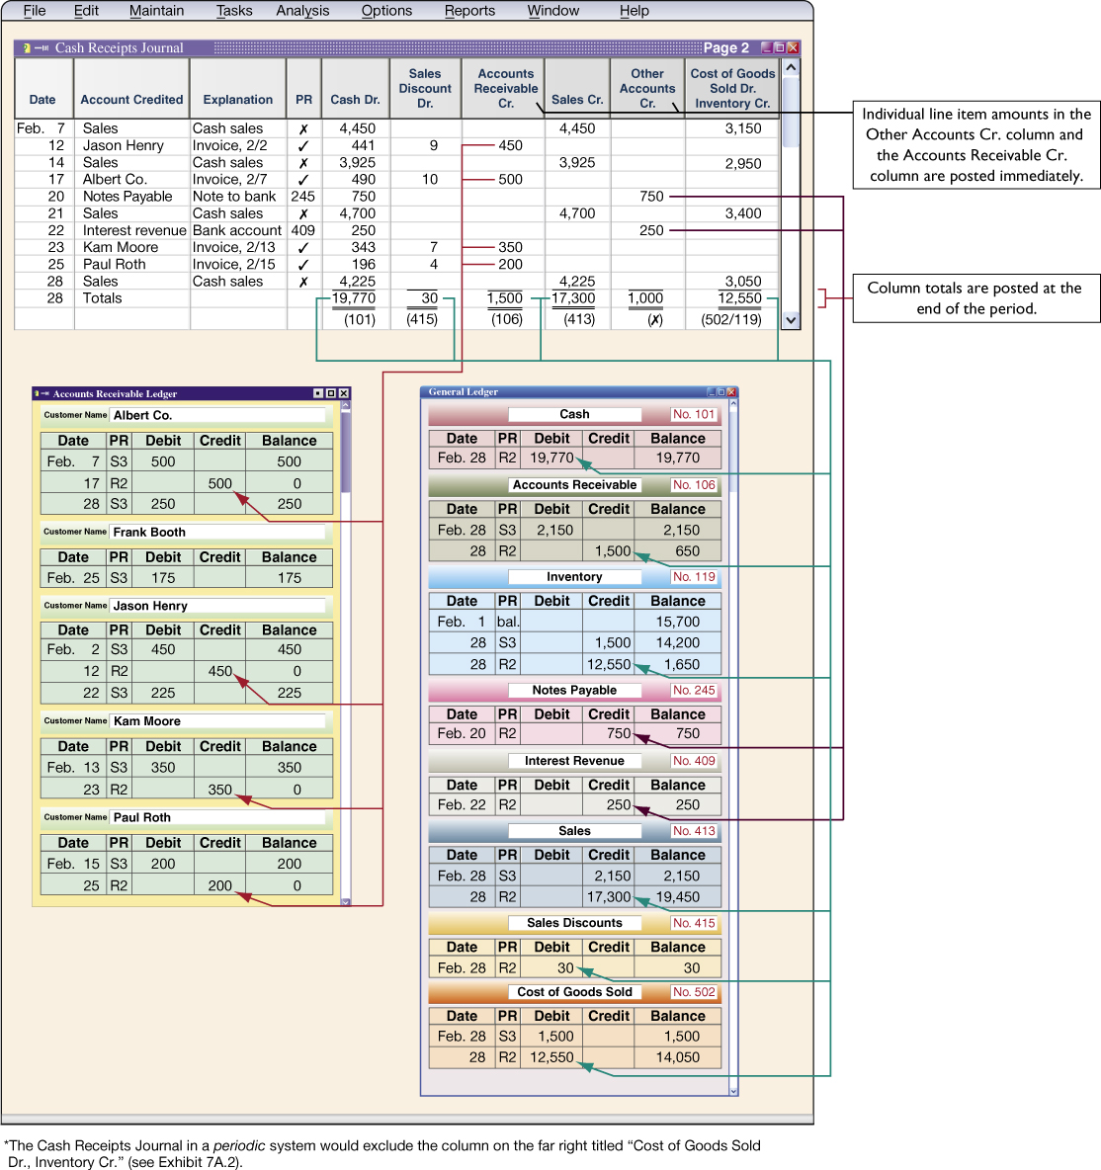
Cash Receipts Journal
Exhibit 7.7
Cash Receipts Types
Cash from credit customers
Cash from cash sales
Cash from other sources
Learning Objective P1: Journalize and post transactions using special journals.
Notes:
A cash receipts journal is used to record all receipts of cash. Cash receipts can be separated into one of three types: (1) cash from credit customers in payment of their accounts, (2) cash from cash sales, and (3) A cash receipts journal is typically used to record all receipts of cash (all transactions that include a debit to Cash). This slide shows one common form of the cash receipts journal.
Journalizing and Posting Cash receipts can be separated into one of three types: (1) cash from credit customers in payment of their accounts, (2) cash from cash sales, and (3) cash from other sources. The cash receipts journal in Exhibit 7.7 has a separate credit column for each of these three sources. We describe how to journalize transactions from each of these three sources. (An Explanation column is included in the cash receipts journal to identify the source.)
Cash from credit customers. Journalizing. To record cash received in payment of a customer’s account, the customer’s name is first entered in the Account Credited column—see transactions dated February 12, 17, 23, and 25. Then the amounts debited to both Cash and Sales Discount (if any) are entered in their respective columns, and the amount credited to the customer’s account is entered in the Accounts Receivable Cr. column.
Posting. Individual amounts in the Accounts Receivable Cr. column are posted immediately to customer accounts in the subsidiary accounts receivable ledger. The $1,500 column total is posted at the end of the period (month in this case) as a credit to the Accounts Receivable controlling account in the general ledger.
Cash sales. Journalizing. The amount for each cash sale is entered in the Cash Dr. column and the Sales Cr. column. The February 7, 14, 21, and 28 transactions are examples. (Cash sales are usually journalized daily or at point of sale, but are journalized weekly in Exhibit 7.7 for brevity.) Each cash sale also yields an entry to Cost of Goods Sold Dr. and Inventory Cr. for the cost of merchandise—see the far right column.
Posting. For cash sales, we place an x in the PR column to indicate that its amount is not individually posted. We do post the $17,300 Sales Cr. total and the $12,550 total from the “cost” column.
Cash from other sources. Journalizing. Examples of cash from other sources are money borrowed from a bank, cash interest received on account, and cash sale of noninventory assets. The transactions of February 20 and 22 are illustrative. The Other Accounts Cr. column is used for these transactions.
Posting. Amounts from these transactions are immediately posted to their general ledger accounts and the PR column identifies those accounts.

Slide 21
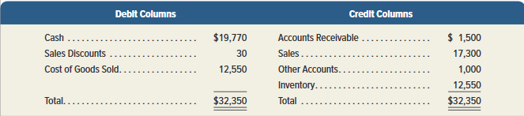
Footing, Crossfooting, and Posting
Exhibit 7.8
Learning Objective P1: Journalize and post transactions using special journals.
Notes:
To be sure that total debits and credits in a columnar journal are equal, we often crossfoot column totals before posting them. To foot a column of numbers is to add it. To crossfoot in this case is to add the Debit column totals, then add the Credit column totals, and compare the two sums for equality.
Review what you have learned in the following NEED-TO-KNOW Slide.

Slide 22
NEED-TO-KNOW 7-4
Prepare headings for a cash receipts journal and then record the following cash receipts transactions.
July 1
The company borrowed $5,000 cash by signing a note payable to the bank.
2
C.Ming, the owner, contributed $1,000 cash to the company.
11
The company sold merchandise costing $100 to Mulan for $400 cash.
29
The company received $950 cash from Chan in payment of a July 7 purchase (where the company sold
merchandise costing $700 on credit to Chan for $1,000, subject to a $50 sales discount if paid by end of
month).
Cash Receipts Journal
Date
Account
Explanation
Cash Dr.
Sales
Accounts
Sales Cr.
Other
Cof GS Dr.
credited
Discount
Receivable
Accounts
Inventory
Dr.
Cr.
Cr.
July 1
Notes payable
Note to bank
5,000
5,000
2
Ming, Capital
Contribution
1,000
1,000
11
Sales
Cash sale
400
400
100
29
Chan
Invoice, July 7
950
50
1,000
The Cash Receipts Journal is used to record all cash receipts; every transaction that includes a debit to Cash.
Learning Objective P1: Journalize and post transactions using special journals.
Notes:
Prepare headings for a cash receipts journal and then record the following cash receipts transactions. A cash receipts journal is used to record all cash receipts; every transaction that includes a debit to Cash. When cash is debited, the common accounts to be credited include: Accounts receivable for collections of accounts receivable, including any related sales discount; Cash sales including the cost of those sales; and miscellaneous accounts to be credited.
July 1 - The company borrowed $5,000 cash by signing a note payable to the bank. The account to be credited is notes payable. The transaction results in a debit to Cash, $5,000, and a credit to Notes payable.
July 2 - C. Ming, the owner, contributed $1,000 cash to the company. This transaction is a credit to Ming's capital account for the amount of the contribution; we debit Cash, $1,000, and credit Ming's capital account.
July 11 - The company sold merchandise costing $100 to Mulan for $400 cash. This is a cash sale. We debit Cash, $400, and credit Sales. And, because we're using the perpetual inventory system, we also record the cost of goods sold, $100; debiting Cost of goods sold and crediting Inventory.
July 29 - The company received $950 cash from Chan in payment of a July 7 purchase (where the company sold merchandise costing $700 on credit to Chan for $1,000, subject to a $50 sales discount if paid by end of month). The sale on account and the related cost of goods sold were recorded in the sales journal on July 7. On July 29, we record simply the cash receipt. We credit the accounts receivable subsidiary ledger from Chan. The amount of the cash receipt, the debit to Cash, is $950. This represents a $50 sales discount and a reduction in accounts receivable of $1,000.

Slide 23
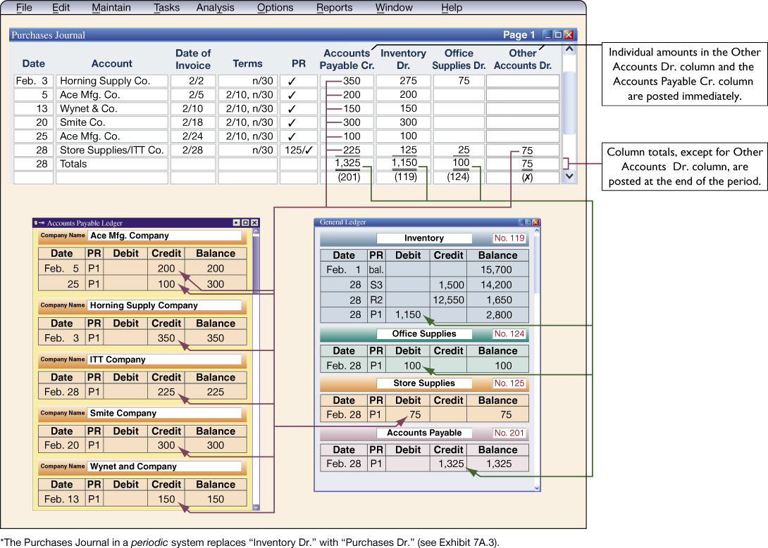
Purchases Journal
Exhibit 7.9
Learning Objective P1: Journalize and post transactions using special journals.
Notes:
A purchases journal is used to record all credit purchases, including those for inventory.
Purchases for cash are recorded in the Cash Disbursements Journal. Entries in the purchases journal reflect purchase invoices or other source documents. We use the invoice date and terms to compute the date when payment for each purchase is due. The Accounts Payable Cr. column is used to record the amounts owed to each creditor. Inventory purchases are recorded in the Inventory Dr. column. To illustrate, inventory costing $200 is purchased from Ace Manufacturing on February 5. The creditor’s name (Ace) is entered in the Account column, the invoice date is entered in the Date of Invoice column, the purchase terms are entered in the Terms column, and the $200 amount is entered in the Accounts Payable Cr. and the Inventory Dr. columns. When a purchase involves an amount recorded in the Other Accounts Dr. column, we use the Account column to identify the general ledger account debited.
The amounts in the Accounts Payable Cr. column are immediately posted to individual creditor accounts in the accounts payable subsidiary ledger. Individual amounts in the Other Accounts Dr. column are immediately posted to their general ledger accounts. At the end of the period, all column totals except the Other Accounts Dr. column are posted to their general ledger accounts.

Slide 24
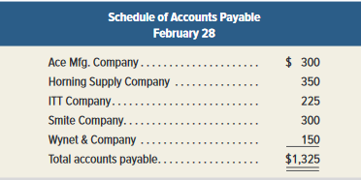
Proving the Ledger
A schedule of accounts payable lists each supplier and the balance owed to them.
The balance of the Accounts Payable controlling account in the general ledger should equal the accounts in the accounts payable subsidiary ledger.
Learning Objective P2: Prepare and prove the accuracy of subsidiary ledgers.
Notes:
Accounts payable balances in the subsidiary ledger are proved after posting the purchases journal. We prove the subsidiary ledger by preparing a schedule of accounts payable, which is a list of accounts from the accounts payable ledger with their balances and the total. If the total equals the balance of the Accounts Payable controlling account, the accounts in the accounts payable ledger are assumed correct.
Review what you have learned in the following NEED-TO-KNOW Slide.

Slide 25
NEED-TO-KNOW 7-5
Prepare headings for a purchases journal and then journalize the following purchases transactions.
July 1
Purchased $1,000 of merchandise on credit from Kim, Inc., terms n/60.
4
Purchased $200 of store supplies from Chi Company on credit, terms n/30.
7
Purchased $600 of office supplies on credit from Min Company, terms n/30.
Purchases Journal
Date
Account
Date of
Terms
PR
Accounts
Inventory
Office
Other
Invoice
Payable Cr.
Dr.
Supplies
Accounts
Dr.
Dr.
July 1
Kim, Inc.
7/1
n/60
1,000
1,000
4
Store Supplies/Chi. Co.
7/4
n/30
200
200
7
Min Company
7/7
n/30
600
600
The Purchases Journal is used to record all purchases on account; every transaction that includes a credit to Accounts Payable.
Learning Objective P1: Journalize and post transactions using special journals.
Notes:
Prepare headings for a purchases journal and then journalize the following purchases transactions. A purchases journal is used to record all purchases on account; every transaction that includes a credit to Accounts payable. The accounts to be debited commonly include the Inventory account, for purchases of merchandise, Office supplies, and miscellaneous other accounts.
On July 1 - Purchased $1,000 of merchandise on credit from Kim, Inc., terms n/60. We include the date, July 1; the account to be credited in the accounts payable subsidiary ledger, Kim, Inc.; the date of the invoice, July 1; the terms of the purchase, net 60; the credit to accounts payable, $1,000; and because this is a purchase of merchandise, we debit the Inventory account.
July 4 - Purchased $200 of store supplies from Chi Company on credit, terms n/30. The account to be credited in the accounts payable subsidiary ledger is Chi Company. We also include the account to be debited, Store supplies. The date of the invoice, is July 4. The terms of the purchase are net 30. We credit Accounts payable and debit Store supplies for $200.
July 7 - Purchased $600 of office supplies on credit from Min Company, terms n/30. We include the date, July 7; the account to be credited in the accounts payable subsidiary ledger, Min Company; the date of the invoice, also July 7; the terms of the purchase, net 30; the amount to be credited to Accounts payable, $600; and we debit Office supplies.

Slide 26
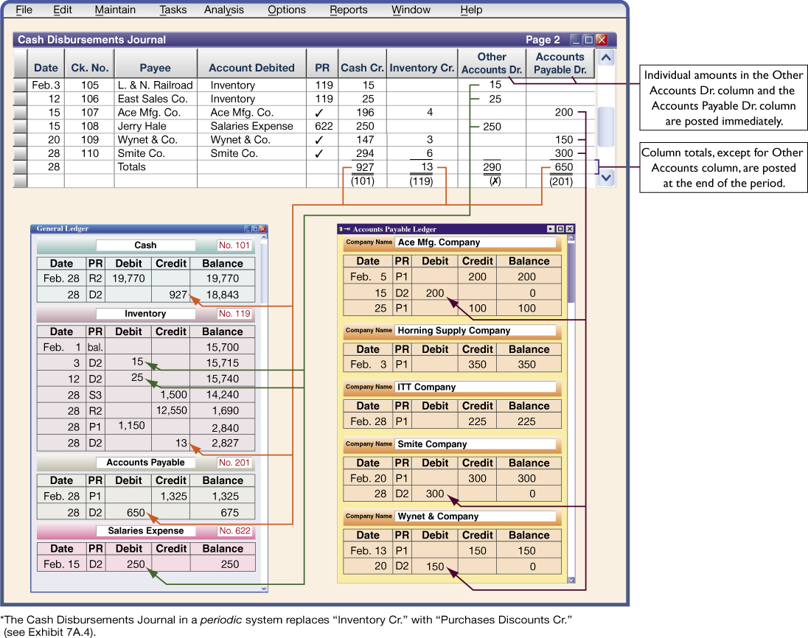
Cash Disbursements Journal
Exhibit 7.11
Learning Objective P1: Journalize and post transactions using special journals.
Notes:
A cash disbursements journal, also called a cash payments journal, is used to record all cash payments (all transactions with a credit to Cash).
The cash disbursements journal shown in this slide illustrates repetitive entries to the Cash Cr. column of this journal (reflecting cash payments). Also note the frequent credits to Inventory (which reflect purchase discounts) and the debits to Accounts Payable. For example, on February 15, the company pays Ace on account (credit terms of 2/10, n/30—see February 5 transaction in Exhibit 7.9). Since payment occurs in the discount period, the company pays $196 ($200 invoice less $4 discount). The $4 discount is credited to Inventory. Note that when this company purchases inventory for cash, it is recorded using the Other Accounts Dr. column and the Cash Cr. column as illustrated in the February 3 and 12 transactions. Generally, the Other Accounts column is used to record cash payments on items for which no column exists. For example, on February 15, the company pays salaries expense of $250. The title of the account debited (Salaries Expense) is entered in the Account Debited column.
The cash disbursements journal has a column titled Ck. No. (check number). For control over cash disbursements, all payments except for those of small amounts are made by check. Checks should be prenumbered and each check’s number entered in the journal in numerical order in the column headed Ck. No. This makes it possible to search the numbers in the column for omitted checks. When a cash disbursements journal has a column for check numbers, it is sometimes called a check register.
Individual amounts in the Other Accounts Dr. column of a cash disbursements journal are immediately posted to their general ledger accounts. Individual amounts in the Accounts Payable Dr. column are also immediately posted to creditors’ accounts in the subsidiary accounts payable ledger. At the end of the period, we crossfoot column totals and post the Accounts Payable Dr. column total to the Accounts Payable controlling account. Also, the Inventory Cr. column total is posted to the Inventory account, and the Cash Cr. column total is posted to the Cash account.

Slide 27
General Journal Transactions
Purchase of plant assets by Note Payable
Receipt of a Note Receivable
Purchase Returns & Allowances
Sales
Returns & Allowances
Learning Objective P1: Journalize and post transactions using special journals.
Notes:
When special journals are used, we still need a general journal for adjusting, closing, and any other transactions for which no special journal has been set up. Examples of these other transactions might include purchases returns and allowances, purchases of plant assets by issuing a note payable, sales returns if a sales returns and allowances journal is not used, and receipt of a note receivable from a customer.
Review what you have learned in the following NEED-TO-KNOW Slide.

Slide 28
NEED-TO-KNOW 7-6
Prepare headings for a cash disbursements journal and then journalize the following cash payments transactions.
July 5
Issued Check No. 910 to Kam Corp. to buy store supplies for $500.
13
Issued Check No. 911 for $4,000 to pay off a note payable to China Bank.
24
Issued Check No. 912 to Lim to pay the amount due from a July 16 purchase, less the discount
(it purchased merchandise for $1,000 on credit from Lim, terms 2/10, n/30).
29
Paid salary of $700 to B.Tung by issuing Check No. 913.
Cash Disbursements Journal
Date
Ck. No.
Payee
Account Debited
PR
Cash Cr.
Inventory
Other
Accounts
Cr.
Accounts Dr.
Payable Dr.
July 5
910
Kam Corp.
Store Supplies
500
500
13
911
China Bank
Notes Payable
4,000
4,000
24
912
Lim
Lim
980
20
1,000
29
913
B. Tung
Salaries Expense
700
700
The Cash Disbursements Journal is used to record all cash payments; every transaction that includes a credit to Cash.
Learning Objective P1: Journalize and post transactions using special journals.
Notes:
Prepare headings for a cash disbursements and then journalize the following cash payments transactions. A cash disbursements journal is used to record all cash payments; every transaction that includes a credit to Cash. The most common cash disbursement is for a payment on account, debits to Accounts payable, including those payments within the discount period that result in credits to the merchandise inventory account. Other accounts will also be debited.
On July 5 - Issued Check No. 910 to Kam Corp. to buy store supplies for $500. We include the date, July 5; the check number, 910; the payee, Kam Corporation; the account to be debited, Store supplies; the credit to Cash, $500; and the debit to Store supplies, a total of $500.
July 13 - Issued Check No. 911 for $4,000 to pay off a note payable to China Bank. The account to be debited is Notes payable. We credit Cash, $4,000, and debit Notes payable.
July 24 - Issued Check No. 912 to Lim Co. to pay the amount due from a July 16 purchase, less the discount (it purchased merchandise for $1,000 on credit from Lim, terms 2/10, n/30). The account to be debited within the accounts payable subsidiary ledger is the Lim Company. The journal entry is a credit to Cash, $980, a debit to Inventory for the 2% discount (2% of $1,000 is $20) and a debit to Accounts payable for $1,000.
July 29 - Paid salary of $700 to B. Tung by issuing Check No. 913. The payee is B. Tung. The account to be debited is Salaries expense. Credit Cash, $700, and debit Salaries expense.

Slide 29
Technology-Based Accounting Systems
Integrated Software
Actions taken in one part of the system automatically affect related parts. For instance, when a credit sale is entered, several parts of the system are automatically updated.
Off-the-Shelf Software
Familiar accounting programs such as Sage 50 and QuickBooks® are designed to be user friendly and menu driven.
Notes:
Computer technology provides accuracy, speed, efficiency, and convenience in performing accounting tasks. A program can be written, for instance, to process customers’ merchandise orders. Multipurpose off-the-shelf software applications exist for a variety of business operations.
These include familiar accounting programs such as Sage 50 (formerly known as Peachtree®) and QuickBooks®. Off-the-shelf programs are menu driven, and many operate more efficiently as integrated systems. In an integrated system, actions taken in one part of the system automatically affect related parts. When a credit sale is recorded in an integrated system, for instance, several parts of the system are automatically updated, such as posting.

Slide 30
Data Processing in Accounting
Online processing enters and processes data immediately.
Batch processing accumulates information for a period of time and then processes all the data at one time (daily, weekly, or monthly).
Notes:
Accounting systems differ with regard to how input is entered and processed. Online processing enters and processes data as soon as source documents are available. This means that databases are immediately updated. Batch processing accumulates source documents for a period of time and then processes them all at once such as daily, weekly, or monthly. The advantage of online processing is timeliness. The advantage of batch processing is that it requires only periodic updating of databases.

Slide 31
Computer Networks in Accounting
Server
Work Stations
Computer networks are links among computers giving different users access to common databases and programs.
Notes:
Networking, or linking computers with each other, can create information advantages (and cost efficiencies). Computer networks are links among computers giving different users and different computers access to common databases, programs, and hardware.

Slide 32
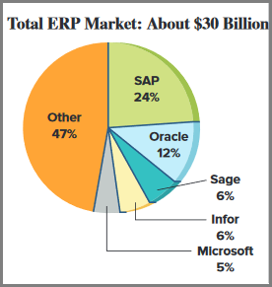
Enterprise Resource
Planning Software (ERP)
Programs that manage and integrate a company’s vital operations.
Notes:
Enterprise resource planning (ERP) software includes the programs that manage a company’s operations. They extend from order taking to manufacturing to accounting. (Your college likely relies on ERP software to track its budget and student records information.) When working properly, these integrated programs can speed decision making, identify costs for reduction, and give managers control over operations with the click of a mouse. For many managers, ERP software allows them to scrutinize business, identify where inventories are piling up, and see what plants are most efficient. The software is designed to link every part of a company’s operations.
ERP has several suppliers. SAP leads the market, with Oracle a distant second (AMR Research).
Enterprise resource planning (ERP) software includes the programs that manage a company’s operations. They extend from order taking to manufacturing to accounting. When working properly, these integrated programs can speed decision making, identify costs for reduction, and give managers control over operations with the click of a mouse. For many managers, ERP software allows them to scrutinize business, identify where inventories are piling up, and see what plants are most efficient.

Slide 33




Cloud Computing
Cloud computing is the delivery of computing as a service rather than a product.
Laptop
Cloud Computing
Computer
Cell Phone
Tablet
Cloud computing uses applications via the Web instead of installing them on one's own computer.
Notes:
Cloud computing is the delivery of computing as a service rather than a product. Cloud computing uses applications via the web instead of installing them on individual computers. This means that companies lease, rather than purchase, those applications.
Cloud computing has enormous potential for greater efficiency and effectiveness with information systems applications. The future will reveal whether or not that potential will be achieved. Cloud computing has the potential to improve controls due to data centralization and the enhanced security from providers who can spread that cost over many customers. Users should consider the following factors when looking at providers of cloud computing:
Provider’s knowledge of the user’s business.
Security of the provider’s cloud, including firewalls.
Provider’s history, reputation, and references.
Service level agreement for hardware and software.
Provider’s cloud compatibility with user’s system.

Slide 34
A1:
Compute segment return on assets and use it to evaluate segment performance.
Learning Objective

Slide 35
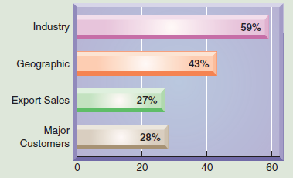
Segment Return on Assets
A good AIS collects financial data for a company’s various segments.
Exhibit 7.12
Companies Reporting Operations
by Segments
A segment is a part of a company that is separately identified by its products, services, or geographic market.
*Total exceeds 100% because companies can report more than one segment.
Learning Objective A1: Compute segment return on assets and use it to evaluate segment performance.
Notes:
Good accounting information systems collect financial data for a company’s various segments. A segment refers to a part of a company that is separately identified by its products or services, or by the geographic market it serves. Companies must report segment information, including their sales, operating income, identifiable assets, capital expenditures, and depreciation. However, managers are reluctant to release information that can harm competitive position.

Slide 36
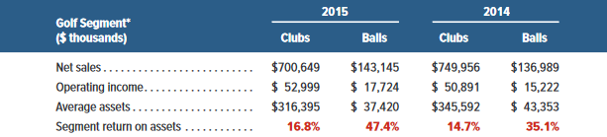
Segment Return on Assets
Exhibit 7.13
Segment return
on assets
Segment operating income
Segment average assets
=
Callaway Golf Company reports that it operates in two business segments: (1) golf clubs and (2) golf balls.
Learning Objective A1: Compute segment return on assets and use it to evaluate segment performance.
Notes:
One measure of success for business segments is the segment return on assets ratio, defined as segment operating income divided by segment average assets. This ratio reflects on the profitability of a segment.
Callaway Golf Company reports that it operates in two business segments: (1) golf clubs and (2) golf balls. Callaway’s performance has been improving over the past few years. Years 2014 and 2015 were good for Callaway as both its golf club and golf ball segments generated positive income. However, its net sales for clubs declined in 2015. Callaway must work to improve its net sales for clubs while maintaining its return on assets if it wishes to achieve sustained success. Callaway might also consider making greater investments in its golf ball segment. If additional golf ball assets can generate a similar 47.4% return versus a return on 16.8% for golf club assets, Callaway should make additional asset investments in the golf ball segment. This analysis can be extended to geographical segments and any other segments that companies report.

Slide 37
End of Chapter 7

