Slide 1
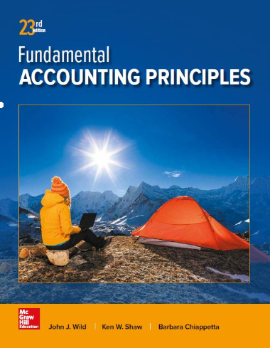
Performance Measurement and Responsibility Accounting
Chapter 24
Wild, Shaw, and Chiappetta
Fundamental Accounting Principles
23rd Edition
Notes:
Chapter 24: Performance Measurement and Responsibility Accounting

Slide 2
Chapter 24 Learning Objectives
CONCEPTUAL
C1 Distinguish between direct and indirect expenses and identify bases for allocating indirect
expenses to departments.
C2 Explain transfer pricing and methods to set transfer prices.
C3 Describe allocation of joint costs across products. (Appendix 24C)
ANALYTICAL
A1 Analyze investment centers using return on investment and residual income.
A2 Analyze investment centers using profit margin and investment turnover.
A3 Analyze investment centers using balanced scorecard.
A4 Compute cycle time and cycle efficiency, and explain their importance to production management.
PROCEDURAL
P1 Prepare a responsibility accounting report using controllable costs.
P2 Allocate indirect expenses to departments.
P3 Prepare departmental income statements and contribution reports.

Slide 3
Performance Evaluation
Large companies are easier to manage if divided into smaller units, called divisions, segments, or departments.
In decentralized organizations, decisions are made by unit managers instead of by top management.
Cost
center
Profit
center
Investment
center
Evaluated on
their success in
controlling costs.
Evaluated on their success in generating income.
Evaluated on use of investment center assets to generate income.
Notes:
Many large companies are easier to manage if they are divided into smaller units, called divisions, segments, or departments. For example, LinkedIn organizes its operations around three geographic segments: North America, Europe, and Asia-Pacific. Callaway Golf organizes its operations around two product lines, golf balls and golf clubs, while Kraft Heinz organizes its operations both geographically and around several product lines. In these decentralized organizations, decisions are made by unit managers rather than by top management. Top management then evaluates the performance of each of these unit managers.
In responsibility accounting, unit managers are evaluated only on what they are responsible for. The methods of performance evaluation vary for cost centers, profit centers, and investment centers.
Cost center managers are evaluated on their success in controlling costs, compared to budgeted costs.
Profit center generates revenues and incurs costs. Profit center managers are evaluated on their success in generating income.
Investment center generate revenues and incurs costs. Managers are also responsible for the investments made in operating assets. Investment center managers are evaluated on their use of investment center assets to generate income.

Slide 4
P1:
Prepare a responsibility accounting report using controllable costs.
Learning Objective

Slide 5
Controllable versus
Uncontrollable Costs
A cost is controllable if a manager has the power to determine or at least significantly affect the amount incurred.
Uncontrollable costs
are not within the manager’s control or influence.
Supplies used in the manager’s department
The department manager’s own salary
Learning Objective P1: Prepare a responsibility accounting report using controllable costs.
Notes:
A manager’s performance using responsibility accounting reports should be evaluated using costs that the manager can control. A cost is controllable if a manager has the power to determine or at least significantly affect the amount incurred. Uncontrollable costs are not within the manager’s control or influence. For example, department managers rarely control their own salaries. However, they can control or influence items such as the cost of supplies used in their department.

Slide 6
Responsibility Accounting System
An accounting system that
provides information . . .
Relating to the
responsibilities of
individual managers.
To evaluate
managers on
controllable items.
Learning Objective P1: Prepare a responsibility accounting report using controllable costs.
Notes:
A responsibility accounting system uses the concept of controllable costs to evaluate a manager’s performance. Responsibility for controllable costs is clearly defined and performance is evaluated based on the ability to manage and control those costs. Prior to each reporting period, a company prepares plans that identify costs and expenses under each manager’s control. These responsibility accounting budgets are typically based on the flexible budgeting approach covered in chapter 23.

Slide 7
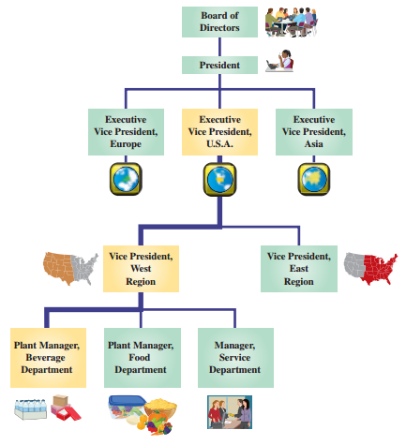
Responsibility accounting recognizes that control over costs and expenses belongs to several levels of management.
Exhibit 24.1
Learning Objective P1: Prepare a responsibility accounting report using controllable costs.
Notes:
A responsibility accounting system recognizes that control over costs and expenses belongs to several levels of management. We illustrate this in the organization chart in Exhibit 24.1. The lines in this chart connecting the managerial positions reflect channels of authority. For example, the three department managers (beverage, food, and service) in this company are responsible for controllable costs incurred in their departments. These department managers report to the vice president (VP) of the Southeast region, and thus these same costs are subject to the overall control of this VP. Similarly, the costs of the Southeast region are reported to and subject to the control of the executive vice president (EVP) of operations, the president, and, ultimately, the board of directors.

Slide 8
Responsibility Accounting
Performance Report
Amount of detail varies according
to the level in the organization.
A store manager receives summarized information from each department.
A department manager
receives detailed reports.
Learning Objective P1: Prepare a responsibility accounting report using controllable costs.
Notes:
Responsibility accounting performance report reports actual expenses that a manager is responsible for and their budgeted amounts. Management’s analysis of differences between budgeted and actual amounts often results in corrective or strategic managerial actions. Upper-level management uses performance reports to evaluate the effectiveness of lower-level managers in keeping costs within budgeted amounts.

Slide 9
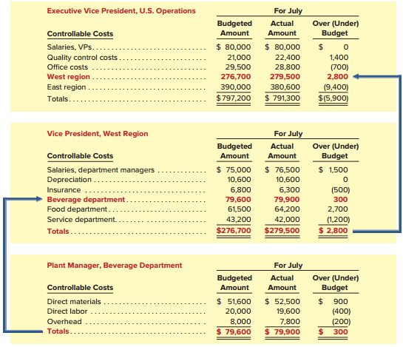
Responsibility Accounting Performance Reports
Exhibit 24.2
Learning Objective P1: Prepare a responsibility accounting report using controllable costs.
Notes:
Exhibit 24.2 shows summarized performance reports for three management levels. The beverage department is a cost center, and its manager is responsible for controlling costs. This exhibit shows that costs under the control of the beverage department plant manager are totaled and included among the controllable costs of the VP of the West region. Costs under the control of the VP are totaled and included among the controllable costs of the EVP of operations. In this way, responsibility accounting reports provide relevant information for each U.S. management level. A good responsibility accounting system makes every effort to provide relevant information to the right person (the one who controls the cost) at the right time (before a cost is out of control).
Review what you have learned in the following NEED-TO-KNOW Slides.

Slide 10

NEED-TO-KNOW 24-1
Below are the annual budgeted and actual costs for the Western region’s manufacturing plant of Rios Co.
The plant has two operating departments: motorcycle and ATV. The plant manager is responsible for all of
the plant’s costs (other than her own salary). Each operating department has a manager who is responsible
for that department’s direct materials, direct labor, and overhead costs. Prepare responsibility accounting
reports for (1) the plant manager and (2) each operating department manager.
Budgeted Amount
Actual Amount
Motorcycle
ATV
Motorcycle
ATV
Direct materials
$97,000
$138,000
$98,500
$133,800
Direct labor
52,000
105,000
56,100
101,300
Dept. mgr. salary
60,000
56,000
60,000
56,000
Rent and utilities
9,000
12,000
8,400
10,900
Overhead
45,000
81,000
47,000
78,000
Totals
$263,000
$392,000
$270,000
$380,000
Learning Objective P1: Prepare a flexible budget and interpret a flexible budget performance report.
Notes:
Need-to-Know 24.1

Slide 11
NEED-TO-KNOW 24-1
Budgeted Amount
Actual Amount
Motorcycle
ATV
Motorcycle
ATV
Direct materials
$97,000
$138,000
$98,500
$133,800
Direct labor
52,000
105,000
56,100
101,300
Dept. mgr. salary
60,000
56,000
60,000
56,000
Rent and utilities
9,000
12,000
8,400
10,900
Overhead
45,000
81,000
47,000
78,000
Totals
$263,000
$392,000
$270,000
$380,000
Responsibility Accounting Performance Report
Plant Manager, Western Region
Budgeted
Actual
Over (Under) Budget
Dept. mgr. salary
$116,000
$116,000
$0
Rent and utilities
21,000
19,300
(1,700)
Motorcycle dept.
194,000
201,600
7,600
ATV dept.
324,000
313,100
(10,900)
Totals
$655,000
$650,000
($5,000)
Responsibility Accounting Performance Report
Responsibility Accounting Performance Report
Department Manager, Motorcycle Department
Department Manager, ATV Department
Budgeted
Actual
Over (Under) Budget
Budgeted
Actual
Over (Under) Budget
Direct materials
$97,000
$98,500
$1,500
Direct materials
$138,000
$133,800
($4,200)
Direct labor
52,000
56,100
4,100
Direct labor
105,000
101,300
(3,700)
Overhead
45,000
47,000
2,000
Overhead
81,000
78,000
(3,000)
Totals
$194,000
$201,600
$7,600
Totals
$324,000
$313,100
($10,900)
Learning Objective P1: Prepare a flexible budget and interpret a flexible budget performance report.
Notes:
Need-to-Know 24.1

Slide 12
C1:
Distinguish between direct and indirect expenses and identify bases for allocating indirect expenses to departments.
Learning Objective

Slide 13
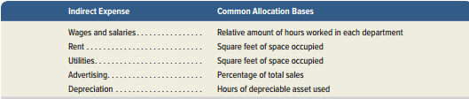
Direct and Indirect Expenses
Direct expenses are costs traced directly to a department and incurred for that department’s sole benefit.
Indirect expenses
are costs incurred for the joint benefit; they cannot be traced to only one department.
Exhibit 24.4
Learning Objective C1: Distinguish between direct and indirect expenses and identify bases for allocating indirect expenses to departments.
Notes:
Departmental income statements are a common way to report profit center performance. When a company computes departmental profits, it confronts two key accounting challenges that involve allocating expenses:
1. How to allocate indirect expenses, such as rent and utilities, which benefit several departments.
How to allocate service department expenses, such as payroll or purchasing, that perform services that benefit several departments.
General Model for Cost Allocation
Allocated Cost = Total Cost to Allocate x Percentage of Allocation Base Used
This slide shows common bases for allocating indirect expenses.
Direct expenses can be readily traced to one department. They are incurred for the sole benefit of one department. A good example of a direct expense is the salary of an employee who works in only one department. Indirect expenses cannot be traced to one department because they are incurred for the benefit of two or more departments. For example, if two or more departments share a single building, all enjoy the benefits of the expenses for rent, heat, and light. Since we cannot trace indirect expenses to individual departments, we must allocate them to departments on the basis of the relative benefits each department receives from the shared indirect expenses. Ideally, we allocate indirect expenses by using a cause-effect relation.

Slide 14
P2:
Allocate indirect expenses to departments.
Learning Objective

Slide 15
Allocating Service Department Expenses
Service department costs are shared, indirect expenses that support the activities of two or more production departments.
Exhibit 24.5
Learning Objective P2: Allocate indirect expenses to departments.
Notes:
To generate revenues, operating departments require support services provided by departments such as personnel, payroll, and purchasing. Such service departments are typically evaluated as cost centers because they do not produce revenues. A departmental accounting system can accumulate and report costs incurred by each service department for this purpose. The system then allocates a service department’s expenses to operating departments benefiting from them. This slide shows some commonly used bases for allocating service department’s expenses to operating departments.
Exhibit 24.5 shows some commonly used bases for allocating service department expenses to operating departments.

Slide 16
Illustration of Cost Allocation
Classic Jewelry pays its janitorial service $800 per month to clean its store. Management allocates this cost to its three departments according to the floor space each occupies.
Exhibit 24.6
Learning Objective P2: Allocate indirect expenses to departments.
Notes:
We illustrate the general approach to allocating costs with an indirect cost—cleaning services for a retail store. An outside company cleans the retail store for a total cost of $800 per month. Management allocates this cost across the store’s three departments based on the floor space (in square feet) that each department occupies. Exhibit 24.6 shows this allocation.
The total cost to allocate is $800. Since the jewelry department occupies 60% of the store’s total floor space (2,400 square feet/4,000 square feet) it is allocated 60% of the total cleaning cost. This allocated cost of $480 is computed as $800 x 60%. When the allocation process is complete, these and other allocated costs are deducted in computing the net income for each department. The calculations are similar for other allocation bases and for service department costs.
Review what you have learned in the following NEED-TO-KNOW Slides.

Slide 17
NEED-TO-KNOW 24-2
Allocate a retailer’s purchasing department’s costs of $20,000 to its operating
departments using each department’s percentage of total purchase orders.
Department
Number of
Fraction % of total
Cost
Allocated
Purchase
to Allocate
Amount
Orders
Clothing
250
250 / 1,000 =
25%
x $20,000
$5,000
Health care
450
450 / 1,000 =
45%
x $20,000
9,000
Sporting goods
300
300 / 1,000 =
30%
x $20,000
6,000
1,000
100%
$20,000
Responsibility Accounting Performance Report
Department Manager, ATV Department
Budgeted
Actual
Over (Under) Budget
Direct materials
$138,000
$133,800
($4,200)
Direct labor
105,000
101,300
(3,700)
Overhead
81,000
78,000
(3,000)
Totals
$324,000
$313,100
($10,900)
Notes:
Need-to-Know 24.2

Slide 18
P3:
Prepare departmental income statements and contribution reports.
Learning Objective

Slide 19
Departmental Income Statements
Let’s prepare departmental income statements using the following steps:
  Accumulating revenues and direct expenses by department, and total indirect expenses.
  Allocating indirect expenses across both service and operating departments.
  Allocating service department expenses to operating departments.
  Preparing departmental income statements.
Learning Objective P3: Prepare departmental income statements and contribution reports.
Notes:
Now that we have discussed direct expenses and the allocation of indirect expenses, we are ready to put our knowledge to work by preparing departmental income statements. These statements are the primary tool for evaluating departmental performance. Before we prepare the departmental income statements, we must determine the expenses for each department using the first three steps of the four-step process that you see on your screen.
Step 1: Accumulating revenues and direct expenses by department and total indirect expenses.
Step 2: Allocating indirect expenses across both service and operating departments.
Step 3: Allocating service department expenses to operating departments.
Step 4: Preparing departmental income statements.
We show how to prepare departmental income statements using A-1 Hardware and its five departments. Two of them (general office and purchasing) are service departments and the other three (hardware, housewares, and appliances) are operating departments. Since the service departments do not generate sales, we do not compute departmental income statements for them. Instead, we allocate their expenses to operating departments.
Preparing departmental income statements involves four steps.

Slide 20
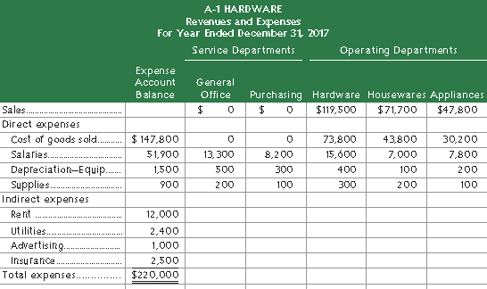
Apply Step 1:
Departmental Expense Allocation Spreadsheet
Exhibit 24.9
Learning Objective P3: Prepare departmental income statements and contribution reports.
Notes:
Apply Step 1: We first collect the necessary data from general company and departmental
accounts. Exhibit 24.9 shows these data. Exhibit 24.9 shows the direct and indirect expenses by department. Each department uses payroll records, fixed asset and depreciation records, and supplies requisitions to determine the amounts of its expenses for salaries, depreciation, and supplies. The total amount for each of these direct expenses is entered in the Expense Account Balance column. That column also lists the amount of each indirect expense.

Slide 21
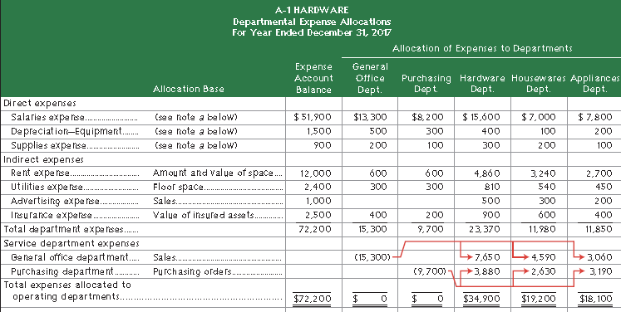
Apply Steps 2 and 3:
Departmental Expense Allocation Spreadsheet
Exhibit 24.10
Learning Objective P3: Prepare departmental income statements and contribution reports.
Notes:
Apply Step 2: Using the general model, A-1 Hardware allocates indirect costs. We show this
with the departmental expense allocation spreadsheet in Exhibit 24.10. After selecting allocation bases, indirect expenses are recorded in company accounts and allocated to both operating and service departments.
Apply Step 3: We then allocate service department expenses to operating departments. Service department expenses typically are not allocated to other service departments. After service department costs are allocated, no expenses remain in the service departments, as shown in row 21 of Exhibit 24.10.
Detailed calculations for indirect expense allocations and service department expense allocations, which follow the general model of cost allocation, are in Appendix 24A.

Slide 22
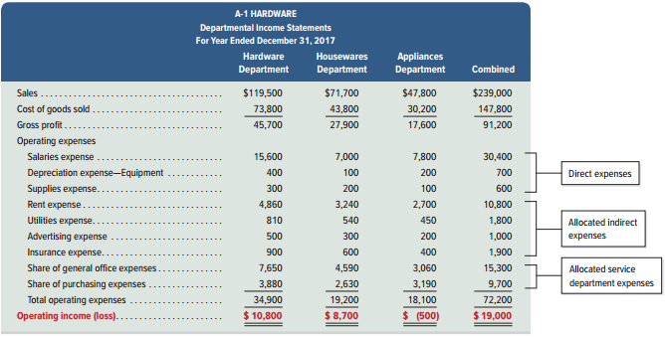
Apply Step 4:
Departmental Income Statements
Exhibit 24.11
Learning Objective P3: Prepare departmental income statements and contribution reports.
Notes:
Step 4: The departmental expense allocation spreadsheet can now be used to prepare departmental performance reports. The general office and purchasing departments are cost centers, and their managers will be evaluated on their control of costs, as we showed in Exhibit 24.2.
Exhibit 24.11 shows income statements for A-1 Hardware’s three operating departments. This exhibit uses the spreadsheet (in Exhibit 24.10) for its operating expenses; information on sales and cost of goods sold comes from departmental records.

Slide 23
Departmental Contribution to Overhead
Departmental revenue
– Direct expenses
= Departmental contribution to overhead
Departmental contribution . . .
  Is used to evaluate departmental performance.
  Is not a function of arbitrary allocations of indirect expenses.
A department may be a candidate for elimination when its departmental contribution is negative.
Learning Objective P3: Prepare departmental income statements and contribution reports.
Notes:
Departmental contribution to overhead, is an important concept for managers. We subtract departmental direct expenses from departmental revenue to get departmental contribution to overhead. It is the amount that a department contributes to covering indirect expenses of the company. If the total of all the departments’ contribution is not sufficient to cover indirect costs, the company’s net income will be negative. If an individual department’s contribution is negative, it contributes nothing toward covering indirect costs and should be a candidate for elimination.
Departmental contribution to overhead, because it focuses on the direct expenses that are under the profit center manager’s control, is often a better way to assess that manager’s performance.

Slide 24
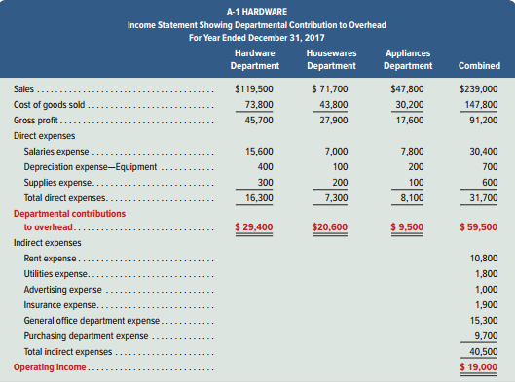
Departmental Contribution to Overhead
Exhibit 24.12
Departmental contributions to indirect expenses (overhead) are emphasized. Departmental contributions are positive so neither department is a candidate for elimination.
Learning Objective P3: Prepare departmental income statements and contribution reports.
Notes:
Exhibit 24.12 shows a $9,500 positive contribution to overhead for the appliances department. If this department were eliminated, the company would be worse off. Further, the appliance department’s manager is better evaluated on this $9,500, because it excludes all allocated costs, than the department’s operating loss of $(500). A-1 Hardware can compare each department’s contribution to overhead to budgeted amounts to assess each department’s performance.

Slide 25
A1:
Analyze investment centers using return on investment and residual income.
Learning Objective

Slide 26
Investment Centers
Investment center managers are evaluated using performance measures that combine income and assets.
Performance measures are:
Return on investment
Residual income
Profit margin
Investment turnover
Learning Objective A1: Analyze investment centers using return on investment and residual income.
Notes:
Investment center managers are responsible for generating profit and for the investment of assets. They will be evaluated based on their ability to generate enough operating income to justify the investment in assets used to generate the operating income. Typically, investment center managers are evaluated using performance measures that combine income and assets.
Several of those measures will be described on the slides that follow including:
Return on assets
Residual income
Profit margin
Investment turnover

Slide 27
Investment Center Return on Investment (ROI)
Exhibit 24.13
Investment Center Income
Investment Center Average Invested Assets
ROI =
LCD Division earned more dollars of income, but it was less
efficient in using its assets to generate income compared
to S-Phone Division.
Learning Objective A1: Analyze investment centers using return on investment and residual income.
Notes:
An investment center’s performance is often evaluated using a measure called return on investment (ROI). ROI is defined as operating income divided by average invested assets.
Consider the following data for Ztel, a company that operates two divisions: LCD and S-Phone. The LCD Division manufactures liquid crystal display (LCD) monitors and sells them for use in computers, cellular phones, and other products. The S-Phone division sells smartphones. Exhibit 24.13 shows current year income and assets for those divisions. Based on this information, we can determine the ROI or return on investment for each. The ROI for LCD is 21 percent, while the ROI for S-Phone is 23 percent.
LCD Division earned more dollars of income, but it was less efficient in using its assets to generate income compared to S-Phone Division.

Slide 28
Investment Center Residual Income
Exhibit 24.14
Residual
Income
=
Investment Center
Net Income
–
Target Investment
Center Net Income
Assume the target net income is 8% of divisional assets.
Learning Objective A1: Analyze investment centers using return on investment and residual income.
Notes:
Another way to evaluate division performance is to compute investment center residual income. Residual income is the difference between the investment center net income and target investment center net income. The target investment center net income is the minimum rate of return on investment center invested assets.
Let’s assume that the target net income for the LCD and S-Phone Divisions is 8 percent. When we compute the target investment center net income for each division and subtract it from net income, we see that the LCD division has a higher residual income.
One of the real advantages of residual income is that it encourages managers to make profitable investments that might be rejected by managers whose performance is evaluated on the basis of ROI. This occurs when the ROI associated with an investment opportunity exceeds the company’s minimum required return, but is less than the ROI being earned by the division manager contemplating the investment. Regardless of the division’s current return on investment, its residual income will increase as long as the manager invests only in projects that exceed the company’s minimum required return.
Residual income is expressed in dollars, not as a percentage. The LCD division produced more dollars of residual income than the S-Phone division. Ztel’s management can use residual income, along with ROI, to evaluate investment center manager performance.
Let’s review what you have learned in the following NEED-TO-KNOW Slide.

Slide 29
NEED-TO-KNOW 24-3
The media division of a company reports income of $600,000, average invested assets of
$7,500,000, and a target income of 6% of invested assets. Compute the division’s
(a) return on investment and (b) residual income.
Return on Investment (ROI) represents the earnings power of invested assets.
Return on investment = Net Income
Average Invested Assets
$600,000
$7,500,000
8%
Learning Objective A1: Analyze investment centers using return on investment and residual income.
Notes:
The media division of a company reports income of $600,000, average invested assets of $7,500,000, and a target income of 6% of invested assets.
Compute the division’s return on investment and residual income.
Return on Investment (ROI) represents the earnings power of invested assets.
It's calculated by taking net income and dividing by average invested assets. $600,000
divided by $7,500,000 is 8%.
Every $1.00 of invested assets yields $.08 in net income.

Slide 30
NEED-TO-KNOW 24-3
The media division of a company reports income of $600,000, average invested assets of
$7,500,000, and a target income of 6% of invested assets. Compute the division’s
(a) return on investment and (b) residual income.
Residual income is the amount earned above a targeted amount.
Net income $600,000
Target income ($7,500,000 x .06) 450,000
Residual income $150,000
Learning Objective A1: Analyze investment centers using return on investment and residual income.
Notes:
Residual income is the amount earned above a targeted amount.
Net income is $600,000.
Targeted income is calculated as 6% of the average invested assets of $7,500,000,
$450,000.
Residual income is the amount earned above 6%, $150,000.

Slide 31
A2:
Analyze investment centers using profit margin and investment turnover.
Learning Objective

Slide 32
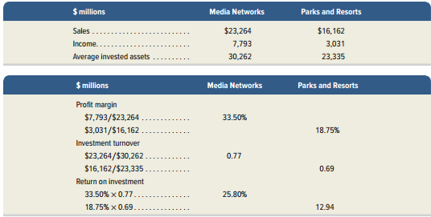
Investment Center Profit Margin and Investment Turnover
Return on
investment (ROI)
Profit
Margin
Investment
turnover
=
×
Investment center income
Investment center sales
Investment center sales
Investment center average assets
Exhibit 24.15
Exhibit 24.16
Learning Objective A2: Analyze investment centers using profit margin and investment turnover.
Notes:
We can further examine investment center (division) performance by splitting return on investment into two measures: profit margin and investment turnover.
Profit margin measures the income earned per dollar of sales. It is computed as investment center income divided by investment center sales.
Investment turnover measures how efficiently an investment center generates sales from its invested assets. It is calculated as investment center sales divided by investment center average assets. Profit margin is expressed as a percentage, while investment turnover is interpreted as the number of times assets were converted into sales. Higher profit margin and higher investment turnover indicate better performance. To illustrate, consider Walt Disney Co., which reports results for two of its operating segments: Media Networks and Parks and Resorts.
Disney's Media Networks division generates 33.50 cents of profit for every dollar of sales, while its Parks and Resorts division generates 18.75 cents of profit per dollar of sales. The Media Networks division (0.77 investment turnover) is slightly more efficient than the Parks and Resorts division (0.69 investment turnover) in using assets. Top management can use profit margin and investment turnover to evaluate the performance of division managers. The measures can also aid management when considering further investment in its divisions.
Let’s review what you have learned in the following NEED-TO-KNOW Slide.

Slide 33
NEED-TO-KNOW 24-4
A division reports sales of $50,000, income of $2,000, and average invested assets of $10,000.
Compute the division’s (a) profit margin, (b) investment turnover, and (c) return on investment.
Profit margin measures the income earned per dollar of sales.
Profit margin = Net Income
Sales
$2,000
$50,000
4%
Learning Objective A2: Analyze investment centers using profit margin and investment turnover.
Notes:
A division reports sales of $50,000, income of $2,000, and average invested assets of $10,000.
Compute the division’s (a) profit margin, (b) investment turnover, and (c) return on investment.
Profit margin measures the income earned per dollar of sales. It's calculated by taking net income and dividing by
sales.
Net income of $2,000 divided by $50,000 in sales is 4%.
$0.04 of every $1.00 of sales is profit.

Slide 34
Need to Know (24-2b)
NEED-TO-KNOW 24-4
A division reports sales of $50,000, income of $2,000, and average invested assets of $10,000.
Compute the division’s (a) profit margin, (b) investment turnover, and (c) return on investment.
Investment turnover measures how efficiently an investment center generates sales from its invested assets.
Investment turnover = Sales
Average Invested Assets
$50,000
$10,000
5
Learning Objective A2: Analyze investment centers using profit margin and investment turnover.
Notes:
Investment turnover measures how efficiently an investment center generate sales from its invested assets. It's calculated by taking sales and dividing by average invested assets.
$50,000 in sales divided by average invested assets of $10,000 is an investment turnover of 5.
Every $1.00 of invested assets yields $5.00 in sales.

Slide 35
Need to Know (24-2c)
NEED-TO-KNOW 24-4
A division reports sales of $50,000, income of $2,000, and average invested assets of $10,000.
Compute the division’s (a) profit margin, (b) investment turnover, and (c) return on investment.
Return on Investment (ROI) represents the earnings power of invested assets.
Return on investment = Net Income
Average Invested Assets
$2,000
$10,000
20%
Learning Objective A2: Analyze investment centers using profit margin and investment turnover.
Notes:
Return on investment represents the earnings power of invested assets.
It's calculated by taking net income and dividing by the average invested assets.
Net income of $2,000 divided by average invested assets of $10,000 is a return on investment of 20%.

Slide 36
Need to Know (24-2d)
NEED-TO-KNOW 24-4
A division reports sales of $50,000, income of $2,000, and average invested assets of $10,000.
Compute the division’s (a) profit margin, (b) investment turnover, and (c) return on investment.
Return on Investment (ROI) represents the earnings power of invested assets.
Return on investment = Profit Margin x Investment Turnover
Net Income = Net Income Sales
Average Invested Assets Sales Average Invested Assets
20% = 4% x 5
Learning Objective A2: Analyze investment centers using profit margin and investment turnover.
Notes:
An alternative way to calculate return on investment is to take the profit margin and multiply by the investment turnover.
Because if we divide by sales in the profit margin and multiply by sales in the investment turnover, we're left with net income divided by average invested assets.
The 20% return on investment is equal to the 4% profit margin multiplied by the investment turnover of 5.

Slide 37
A3:
Analyze investment centers using balanced scorecard.
Learning Objective

Slide 38
Balanced Scorecard
Collects information on several key performance indicators within each of the four perspectives.
Customer
What do customers
think of us?
Innovation/Learning
How can we
improve?
Performance
Indicators
Internal
Processes
Which operations are critical
to meeting customer needs?
Financial
What do our owners
think of us?
Learning Objective A3: Analyze investment centers using balanced scorecard.
Notes:
A balanced scorecard consists of an integrated set of performance measures that are derived from and support a company’s vision and strategy. The balanced scorecard is used to assess company and division manager performance. The balanced scorecard requires managers to think of their company from four perspectives:
1. Customer: What do customers think of us?
2. Internal processes: Which of our operations are critical to meeting customer needs?
3. Innovation and learning: How can we improve?
4. Financial: What do our owners think of us?
In the balanced scorecard approach, we continually develop indicators that help us analyze or answer questions such as: how do we appear to our owners; how do we appear to our customers; what kind of continual innovation and learning is taking place; and which processes within the organization are excellent and which need improvement?
The key sequence of events in the balanced scorecard approach is that learning improves business processes. Improved business processes translate to improved customer satisfaction. When we have a high degree of customer satisfaction, we have improved financial results.
Let’s review what you have learned in the following NEED-TO-KNOW Slide.

Slide 39
NEED-TO-KNOW 24-5
Classify each of the performance measures below into the most likely balanced scorecard
perspective to which it relates: customer (C), internal processes (P), innovation and growth (I), or
financial (F).
1.
On-time delivery rate
(C) Customer
2.
Accident-free days
(P) Internal processes
3.
Sustainability training workshops held
(I) Innovation and growth
4.
Defective products made
(P) Internal processes
5.
Residual income
(F) Financial
6.
Patents applied for
(I) Innovation and growth
7.
Sales returns
(C) Customer
8.
Customer complaints
(C) Customer
Customer
What do customers think of us?
Internal Processes
Which of our operations are critical to meeting customer needs?
Innovation and Growth
How can we improve?
Financial
What do our owners think of us?
Learning Objective P2: Allocate indirect expenses to departments.
Notes:
Need-to-Know 24.5

Slide 40
C2
Explain transfer pricing and methods to set transfer prices.
Learning Objective

Slide 41


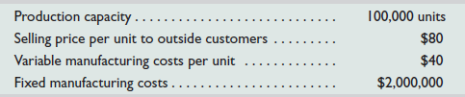
Transfer Pricing
A transfer price is the amount charged when one
division sells goods or services to another division.
LCD Displays
S-Phone Division
LCD Division
S-Phone can purchase displays for $80 from other companies.
Learning Objective C2: Explain transfer pricing and methods to set transfer prices.
Notes:
Transfer prices are set using one of three approaches:
1. Cost (for example, variable manufacturing cost per unit)
2. Market price
3. Negotiated price
To illustrate the impact of alternative transfer prices on divisional profits, consider ZTel, a maker of smartphones. ZTel’s LCD division manufactures touch-screen monitors that can be used in ZTel’s products or sold to outside customers. Assume LCD’s variable manufacturing cost per monitor is $40 and the market price is $80 per monitor. If the LCD division is organized as a profit or investment center, its manager will object to a transfer price of $40 per monitor, because her division will show a loss equal to its fixed costs at this price. Setting the transfer price at $80 per monitor would make ZTel indifferent to buying from the LCD division or from an outside supplier; buying from an outside supplier might not be best for ZTel as it would have less control over production and might not be a good use of its productive capacity. Thus, a negotiated price somewhere between $40 and $80 per unit might be best. In Appendix 24B we discuss how to determine the transfer price using these three approaches.

Slide 42
A4:
Compute cycle time and cycle efficiency, and explain their importance to production management.
Learning Objective

Slide 43
Cycle Time and Cycle Efficiency
A metric that measures the time involved in manufacturing a product.
Order Received
Production
Started
Goods Shipped
Process Time + Inspection Time
+ Move Time + Wait Time
Manufacturing Cycle Time
Total Time
Process time is the time spent producing the product and it is the only value-added time!
Learning Objective A4: Compute cycle time and cycle efficiency, and explain their importance to production management..
Notes:
Total time is the elapsed time from when a customer order is received to when the completed order is shipped. The manufacturing cycle time is the amount of time required to turn raw materials into completed products. This includes process time, inspection time, move time, and wait time. Process time is the time spent producing the product and it is the only value-added activity of the four components of cycle time because it is the only activity in cycle time that adds value to the product form the customer’s perspective.

Slide 44
Cycle Time and Cycle Efficiency
Order Received
Production
Started
Goods Shipped
Process Time + Inspection Time
+ Move Time + Wait Time
Manufacturing Cycle Time
Total Time
Cycle
Efficiency
Value-added time
Cycle time
Exhibit 24.21
=
Learning Objective A4: Compute cycle time and cycle efficiency, and explain their importance to production management..
Notes:
Companies strive to reduce non-value-added time to improve cycle efficiency (CE), which is a measure of production efficiency. Cycle efficiency (CE) is computed by dividing value-added time by cycle (throughput) time. A CE less than one indicates that non-value-added time is present in the production process and they need to evaluate it to identify ways to reduce non-value-added activities.

Slide 45
Appendix 24A:
Cost Allocations
Cost allocations in Exhibits 24.10 and 24.11.
Allocated cost = Total cost to allocate x % of allocation base used
Company will allocate four indirect costs:
  Rent expense - $12,000
  Utilities expense - $2,400
  Advertising expense - $1,000
  Insurance expense - $2,500
Notes:
Appendix 24A will use the general model of cost allocation shown in Exhibit 24.3 to show hot the cost allocations in Exhibits 24.10 and 24.11 are computed for A-1 Hardware.
General formula of Allocated cost = Total Cost to Allocate x percentage of Allocation Base Used.
The company will allocate the following four indirect costs: rent expense, utilities expense, advertising expense, and insurance expense.

Slide 46
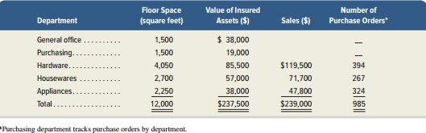
Department Allocation Bases
A-1 Hardware uses the following allocation bases:
  Square feet of floor space
  Dollar value of insured assets
  Sales dollars
  Number of purchase orders
Exhibit 24A.1
Learning Objective A4: Compute cycle time and cycle efficiency, and explain their importance to production management..
Notes:
In this appendix we use our general model of cost allocation (see Exhibit 24.3) to show how the cost allocations in Exhibits 24.10 and 24.11 are computed. A-1 Hardware’s departments use the allocation bases in Exhibit 24A.1: square feet of floor space, dollar value of insured assets, sales dollars, and number of purchase orders.

Slide 47
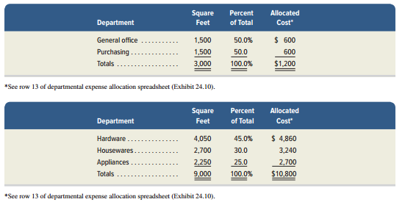
Allocation of Rent
Two service departments occupy 25% of total space, but value of space is $1,200 ($12,000 x 10%).
Operating departments are allocated remainder of rent cost ($12,000 - $1,200) $10,800 based on each department’s percent of total.
Exhibit 24A.2
Exhibit 24A.3
Learning Objective A4: Compute cycle time and cycle efficiency, and explain their importance to production management..
Notes:
The two service departments (office and purchasing) occupy 25% of the total space (3,000 sq. feet/12,000 sq. feet). However, they are located near the back of the building, which is of lower value than space near the front that is occupied by operating departments. Management estimates that space near the back accounts for $1,200 (10%) of the total rent expense of $12,000.
Exhibit 24A.2 shows how we allocate the $1,200 rent expense between these two service departments in proportion to their square footage. We then have the remaining amount of $10,800 ($12,000 - $1,200) of rent expense to allocate to the three operating departments which is shown in Exhibit 24A.3.

Slide 48
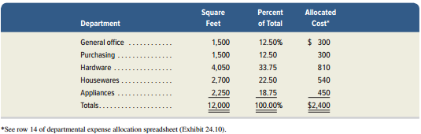
Allocation of Utilities
$2,400 utilities expense is allocated based on square footage occupied.
Exhibit 24A.4
Learning Objective A4: Compute cycle time and cycle efficiency, and explain their importance to production management..
Notes:
We continue step 2 by allocating the $2,400 of utilities expense to all departments based on the square footage occupied, as shown in Exhibit 24A.4.

Slide 49
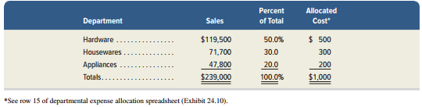
Allocation of Advertising
$1,000 advertising expense is allocated based on sales dollars.
Exhibit 24A.5
Learning Objective A4: Compute cycle time and cycle efficiency, and explain their importance to production management..
Notes:
Exhibit 24A.5 shows the allocation of $1,000 of advertising expense to the three operating departments on the basis of sales dollars. We exclude the service department from this allocation because they do not generate sales.

Slide 50
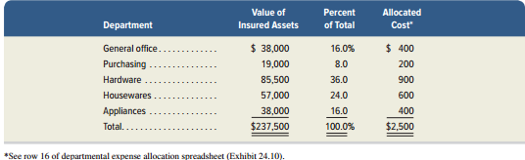
Allocation of Insurance
$2,500 insurance expense is allocated based on value of insured assets.
Exhibit 24A.6
Learning Objective A4: Compute cycle time and cycle efficiency, and explain their importance to production management..
Notes:
To complete step 2, we allocate insurance expense to each service and operating department as shown in Exhibit 24A.6.

Slide 51
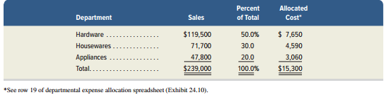
Allocation of Service Department Expenses
$15,300 of General office service department is allocated to operating departments based on sales.
Exhibit 24A.7
Learning Objective A4: Compute cycle time and cycle efficiency, and explain their importance to production management..
Notes:
Third (step 3), total expenses of the two service departments are allocated to the three operating departments. Exhibit 24A.7 shows the allocation of total general office expenses ($15,300) to operating departments. This amount of $15,300 includes the $14,000 of direct service department expenses, plus $1,300 of indirect expenses that were allocated to the service department.

Slide 52
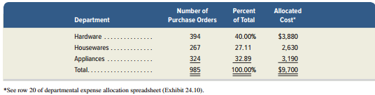
Allocation of Service Department Expenses
$9,700 of purchasing service department is allocated to operating departments based on number of purchase orders.
Exhibit 24A.8
Learning Objective A4: Compute cycle time and cycle efficiency, and explain their importance to production management..
Notes:
Exhibit 24A.8 shows the allocation of total purchasing department expenses ($9,700) to operating departments.

Slide 53
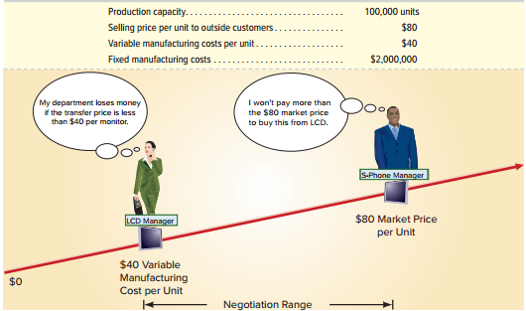
Appendix 24B Transfer Pricing
A transfer price is the amount charged when one
division sells goods or services to another division.
Exhibit 24B.1
Notes:
The top portion of Exhibit 24B.1 reports data on the LCD division of ZTel. That division manufactures liquid crystal display (LCD) touch-screen monitors for use in ZTel’s
S-Phone division’s smartphones. The monitors can also be used in other products. The LCD division can sell its monitors to the S-Phone division as well as to buyers other than S-Phone. Likewise, the S-Phone division can purchase monitors from suppliers other than LCD.
The bottom portion of Exhibit 24B.1 reveals the range of transfer prices for transfers of monitors from LCD to S-Phone. As you can see, the transfer price can reasonably range from $40 (the variable manufacturing cost per unit) to $80 (the cost of buying the monitor from an outside supplier). The manager of LCD wants to report a divisional profit. Thus, this manager will not accept a transfer price less than $40; a price less than $40 would cause the division to lose money on each monitor transferred. The LCD manager will consider transfer prices of only $40 or more. On the other hand, the S-Phone division manager also wants to report a divisional profit. Thus, this manager will not pay more than $80 per monitor because similar monitors can be bought from outside suppliers at that price. The S-Phone manager will consider transfer prices of only $80 or less.
As any transfer price between $40 and $80 per monitor is possible, how does ZTel determine the transfer price? The answer depends in part on whether the LCD division has excess capacity to manufacture monitors.

Slide 54
Transfer Pricing
The LCD division is producing and selling 100,000 units to
outside customers.
(No excess capacity)
Transfer price = $80
LCD Displays
LCD Division
S-Phone Division
With no excess capacity, the LCD manager will not accept a transfer price less than $80 per monitor. The S-Phone manager cannot buy monitors for less than $80 from outside suppliers, so the $80 price is acceptable.
Learning Objective C2: Explain transfer pricing and methods to set transfer prices.
Notes:
If the LCD division can sell every monitor it produces, a market-based transfer price of $80 per monitor is preferred. At that price, the LCD division manager is willing to either transfer monitors to S-Phone or sell to outside customers. The S-Phone division manager cannot buy monitors for less than $80 from outside suppliers, so the $80 price is acceptable. Further, with a transfer price of $80 per monitor, top management of Ztel is indifferent to the S-Phone division buying from the LCD division or buying similar-quality monitors from outside suppliers. With no excess capacity, the LCD manager will not accept a transfer price less than $80 per monitor. For example, suppose the S-Phone division manager suggests a transfer price of $70 per monitor. At that price, the LCD manager incurs an unnecessary opportunity cost of $10 per monitor (computed as $80 market price minus $70 transfer price). This would lower the LCD division’s income and hurt its performance evaluation.

Slide 55
Transfer Pricing
The LCD division is producing and selling less than100,000 units to outside customers. (Excess capacity)
Transfer price = $40 to $80
LCD Displays
LCD Division
S-Phone Division
At a transfer price greater than $40, the LCD division receives contribution margin. At a transfer price less than $80, the S-Phone division manager is pleased to buy from the LCD division, since that price is below the market price of $80.
Learning Objective C2: Explain transfer pricing and methods to set transfer prices.
Notes:
Assume that the LCD division has excess capacity. For example, the LCD division might currently be producing only 80,000 units. Consequently, with excess capacity, the LCD division should accept any transfer price of $40 per unit or greater and the S-Phone division should purchase monitors from the LCD division. For example, if a transfer price of $50 per monitor is used, the S-Phone manager is pleased to buy from the LCD division, since that price is below the market price of $80. For each monitor transferred from the LCD division to the S-Phone division at $50, the LCD division receives a contribution margin of $10 (computed as $50 transfer price less $40 variable cost) to contribute towards its fixed costs and increase ZTel’s overall profits. This form of transfer pricing is called cost-based transfer pricing. Under this approach, the transfer price might be based on variable costs, total costs, or variable costs plus a markup.

Slide 56
C3 (Appendix 24C):
Describe allocation of joint costs across products.
Learning Objective

Slide 57
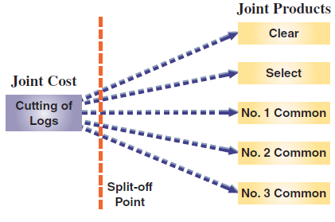
Joint Costs and Their Allocation
Joint costs are costs incurred to produce or purchase two or more products at the same time. Consider a sawmill company:
Exhibit 24C.1
How should the joint costs be allocated to the different products?
Learning Objective C3: Describe allocation of joint costs across products.
Notes:
Joint costs are costs incurred to produce or purchase two or more products at the same time. For example, a sawmill company incurs a joint cost when it buys logs that it cuts into lumber. The joint cost includes the logs (raw material) and its cutting (conversion) into boards classified as Clear, Select, No. 1 Common, No. 2 Common, No. 3 Common, and other types of lumber and by-products.
Financial statements prepared according to GAAP must assign joint costs to products. To do this, management must decide how to allocate joint costs across products benefiting from these costs. If some products are sold and others remain in inventory, allocating joint costs involves assigning costs to both cost of goods sold and ending inventory. The two usual methods to allocate joint costs are: (1) the physical basis and (2) the value basis.

Slide 58
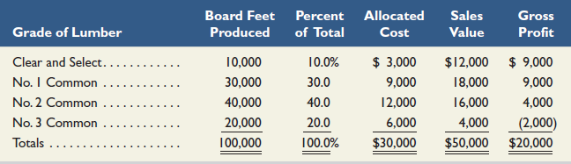
Joint Costs and Their Allocation
Exhibit 24C.2
Physical Basis Allocation of Joint Cost
In this sawmill, joint costs include the logs and their being cut into boards. This joint cost will need to be allocated to the different products resulting from it. We will focus on board feet produced…
10,000 ÷ 100,000 = 10%
10% of $30,000 = $3,000
Learning Objective C3: Describe allocation of joint costs across products.
Notes:
The physical basis allocation of joint costs typically involves allocating joint cost using physical characteristics such as the ratio of pounds, cubic feet, or gallons of each joint product to the total pounds, cubic feet, or gallons of all joint products flowing from the cost. Consider a sawmill that bought logs for $30,000. When cut, these logs produce 100,000 board feet of lumber in the grades and amounts shown. The logs produce 20,000 board feet of No. 3 Common lumber, which is 20% of the total. With physical allocation, the No. 3 Common lumber is assigned 20% of the $30,000 cost of the logs, or $6,000 ($30,000 × 20%). Because this low-grade lumber sells for $4,000, this allocation gives a $2,000 loss from its production and sale. The physical basis for allocating joint costs does not reflect the extra value flowing into some products or the inferior value flowing into others. That is, the portion of a log that produces Clear and Select grade lumber is worth more than the portion used to produce the three grades of common lumber, but the physical basis fails to reflect this. Consequently, this method is not preferred because the resulting cost allocations do not reflect the relative market values the joint cost generates. The preferred approach is the value basis, which allocates joint cost in proportion to the sales value of the output produced by the process at the “split-off point.”

Slide 59
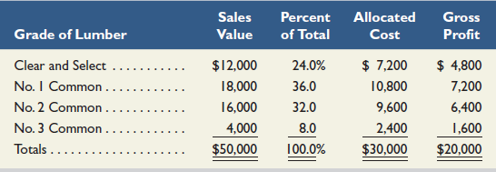
Joint costs and Their Allocation
Allocating Joint Costs on a Value Basis
In this sawmill, joint costs include the logs and their being cut into boards. This joint cost will need to be allocated to the different products resulting from it. We will focus on sales value…
$12,000 ÷ $50,000 = 24%
24% of $30,000 = $7,200
Learning Objective C3: Describe allocation of joint costs across products.
Notes:
The value basis method of joint cost allocation determines the percentage of the total costs allocated to each grade by the ratio of each grade’s sales value to the total sales value, at the split-off point, to the total sales value of $50,000 (sales value is the unit selling price multiplied by the number of units produced). The Clear and Select lumber grades receive 24% of the total cost ($12,000 ÷ $50,000) instead of the 10% portion using a physical basis. The No. 3 Common lumber receives only 8% of the total cost, or $2,400, which is much less than the $6,000 assigned to it using the physical basis. An outcome of value basis allocation is that each grade produces exactly the same 40% gross profit at the split-off point. This 40% rate equals the gross profit rate from selling all the lumber made from the $30,000 logs for a combined price of $50,000.

Slide 60
End of Chapter 24

